Slide 1
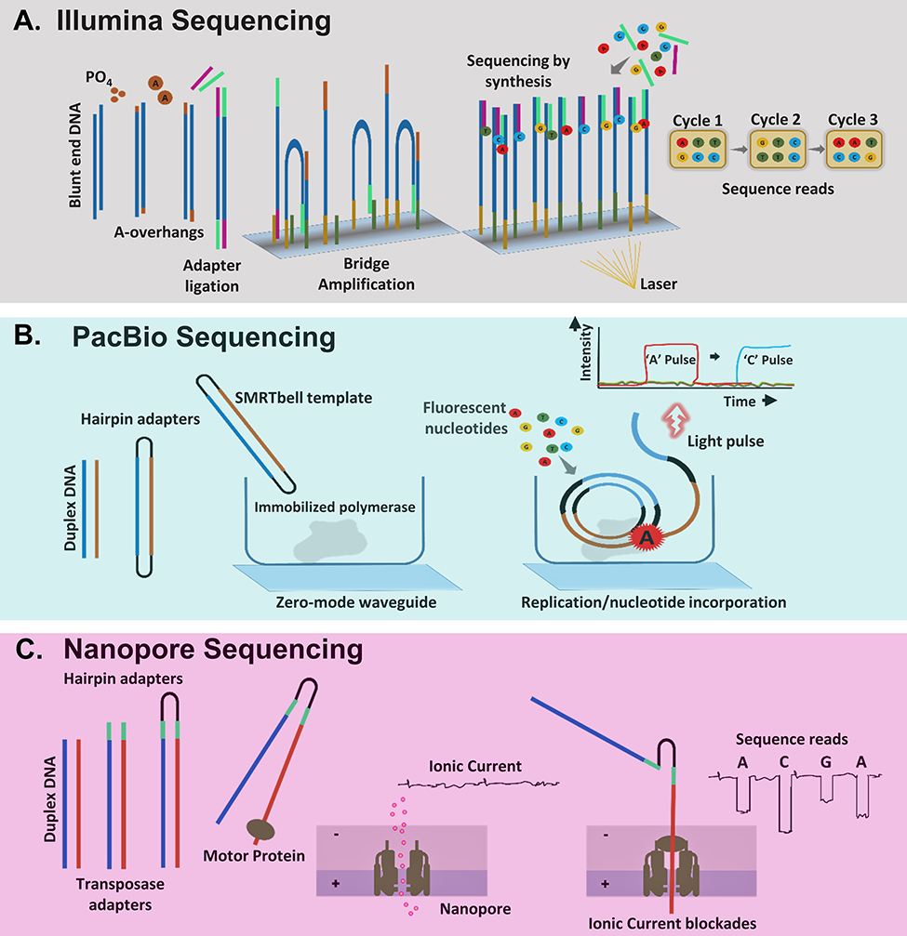

Figure 3 Major short-read and long-read sequencing technologies. (A) Illumina sequencing involves initial trimming, ...
Notes:
Figure 3 Major short-read and long-read sequencing technologies. (A) Illumina sequencing involves initial trimming, adenylation of the blunt ends and ligation of specific adapters to DNA molecules. Following this library, fragments are amplified in situ on flow cell surfaces through bridge amplification and produce sequencing clusters. Finally, reversible dye terminator sequencing step is implemented where single-nucleotide addition reactions and presence of blocking group at the 3′-OH (of the ribose moiety) help to identify sequencing clusters through a reporter fluorescent signal. (B) PacBio sequencing involves a circular consensus sequencing (CCS) SMRTbell technique. Herein, ligation of hairpin adapters to each end of a duplex DNA molecule forms a closed loop, which is sequenced in a zero-mode waveguide (ZMW), fluorescence-based readout of nucleotide incorporation. Each strand in the duplex DNA is sequenced together in multiple passes, and the consensus sequences from both strands are incorporated. (C) Nanopore sequencing involves ligation of hairpin adapters at one end of duplex DNA molecule before initiating nanopore sequencing of the linked original DNA strands. The blockades in ionic current through the nanopore are optimally quantified as DNA base sequences.
Unless provided in the caption above, the following copyright applies to the content of this slide: © The Author(s) 2019. Published by Oxford University Press.This is an Open Access article distributed under the terms of the Creative Commons Attribution License (http://creativecommons.org/licenses/by/4.0/), which permits unrestricted reuse, distribution, and reproduction in any medium, provided the original work is properly cited.

