Slide 1
Seattle Airbnb
machine learning-inspired RECOMMENDATIONS FOR AIRBNB HOSTS: how to INCRESE the revenue and what to expect
D. Ivanov
https://dmiivanov.com
04/2021

Slide 2
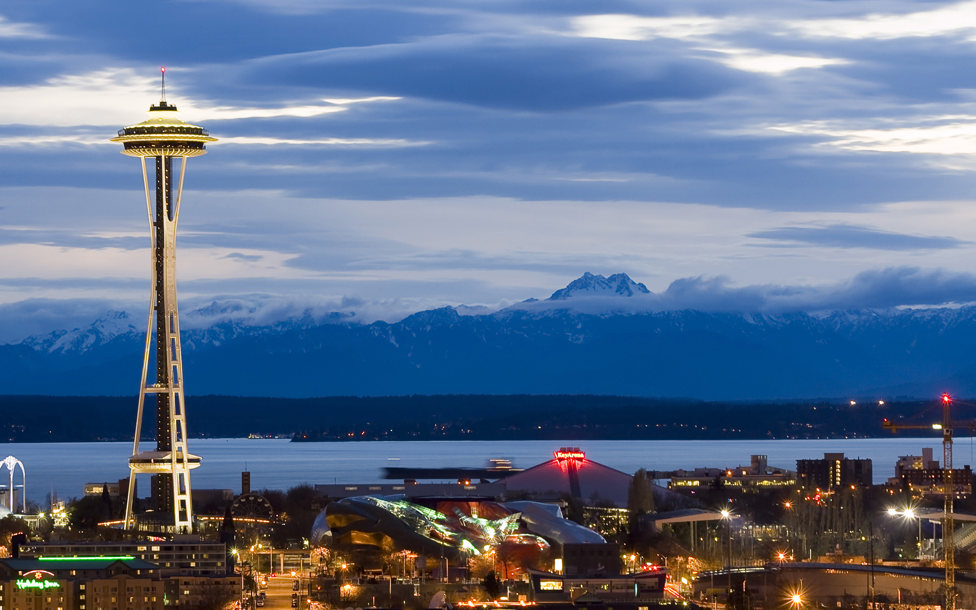
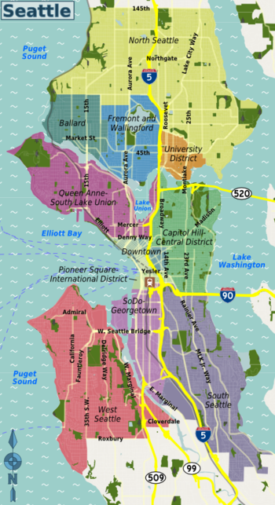

Introduction
People travel to Seattle, WA frequently
Businesses and private individuals are renting out their properties through Airbnb platform, supplying temporary housing for the travelers
Booking and listing data for 01/04/2016 - 01/02/2017 had been collected and made publicly available on Kaggle data science platform: A sneak peek into the Airbnb activity in Seattle, WA, USA

Slide 3
Questions
What pricing, policy, and property choices would increase my revenue?
What revenue and booking rates can I expect when I rent my property through Airbnb in Seattle, WA?

Slide 4
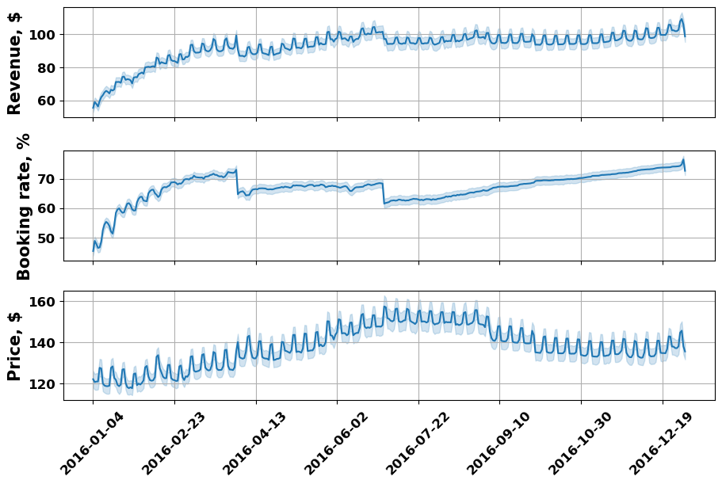
Seattle Airbnb PERFORMANCE (1/2)
Large stable revenues seen in the summer when the demand is high
Dips correspond to Christmas, New Year, Easter, and the Fourth of July drops in the demand
Small scale revenue fluctuations are due to the changes in the demand throughout the week: higher demand on the weekends, lower demand during the business days

Slide 5
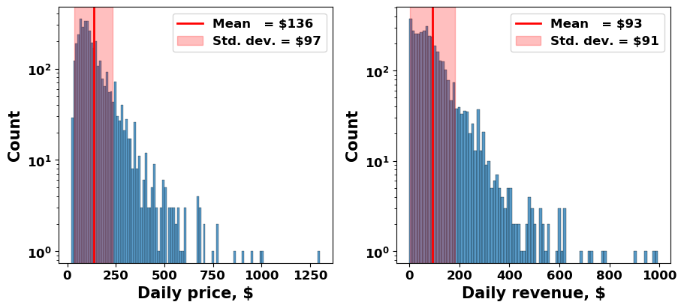
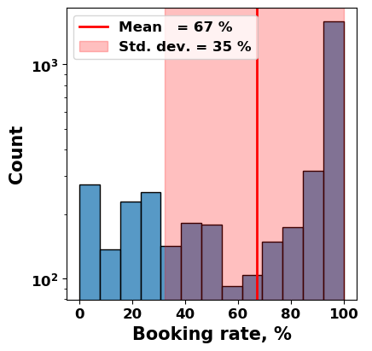
Seattle Airbnb PERFORMANCE (2/2)
Average Airbnb hosts in Seattle:
$136 daily price
67% daily booking rate
$93 daily revenue

Slide 6
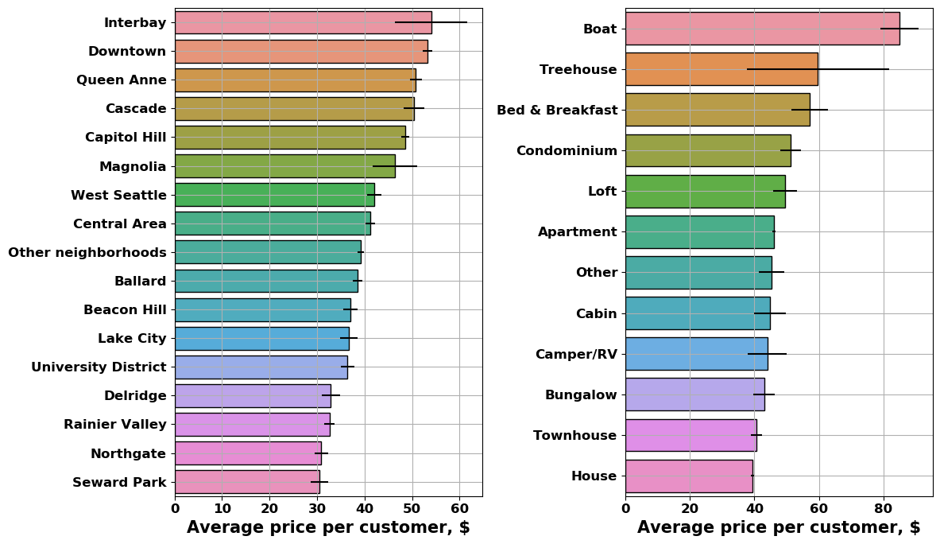
Typical pricing
The highest priced neighborhoods are Interbay, Downtown, and Queen Anne
The highest-priced property types are Boats, Treehouses, and Bed & Breakfast.
Typical costs (per person) for houses, apartments, and condominiums are in 40 to 50$ range.

Slide 7
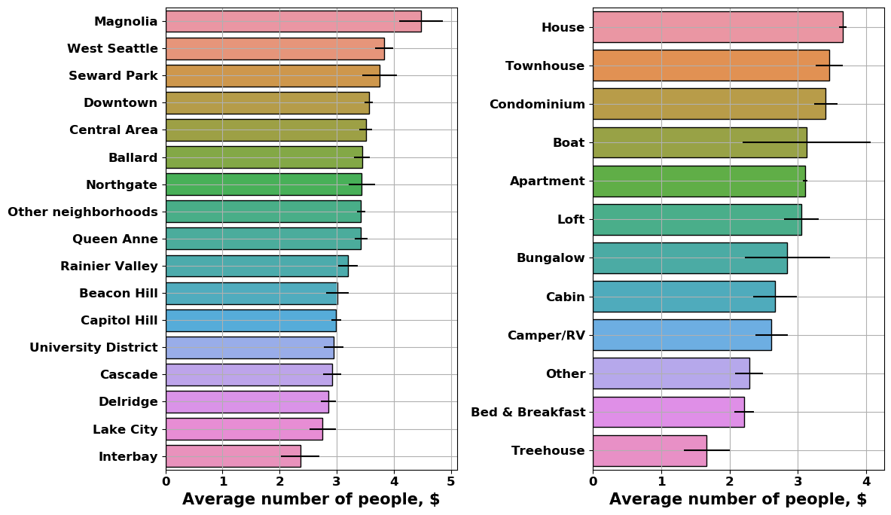
TYPICAL ACCOMMODATION SIZE
Hosts in Magnolia, West Seattle, and Seward Park neighborhoods tend to offer larger accommodation rentals
Houses, townhouses, and condominiums accommodate the most people

Slide 8
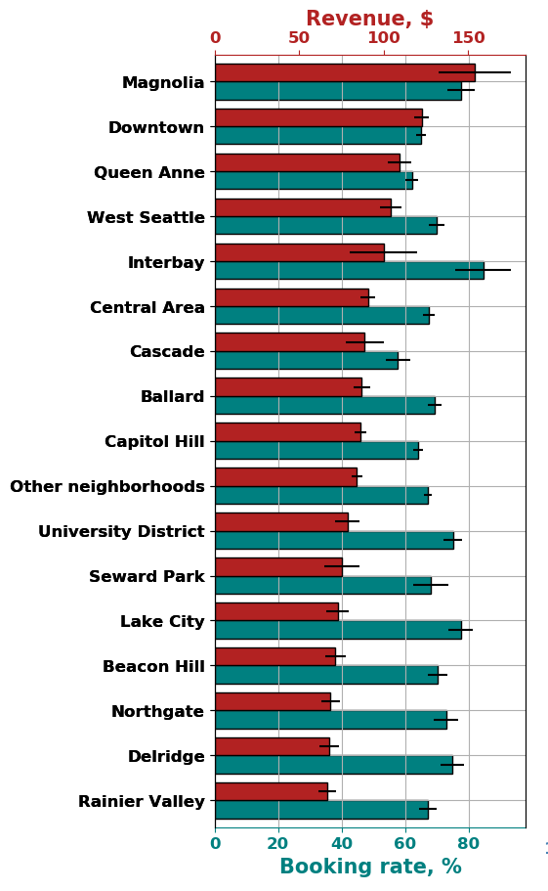
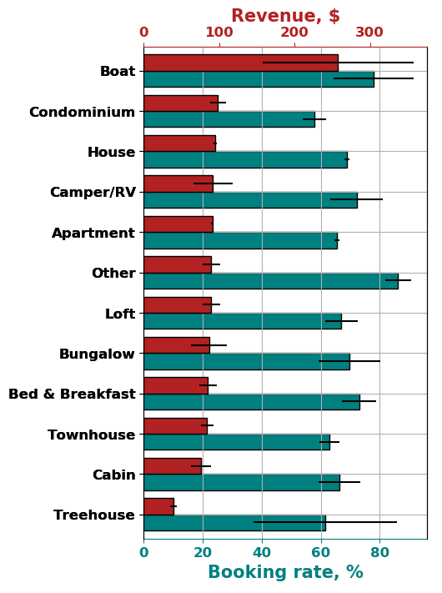
Typical revenue and booking rate
Properties in Magnolia, Downtown, and Queen Anne neighborhoods draw largest revenue
Rooms on boats collect the largest revenue
Most other property types draw similar revenues, with condominiums, houses, Camper/RVs, apartments being on the higher side
Cabins and treehouses produce considerably smaller average daily revenues than other properties. This is likely due to the high seasonal dependence of the demand for such properties.

Slide 9
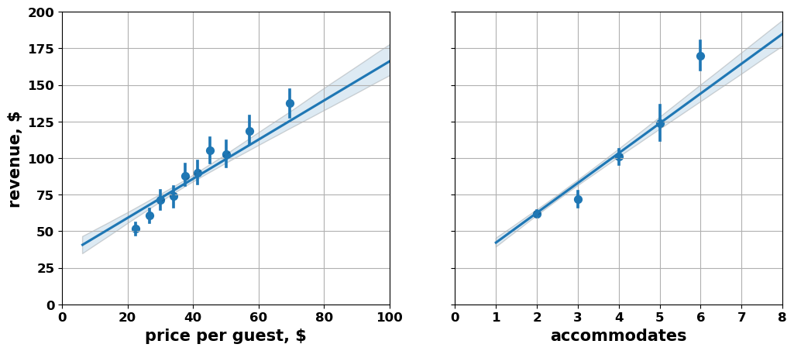
PRICE and SIZE ARE IMPORTANT
Price per guest and the number of accommodated customers correlate very strongly with the revenue: the higher is the price per guest and the number of accommodated people, the higher is the revenue for the host

Slide 10
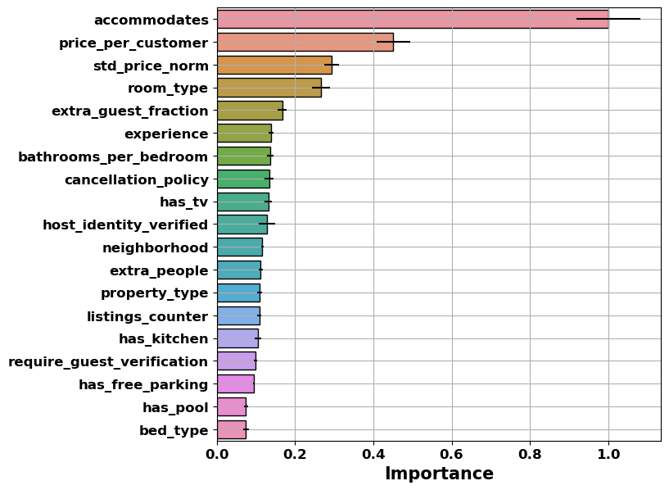
OTHER FACTORS
Trained XGBRegressor model on listing and booking data to predicts the revenue and to unravel the relative importance of the features:
‘accommodates’ and ‘price_per_customer’ are the most important predictors of the revenue: the larger the number of people and the price per person the larger is the revenue
‘std_price_norm’: adjusting the prices (depending on demand) increases the revenue
‘room_type’: renting whole houses and private rooms bring larger revenue than shared rooms
‘extra_guest_fraction’: too many extra guests have negative effect on revenue
‘experience’: host’s experience increases the revenue
‘bathrooms_per_bedroom’: more than one bathroom per bedroom decreases the revenue
‘cancellation policy’: strict cancellation policy increases the revenue

Slide 11
A sample of model predictions
One person apartment in Downtown area: $50 per guest typical price, $11 extra people fee
$32 expected daily revenue
45% expected daily booking rate
Two person house in Lake City: $40 per guest typical price, $14 extra people fee
$52 expected daily revenue
79% expected daily booking rate
Four person house in Magnolia: $35 per guest typical price, $13 for extra people fee
$94 expected daily revenue
66% expected daily booking rate

Slide 12
Summary
The revenue decreases around Christmas, New Year, Easter, and the Fourth of July. Market prices surge and the revenue increases during the summer, when there is an increased demand for the Airbnb hosts due to the increased number of people taking vacations.
Higher guest prices, larger accommodations, stricter cancellation policies, and larger fees for extra guests all increase the revenue. Price per customer and the number of people accommodated are the most important predictors. Price adjustments (depending on the demand) increase the revenue also.
The revenue and the booking rate models provide forecasts of the expected daily revenue and the booking rate for specified host's property attributes, pricing, policies, and location.

