Slide 1

Cyclitics Bike share Data Analysis Report
Pan Wing Lok
2022-6-4

Slide 2
Background
This company is a bike-sharing company and have two types of customers(member and casual)
This report aims to provide recommendation to help marketing team convert casuals to member

Slide 3
Data cleaning process
Rstudio is used to preform data cleaning
“Null” data is keeped in order to show the margin of error

Slide 4
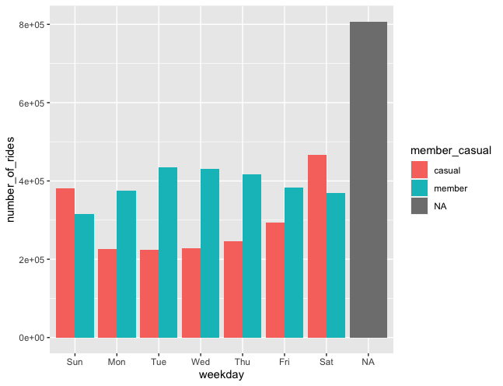
Key Finding One: Number of rides
Casual tends to ride bike during holiday
Member tends to ride bike during weekday
This reveals that member tends to ride bike for daily
use while casual tends to ride bike for entertaining

Slide 5
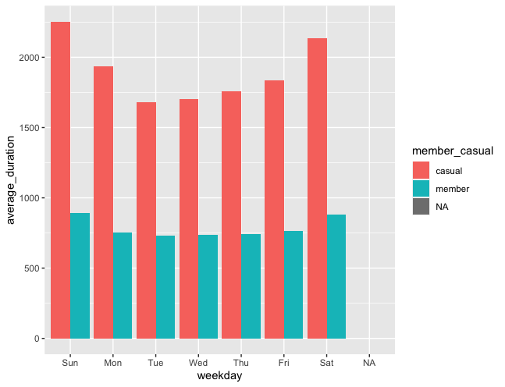
Key Finding Two: Average duration
The duration of casual`s ride is longer than
Member`s
This reveals that casual ride bike for exercising or
entertaining while member ride bike for travel
between home and workspace

Slide 6
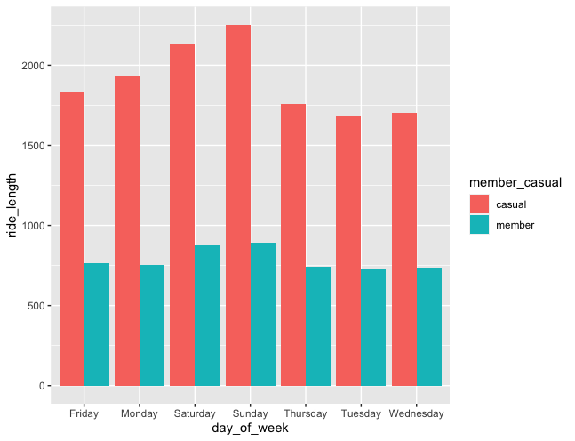
Key Finding Three: Ride length
The average length per ride of causal is much
longer than that of member
This reveals that causal tends to ride bike for
longer travels while member tends to ride bike
for short travels

Slide 7
Recommendation One
The marketing team might give a special discount to member that if they ride bike during holiday, they can have a 20% off.
This could attract casual to join the membership

Slide 8
Recommendation Two
Marketing team can impose a “flying miles” scheme. Member can earn “cycling miles” to exchange for rewards.
This could attract more casual to join the member as their ride length is longer than member

Slide 9
Recommendation Three
Marketing team can launch some “one day plan” for members.
This could attract casual to join membership as their ride duration is long so they would like to use a cheaper price to ride the bike

