Slide 1
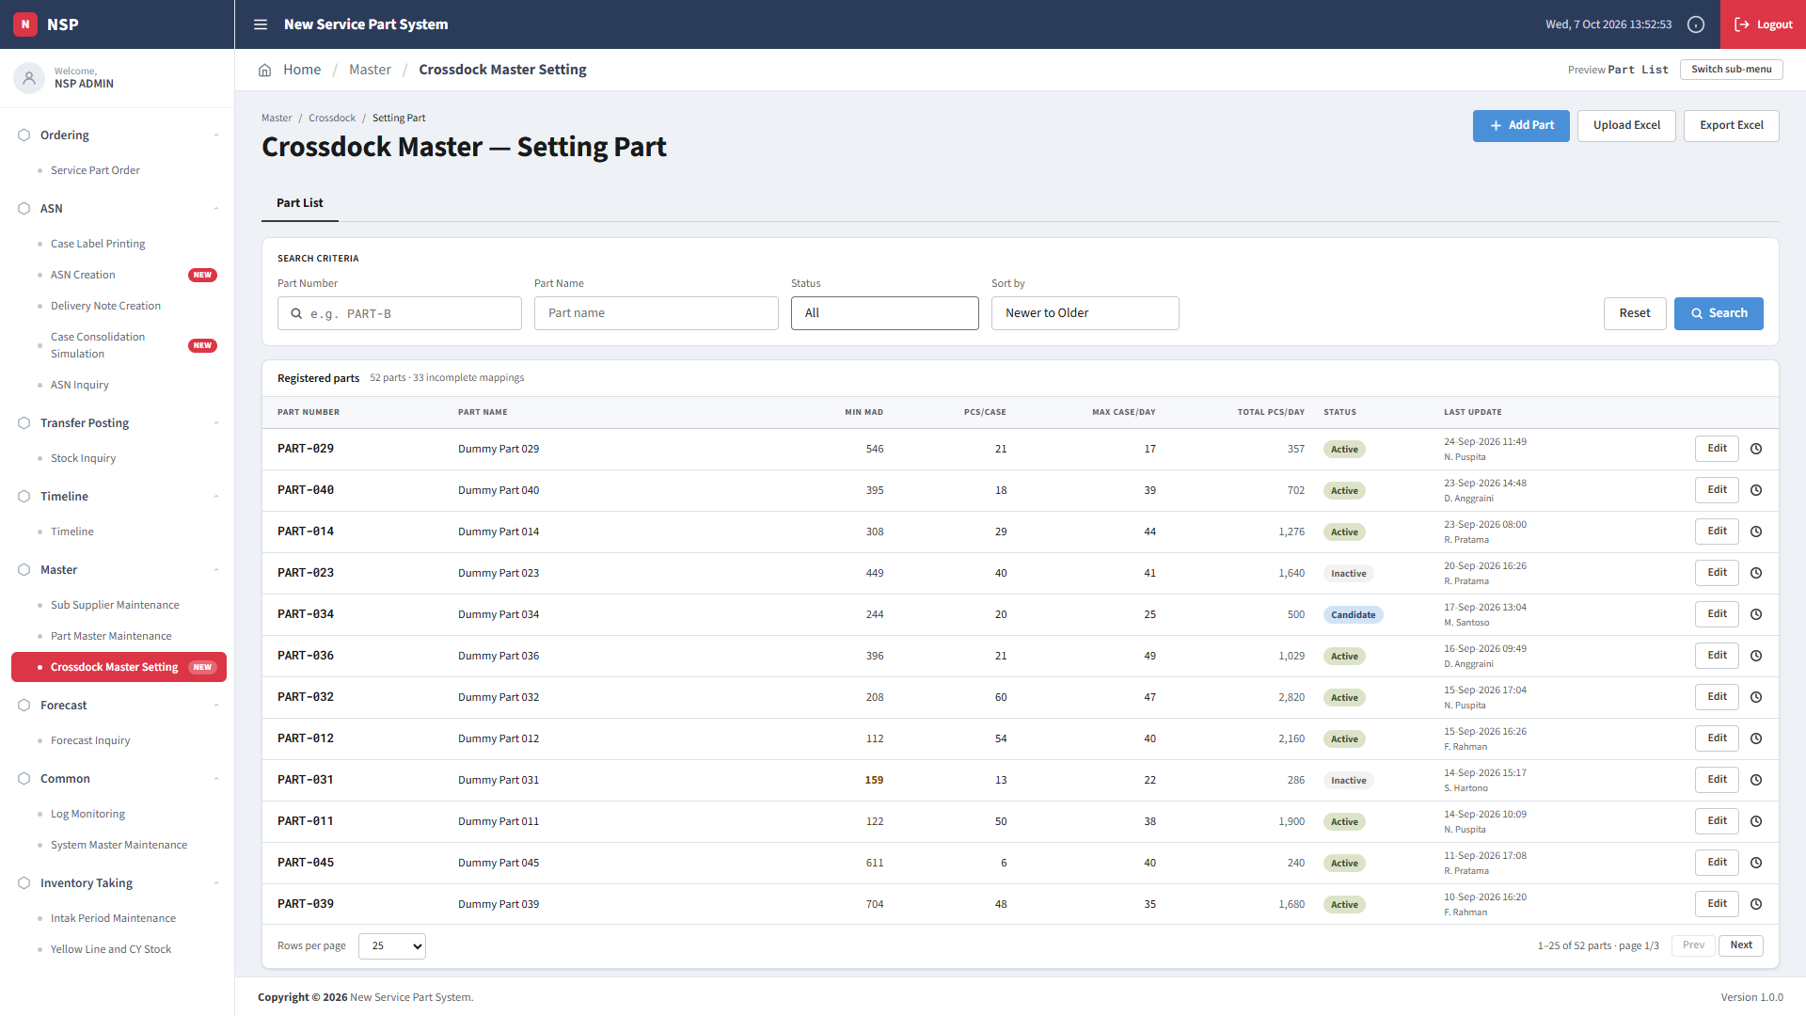
Crossdock Master Setting
01 / 07
Mode Procurement · Part List

Slide 2
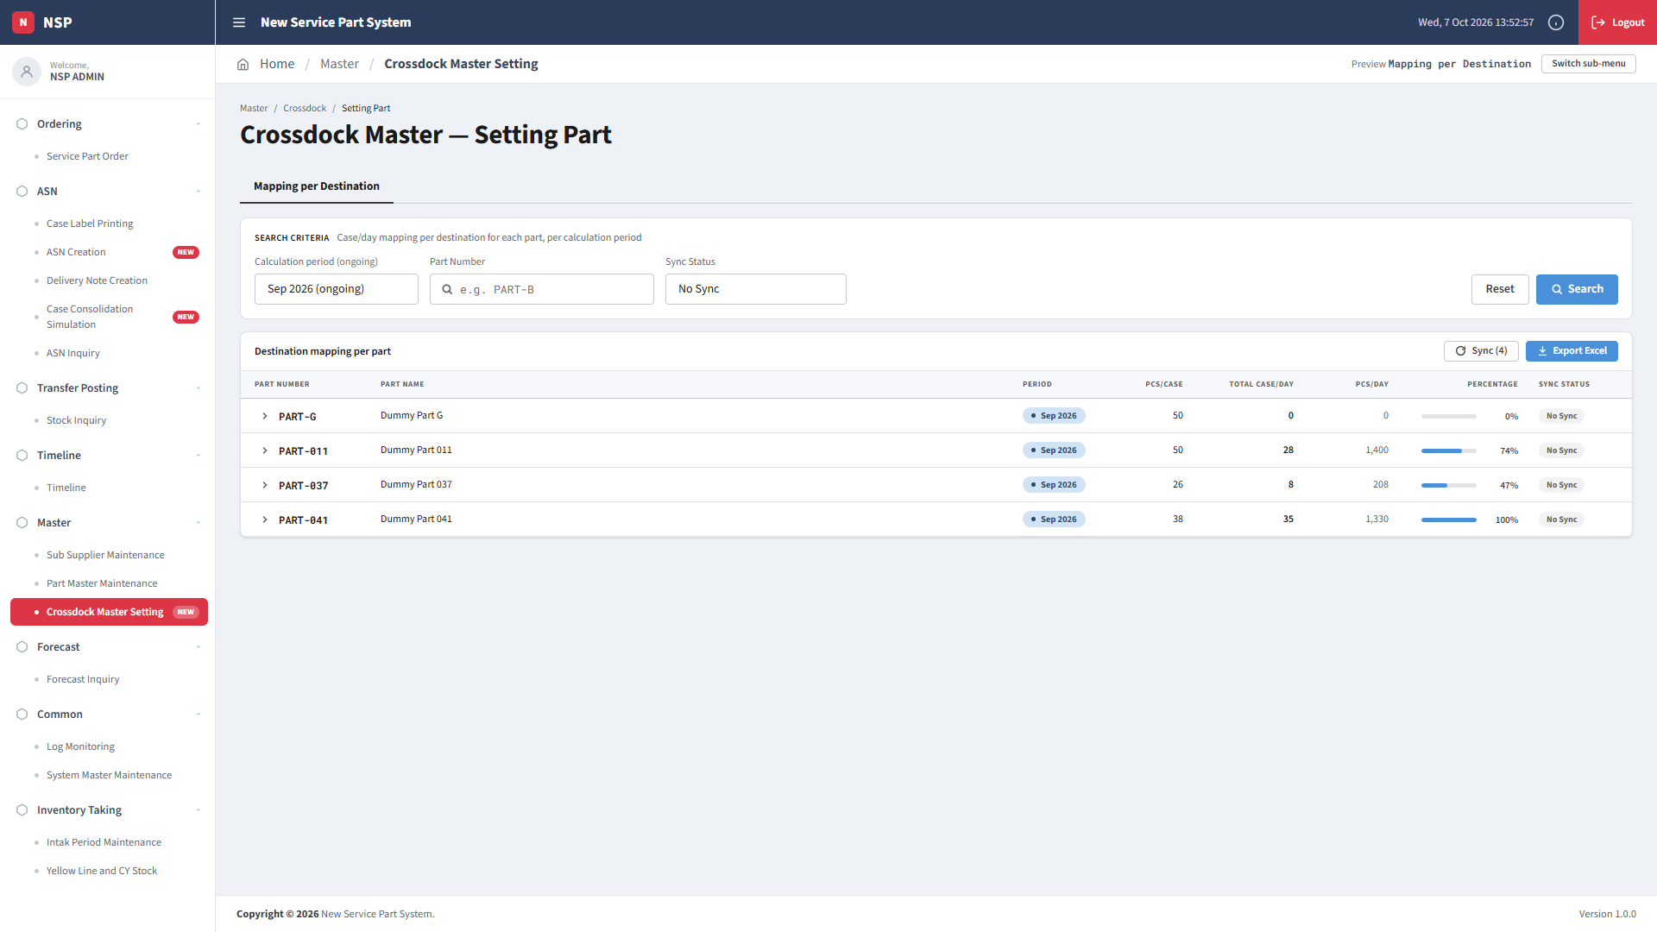
Crossdock Master Setting
02 / 07
Mode Demand Supply · Mapping per Destination

Slide 3
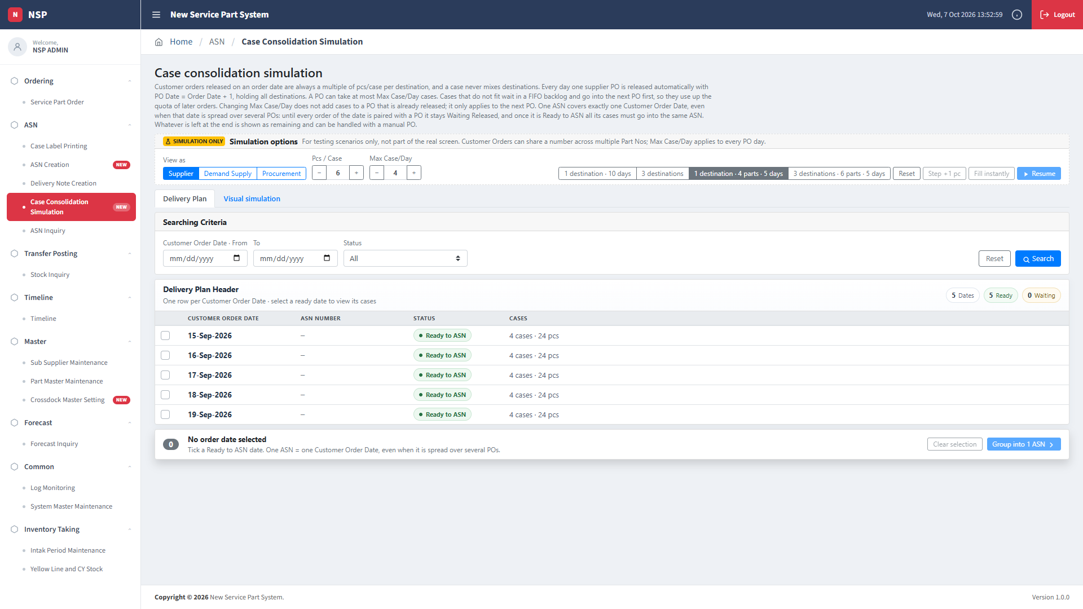
Case Consolidation
03 / 07
Mode Supplier · Delivery Plan

Slide 4
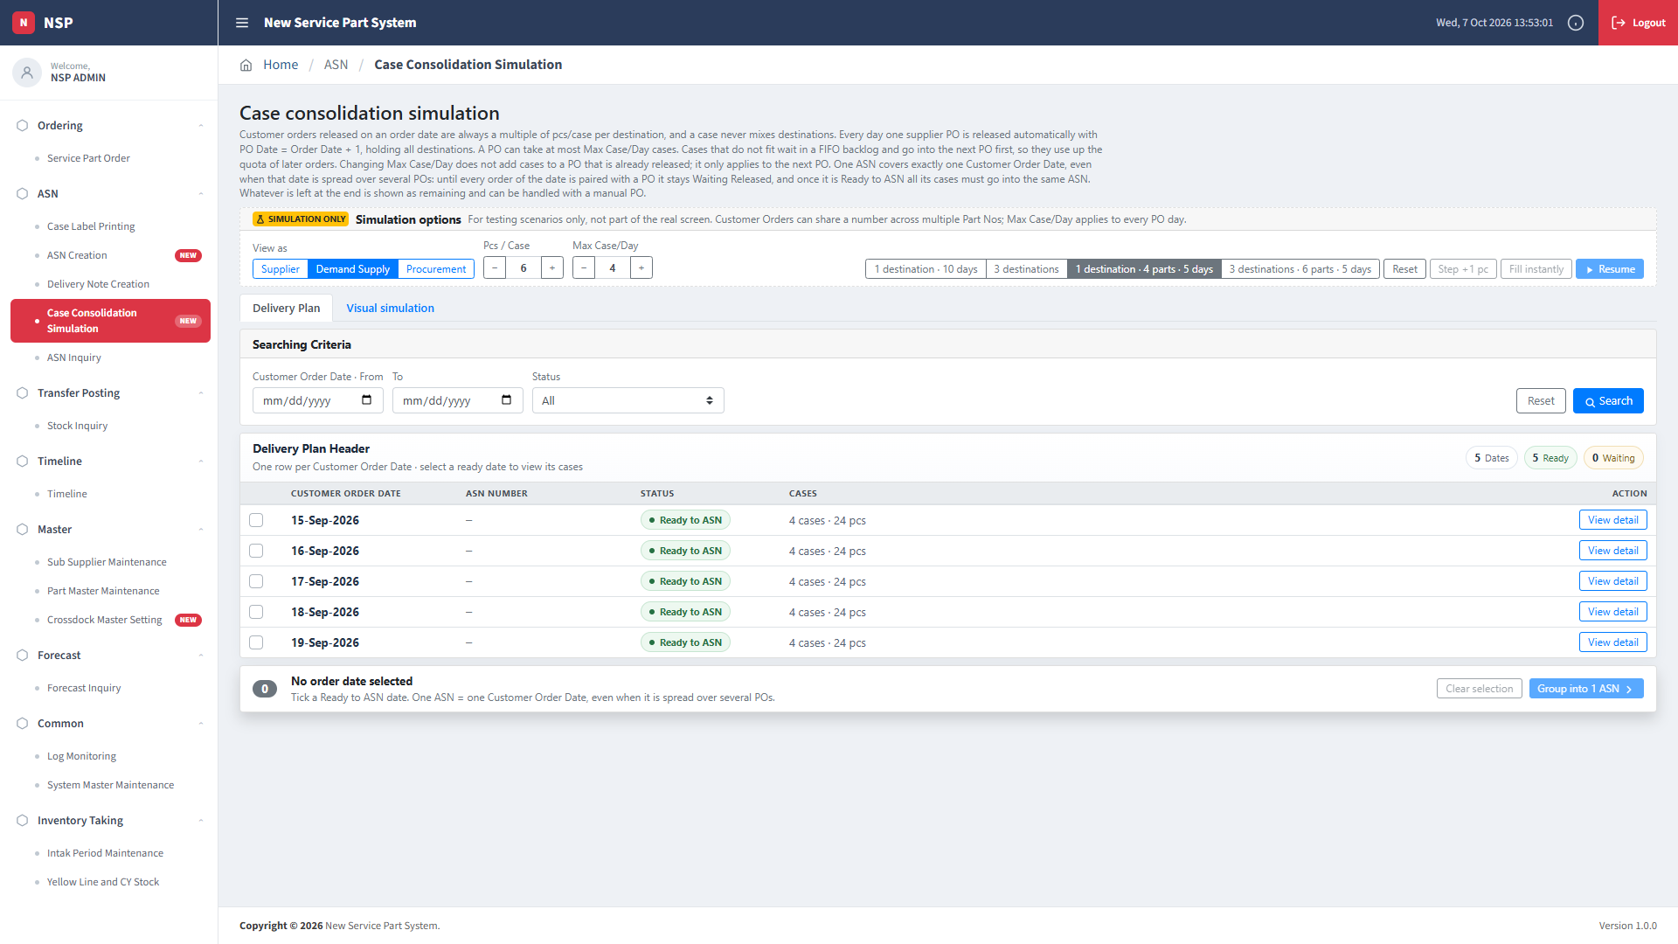
Case Consolidation
04 / 07
Mode Demand Supply · Delivery Plan

Slide 5
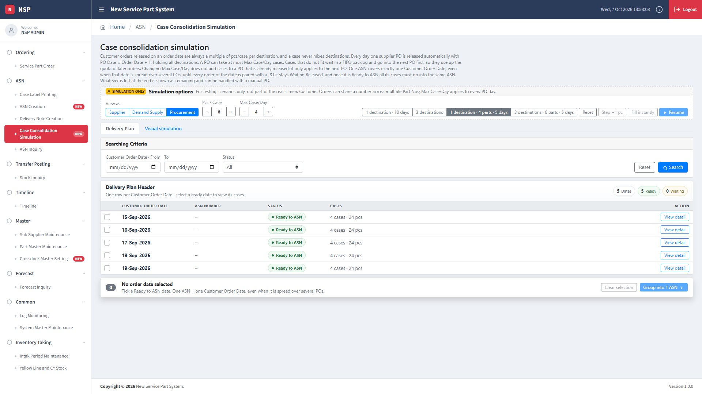
Case Consolidation
05 / 07
Mode Procurement · Delivery Plan

Slide 6
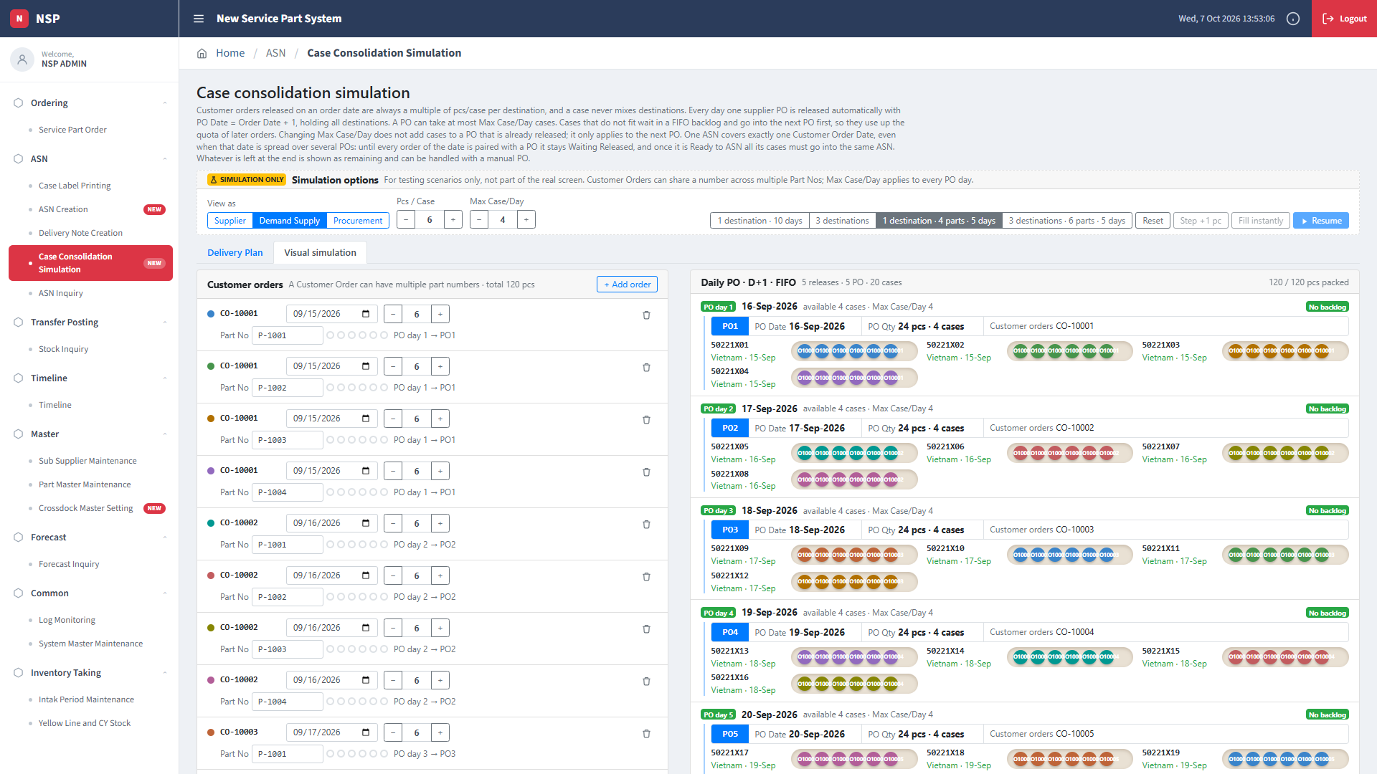
Case Consolidation
06 / 07
Visual Simulation · completed scenario

Slide 7
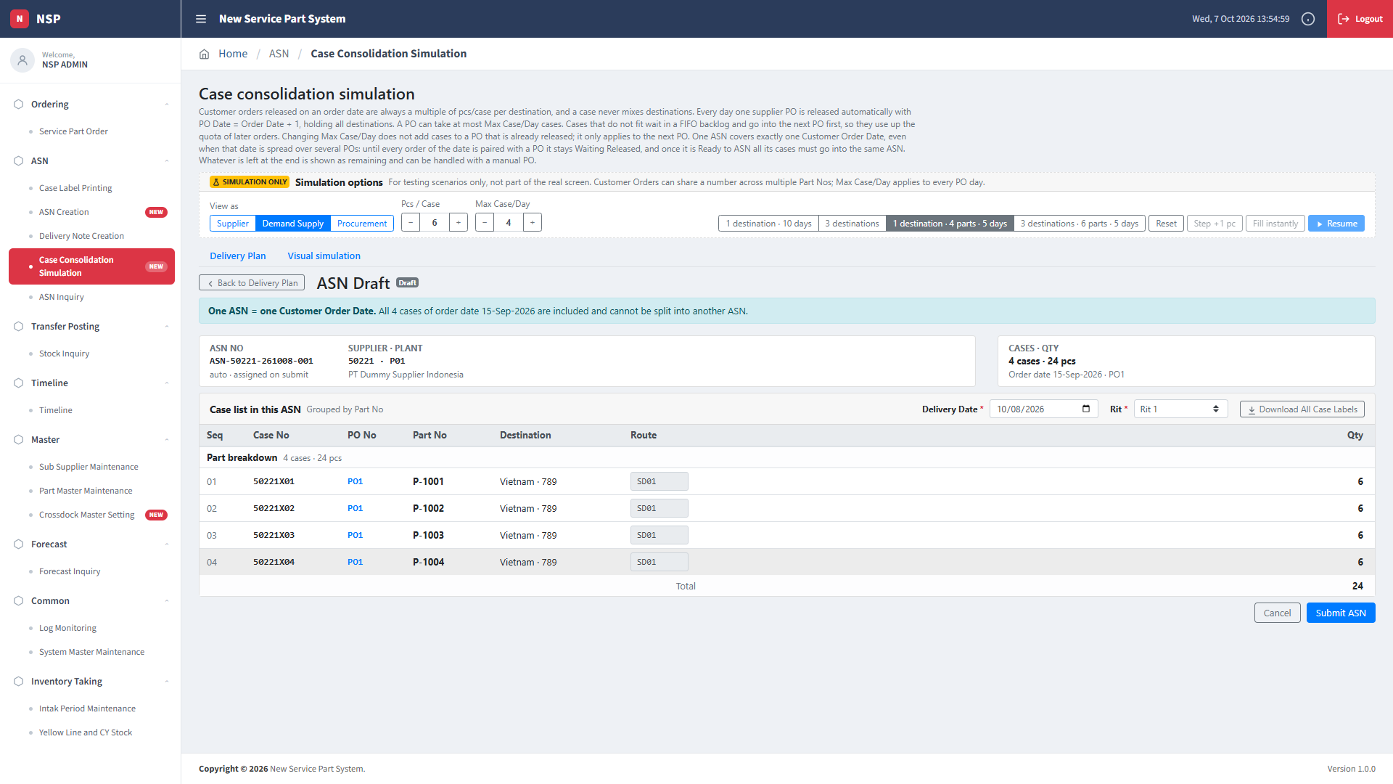
Case Consolidation
07 / 07
ASN Draft · grouped order date

