Slide 1
SENTIMENT ANALYSIS
Classifying Amazon Product Reviews
with VADER, TextBlob & BERT
Ivan Rodriguez & Sehdev Singh
Assignment #4 | Sentiment Analysis Practice
Dataset: Amazon Fine Food Reviews (Kaggle)

Slide 2
PROJECT OBJECTIVE
Can Machines Read Between the Lines?
Sentiment analysis automatically detects positive, negative, or neutral opinion in text. This project builds a complete local pipeline that scores real customer reviews and asks a harder question than most tutorials: which method actually gets it right?
3
sentiment methods compared
Build an end-to-end pipeline: collect → process → store → visualize
Compare 3 sentiment methods on the same 40,000 reviews
40,000
Evaluate each method against real ground truth (star ratings)
real Amazon reviews scored
Identify where automated sentiment scoring breaks down
100% local
Python + SQLite, no Azure required

Slide 3
PIPELINE
Project Architecture
1
2
3
4
COLLECTION
PROCESSING
INGESTION
VISUALIZATION
Amazon Fine Food
Reviews CSV (Kaggle)
VADER, TextBlob &
DistilBERT scoring
SQLite database
(reviews + scores)
matplotlib + plotly
charts
Local equivalent of the Azure reference architecture (Blob Storage → Data Factory → SQL Server → Power BI) — the assignment allows Azure to be optional, so this pipeline runs entirely local with open-source tools.

Slide 4
DATA SOURCE
Amazon Fine Food Reviews
Sourced from Kaggle's Amazon Fine Food Reviews dataset (568,454 reviews total). A sample of 40,000 reviews was used for this analysis, with each review's star rating (1–5) converted into a ground-truth sentiment label for evaluation.
4–5 ★ Positive 3 ★ Neutral 1–2 ★ Negative
31,284
3,016
5,700
Positive reviews
Neutral reviews
Negative reviews
78.2% of dataset
7.5% of dataset
14.3% of dataset
Note: the dataset is heavily imbalanced toward positive reviews, this matters for interpreting accuracy later.

Slide 5
METHODS
Three Approaches, One Dataset
V
VADER
T
TextBlob
B
DistilBERT
Rule-based lexicon scoring tuned for short, informal text.
Pattern-based polarity scoring from a simple Python API.
Transformer model fine-tuned on the SST-2 sentiment task.
Fast — no training needed
Simple, widely used baseline
Deep learning / contextual
Rule-based compound score
Also does POS-tagging, etc.
Distilled BERT — lighter, faster
Built for social/review text
Shown in course material
Positive/Negative only, natively

Slide 6
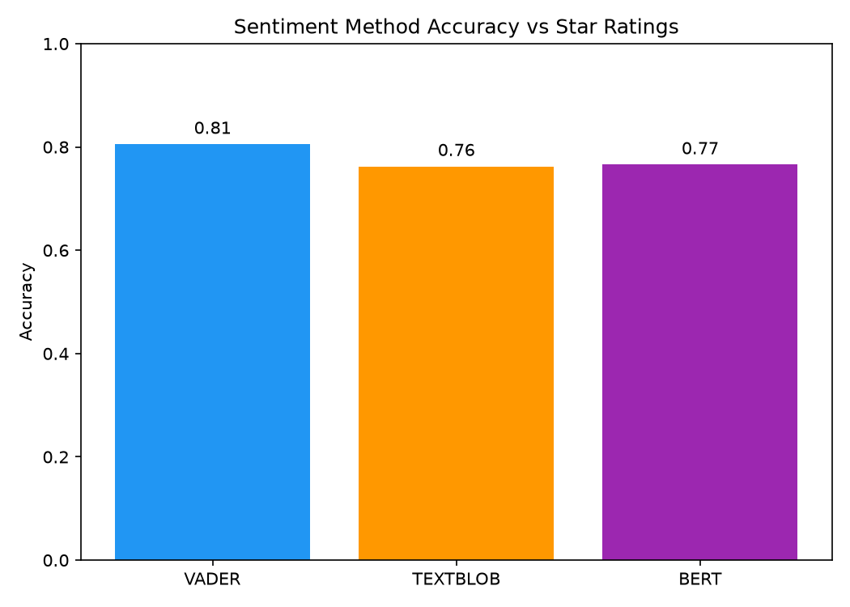
RESULTS
Accuracy vs. Star-Rating Ground Truth
81%
VADER — highest accuracy
VADER edges out both other methods on this dataset, its lexicon is well suited to short, informal review text.
TextBlob and BERT land within 1 point of each other, but for different reasons (see next slide).
All three sit close to the 78% positive-class baseline, accuracy alone can be misleading here.

Slide 7
RESULTS
Accuracy Hides the Real Story
Overall accuracy is dominated by the 78% positive class. Breaking each method down by class (F1-score) shows very different strengths — especially on the minority Negative and Neutral reviews.
Method | Accuracy | Positive F1 | Neutral F1 | Negative F1
VADER | 81% | 0.90 | 0.06 | 0.48
TextBlob | 71% | 0.88 | 0.14 | 0.40
DistilBERT | 77% | 0.87 | 0.05 | 0.57
Every method fails on Neutral
F1 scores of 0.05 - 0.14: 3-star reviews often mix praise and complaints, and none of the three approaches can reliably separate “mixed” from “mild” sentiment.
BERT wins on Negative recall
Its 0.57 F1 on Negative reviews beats VADER (0.48) and TextBlob (0.40), valuable if catching complaints matters more than raw accuracy.

Slide 8
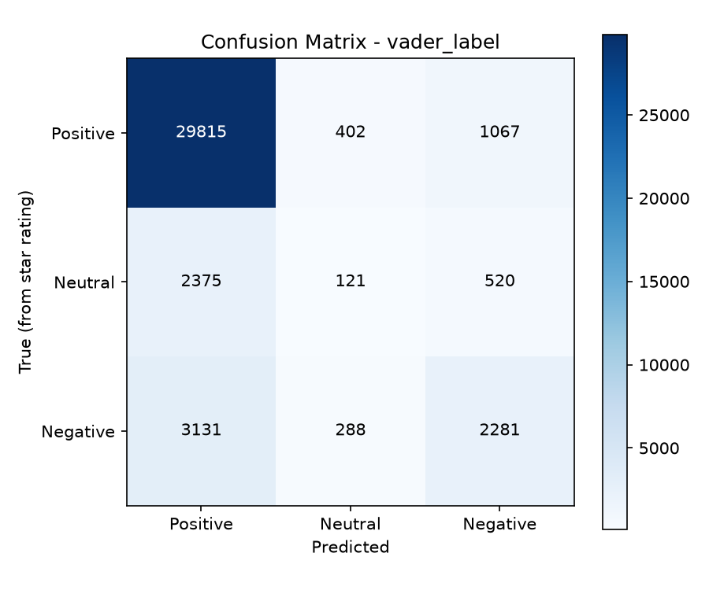
RESULTS
Where VADER Gets Confused
Reading the matrix:
29,815 / 31,284
true-Positive reviews correctly classified (95.3%)
3,131
true-Negative reviews mislabeled as Positive — the largest single error group
2,375 + 520
true-Neutral reviews split almost entirely into Positive or Negative — only 121 correctly kept Neutral
Takeaway: Neutral is essentially invisible to VADER - only 4% of true-neutral reviews were classified correctly.

Slide 9
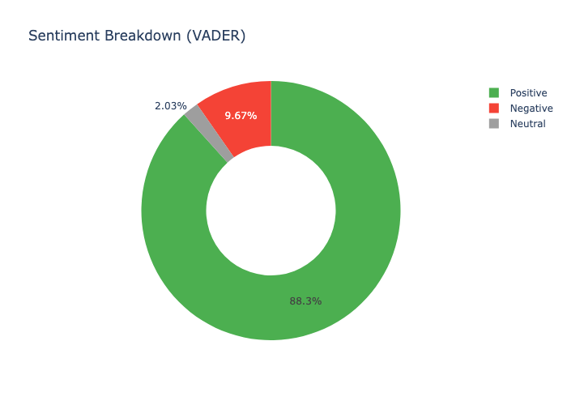
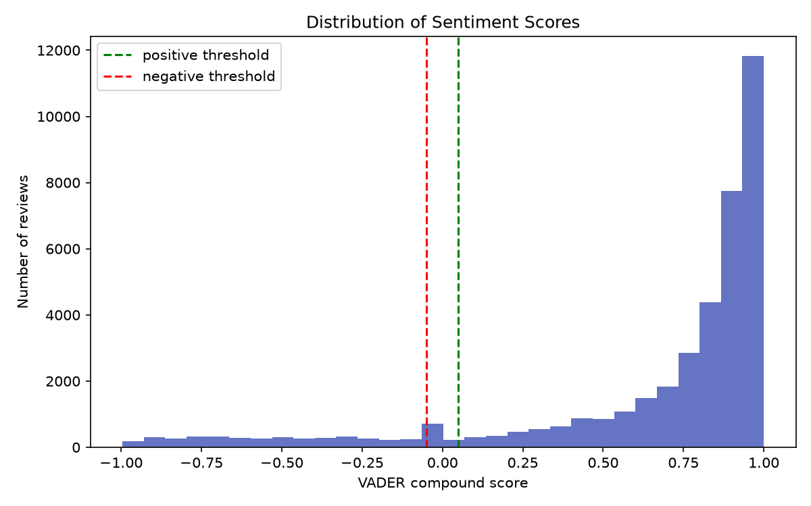
RESULTS
Predicted Sentiment at a Glance
VADER predicted 88.3% of all reviews as Positive, close to, but higher than, the 78.2% true positive rate.
Most reviews score near +1.0 (strongly positive) or spread thinly across the negative range, few land near the neutral thresholds, which is exactly why the Neutral class is so hard to hit.

Slide 10
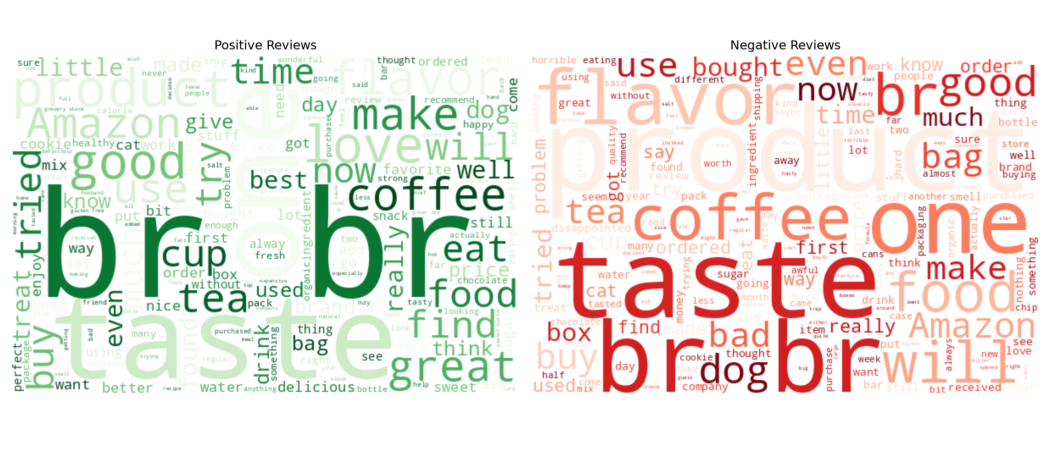
RESULTS
What Drives Sentiment?

Slide 11
CONCLUSIONS
Key Findings
Best overall: VADER
Best for catching complaints: BERT
Highest raw accuracy (80.5%) and strongest Positive-class F1 (0.90), the right default for fast, general-purpose scoring.
Highest Negative-class F1 (0.57), better choice when missing a negative review is costly (e.g., customer support triage).
Nobody handles Neutral well
Class imbalance shapes everything
All three methods score under 0.15 F1 on Neutral, 3-star, mixed-sentiment reviews remain a genuine open problem.
With 78% of reviews Positive, accuracy alone rewards guessing Positive - per-class F1 is essential for a fair comparison.

Slide 12
CHALLENGES & LIMITATIONS
What Made This Hard
Neutral is inherently ambiguous
Class imbalance skews evaluation
A 3-star review often contains both praise and criticism in the same sentence, no lexicon or model tested could reliably separate this from mild positive/negative sentiment.
With ~78% Positive reviews, a method that mostly guesses “Positive” still scores well on raw accuracy - per-class metrics were necessary to get a fair picture.
BERT inference cost on CPU
Threshold sensitivity
Running DistilBERT on the full 568K-row dataset was impractical without a GPU; results here are based on a 40,000-review sample, batched for speed.
VADER's ±0.05 compound-score cutoff for Positive/Negative is a simple heuristic shifting it changes the Neutral count substantially, as seen in the score distribution chart.

Slide 13
Thank You

