Slide 1
Hero.js
By: Ivan Goncalves Ruby
Masters of Computer Applications
University College of Engineering, Osmania University
Hyderabad, India
14/03/2014

Slide 2
What will we cover?
Basics: Web Pages vs Web Applications
Motivation: Single Page Applications
Features: Offline Storage, Geolocation and Caching
Hands-on Hero.js

Slide 3
<HTML>
Hyper Text Markup Language: language for creating web pages and other information that can be displayed in a web browser.

Slide 4
Web Page
HTML
CSS
Client-Side Scripting
*Client-Side Scripting Languages: Javascript, VBScript, etc

Slide 5
Web Application 3 Tier Structure
Web Application
Presentation: HTML + CSS
Logic/Application: Javascript, PHP, Java EE, etc
Data Storage: MySQL, Oracle, SQL Server, etc

Slide 6
Single-Page Application (SPA)
is a web application or web site that fits on a single web page with the goal of providing a more fluid user experience akin to a desktop application

Slide 7
What happens when you access an SPA
1. Downloads all the HTML, CSS and JavaScript. 2. Process the JavaScript. 3. Download the data from server. 4. Download templates needed to render the data. 5. Generate HTML from the template. 6. Inject HTML into the DOM.

Slide 8
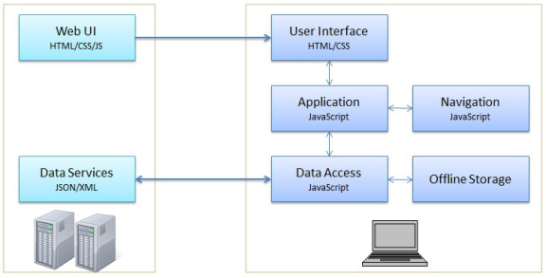
Structure of an SPA
Server
(Web Server)
Client
(Web Browser)

Slide 9
Hero.js
Offline Storage + Geo-location + Caching

Slide 10
Offline Storage
What is it: Mechanism for storing web application related data
locally, i.e., on the client’s device (Computer, Mobile
phone, tablet, etc.)
Advantage: Decreases network load, enables offline functionality of the web application
Disadvantage: Data is more vulnerable and the user can't access it from multiple clients (web browsers)
Recommended for: Non-critical data
(No passwords, Credit Card details, etc.)

Slide 11
Geo-location
What is it: Identification of the real-world geographic location of an object, such as a radar, mobile phone or an Internet-connected computer terminal
Applications: Geo Marketing, Location-aware Services, Criminal investigations, etc.
Issues raised: Privacy.
In some cases, it is in the interest of users to be accurately located, for example, so that they can be offered information relevant to their location. In other cases, users prefer to not disclose their location for privacy or other reasons.

Slide 12
Cache
What is it: is a mechanism for the temporary storage (caching) of web documents, such as HTML pages and images, to reduce bandwidth usage, server load, and perceived lag.
Purpose: Reduce bandwidth usage, server load, and perceived lag
Example: Images of frequently accessed web pages are cached in
order to avoid downloading the same image multiple times

Slide 13
hero.js
hero.db
insert()
remove()
hero.geo
init()
hero.cache
require()
update()
get()
network()
fallback()
register()
search()
get().sort()
create()
generate()

Slide 14
Hands on hero.js
(Domain: demo.ivanruby.com/hero)

Slide 15
Questions
?

Slide 16
Bibliography
http://en.wikipedia.org/wiki/Web_page
http://en.wikipedia.org/wiki/Web_application
http://en.wikipedia.org/wiki/Single-page_application
http://devmanagement.wordpress.com/2012/09/13/1226/
http://www.html5rocks.com/en/features/storage
http://en.wikipedia.org/wiki/Geolocation
http://en.wikipedia.org/wiki/Geolocation_software
http://en.wikipedia.org/wiki/Web_cache
*Seen on 12/03/2014

