Slide 1


“So Called engineers”
Team Members: Rohan,IVAN,varun
A one stop solution for vaccine delivery

Slide 2
Content:
Problem Statement
Solution
Object Model
Scope
Use Case

Slide 3
Problem Statement
Throughout the developing world, access to lifesaving and critical health products is hampered by what is known as the last-mile problem: the inability to deliver needed medicine from a city to rural or remote locations due to lack of adequate transportation, communication and supply chain infrastructure.
In Rwanda, postpartum hemorrhaging is the leading cause of death for pregnant women, thus the result is that all too often someone in need of a lifesaving transfusion cannot access the blood they need to survive.
The process of collating patient info, redirecting it to appropriate medical facility and eventually prescribing appropriate medical assistance is long and elaborate. Medical supplies require storage and transport at safe temperatures and spoils quickly. There are many different medical products and no way to accurately project future needs.

Slide 4
Solution
Our application focuses on tackling the transportation, communication and supply chain problem faced by developing countries like Rwanda.
The application focuses to improve the efficiency, accountability, and the ability to respond to safety problems and public health crises.
The solution addresses medical supplies financial management, vaccine distribution, provider ordering (hospital and clinics), inventory management, and the operation of the national vaccine stockpile.
The application provides an end-to-end solution to the problem of storing medical supplies to delivering it to the concerned patients.

Slide 5
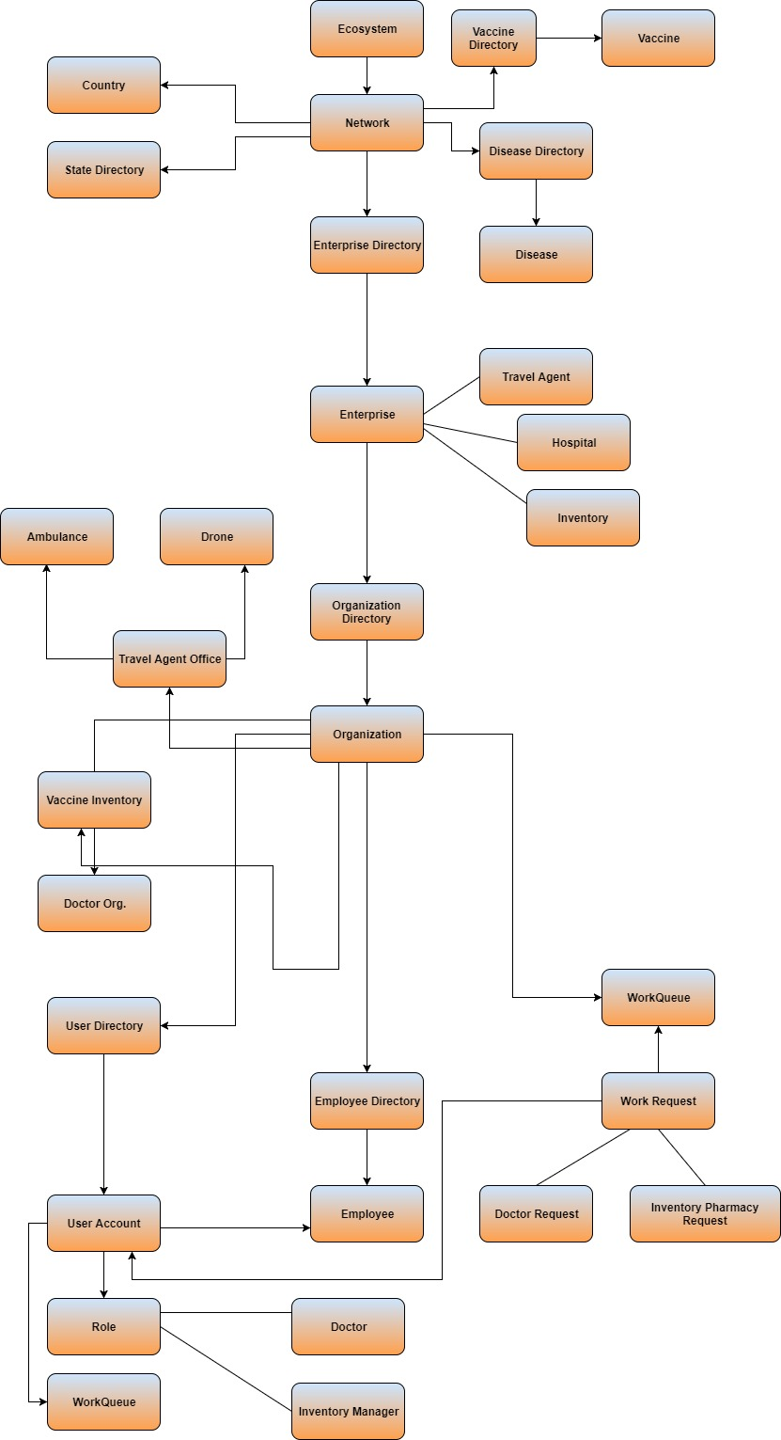
Object Model

Slide 6
Scope
The request raised by the doctor would be first handled by the local pharmacies and clinics in order to ensure quick response.
If the local pharmacies, clinics or hospitals are unable to suffice the needs, the request would then be routed to the nearest inventories based out of the geo fence area.
At the warehouse, the supplies would be monitored constantly in order to keep a track of the supply- demand ratios and also to maintain the storage standards specified by the CDC and Public Health dept.
The CDC and the Public health dept. would be responsible for prescribing the scheduled medicines at the warehouse and the supplies would be delivered only on their approval.
The application would also track the demographics of the patients and basis which the decision would be made for providing the infrastructure of the local health dept.(hospitals, clinics, pharmacies)
To avoid the wastage of medicines at the warehouses, the application would closely monitor the demand for drugs and align the supplies accordingly.
The application also tracks the cost involved in flying the drones and ambulances across the geographic locations.

Slide 7
Use Cases
Authorizing role types for organization and assigning functionalities to each role types.
Defining location data for all the involved entities.
Real time location mapping for doctors.
Vaccine and emergency supply requests from doctor to pharmacy and from Pharmacy to Inventor.
Distribute the requested vaccine back to the doctor.
Trade-off between mode of transport to deliver the vaccine.
Tracking inventory stocks and redistribution.

Slide 8
