Slide 1
Chapter 4: Linear Regression
Zhijian He

Slide 2
Simple Linear Models
The linear model is given by
$$y_{i}=β_{0}+β_{1}x_{i}+ϵ_{i}, i=1,…,n.$$
  $ϵ_{i}$ are random (need some assumptions)
  $x_{i}$ are fixed (independent/predictor variable)
  $y_{i}$ are random (dependent/response variable)
  $β_{0}$ is the intercept
  $β_{1}$ is the slope

Slide 3
Least square estimators
Choose $β_{0},β_{1}$ to minimize
$$Q(β_{0},β_{1})=\sum_{i=1}^{n}{(}y_{i}−β_{0}−β_{1}x_{i})^{2}.$$
The minimizers ${\overset{̂}{β}}_{0},{\overset{̂}{β}}_{1}$ are given by
$${\overset{̂}{β}}_{1}=\frac{\sum_{i=1}^{n}{(}y_{i}−\overline{y})x_{i}}{\sum_{i=1}^{n}{(}x_{i}−\overline{x})x_{i}}, {\overset{̂}{β}}_{0}=\overline{y}−{\overset{̂}{β}}_{1}\overline{x}.$$
Regression function: $\overset{̂}{y}={\overset{̂}{β}}_{0}+{\overset{̂}{β}}_{1}x$.

Slide 4
Some useful notations
$$ℓ_{xx}=\sum_{i=1}^{n}{(}x_{i}−\overline{x})^{2}$$
$$ℓ_{yy}=\sum_{i=1}^{n}{(}y_{i}−\overline{y})^{2}$$
$$ℓ_{xy}=\sum_{i=1}^{n}{(}x_{i}−\overline{x})(y_{i}−\overline{y})$$
$${\overset{̂}{β}}_{1}=\frac{\sum_{i=1}^{n}{(}y_{i}−\overline{y})(x_{i}−\overline{x})}{\sum_{i=1}^{n}{(}x_{i}−\overline{x})(x_{i}−\overline{x})}=\frac{ℓ_{xy}}{ℓ_{xx}}=\frac{1}{ℓ_{xx}}\sum_{i=1}^{n}{(}x_{i}−\overline{x})y_{i}$$

Slide 5
Expected values and variances
Assumption A1: $E[ϵ_{i}]=0,i=1,…,n$.
Theorem 1: Under Assumption A1, ${\overset{̂}{β}}_{0},{\overset{̂}{β}}_{1}$ are unbiased estimators for $β_{0},β_{1}$, respectively.
Assumption A2: $Cov(ϵ_{i},ϵ_{j})=σ^{21}\{i=j\}$.
Theorem 2: Under Assumption A2, we have
$$Var[{\overset{̂}{β}}_{0}]=\left(\frac{1}{n}+\frac{{\overline{x}}^{2}}{ℓ_{xx}}\right)σ^{2}, Var[{\overset{̂}{β}}_{1}]=\frac{σ^{2}}{ℓ_{xx}}$$
$$Cov({\overset{̂}{β}}_{0},{\overset{̂}{β}}_{1})=\frac{−\overline{x}}{ℓ_{xx}}σ^{2}.$$

Slide 6
Estimation of $σ^{2}$
Definition: The sum of squared errors (SSE) is defined by
$$S_{e}^{2}=\sum_{i=1}^{n}{(}y_{i}−{\overset{̂}{β}}_{0}−{\overset{̂}{β}}_{1}x_{i})^{2}.$$
Theorem 3: Let
$${\overset{̂}{σ}}^{2}:=\frac{Q({\overset{̂}{β}}_{0},{\overset{̂}{β}}_{1})}{n−2}=\frac{\sum_{i=1}^{n}{(}y_{i}−{\overset{̂}{β}}_{0}−{\overset{̂}{β}}_{1}x_{i})^{2}}{n−2}=\frac{S_{e}^{2}}{n−2}.$$
Under Assumptions A1 and A2, we have $E[{\overset{̂}{σ}}^{2}]=σ^{2}$.

Slide 7
Normal distributions
Assumption B: $ϵ_{i}\overset{iid}{∼}N(0,σ^{2}),i=1,…,n$.
Assumption B includes Assumptions A1 and A2.
Theorem 4: Under Assumption B, we have
(1). ${\overset{̂}{β}}_{0}∼N(β_{0},(\frac{1}{n}+\frac{{\overline{x}}^{2}}{ℓ_{xx}})σ^{2})$
(2). ${\overset{̂}{β}}_{1}∼N(β_{1},\frac{σ^{2}}{ℓ_{xx}})$
(3). $\frac{(n−2){\overset{̂}{σ}}^{2}}{σ^{2}}=\frac{S_{e}^{2}}{σ^{2}}∼χ^{2}(n−2)$
(4). ${\overset{̂}{σ}}^{2}$ is independent of $({\overset{̂}{β}}_{0},{\overset{̂}{β}}_{1})$.

Slide 8
Inferences about $β_{1}$
For known $σ$ we can make tests and confidence intervals using
$$\frac{{\overset{̂}{β}}_{1}−β_{1}}{σ/\sqrt{ℓ_{xx}}}∼N(0,1).$$
The $100(1−α)\%$ confidence interval for $β_{1}$ is given by
$${\overset{̂}{β}}_{1}±u_{1−α/2}σ/\sqrt{ℓ_{xx}}.$$
For testing
$$H_{0}:β_{1}=β_{1}^{*} vs. H_{1}:β_{1}≠β_{1}^{*},$$
we reject $H_{0}$ if $|{\overset{̂}{β}}_{1}−β_{1}^{*}|>u_{1−α/2}σ/\sqrt{ℓ_{xx}}$

Slide 9
Inferences about $β_{1}$
In the more realistic setting of unknown $σ$, using claims (2-4) gives
$$\frac{{\overset{̂}{β}}_{1}−β_{1}}{\overset{̂}{σ}/\sqrt{ℓ_{xx}}}∼t(n−2).$$
The $100(1−α)\%$ confidence interval for $β_{1}$ is
$${\overset{̂}{β}}_{1}±t_{1−α/2}(n−2)\overset{̂}{σ}/\sqrt{ℓ_{xx}}.$$
For testing
$$H_{0}:β_{1}=β_{1}^{*} vs. H_{1}:β_{1}≠β_{1}^{*},$$
we reject $H_{0}$ if $|{\overset{̂}{β}}_{1}−β_{1}^{*}|>t_{1−α/2}(n−2)\overset{̂}{σ}/\sqrt{ℓ_{xx}}$.

Slide 10
Inferences about $β_{0}$
Similarly, for drawing inferences about $β_{0}$, we can use
$$\frac{{\overset{̂}{β}}_{0}−β_{0}}{σ\sqrt{1/n+{\overline{x}}^{2}/ℓ_{xx}}}∼N(0,1),$$
$$\frac{{\overset{̂}{β}}_{0}−β_{0}}{\overset{̂}{σ}\sqrt{1/n+{\overline{x}}^{2}/ℓ_{xx}}}∼t(n−2).$$

Slide 11
Inferences about $σ^{2}$
The $100(1−α)\%$ confidence interval for $σ^{2}$ is
$$\left[\frac{(n−2){\overset{̂}{σ}}^{2}}{χ_{1−α/2}^{2}(n−2)},\frac{(n−2){\overset{̂}{σ}}^{2}}{χ_{α/2}^{2}(n−2)}\right]$$
or,
$$\left[\frac{S_{e}^{2}}{χ_{1−α/2}^{2}(n−2)},\frac{S_{e}^{2}}{χ_{α/2}^{2}(n−2)}\right].$$

Slide 12
Case study 1
A manufacturer of air conditioning units is having assembly problems due to the failure of a connecting rod to meet finished-weight specifications. Too many rods are being completely tooled, then rejected as overweight. To reduce that cost, the company’s quality-control department wants to quantify the relationship between the weight of the finished rod, $y$, and that of the rough casting, $x$. Castings likely to produce rods that are too heavy can then be discarded before undergoing the final (and costly) tooling process.

Slide 13
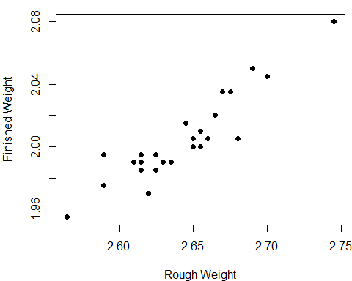
Graphed data

Slide 14
Model setting
Consider the linear model
$$y_{i}=β_{0}+β_{1}x_{i}+ϵ_{i}, ϵ_{i}\overset{iid}{∼}N(0,σ^{2}).$$
  The observed data gives
  $$\overline{x}=2.643, \overline{y}=2.0048,ℓ_{xx}=0.0367, ℓ_{xy}=0.023565.$$
  The least square estimates are
  $${\overset{̂}{β}}_{1}=\frac{ℓ_{xy}}{ℓ_{xx}}=\frac{0.023565}{0.0367}=0.642, {\overset{̂}{β}}_{0}=\overline{y}−{\overset{̂}{β}}_{1}\overline{x}=0.308.$$
  variance estimator: $\overset{̂}{σ}=0.0113$
  The regession function $\overset{̂}{y}=0.308+0.642x$

Slide 15
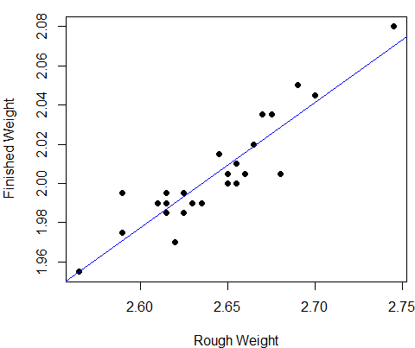
The results

Slide 16
Summary report
##
## Call:
## lm(formula = finished_weight ~ rough_weight)
##
## Residuals:
## Min 1Q Median 3Q Max
## -0.023558 -0.008242 0.001074 0.008179 0.024231
##
## Coefficients:
## Estimate Std. Error t value Pr(>|t|)
## (Intercept) 0.30773 0.15608 1.972 0.0608 .
## rough_weight 0.64210 0.05905 10.874 1.54e-10 ***
## ---
## Signif. codes: 0 '***' 0.001 '**' 0.01 '*' 0.05 '.' 0.1 ' ' 1
##
## Residual standard error: 0.01131 on 23 degrees of freedom
## Multiple R-squared: 0.8372, Adjusted R-squared: 0.8301
## F-statistic: 118.3 on 1 and 23 DF, p-value: 1.536e-10

Slide 17
Assessing the Fit
As an aid in assessing the quality of the fit, we will make extensive use of the residuals, which are the differences between the observed and fitted values:
$${\overset{̂}{ϵ}}_{i}=y_{i}−{\overset{̂}{β}}_{0}−{\overset{̂}{β}}_{1}x_{i}, i=1,…,n.$$
It is most useful to examine the residuals graphically. Plots of the residuals versus the $x$ values may reveal systematic misfit or ways in which the data do not conform to the fitted model. Ideally, the residuals should show no relation to the $x$ values, and the plot should look like a horizontal blur.

Slide 18
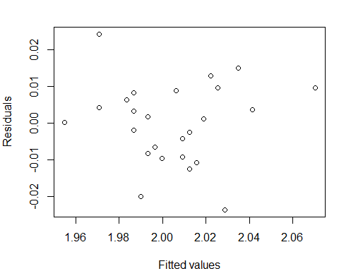
The graphed residuals

Slide 19
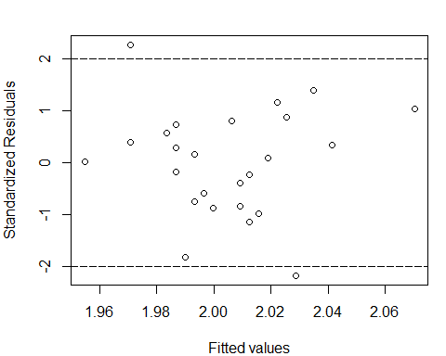
Standardized residuals

Slide 20
Drawing Inferences about $E[y]$
For given $x$, we want to estimate the expected value of $y$, i.e., $E[y]=β_{0}+β_{1}x.$ A natural unbiased estimate is $\overset{̂}{y}={\overset{̂}{β}}_{0}+{\overset{̂}{β}}_{1}x$.
Theorem 5: Suppose Assumption B is satisfied. Then we have
$$\overset{̂}{y}={\overset{̂}{β}}_{0}+{\overset{̂}{β}}_{1}x∼N(β_{0}+β_{1}x,[1/n+(x−\overline{x})^{2}/ℓ_{xx}]σ^{2}).$$
A $100(1−α)\%$ confidence interval for $E[y]=β_{0}+β_{1}x$ is given by
$$\overset{̂}{y}±t_{1−α/2}(n−2)\overset{̂}{σ}\sqrt{\frac{1}{n}+\frac{(x−\overline{x})^{2}}{ℓ_{xx}}}.$$

Slide 21
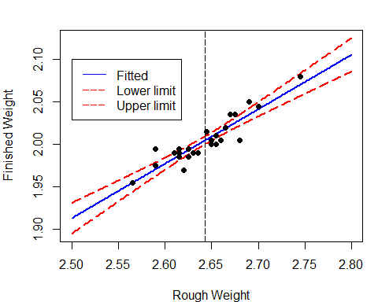
Case study 1: Confidence interval

Slide 22
Drawing Inferences about $y$
We now give a prediction interval for the future observation $y$ rather than its expected value $E[y]$. Note that here $y$ is no longer a fixed parameter, which is assumed to be independent of $y_{i}$’s.
Definition: A prediction interval is a range of numbers that contains $y$ with a specified probability.
Theorem 6: Suppose Assumption B is satisfied. Let $y=β_{0}+β_{1}x+ϵ$, where $ϵ∼N(0,σ^{2})$ is independent of $ϵ_{i}$’s. A $100(1−α)\%$ prediction interval for $y$ is given by
$$\overset{̂}{y}±t_{1−α/2}(n−2)\overset{̂}{σ}\sqrt{1+\frac{1}{n}+\frac{(x−\overline{x})^{2}}{ℓ_{xx}}}.$$

Slide 23
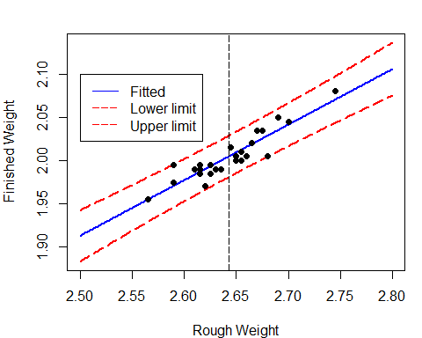
Case study 1: Prediction interval

Slide 24
How to control y?
Consider case study 1 again. Castings likely to produce rods that are too heavy can then be discarded before undergoing the final (and costly) tooling process. The company’s quality-control department wants to produce the rod $y$ with weights no large than 2.05 with probablity no less than 0.95. How to choose the rough casting?
Now we want $y≤y_{0}=2.05$ with probability $1−α$. Similarly to Theorem 6, we can construct one-side confidence interval for $y$, that is
$$(−∞,\overset{̂}{y}+t_{1−α}(n−2)\overset{̂}{σ}\sqrt{1+\frac{1}{n}+\frac{(x−\overline{x})^{2}}{ℓ_{xx}}}].$$

Slide 25
How to control y?
$${\overset{̂}{β}}_{0}+{\overset{̂}{β}}_{1}x+t_{1−α}(n−2)\overset{̂}{σ}\sqrt{1+\frac{1}{n}+\frac{(x−\overline{x})^{2}}{ℓ_{xx}}}≤y_{0}$$

Slide 26
Multiple linear regression
Consider a model of the form
$$y_{i}=β_{0}+β_{1}x_{i1}+β_{2}x_{i2}+…+β_{p−1}x_{i,p−1}+ϵ_{i}, i=1,…,n.$$
In the matrix form:
$$\left[\begin{matrix}y_{1} \\ y_{2} \\ ⋮ \\ y_{n}\end{matrix}\right]=\left[\begin{matrix}1 & x_{11} & x_{12} & ⋯ & x_{1,p−1} \\ 1 & x_{21} & x_{22} & ⋯ & x_{2,p−1} \\ ⋮ & ⋮ & ⋮ & ⋮ & ⋮ & \\ 1 & x_{n1} & x_{n2} & ⋯ & x_{n,p−1}\end{matrix}\right]\left[\begin{matrix}β_{0} \\ β_{1} \\ ⋮ \\ β_{p−1}\end{matrix}\right]+\left[\begin{matrix}ϵ_{1} \\ ϵ_{2} \\ ⋮ \\ ϵ_{n}\end{matrix}\right].$$
$$Y=Xβ+ϵ$$
  the matrix $X$ is called the design matrix

Slide 27
Least squares estimation (LSE)
Find $β$ to minimize
$$\begin{matrix}Q(β) & =\sum_{i=1}^{n}{(}y_{i}−β_{0}−β_{1}x_{i1}−…−β_{p−1}x_{i,p−1})^{2} \\ & =||Y−Xβ||^{2}=(Y−Xβ)^{⊤}(Y−Xβ) \\ & =Y^{⊤}Y−2Y^{⊤}Xβ+β^{⊤}X^{⊤}Xβ.\end{matrix}$$
If we differentiate $Q$ with respect to each $β_{i}$ and set the derivatives equal to zero, we see that the minimizers ${\overset{̂}{β}}_{0},…,{\overset{̂}{β}}_{p−1}$ satisfy
$$\frac{∂Q}{∂β_{i}}=−2(Y^{⊤}X)_{i}+2(X^{⊤}X)_{i⋅}\overset{̂}{β}=0.$$

Slide 28
Normal equations
We thus arrive at the so-called normal equations:
$$X^{⊤}X\overset{̂}{β}=X^{⊤}Y$$
If the design matrix $X^{⊤}X$ is nonsingular, the formal solution is
$$\overset{̂}{β}=(X^{⊤}X)^{−1}X^{⊤}Y.$$
Lemma 1: The matrix $X^{⊤}X$ is nonsingular if and only if $rank(X)=p$.
NOTE: In what follows, we assume that $rank(X)=p<n$. If $p>n$, it belongs to the field of high-dimensional statistics.

Slide 29
Expected values and variances
Assumption A: Assume that $E[ϵ]=0$ and $Var[ϵ]=σ^{2}I_{n}$.
Theorem 7: Suppose that Assumption A is satisfied and $rank(X)=p<n$, we have
(1). $E[\overset{̂}{β}]=β,$
(2). $Var[\overset{̂}{β}]=σ^{2}(X^{⊤}X)^{−1}$.

Slide 30
Estimation of $σ^{2}$
Definition:
  The fitted values: $\overset{̂}{Y}=X\overset{̂}{β}$
  The vector of residuals: $\overset{̂}{ϵ}=Y−\overset{̂}{Y}$
  The sum of squared errors (SSE): $S_{e}^{2}=Q(\overset{̂}{β})=||Y−\overset{̂}{Y}||^{2}=||\overset{̂}{ϵ}||^{2}$
Note that
$$\overset{̂}{Y}=X\overset{̂}{β}=X(X^{⊤}X)^{−1}X^{⊤}Y=:PY$$
  The projection matrix: $P=X(X^{⊤}X)^{−1}X^{⊤}$
The vector of residuals is then $\overset{̂}{ϵ}=(I_{n}−P)Y$.

Slide 31
The projection matrix
Two useful properties of $P$ are given in the following lemma.
The projection matrix:
$$P=X(X^{⊤}X)^{−1}X^{⊤}$$
Lemma 2: Let $P$ be defined as before. Then
$$P=P^{⊤}=P^{2}$$
$$I_{n}−P=(I_{n}−P)^{⊤}=(I_{n}−P)^{2}.$$
The sum of squared residuals is then
$$\begin{matrix}S_{e}^{2}:=||\overset{̂}{ϵ}||^{2}=Y^{⊤}(I_{n}−P)^{⊤}(I_{n}−P)Y=Y^{⊤}(I_{n}−P)Y.\end{matrix}$$

Slide 32
Estimation of $σ^{2}$
Theorem 8: Suppose that Assumption A is satisfied and $rank(X)=p<n$,
$${\overset{̂}{σ}}^{2}=\frac{S_{e}^{2}}{n−p}$$
is an unbiased estimate of $σ^{2}$.

Slide 33
Normal distribution
Assumption B: Assume that $ϵ∼N(0,σ^{2}I_{n})$.
Theorem 9: Suppose that Assumption B is satisfied and $rank(X)=p<n$, we have
(1). $\overset{̂}{β}∼N(β,σ^{2}(X^{⊤}X)^{−1})$,
(2). $\frac{(n−p){\overset{̂}{σ}}^{2}}{σ^{2}}=\frac{S_{e}^{2}}{σ^{2}}∼χ^{2}(n−p)$,
(3). $\overset{̂}{ϵ}$ is independent of $\overset{̂}{Y}$,
(4). $S_{e}^{2}$ (or equivalently ${\overset{̂}{σ}}^{2}$) is independent of $\overset{̂}{β}$.

Slide 34
Confidence intervals for $β_{i}$
Let $C=(X^{⊤}X)^{−1}$ with entries $c_{ij}$. By Theorem 9, we have
$$\frac{{\overset{̂}{β}}_{i}−β_{i}}{σ\sqrt{c_{ii}}}∼N(0,1),$$
$$\frac{{\overset{̂}{β}}_{i}−β_{i}}{\overset{̂}{σ}\sqrt{c_{ii}}}∼t(n−p).$$
If $σ^{2}$ is known, the $100(1−α)\%$ CI is
$${\overset{̂}{β}}_{i}±u_{1−α/2}σ\sqrt{c_{ii}}.$$
If $σ^{2}$ is unknown, for each $β_{i}$, the $100(1−α)\%$ CI is
$${\overset{̂}{β}}_{i}±t_{1−α/2}(n−p)\overset{̂}{σ}\sqrt{c_{ii}}.$$

Slide 35
Hypothesis tests on $β_{i}$
Consider the test
$$H_{0}:β_{i}=β_{i}^{*} vs. H_{1}:β_{i}≠β_{i}^{*}.$$
The test statistic is
$$T=\frac{{\overset{̂}{β}}_{i}−β_{i}^{*}}{\overset{̂}{σ}\sqrt{c_{ii}}}.$$
The rejection region is
$$W=\{|T|>t_{1−α/2}(n−p)\}.$$
NOTE: We are particularly interested in the case of $β_{i}^{*}=0$.

Slide 36
Significance tests
Consider the hypothesis test:
$$H_{0}:β_{1}=…=β_{p−1}=0 vs. H_{1}:β_{i^{*}}≠0 for some i^{*}≥1.$$
Definition:
  The total sum of squares (SST): $S_{T}^{2}=\sum_{i=1}^{n}{(}y_{i}−\overline{Y})^{2}$
  The sum of squares due to regression (SSR): $S_{R}^{2}=\sum_{i=1}^{n}{(}{\overset{̂}{y}}_{i}−\overline{Y})^{2}$
  The sum of squared errors (SSE): $S_{e}^{2}=\sum_{i=1}^{n}{(}y_{i}−{\overset{̂}{y}}_{i})^{2}$
The relationship is
$$S_{T}^{2}=S_{R}^{2}+S_{e}^{2}.$$

Slide 37
The GLR test
The likelihood function for $Y$ is given by
$$L(β,σ^{2})=(2πσ^{2})^{−n/2}e^{−\frac{||Y−Xβ||^{2}}{2σ^{2}}}.$$
The likelihood ratio is then given by
$$λ=\frac{\sup_{θ∈Θ}L(β,σ^{2})}{\sup_{θ∈Θ_{0}}L(β,σ^{2})}={\left(\frac{S_{T}^{2}}{S_{e}^{2}}\right)}^{n/2}={\left(1+\frac{S_{R}^{2}}{S_{e}^{2}}\right)}^{n/2}.$$

Slide 38
F-tests
Theorem 10: Suppose that Assumption B is satisfied and $rank(X)=p<n$, we have
(1). $S_{R}^{2},S_{e}^{2},\overline{Y}$ are independent, and
(2). if the null $H_{0}:β_{1}=…=β_{p−1}=0$ is true,
$$S_{R}^{2}/σ^{2}∼χ^{2}(p−1),$$
$$F=\frac{S_{R}^{2}/(p−1)}{S_{e}^{2}/(n−p)}∼F(p−1,n−p).$$
We take $F$ as the test statistic. The rejection region is $W=\{F>F_{1−α}(p−1,n−p)\}$.

Slide 39
Coefficient of determination
Definition: The coefficient of determination is sometimes used as a crude measure of the strength of a relationship that has been fit by least squares. This coefficient is defined as
$$R^{2}=\frac{S_{R}^{2}}{S_{T}^{2}}=\frac{\sum_{i=1}^{n}{(}{\overset{̂}{y}}_{i}−\overline{y})^{2}}{\sum_{i=1}^{n}{(}y_{i}−\overline{y})^{2}}.$$
It can be interpreted as the proportion of the variability of the dependent variable that can be explained by the independent variables.
It is easy to see that
$$F=\frac{S_{T}^{2}R^{2}/(p−1)}{S_{T}^{2}(1−R^{2})/(n−p)}=\frac{R^{2}/(p−1)}{(1−R^{2})/(n−p)}.$$

Slide 40
Correlation coefficient
For the simple linear model $p=2$, we have
$$S_{R}^{2}=\sum_{i=1}^{n}{(}{\overset{̂}{y}}_{i}−\overline{y})^{2}={\overset{̂}{β}}_{1}^{2}\sum_{i=1}^{n}{(}x_{i}−\overline{x})^{2}=\frac{ℓ_{xy}^{2}}{ℓ_{xx}}.$$
This gives
$$R^{2}=\frac{ℓ_{xy}^{2}}{ℓ_{xx}ℓ_{yy}}=ρ^{2},$$
where the correlation coefficient between $x_{i}$ and $y_{i}$ is
$$ρ=\frac{ℓ_{xy}}{\sqrt{ℓ_{xx}ℓ_{yy}}}=\frac{\sum_{i=1}^{n}{(}x_{i}−\overline{x})(y_{i}−\overline{y})}{\sqrt{\sum_{i=1}^{n}{(}x_{i}−\overline{x})^{2}}\sqrt{\sum_{i=1}^{n}{(}y_{i}−\overline{y})^{2}}}.$$

Slide 41
Case study 2
It is found that the systolic pressure is linked to the weight and the age. We now have the following data.

Slide 42
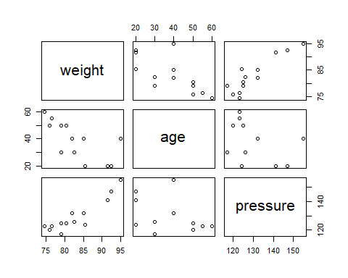

Slide 43
Summary report
##
## Call:
## lm(formula = pressure ~ weight + age, data = blood)
##
## Residuals:
## Min 1Q Median 3Q Max
## -4.0404 -1.0183 0.4640 0.6908 4.3274
##
## Coefficients:
## Estimate Std. Error t value Pr(>|t|)
## (Intercept) -62.96336 16.99976 -3.704 0.004083 **
## weight 2.13656 0.17534 12.185 2.53e-07 ***
## age 0.40022 0.08321 4.810 0.000713 ***
## ---
## Signif. codes: 0 '***' 0.001 '**' 0.01 '*' 0.05 '.' 0.1 ' ' 1
##
## Residual standard error: 2.854 on 10 degrees of freedom
## Multiple R-squared: 0.9461, Adjusted R-squared: 0.9354
## F-statistic: 87.84 on 2 and 10 DF, p-value: 4.531e-07

Slide 44
The regression function
$$\overset{̂}{y}=−62.96336+2.13656x_{1}+0.40022x_{2}$$
  $R^{2}=0.9461$
  the estimated covariance matrix ${\overset{̂}{σ}}^{2}(X^{⊤}X)^{−1}$ is

Slide 45
 | intercept | weight | age
intercept | 288.991861 | -2.9499280 | -1.1174334
weight | -2.949928 | 0.0307450 | 0.0102176
age | -1.117433 | 0.0102176 | 0.0069243

Slide 46
Confidence interval for $E[y_{n+1}]$
Consider
$$y_{n+1}=β_{0}+β_{1}x_{n+1,1}+…+β_{p−1}x_{n+1,p−1}+ϵ_{n+1}.$$
Under Assumption B, $y_{n+1}=v^{⊤}β+ϵ_{n+1}∼N(v^{⊤}β,σ^{2})$ , where $v=(1,x_{n+1,1},x_{n+1,2},…,x_{n+1,p−1})^{⊤}$. An unbiased estimate of the expected value of $E[y_{n+1}]=v^{⊤}β$ is the fitted value
$${\overset{̂}{y}}_{n+1}=v^{⊤}\overset{̂}{β}∼N(v^{⊤}β,σ^{2}v^{⊤}(X^{⊤}X)^{−1}v).$$
The $100(1−α)\%$ CI for $E[y_{n+1}]$ is
$${\overset{̂}{y}}_{n+1}±t_{1−α/2}(n−p)\overset{̂}{σ}\sqrt{v^{⊤}(X^{⊤}X)^{−1}v}.$$

Slide 47
Prediction interval for $y_{n+1}$
Similarly,
$$\frac{y_{n+1}−{\overset{̂}{y}}_{n+1}}{\overset{̂}{σ}\sqrt{1+v^{⊤}(X^{⊤}X)^{−1}v}}∼t(n−p).$$
The $100(1−α)\%$ prediction interval for $y$ is
$${\overset{̂}{y}}_{n+1}±t_{1−α/2}(n−p)\overset{̂}{σ}\sqrt{1+v^{⊤}(X^{⊤}X)^{−1}v}.$$

Slide 48
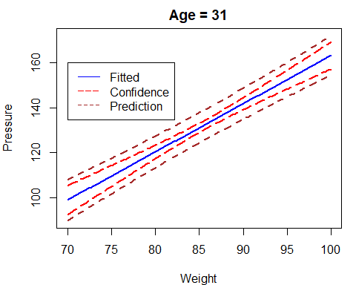
Case study 2

Slide 49
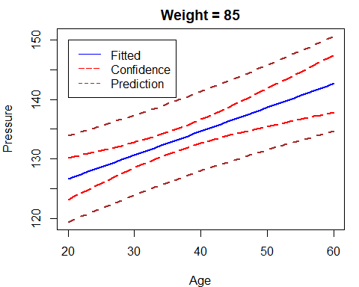
Case study 2

Slide 50
Extension to general models
Inherently Linear models:
$$\begin{matrix}f(y) & =β_{0}+β_{1}g_{1}(x_{1},…,x_{p−1})+… \\ & +β_{k−1}g_{k−1}(x_{1},…,x_{p−1})+ϵ\end{matrix}$$
Let $y^{*}=f(y), x_{i}^{*}=g_{i}(x_{1},…,x_{p−1})$. The transformed model is linear
$$y^{*}=β_{0}+β_{1}x_{1}^{*}+…+β_{k−1}x_{k−1}^{*}+ϵ.$$

Slide 51
Examples
  Polynomial models:
  $$y=β_{0}+β_{1}x+β_{2}x^{2}+β_{p−1}x^{p}+ϵ$$
  Interaction models:
  $$y=β_{0}+β_{1}x_{1}+β_{2}x_{2}^{2}+β_{3}x_{1}x_{2}+ϵ$$
  Multiplicative models:
  $$y=γ_{1}X_{1}^{γ_{2}}X_{2}^{γ_{3}}ϵ^{*}$$
  Exponential models:
  $$y=exp\{β_{0}+β_{1}x_{1}+β_{2}x_{2}\}+ϵ^{*}$$

Slide 52
Examples
  Reciprocal models:
  $$y=\frac{1}{β_{0}+β_{1}x+β_{2}x^{2}+β_{p−1}x^{p}+ϵ}$$
  Semilog models:
  $$y=β_{0}+β_{1}log(x)+ϵ$$
  Logit models:
  $$log\left(\frac{y}{1−y}\right)=β_{0}+β_{1}x+ϵ$$
  Probit models: $Φ^{−1}(y)=β_{0}+β_{1}x+ϵ$, where $Φ$ is the CDF of $N(0,1)$.

Slide 53
回归诊断
回归分析都是基于误差项的假定进行的，最常见的假设
$$ϵ_{i}\overset{iid}{∼}N(0,σ^{2}).$$
  如何考察数据基本上满足这些假设？自然从残差的角度来解决问题，这种方法叫残差分析。
  研究那些数据对统计推断（估计、检验、预测和控制）有较大影响的点，这样的点叫做影响点。剔除那些有较强影响的异常/离群(outlier)数据，这就是所谓的影响分析(influence analysis).
残差的定义为
$$\overset{̂}{ϵ}=Y−\overset{̂}{Y}$$

Slide 54
残差的性质
在假设$ϵ∼N(0,σ^{2}I_{n})$下，
  $\overset{̂}{ϵ}∼N(0,σ^{2}(I_{n}−P))$
  $Cov(\overset{̂}{Y},\overset{̂}{ϵ})=0$
  $1^{⊤}\overset{̂}{ϵ}=0$
从中可以看出，$Var[{\overset{̂}{ϵ}}_{i}]=σ^{2}(1−p_{ii})$, 其中$p_{ij}$为投影矩阵的元素。该方差与$σ^{2}$以及$p_{ii}$有关，因此直接比较残差${\overset{̂}{ϵ}}_{i}$是不恰当的。
为此，将残差标准化：
$$\frac{{\overset{̂}{ϵ}}_{i}−E[{\overset{̂}{ϵ}}_{i}]}{\sqrt{Var[{\overset{̂}{ϵ}}_{i}}]}=\frac{{\overset{̂}{ϵ}}_{i}}{σ\sqrt{1−p_{ii}}}, i=1,…,n$$

Slide 55
学生化残差
由于$σ$是未知的，所以用$\overset{̂}{σ}$来代替，其中${\overset{̂}{σ}}^{2}=S_{e}^{2}/(n−p)$. 于是得到学生化(studentized residuals)
$$t_{i}=\frac{{\overset{̂}{ϵ}}_{i}}{\overset{̂}{σ}\sqrt{1−p_{ii}}}$$
  $t_{i}$虽然是${\overset{̂}{ϵ}}_{i}$的学生化，但它的分布并不服从$t$分布，它的分布通常比较复杂
  $t_{1},…,t_{n}$通常是不独立的
  在实际应用中，可以近似认为：$t_{1},…,t_{n}$是相互独立，服从$N(0,1)$分布
  在实际应用中使用的残差图就是根据上述假定来对模型合理性进行诊断的。

Slide 56
残差图
残差图：以残差为纵坐标，其他的量（一般为拟合值${\overset{̂}{y}}_{i}$）为横坐标的散点图。
由于可以近似认为：$t_{1},…,t_{n}$是相互独立，服从$N(0,1)$分布，所以可以把它们看作来自$N(0,1)$的iid样本
根据标准正态的性质，大概有$95\%$的$t_{i}$落入区间$[−2,2]$中。由于$\overset{̂}{Y}$与$\overset{̂}{ϵ}$不相关，所以${\overset{̂}{y}}_{i}$与学生化残差$t_{i}$的相关性也很小。
这样在残差图中，点$({\overset{̂}{y}}_{i},t_{i}),i=1,…,n$大致应该落在宽度为4的水平带$|t_{i}|≤2$的区域内，且不呈现任何趋势。

Slide 57
残差图（1）

Slide 58
残差图（2）

Slide 59
残差图（3）

Slide 60
残差图（4）

Slide 61
残差图（5）

Slide 62
残差图（6）

Slide 63
残差图诊断的思路
  如果残差图中显示误差方差不相等(heterogeneity, 方差非齐性)，可以对变量做适当的变换，使得变换后的相应变量具有近似相等的方差(homogeneity, 方差齐性)。最著名的方法是Box-Cox变换，见综述论文：
R. M. Sakia. The Box-Cox Transformation Technique: A Review. The Statistician, 41: 169-178, 1992.
  如果残差图中显示非线性，可适当增加自变量的二次项或者交叉项。具体问题具体分析。

Slide 64
离群值(outlier)
产生离群值的原因：
  主观原因：收集和记录数据时出现错误
  客观原因：重尾分布（比如，$t$分布）和混合分布
离群值的简单判断：
  数据散点图
  学生化残差图，如果$|t_{i}|>3$ (或者2.5,2)，则对应的数据判定为离群值。
  离群值的统计检验方法，M-估计(Maximum likelihood type estimators)

Slide 65
案例
Anscombe在1973年构造了4组数据，每组数据都是由11对点$(x_{i},y_{i})$组成，试分析4组数据是否通过回归方程的检验。

Slide 66
x1 | 10.00 | 8.00 | 13.00 | 9.00 | 11.00 | 14.00 | 6.00 | 4.00 | 12.00 | 7.00 | 5.00
x2 | 10.00 | 8.00 | 13.00 | 9.00 | 11.00 | 14.00 | 6.00 | 4.00 | 12.00 | 7.00 | 5.00
x3 | 10.00 | 8.00 | 13.00 | 9.00 | 11.00 | 14.00 | 6.00 | 4.00 | 12.00 | 7.00 | 5.00
x4 | 8.00 | 8.00 | 8.00 | 8.00 | 8.00 | 8.00 | 8.00 | 19.00 | 8.00 | 8.00 | 8.00
y1 | 8.04 | 6.95 | 7.58 | 8.81 | 8.33 | 9.96 | 7.24 | 4.26 | 10.84 | 4.82 | 5.68
y2 | 9.14 | 8.14 | 8.74 | 8.77 | 9.26 | 8.10 | 6.13 | 3.10 | 9.13 | 7.26 | 4.74
y3 | 7.46 | 6.77 | 12.74 | 7.11 | 7.81 | 8.84 | 6.08 | 5.39 | 8.15 | 6.42 | 5.73
y4 | 6.58 | 5.76 | 7.71 | 8.84 | 8.47 | 7.04 | 5.25 | 12.50 | 5.56 | 7.91 | 6.89

Slide 67
回归结果
## [[1]]
## Estimate Std. Error t value Pr(>|t|)
## (Intercept) 3.0000909 1.1247468 2.667348 0.025734051
## x1 0.5000909 0.1179055 4.241455 0.002169629
##
## [[2]]
## Estimate Std. Error t value Pr(>|t|)
## (Intercept) 3.000909 1.1253024 2.666758 0.025758941
## x2 0.500000 0.1179637 4.238590 0.002178816
##
## [[3]]
## Estimate Std. Error t value Pr(>|t|)
## (Intercept) 3.0024545 1.1244812 2.670080 0.025619109
## x3 0.4997273 0.1178777 4.239372 0.002176305
##
## [[4]]
## Estimate Std. Error t value Pr(>|t|)
## (Intercept) 3.0017273 1.1239211 2.670763 0.025590425
## x4 0.4999091 0.1178189 4.243028 0.002164602

Slide 68
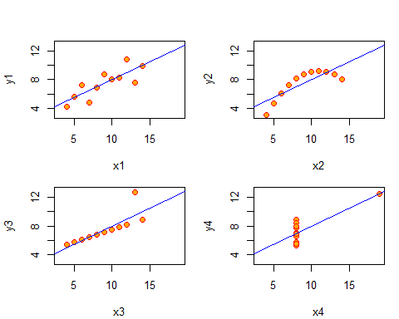
回归直线

Slide 69
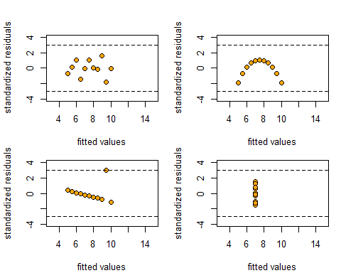
残差

Slide 70
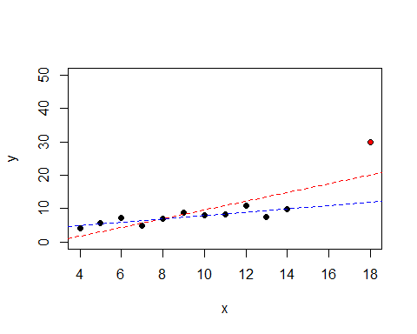
异常值

Slide 71
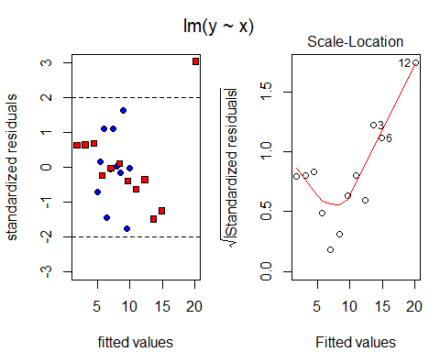
残差图

Slide 72
回归分析的其他内容
  共线性(collinear)分析，岭回归(ridge regression)方法
  变量选择方法：向前/后回归法、逐步回归法、完全子集法、交叉核实(cross validation)法，见课本P208-214
  现代变量选择方法：LASSO (Least Absolute Shrinkage & Selection Operator)

Slide 73
LASSO
https://statweb.stanford.edu/~tibs/
LASSO是斯坦福大学统计系Tibshirani于1996年发表的著名论文“Regreesion shrinkage and selection via the LASSO” (Journal of Royal Statistical Society, Seriers B, 58, 267-288)中所提出的一种变量选择方法。

Slide 74
回归分析与因果分析
即使建立了回归关系式并且统计检验证明相关关系成立，也只能说明研究的变量是统计相关的，而不能就此断定变量之间有因果关系。
案例(Ice Cream Causes Polio)：小儿麻痹症疫苗发明前，美国北卡罗来纳州卫生部研究人员通过分析冰淇淋消费量和小儿麻痹症的关系发现当冰淇淋消费量增加时，小儿麻痹疾病也增加。州卫生部发生警告反对吃冰淇淋来试图阻止这种疾病的传播。

Slide 75
没有观察的混杂因素——温度
Polio and ice cream consumption both increase in the summertime. Summer is when the polio virus thrived.

