Slide 1


Artificial Intelligence : Prolog
Professor Igor Bessmertny
2024

Slide 2

Prolog PROGRAMMING LANGUAGE
Prolog is a logic programming language associated with artificial intelligence and computational linguistics.
Prolog has its roots in first-order logic, a formal logic, and unlike many other programming languages, Prolog is intended primarily as a declarative programming language: the program logic is expressed in terms of relations, represented as facts and rules. A computation is initiated by running a query over these relation
https://en.wikipedia.org/wiki/Prolog
ALAIN COLMERAUER
1972
Philippe Roussel
© И.А.Бессмертный

Slide 3




Prolog Translators
© I. Bessmertny

Slide 4
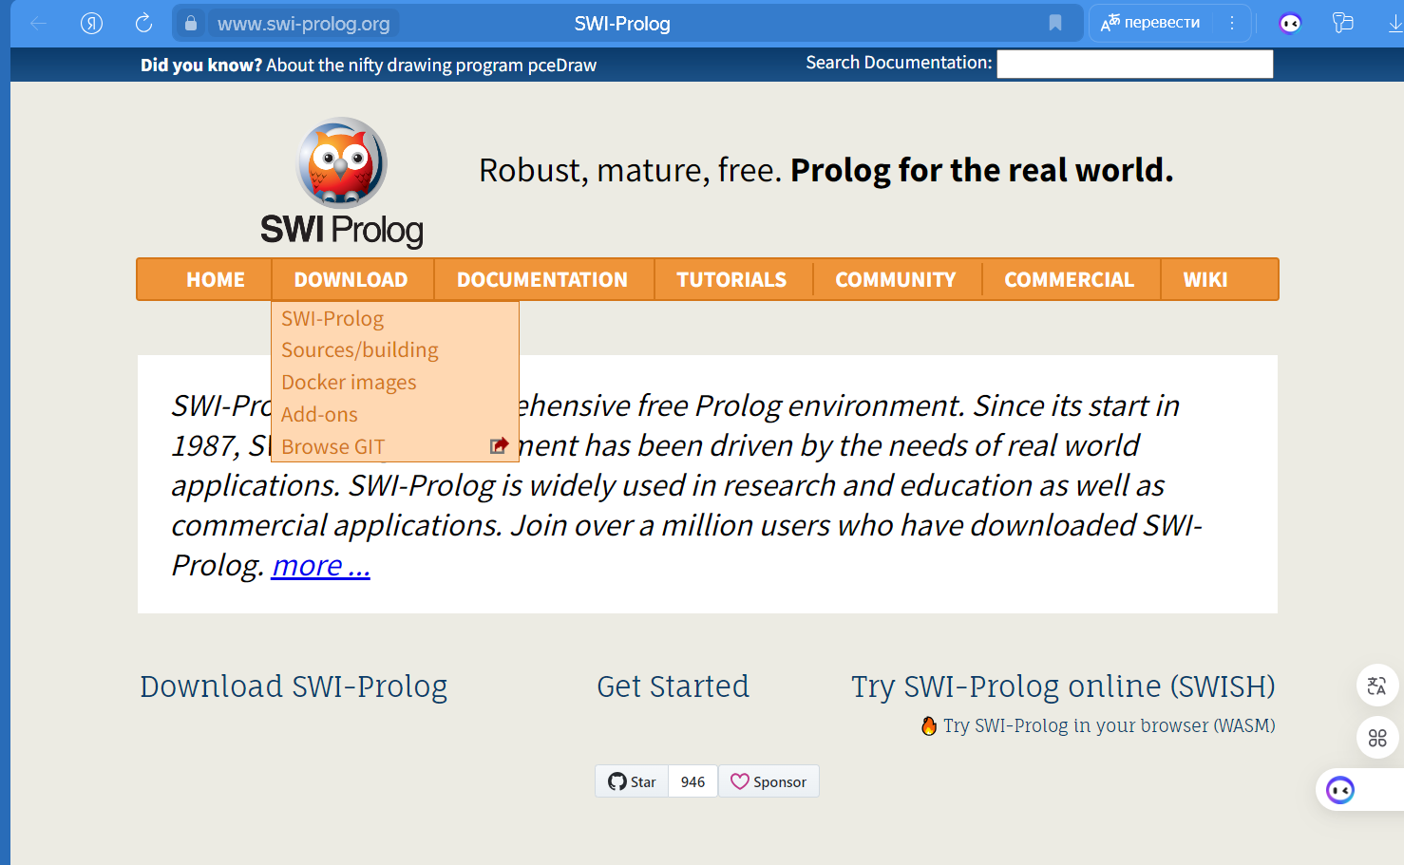
Prolog Translators
Source:
www.swi-prolog.org
© I. Bessmertny

Slide 5
Prolog Programming Language
PROLOG -
Predicate calculus language
Declarative language
Does not contain algorithm

Slide 6
Predicate calculus language
Traditional program:
Set of instruction.
Odd/even number:
Even: X = (X div 2) * 2
Odd: X ≠ (X div 2) * 2
Prolog:
Set of predicates.
even(0)
even(X) if even(X-2)

Slide 7
Prolog: AXIOMS (FACTS)
parent(sergey,nikita).

Slide 8
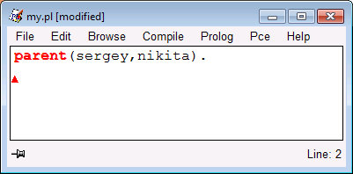
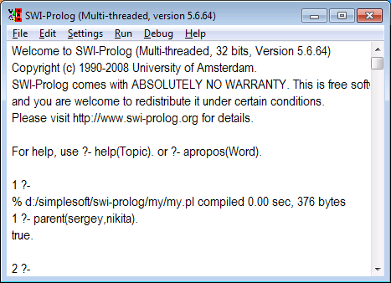
Prolog: AXIOMS (FACTS)

Slide 9
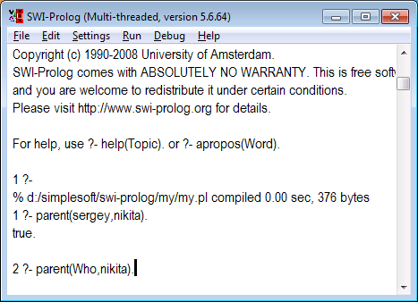
Prolog: AXIOMS (FACTS)
Variables start from capital letters.
Variable is an analog of a question word.

Slide 10
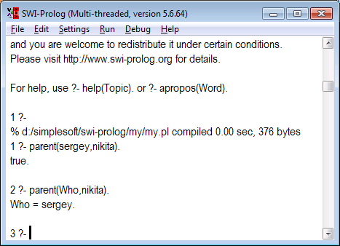
Prolog: AXIOMS (FACTS)

Slide 11
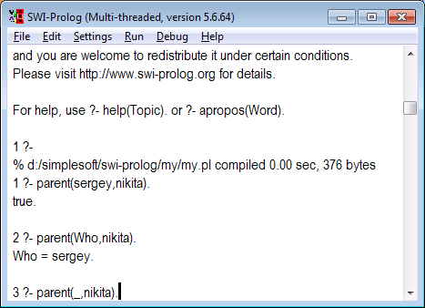
Prolog: AXIOMS (FACTS)
Anonymous variables start from «_»
Anonymous variable – analog of something

Slide 12
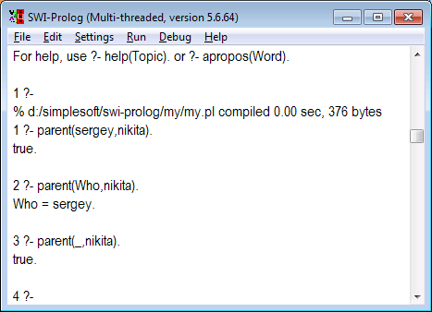
Prolog: AXIOMS (FACTS)

Slide 13
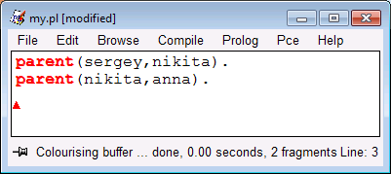
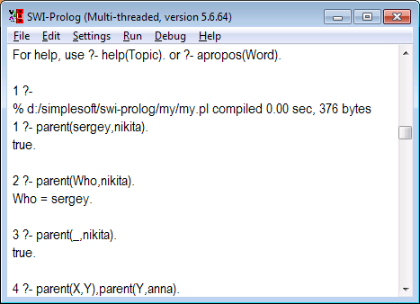
Prolog: AXIOMS (FACTS)

Slide 14
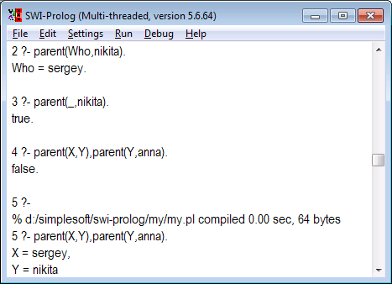
Prolog: AXIOMS (FACTS)

Slide 15
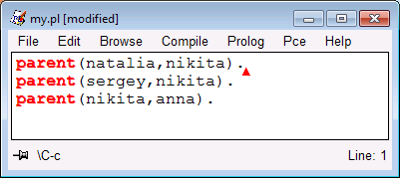
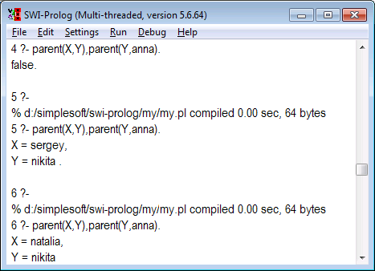
Prolog: AXIOMS (FACTS)

Slide 16
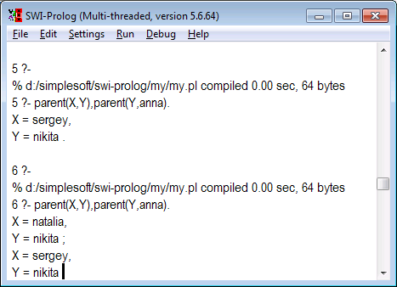
Prolog: AXIOMS (FACTS)

Slide 17
Prolog: FACTS AND RULES
Facts – something known
Rules – a way to yield new facts from known ones

Slide 18
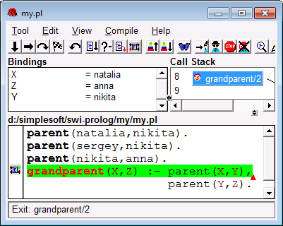
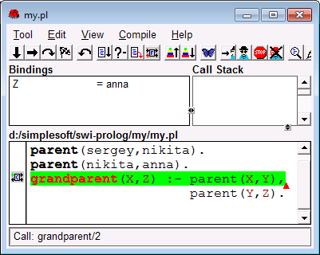
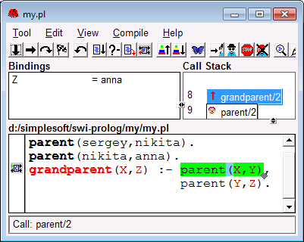
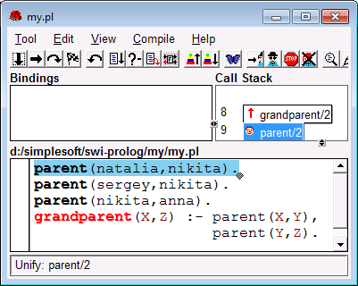
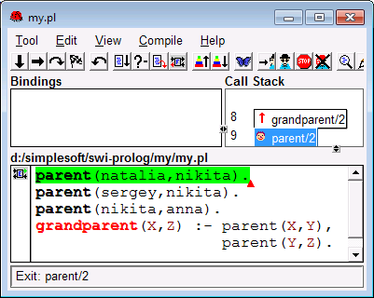
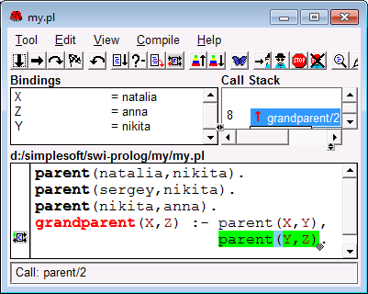
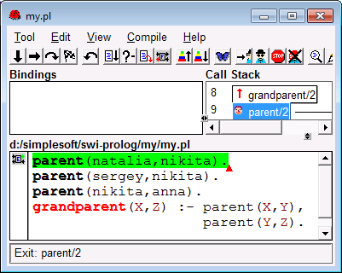
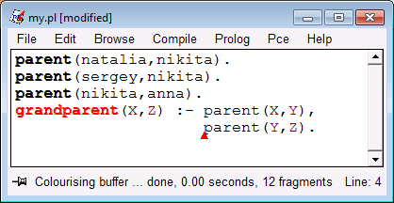
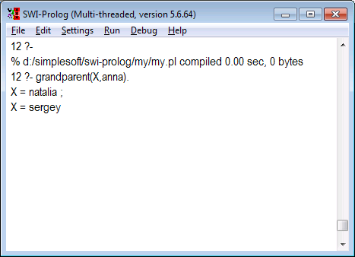
Prolog: RULES

Slide 19
Prolog: RULES
parent(sergey, nikita).
parent(sergey, andrey).
sibling(X,Y) :- parent(Z,X), parent(Z,Y).

Slide 20
Prolog: RULES
parent(sergey, nikita).
parent(sergey, andrey).
sibling(X,Y) :- parent(Z,X), parent(Z,Y).
?- sibling(nikita,Who).

Slide 21
Prolog: Rules
parent(sergey, nikita).
parent(sergey, andrey).
sibling(X,Y) :- parent(Z,X), parent(Z,Y).
?- sibling(nikita,Who).
Who = nikita ; - The son of my father but not
my brother!
Who = andrey

Slide 22
Prolog: RULES
parent(sergey, nikita).
parent(sergey, andrey).
sibling(X,Y) :- parent(Z,X), parent(Z,Y), X\=Y.

Slide 23
Prolog: RULES
parent(sergey, nikita).
parent(sergey, andrey).
sibling(X,Y) :- parent(Z,X), parent(Z,Y), X\=Y.
?- sibling(nikita,Who).
Who = andrey

Slide 24
Prolog: Recursions
Recursion – a call of a procedure from itself
Recursion – a definition of a predicate from itself

Slide 25
Prolog: Recursions
parent(vladimir, sergey).
parent(sergey, andrey).
parent(sergey, nikita).
parent(nikita, anna).
predecessor(X,Y) :- parent(X,Y).
predecessor(X,Y) :- parent(X,Z), predecessor(Z,Y).
?- predecessor(vladimir, Who).
Who = sergey ;
Who = andrey ;
Who = nikita;
Who = anna

Slide 26
Prolog: Recursions
Factorial
Math definition:
0! = 1
N! = N*(N-1)!

Slide 27
Prolog: Recursions
% 0! = 1
% N! = N*(N-1)!
factorial( 0,1 ).
factorial( N,F ) :- N1 is N-1,
factorial( N1,F1) ,
F is F1*N.

Slide 28
Prolog: Recursions
factorial( 0,1 ).
factorial( N,F) :- N1 is N-1,
factorial( N1,F1 ),
F is F1*N.
?- factorial(3,F).
F = 6
Tail recursion.
Demands to save all the environment.
It is necessary to avoid tail recursion. Otherwise, stack overflow is possible

Slide 29
Prolog: Hanoi Tower
Task: To move disks one by one from the left pile to the right one using the middle as a temporary storage. Putting a bigger disk to the smaller is not permitted

Slide 30
Prolog: Hanoi Tower
Solution

Slide 31
Prolog: Hanoi Tower
Solution

Slide 32
Prolog: Hanoi Tower
hanoi(N) :- move(N,left,middle,right).
move(1,Source,_,Target) :- inform(Source,Target),!.
move(N,Source,Spare,Target) :-
N1 is N-1,
move(N1,Source,Target,Spare),
inform(Source,Target),
move(N1,Spare,Source,Target).
inform(Source,Target) :- write( 'Move disc from ' ),
write( Source ), write( ' to ' ), write( Target ), nl.

Slide 33
Prolog: Game 23 Sticks
There are 23 sticks on the table.
Player’s move is to take 1, 2 or 3 sticks.
The player who takes the last stick loses.

Slide 34
Prolog: Game 23 Sticks
% permitted moves
move(1). move(2). move(3).

Slide 35
Prolog: Game 23 Sticks
% permitted moves
move(1). move(2). move(3).
% Rule for a good move
good_move( X, M ) :- move(M), X – M = 1.

Slide 36
Prolog: Game 23 Sticks
% permitted moves
move(1). move(2). move(3).
% Rule for a good move
good_move( X, M ) :- move(M), X – M = 1.
good_move( X,M ) :-
move(M),
X1 is X-M,
not(good_move(X1,_)).

Slide 37
Prolog: Cuts
spouse(andrey,julia).
spouse(nikita,tatiana).
spouse(X,Y) :- spouse(Y,X).
rich(sergey).
rich(andrey).
inheritor(X,Y) :- spouse(X,Y),rich(X).

Slide 38
Prolog: Cuts
spouse(andrey,julia).
spouse(nikita,tatiana).
spouse(X,Y) :- spouse(Y,X).
rich(sergey).
rich(andrey).
Inheritor(X,Y) :- spouse(X,Y),rich(X).
?- inheritor(X,julia).

Slide 39
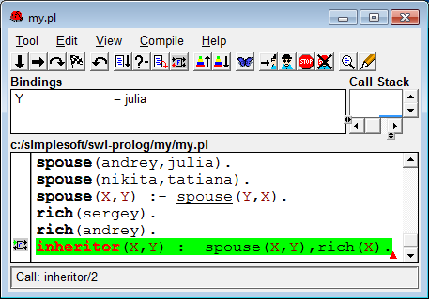
Prolog: Cuts

Slide 40
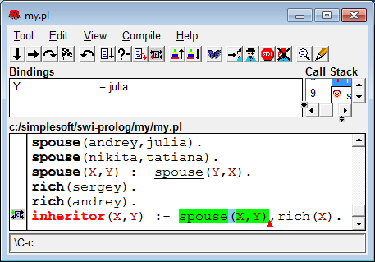
Prolog: Cuts

Slide 41
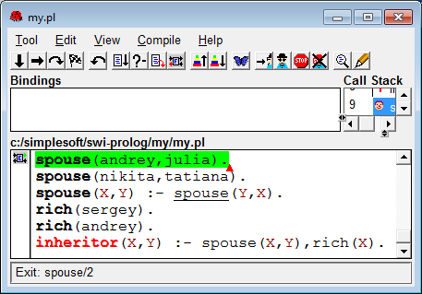
Prolog: Cuts

Slide 42
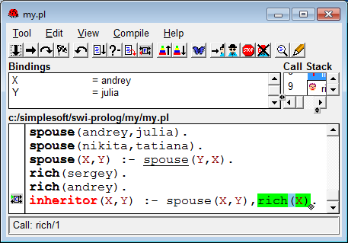
Prolog: Cuts

Slide 43
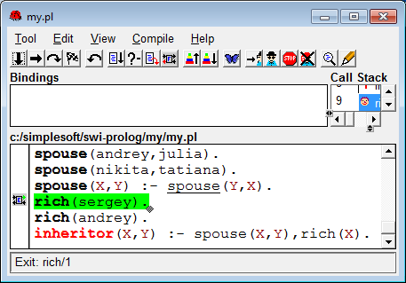
Prolog: Cuts

Slide 44
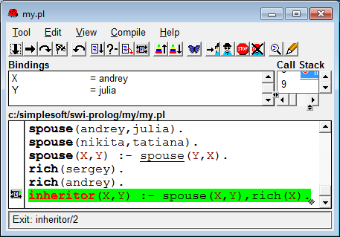
Prolog: Cuts

Slide 45
Prolog: Cuts
spouse(andrey,julia).
spouse(nikita,tatiana).
spouse(X,Y) :- spouse(Y,X).
rich(sergey).
rich(andrey).
Inheritor(X,Y) :- spouse(X,Y),rich(X).
?- inheritor(X,tatiana).

Slide 46

Prolog: Cuts

Slide 47
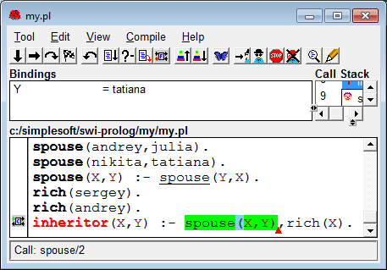
Prolog: Cuts

Slide 48
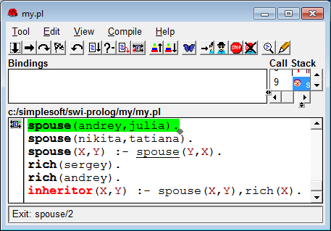
Prolog: Cuts

Slide 49
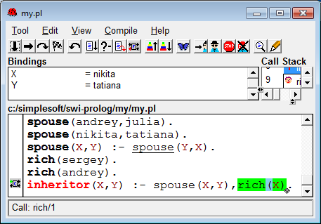
Prolog: Cuts

Slide 50
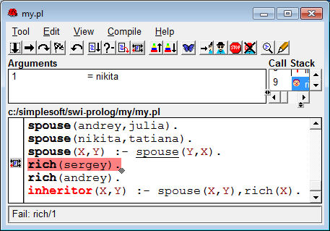
Prolog: Cuts

Slide 51
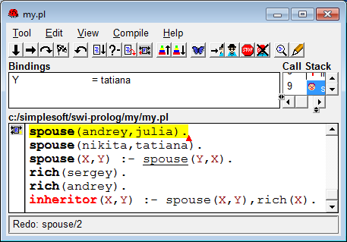
Prolog: Cuts

Slide 52
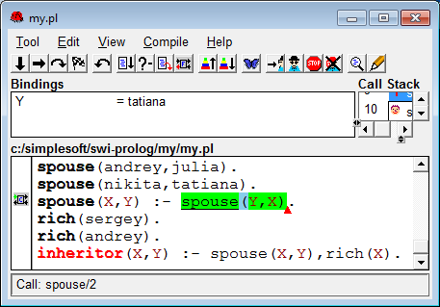
Prolog: Cuts

Slide 53
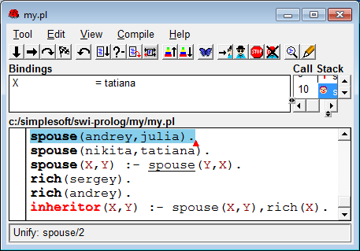
Prolog: Cuts

Slide 54

Prolog: Cuts

Slide 55
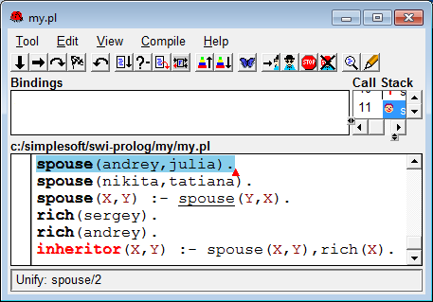
Prolog: Cuts

Slide 56
Prolog: Cuts
spouse(andrey,julia) :- !.
spouse(nikita,tatiana) :- !.
spouse(X,Y) :- spouse(Y,X).
rich(sergey).
rich(andrey).
inheritor(X,Y) :- spouse(X,Y),rich(X).
?- inheritor(X,tatiana).

Slide 57

Prolog: Cuts

Slide 58
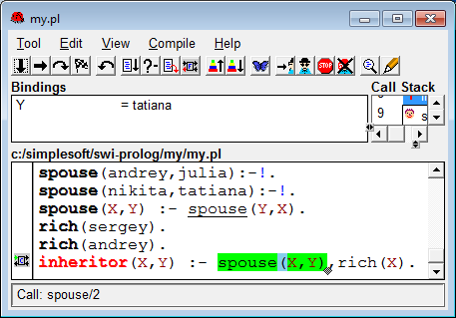
Prolog: Cuts

Slide 59
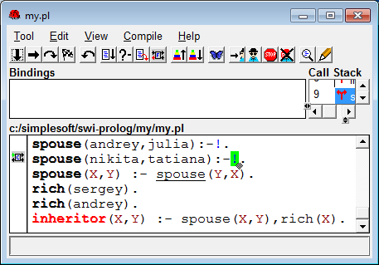
Prolog: Cuts

Slide 60
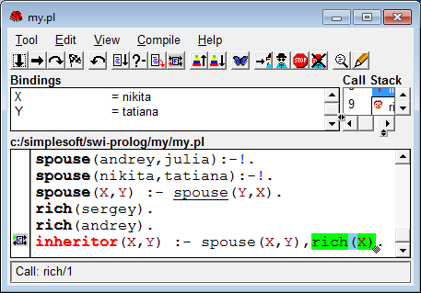
Prolog: cuts

Slide 61

Prolog: Cuts

Slide 62
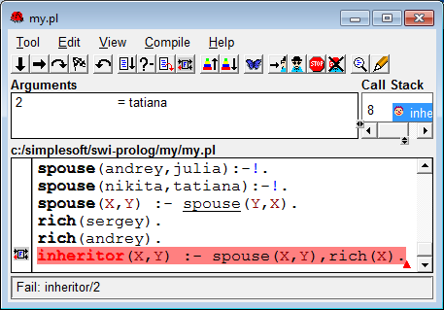
Prolog: Cuts

Slide 63
Prolog: Cuts
Cut makes the predicate deterministic.
There is one solution either no solutions!

Slide 64
Prolog: Lists
List – ordered set of monotype items
[mon,tue,wed,thu,fri,sat,sun]
[1,1,2,3,5,8,13]
[3.14, 2.71828, 0]
[]
[ [0,1],[1,2,6,3],[5] ]
- Permitted lists

Slide 65
Prolog: Lists
List – ordered set of monotype items
[one, 2, “три”]
[29.14, true, false]
[ [1,2,5], 4, [week] ]
–non-permitted lists

Slide 66
Prolog: Lists
The only allowable operation on lists – head disjoint
print_list( [ ] ).
print_list( [H | T] ) :- write( H ), print_list( T ).

Slide 67
Prolog: Lists
% Useful predicates
member( H, [H | _] ).
member( X, [ _ | T] ) :- member( X, T ).
include( H, T, [ H | T] ).
exclude( H, [ H | T ], T ).
exclude( X, [ H | T ], [H|T1]) :- exclude( X, T, T1 ).

Slide 68
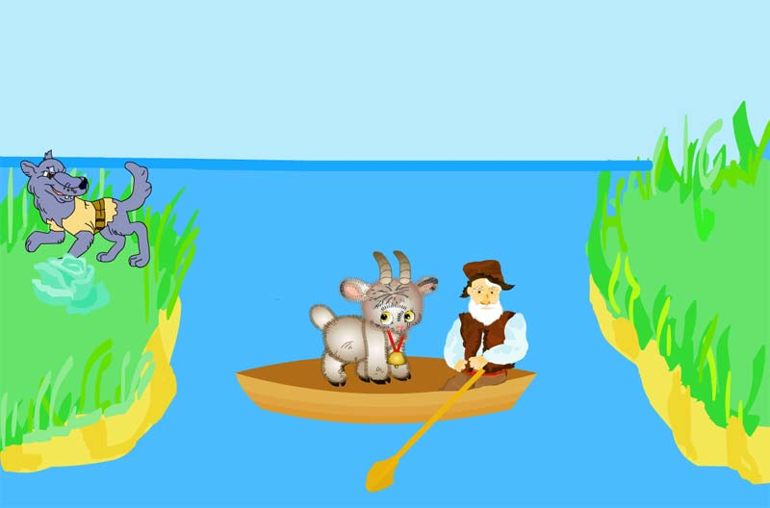
Prolog: Wolf, Goat and Cabbage
Given:
A farmer on a boat, a wolf, a goat and a cabbage are on the left shore of a river.
Task:
Carry everything to the right shore.
Limits:
The boat can load just one item.
While unsupervised by the farmer
the wolf eats the goat and the goat eats the cabbage.

Slide 69
Prolog: Wolf, Goat and Cabbage
stuff(wolf) . stuff(goat). stuff(cabbage).

Slide 70
Prolog: Wolf, Goat and Cabbage
stuff(wolf) . stuff(goat). stuff(cabbage).
conflict(L) :- member(wolf, L), member(goat, L).
conflict(L) :- member(cabbage, L),
member(goat, L).

Slide 71
Prolog: Wolf, Goat and Cabbage
go_right([ ], _ ).
go_right( L, R ) :-
stuff(S), member( S,L ),
exclude(S, L, L1),
not( conflict( L1 ) ),
include( S, R, R1),
go_left( L1, R1).

Slide 72
Prolog: Wolf, Goat and Cabbage
go_left([ ], _).
go_left( L, R ) :-
not( conflict( R ) ),
go_right( L, R).
go_left( L, R ) :-
stuff( S ),
exclude( S, R, R1),
not( conflict( R1 ) ),
include( S, L, L1),
go_right( L1, R1).

Slide 73
Prolog: Wolf, Goat and Cabbage
?- go_right( [wolf, goat, cabbage], [ ]).
A Problem!
First, the farmer carries a goat.
Second, he returns back to pick up the wolf.
Third, it is impossible to leave the wolf together with the goat so the farmer carries it back.
HE WILL ENDLESSLY CARRY THE WOLF
Cause: The farmer has too short memory

Slide 74
Prolog: Wolf, Goat and Cabbage
go_right([ ], _ ,_).
go_right( L, R , Last) :-
stuff(S), S \= Last,
member( S,L ),
exclude(S, L, L1),
not( conflict( L1 ) ),
include( S, R, R1),
go_left( L1, R1, S).

Slide 75
Prolog: Wolf, Goat and Cabbage
go_left([ ], _, _).
go_left( L, R , Last) :-
not( conflict( R ) ),
go_right( L, R, Last).
go_left( L, R , Last) :-
stuff( S ), S \= Last,
exclude( S, R, R1),
not( conflict( R1 ) ),
include( S, L, L1),
go_right( L1, R1, S).

Slide 76
Prolog: CONCLUSION
Prolog allows to create nice programs.
Prolog programing is an art.
Behavior of Prolog programs is often far from expected one.

Slide 77
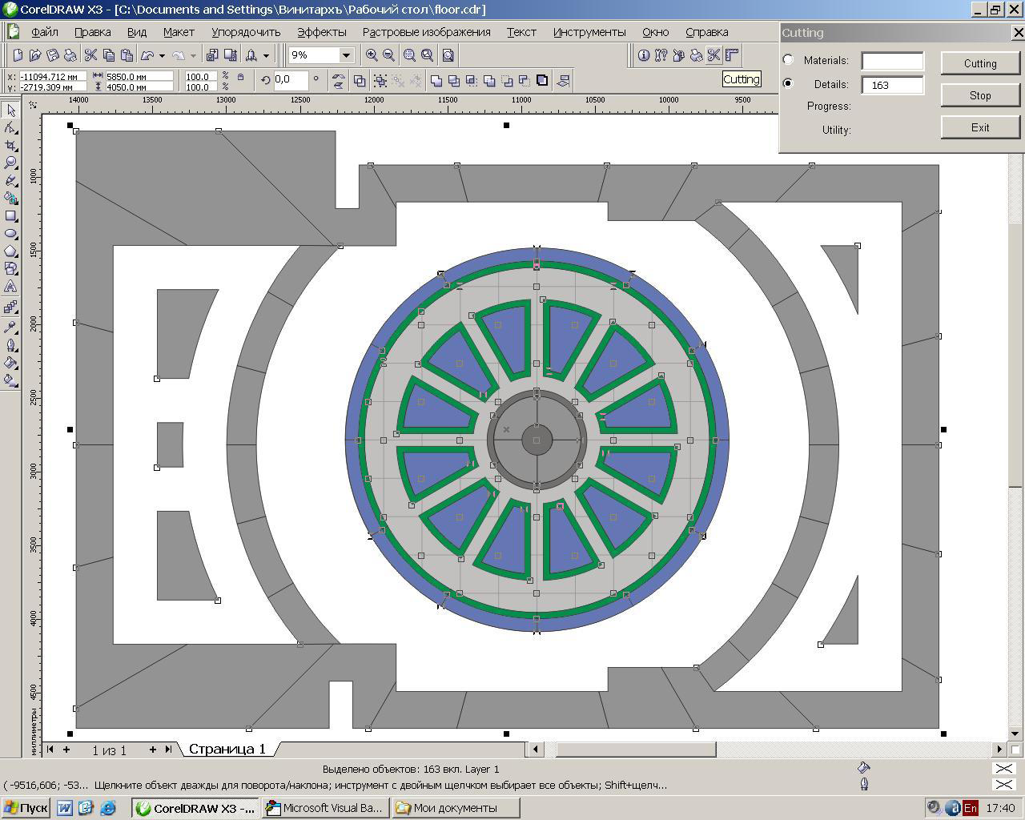
Prolog: PROJECT EXAMPLES
Program for
cutting out
/packing
http://download.pdc.dk/vip/vip_alc/2008/VIP-ALC08-Proceedings.pdf

Slide 78
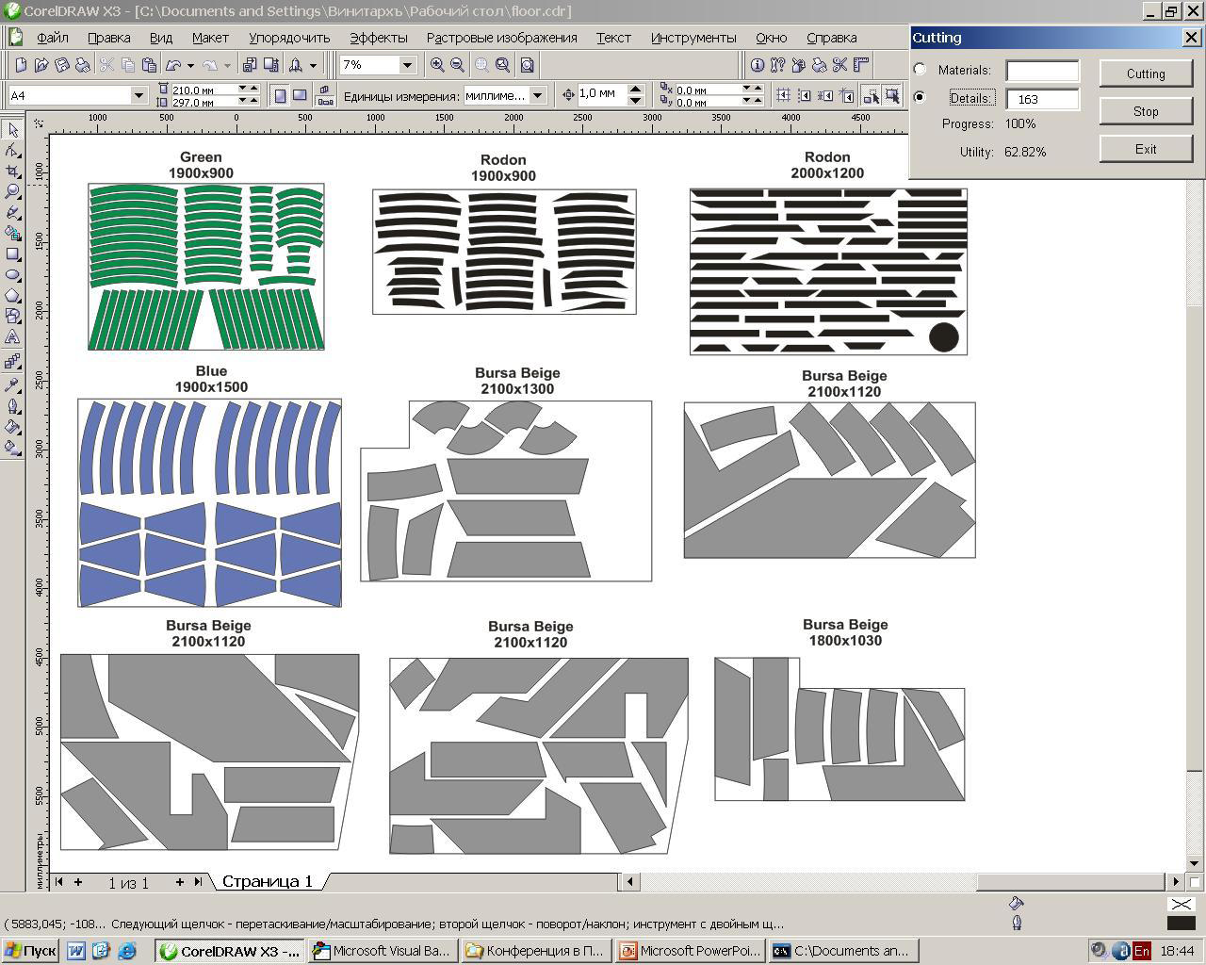
Prolog: PROJECT EXAMPLES
Program for
cutting out
/packing

Slide 79
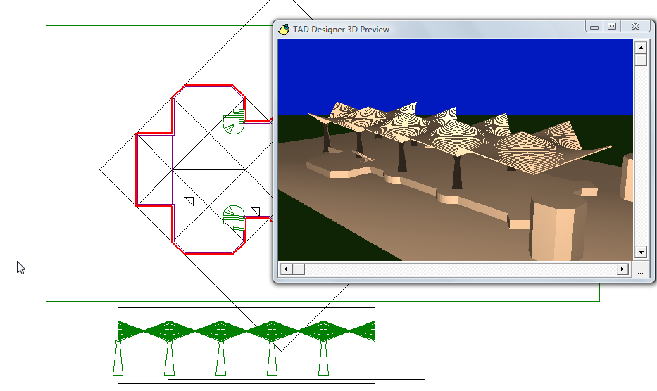
Prolog: PROJECT EXAMPLES
3D Design

Slide 80
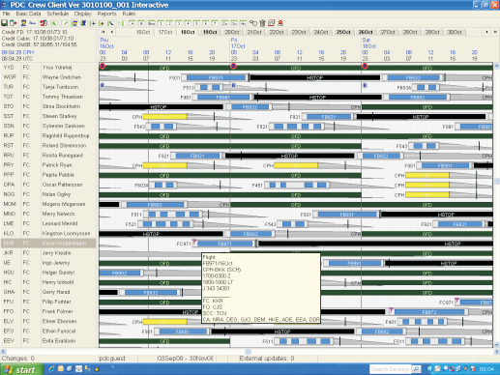
Prolog: PROJECT EXAMPLES
Scheduling
http://www.pdc.dk/Aviation solutions/downloads/Airline-Suite.pdf

Slide 81

Prolog: PROJECT EXAMPLES
Speech recognition and synthesis
http://www.pdc.dk/dk/dictus/

Slide 82
Prolog: Critics
Hard to learn
Higher programmer’s skill needed
Debugging challenge
Weak programming technology
Bad control of intermediate results
Actually, Prolog is far from pure declarative language
© И.А.Бессмертный

Slide 83
QUESTIONS?
© И.А.Бессмертный

