Slide 1


Искусственный интеллект: Семантические сети
Профессор Игорь Александрович Бессмертный

Slide 2
Problem statement
How to write knowledge being understandable as by human as by computer?

Slide 3

Methods of knowledge representation
Method | Good for human? | Good for computer?
Text | Language dependent. Can be boring | No
Math formulas | Math skill is needed. Not applicable for a wide domain | More or less
Music notes | Music literacy is needed. Restricted domain | Perhaps
Pictures, maps, videos | Yes | No
Database | Good for mass homogenous data. Strict classification is needed | Yes

Slide 4
Semantic networks
A semantic network is a network which represents semantic relations among concepts. This is often used as a form of knowledge representation. It is a directed or undirected graph consisting of vertices, which represent concepts, and edges
http://en.wikipedia.org

Slide 5
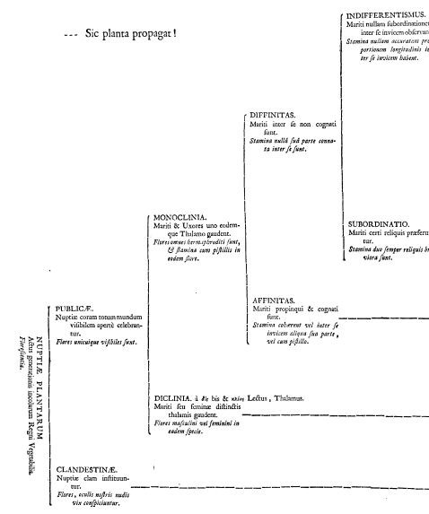

Semantic networks: history
Karl Linnaeus(1735)
– biological classification

Slide 6
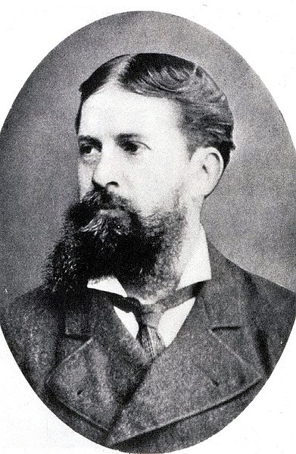
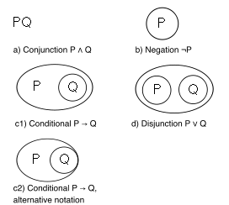
Semantic networks: history
Charles Pierce(1909) – existencial graph

Slide 7
Semantic networks: history
Richard Richens (1956) – semantic network as an intermediary knowledge representation at machine translation

Slide 8
Semantic networks: why?
a ∈ b ∧ b ⊂ с ⇒ a ∈ c
ISA = “is a”, AKO = “a kind of”
b
AKO
ISA
c
a
ISA

Slide 9
Semantic networks
Relational graph
is_a
a_kind_of
a_kind_of_a
Larry Smith
Man
Person
Mammal
wife
husband
a_kind_of
is_a
Laura Smith
Woman

Slide 10
Semantic networks
Conceptual graph– propositional network
«An aircraft flies from St.Petersburg to Moscow»
Subject = Aircraft
Predicate = flies
Object = ???

Slide 11
Semantic networks
Conceptual graph– propositional network
«An aircraft flies from St.Petersburg to Moscow»
does
from
Aircraft
flight
Petersburg
to
Moscow

Slide 12
Semantic networks
Conceptual graph– propositional network
«A boy thinks that an aircraft flies from St.Petersburg to Moscow»
Boy
thinks
does
from
Aircraft
flight
Petersburg
to
Moscow

Slide 13
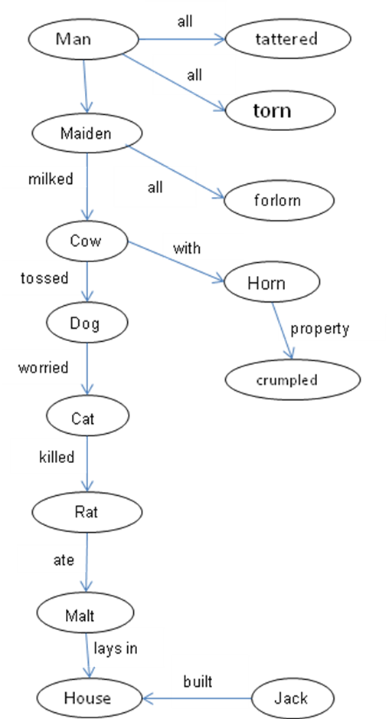

example

Slide 14
Semantic networks
Representation of events– Rastier’s graph
Dog
bite
Mailman
Agent
Object

Slide 15
Semantic networks
Representation of events– Rastier’s graph
Dog
Agent
bite
manner
ugly
Object
Object
own
Result
Mailman
Agent
Agent
Owner
Object
beat
Place
Yard

Slide 16
Types of relations in rastier’s graph
Name | Type | Definition | Simpified name
(ACC) | accusative | Object of an acion | PATient
(ASS) | assumptive | Point of view | PERspective
(ATT) | attributive | Property, characteristics | CHARacteristic
(BEN) | benefactive | Entity as a beneficiary | BENeficiary
(CLAS) | classitive | Specimen of a class | CLASsitive
(COMP) | comparative | Items joined by comparation | COMParison
(DAT) | dative | Receiver | RECeiver
(ERG) | ergative | Ergative, agent of a process or an action | AGEnt
(FIN) | final | Result or expected goal | GOAL
(INST) | instrumental | Used means | MEAns
(LOC S) | spatial locative | Position (location) in space | SPAce
(LOC T) | temporal locative | Position (location) in time | TIME
(MAL) | malefactive | The party suffered from the action | MALeficiary
(PART) | partitive | Part of the whole | PARTitive
(RES) | resultative | Result, effect, consequence | EFFect (или CAUse)

Slide 17
SEMANTIC NETWORKS
Rastier’s graph with unified relations
dog
ERG
bite
ATT
ugly
ACC
ACC
own
RES
mailman
ERG
ERG
owner
ACC
beat
LOC S
back yard

Slide 18
example
Summer
LOC T
Sing
RES
No food
ERG
RES
RES
"The Cicada and the Ant"
Jean de La Fontaine (1988)
Cicada, having sung her song She said, "I'll pay you everything
All summer long, Before fall, my word as animal,
Found herself without a crumb Interest and principal."
When winter winds did come. Well, no hasty lender is the Ant;
Not a scrap was there to find It's her finest virtue by a lot.
Of fly or earthworm, any kind. "And what did you do when it was hot?"
Hungry she ran off to cry She then asked this mendicant.
To neighbor Ant, and specify: "To all comers, night and day,
Asking for a loan of grist, I sang. I hope you don't mind."
A seed or two so she'd subsist "You sang? Why, my joy is unconfined.
Just until the coming spring. Now dance the winter away."
Dance
ERG
The Cicada
ACC
Hunger
ACC
FIN
ERG
RES
LOC T
Offer
RES
Go
Winter
ERG
DAT
FIN
The Ant
Food

Slide 19
problems
IS A
can
Тu-154 # 85600
Aircrafts
fly
can
Ту-154 # 85600
fly
McDermott, Drew. “Artificial Intelligence Meets Natural Stupidity”, SIGART Newsletter, No.57 (April, 1976), pp. 4-9.
IS A
Have property
Socrates
People
many
Has property
Socrates
many

Slide 20
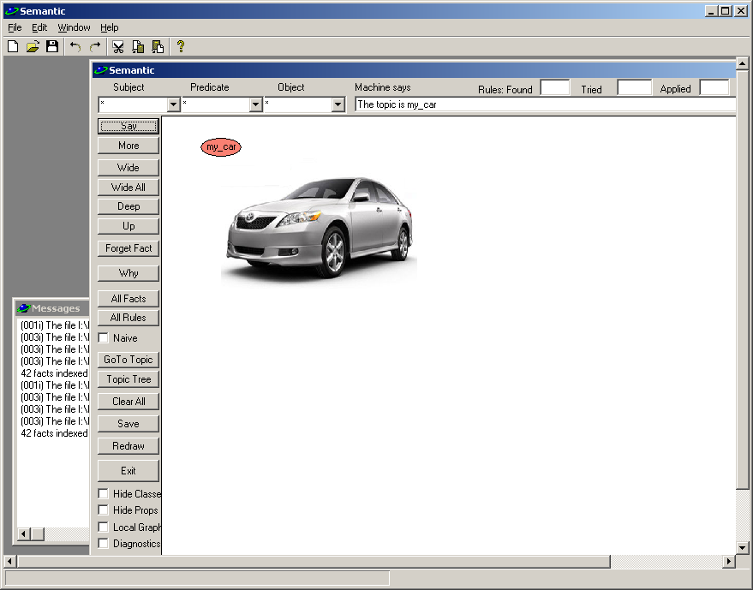
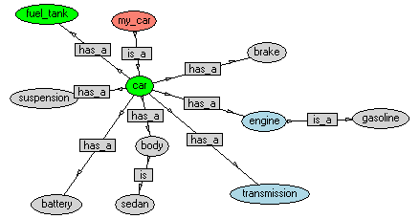
Program Semantic
Purpose:
Learning of knowledge representation
Knowledge visualization
Research of inference methods

Slide 21
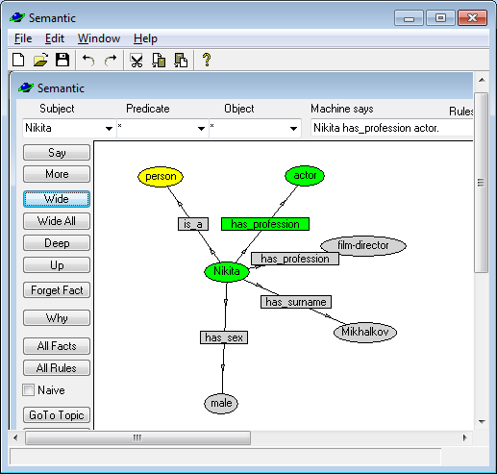
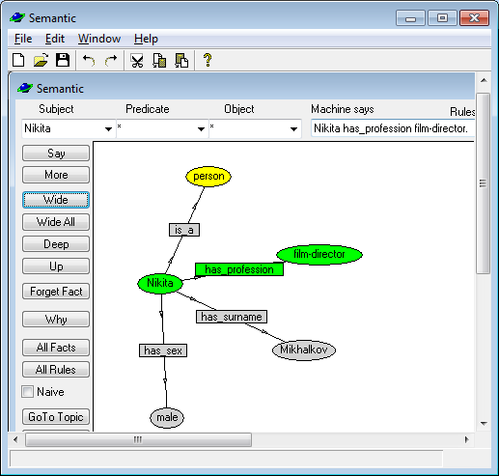
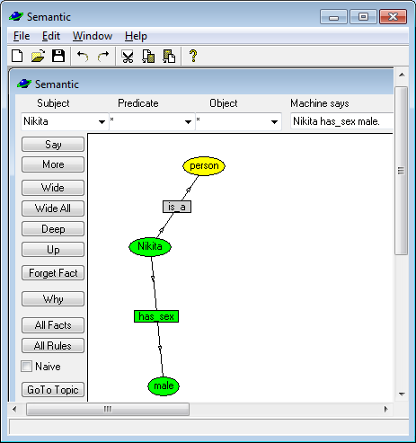
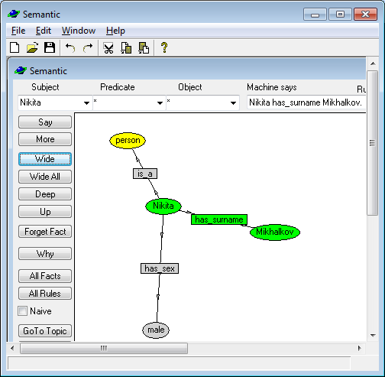
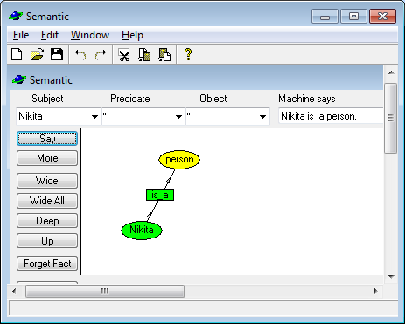
Program Semantic: facts
f("Nikita" , "is_a" , "person").
f("Nikita" , "has_sex" , "male").
f("Nikita" , "has_surname" , "Mikhalkov").
f("Nikita" , "has_profession" , "film-director").
f("Nikita" , "has_profession" , "actor").

Slide 22
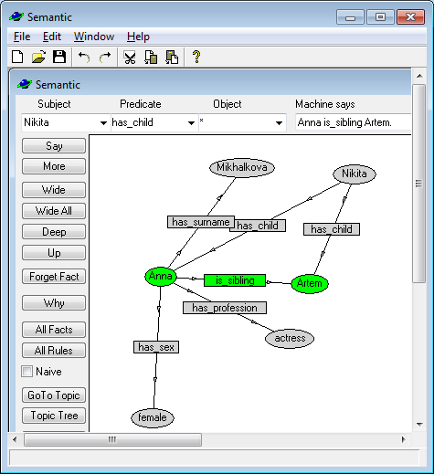
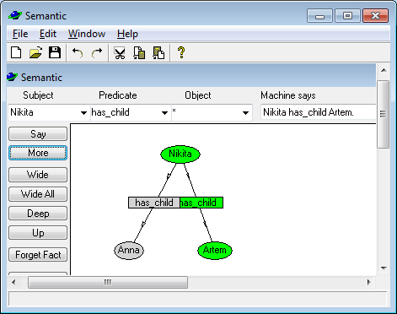
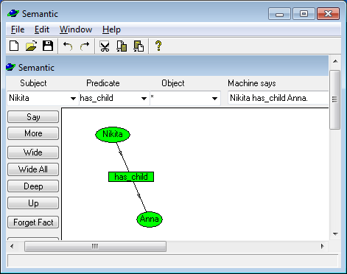
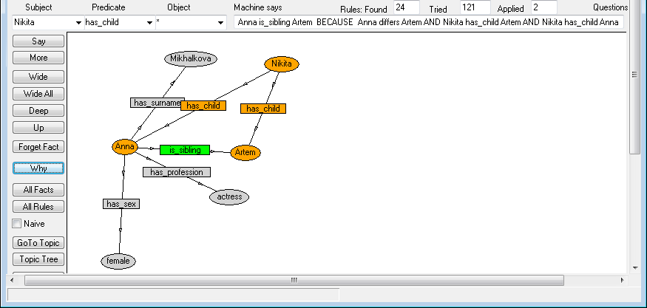
program Semantic: rules
f("Nikita" , "is_a" , "person").
f("Nikita" , "has_sex" , "male").
f("Nikita" , "has_surname" , "Mikhalkov").
f("Nikita" , "has_profession" , "film-director").
f("Nikita" , "has_profession" , "actor").
f("Nikita" , "has_child" , "Anna").
f("Nikita" , "has_child" , "Artem").
r( [t("?x","has_child","?y"),t("?x","has_child","?z"),t("?y","differs","?z")],
[t("?y","is_sibling","?z")] ).

Slide 23
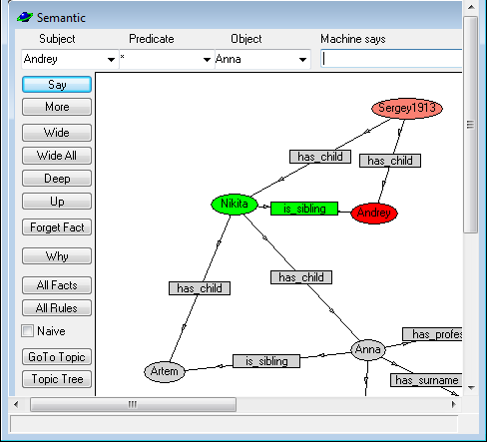
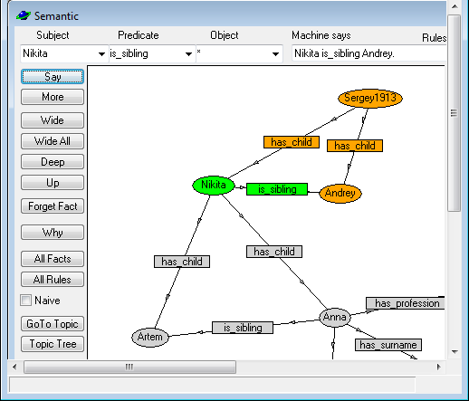
program Semantic: rules
…
f("Sergey1913" , "has_child" , "Nikita").
f("Sergey1913" , "has_child" , "Andrey").
…
r( [t("?x","has_child","?y"),t("?x","has_child","?z"),t("?y","differs","?z")],
[t("?y","is_sibling","?z")] ).

Slide 24
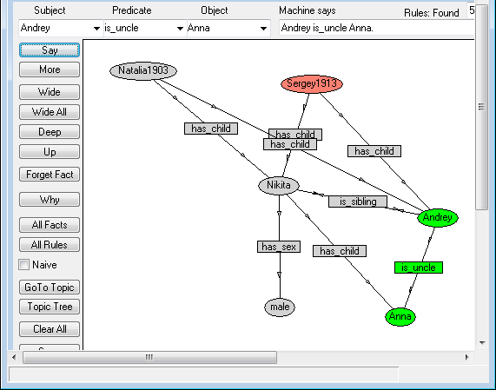
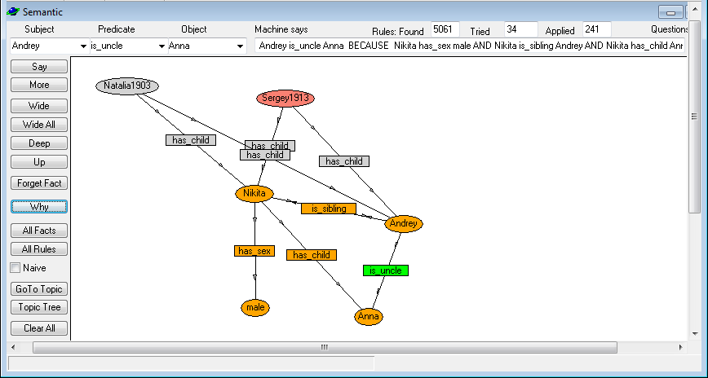
program Semantic: rules
r( [t("?x","has_child","?y"),t("?x","is_sibling","?z"), t("?x","has_sex","male")],
[t("?z","is_uncle", "?y")] ).

Slide 25
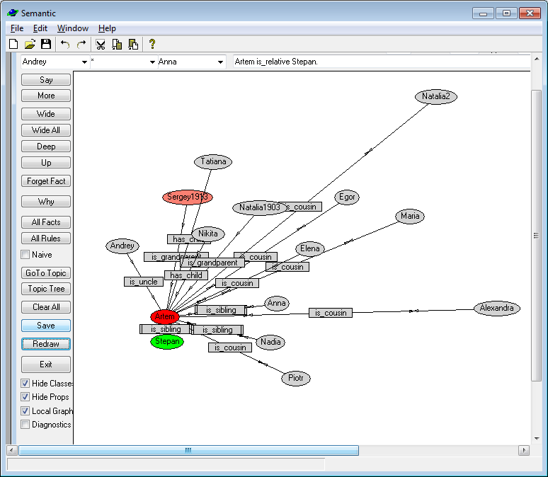
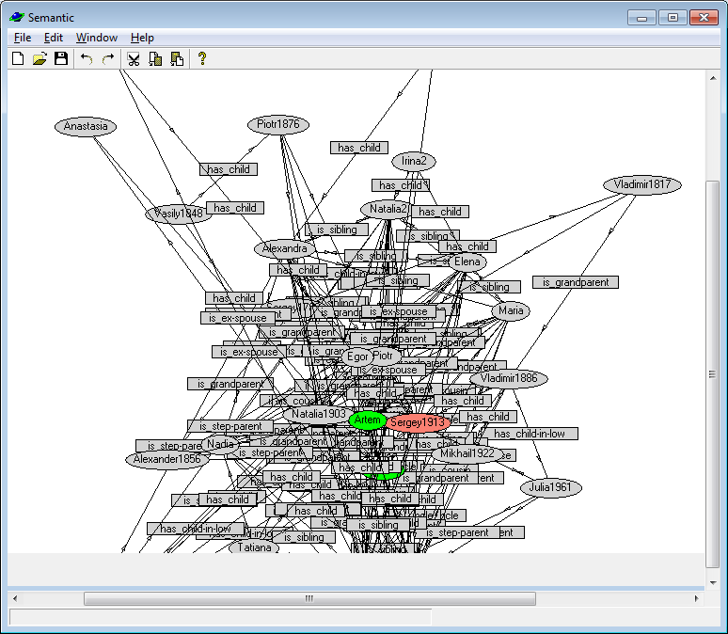
program Semantic: local graph

Slide 26
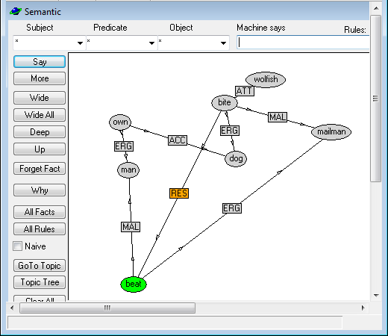
program Semantic: rastier’s graph
f("beat","ERG","mailman").
f("beat","MAL","man").
f("beat","RES","sue").
f("bite","MAL","mailman").
f("bite","ERG","dog").
f("bite","ATT","wolfish").
f("bite","RES","beat").
f("own","ERG","man").
f("own","ACC","dog").

Slide 27
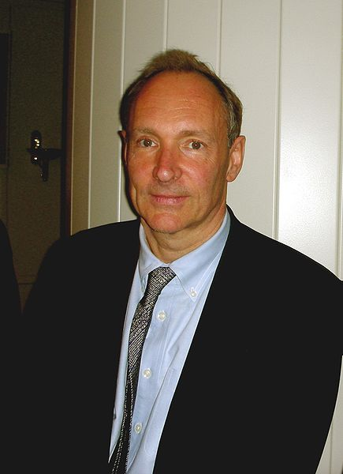
Semantic web
Sir Timothy John "Tim" Berners-Lee, OM, KBE, FRS, FREng, FRSA (born 8 June 1955^{[1]}), is a British engineer and computer scientist and MIT professor credited with inventing the World Wide Web, making the first proposal for it in March 1989.^{[2]} On 25 December 1990, with the help of Robert Cailliau and a young student at CERN, he implemented the first successful communication between an HTTP client and server via the Internet.
Berners-Lee is the director of the World Wide Web Consortium (W3C), which oversees the Web's continued development. He is also the founder of the World Wide Web Foundation, and is a senior researcher and holder of the 3Com Founders Chair at the MIT Computer Science and Artificial Intelligence Laboratory (CSAIL).^{[3]} He is a director of The Web Science Research Initiative (WSRI),^{[4]} and a member of the advisory board of the MIT Center for Collective Intelligence.^{[5][6]} In April 2009, he was elected as a member of the United States National Academy of Sciences, based in Washington, D.C.
(http://en.wikipedia.org)

Slide 28
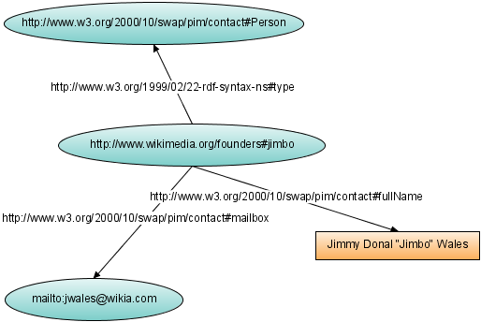
Semantic web
Semantic tagging
Data acquisition by intellectual agents
Providing to the user a solution instead of links to documents

Slide 29
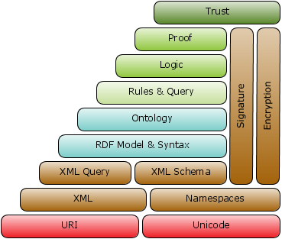
Web 3.0 vs. Web 1.0, web2.0

Slide 30
Rdf – resource description framework
@prefix : <http://www.example.org/> .
:john a :Person .
:john :hasMother :susan .
:john :hasFather :richard .
:richard :hasBrother :luke .
<rdf:RDF xmlns:rdf="http://www.w3.org/1999/02/22-rdf-syntax-ns#" xmlns:ns="http://www.example.org/#">
<ns:Person rdf:about="http://www.example.org/#john">
<ns:hasMother rdf:resource="http://www.example.org/#susan" />
<ns:hasFather>
<rdf:Description rdf:about="http://www.example.org/#richard">
<ns:hasBrother rdf:resource="http://www.example.org/#luke" />
</rdf:Description>
</ns:hasFather>
</ns:Person>
</rdf:RDF>

Slide 31
Owl – web ontology language
Model of ontology
O = <X,R,F>, where
X — set of entities,
R — set of relations,
F — set of interpreting functions.
SubClassOf(
:Teenager
DataSomeValuesFrom( :hasAge
DatatypeRestriction( xsd:integer
xsd:minExclusive "12"^^xsd:integer
xsd:maxInclusive "19"^^xsd:integer
)
)
)

Slide 32

swrl – semantic web rule language

Slide 33
sparql – sparql protocol and query language
@prefix foaf: <http://xmlns.com/foaf/0.1/> .
_:a foaf:name "Johnny Lee Outlaw" .
_:a foaf:mbox <mailto:jlow@example.com> .
_:b foaf:name "Peter Goodguy" .
_:b foaf:mbox <mailto:peter@example.org> .
PREFIX foaf: <http://xmlns.com/foaf/0.1/>
SELECT ?name ?mbox
WHERE { ?x foaf:name ?name . ?x foaf:mbox ?mbox }
name | mbox
"Johnny Lee Outlaw" | <mailto:jlow@example.com>
"Peter Goodguy" | <mailto:peter@example.org>

Slide 34
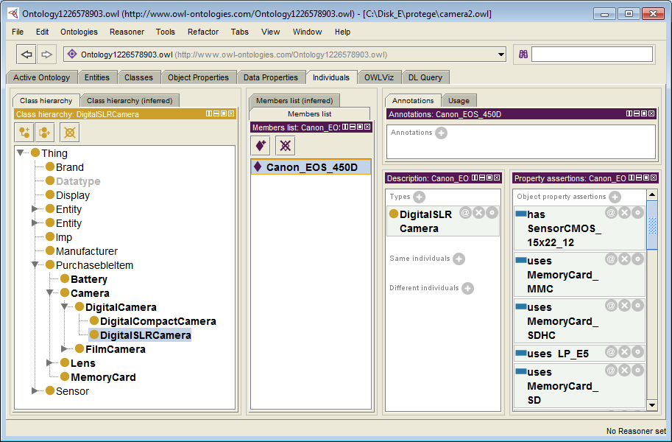
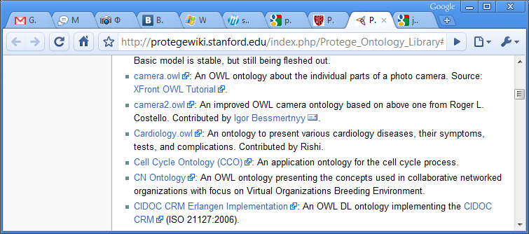
Protégé owl – ontology editor
http://protege.stanford.edu

Slide 35
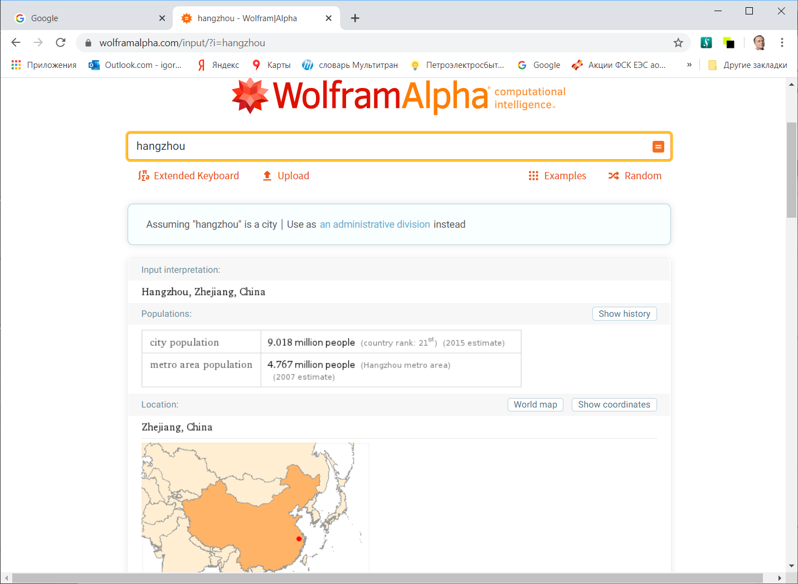
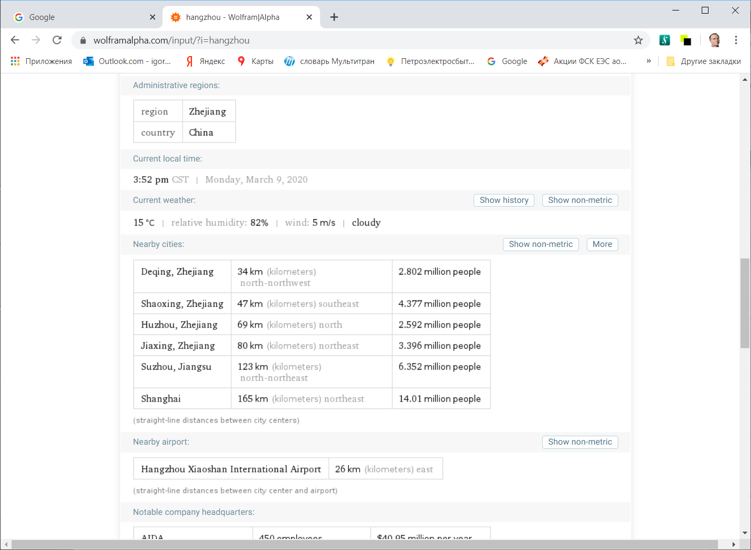
Semantic web: example - Wolframalpha
http://wolframalpha.com

Slide 36
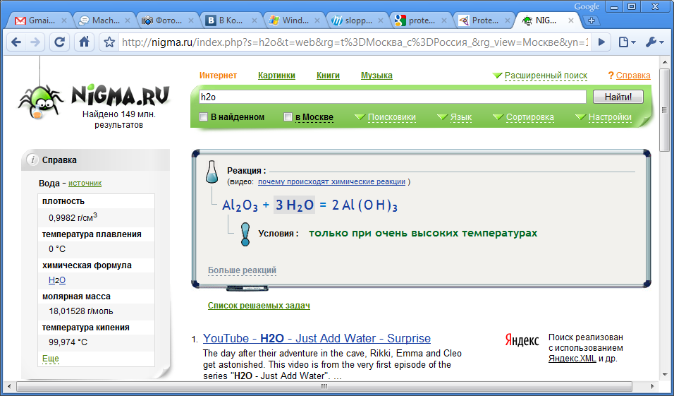
Semantic web: example - NIGMA
http://nigma.ru

Slide 37
Semantic web
Critics
Impossible to create
Missing of obvious way to divide the World into concepts
Double typing of documents
Each document should be presented twice: in a human and in a machine readable format
No commercial benefit
If people do not visit web pages, who will read ads?
© Igor Bessmertny - 2010

Slide 38
JOB FOR LAB WORK 2
Download and install the ‘Semantic’ program.
Transfer the knowledge base created in the Lab.1 to the ‘Semantic’ environment.
Add to objects in the knowledge base attributes: profession, hobby, etc. by your choice.
Create rules defining relations: colleague, common interests, etc. At least 3 rules.
Make screenshots demonstrating results of inference from your rules.
Report Chapters: Problem statement, Knowledge base text, Rules definition, Screenshots, Summary.
© Igor Bessmertny - 2010

