Slide 1
Initial findings revou labs
Ivan Sudibyo

Slide 2
01
Company
QUICKCOMMERCE

Slide 3
Our Company
QUICKCOMMERCE
Our company provides fresh food products through a seamless quick e-commerce platform. We offer a variety of healthy and sustainable options to support a nutritious lifestyle. With our user-friendly application, customers can easily order groceries and have them delivered to their door. We are dedicated to making healthy eating convenient and accessible.

Slide 4
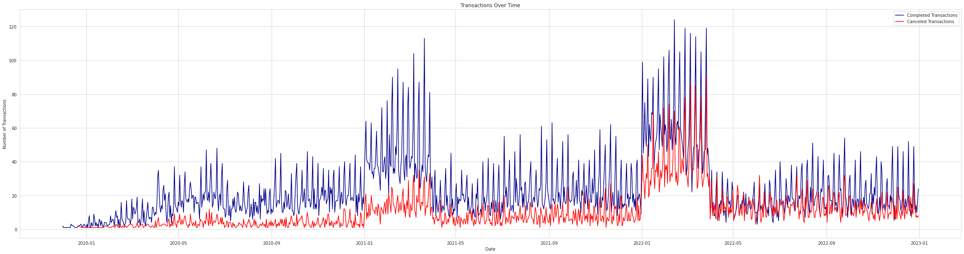
Root Cause Analysis
The transactions in the latest year have been declined.
The highest transaction periods in both January to March of 2021 and 2022 were characterized by the Indonesian government's implementation of restrictions on social activities. In 2021, PSSB was implemented, while in 2022, PPKM (Large-Scale Social Restrictions) Level 1 and Level 3 were implemented, affecting consumer behavior and leading to the highest transactions of each respective year.
Notes:
During the highest transaction period from January 2021 to March 2021 in Indonesia, the government announced restrictions on social activities through PSSB, causing people to stay at home and decrease their outdoor activities.
The highest transactions in Indonesia in the first quarter of 2022 were influenced by the implementation of PPKM (Large-Scale Social Restrictions) Level 1 in January 2022 and Level 3 in February-March 2022. PPKM Level 1 allowed for a limited resumption of activities, including the return of college students to offline learning on campus. PPKM Level 3 imposed stricter measures, limiting the number of visitors in public places to 60%, which impacted consumer behavior and led to the highest transactions of the year.

Slide 5
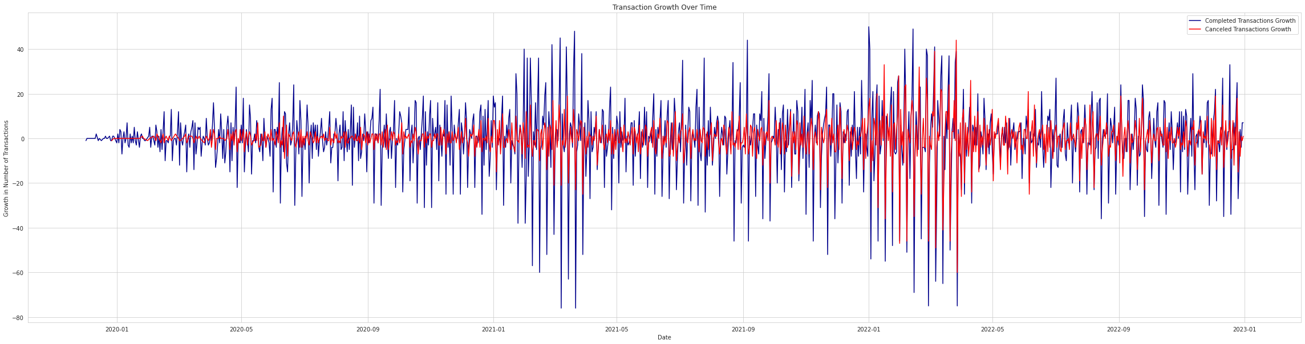
Root Cause Analysis
The growth has declined in the last few months.

Slide 6
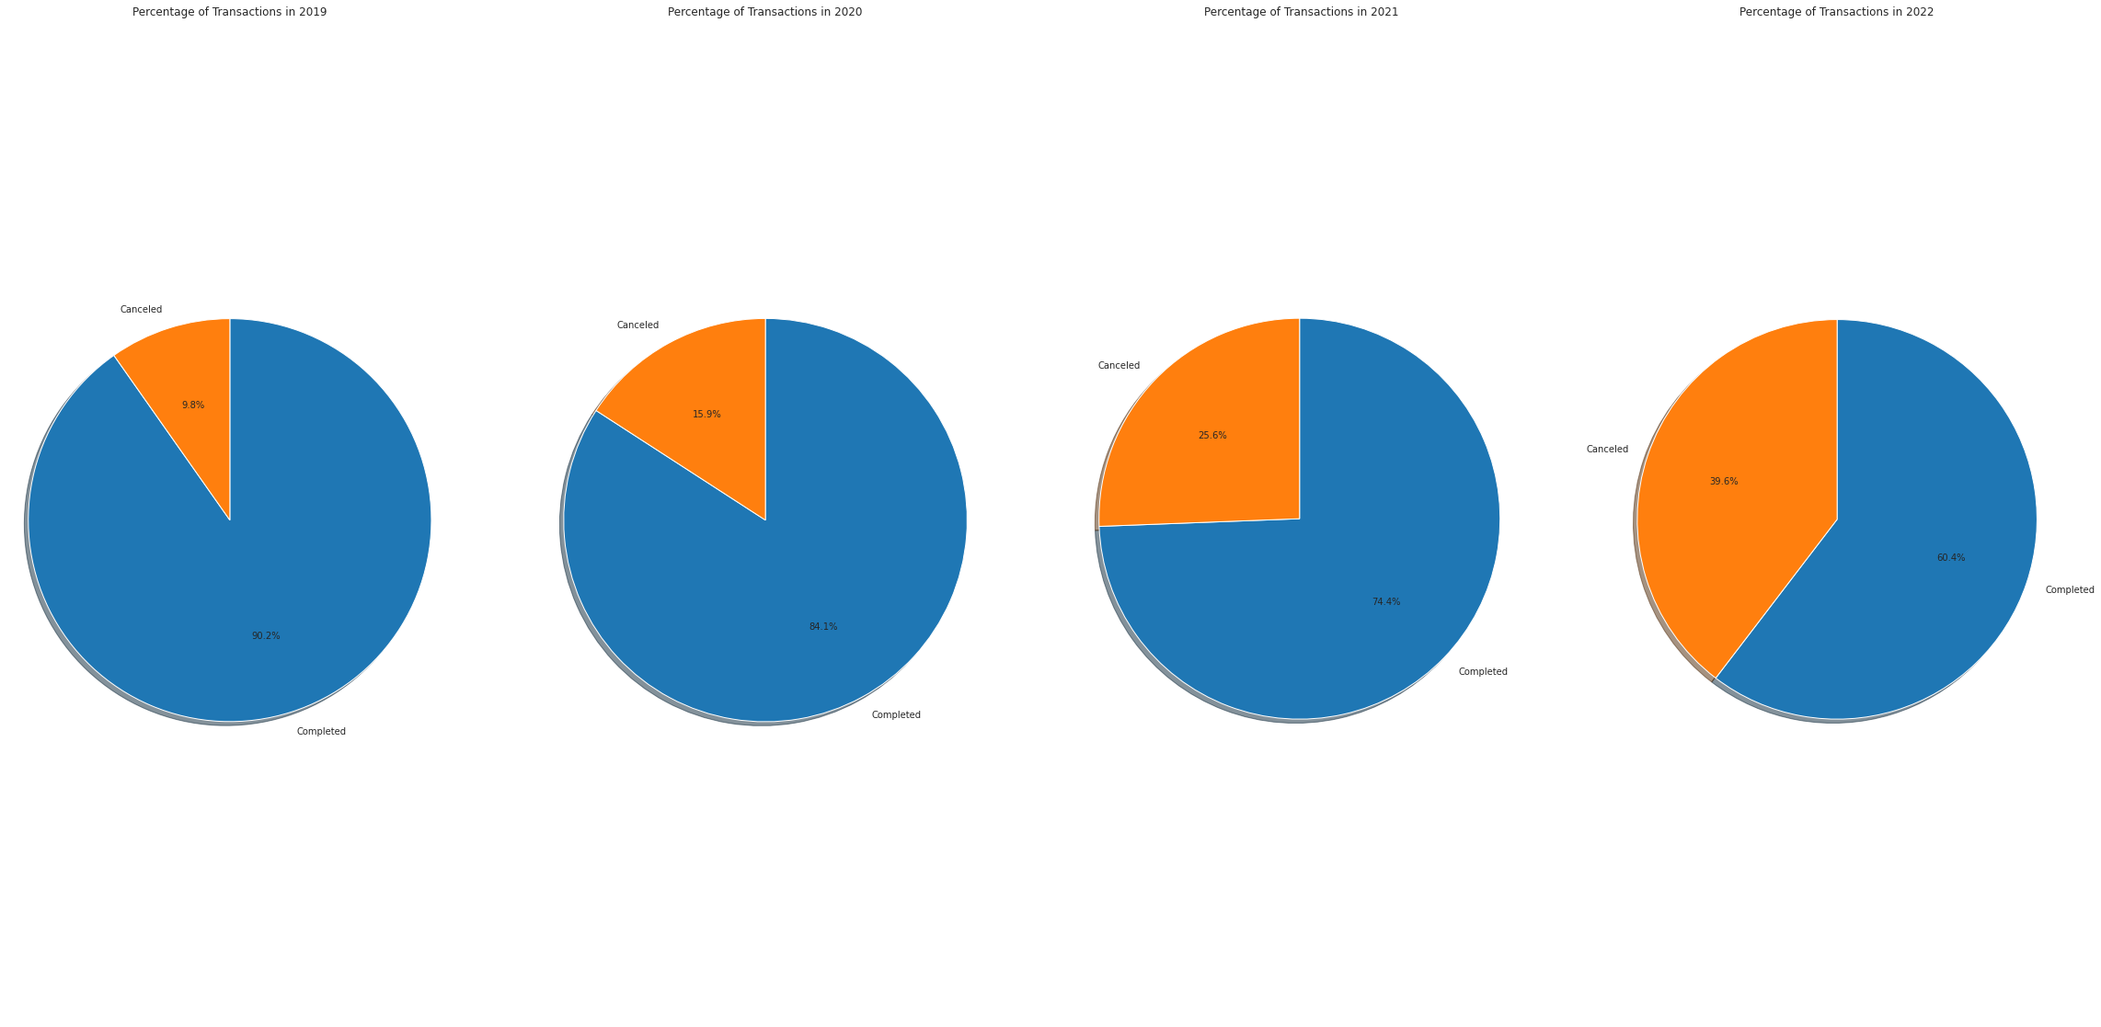
Root Cause Analysis
The number of canceled transactions has increased in the latest year.

Slide 7
Root Cause Analysis
Young Age had been the smallest proportions of canceled and completed count. Mid Age had been the largest proportions of canceled and completed count.

Slide 8
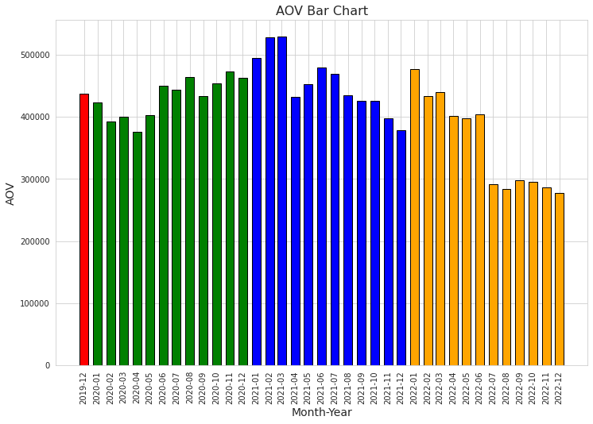
Root Cause Analysis
The average order value has been declining over the recent years.

Slide 9
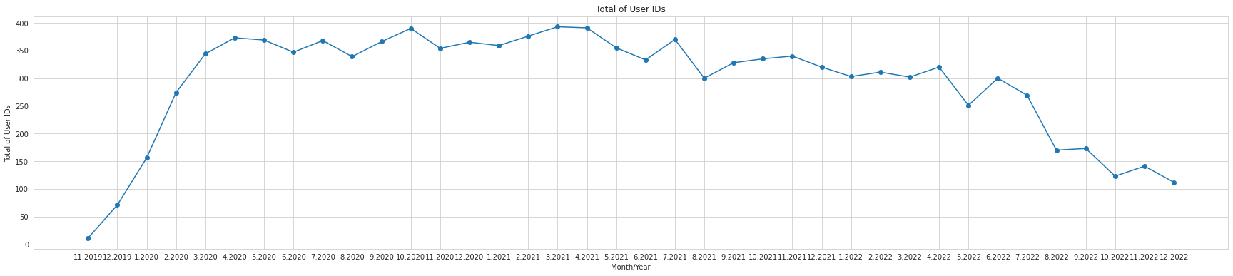

Root Cause Analysis
The number of registered user IDs has decreased in 2022.

Slide 10
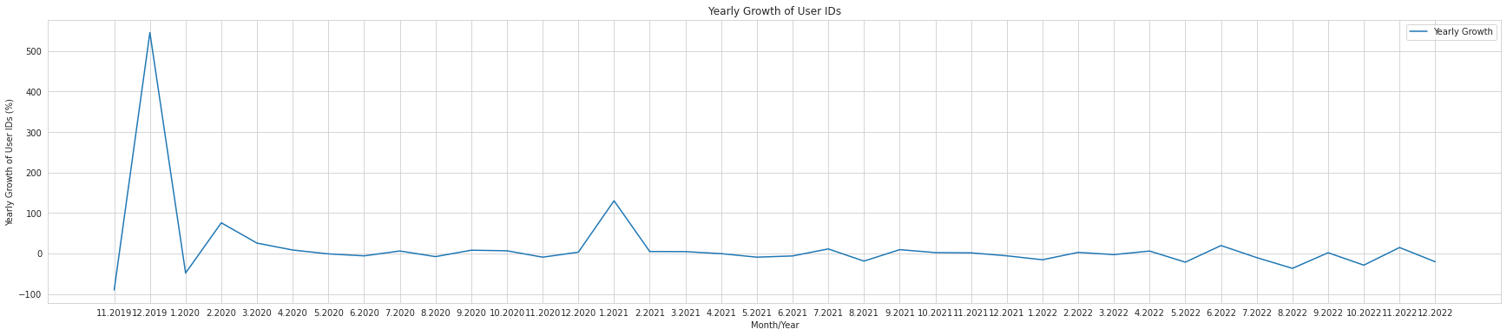
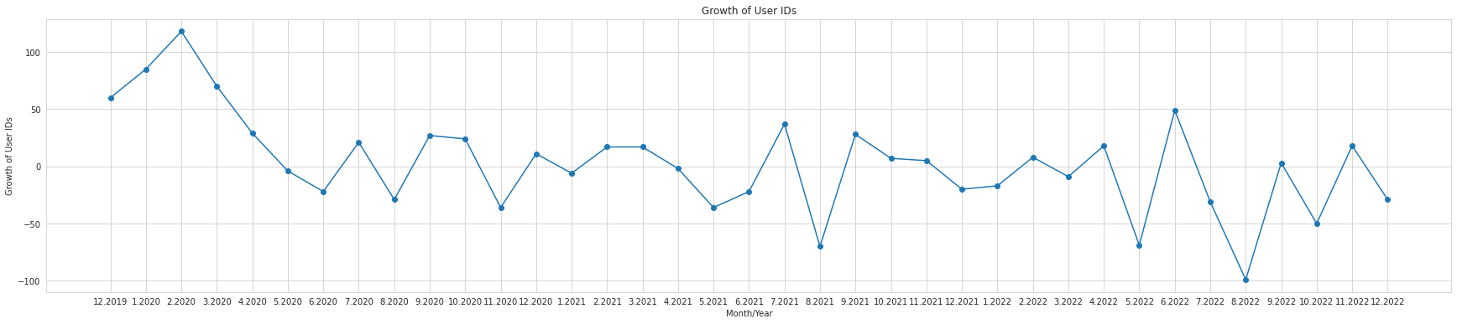
Root Cause Analysis
The growth of registered user IDs has decreased in 2022.

Slide 11
Root Cause Analysis
AVERAGE of percentage | month_number
cohort_month | 0,0 | 1,0 | 2,0 | 3,0 | 4,0 | 5,0 | 6,0 | 7,0 | 8,0 | 9,0 | 10,0 | 11,0 | 12,0 | 13,0 | 14,0 | 15,0 | 16,0 | 17,0 | 18,0 | 19,0 | 20,0 | 21,0 | 22,0 | 23,0 | 24,0 | 25,0 | 26,0 | 27,0 | 28,0 | 29,0 | 30,0 | 31,0 | 32,0 | 33,0 | 34,0 | 35,0 | 36,0
01/12/2019 | 100,0 | 35,7 | 28,6 | 17,9 | 35,7 | 17,9 | 25,0 | 3,6 | 7,1 | 3,6 | 10,7 | 10,7 | 14,3 | 17,9 | 10,7 | 14,3 | 7,1 | 10,7 |  | 3,6 | 3,6 |  |  | 3,6 | 7,1 | 14,3 | 10,7 | 14,3 |  |  | 3,6 | 3,6 |  | 3,6 | 3,6 | 7,1 | 7,1
01/01/2020 | 100,0 | 29,4 | 36,8 | 30,9 | 30,9 | 23,5 | 16,2 | 11,8 | 13,2 | 4,4 | 10,3 | 5,9 | 11,8 | 14,7 | 14,7 | 5,9 | 4,4 | 5,9 | 5,9 | 4,4 | 5,9 | 5,9 | 8,8 | 2,9 | 8,8 | 8,8 | 7,4 | 4,4 | 7,4 | 2,9 | 1,5 | 5,9 | 5,9 | 1,5 | 2,9 | 4,4
01/02/2020 | 100,0 | 31,8 | 28,0 | 23,4 | 17,8 | 11,2 | 13,1 | 9,3 | 8,4 | 9,3 | 10,3 | 14,0 | 15,0 | 11,2 | 4,7 |  | 0,9 | 0,9 | 5,6 | 2,8 | 5,6 | 4,7 | 3,7 | 10,3 | 6,5 | 8,4 | 0,9 | 2,8 | 3,7 | 0,9 | 2,8 | 1,9 | 2,8 | 1,9 | 1,9
01/03/2020 | 100,0 | 29,6 | 30,2 | 25,2 | 11,9 | 13,2 | 6,3 | 10,7 | 9,4 | 9,4 | 13,2 | 15,7 | 12,6 | 4,4 | 3,1 | 4,4 | 3,8 | 6,9 | 5,0 | 3,1 | 1,9 | 3,1 | 5,0 | 8,2 | 3,1 | 0,6 | 0,6 | 2,5 | 3,1 | 2,5 | 1,9 | 0,6 |  | 0,6
01/04/2020 | 100,0 | 27,0 | 25,1 | 15,2 | 9,1 | 10,6 | 12,2 | 6,8 | 7,6 | 17,5 | 16,0 | 15,2 | 4,6 | 3,0 | 3,0 | 4,2 | 6,1 | 4,6 | 4,6 | 4,6 | 3,0 | 12,9 | 12,2 | 9,1 | 2,7 | 2,3 | 1,1 | 1,5 | 1,9 | 3,0 | 1,1 | 3,0 | 2,7
01/05/2020 | 100,0 | 33,6 | 13,0 | 14,6 | 9,3 | 12,6 | 15,6 | 10,6 | 23,3 | 21,9 | 19,3 | 5,6 | 6,0 | 2,3 | 4,7 | 4,0 | 6,3 | 6,0 | 6,3 | 3,7 | 12,6 | 10,0 | 11,6 | 3,3 | 1,3 | 1,3 | 2,3 | 2,7 | 1,3 | 1,7 | 2,7 | 1,7
01/06/2020 | 100,0 | 17,9 | 17,2 | 16,1 | 15,8 | 12,6 | 10,5 | 25,3 | 21,8 | 17,5 | 5,3 | 7,4 | 6,0 | 6,7 | 6,3 | 7,0 | 5,6 | 5,3 | 4,2 | 16,5 | 15,1 | 13,7 | 2,5 | 3,5 | 1,8 | 3,5 | 2,5 | 3,5 | 2,1 | 2,1 | 1,8
01/07/2020 | 100,0 | 14,1 | 15,9 | 19,1 | 15,9 | 10,5 | 25,5 | 27,7 | 25,5 | 5,5 | 5,5 | 8,6 | 7,7 | 5,9 | 5,0 | 8,6 | 5,5 | 3,6 | 15,0 | 13,6 | 15,0 | 3,2 | 1,4 | 4,1 | 2,3 | 2,3 | 2,3 | 3,2 | 1,4 | 0,9
01/08/2020 | 100,0 | 15,6 | 18,4 | 16,0 | 12,3 | 26,4 | 26,9 | 25,9 | 5,2 | 7,5 | 6,6 | 8,0 | 7,5 | 4,2 | 5,7 | 8,5 | 4,7 | 17,9 | 15,1 | 12,7 | 3,8 | 3,8 | 1,4 | 2,4 | 3,3 | 2,4 | 3,3 | 3,3 | 3,3
01/09/2020 | 100,0 | 14,1 | 20,2 | 16,3 | 25,9 | 29,3 | 20,5 | 6,1 | 6,5 | 5,7 | 8,7 | 7,6 | 9,9 | 5,7 | 4,2 | 4,9 | 16,0 | 17,9 | 13,3 | 2,7 | 1,9 | 1,9 | 3,8 | 2,3 | 2,3 | 1,5 | 2,7 | 2,7
01/10/2020 | 100,0 | 16,6 | 13,4 | 28,3 | 25,5 | 23,8 | 5,9 | 7,2 | 6,6 | 7,2 | 6,2 | 5,2 | 9,7 | 5,5 | 5,9 | 23,4 | 16,9 | 16,6 | 2,8 | 2,1 | 4,5 | 3,8 | 2,8 | 3,4 | 2,8 | 3,4 | 2,1
01/11/2020 | 100,0 | 17,4 | 30,9 | 27,2 | 25,7 | 7,2 | 7,2 | 6,4 | 12,8 | 9,4 | 5,7 | 4,9 | 8,3 | 6,8 | 19,6 | 18,9 | 15,5 | 4,2 | 4,2 | 3,4 | 3,0 | 2,6 | 4,5 | 3,0 | 1,9 | 2,6
01/12/2020 | 100,0 | 31,7 | 29,0 | 30,0 | 9,3 | 6,9 | 6,6 | 6,9 | 7,6 | 9,0 | 6,6 | 7,2 | 4,5 | 21,7 | 20,3 | 17,9 | 4,1 | 5,5 | 4,1 | 2,4 | 4,5 | 4,1 | 2,1 | 2,4 | 1,7
01/01/2021 | 100,0 | 33,6 | 33,1 | 11,4 | 9,6 | 6,8 | 8,8 | 10,4 | 6,3 | 7,1 | 6,1 | 6,6 | 26,0 | 19,7 | 22,2 | 4,5 | 4,8 | 5,3 | 5,3 | 4,0 | 3,0 | 3,5 | 3,5 | 3,0
01/02/2021 | 100,0 | 33,1 | 7,2 | 7,8 | 10,0 | 13,1 | 9,7 | 8,9 | 8,1 | 7,8 | 7,5 | 29,2 | 28,1 | 21,7 | 5,6 | 4,7 | 3,1 | 5,3 | 4,5 | 5,6 | 3,6 | 3,6 | 5,3
01/03/2021 | 100,0 | 8,4 | 8,1 | 9,9 | 7,5 | 9,3 | 11,2 | 9,6 | 5,6 | 7,8 | 28,3 | 29,5 | 26,1 | 8,1 | 5,3 | 4,7 | 5,3 | 5,6 | 3,7 | 5,0 | 3,7 | 2,2
01/04/2021 | 100,0 | 8,8 | 7,3 | 9,3 | 6,8 | 7,3 | 6,8 | 7,8 | 9,8 | 21,5 | 22,0 | 20,5 | 5,9 | 6,8 | 4,9 | 5,9 | 4,4 | 5,9 | 6,3 | 3,9 | 2,4
01/05/2021 | 100,0 | 8,6 | 13,1 | 10,4 | 8,1 | 12,2 | 11,8 | 6,3 | 25,8 | 24,4 | 24,4 | 3,6 | 3,6 | 6,3 | 7,7 | 5,4 | 3,6 | 5,0 | 2,3 | 2,3
01/06/2021 | 100,0 | 7,0 | 8,0 | 8,5 | 6,0 | 9,0 | 8,5 | 28,4 | 24,4 | 22,9 | 7,0 | 4,0 | 4,0 | 7,0 | 5,5 | 8,0 | 4,0 | 3,0 | 5,0
01/07/2021 | 100,0 | 9,2 | 8,9 | 9,9 | 8,9 | 8,9 | 19,1 | 24,5 | 19,5 | 5,3 | 5,0 | 8,2 | 4,3 | 3,9 | 2,8 | 6,7 | 5,3 | 3,2
01/08/2021 | 100,0 | 11,8 | 9,4 | 8,4 | 7,0 | 17,4 | 20,6 | 19,9 | 4,2 | 3,8 | 4,9 | 7,0 | 7,7 | 3,5 | 2,4 | 3,1 | 4,5
01/09/2021 | 100,0 | 12,4 | 9,6 | 8,9 | 23,0 | 19,5 | 19,1 | 6,0 | 3,2 | 4,3 | 7,4 | 6,0 | 7,1 | 5,0 | 6,4 | 4,6
01/10/2021 | 100,0 | 11,1 | 7,2 | 22,2 | 20,4 | 19,0 | 6,1 | 5,4 | 3,6 | 7,5 | 6,8 | 6,8 | 7,5 | 5,0 | 6,8
01/11/2021 | 100,0 | 8,4 | 24,0 | 19,5 | 19,5 | 5,9 | 4,2 | 5,9 | 9,1 | 9,8 | 5,2 | 5,6 | 6,3 | 7,3
01/12/2021 | 100,0 | 24,8 | 21,4 | 18,9 | 7,1 | 4,6 | 4,2 | 8,0 | 5,5 | 8,8 | 4,6 | 5,5 | 4,2
01/01/2022 | 100,0 | 30,9 | 36,2 | 10,1 | 10,6 | 7,7 | 10,4 | 8,0 | 7,7 | 6,9 | 7,7 | 7,7
01/02/2022 | 100,0 | 36,7 | 8,9 | 9,3 | 8,5 | 8,1 | 9,6 | 9,3 | 11,5 | 8,5 | 5,6
01/03/2022 | 100,0 | 10,1 | 7,3 | 7,3 | 10,1 | 12,3 | 15,6 | 7,8 | 11,7 | 8,4
01/04/2022 | 100,0 | 3,8 | 2,8 | 8,5 | 8,5 | 4,7 | 5,7 | 4,7 | 7,5
01/05/2022 | 100,0 | 2,7 | 8,0 | 11,5 | 8,0 | 7,1 | 4,4 | 9,7
01/06/2022 | 100,0 | 7,8 | 7,8 | 8,8 | 2,9 | 6,9 | 3,9
01/07/2022 | 100,0 | 9,5 | 9,9 | 5,6 | 3,9 | 6,5
01/08/2022 | 100,0 | 8,2 | 6,9 | 4,7 | 7,7
01/09/2022 | 100,0 | 6,3 | 4,5 | 5,9
01/10/2022 | 100,0 | 4,5 | 4,5
01/11/2022 | 100,0 | 6,6
01/12/2022 | 100,0
The retention rate has decreased in the last few months
retention_chart

Slide 12
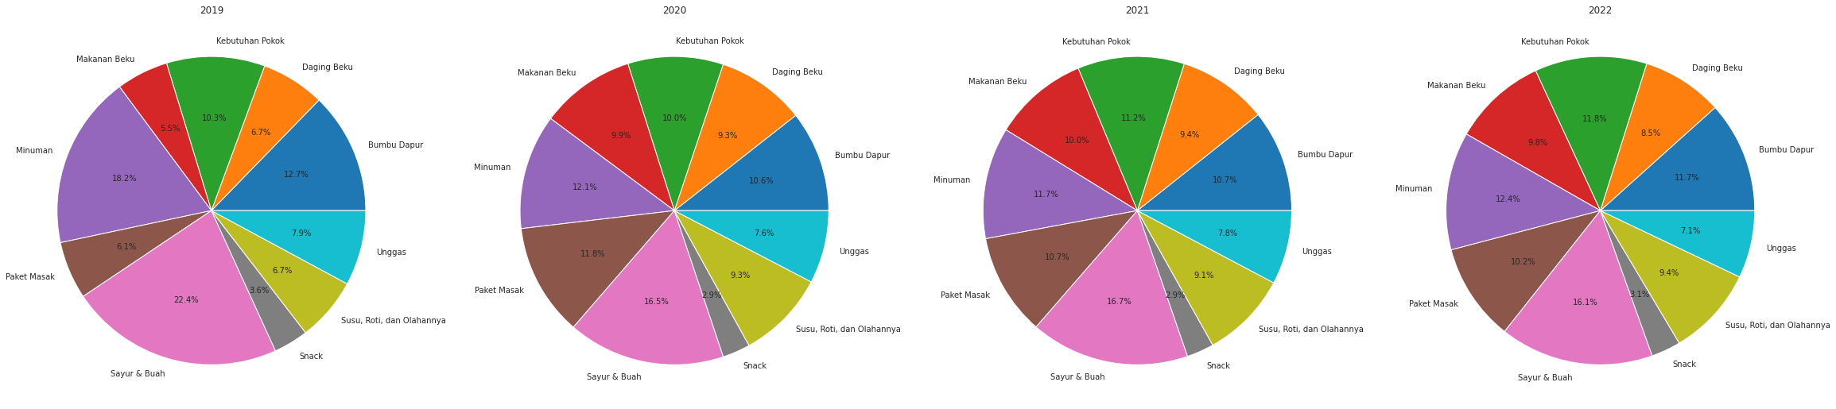
Root Cause Analysis
The product categories with the largest proportion are ‘vegetables and fruits’.

Slide 13
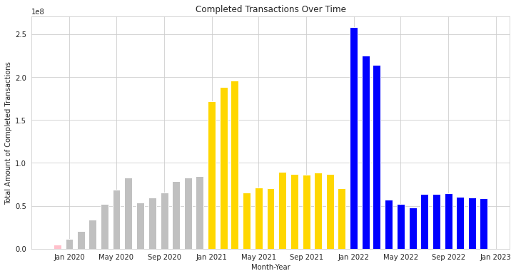
Root Cause Analysis
Completed_Amount has decreased last few months.

Slide 14
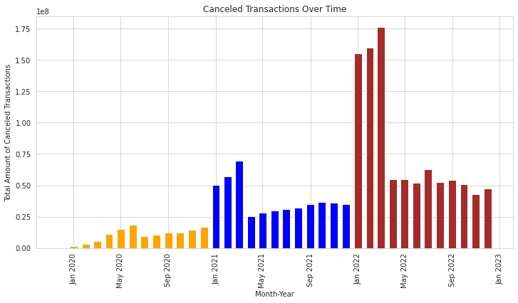
Root Cause Analysis
Canceled_Amount has increased last year.

Slide 15
Current Marketing Strategy evaluation
The only Visits(other_count) had been dominated in all years.

Slide 16
CVR
The CVR(conversion rate) has decreased in the last few year.

Slide 17
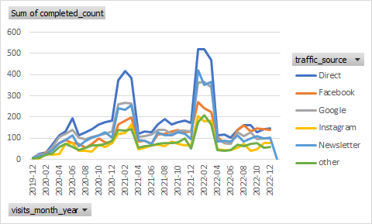
Current Marketing Strategy evaluation
Direct traffic has dominated the traffic of completed_count

Slide 18
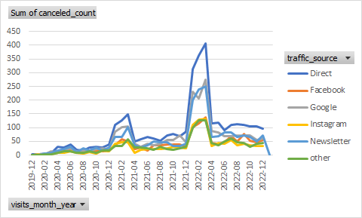
Current Marketing Strategy evaluation
Direct traffic has dominated the traffic of canceled_count

Slide 19
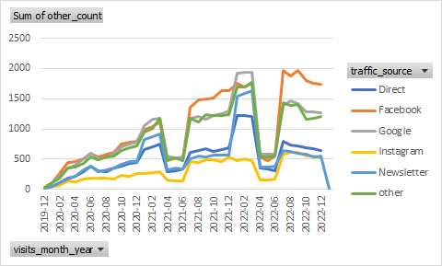
Current Marketing Strategy evaluation
Facebook and Google traffic has dominated the traffic of other_count

Slide 20

— Thomas A. Edison
“Two percent is genius and ninety-eight percent. is hard work.”
.”

Slide 21
Clustering methods:
RFM helped to make customer profiling and raise engagement (loyalty)
K-Means (location and activeness) for map customer’s status and raise new customer acquisition and make intervention based on geographical way.
script link simulation 2
script link simulation 1
Notes:
Grouping customers based on their purchasing behavior is a useful technique that businesses can use to develop targeted marketing strategies to improve customer engagement and loyalty. By analyzing the recency, frequency, and monetary value of customers' transactions, businesses can identify their most valuable customers and tailor their marketing efforts to their specific needs and preferences. This approach can also help businesses identify at-risk customers who may be likely to churn, allowing them to intervene with targeted retention strategies.
Another way to improve customer acquisition is to use K-means clustering to segment customers based on their behavior and location. By grouping customers with similar characteristics, businesses can develop targeted promotions and offers to attract new customers. K-means clustering can also help businesses identify areas with high potential for customer acquisition, allowing them to focus their marketing efforts and resources on those areas. By using a combination of customer segmentation techniques, businesses can optimize their marketing strategies and achieve sustainable growth.

Slide 22
Business recommendation
The company is recommended to develop an evaluation survey to gather feedback from churned customers on the prices, delivery services, product quality, and mobile application quality, and customer’s favorite purchase behavior(offline/online). This feedback can be used to improve every aspect of their services and better meet the needs of their customers.
Build UX research by qualitative approach on targeted customer’s sample to evaluate UX readability
Use referral program to raise customer acquisition*
Voucher, cashback, points (loyalty program) for specific targeted users to raise loyalty.
Marketing Strategies recommendation: New traffic channel; tiktok, whatsapp(personalized marketing which promoted the products of customer’s favorite), telemarketing. Event marketing on targeted location to raise acquisition new customers and brand awareness and event marketing on FMCG corporate event to raised engagement and brand awareness(based on prior calculation and budget).
Notes:
Source link: https://journals.sagepub.com/doi/abs/10.1509/jmkr.45.1.048?journalCode=mrja

Slide 23
python
script link
script link simulation 2

Slide 24
Thanks!
Do you have any questions?
youremail@freepik.com
+91 620 421 838
yourcompany.com
Please keep this slide for attribution

Slide 25


