Slide 1
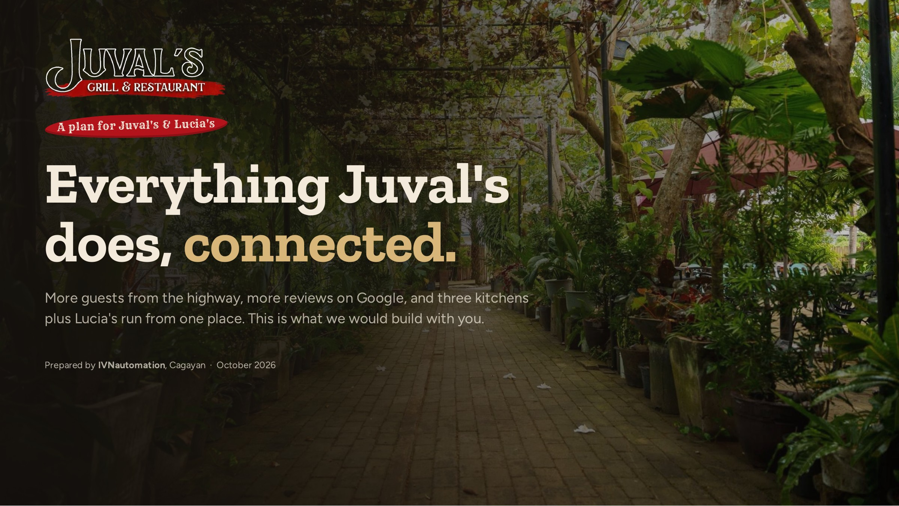
Notes:
Thank them for the reply. Today: what they already have, where guests slip away, the system we propose and the plan. Ask what they want most from the meeting.

Slide 2
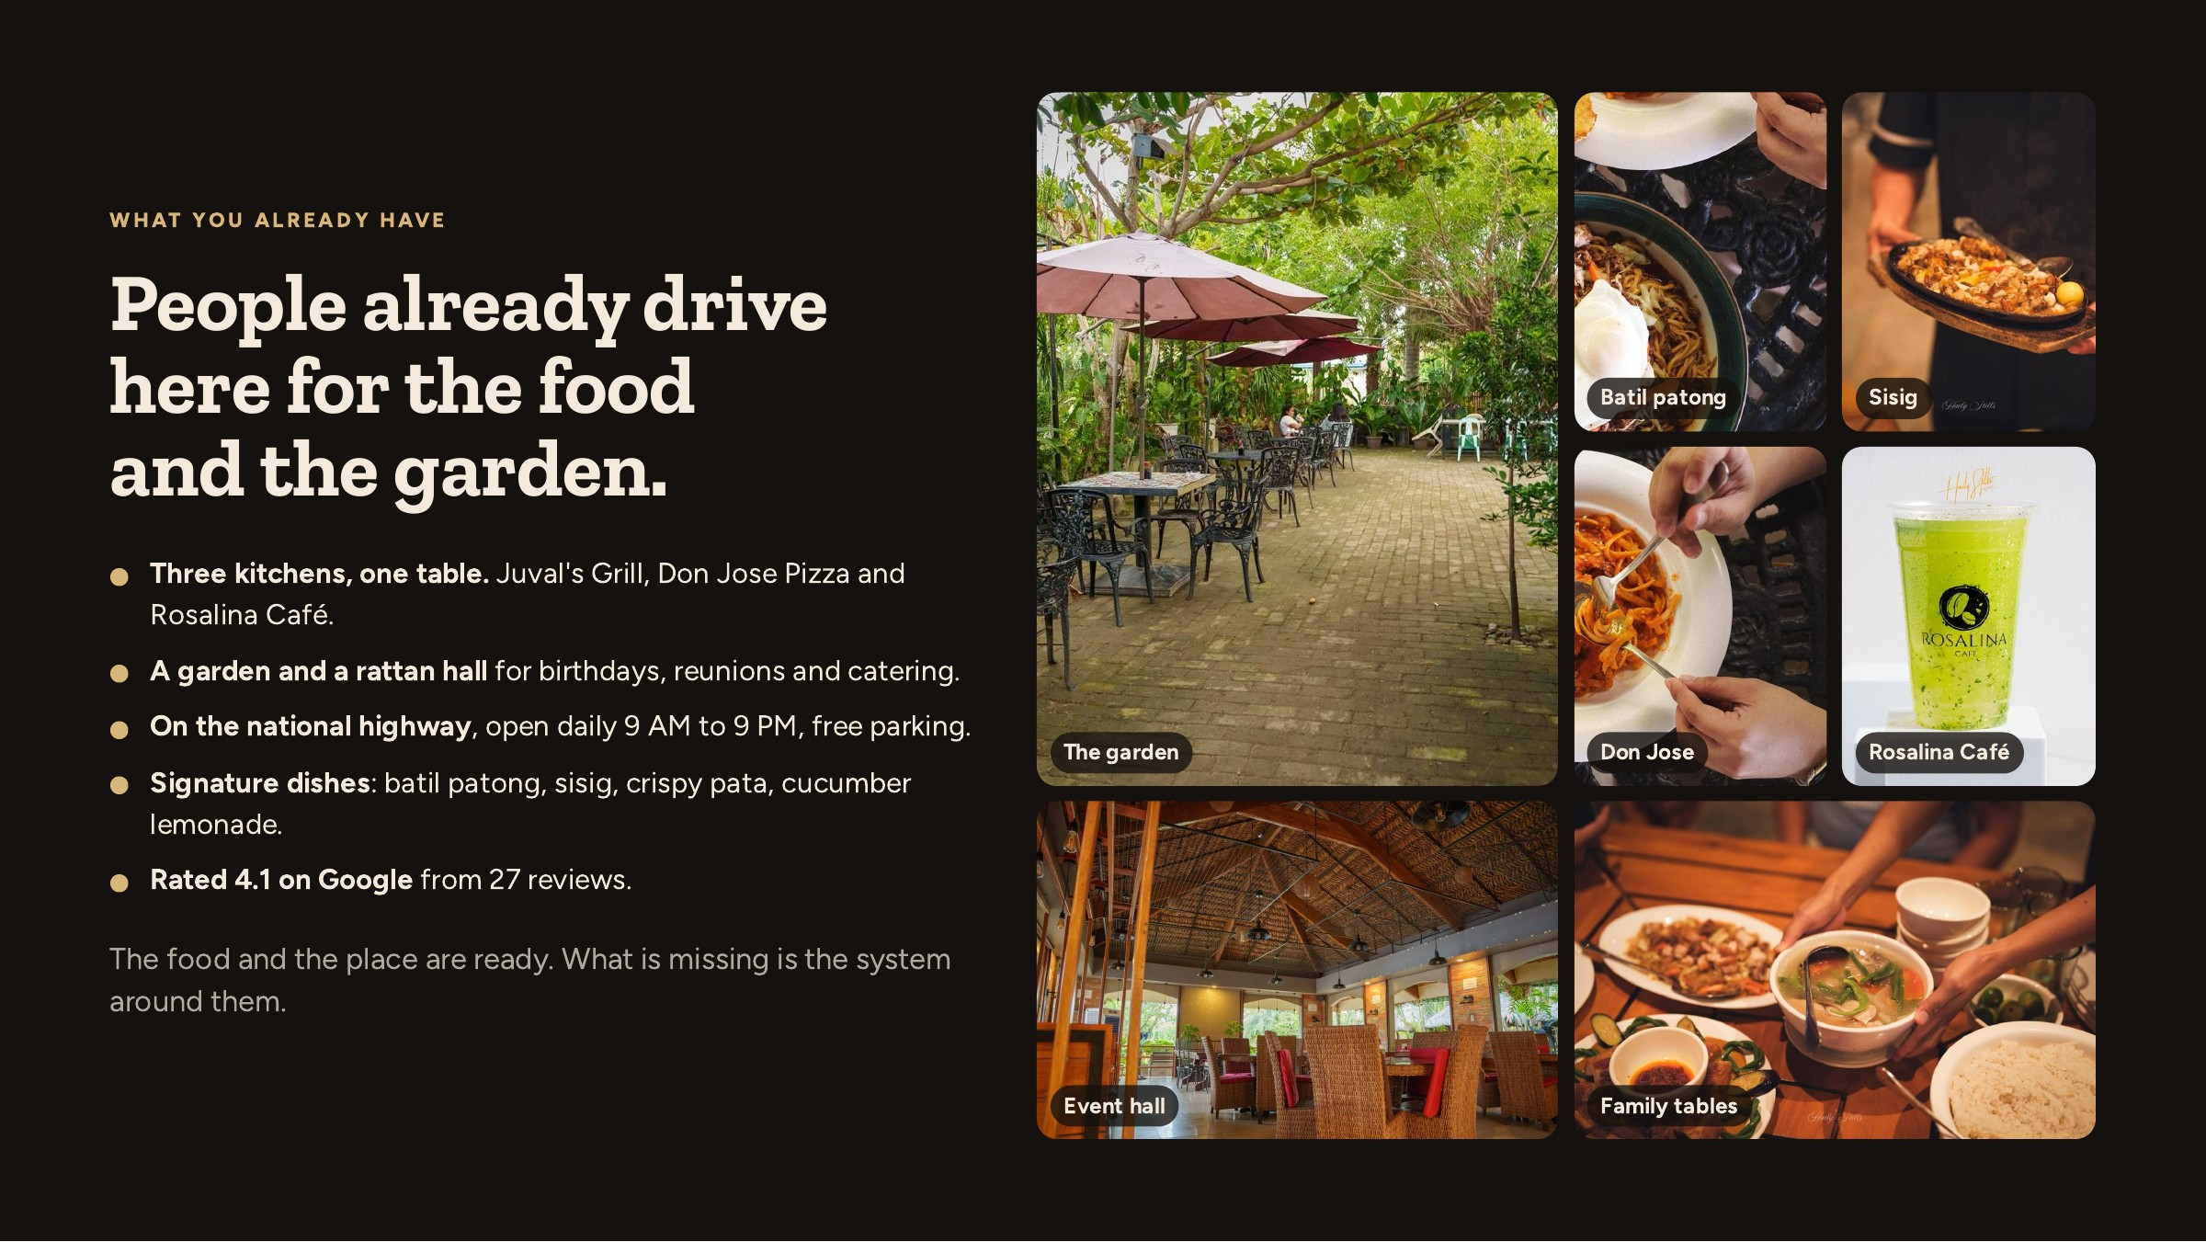
Notes:
Start positive. Everything here comes from their own photos and menu. The point: the product is strong, the reach and the systems are not.

Slide 3
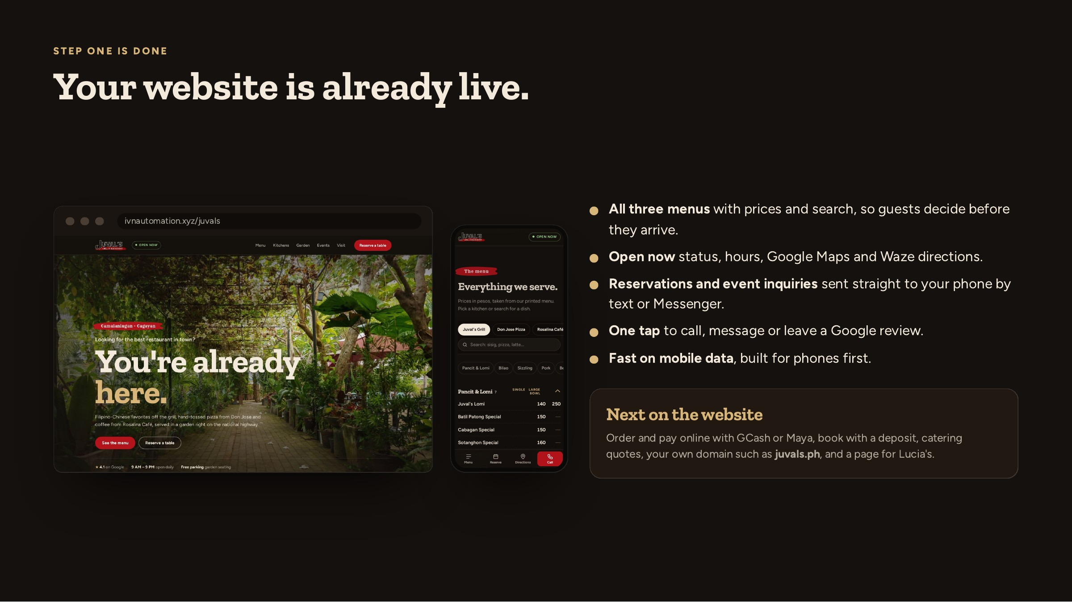
Notes:
Open the live site on the TV or their phone. Show the menu search, the open-now chip, and the reserve form sending to Messenger.

Slide 4
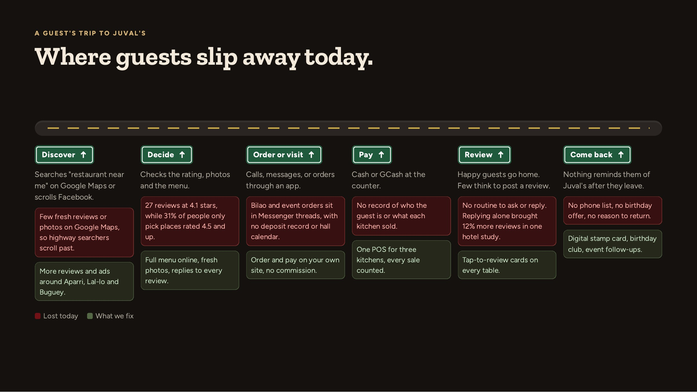
Notes:
Walk the road left to right. Every red box is money or a guest we lose today. Every green box is a module in the system.

Slide 5
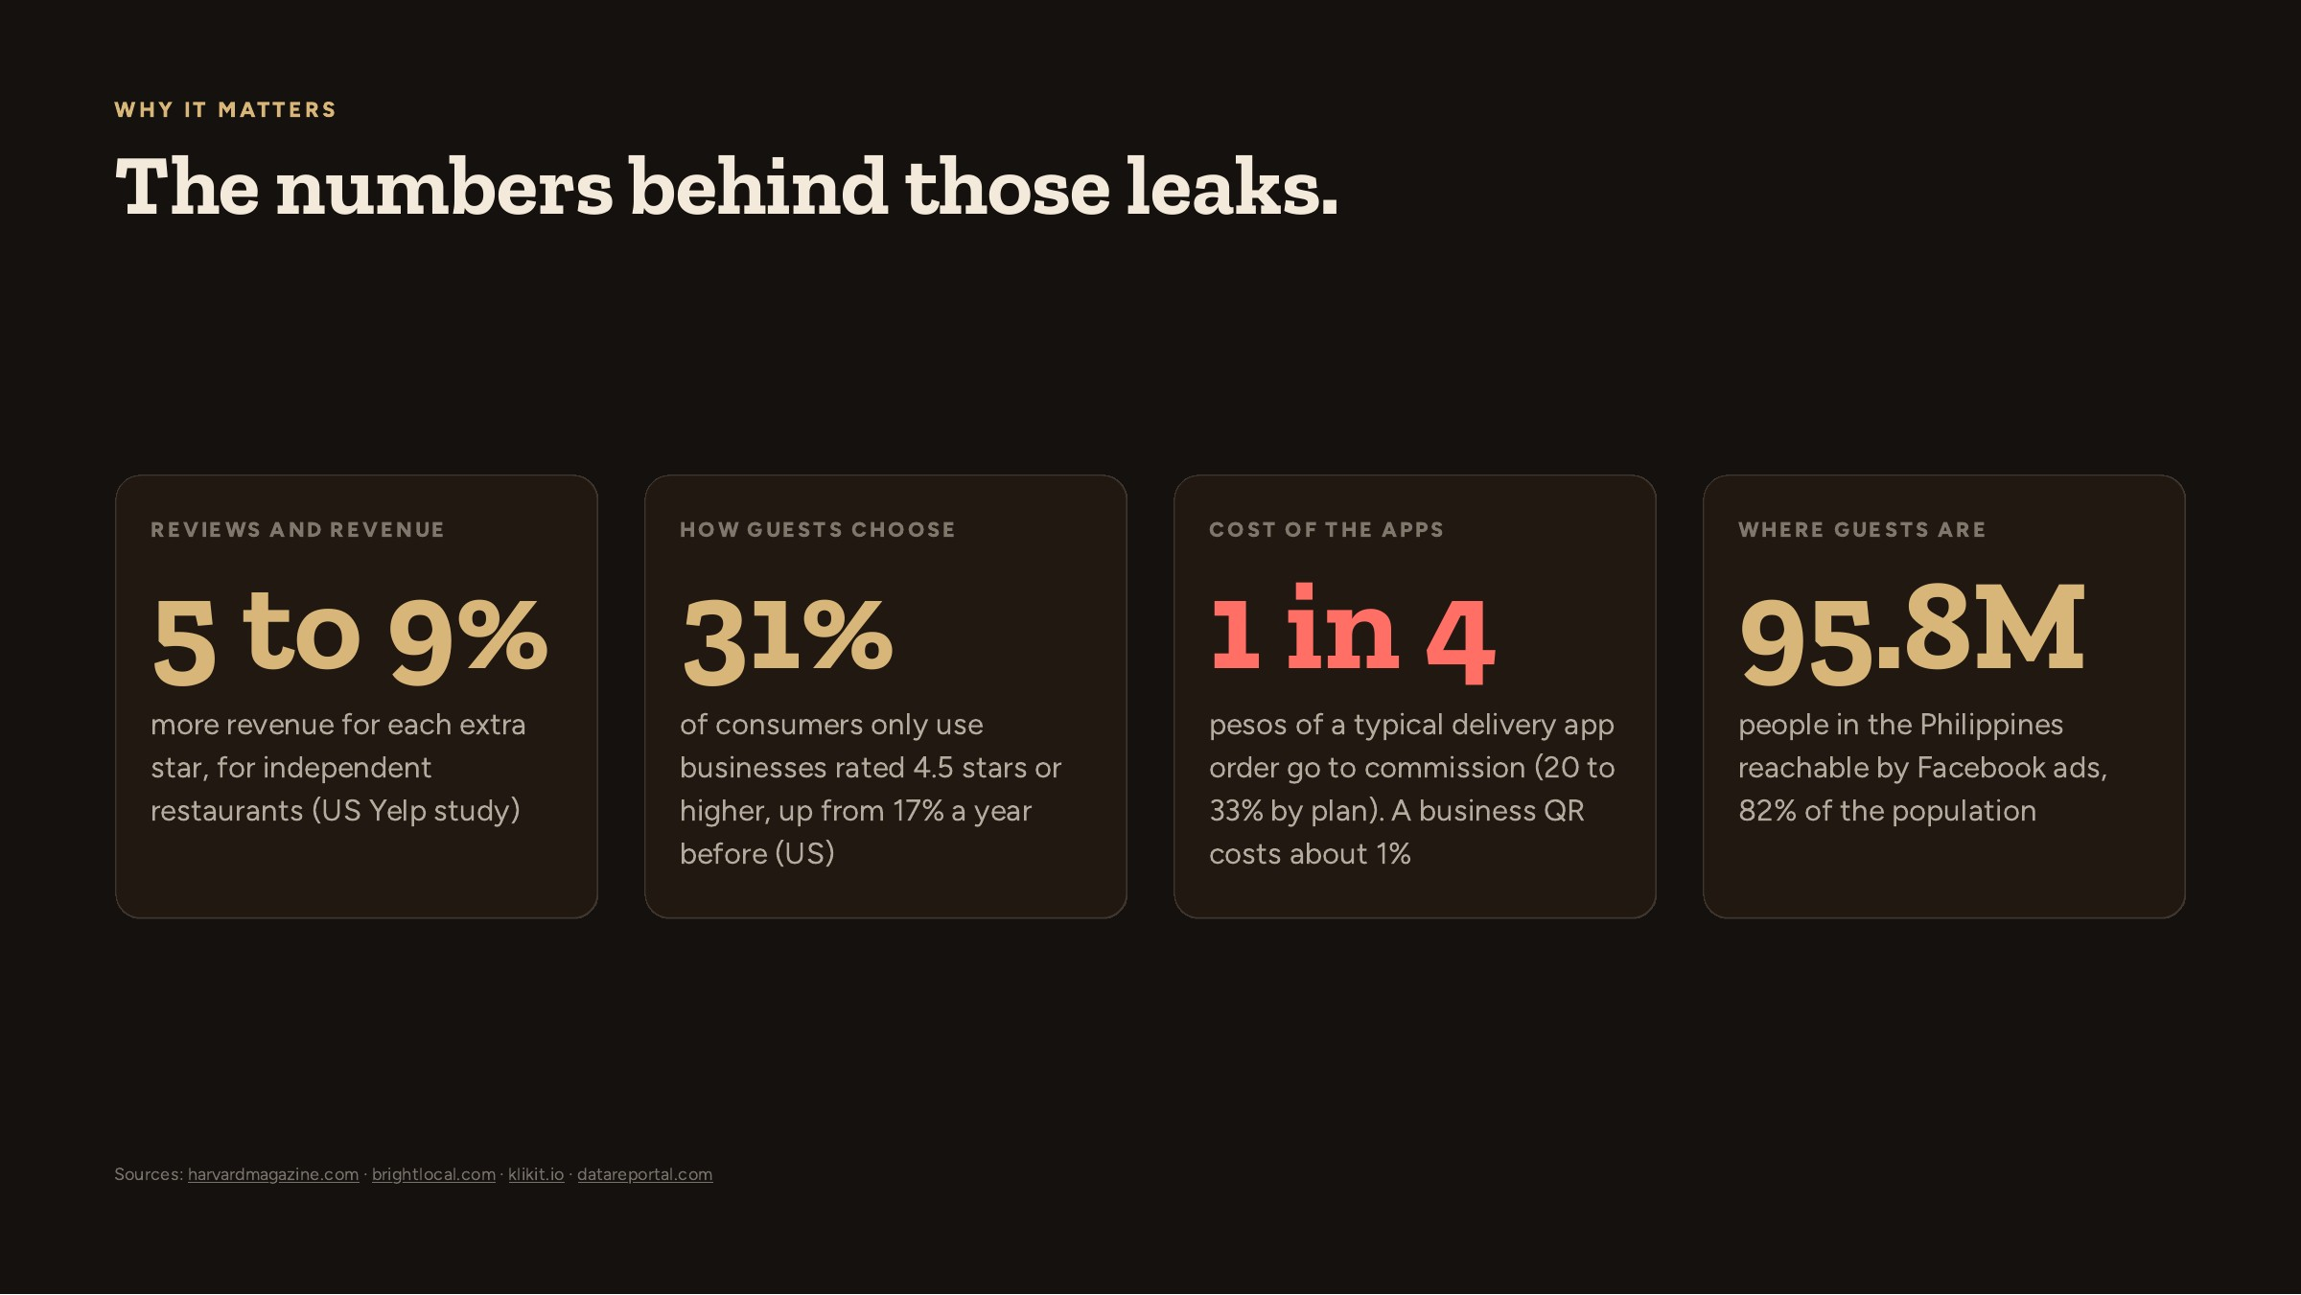
Notes:
5 to 9%: more revenue for each extra star, for independent restaurants (US Yelp study). 31%: of consumers only use businesses rated 4.5 stars or higher, up from 17% a year before (US). 1 in 4: pesos of a typical delivery app order go to commission (20 to 33% by plan). A business QR costs about 1%. 95.8M: people in the Philippines reachable by Facebook ads, 82% of the population.

Slide 6
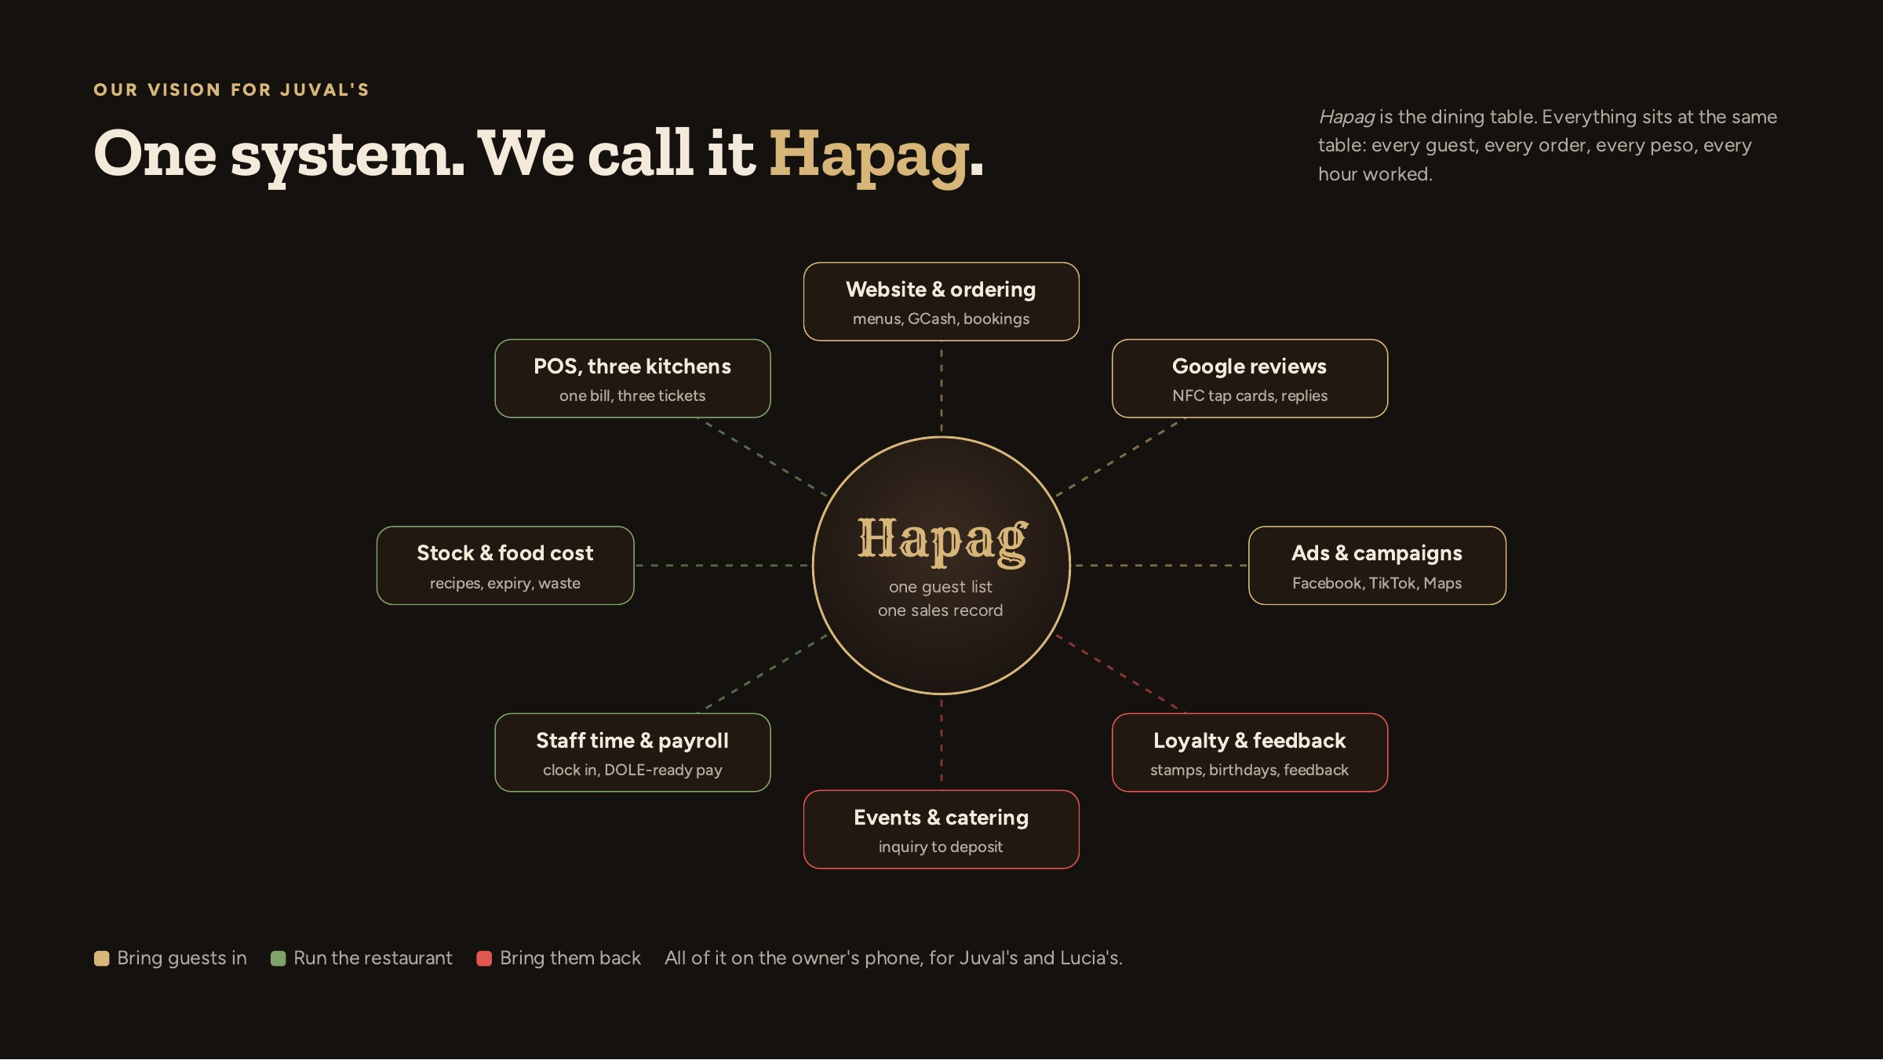
Notes:
This is the heart of the pitch. Eight tools that usually come from eight vendors, here sharing one guest list and one sales record. That is why reports finally agree.

Slide 7
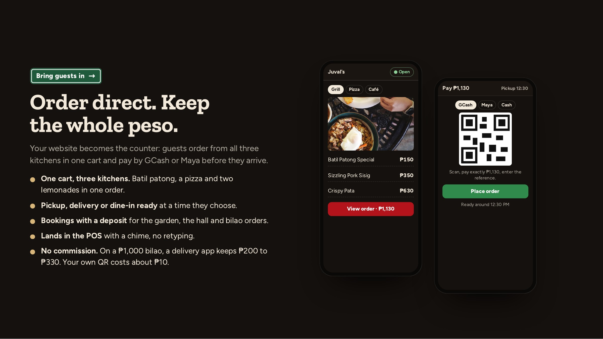
Notes:
Show the ordering flow in the Mogoba demo: GCash or Maya by QR, staff confirm the money in the app, the order lands in Orders, Online. One cart for three kitchens and kitchen printing are what we add for Juval's.

Slide 8
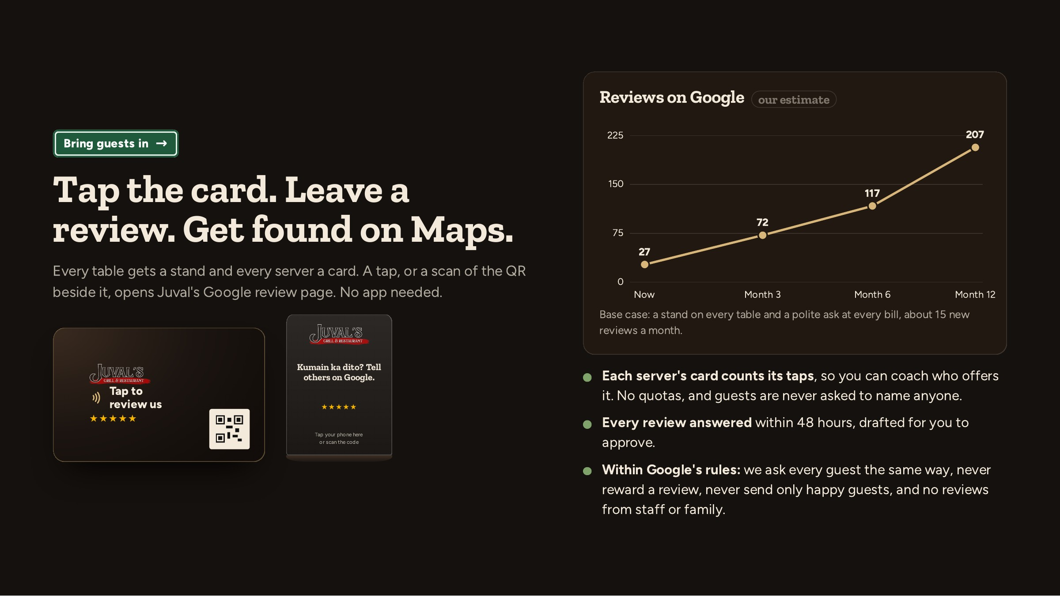
Notes:
Review projection: now 27, month 3 72, month 6 117, month 12 207. Our estimate, from the reviews research.

Slide 9
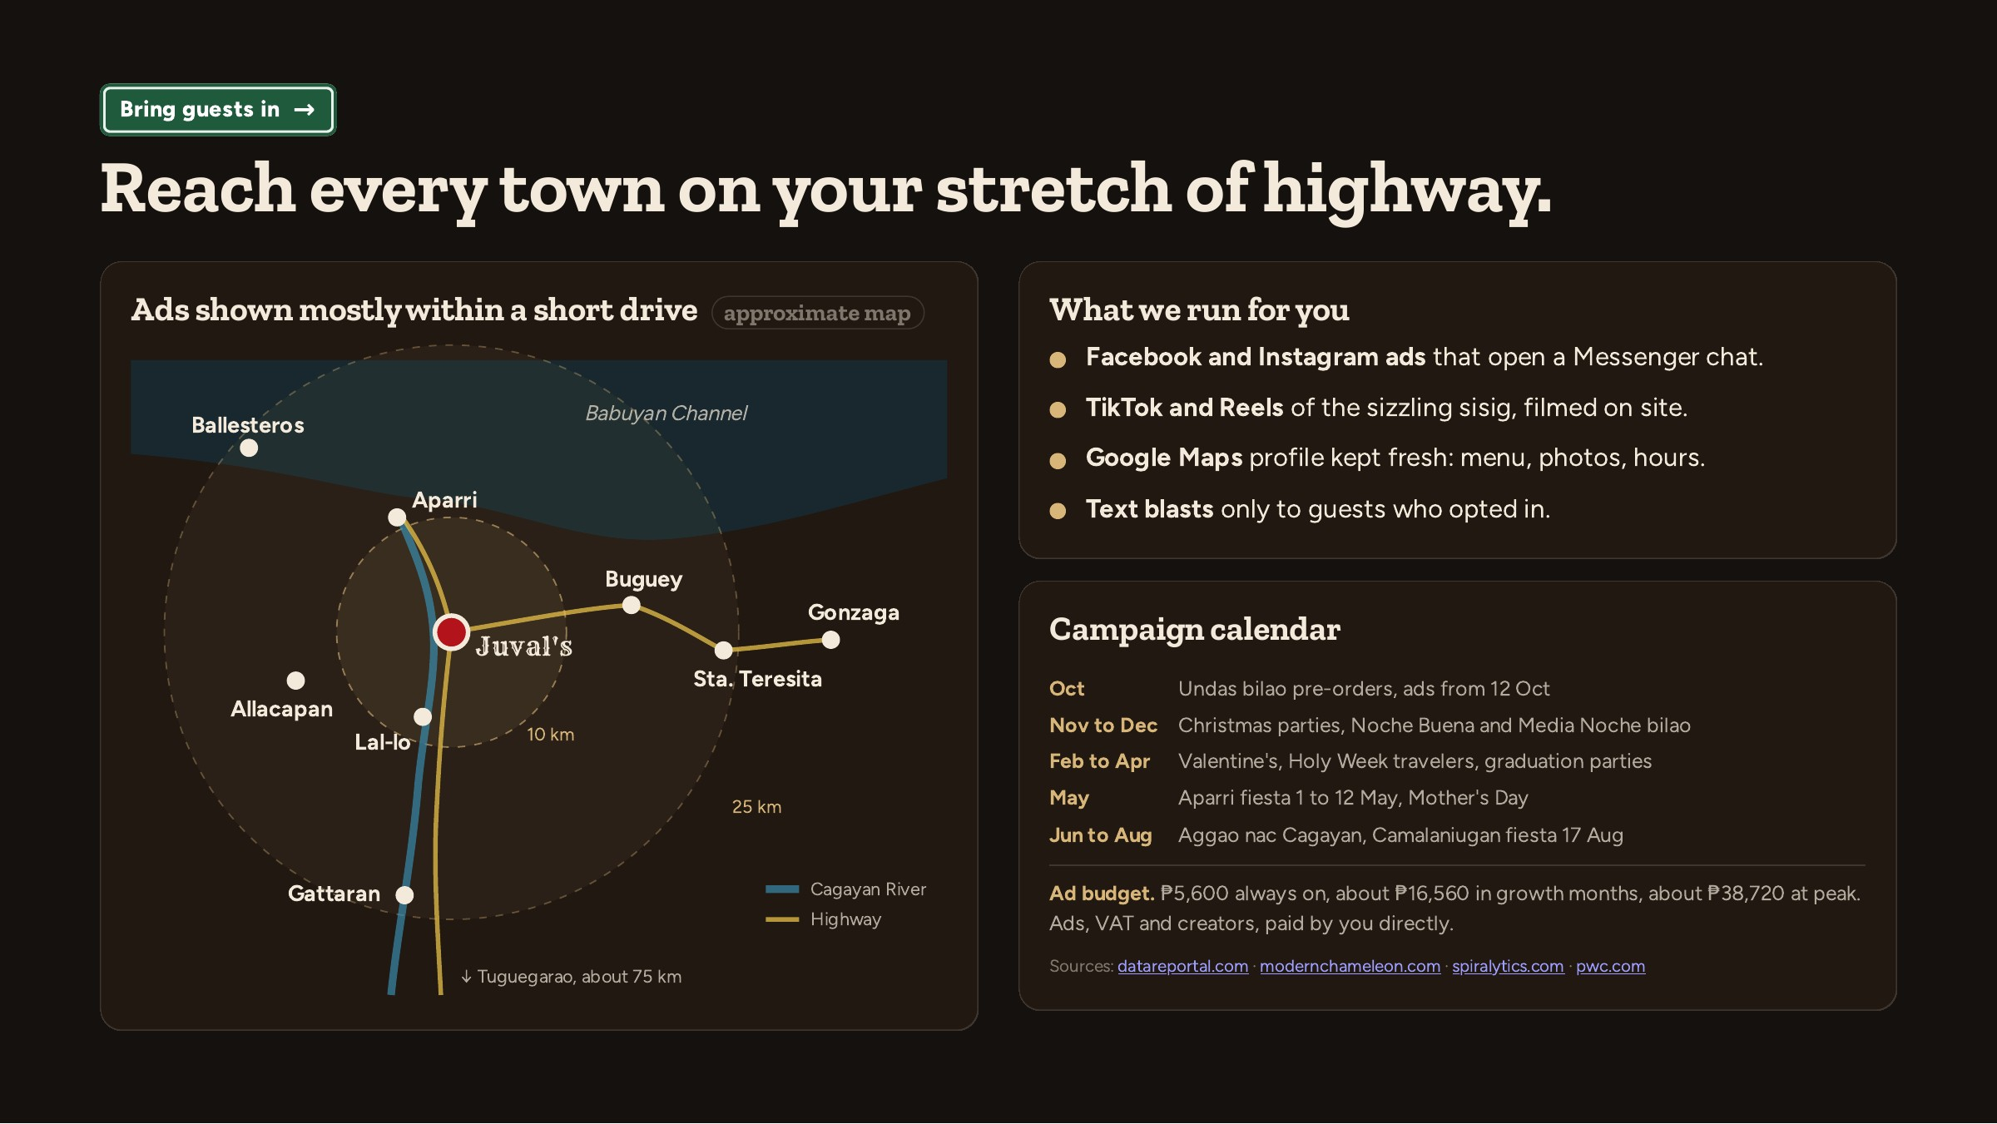
Notes:
Ad money is paid by Juval's directly to Meta, TikTok and the creators; our fee is separate. ₱5,600 always on, about ₱16,560 in growth months, about ₱38,720 at peak. Ads, VAT and creators, paid by you directly.

Slide 10
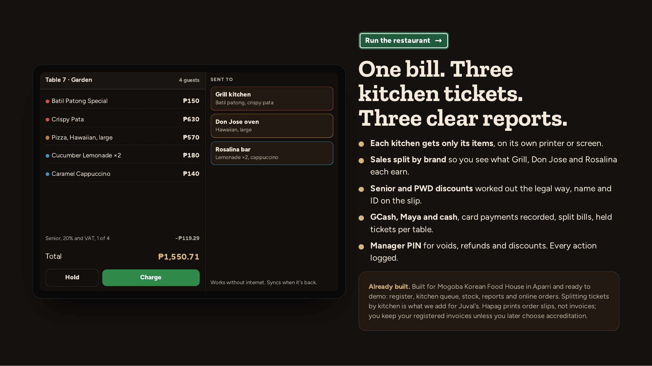
Notes:
Offer the Mogoba demo here. On BIR: Hapag prints order slips, not invoices; you keep your registered invoices unless you later choose accreditation.

Slide 11
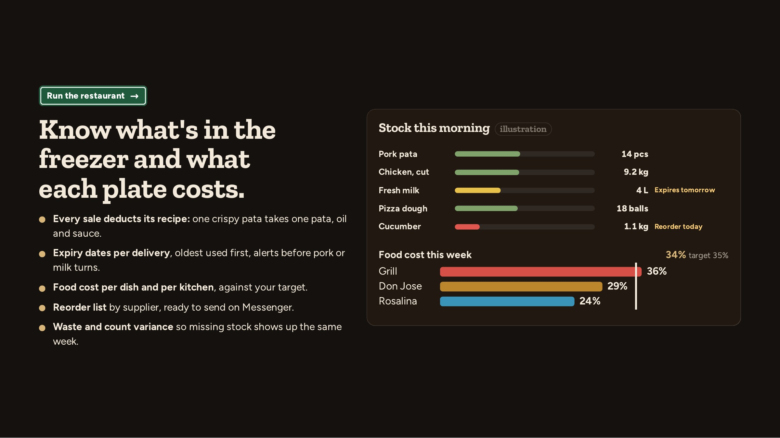
Notes:
Show the Mogoba stock screen on the tablet if they want to see it working. Recipes and par levels are set up with their cooks in week one.

Slide 12
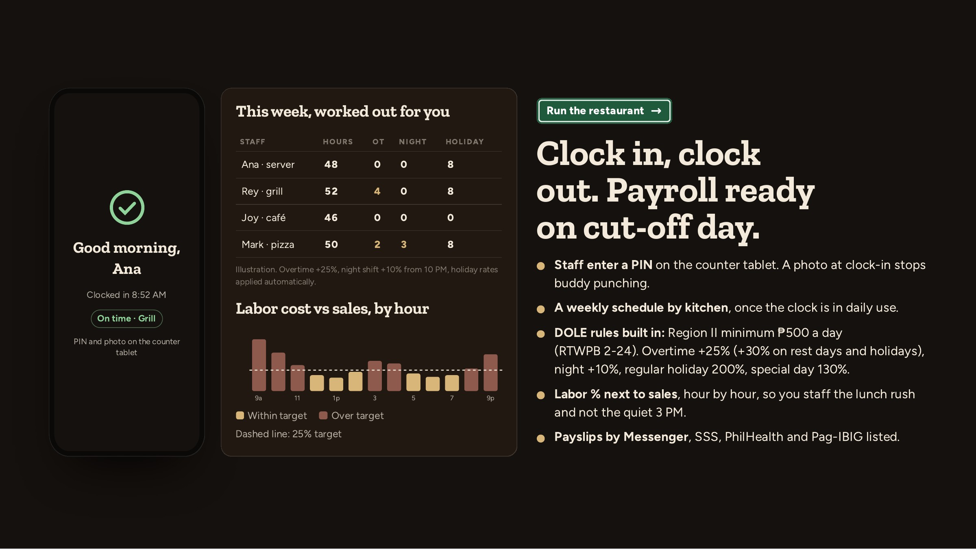
Notes:
Payroll is prepared, not filed: the owner or bookkeeper approves. Region II minimum ₱500 a day (RTWPB 2-24). Overtime +25% (+30% on rest days and holidays), night +10%, regular holiday 200%, special day 130%.

Slide 13
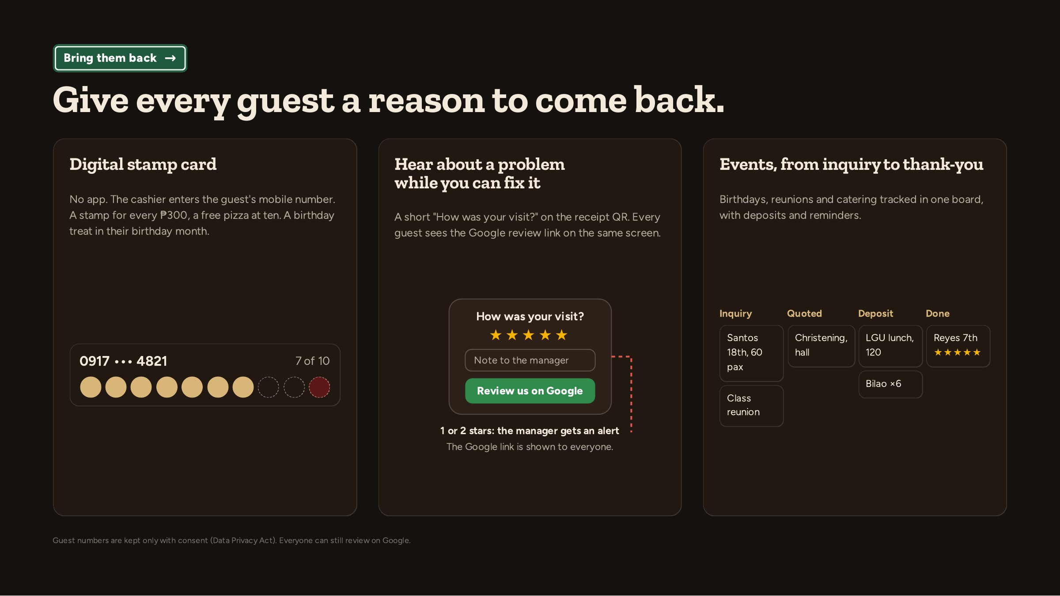
Notes:
No app for the guest. Consent when we take the number. Unhappy guests reach the manager, and still see the Google link.

Slide 14
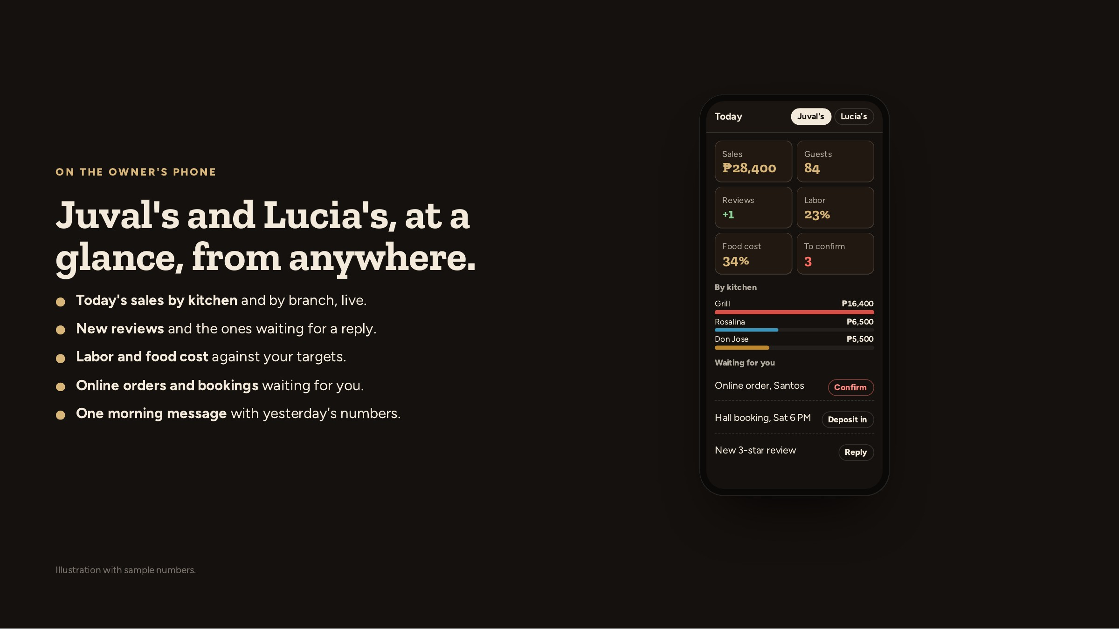
Notes:
This is the screen the owner will open every night. Ask what numbers they check today and how.

Slide 15
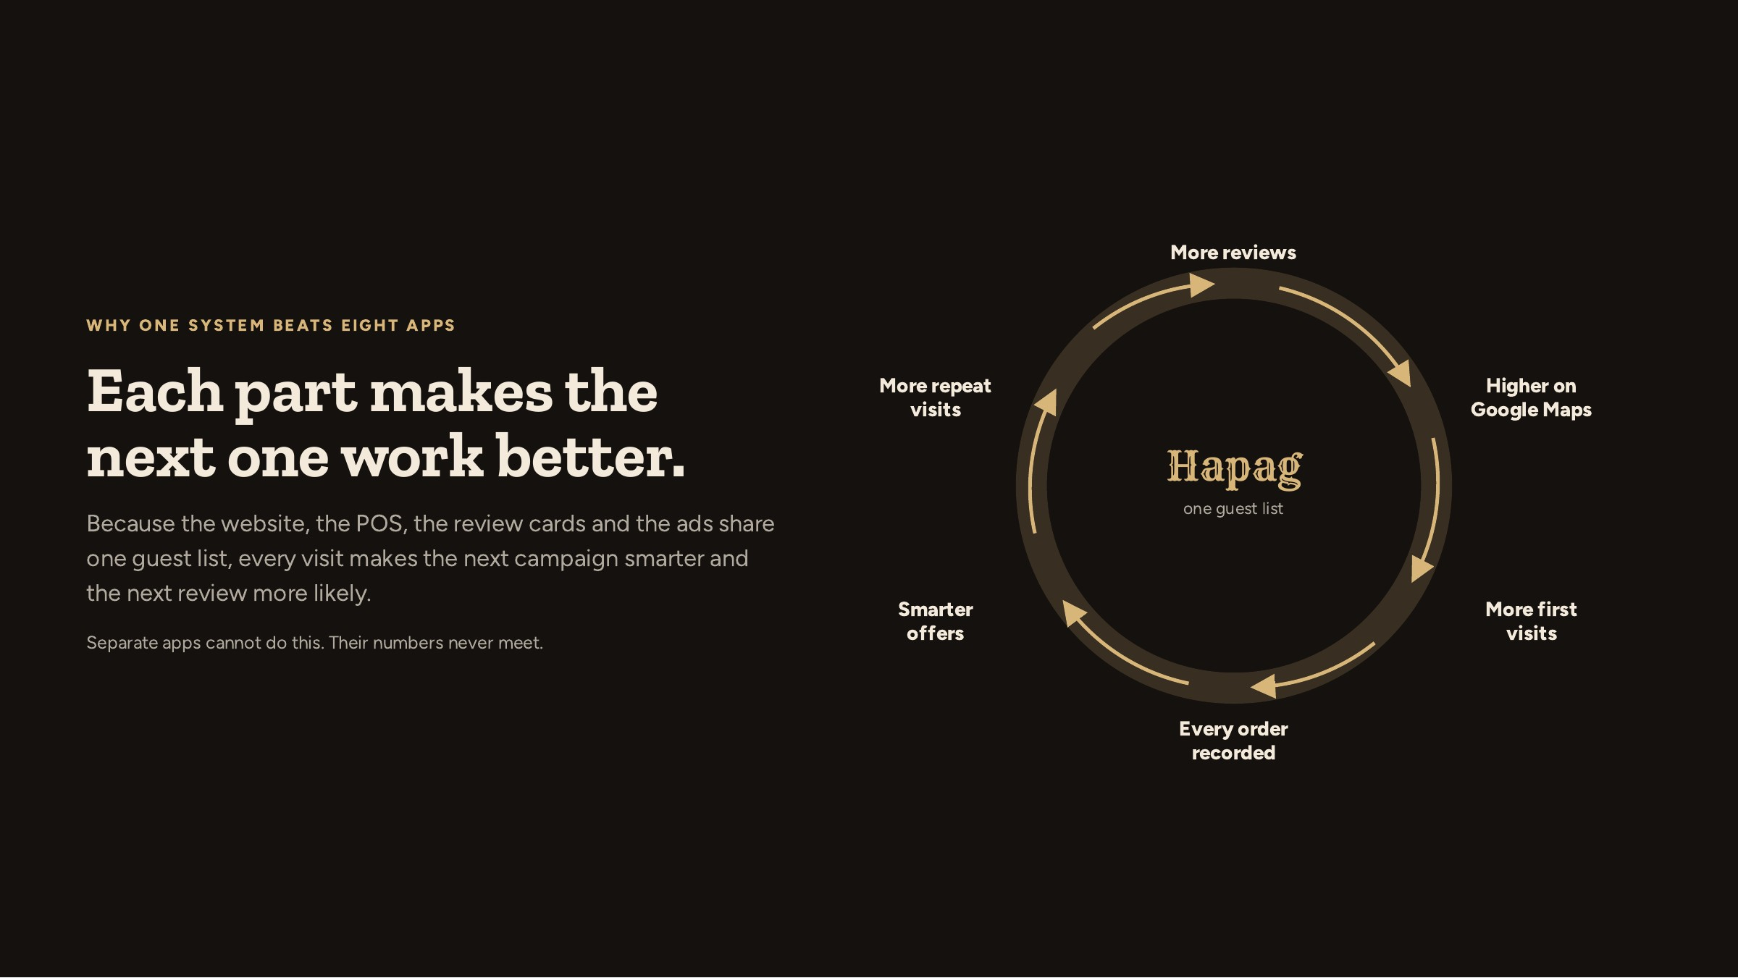
Notes:
Spend a minute here. This is why a combined system is worth more than buying a POS from one company and ads from another.

Slide 16
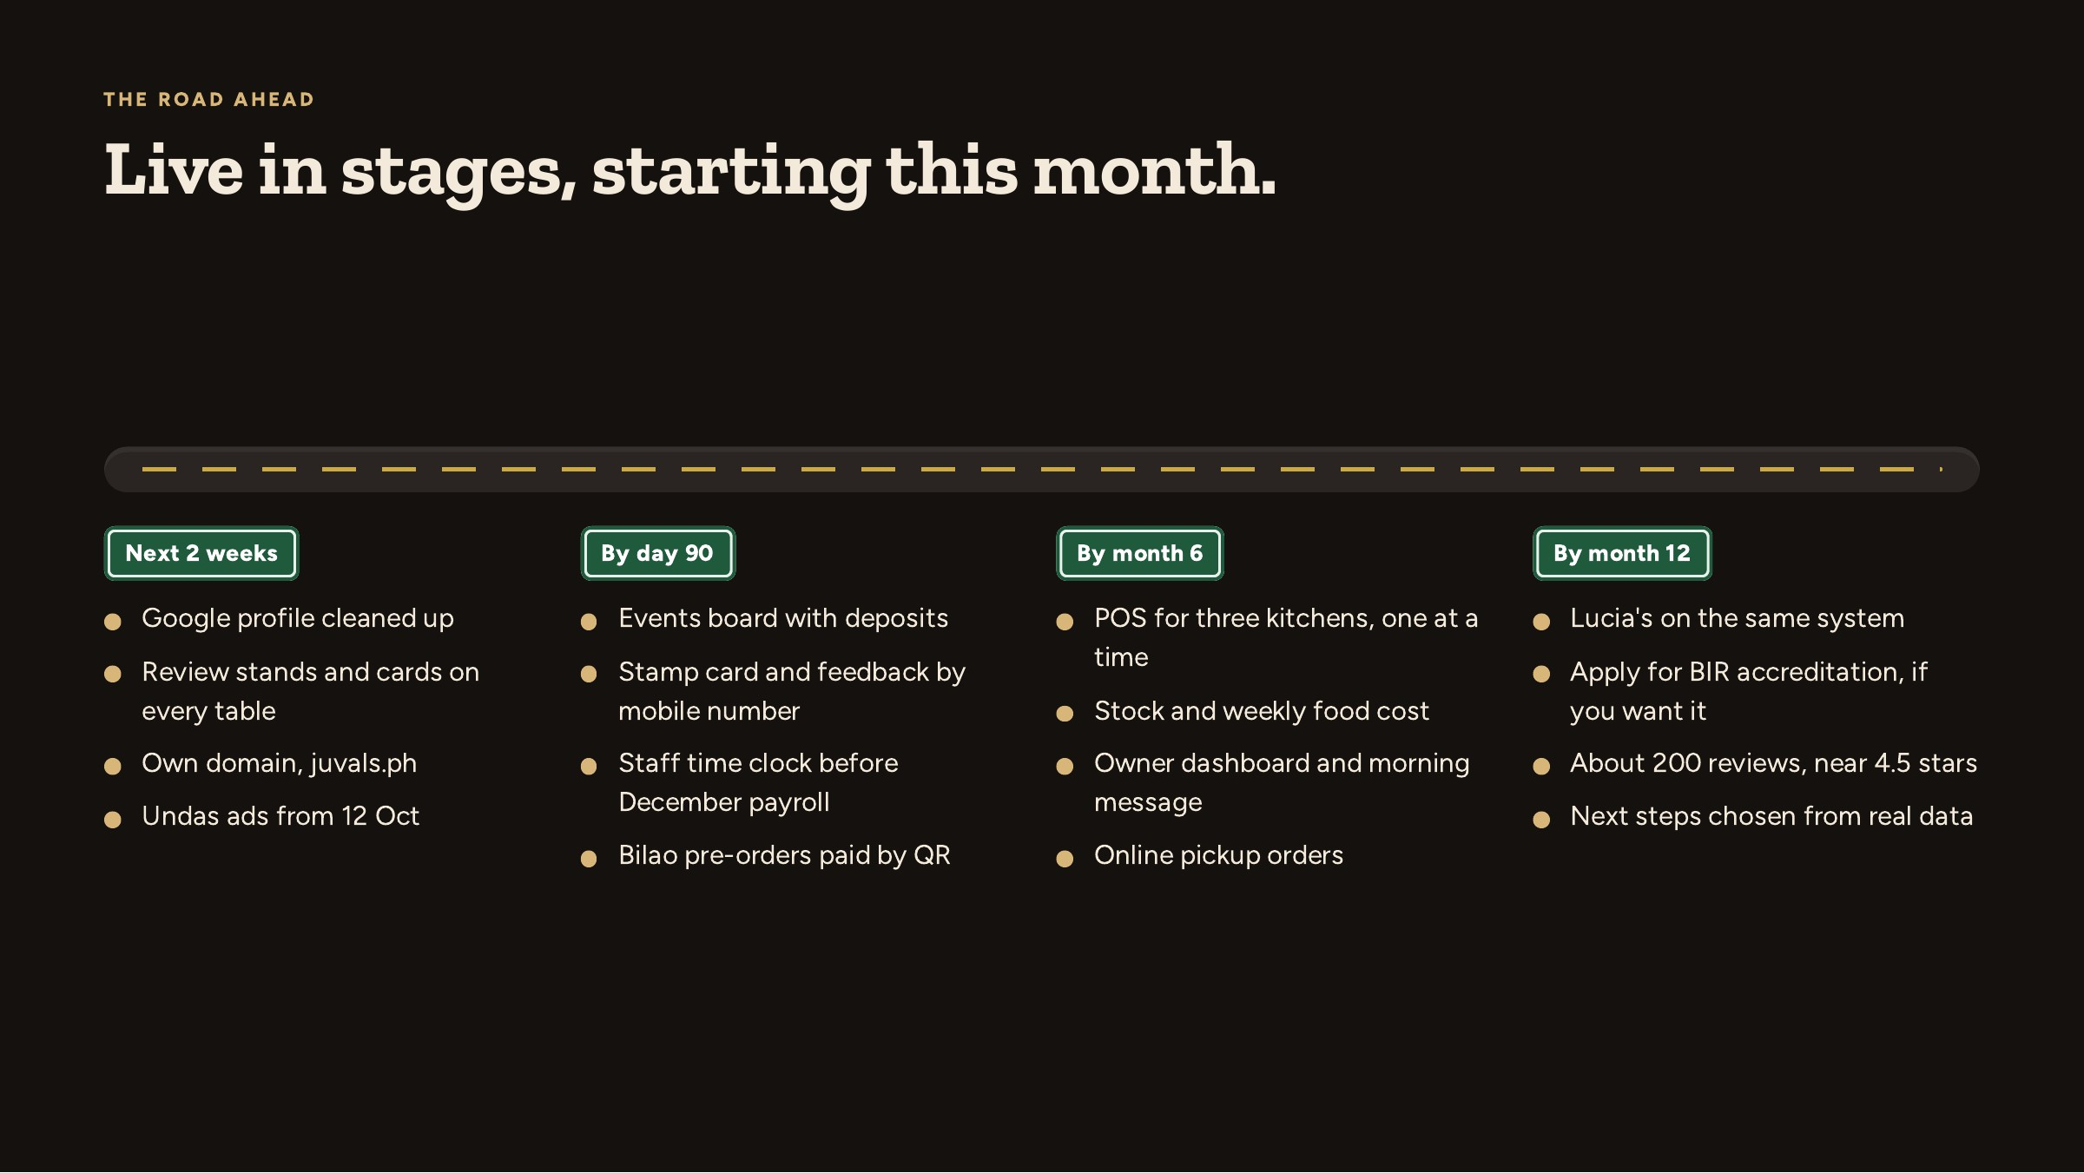
Notes:
Stage by stage. Each stage starts only when the one before it is used by the staff.

Slide 17
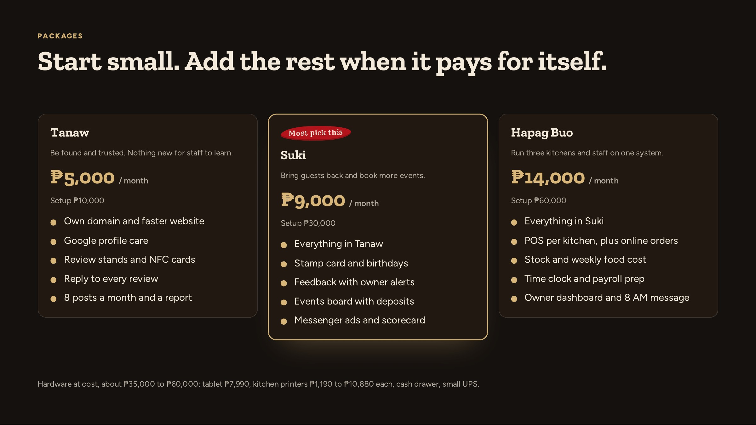
Notes:
Presenter only, not in the client PDF. Prices are starting points; ad spend and payment fees are paid by Juval's directly.

Slide 18
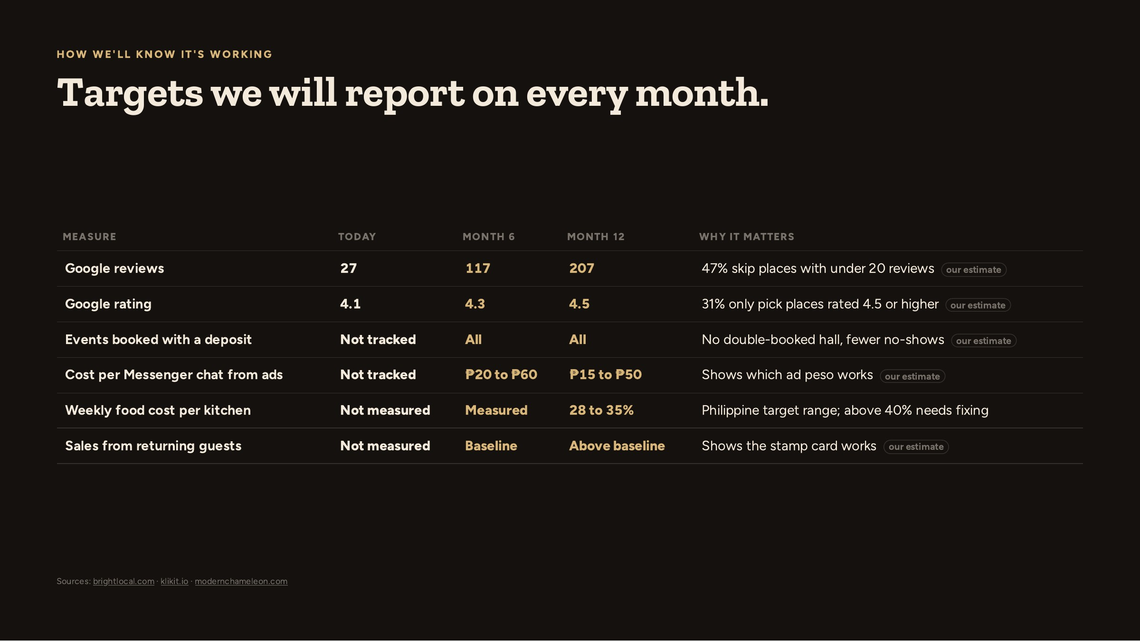
Notes:
Targets are our estimates. We agree the starting numbers together in week one and report against them monthly.

Slide 19
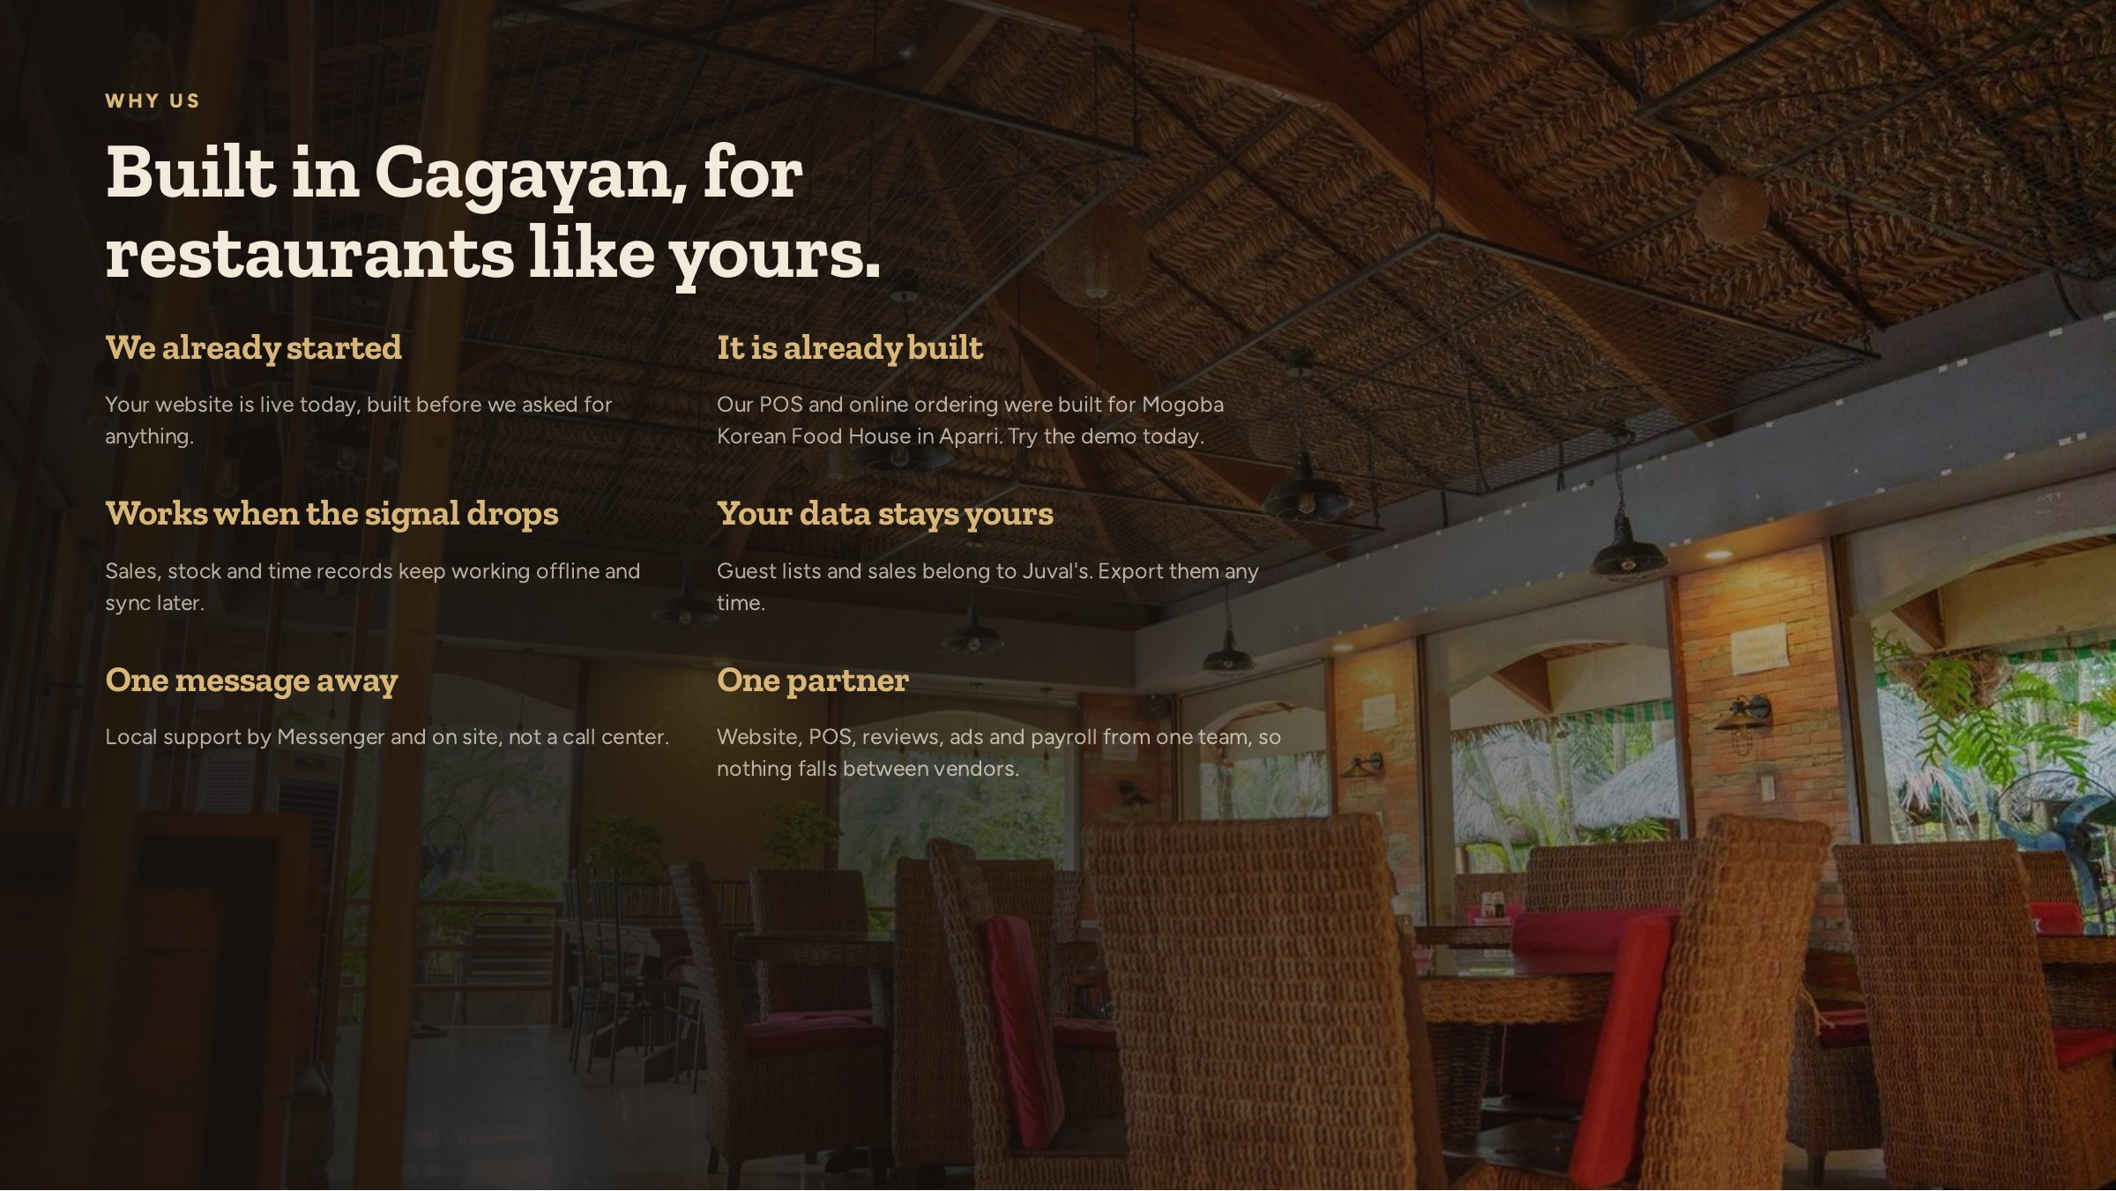
Notes:
Keep it short. Then move to next steps.

Slide 20
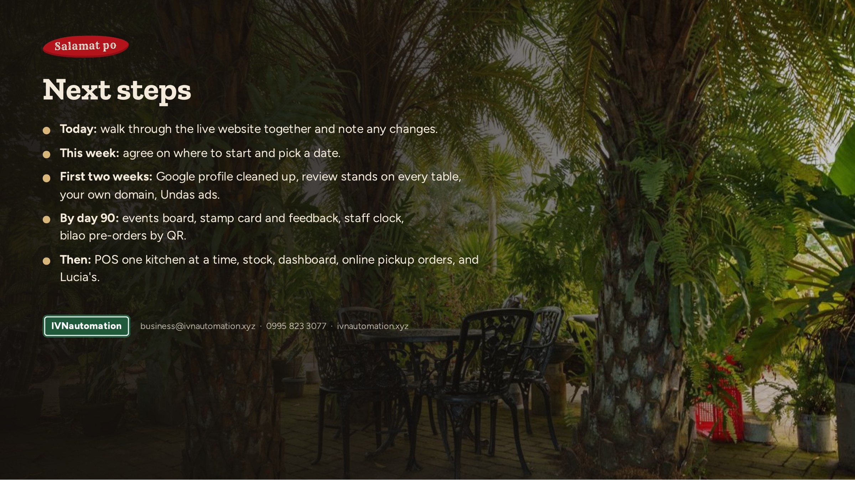
Notes:
Ask for the start date, not for a yes. Offer the two-week review-card pilot as the low-risk first step.

