Slide 1







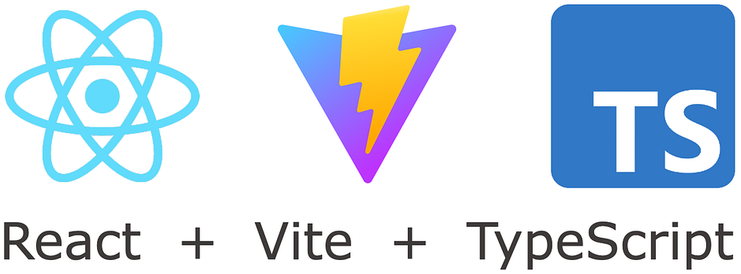


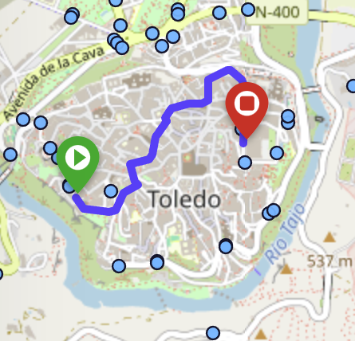
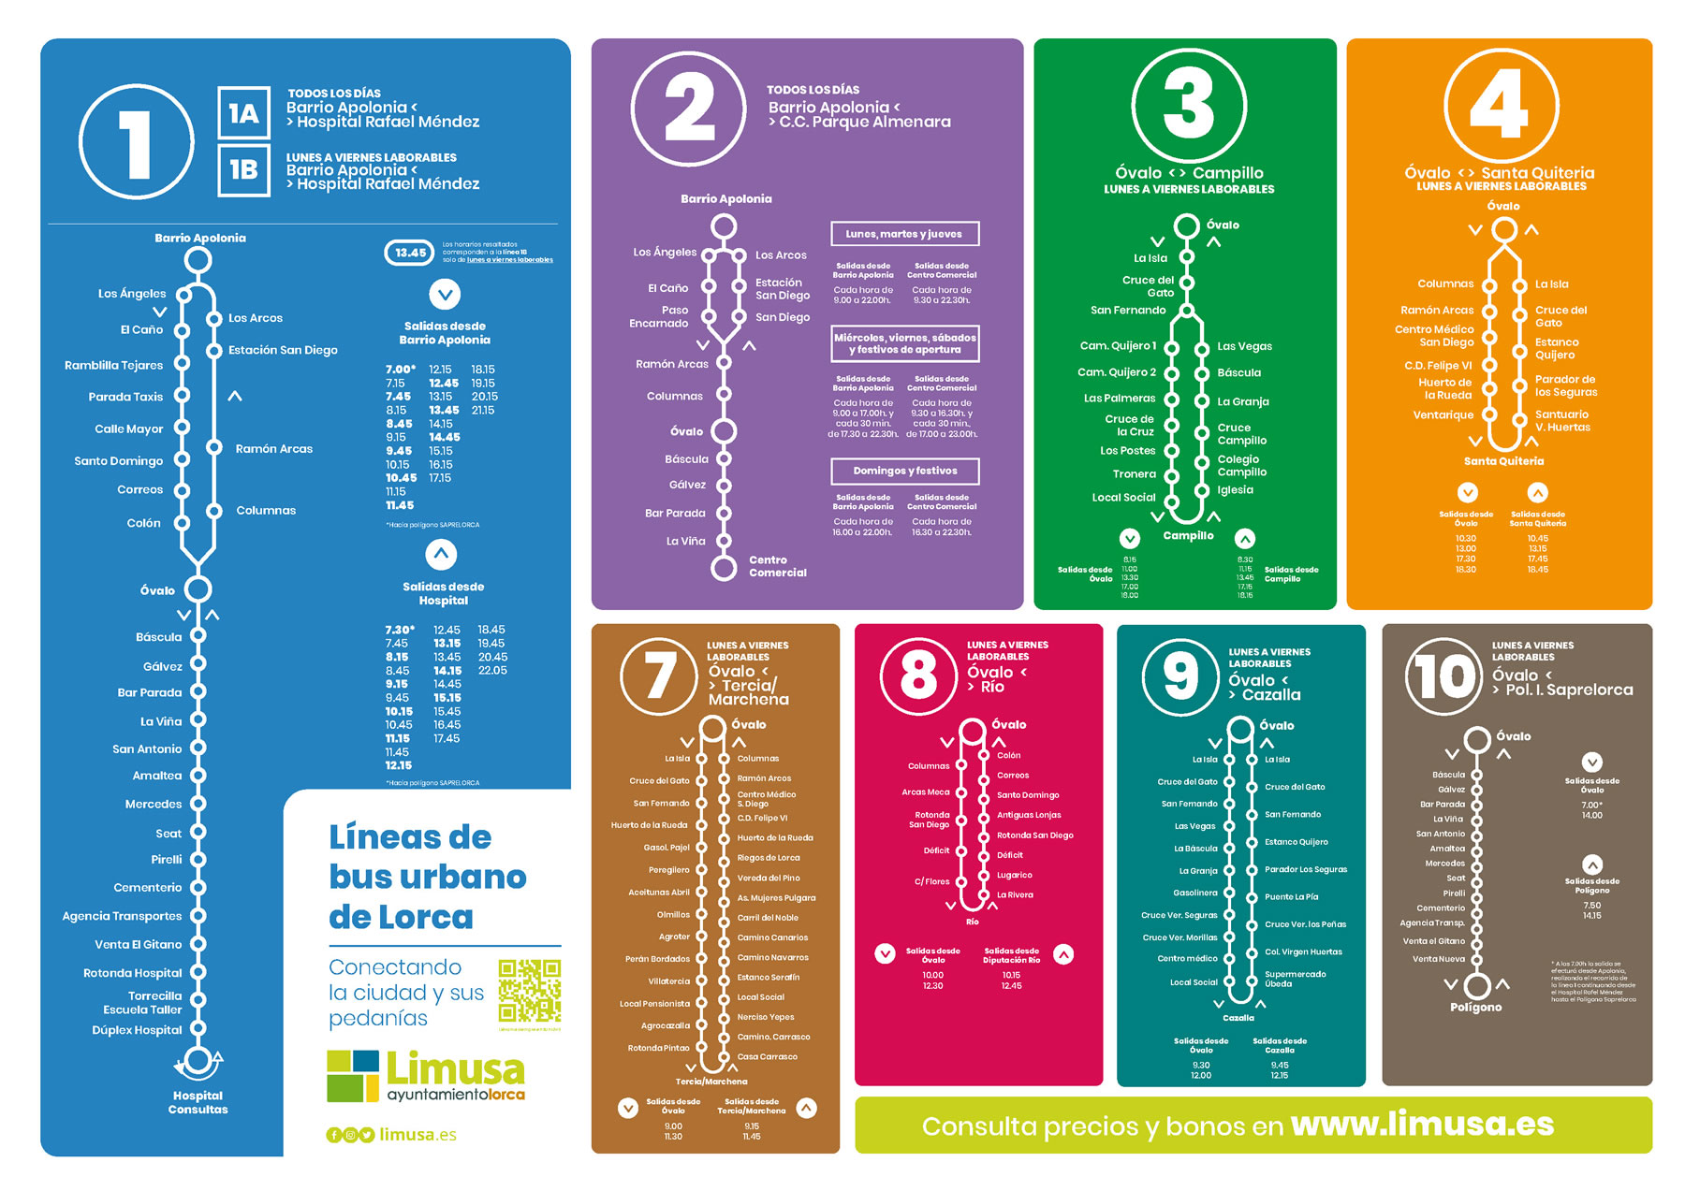





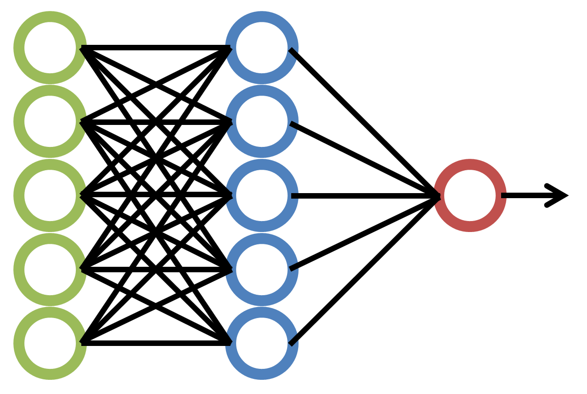




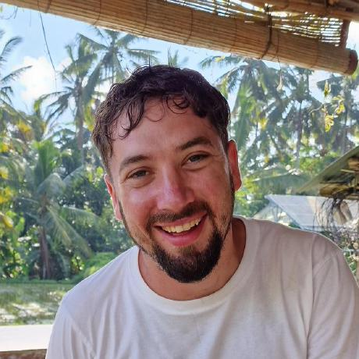
Arquitectura del Simulador de Movilidad Urbana
docker-compose
Fuentes de datos
frontend
backend
Castilla-La Mancha
:5173
:8000
osrm-car
:5000
Usuario
osrm-backend
osrm-bike
:latest
CLM.osm.pbf
:5001
osrm-extract (×3)
/api/osrm
osrm-foot
Grafos OSRM
car / bike / foot
:5002
/api/otp
otp
OpenTripPlanner
graph.obj
:8080
OTP
Multimodal Trip Planning
OTP build
Feed GTFS
stops.txt · routes.txt · trips.txt
/api/gtfs
Descargar GTFS
Bus Urbano Toledo
/predict
/train
/api/lpmc
Dataset LPMC Hillel et al. 2018 – Londres

