Slide 1
NATIVE OCI STREAMING · OCTOBER 2026
HeatWave Audit Center
Capture selected row changes. Preserve their context.
Recover with full offsets and validated GTID boundaries.
Oracle Linux 9 · OCI · Source and target HeatWave
Oracle-style project presentation; not an Oracle publication or endorsement.
Notes:
Purpose: explain the solution, capture mechanics, architecture, UI search and current delivery boundaries. All screenshot business records in this deck are illustrative.

Slide 2
IMPORTANT INFORMATION
Safe harbor statement
The following is intended to outline our general product direction. It is intended for information purposes only, and may not be incorporated into any contract. It is not a commitment to deliver any material, code, or functionality, and should not be relied upon in making purchasing decisions. The development, release, timing, and pricing of any features or functionality described for Oracle’s products may change and remains at the sole discretion of Oracle Corporation.
HeatWave Audit Center | Technical overview
02
Notes:
Required supplied Safe harbor statement, reproduced verbatim.

Slide 3
BACKGROUND
A current row cannot explain its history
What happened to
order 1042?
•
Capture committed INSERT, UPDATE and DELETE events.
•
Keep BEFORE / AFTER values with source evidence.
Current value: status = paid
•
Search a server, table and primary key for its history.
A row alone does not show the previous value,
the sequence of changes or a deleted state.
HeatWave Audit Center | Technical overview
03
Notes:
Illustrative order example. The application is a change-history store and control plane, not merely a replica that overwrites each previous row state.

Slide 4
CHALLENGES AND SOLUTION
Capture quality and recovery determine trust
Challenge | Solution in the audit design
Incomplete row images | Validate ROW + FULL logging and complete JSON values before capture.
Retries and service outages | Durable queue/state, target commit before acknowledgement, event deduplication.
Long histories and slow searches | Row-key index for lookup; monthly partitions for time ranges and retention.
Changing structure and permissions | Separate row, schema and security evidence; display unknown or partial coverage.
HeatWave Audit Center | Technical overview
04
Notes:
Solution-design mapping. Source readiness rules and proof boundaries: https://dev.mysql.com/doc/refman/8.4/en/replication-options-binary-log.html ; https://debezium.io/documentation/reference/3.4/connectors/mysql.html. Indexing, partitioning and typed evidence are application design choices.

Slide 5
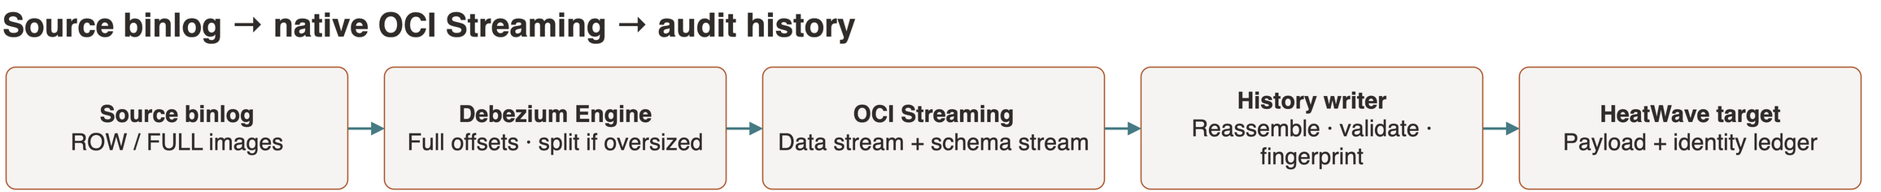
SOLUTION OVERVIEW
One flow connects source changes to audit history
A selected source scope feeds native Streaming; audit history retains the observed changes.
CAPTURE
BUFFER
PRESERVE
Embedded Debezium Engine
and OCI Java SDK.
Native OCI Streaming
retains the delivery buffer.
Python OCI SDK writer
commits audit evidence.
HeatWave Audit Center | Technical overview
05
Notes:
Logical data-flow diagram, separate from network deployment. Editable source: internal_doc/diagrams/presentation-data-flow.drawio. Official OCI HeatWave, Container and Streaming assets. The official generic Container symbol represents OCI Container Instances running Debezium and the history writer.

Slide 6
CAPTURE MECHANICS
MySQL supplies the BEFORE and AFTER images
Debezium decodes the row event; it does not reconstruct the old value with a later SELECT.
SOURCE SETTINGS
Operation | BEFORE | AFTER
INSERT | null | Inserted row
UPDATE | Old row | New row
DELETE | Deleted row | null
SNAPSHOT | null | Current baseline
binlog_format = ROW
binlog_row_image = FULL
binlog_row_value_options = ''
Retain binlogs beyond the recovery window.
App check: more than 3 days; initial advice: 7 days.
A snapshot cannot recover earlier changes.
HeatWave Audit Center | Technical overview
06
Notes:
Primary sources: https://dev.mysql.com/doc/refman/8.4/en/replication-options-binary-log.html ; https://debezium.io/documentation/reference/3.4/connectors/mysql.html. FULL preserves all available columns; disable PARTIAL_JSON for complete JSON update images. Global session-variable changes require writer reconnection and a controlled test. Missing historical images cannot be reconstructed from incomplete or purged binlogs.

Slide 7
HOW DATA MOVES
The event carries values and an evidence trail
Illustrative UPDATE excerpt; the full envelope also carries schema and source coordinates.
{
"op": "u",
"before": {
"id": 1042, "status": "new"
},
"after": {
"id": 1042, "status": "paid"
},
"source": { "db": "demo_sales", "table": "orders" }
}
PROCESSOR CONTRACT
•
Validate the registered table and complete images.
•
Compute row, image and event fingerprints.
•
Commit target history before acknowledging the queue.
HeatWave Audit Center | Technical overview
07
Notes:
Simplified illustrative Debezium envelope; production events also carry source coordinates, timestamps and converter/type metadata. Application write ordering is implemented in modules/events.py and worker.py. https://debezium.io/documentation/reference/3.4/connectors/mysql.html

Slide 8
CAPTURE TO SEARCHABLE HISTORY
Preserve the images and their capture context
The processor appends each event; a later source SELECT cannot recover an overwritten value.
PRESERVE EACH EVENT
FIND THE ROW AGAIN
•
Store BEFORE / AFTER, table, key and schema context.
•
Enter the complete primary key as typed JSON.
•
Keep source coordinates and event time with the images.
•
Compute the same keyed fingerprint used at ingestion.
•
Commit history and the dedup ledger before queue acknowledgement.
•
Use the row-history index and a bounded time range.
Missing or purged binlogs create a coverage gap. A new snapshot establishes a baseline; it does not restore lost history.
HeatWave Audit Center | Technical overview
08
Notes:
Current implementation: modules/events.py, modules/heatwave.py, modules/audit_service.py and worker.py. HMAC namespace includes source identity, source schema/table and canonical JSON key. Schema document/fingerprint is retained when the converter supplies schema metadata. Event source coordinates support DML replay deduplication; failover and row-key aliases need acceptance validation. https://debezium.io/documentation/reference/3.4/connectors/mysql.html

Slide 9
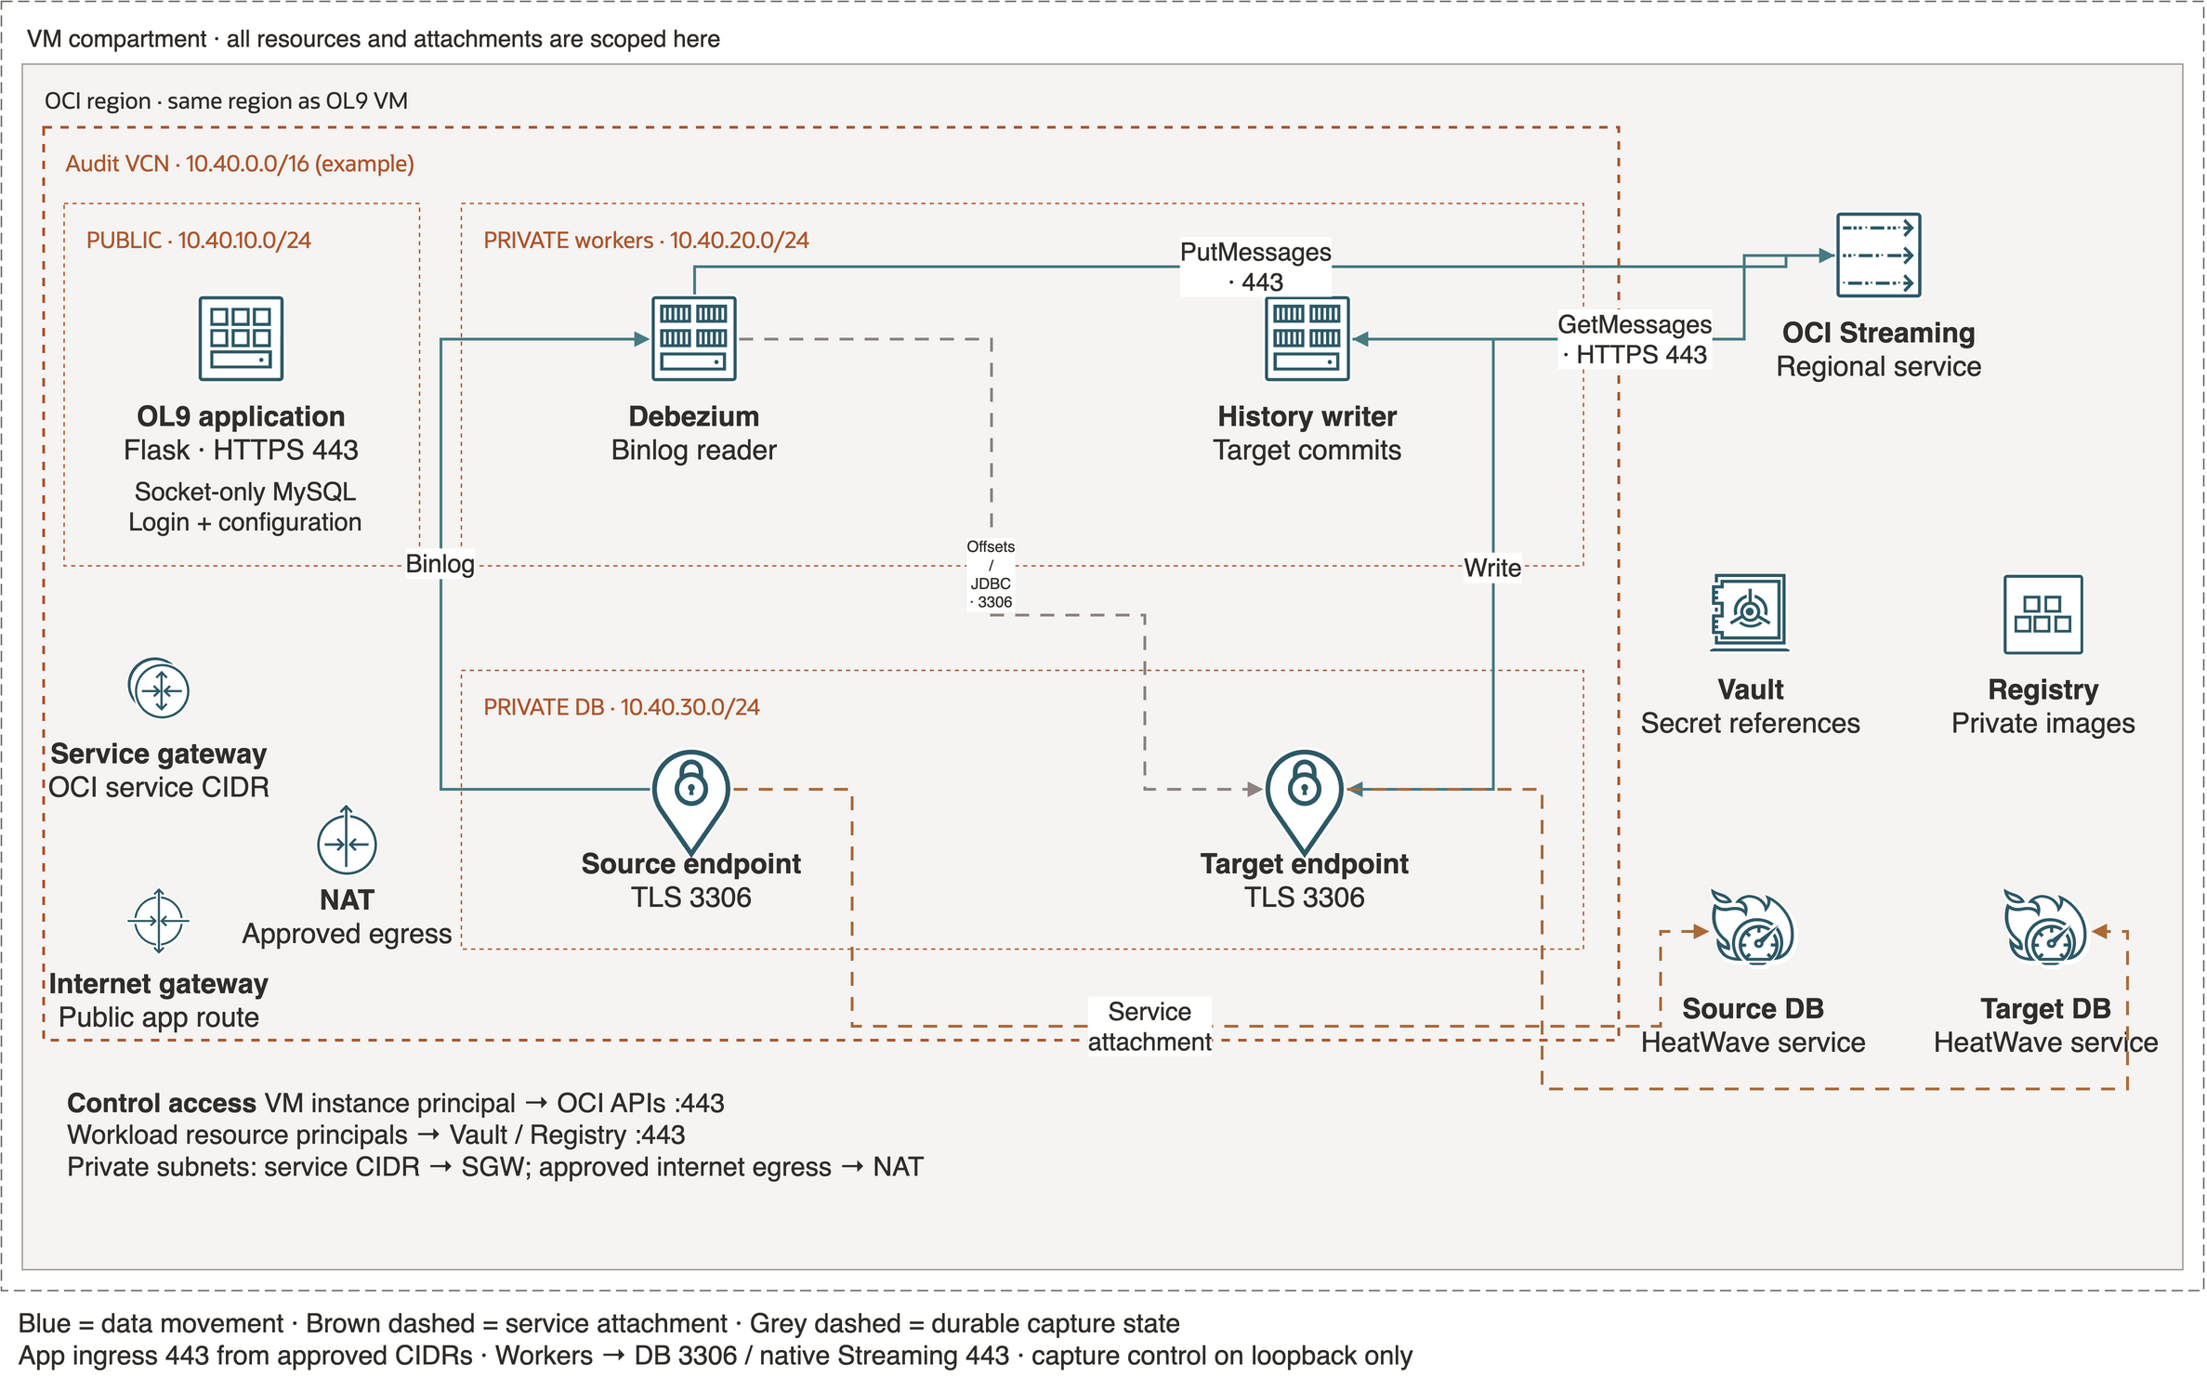
NATIVE OCI DEPLOYMENT
Private workloads, scoped regional services
Reference topology with example CIDRs; resources and attachments remain in the VM compartment.
HeatWave Audit Center | Technical overview
09
Notes:
Architecture uses official OCI Library and HeatWave toolkit assets. All boundary containment is preserved in editable source: internal_doc/diagrams/presentation-kafka-network.drawio. Broker endpoint uses official private endpoint icon; generic Container glyph represents OCI Container Instances for Debezium and the processor. Debezium initiates source replication TCP 3306; the source streams changes over that established connection. Managed Kafka broker access uses private subnets. https://www.oracle.com/uk/cloud/apache-kafka/faq/ ; https://docs.oracle.com/en-us/iaas/Content/kafka/security-sasl.htm

Slide 10
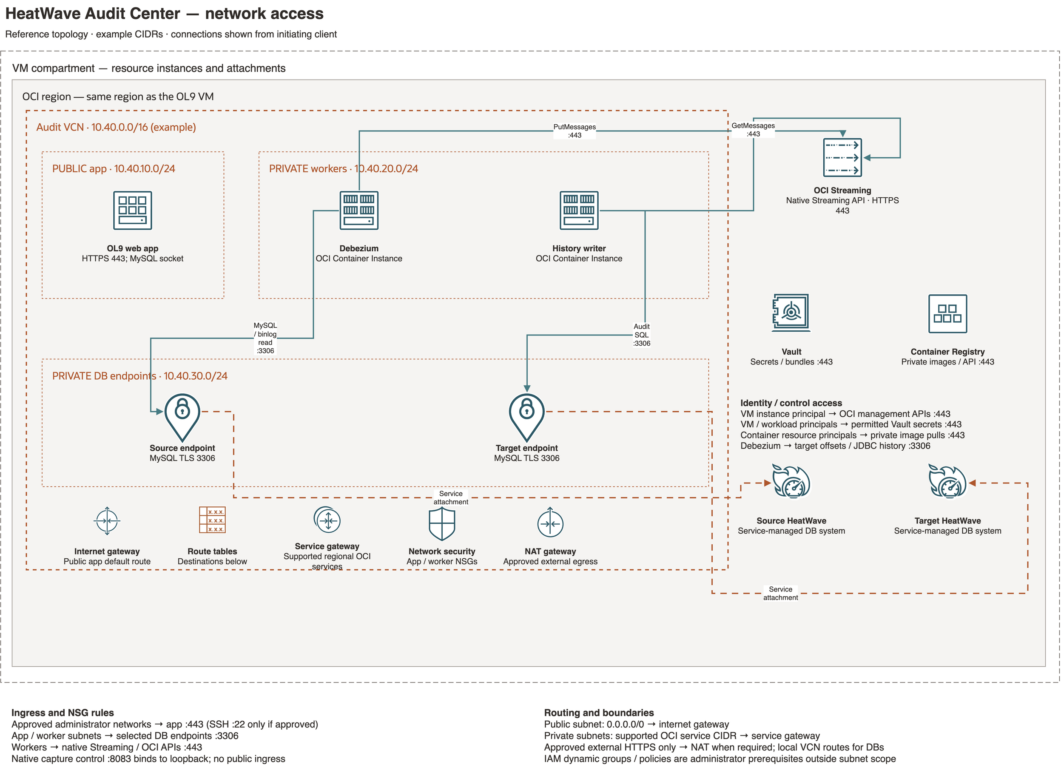
CONNECTIVITY AND RECOVERY STATE
Native HTTPS messaging; MySQL for source and state
Clients initiate the shown connections. Full offsets and JDBC history still depend on the target.
HeatWave Audit Center | Technical overview
10
Notes:
Editable source: internal_doc/diagrams/presentation-streaming-network.drawio. OCI Streaming differs from managed Kafka: ordinary stream retention is 24 hours to 7 days, message limit 1 MB; normal streams are not a lifetime schema-history archive. Harness internal topics are for Connect config/offset/status only. JDBC schema history requires tested driver/storage JARs and target access. https://docs.oracle.com/en-us/iaas/Content/Streaming/Tasks/kafkacompatibility.htm ; https://docs.oracle.com/en-us/iaas/Content/Streaming/Tasks/kafkacompatibility_topic-Kafka_Connect.htm ; https://docs.oracle.com/en-us/iaas/Content/Streaming/Concepts/streamingoverview_topic-Limits_on_Streaming_Resources.htm ; https://debezium.io/documentation/reference/3.4/configuration/storage.html

Slide 11
SOURCE SCOPES
Choose the source scope explicitly
Source selection | Capture contract
sales.orders | One named base table with a complete stable primary key.
sales.* | Eligible current and newly discovered tables in one database.
*.* | Eligible tables across databases; exclude system and audit schemas.
Inventory boundary | At most 1,000 current tables; keyless or unsafe scopes stop for review.
HeatWave Audit Center | Technical overview
11
Notes:
Solution-design mapping. Source readiness rules and proof boundaries: https://dev.mysql.com/doc/refman/8.4/en/replication-options-binary-log.html ; https://debezium.io/documentation/reference/3.4/connectors/mysql.html. Indexing, partitioning and typed evidence are application design choices.

Slide 12
TARGET LAYOUT
Choose where each table’s history lands
Target grouping | Physical audit layout
By flow | One audit table for every included source table.
By source database | One generated audit table per actual source database.
By source table | One generated audit table per database/table pair.
Continuity | All destinations stay in the selected target schema; routes and claims persist.
HeatWave Audit Center | Technical overview
12
Notes:
Solution-design mapping. Source readiness rules and proof boundaries: https://dev.mysql.com/doc/refman/8.4/en/replication-options-binary-log.html ; https://debezium.io/documentation/reference/3.4/connectors/mysql.html. Indexing, partitioning and typed evidence are application design choices.

Slide 13
INITIAL CAPTURE
Choose a baseline without an unwanted row scan
Initial capture | Source behavior
End · default | Read schema metadata, then capture new changes; no current-row copy.
Start | Query current source rows for a snapshot, then follow the binlog.
Specific GTID | Establish schema, then follow transactions after the processed set.
Existing wildcard flow | Restart from full saved offsets; historical repositioning is disabled.
HeatWave Audit Center | Technical overview
13
Notes:
Solution-design mapping. Source readiness rules and proof boundaries: https://dev.mysql.com/doc/refman/8.4/en/replication-options-binary-log.html ; https://debezium.io/documentation/reference/3.4/connectors/mysql.html. Indexing, partitioning and typed evidence are application design choices.

Slide 14
GTID BOUNDARIES
The GTID set describes what is already processed
A row event’s source.gtid identifies its transaction; it is not the complete recovery offset.
UUIDS AND INTERVALS
RETENTION AND ORDER
•
One UUID can contain several transaction intervals.
•
Require purged ⊆ selected ⊆ executed.
•
One set can contain several server UUID groups.
•
Every transaction still needed must remain retained.
•
Example: UUID-A:1-32:40-45, UUID-B:1-18.
•
Also prove a supported ordered cut and schema coverage.
Already-processed purged transactions belong in the selected set. A transaction that still needs capture cannot have been purged.
HeatWave Audit Center | Technical overview
14
Notes:
Current implementation: modules/events.py, modules/heatwave.py, modules/audit_service.py and worker.py. HMAC namespace includes source identity, source schema/table and canonical JSON key. Schema document/fingerprint is retained when the converter supplies schema metadata. Event source coordinates support DML replay deduplication; failover and row-key aliases need acceptance validation. https://debezium.io/documentation/reference/3.4/connectors/mysql.html

Slide 15
DEBEZIUM RECOVERY
Bootstrap schema once; preserve full offsets
Specific GTID initialization avoids scanning the current business rows.
INITIALIZATION
RESTART
•
Check the chosen set and supported source schema boundary.
•
Retain file, position, event, row and GTID progress.
•
Publish schema evidence from the schema-only phase.
•
Retain JDBC history, stream IDs and target checkpoints.
•
Require durable publication progress before normal streaming.
•
Keep source lineage and the same fingerprint key.
A GTID string alone can lose progress within a transaction. Ordinary Start/Resume and image updates keep the complete checkpoint.
HeatWave Audit Center | Technical overview
15
Notes:
Current implementation: modules/events.py, modules/heatwave.py, modules/audit_service.py and worker.py. HMAC namespace includes source identity, source schema/table and canonical JSON key. Schema document/fingerprint is retained when the converter supplies schema metadata. Event source coordinates support DML replay deduplication; failover and row-key aliases need acceptance validation. https://debezium.io/documentation/reference/3.4/connectors/mysql.html

Slide 16
STAGING AND AVAILABILITY
Streaming absorbs a temporary apply delay
The retained stream lets publishing and target apply progress at different speeds.
DURABLE BUFFER
CURRENT DEPENDENCY
•
Keep queued changes while the writer is stopped or slow.
•
Capture offsets also live in the target database.
•
Resume consumption after the durable delivery checkpoint.
•
Private JDBC schema history uses that target too.
•
Plan retention for outages and catch-up, not only normal load.
•
A full target outage can therefore pause extraction.
Streaming decouples row apply, but capture is not fully target-independent. Preserve source binlogs for the target-state outage window.
HeatWave Audit Center | Technical overview
16
Notes:
Current implementation: modules/events.py, modules/heatwave.py, modules/audit_service.py and worker.py. HMAC namespace includes source identity, source schema/table and canonical JSON key. Schema document/fingerprint is retained when the converter supplies schema metadata. Event source coordinates support DML replay deduplication; failover and row-key aliases need acceptance validation. https://debezium.io/documentation/reference/3.4/connectors/mysql.html

Slide 17
MESSAGE SIZE
Plan both service and logical event limits
Boundary | Current behavior
OCI message / PUT | Service maximum: 1 MiB. Application batching does not raise it.
Publisher budget | 900,000 estimated encoded bytes including key and overhead.
Logical event | 16 MiB default; configurable from 1 to 64 MiB.
Pending custody | 128 MiB default, up to 1 GiB; target packet/storage limits still apply.
HeatWave Audit Center | Technical overview
17
Notes:
Solution-design mapping. Source readiness rules and proof boundaries: https://dev.mysql.com/doc/refman/8.4/en/replication-options-binary-log.html ; https://debezium.io/documentation/reference/3.4/connectors/mysql.html. Indexing, partitioning and typed evidence are application design choices.

Slide 18
CONDITIONAL FRAGMENTATION
Split oversized events; reassemble before apply
Normal events keep their original key and full envelope in one message.
PUBLISH
REASSEMBLE
•
Measure UTF-8 key/value plus framing overhead.
•
Persist part custody and verify part/full checksums.
•
Split only above the publisher’s encoded byte budget.
•
Write only a complete reconstructed audit event.
•
Acknowledge source progress after all parts are accepted.
•
Release completed blobs; retain compact replay receipts.
Interrupted source attempts can leave incomplete generations. Custody is bounded; reconcile retained evidence before explicit cleanup.
HeatWave Audit Center | Technical overview
18
Notes:
Current implementation: modules/events.py, modules/heatwave.py, modules/audit_service.py and worker.py. HMAC namespace includes source identity, source schema/table and canonical JSON key. Schema document/fingerprint is retained when the converter supplies schema metadata. Event source coordinates support DML replay deduplication; failover and row-key aliases need acceptance validation. https://debezium.io/documentation/reference/3.4/connectors/mysql.html

Slide 19
REQUEST CONTROL
Batch and pace before retrying
Live fixture: 100 row events + 1 schema event → 2 PUT calls, 101 messages, zero throttles.
PUBLISH FEWER CALLS
READ LESS OFTEN
•
Small events share a PUT request, still as separate messages.
•
Fetch up to 1,000 records per GET by default.
•
Bound batches by both record count and encoded bytes.
•
Back off empty polls; pace reads by returned bytes.
•
Smooth byte volume and call rate independently per stream.
•
Share Control Center status checks across web workers.
Bounded retries remain fallback handling. A functional burst result is not a general throughput or latency benchmark.
HeatWave Audit Center | Technical overview
19
Notes:
Current implementation: modules/events.py, modules/heatwave.py, modules/audit_service.py and worker.py. HMAC namespace includes source identity, source schema/table and canonical JSON key. Schema document/fingerprint is retained when the converter supplies schema metadata. Event source coordinates support DML replay deduplication; failover and row-key aliases need acceptance validation. https://debezium.io/documentation/reference/3.4/connectors/mysql.html

Slide 20
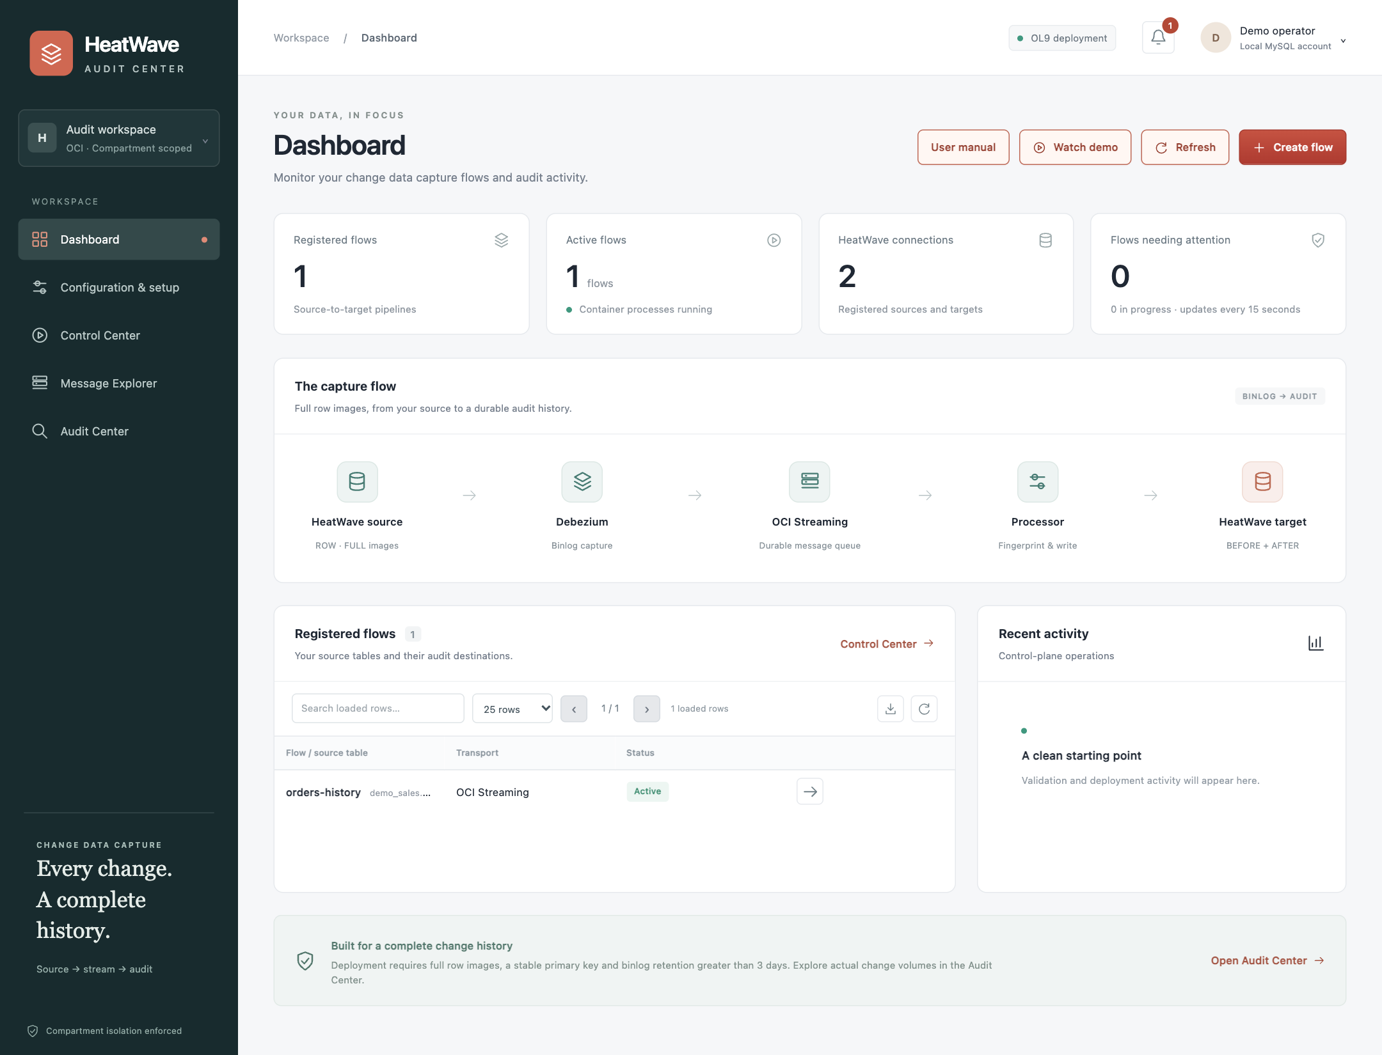
APPLICATION OVERVIEW
The dashboard gives operators a starting point
Application preview with illustrative records; no live CDC result is implied.
FIVE WORK AREAS
•
Dashboard
•
Configuration & setup
•
Control Center
•
Message Explorer
•
Audit Center
HeatWave Audit Center | Technical overview
20
Notes:
Screenshot: repository dashboard.html rendered in an isolated local preview using one illustrative registered flow. KPI counts and activity are fixture data; not measurements from the deployed customer system.

Slide 21
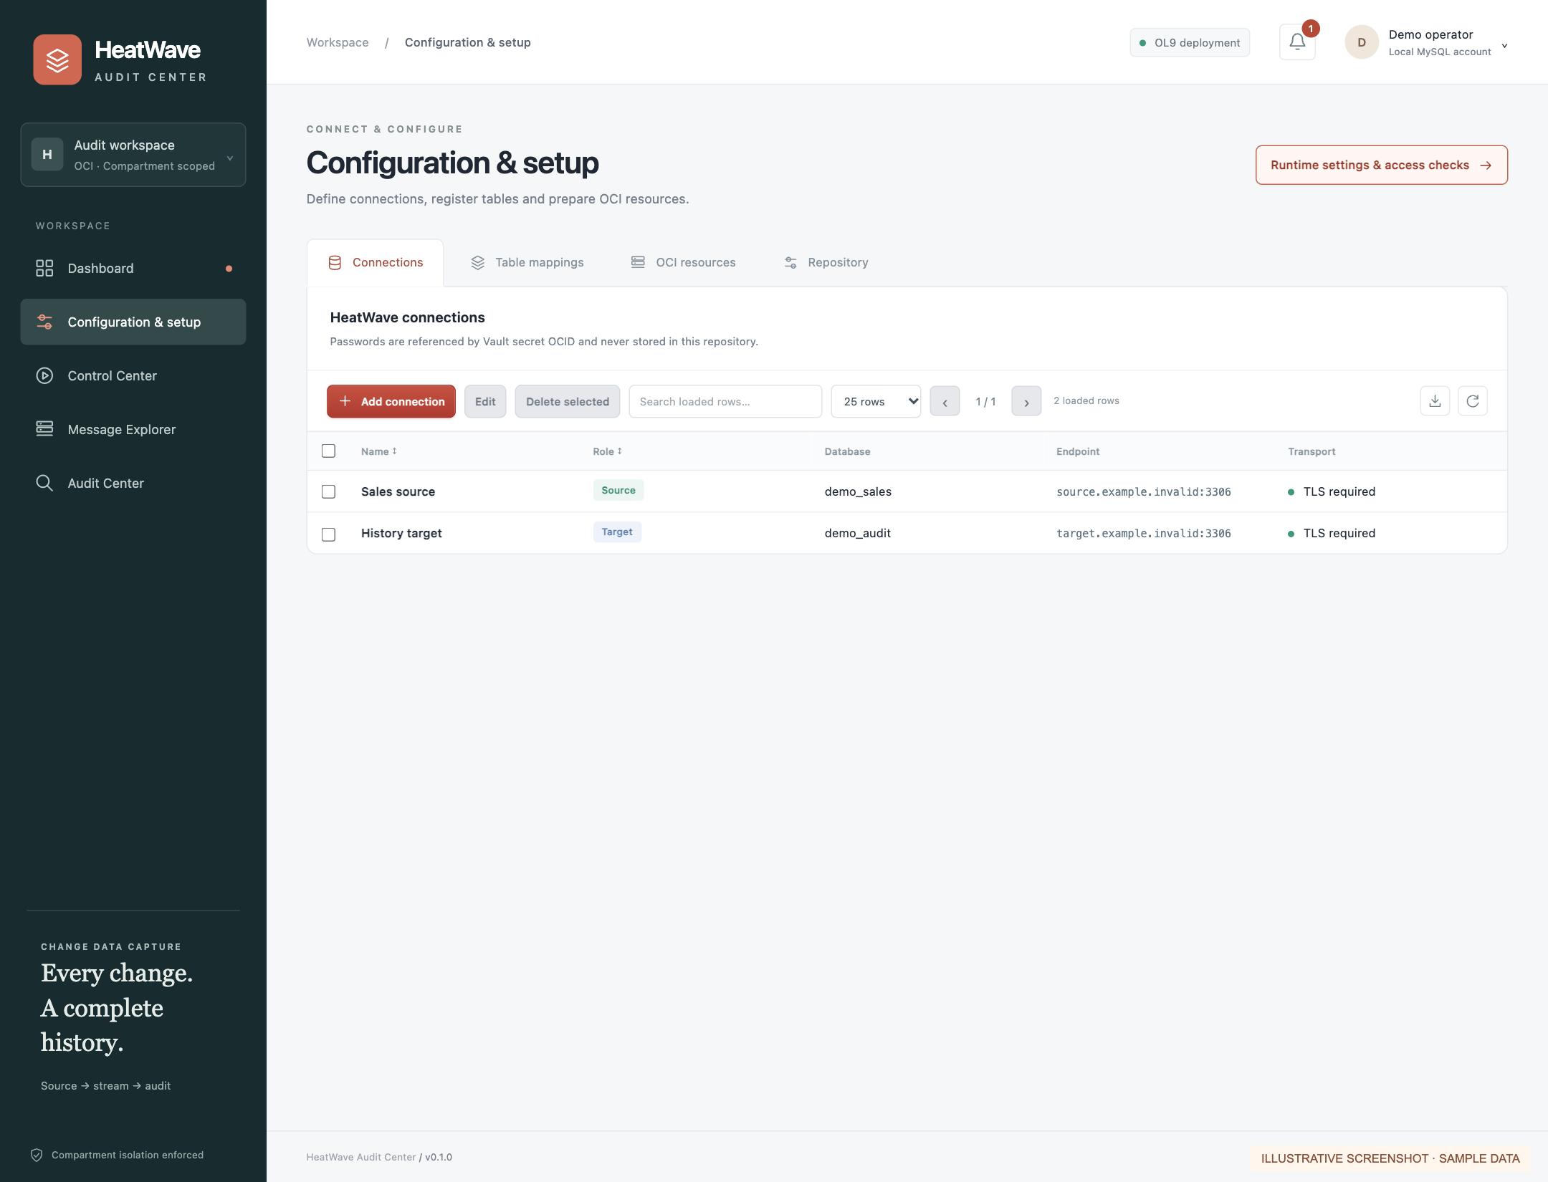
CONFIGURATION AND SETUP
Register the path before deploying capture
Vault-backed connections, source scopes, native streams and target grouping define each flow.
SETUP SEQUENCE
•
Register source and target.
•
Choose scope and target layout.
•
Run live source checks.
•
Deploy only when ready.
HeatWave Audit Center | Technical overview
21
Notes:
Screenshot uses the actual shared table implementation, with synthetic source/target endpoints under example.invalid. Passwords are not included. Tables support checkbox selection, left toolbar actions/search/paging, right download/reset icons and saved resize/reorder/sort.

Slide 22
AUDIT-STORE DESIGN
Fingerprints support lookup, comparison and replay
Fingerprint | Question it answers | How it is used
Row-key fingerprint | Which row is this? | HMAC over source/table identity and canonical key → indexed lookup.
Image fingerprint | Did its contents change? | Compare BEFORE / AFTER content while preserving type/schema context.
Event identity | Have we stored this event? | Source coordinates + lineage; independent ledger rejects replay duplicates.
The same source event can be retried at a new queue offset. Queue offsets alone do not prove a new change.
HeatWave Audit Center | Technical overview
22
Notes:
Application design and implementation: modules/events.py, modules/heatwave.py, modules/audit_service.py. Source-coordinate deduplication is implemented for supported DML coordinates. Full cross-failover identity and snapshot-lineage handling remain acceptance work. Fingerprints are not encryption or proof of immutability.

Slide 23
TARGET AUDIT STORAGE
Partitions manage time; indexes find the row
MONTHLY EVENT TABLES
INDEPENDENT IDENTITY LEDGER
•
Keep complete row images and source metadata.
•
Keep event identity unique across partitions.
•
Partition by UTC event_time with a monthly runway.
•
Write ledger and payload in one target transaction.
•
Use an indexed flow + key hash + event-time path.
•
Grouped cleanup needs coordinated review.
MySQL requires the partition column in every unique key.
New payload tables use PRIMARY KEY (event_time, event_id).
HeatWave Audit Center | Technical overview
23
Notes:
Monthly partition lifecycle pattern reviewed from https://github.com/ivanxma/heatwave_log_archiver/tree/e61b2c4230b728aa7911aba9e2a617df3bda3894. CDC uses source-event identity rather than the archiver’s polled-row timestamp/content fingerprint. MySQL unique key requirement: https://dev.mysql.com/doc/refman/8.4/en/partitioning-limitations-partitioning-keys-unique-keys.html. Real local MySQL validation covered partition DDL, dedup ledger and indexed row-key retrieval; this is not a live HeatWave CDC performance test.

Slide 24
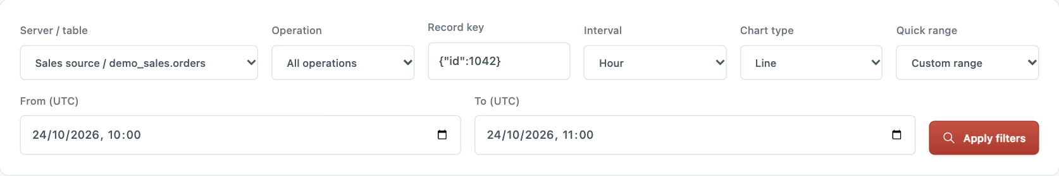
FIND A DATA CHANGE
Search a server, table and complete primary key
Example key: {"id":1042}. For wildcards, select the actual source database and table.
{"id": 1042}
•
Choose the actual source database / table.
•
Enter every primary-key column as JSON.
•
Browse matching events, then compare images.
Lookup path: source + table + key fingerprint → indexed history query → bounded results
HeatWave Audit Center | Technical overview
24
Notes:
Screenshot: actual audit.html controls rendered with illustrative data. Current form accepts a complete primary-key JSON object. Indexed lookup is implemented; full key-definition version and row-lifetime alias handling remains planned. No latency guarantee is claimed.

Slide 25
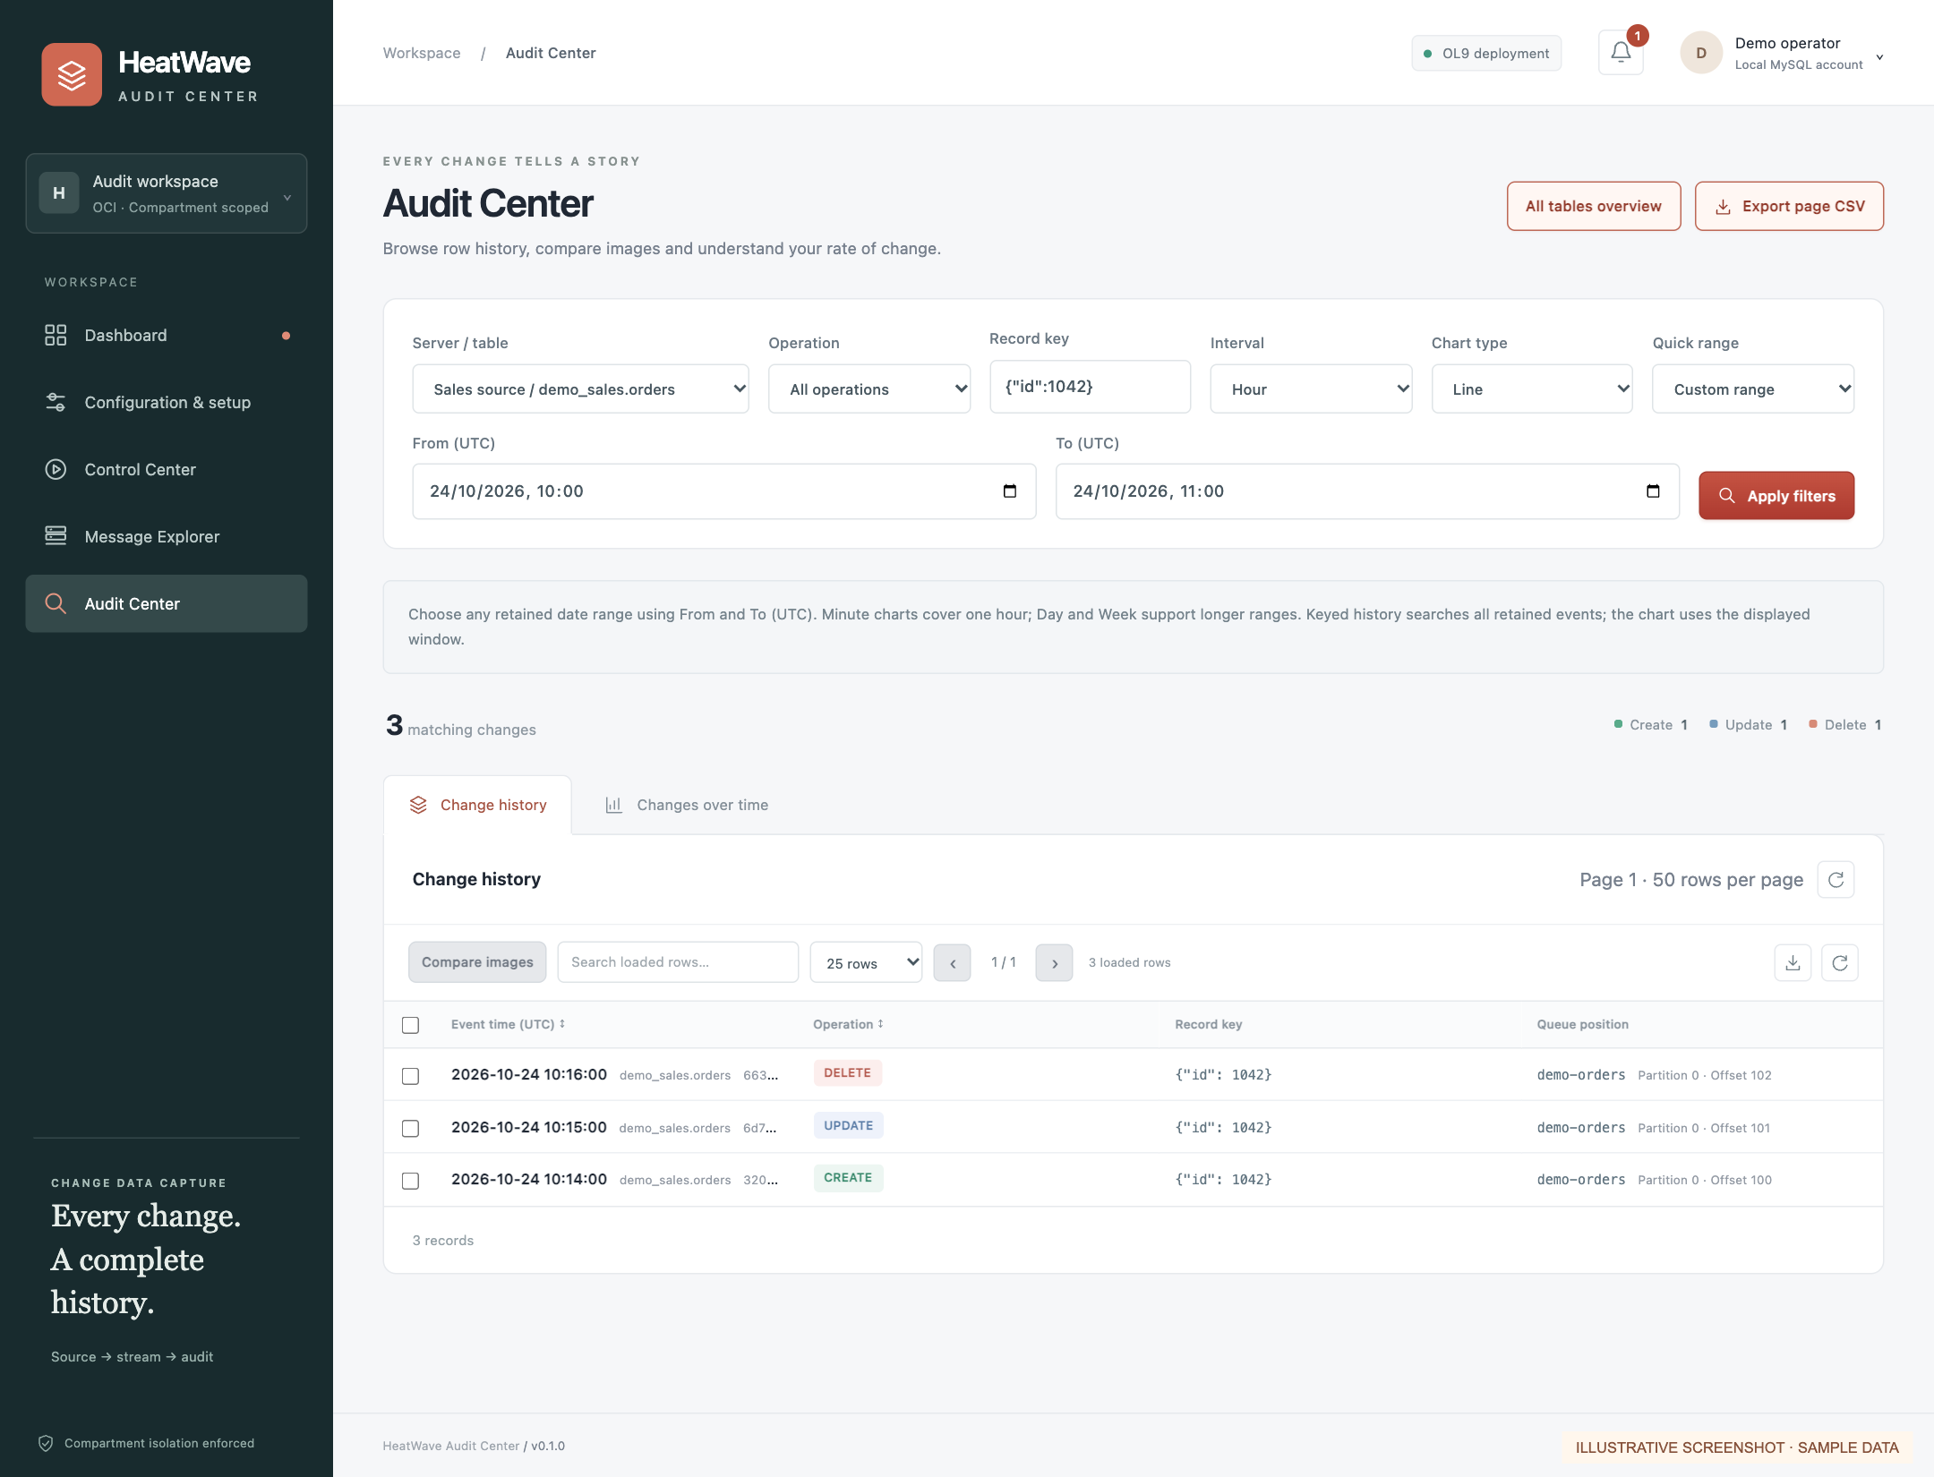
BROWSE THE MATCHING EVENTS
The history list keeps each captured transition
Illustrative order history: CREATE, UPDATE and DELETE, with the same typed row key.
Select one event and choose Compare images. Export selected or loaded matching rows as CSV.
HeatWave Audit Center | Technical overview
25
Notes:
Actual shared table UI with illustrative records. A snapshot is a baseline, not proof of an original INSERT. Stable source ordering and coverage must be considered when interpreting a timeline. Search/chart rows shown here are fixtures, not customer records.

Slide 26
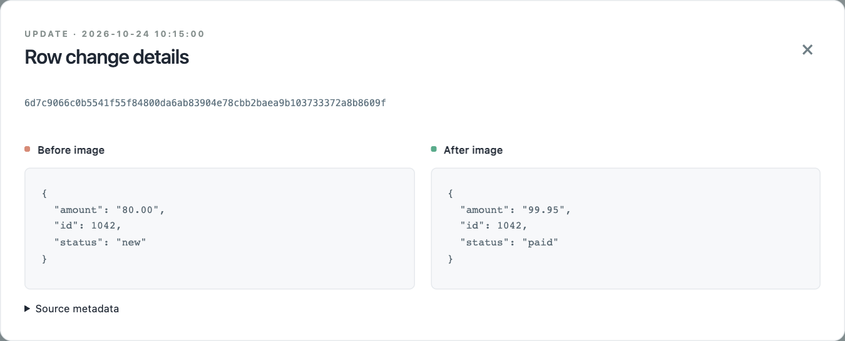
INSPECT THE CHANGE
Compare both images for the same event
The key remains id 1042; status and amount change in this illustrative update.
BEFORE
new · 80.00
AFTER
paid · 99.95
HeatWave Audit Center | Technical overview
26
Notes:
Actual comparison dialog rendered with illustrative data and enlarged JSON text for presentation readability. The UI displays complete stored images and optional source metadata. No production data or credentials appear.

Slide 27
BEYOND BUSINESS ROWS
Structure and security need different evidence
History | What the audience can understand | Evidence boundary
Row change | Old and new values for one captured record. | Committed Debezium row envelopes.
Schema change | Added columns; type/default/index/partition differences. | Baseline + public schema events; detailed properties can be partial.
Privilege or access | Who granted access, role changes and failed attempts. | Separate database audit collector and entitlement observations.
Example: ADD COLUMN x INT → “x added, INT, nullable”; it is a structure event, not an UPDATE to every row.
HeatWave Audit Center | Technical overview
27
Notes:
Public schema history is separate from Debezium private recovery history. MySQL row CDC is not a complete security audit feed. Detailed metadata enrichment and privilege/access collectors remain implementation/validation work. https://debezium.io/documentation/reference/3.4/connectors/mysql.html ; https://docs.oracle.com/en-us/iaas/mysql-database/doc/mysql-enterprise-audit-plugin.html

Slide 28
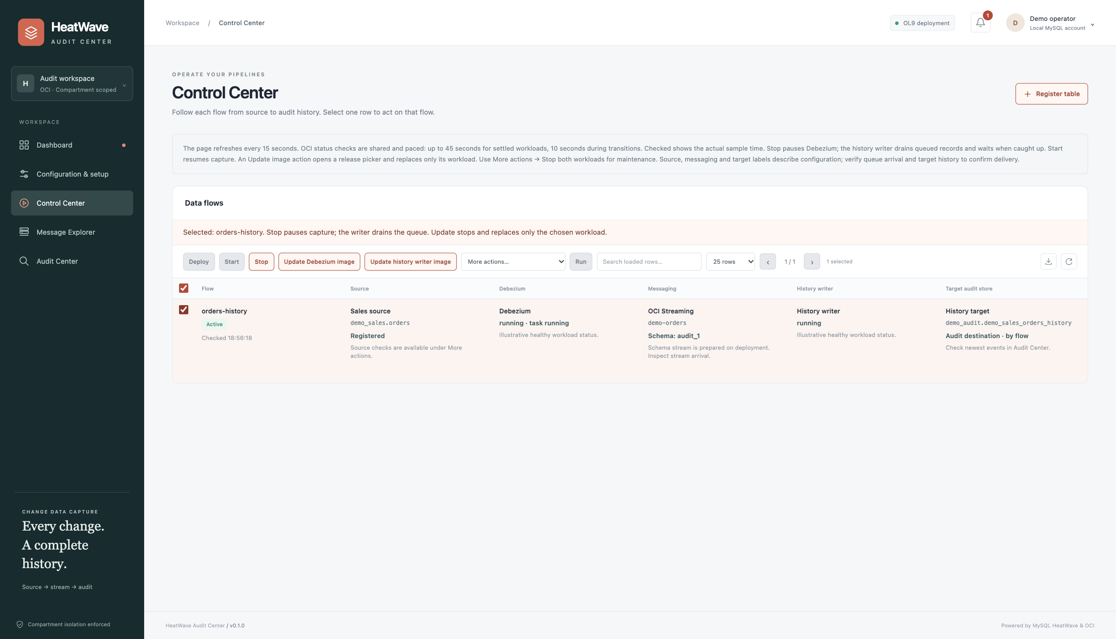
CONTROL CENTER
Operators control services without losing context
Source task and writer health are checked separately; a default-image difference is informational.
OPERATE SAFELY
•
Run both workloads on OCI Container Instances.
•
Apply saved stream limits and pacing.
•
Retain offsets, schema history and fragment custody.
•
Update the writer before oversized-message capture.
HeatWave Audit Center | Technical overview
28
Notes:
Screenshot: actual control.html with illustrative draft mapping and no real container OCIDs. Current container restart reuses existing configuration. Revision-based hot apply/replacement, graceful drain and independent end-to-end health remain planned. The web app is deployed on OL9 with opaque sessions and forced bootstrap password rotation.

Slide 29
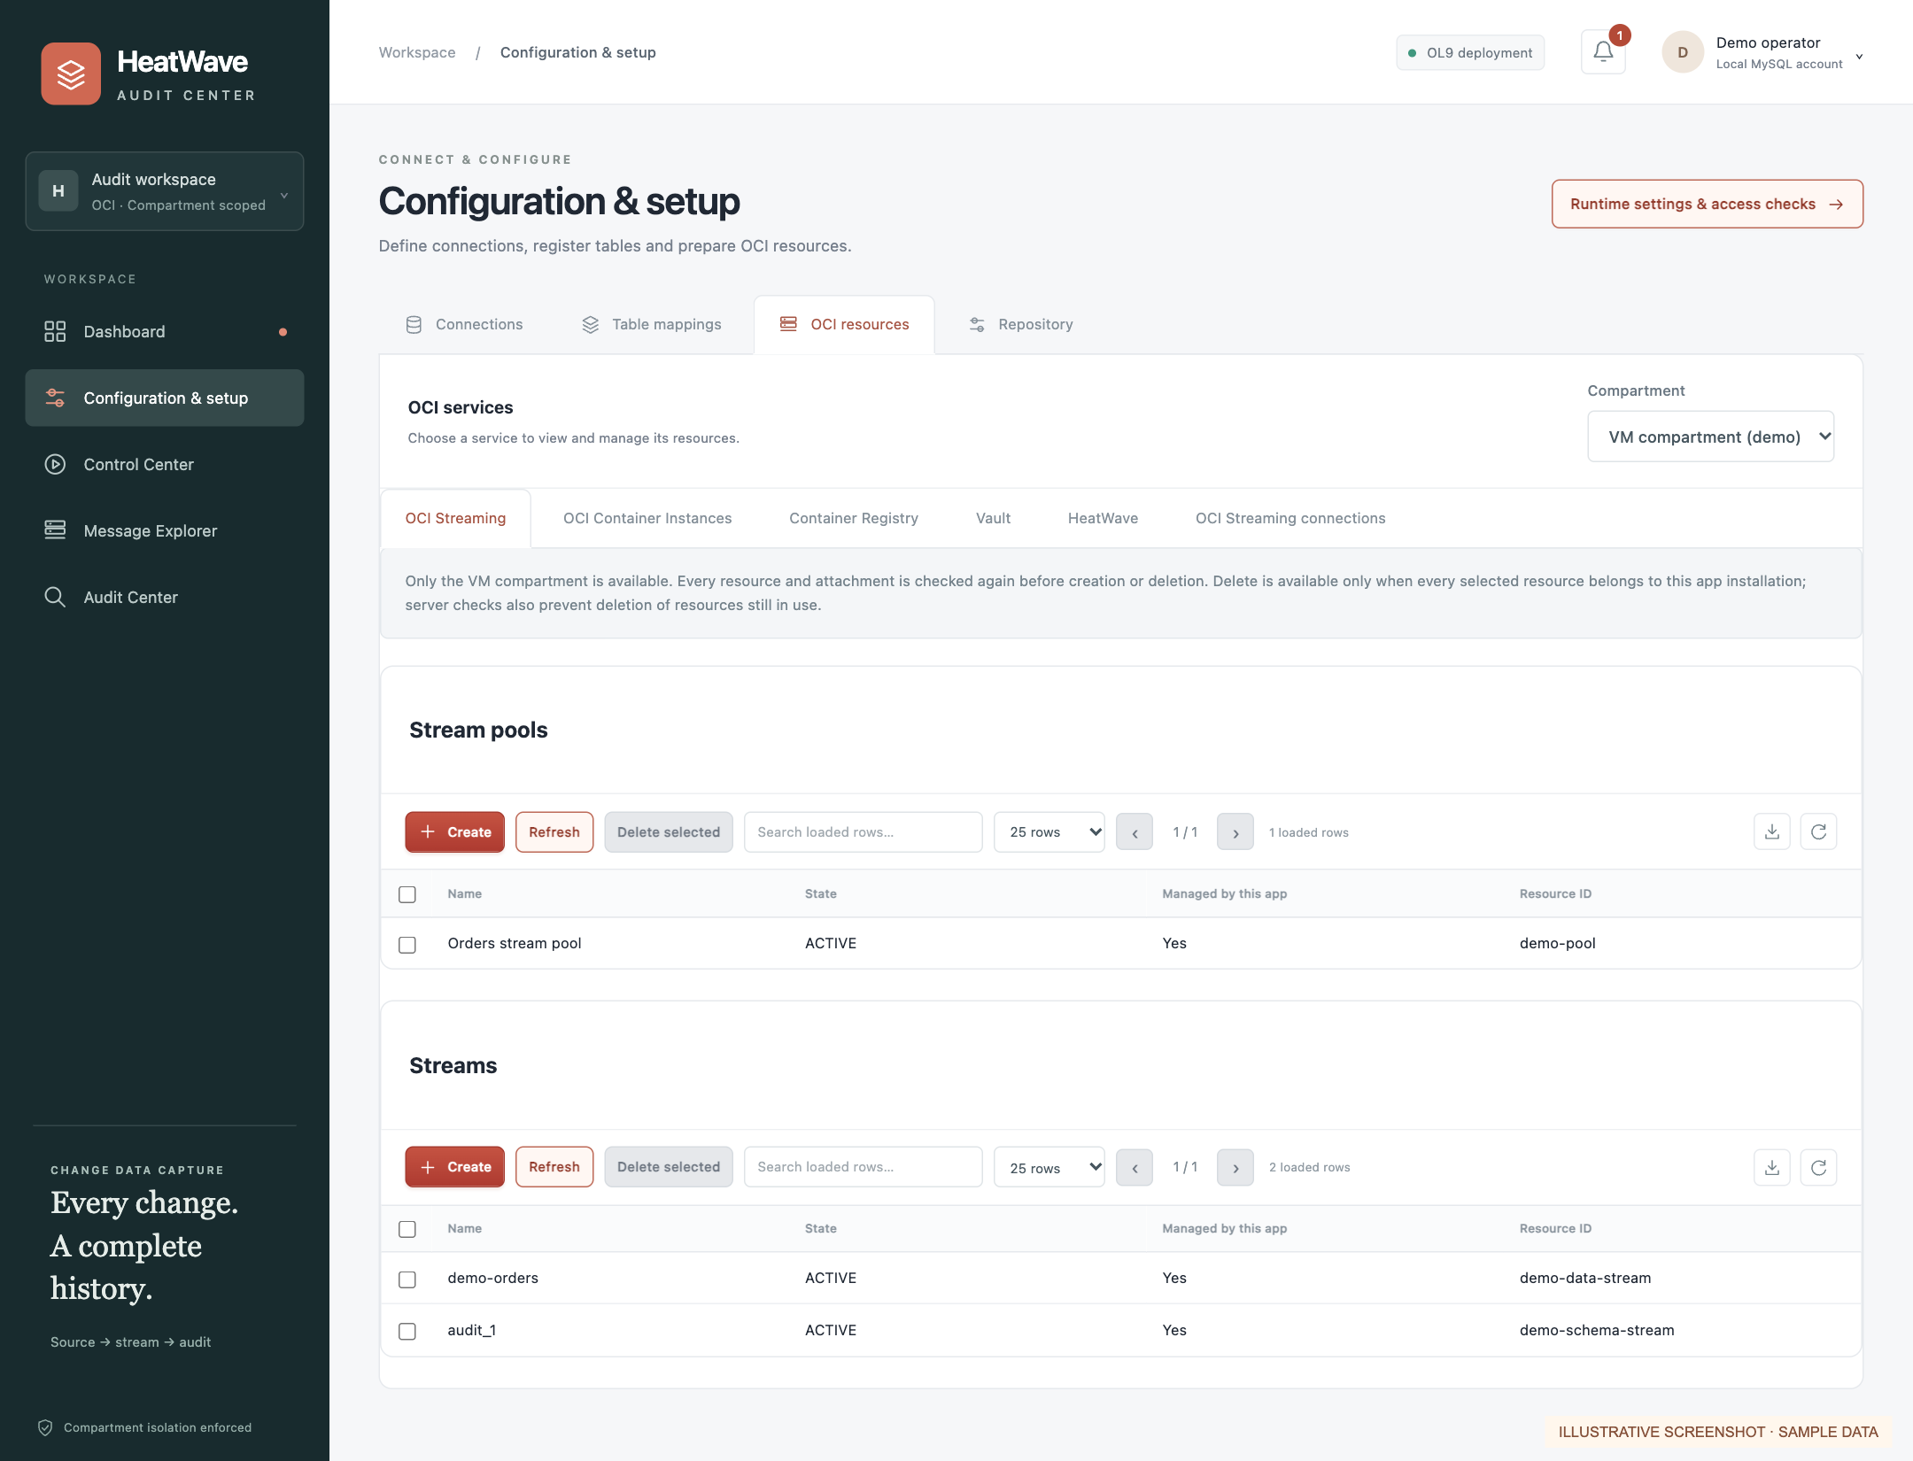
CONFIGURATION AND SETUP
Provision services inside the VM compartment
Native OCI Streaming, private container workloads, Registry and Vault use compartment-scoped controls.
SCOPE AND LIFECYCLE
•
One permitted compartment: the VM’s own.
•
Verify attached resources before every mutation.
•
Create from structured forms; delete unused app-owned resources.
HeatWave Audit Center | Technical overview
29
Notes:
Application screenshot uses illustrative inventory, not a live provisioned queue. Scope comes from VM instance metadata and is enforced server-side with instance-principal credentials. Services include OCI Streaming, managed Apache Kafka, OCI Container Instances, private registry, Vault and HeatWave. OCI authorization and regional availability remain deployment prerequisites.

Slide 30
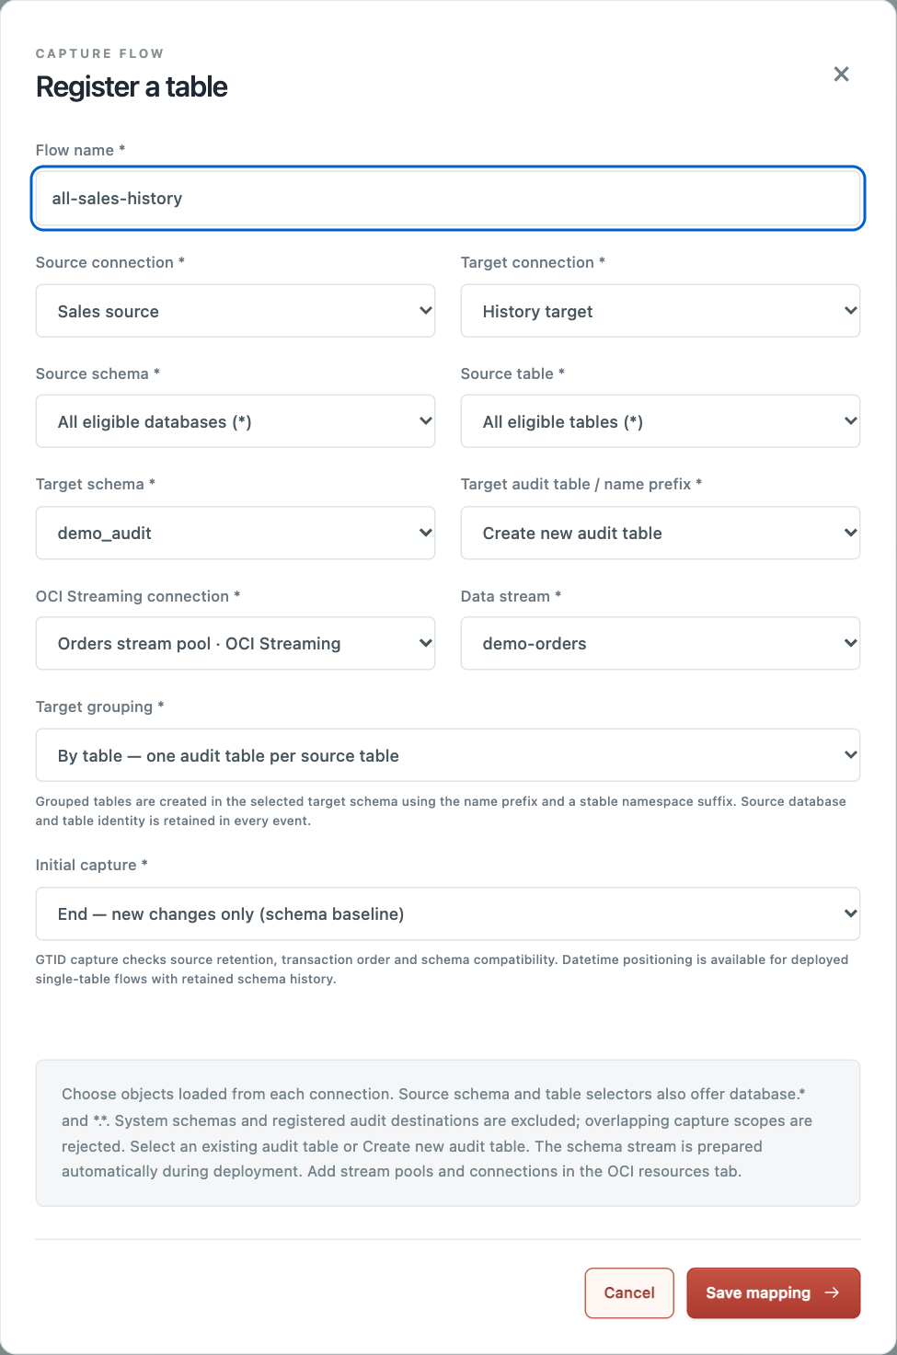
REGISTER A SOURCE SCOPE
Select scope, native stream and target layout
The application connects to each registered database and loads accessible objects.
MAPPING CONTRACT
•
Choose one table, database.* or *.* with stable keys.
•
Select the pool connection and prepared data stream.
•
Choose grouping plus End, Start or Specific GTID.
HeatWave Audit Center | Technical overview
30
Notes:
Illustrative records in the screenshot. A new target audit table can be named automatically. Submitted selections are checked against live metadata. Prepare the single-partition schema topic, validate replication and target settings, then deploy using the selected private container images.

Slide 31
VALIDATED BEHAVIOR AND LIMITS
Retain explainable changes and recovery evidence
VALIDATED IN ISOLATED LIVE CHECKS
OPERATING BOUNDARIES
•
Native Streaming, GTID and wildcard capture.
•
Target-backed capture state still needs source binlogs.
•
All three target layouts and exact large Unicode images.
•
Grouped retention and wildcard repositioning are limited.
•
Partial reassembly and source/writer restart recovery.
•
Incomplete fragment generations need retained-evidence review.
Batching fixture: 100 row events + 1 schema event used 2 PUT calls, with zero throttled entries. Capacity still needs workload-specific testing.
HeatWave Audit Center | Technical overview
31
Notes:
Deployment evidence: internal_doc/deployment-status.html. HTTPS and local repository are deployed; managed Kafka/Streaming inventory returned NotAuthorizedOrNotFound during setup, so live CDC is not claimed. Detailed privilege tracing, full schema fidelity and revision-based replacement remain delivery work. Snapshot previews are illustrative.

Slide 32
APPENDIX
Primary sources and implementation references
MySQL binlog row images and GTID concepts
OCI Streaming throttling and partial PUT failures
Product documentation
Documentation / reviewed project reference
Debezium MySQL 3.4 event and snapshot behavior
MySQL JSON and packet-size boundaries
Product documentation
Documentation / reviewed project reference
Debezium Engine and JSON serialization
HeatWave audit evidence and security boundaries
Product documentation
Documentation / reviewed project reference
OCI native Streaming publishing and message limits
Project manual: scopes, GTID, framing and recovery
Product documentation
Documentation / reviewed project reference
HeatWave Audit Center | Technical overview
32
Notes:
Full cited URLs: https://dev.mysql.com/doc/refman/8.4/en/replication-options-binary-log.html
https://debezium.io/documentation/reference/3.4/connectors/mysql.html
https://www.oracle.com/uk/cloud/apache-kafka/faq/
https://docs.oracle.com/en-us/iaas/Content/kafka/security-sasl.htm
https://docs.oracle.com/en-us/iaas/Content/Streaming/Tasks/kafkacompatibility.htm
https://docs.oracle.com/en-us/iaas/Content/Streaming/Tasks/kafkacompatibility_topic-Kafka_Connect.htm
https://docs.oracle.com/en-us/iaas/Content/Streaming/Concepts/streamingoverview_topic-Limits_on_Streaming_Resources.htm
https://debezium.io/documentation/reference/3.4/configuration/storage.html
https://docs.oracle.com/en-us/iaas/mysql-database/doc/mysql-enterprise-audit-plugin.html
https://dev.mysql.com/doc/refman/8.4/en/partitioning-limitations-partitioning-keys-unique-keys.html
https://github.com/ivanxma/heatwave_log_archiver/tree/e61b2c4230b728aa7911aba9e2a617df3bda3894
Internal design: internal_doc/heatwave-audit-plan.html. Repository source and live deployment checks underpin current-state statements.

