Slide 1
Engineering Ambassadors
Sample Presentation for High School Outreach
Presented by:
Adrienne Crivaro
Jessica Menold
Mechanical Engineering
Penn State
Created by:
Andrew Gricks
Nick Gruber
Kristen Myatt
Penn State

Slide 2
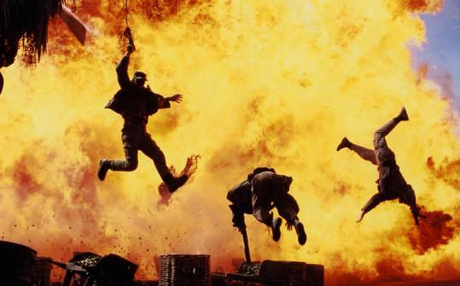

Engineering Movie Magic
Adrienne Crivaro
Jessica Menold
[www.soundonsight.org]
Notes:
Wow! That was an awesome stunt! Chances are you’ve seen stunts like these in many of the action movies you see today. But have you ever wondered how it all works? We are here from engineering ambassadors and today we will show you how engineers make movie magic happen. (Also say your names and majors).
Picture reference:
Mesce, Bill. "Pyromaniacs: Hollywood’s Bad Boys." Sound on Sight. Web. 16 Sept. 2014. <http://www.soundonsight.org/pyromaniacs/>.

Slide 3


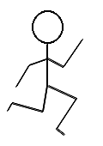
Today we will show you how engineers make movie magic possible
Breakaway Glass
Fireproof Materials
Safe Landings
Notes:
Today we will show you how all engineers helped make all of the magic in that stunt possible. First we will talk about fireproof materials, then we will show you how breakaway glass is made, and finally we will fill you in on what makes a safe landing possible.

Slide 4
Specialized materials prevent actors from getting hurt by extreme heat or cold
Fireproof Materials
Notes:
First we will talk about how actors are able to withstand extremely high (and extremely low) temperatures. You may have noticed that the actor in the video was in fact on fire the whole time. But he was completely fine in the end!

Slide 5
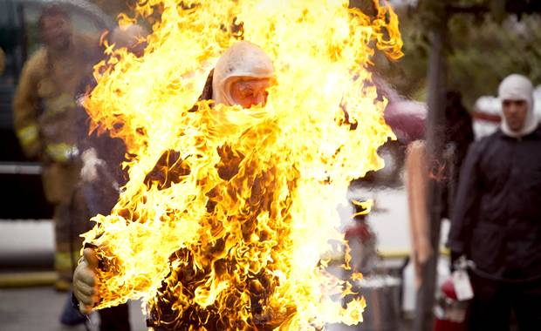
Specialized materials prevent actors from getting hurt
by extreme heat or cold
[www.theglobeandmail.com]
Notes:
Any time a stunt like this is performed on camera, don’t worry, the actor is always safe! While it looks like their clothes are on fire, they are actually wearing a specialized suit underneath that is protecting them from harm. Specialized materials are used to stop the body from receiving or losing any heat; they insulate the body.
Reference:
"Burning man - literally." The Globe and Mail. 6 Sept. 2009. Web. 16 Sept. 2014. <http://www.theglobeandmail.com/news/ british-columbia/burning-man---literally/ article789670/>.

Slide 6
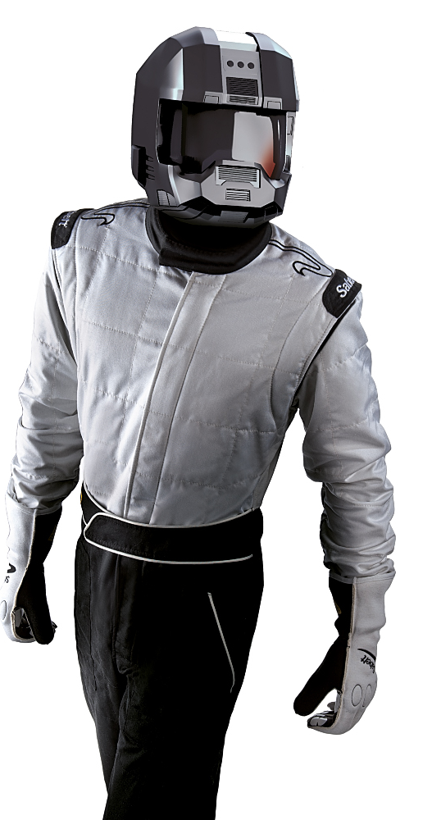
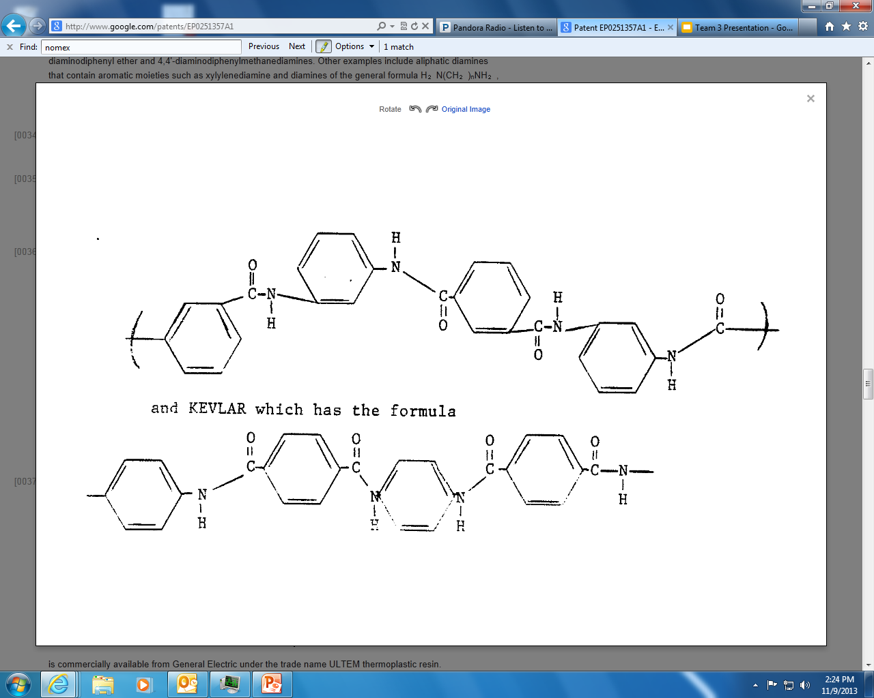
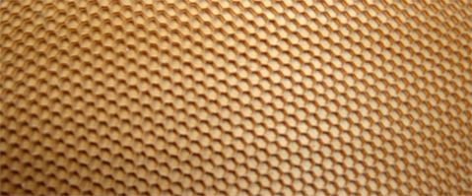
Nomex is an insulating material developed
by chemical and materials engineers
Nomex
[motorsport-tools.com]
Notes:
One such specialized material is called Nomex; it was developed by chemical and materials engineers at DuPont. This material is made from chains of molecules like this. When strung together in repeating units, long chains like this are called polymers—but you may known as plastic! This nomex material is a special kind of polymer that insulates the body, protecting it from outside temperature change. When an actor is wearing a suit made of this material, the material totally insulates the body, so no heat can pass through the barrier. Fire scenes are made totally safe!
Reference:
"Sabelt Racing TI-120 Z14320 FIA Fireproof Driver 3 Nomex Race Suit 3 Layer." Motorsport-Tools. Web. 16 Sept. 2014. <http://www.motorsport-tools.com/ sabelt-racing-ti-120-z14320-fia-fireproof-driver-3-nomex-race-suit-3-layer.html>.

Slide 7
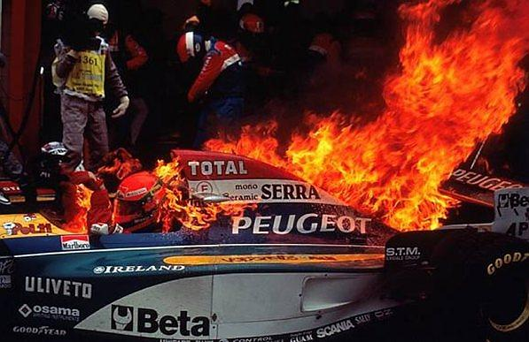
These same fireproof materials are used by firefighters, race car drivers, and military pilots
[en.espnf1.com]
Notes:
These specially engineered fabrics are for more than just cool movie stunts. Firefighters, race car drivers, and military pilots wear nomex suits to protect themselves in the hazardous situations they face every day. Clearly the man in this picture is in a dangerous situation, but he will be okay because he is wearing a nomex suit underneath.
Reference:
Marriott, Andrew. "Strategy will be more crucial in 2010 Read more at http://en.espnf1.com/f1/ motorsport/story/9701.html#AiL8QzfE3ZCtiRGH.99." ESPN F1. 1 Mar. 2010. Web. 16 Sept. 2014. <http://en.espnf1.com/f1/motorsport/story/9701.html>.

Slide 8
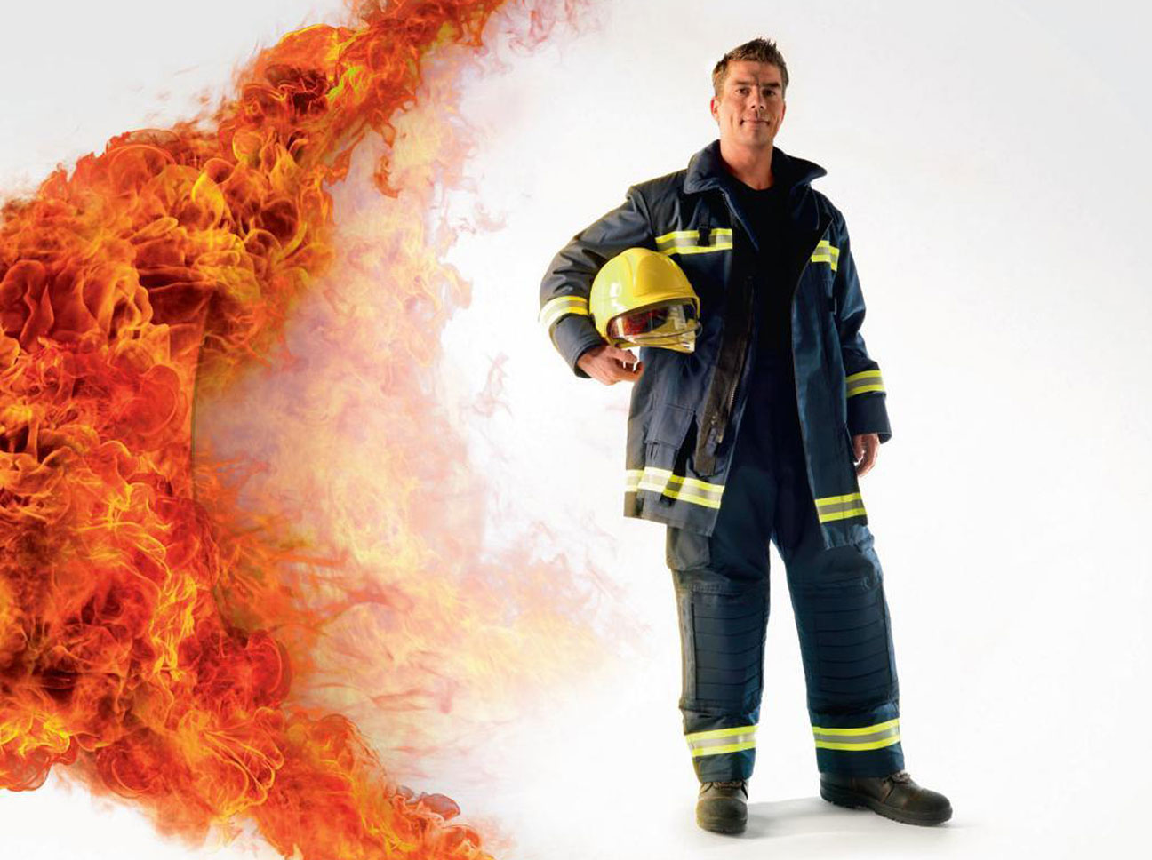

Engineering makes a difference
[us.vocuspr.com]
Notes:
At the end of the day, these engineered fabrics save lives. They make a difference in the lives of firefighters and pilots, who can go to their job every day and feel safe knowing they are protected from harm.
Now we will show you how the man in the video was able to safely break through the glass.
Reference:
"DuPont launches information point dedicated to Nomex® following European wide research." Dupont. May 2011. Web. 16 Sept. 2014. <http://us.vocuspr.com/Newsroom/ MultiQuery.aspx?SiteName=DupontEMEA&Entity=PRAsset&SF_PRAsset_PRAssetID_EQ=120821&XSL=NewsRelease&Inc ludeChildren=True&Lang=English>.

Slide 9
Breakaway glass made from sugar is easily broken with little force
Breakaway Glass
Notes:
Often in movies, stuntmen have to break glass, whether they are jumping through windows or being hit with a glass bottle.

Slide 10
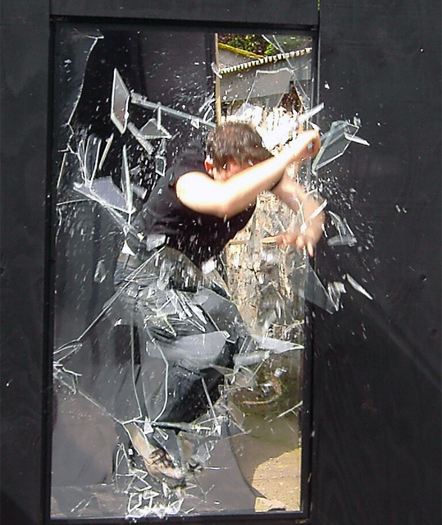

Breakaway glass made from sugar is easily broken with little force
[www.sculpturesupply.com]
[www.pinterest.com]
Notes:
To ensure that they don’t get any real injuries, fake glass made from sugar, or other materials is used. This breakaway glass shatters easily, so not a lot of force is felt, and the fragments are not sharp, so they actors will not get cut!
Reference:
How To Make a Breakaway Glass Bottle Prop. Sculpture Supply Canada. Web. 16 Sept. 2014. <http://www.sculpturesupply.com/ fotos.php?id=184>.
"Break away Props = art." Pinterest. Web. 16 Sept. 2014. <http://www.pinterest.com/ BoardWalkKids/ break-away-props-art/>.

Slide 11
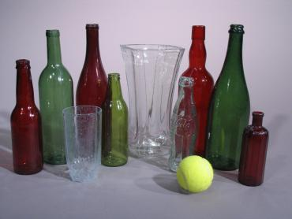
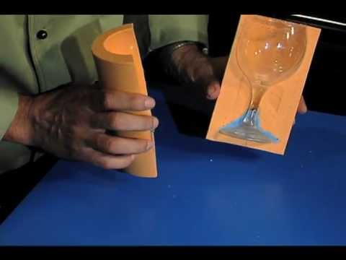
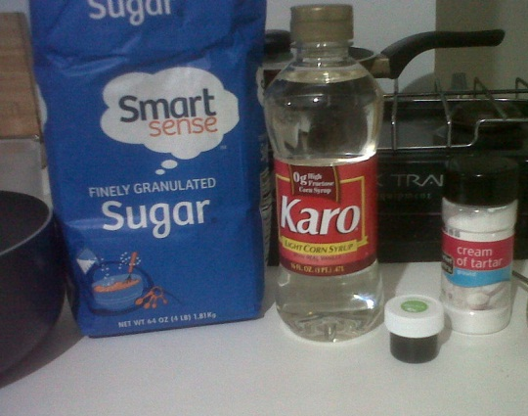
Sugar glass can be molded into different shapes
[www.instructables.com]
Notes:
Sugar glass can be made from items you can buy right at your grocery store. You just have to mix your materials and heat them up, and as they cool, they first form a gel like state which can be molded into any shape the movie needs.
**Animation changes the picture to show molded glass.
Here is a sample of sugar glass that we made! (See http://www.wikihow.com/Make-Sugar-Glass)
Reference:
Yepez, Nelson. "FAKE GLASS BOTTLE / SUGAR GLASS." Instructables. Web. 16 Sept. 2014. <http://www.instructables.com/id/ Fake-glass-bottleSugar-glass/>

Slide 12

As the temperature decreases, the sugar becomes less soluble and crystals begin to form
°F
°F
°F
°F
Notes:
Sugar glass is made by supersaturating a solution with sugar until it can not hold any more product. The solution is heated to allow for more sugar to be dissolved. Then the solution is cooled, and the crystals start to fall out of the solution and grow.
**animations: click to add the different sequences on crystal growth.

Slide 13
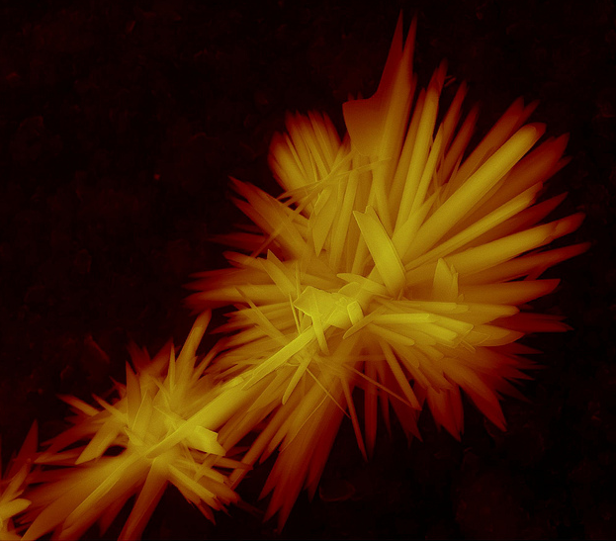
Engineers and chemists also use this technique
to separate and purify chemical compounds
[www.flickr.com]
Notes:
Chemists and engineers also use this technique to purify compounds by dissolving them first in a solution, and then as they crystallize, only one compound will crystallize out and be pure. This is used on products like advil!
Reference:
Rangel, Francisco. "ESEM - Calcium sulfphate dihydrate." Flickr. Web. 16 Sept. 2014. <http://www.flickr.com/photos/42609230@N04/5842526102>.

Slide 14
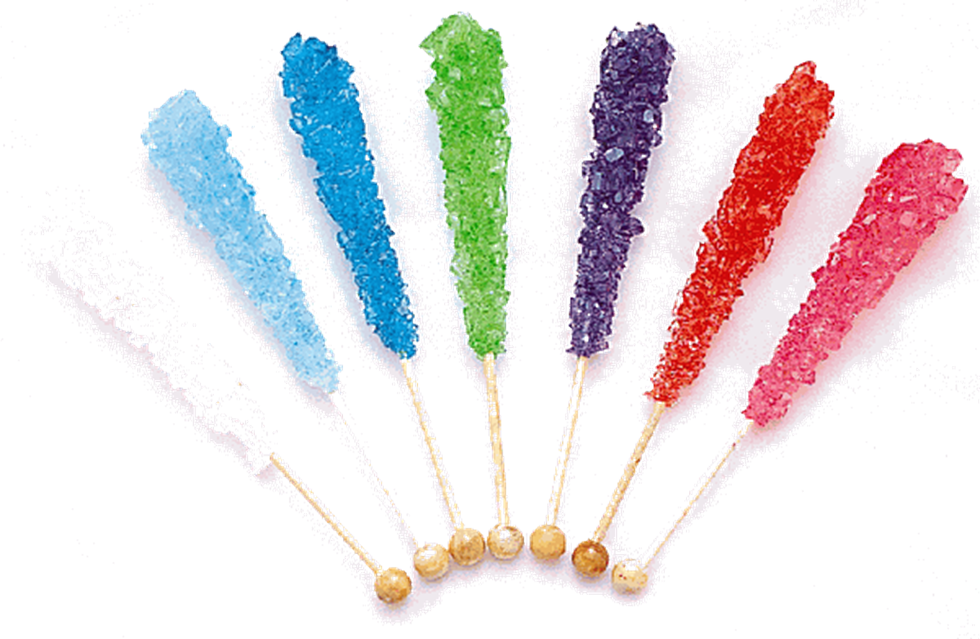
These same techniques can also be used to make a delicious treat!
*Try this at home
[www.sugarlipscandykw.com]
Notes:
Not only is this used for medicine, but you can use these steps to make rock candy! It is a delicious treat that can be easily made by dissolving sugar in hot water and then letting it cool. This is definitely something you should try at home!
Reference:
"Ribbon Candy & Crystal Rock Candy." Sugarlips Candy. Web. 16 Sept. 2014. <http://www.sugarlipscandykw.com/ribbon-candy--crystal-rock-candy.html>.

Slide 15
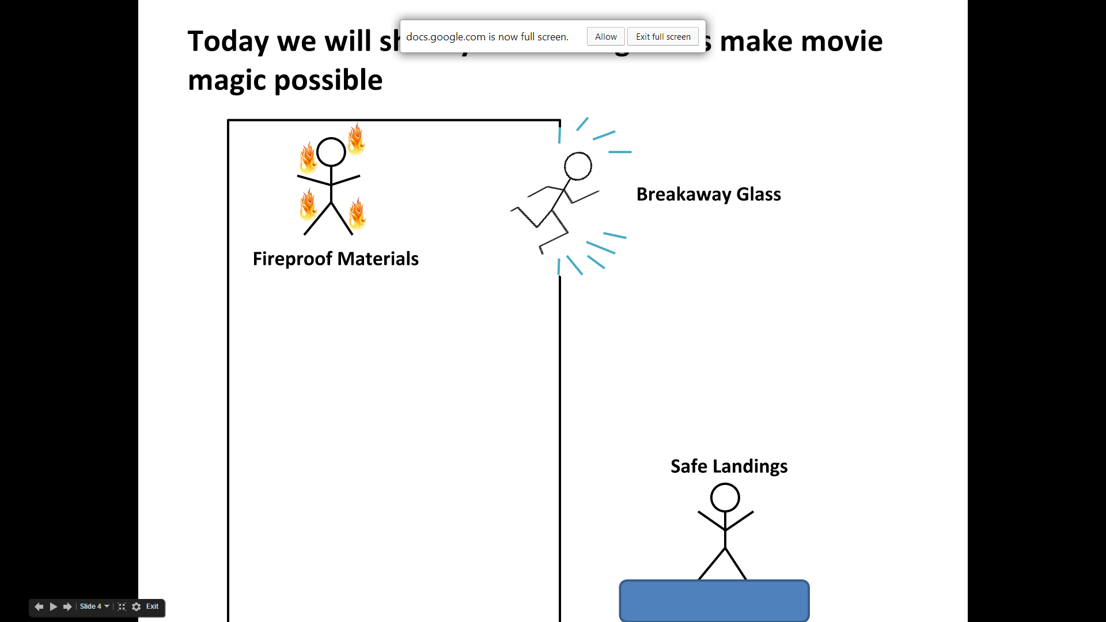
How do safe landings occur?
Notes:
1st Slide (How do Safe Landings Occur)
Another area of obvious interest is in getting the actors and stunt people to land safe after the jump
Much engineering and thought goes into the process, including the jump, the rigging, and the landing
The physics and principles behind the jump are all things that are taught in basic engineering courses

Slide 16
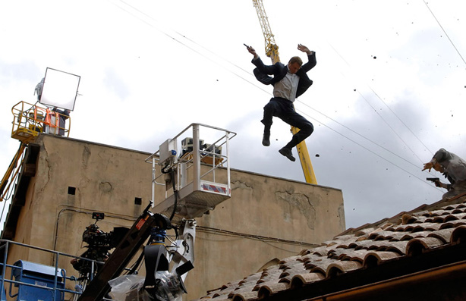
Skyfall
Notes:
2nd Slide (Bond Jumping)
We’ve all watched the movies with actors jumping through windows, onto roofs, off of roofs, etc.
Obviously there is too much risk involved in letting actors perform these stunts unaided
Tom Cruise climbed the worlds tallest building, Burj Khalifa in Mission Impossible
Angelina Jolie scaled a NYC apartment building in Salt
The stunt man in the beginning jumped out of a 20 story building
How do they survive these terrific falls?
With some knowledge of physics, and the help of trained engineers
Reference:
Collias, Nick. "Man Behind The Masks: Skyfall Stuntman Bobby Holland Hanton." Body Building. Web. 16 Sept. 2014. <http://www.bodybuilding.com/fun/ man-behind-the-masks-skyfall-stuntman-bobby-holland-hanton.html>.

Slide 17
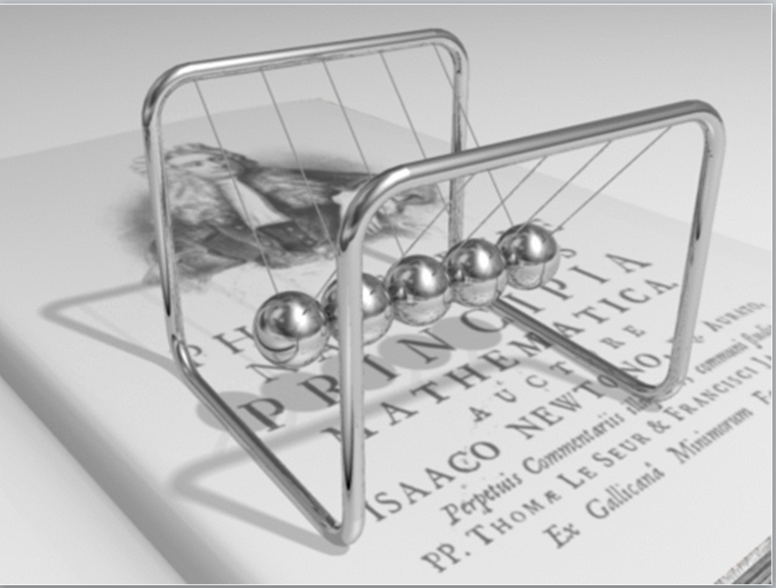
Momentum is
always conserved
p=mv
[en.wikipedia.org]
Notes:
3rd slide (momentum)
When actors travel through the air, they have something called momentum
It is the product of an objects mass, and the velocity it is traveling at
Lets hold the mass constant for the scope of this and look at the velocity
If an actor jumps out of a building in free fall, they accelerate towards earth increasing velocity
As velocity increases, so too does the momentum
If one were to take all that momentum and transfer it immediately to the ground, it would cause a large force on the person, too large for them to survive
**There is an animation to change the P and V in the equation
Reference:
"Newton's Cradle." Wikipedia. Web. 16 Sept. 2014. <http://en.wikipedia.org/wiki/ Newton's_cradle>.

Slide 18
Momentum is
always conserved
p=mv
[en.wikipedia.org]
Notes:
3rd slide (momentum)
When actors travel through the air, they have something called momentum
It is the product of an objects mass, and the velocity it is traveling at
Lets hold the mass constant for the scope of this and look at the velocity
If an actor jumps out of a building in free fall, they accelerate towards earth increasing velocity
As velocity increases, so too does the momentum
If one were to take all that momentum and transfer it immediately to the ground, it would cause a large force on the person, too large for them to survive
**There is an animation to change the P and V in the equation
Reference:
"Newton's Cradle." Wikipedia. Web. 16 Sept. 2014. <http://en.wikipedia.org/wiki/ Newton's_cradle>.

Slide 19
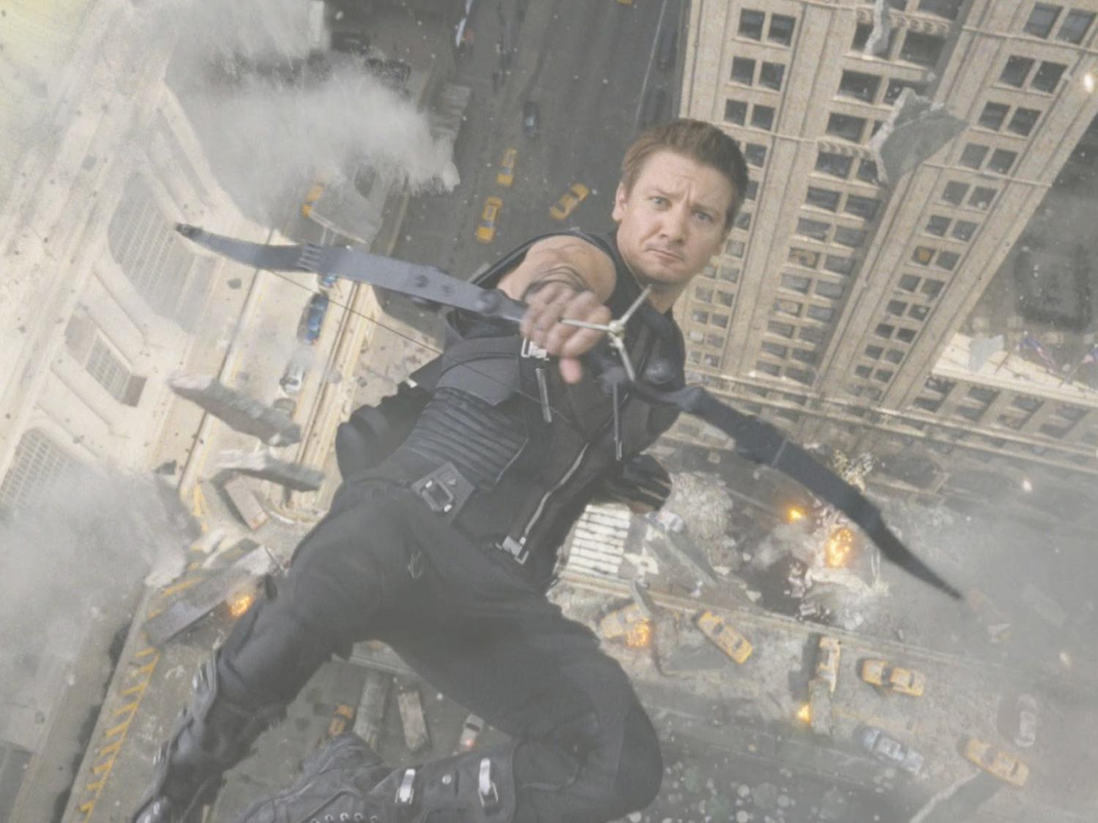
∑F=mass*acceleration
Engineers must also account for force
The Avengers
Notes:
4th slide (dude falling)
Another thing that has to be accounted for is force
Force equals mass times acceleration, and in free fall, that acceleration is equal to 9.81 m/s^2
Reference:
DelaCuesta, JP. "The-Avengers-Jeremy-Renner-Hawkeye-600×328." All Hip Hop. 29 Feb. 2012. Web. 16 Sept. 2014. <http://allhiphop.com/2012/02/29/ amazing-new-trailer-for-this-summers-the-avengers-debuts/ the-avengers-jeremy-renner-hawkeye-600x328/>.

Slide 20
Engineers must also account for force
Notes:
5th slide (dude on roof)
Now, if every action has an equal but opposite reaction, that means if he hits the ground, the ground will produce the same force on the person
For a 100 kg man that means there is 981 Newtons acting on him, a lot of force to hit the ground with
**There is are 2 animations here**

Slide 21
Engineers must also account for force
F_{man}
F_{ground}
Notes:
5th slide (dude on roof)
Now, if every action has an equal but opposite reaction, that means if he hits the ground, the ground will produce the same force on the person
For a 100 kg man that means there is 981 Newtons acting on him, a lot of force to hit the ground with
**There is are 2 animations here**

Slide 22
Engineers must also account for force
F=ma
F=ma
Notes:
6th slide (dude landing on pad)
That is where the airbags come into play. As we know, F=ma. So if you have a large acceleration, you’ll end up hitting the ground with a large force
The pads take that acceleration and slow it down, thus lowering the force, and making for a safe landing

Slide 23
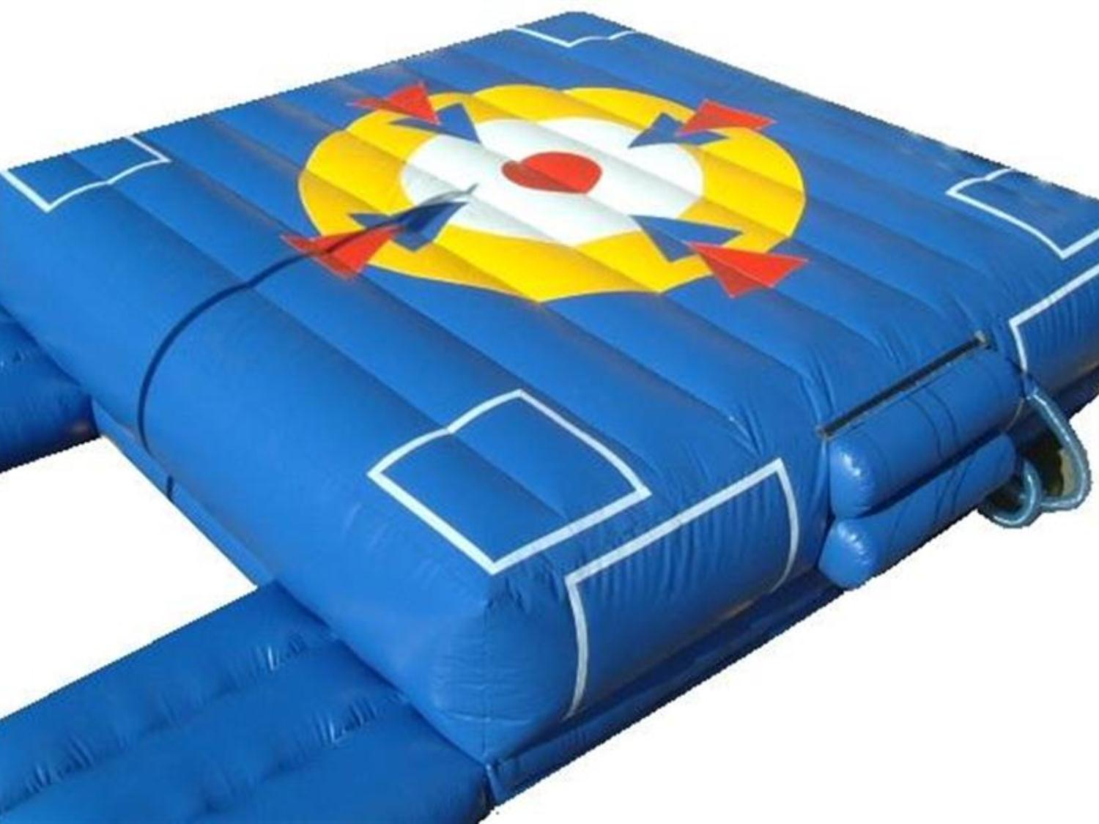
[www.betterbouncedirect.com]
Notes:
7th slide (Landing pad)
Engineers create safety devices such as the one seen here
This is a smaller version of the landing pad used in the video
Engineered based on expected projectile motion
Worked in teams to create most effective design
Multiple air chambers that allow the even flow of air to absorb impact
Originally made of super lightweight parachute materials, but it would occasionally rip
Engineers being the problem solvers they are took this as an opportunity. They looked at the design again and thought of other materials it could be made from
Came up with the idea of using lightweight vinyl that won’t tear when someone lands
Even looked at the way the vents were designed in order to account for the weight of the stuntman
Reference:
"BOUNCY CASTLES, INFLATABLES & SOFT PLAY." Better Bounce Direct. Web. 16 Sept. 2014. <http://www.betterbouncedirect.com/>.

Slide 24
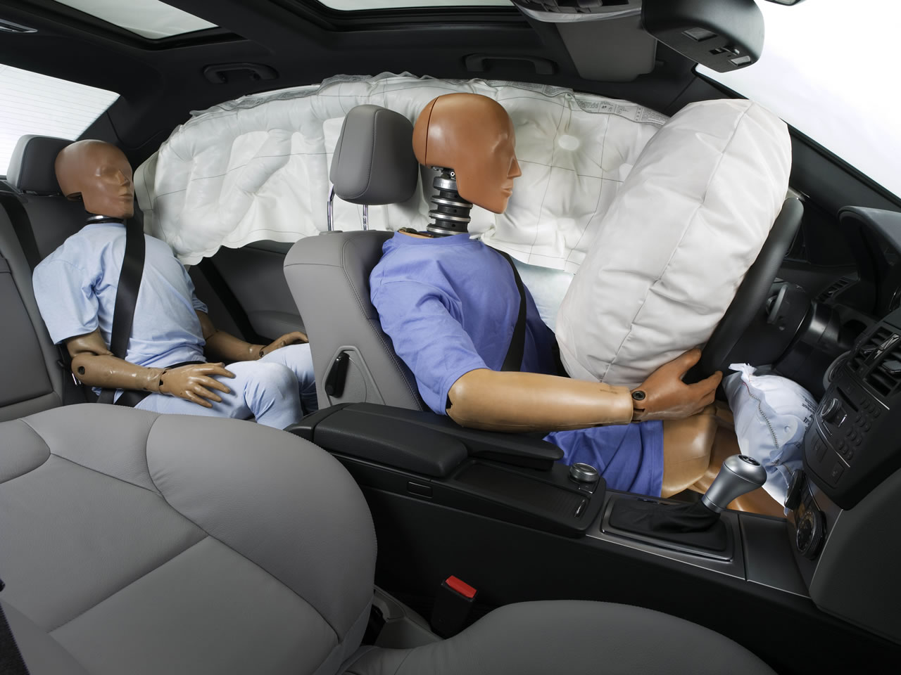
Engineers
save lives
[www.daimler.com]
Notes:
8th slide (airbags)
So safety is obviously huge, but it’s not just in the movies where these innovations come into play
Airbags in your cars are designed by teams of engineers
The original patent for airbags is actually held by and industrial engineer, John Hetrick
He was motivated by a car accident that had involved his family, and that’s what made him passionate about the subject
Passion is something that all engineers possess. There is a will to take the world and make it a better place through innovation and design.
Reference:
"World Safety Premiere: Airbag in the S-Class (W 126)." Daimler. N.p., n.d. Web. 16 Sept. 2014. <http://www.daimler.com/dccom/ 0-5-1210222-1-1521247-1-0-0-0-0-0-0-0-0-0-0-0-0-0-0.html>.

Slide 25
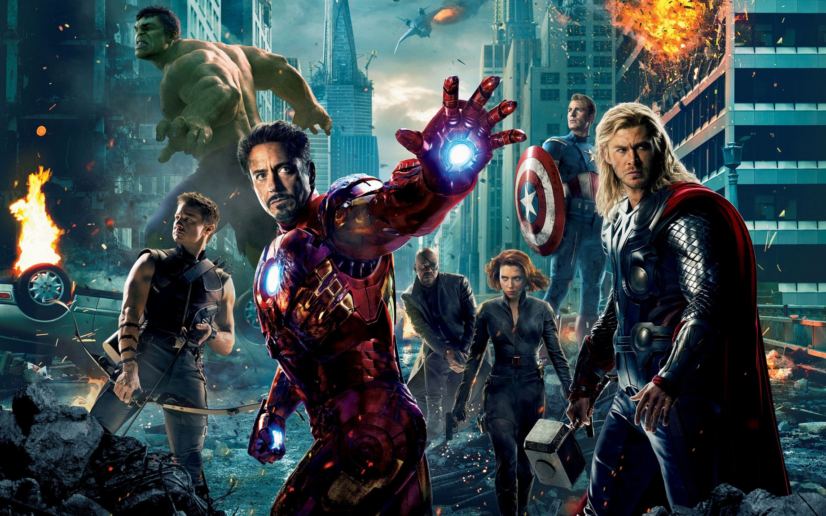
Engineers must work together to make movie magic possible
The Avengers
Notes:
Engineers from all different fields come together and use their specialized skills and knowledge to design special effects to make movies look cool and keep the actors and stuntmen safe.
Reference:
"Avengers Wallpaper Hd." Pichost. Web. 16 Sept. 2014. <http://pichost.me/1697937/>.

Slide 26
Engineers must work together to make movie magic possible
Questions?
The Avengers
Notes:
Engineers from all different fields come together and use their specialized skills and knowledge to design special effects to make movies look cool and keep the actors and stuntmen safe.
Reference:
"Avengers Wallpaper Hd." Pichost. Web. 16 Sept. 2014. <http://pichost.me/1697937/>.

