Slide 1
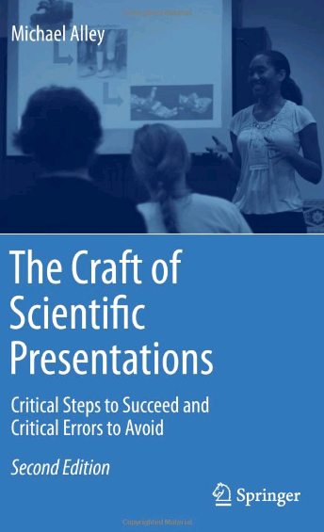

Assertion−Evidence Slide Template
for Engineering Ambassador Presentations
Michael Alley
College of Engineering
Pennsylvania State University
24 January 2014
Notes:
This file is a template for making effective slides for Engineering Ambassador presentations.* Although much about the layout and typography contrasts sharply with the defaults of PowerPoint, these changes are done so to make the slides more effective at communicating technical information. The design advocated by this template arises from Chapter 4 of The Craft of Scientific Presentations, 2nd edition (Springer, 2013). The homepage for this template exists:
http://writing.engr.psu.edu/assertion_evidence_EA.html
Right now you are viewing the notes pages. To work on the slides, click on “Slide” under “View.”
Tip: When creating a new presentation, save this file as the name of your presentation.
___________________________________________
*You are more than welcome to use this template for your presentation slides. You may not, though, distribute this template for profit or distribute this template without giving credit to the source.

Slide 2
Title of Presentation in Initial Capitals:
36 Points, Calibri Bold
Replace this box with key image to introduce talk’s scope, importance, or background
Name
Name
Name
Department
Institution
Date
Replace with
your Logo
Notes:
This slide template is for the title slide of a presentation. Consider repeating a key image from one of the slides later in the presentation. The image helps orient the audience to the key words in the title. This image also gives you the opportunity to say a few things about your work—perhaps addressing the work’s importance or providing key background information. Forcing yourself to spend more time with this slide is good because a common mistake in presentations is not to leave the title slide on long enough. Because of this mistake, many in the audience do not have the chance to comprehend the key details of the title. See pages 172-184 in The Craft of Scientific Presentations, 2nd ed. (CSP).
This template shows one layout for the slide. You might want to rearrange the placement of the body’s wording to accommodate a different sized image.

Slide 3
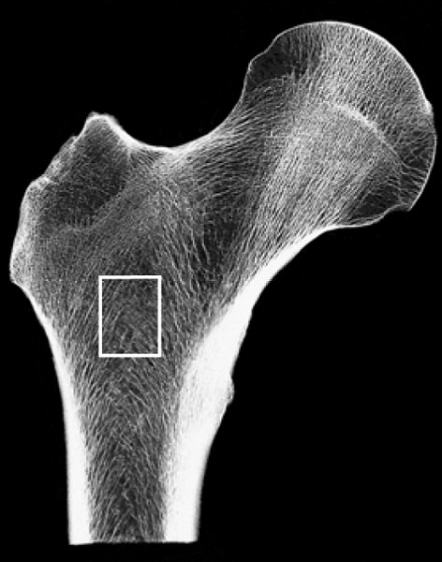
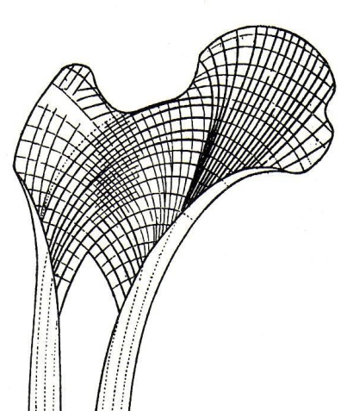
Engineering the Human Body:
Bone Repair
and Reconstruction
Genevieve Brown
Engineering Ambassadors
Department of Bioengineering
The Pennsylvania State University
Notes:
The beginning of a presentation is important for making the audience excited about and have the audience feel comfortable with the topic. If you are using a slide to open a presentation, include an image or series of images that provides a good entry point to the talk. An effective image helps orient the audience to the key words in the title. An effective image, such as what Genevieve Brown included, also gives you the opportunity to say a few things about your work—perhaps addressing the work’s importance or providing key background information. Forcing yourself to spend more time with this slide is good because a common mistake in presentations is not to leave the title slide on long enough. Because of this mistake, many in the audience do not have the chance to comprehend the key details of the title. In her beginning, Genevieve tells a personal story about the effect of replaced bone after an automobile accident, and how that replaced bone was uncomfortable during cold weather. That experience has driven her to search for a better bone repair and reconstruction.
Main References:
Alley, Michael (2013). The Craft of Scientific Presentations, 2nd ed. New York: Springer-Verlag.
Alley, Michael (2003). Rethinking the design of presentation slides: The assertion-evidence structure. http://writing.engr.psu.edu/slides.html.

Slide 4
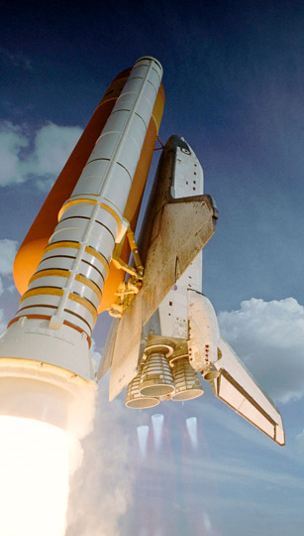

Space Exploration:
To Infinity and Beyond
Kim Harrison
Katie Kirsch
Engineering Ambassadors
Department of Mechanical Engineering
Penn State
[www.pw.utc.com]
Notes:
The beginning of a presentation is important for making the audience excited about and have the audience feel comfortable with the topic. If you are using a slide to open a presentation, include an image or series of images that provides a good entry point to the talk. An effective image helps orient the audience to the key words in the title. An effective image, such as what Kim Harrison and Katie Kirsch included, also gives you the opportunity to say a few things about your work—perhaps addressing the work’s importance or providing key background information. Forcing yourself to spend more time with this slide is good because a common mistake in presentations is not to leave the title slide on long enough. Because of this mistake, many in the audience do not have the chance to comprehend the key details of the title. On this slide, Katie tells a story about seeing the launch of a rocket carrying a satellite. That experience made her interested in space launches.
References:
Alley, Michael (2013). The Craft of Scientific Presentations, 2nd ed. New York: Springer-Verlag.
Alley, Michael (2003). Rethinking the design of presentation slides: The assertion-evidence structure. http://writing.engr.psu.edu/slides.html.
Harrison, Kim & Kirsch, Kathryn (2010). Space exploration: To infinity and beyond. University Park: Penn State Engineering Ambassadors.

Slide 5
Notes:
Blank slide for drafting title slide.

Slide 6
This presentation focuses on… (complete sentence, but go no more than two lines)
Image for
Topic 1
Topic 1
Image for
Topic 2
Topic 2
Image for
Topic 3
Topic 3
Notes:
Mapping slide for the presentation (note that a background slide or a slide justifying the importance might precede this slide). A common mistake with mapping slides is to give the audience simply a boring and unmemorable vertical list of topics (including the names “Introduction” and “Conclusion” and “Questions”). Such a list is quickly forgotten after the slide is removed.
On a mapping slide, take the opportunity to show a key image or perhaps a representative image for each major section of the presentation. In the second case, each image would be repeated on the first visual of the corresponding section and would remind the audience that they have arrived to a major section of the presentation’s middle.
In regards to the names “Introduction” and “Conclusion,” every talk has those sections, and the names are ignored by audiences. So why state them? Also, for the divisions that you do have, find a logical and parallel grouping. Note that groups of two’s, three’s, and four’s are much easier to remember and are not so nearly intimidating as groups of five’s, six’s, and seven’s. See the example mapping slide in the textbook. (CSP, pages 177-181)

Slide 7
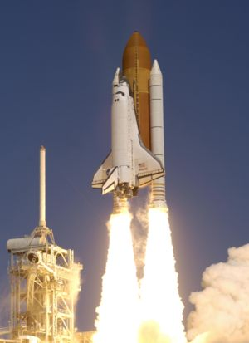
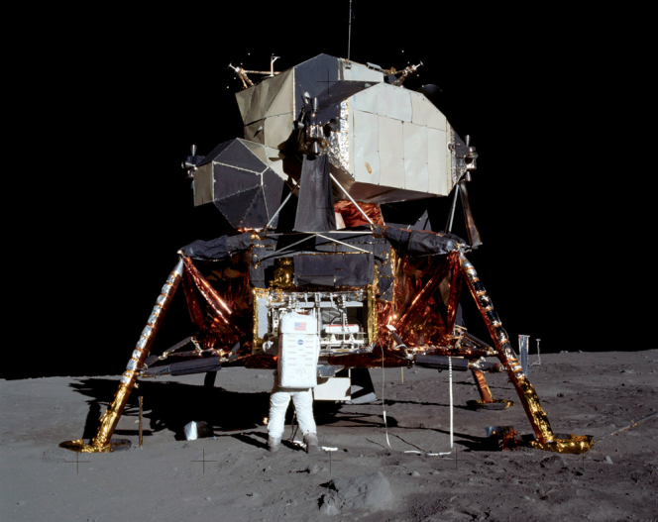
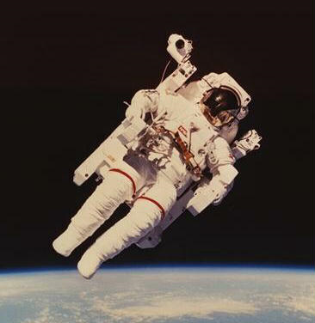
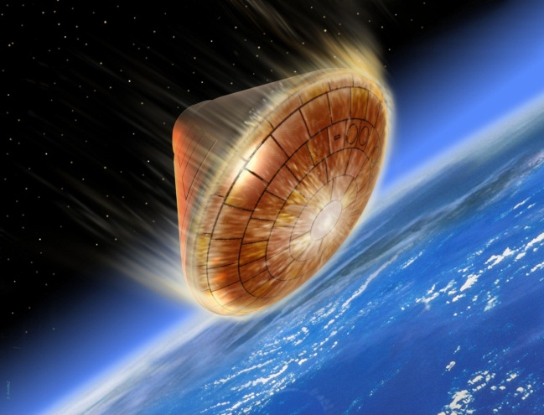
Newton’s laws help engineers fly astronauts to the moon and return them home safely
Propulsion
Landing
Re-entry
Exploration
Notes:
Here’s a mapping slide done the assertion evidence way. It relies on images, as opposed to bullet points. You should have no more than three to four sections on your mapping slide, because as we’ve learned, this is how many points people can remember at one time.
One thing you can do – if you’re giving a particularly long talk – is to come back to this slide as you move from one section to another, to help keep people grounded. You can highlight the picture or section that you’re on.
References:
Alley, Michael (2013). The Craft of Scientific Presentations, 2nd ed. New York: Springer-Verlag.
Alley, Michael (2003). Rethinking the design of presentation slides: The assertion-evidence structure. http://writing.engr.psu.edu/slides.html.
Harrison, Kim & Kirsch, Kathryn (2010). Space exploration: To infinity and beyond. University Park: Penn State Engineering Ambassadors.

Slide 8
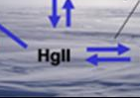
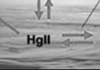
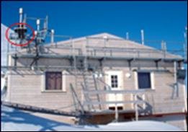
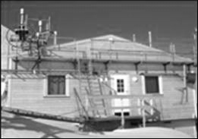
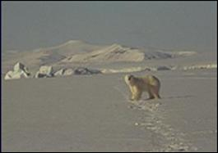
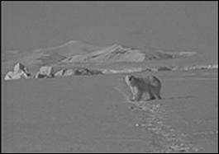
This talk traces what happens to mercury after it depletes from the atmosphere in arctic regions
Theory for mercury cycling
Measurements from Station
Environmental implications
Notes:
Sample mapping slide.
Reference:
Katrina Aspmo, Torunn Berg, and Grethe Wibetoe, “Atmospheric Mercury Depletion Events (AMDEs) in Polar Regions During Arctic Spring,” presentation (Oslo, Norway: University of Oslo, 16 June 2004).

Slide 9
Notes:
Blank slide for drafting mapping slide

Slide 10
This sentence headline makes an assertion on the first topic in no more than two lines
Image(s)
supporting
above assertion
If necessary, identify key assumption or background for audience—keep to two lines (18–24 point type)
Notes:
Body slide from the first section of the presentation’s middle. Consider having the first-topic image from the mapping slide repeated here. Use the headline (no more than two lines) to make an assertion about this topic. In the body of the slide, support that headline with images and with words, if necessary. See Chapter 4 of CSP.
This slide shows one orientation for the image and text in the body of the slide. Other orientations appear in this template. Choose the one that best supports your headline assertion.
Some institutions will insist that you place an institutional logo on each slide. Other institutions recommend a logo on the first slide and the last. If you do place a logo on each slide, make sure that logo is at the bottom of the slide rather than the top. Placing the logo at the top (the place on a slide that receives the most emphasis) shifts the emphasis away from the work and to the people or place doing the work.

Slide 11


When an object in space re-enters Earth, friction from the atmosphere causes the object to heat to 3000⁰F
[www.esa.com]
Notes:
Example assertion-evidence slide from an engineering ambassador presentation. The sentence headline succinctly states the main message of the slide. The message should be one or two lines—our research has found that headlines more than two lines are not read. The visual evidence in this case is an artistic drawing. Such evidence could be photographs, drawings, diagrams, graphs, films, or equations. Bulleted lists are shunned, because bullets do not show connections.
Note the reference listing at the bottom to give credit to the source for the artistic image. Note also that the full URL is not place on the slide—that is too long to show. The full URL, though, should be kept somewhere in case you need to retrieve it.
References:
Alley, Michael (2013). The Craft of Scientific Presentations, 2nd ed. New York: Springer-Verlag.
Alley, Michael (2003). Rethinking the design of presentation slides: The assertion-evidence structure. http://writing.engr.psu.edu/slides.html.
Harrison, Kim & Kirsch, Kathryn (2010). Space exploration: To infinity and beyond. University Park: Penn State Engineering Ambassadors.

Slide 12
Notes:
Blank slide for drafting a body slide.

Slide 13
This sentence headline makes an assertion
on the second topic in no more than two lines
Call-out, if necessary: keep to one or two lines
Call-out, if necessary: keep to one or two lines
Image or equations supporting
the headline assertion
Call-out, if necessary: keep to one or two lines
Notes:
Body slide from the second section of the presentation’s middle. For the first body slide of this second section, consider repeating the corresponding image (or equation) from the mapping slide. Use the headline to make an assertion about this topic. In the body of the slide, support that headline assertion with images and with words, if necessary. See Chapter 4 of CSP.
This slide shows one orientation for the image and text in the body of the slide. Other orientations appear in this template. Choose the orientation that best supports your headline assertion.

Slide 14
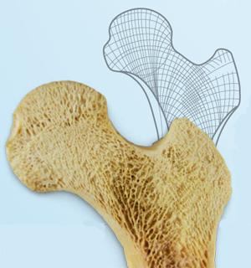
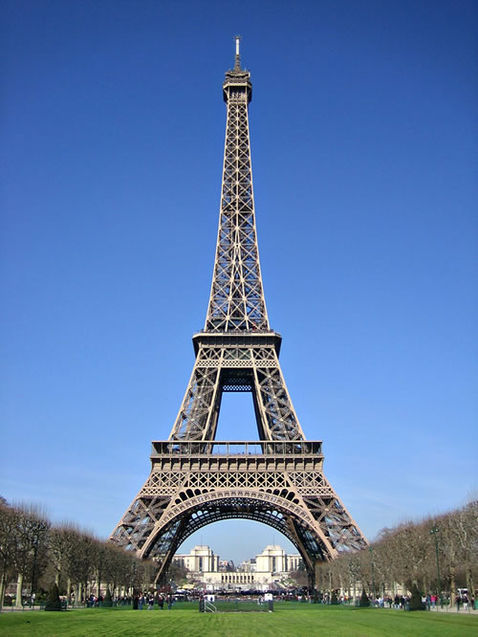
Trabeculae reduce a bone’s weight while giving it maximum strength against multiple forces
Gustav Eiffel, 1889
[www.travlang.com]
[http://www.answersingenesis.org]
Notes:
Example assertion-evidence slide from an engineering ambassador presentation. Words from the speaker are along these lines: “One of the most unique features of bone – the mathematically precise patterned structure that gives rise to trabeculae, which were discovered in the 1860s. Gustav Eiffel said he was inspired by this newly discovered bone structure when he designed the Eiffel Tower at the World Fair in 1889.”
References:
Alley, Michael (2013). The Craft of Scientific Presentations, 2nd ed. New York: Springer-Verlag.
Alley, Michael (2003). Rethinking the design of presentation slides: The assertion-evidence structure. http://writing.engr.psu.edu/slides.html.
Brown, Genevieve (2010). Engineering the human body: Bone repair and reconstruction. University Park: Penn State Engineering Ambassadors.

Slide 15
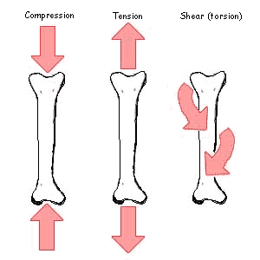
Materials used to reconstruct damaged bones must have similar structural characteristics as healthy bone
Compression
Tension
Shear (torsion)
[depts.washington.edu]
Notes:
Example assertion-evidence slide from an engineering ambassador presentation. The sentence headline succinctly states the main message of the slide. The message should be one or two lines—our research has found that headlines more than two lines are not read. Note that the sentence headlines always begin in the same place—upper left corner and left justified. That formatting allows for faster reading. To achieve that, you have to overcome PowerPoint’s lousy defaults. That is why presenters should begin with a professionally crafted template, such as this one.
Transition words from the speaker are along these lines: “So just as Gustav Eiffel considered bone’s unique properties in designing a building that must be light and withstand high forces, engineers must understand the structural properties of bone when they are designing materials to reconstruct damaged bone.”
References:
Alley, Michael (2013). The Craft of Scientific Presentations, 2nd ed. New York: Springer-Verlag.
Alley, Michael (2003). Rethinking the design of presentation slides: The assertion-evidence structure. http://writing.engr.psu.edu/slides.html.
Brown, Genevieve (2010). Engineering the human body: Bone repair and reconstruction. University Park: Penn State Engineering Ambassadors.

Slide 16
Notes:
Blank slide for drafting a body slide.

Slide 17
This sentence headline makes an assertion
on the third topic in no more than two lines
Image supporting above assertion
Feature or call-out—no more than two lines
Feature or call-out—no more than two lines
Notes:
Body slide from the third section of the presentation’s middle. For the first body slide of this third section, consider repeating the corresponding image from the mapping slide. Use the headline to say state an assertion about this topic. In the body of the slide, support that headline with images and with words, if necessary. See Chapter 4 of CSP.
This slide shows one orientation for the image and text in the body of the slide. Other orientations appear in this template. Choose the orientation that best supports your headline assertion.

Slide 18
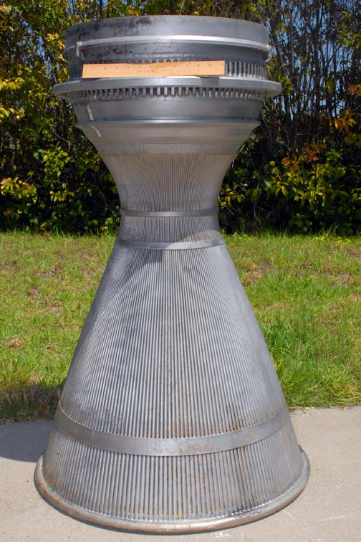
The Law of Conservation of Mass is used to calculate the velocity inside of a nozzle
A₁
A₂
[www.air-n-space.com]
Notes:
Example assertion-evidence slide from an engineering ambassador presentation. Note that the visual evidence in this case is a combination of a photograph and a drawing. Call-outs are used to label the drawing. Other types of evidence could be photographs, drawings, diagrams, graphs, films, or equations. Bulleted lists are shunned, because bullets do not show connections.
Finally note the reference listing at the bottom to give credit to the source for the artistic image.
References:
Alley, Michael (2013). The Craft of Scientific Presentations, 2nd ed. New York: Springer-Verlag.
Alley, Michael (2003). Rethinking the design of presentation slides: The assertion-evidence structure. http://writing.engr.psu.edu/slides.html.
Harrison, Kim & Kirsch, Kathryn (2010). Space exploration: To infinity and beyond. University Park: Penn State Engineering Ambassadors.

Slide 19







The Law of Conservation of Mass is used to calculate the velocity inside of a nozzle
A₁
A₂
Notes:
Example assertion-evidence slide from an engineering ambassador presentation. Note the visual evidence in this case is a combination of a drawing and equations. Call-outs are used to label evidence. Animation is used to sequence in evidence that otherwise could overwhelm the audience. Note that the animation used is appear. Animation is much smoother to use than a laser pointer.
References:
Alley, Michael (2013). The Craft of Scientific Presentations, 2nd ed. New York: Springer-Verlag.
Alley, Michael (2003). Rethinking the design of presentation slides: The assertion-evidence structure. http://writing.engr.psu.edu/slides.html.
Harrison, Kim & Kirsch, Kathryn (2010). Space exploration: To infinity and beyond. University Park: Penn State Engineering Ambassadors.

Slide 20
Notes:
Blank slide for drafting a body slide.

Slide 21
In summary, this sentence headline states the most important assertion of the presentation
Supporting point (no more than two lines)
Another supporting point (parallel to the first)
Image that supports conclusion
Questions?
Logo
Notes:
Conclusion slide. Use the headline (no more than two lines) to state your most important conclusion. Begin the headline with In summary or In conclusion to ensure that the audience knows they have come to the presentation’s end. Support that headline with an image and parallel points.
This slide should be your last slide. Audiences lose patience when they believe that they have come to the end, but other slides follow.
Notice that the word Questions appears at the bottom of this slide. That strategy is much more effective than burning a slide with just the word Questions. This slide allows the audience to look at the most important slide of the presentation during the question period. See CSP, pages 182-183.

Slide 22
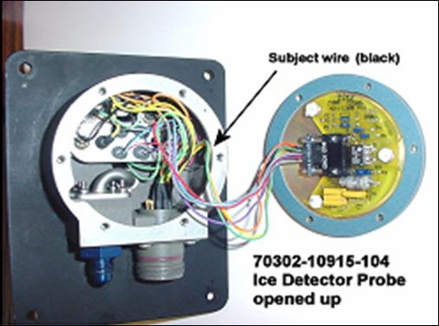

In summary, the detector failed because of a short-circuit created by the abrasion of wire insulation
Wires not harnessed to prevent
contact with housing
Short circuit to ground created
where wire contacted housing
Questions?
Notes:
Sample conclusion slide. Notice how the presenter showed the connection between words blocks on this slide—a strategy that is much more effective than a bullet list, which hides the connections between details.
Reference:
Manning Seltzer, “Failure Analysis of the Ice Detector in the Austria 13 Helicopter,” presentation (Hartford, CT: Sikorsky Helicopter, 30 April 2004).

Slide 23
Notes:
Blank slide for drafting a body slide.

