Slide 1
ERB
Front-end Development
Final Project
Class: PE075DS-1
Chan Yin-man, Ivan(8)
Cheung Ying Ki, Evan(15)
Wong Wing Sum, Wilson(17)

Slide 2
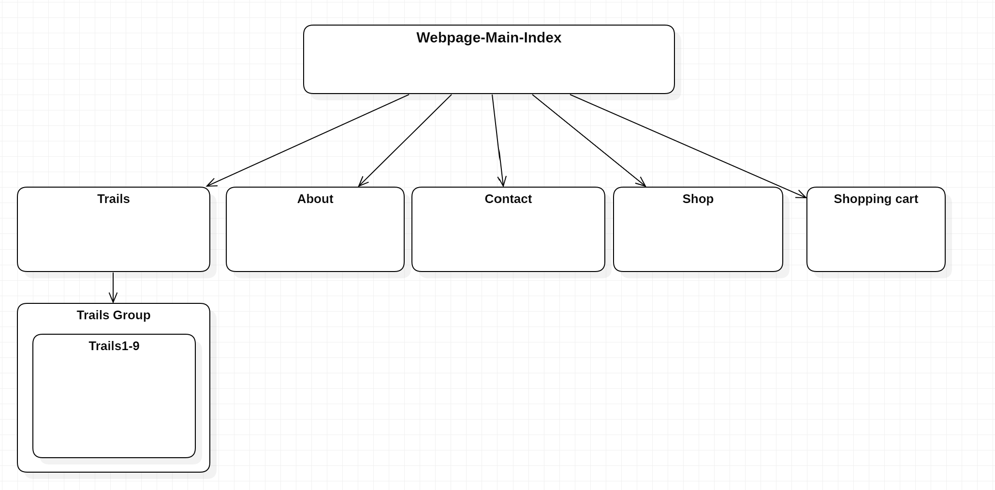
Webpage Structure

Slide 3
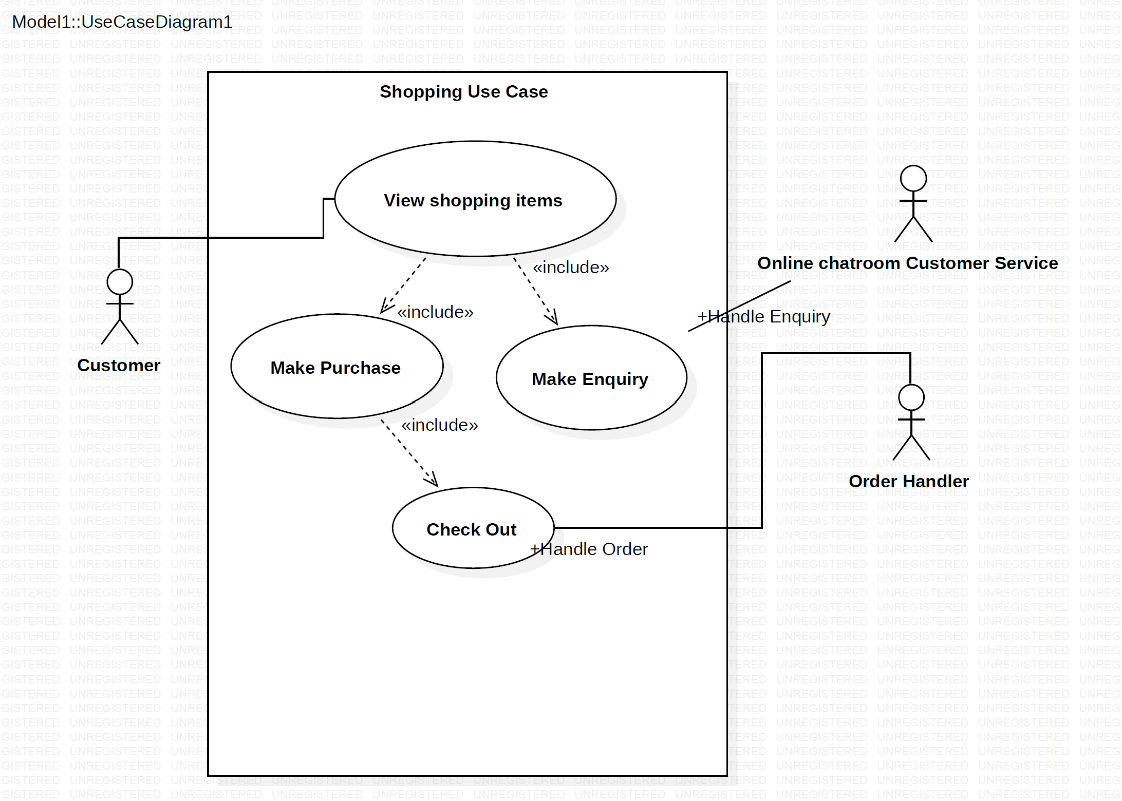
Use Case Diagram

Slide 4
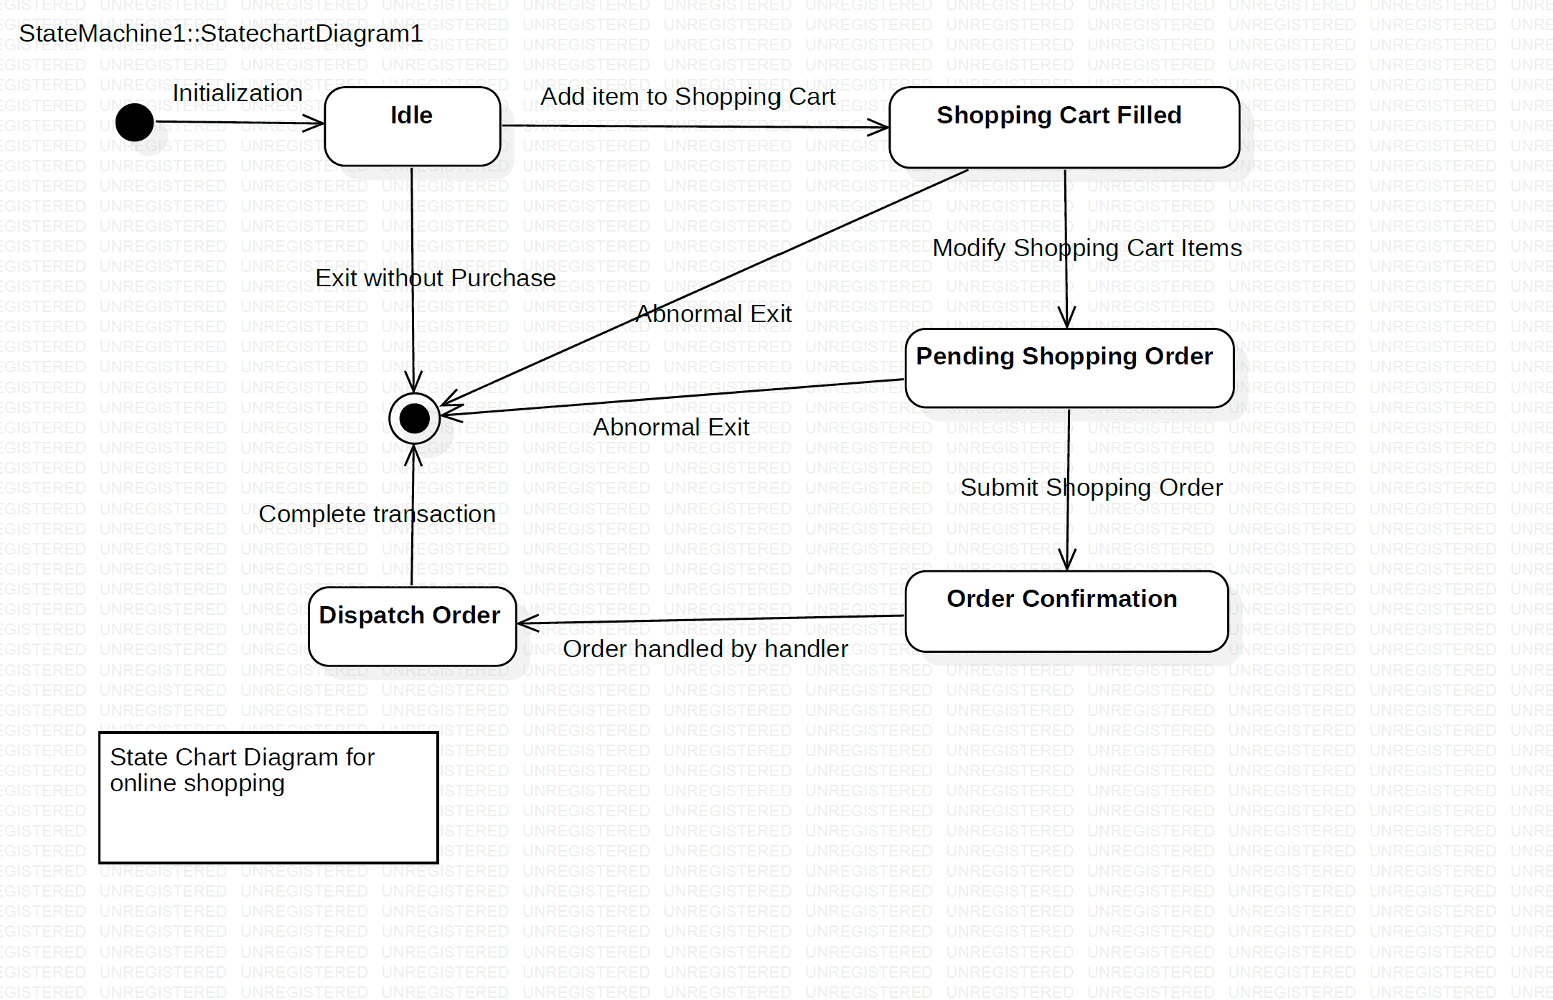
State Chart Diagram

Slide 5
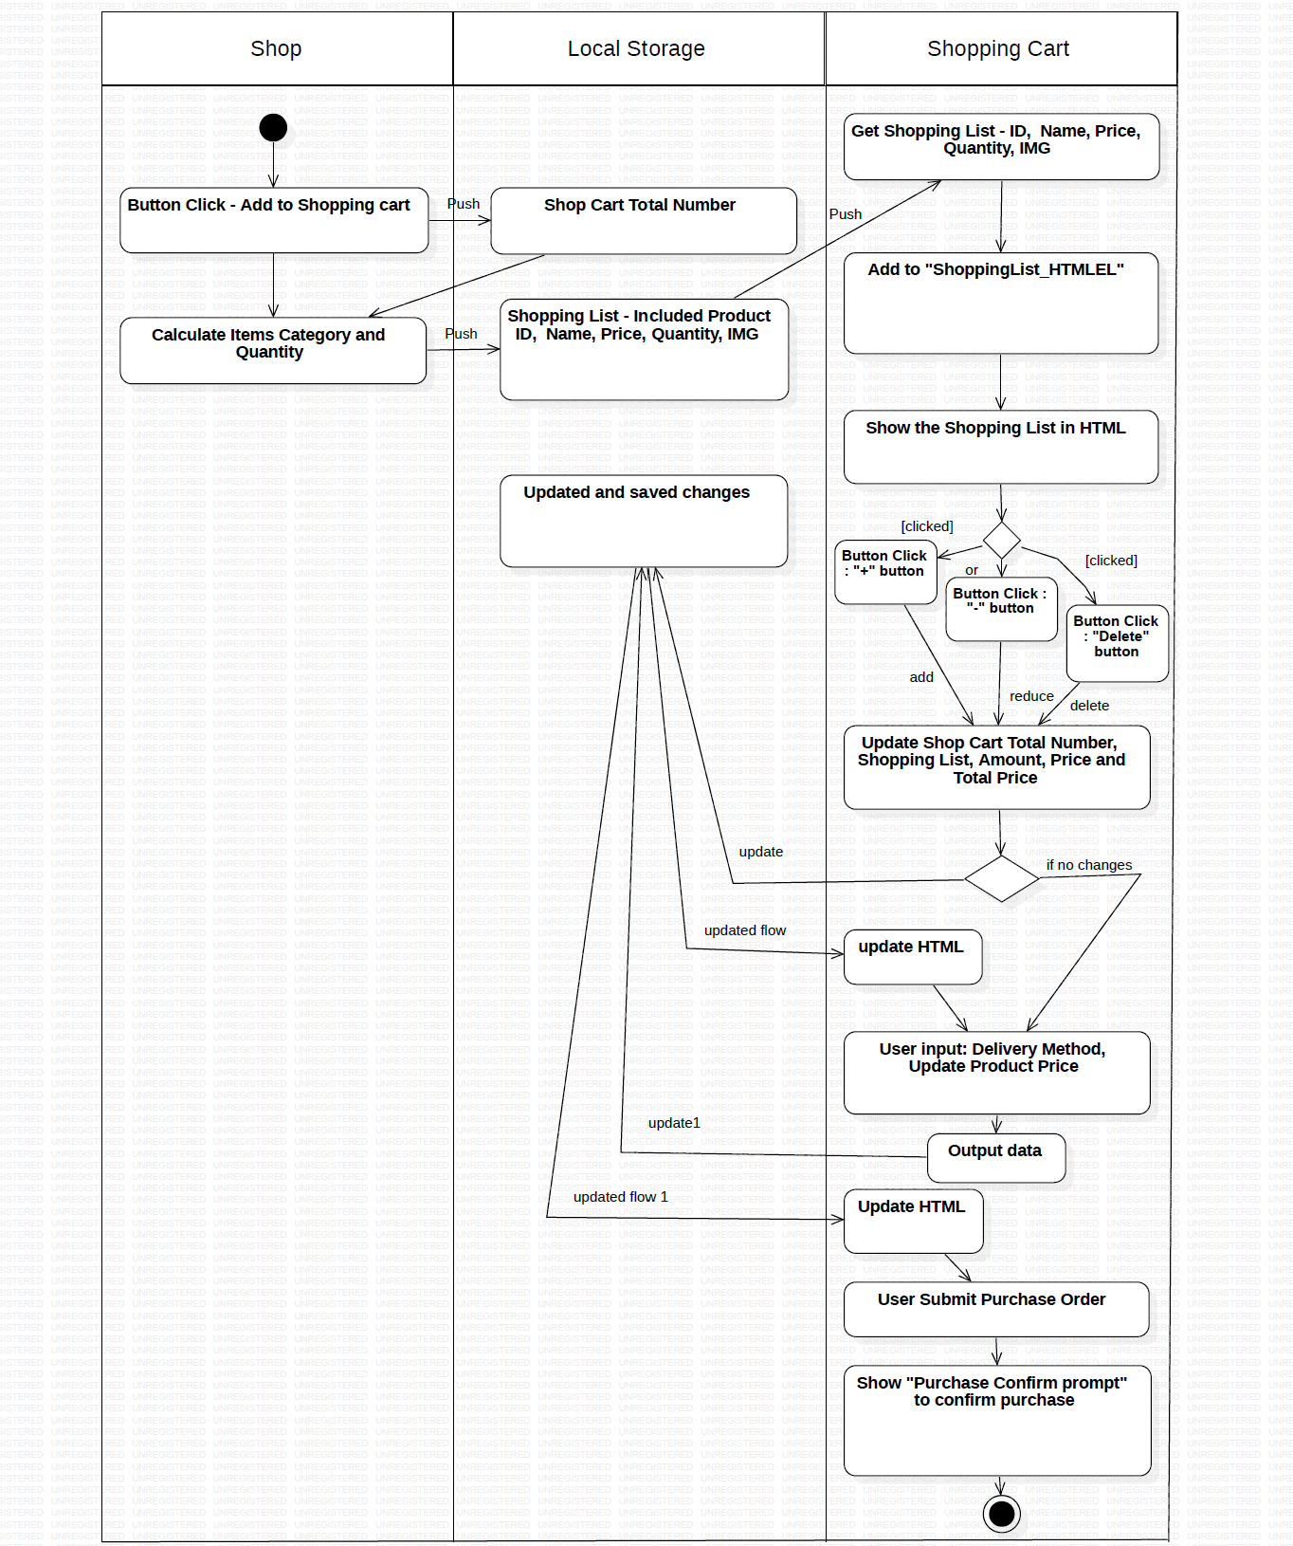
Activity Flow Diagram

Slide 6
Webpage
Demo

Slide 7
Thank you! ~

