Slide 1
ERB
Final Project
Class: PE075DS-1
Chan Yin-man, Ivan(8)
Cheung Ying Ki, Evan(15)
Wong Wing Sum, Wilson(17)

Slide 2
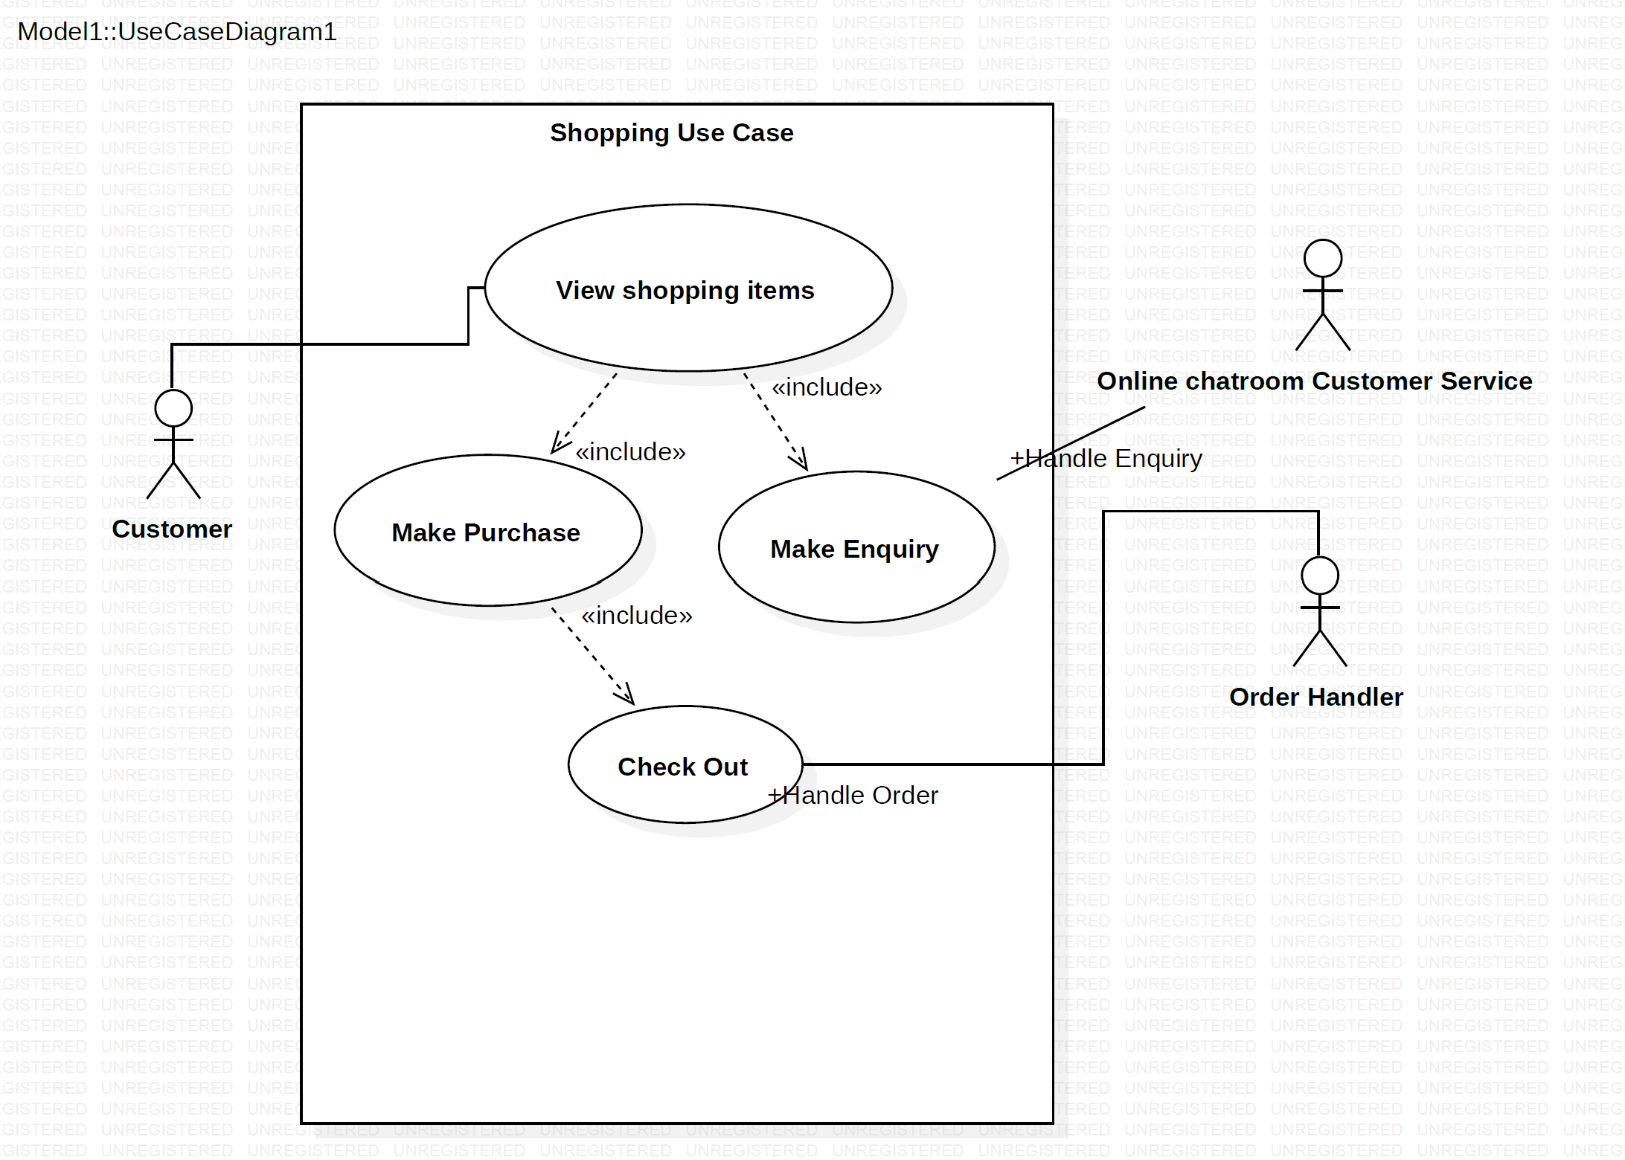
Use Case Diagram

Slide 3
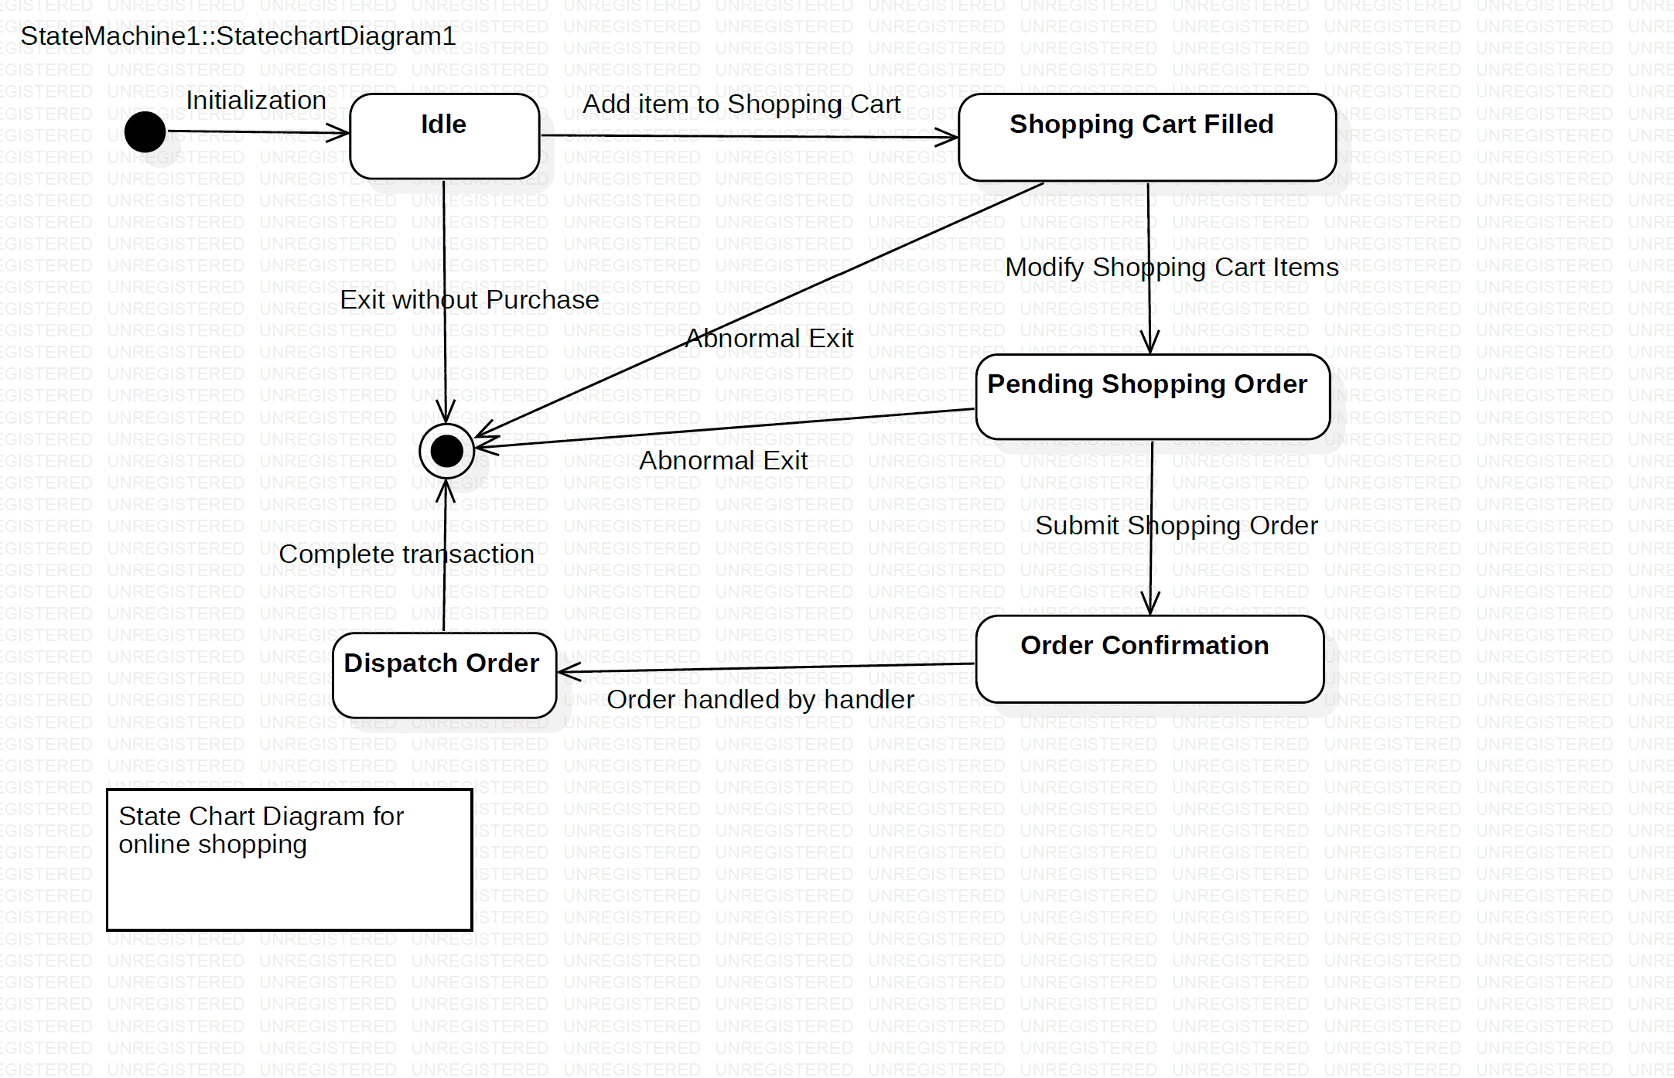
State Chart Diagram

Slide 4
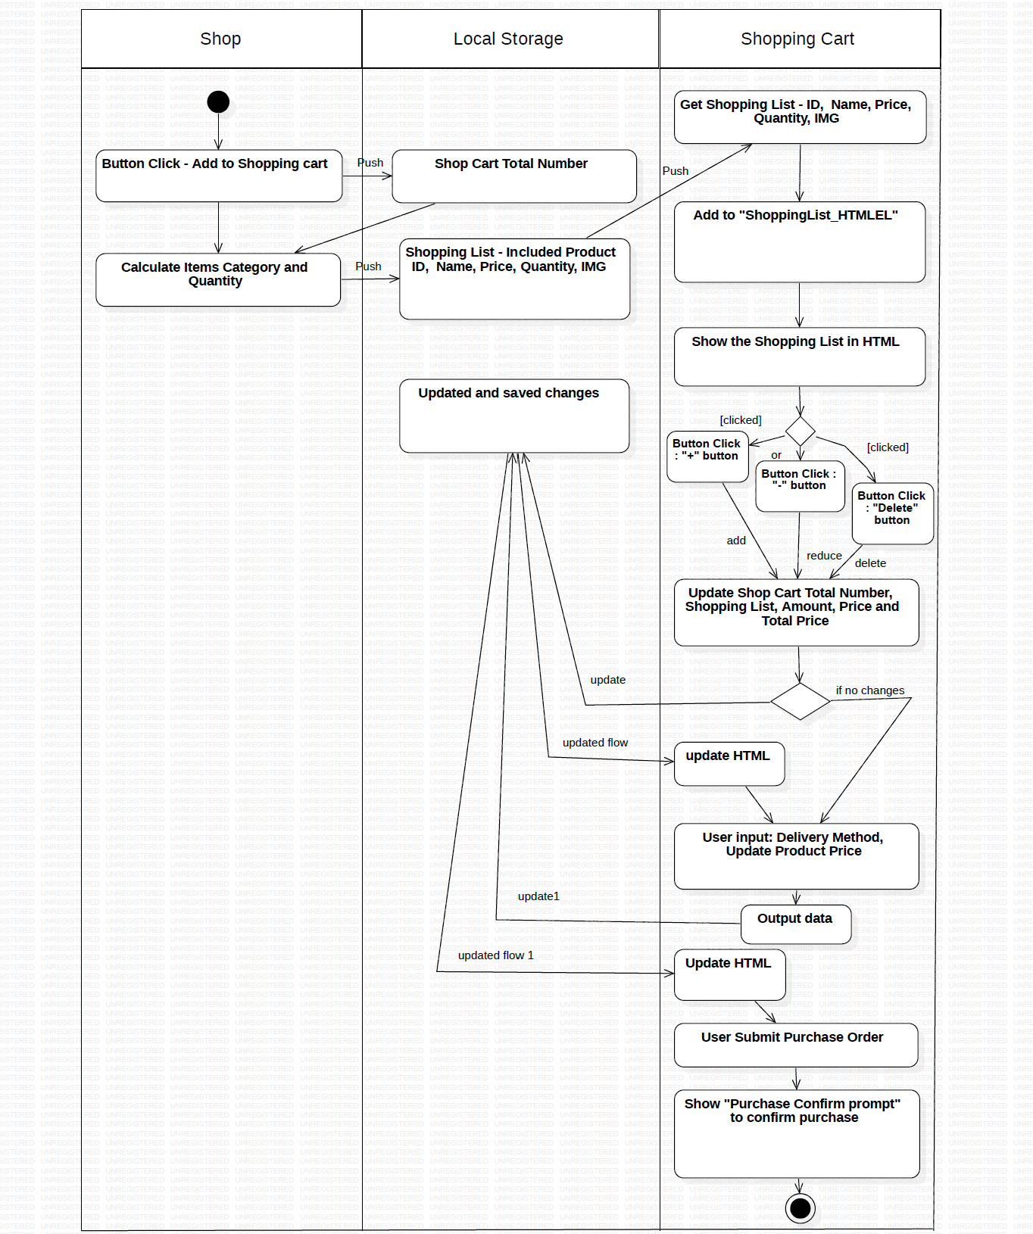
Activity Flow Diagram

Slide 5
Webpage
Demo

Slide 6
Thank you! ~

