Slide 1
Tracking the Emotional Pulse of Doctor–Patient Discourse on Weibo: A Corpus-Based Study 基于微博语料的医患关系情感表达和演变研究
Course: Applied Linguistics & ELT
Presenter: 俞一帆
Date: June 2025

Slide 2
Background & Rationale
Violent incidents of injuring doctors have emerged one after another in recent years, frequently triggering emotional online discussions in China, which are often dominated by negative sentiment (Chen et al., 2024; Lu et al., 2024).
Weibo, as a large-scale, real-time emotional outlet, provides an unprecedented corpus for analysis.
While existing literature offers valuable insights, it often focuses on single events (Tu & Liu, 2015; Zheng et al., 2025) or specific domains (Song et al., 2022), leaving a gap in the long-term, dynamic tracking of the overall topic.
Therefore, this study employs corpus-based sentiment analysis to provide a quantifiable, diachronic insight into the discourse evolution from 2019 to 2025.

Slide 3
Significance & Value
Theoretical Significance
Provides large-scale, diachronic empirical evidence for the sociolinguistic study of medical discourse in the social media context.
Moves beyond description by linking discourse evolution (sentiment shifts, topic changes) to macro-social concepts such as social trust, institutional credibility, and group polarization.
Practical & Pedagogical Significance
For Healthcare & Communication: Offers a data-driven “emotional pulse” for public sentiment monitoring and provides insights for improving doctor-patient communication training.
For Language Education (Applied Linguistics & ELT): The corpus serves as an authentic resource for English for Medical Purpose (EMP), and the research process itself provides a case study for implementing Data-Driven Learning (DDL).
Notes:
"In summary, the value of this research is twofold:"
"Academically, it provides large-scale, empirical evidence for the sociolinguistic study of medical discourse."
"Practically, it offers data-driven support for both public sentiment monitoring and doctor-patient communication training."

Slide 4
Research Questions
RQ1: What is the foundational sentiment polarity of the discourse?
RQ2: How do public sentiment and focus evolve over time(2019-2025)?
RQ3: What topics and features characterize different sentiments??

Slide 5
Data & Corpus Construction
1. Data Collection
Source: Sina Weibo (Original posts & comments)
Time Span: Jan 1st 2019 – May 31st 2025
Keyword: “医患关系” (doctor-patient relationship).
2. Corpus Size
93,548 unique, relevant entries after cleaning and deduplication.
Total Characters: 17,946,839
3. Data Preprocessing
Data Cleaning:
Conversion of timestamps and numeric fields.
Systematic removal of URLs, ads, and irrelevant noise.
remove @mentions and #hashtags# (retaining text content).
Deduplication Strategy:
Advanced deduplication based on cleaned text content, keeping the entry with the highest engagement (likes + reposts + comments).
Filtering:
Removal of posts shorter than 10 characters.

Slide 6
Methods
Stage 1: Corpus Profiling & Sentiment Scoring (Answering RQ1)
Descriptive Statistics:
Calculate and visualize the monthly volume of posts and engagement (likes, reposts, comments) to map the discourse hotspots over time.
Sentiment Analysis:
Assign a sentiment score to each post using established NLP tools (e.g., cntext and DUTIR).
Goal: Determine the overall sentiment distribution (positive, negative, neutral) of the entire corpus.

Slide 7
Methods
Stage 2: Diachronic Analysis of Sentiment & Topics (Answering RQ2)
Sentiment Trend Analysis:
Aggregate monthly mean sentiment scores to plot the "emotional pulse" from 2019 to 2025.
Correlate sentiment peaks and troughs with major real-world events.
Topic Evolution Modeling:
Apply LDA (Latent Dirichlet Allocation) Topic Modeling to the entire corpus to identify a stable set of core themes.
Track the prevalence (average weight and propotion) of these themes on a yearly basis to reveal shifts in public focus.
Goal: Reveals how and when public opinion changed.

Slide 8
Methods
Stage 3: Comparative Analysis of Discourse Features (Answering RQ3)
Sentiment-Based Sub-corpora:
Create separate sub-corpora based on sentiment polarity (e.g., positive vs. negative texts).
Feature Comparison:
Compare the dominant topics (from LDA) and characteristic keywords (from TF-IDF) between the positive and negative sub-corpora.
Visualize keyword co-occurrence networks to explore semantic contexts.
Goal: Explains what people discuss when they express different emotions.

Slide 9
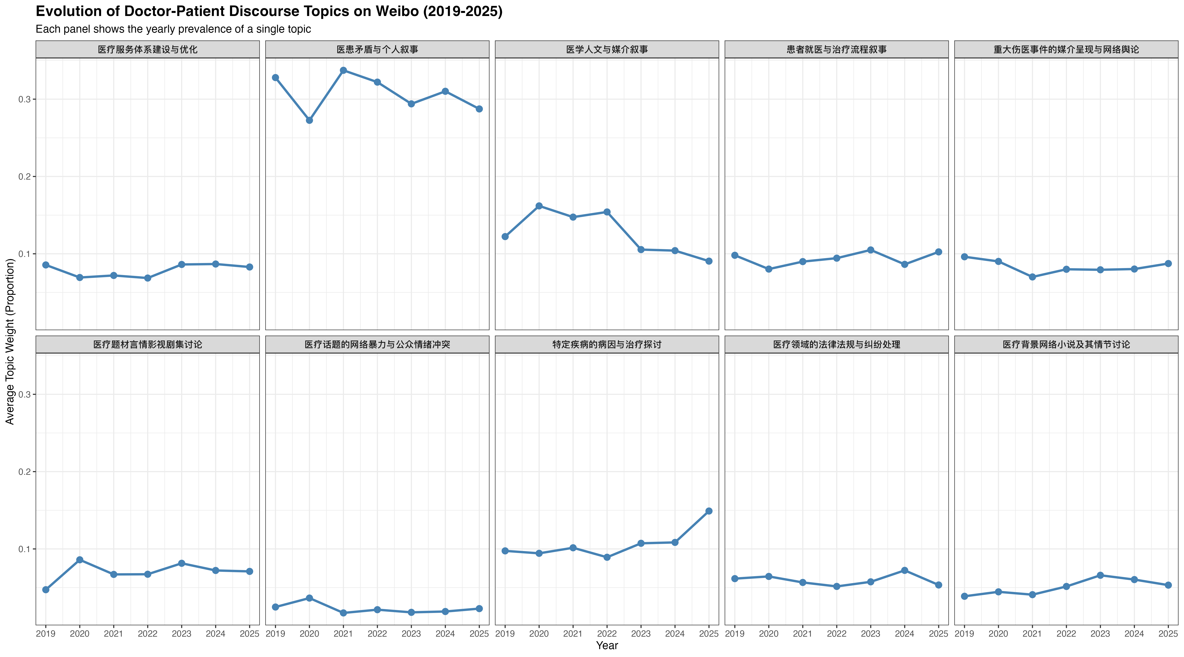
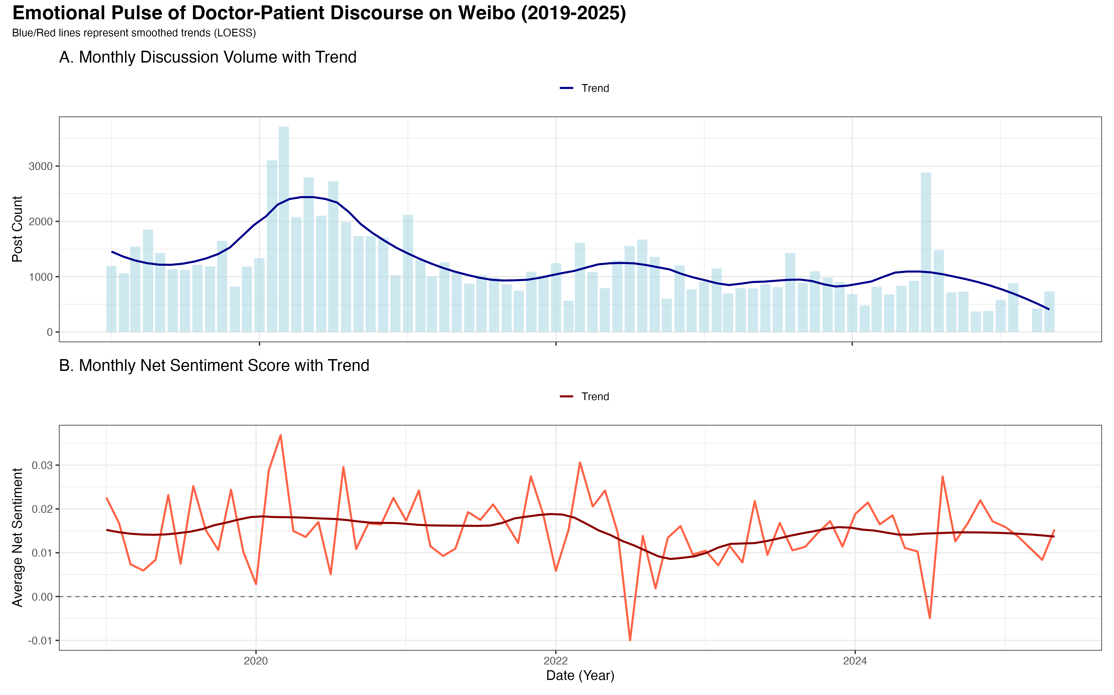
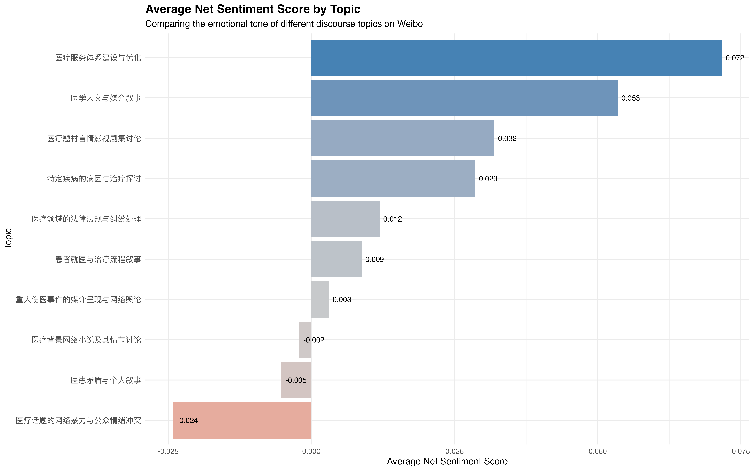
Preliminary Results
topic evolution
emotional pulse
sentiment score by topic

Slide 10
References
Chen, X., Jia, Y., & Liu, X. (2024). Analyzing patient experience on Weibo: Machine learning approach to topic modeling and sentiment analysis. JMIR Medical Informatics, 12, e55462. https://doi.org/10.2196/55462
Lu, X., Li, X., Wu, F., Yu, M., & Zhou, L. (2024). Emotional differences based on comments on doctor-patient disputes with varying levels of severity. World Journal of Psychiatry, 14(7), 1068–1079. https://doi.org/10.5498/wjp.v14.i7.1068
Song, C., Li, S., Zhang, Y., & Li, H. (2022). Comprehensive evolution analysis of public perceptions related to pediatric care: A Sina Weibo case study (2013–2020). SAGE Open, 12(1). https://doi.org/10.1177/21582440221087260
Tu, G., & Liu, S. (2015). 社交媒体环境下医患暴力冲突事件的媒介呈现研究 [A study on the media representation of doctor-patient violent conflict incidents in the social media environment]. 国际新闻界 [Chinese Journal of Journalism & Communication], 37(6), 133–148.
Zheng, Y., Liu, T., & Zhang, Y. (2025). Public attitudes toward violence against doctors: Sentiment analysis of Chinese users. JMIR Medical Informatics, 13, e63772. https://doi.org/10.2196/63772

