Slide 1
Hello World
Getting started with F# interactive

Slide 2
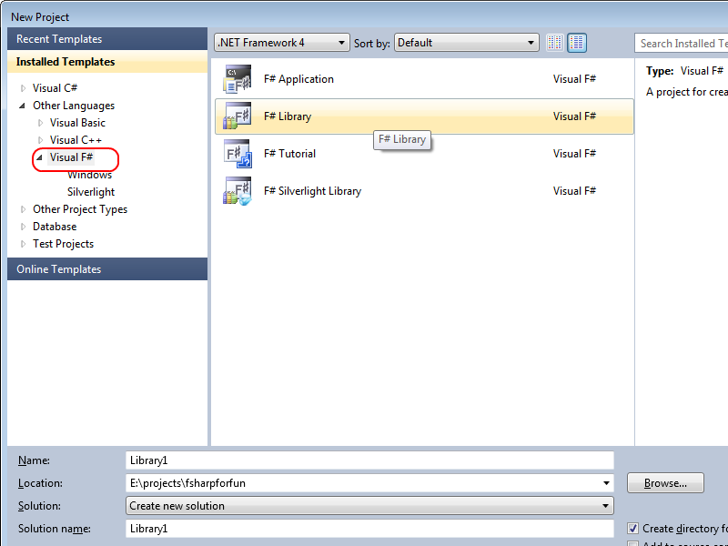

Slide 3
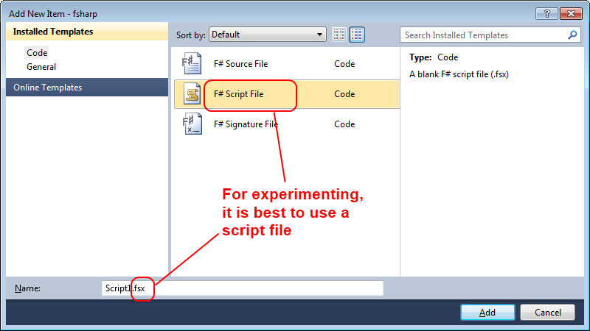

Slide 4
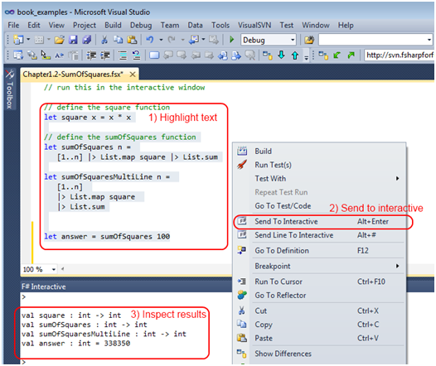

Slide 5
What is DDD and F#?
Hello world!
printfn "hello world"
let myName = "Scott"
printfn "my name is %s" myName
let add x y = x + y
add 1 2 |> printfn "1 + 2 = %i"
Notes:
Focus on the domain and domain logic rather than technology
A creative collaboration between technical and domain experts to iteratively refine a conceptual model that addresses particular domain problems.
I’m going to be jumping back and forth between F# concepts and DDD concepts. And attempting to explain them to those who are not familar.
In order to cover the terrotory quickly, I will be making some oversimplifications in both DDD and F#, so the to the experts in those areas, please forgive me

Slide 6
Hello world
a) This snippet does not need a containing class.
b) It can be run directly in an interactive environment
printfn "hello world"
c) There is a space between the `printfn` function and its parameter, rather than a parenthesis. This will be very important later!

Slide 7
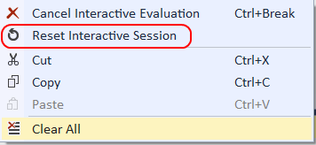
Hello world
In interactive mode, this value is stored globally
let myName = "Scott"
printfn "my name is %s" myName
To clear the globals, right click and do “reset”

