Slide 1
Introduction to the core principals of Functional Programming

Slide 2
Myths about functional programming

Slide 3
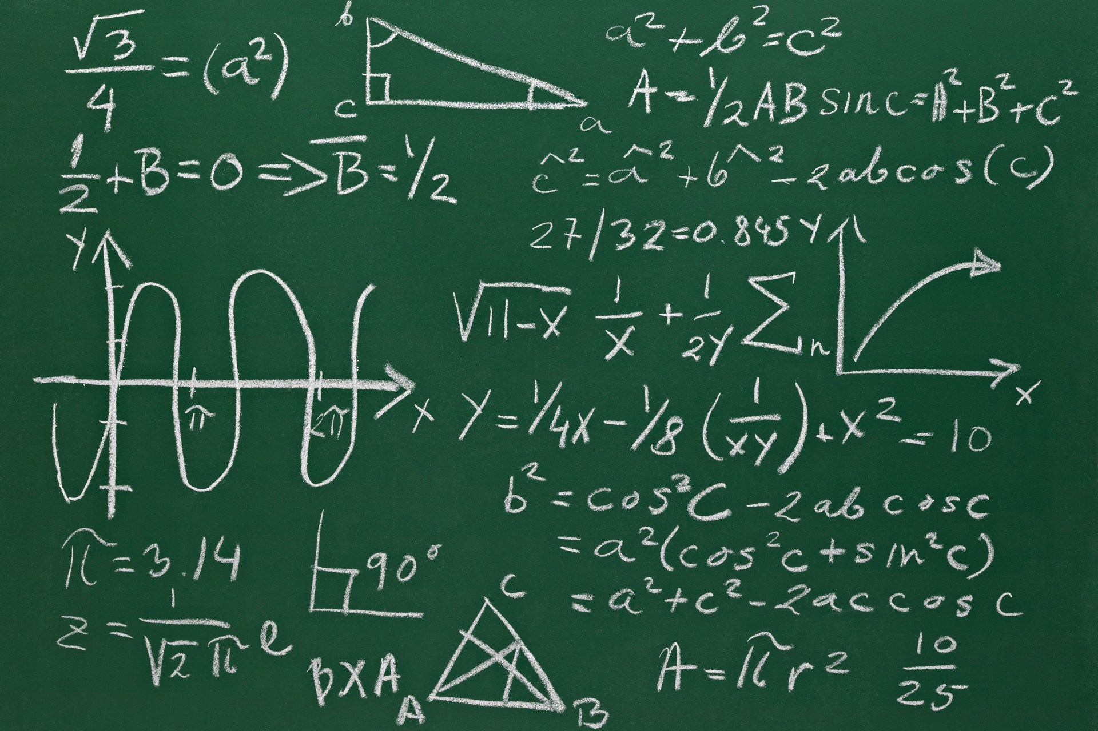
Functional programming is...
I’ve heard that...

Slide 4
Functional programming is...
I’ve heard that...
... good for mathematical and scientific tasks
... good for complicated algorithms
... really good for parallel processing
... but you need a PhD in computer science ☹
All true...
So not true...

Slide 5
Functional programming is good for...
really ^
Boring
Line Of Business
Applications
(BLOBAs)

Slide 6
Must haves for BLOBA development...
Express requirements clearly
Rapid development cycle
High quality deliverables
Easy to communicate domain accurately.
An interactive environment and many conveniences to make teams highly productive
type system ensures correctness
Fun
"fun" is a keyword in F#

Slide 7
Understanding functional programming
A non-technical overview

Slide 8
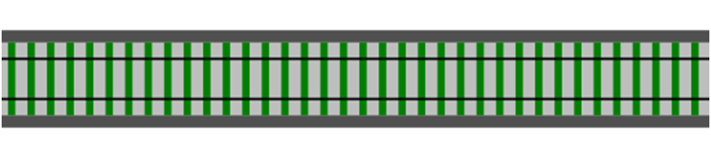
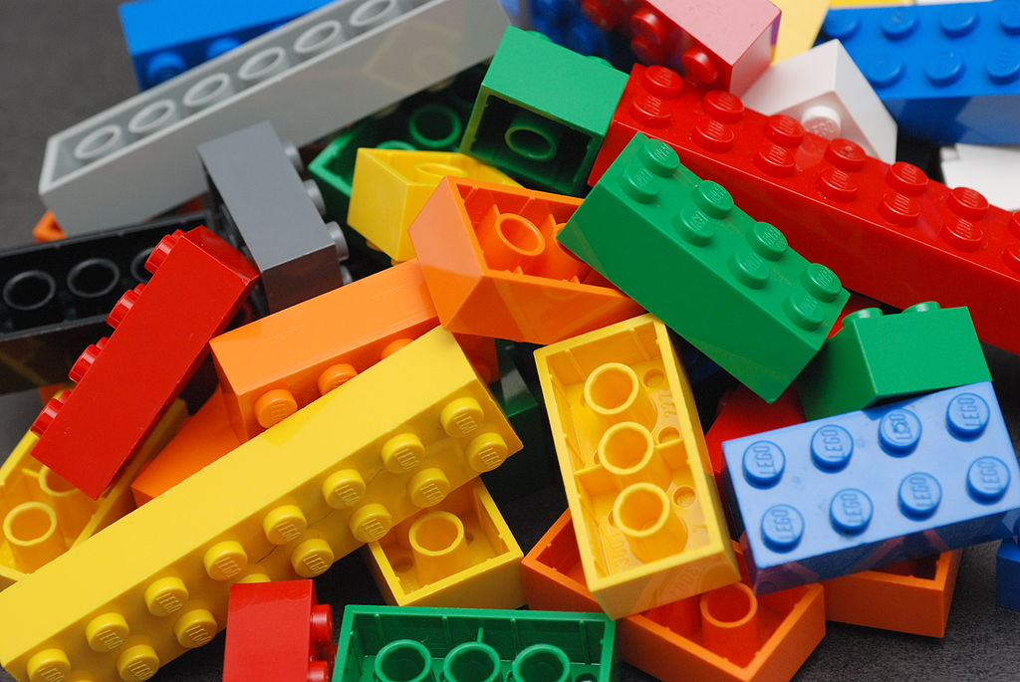
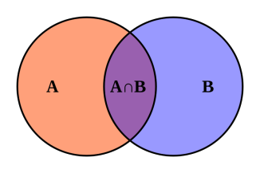
Functional programming in 3 easy steps
Functions
Function
Composition
Types

Slide 9
What are functions?
Function

Slide 10

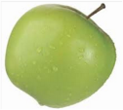
The Tunnel of Transformation
Function apple -> banana
A function is a thing which transforms inputs to outputs

Slide 11
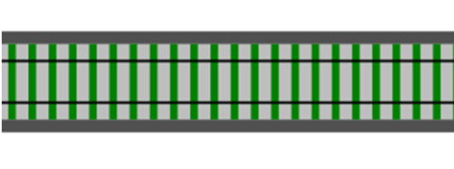

A function is a standalone thing, not attached to a class
It can be used for inputs and outputs of other functions
input
A function can be an output
output
A function can be an input
A function can be a parameter
input
output
from a simple foundation => build complex systems

Slide 12
What is composition?

Slide 13

Function 1 apple -> banana
Function 2 banana -> cherry

Slide 14
Function 1 apple -> banana
Function 2 banana -> cherry
>>
Composition

Slide 15
New function
New Function apple -> cherry
Can't tell it was built from smaller functions!
Where did the banana go?
(abstraction)

Slide 16
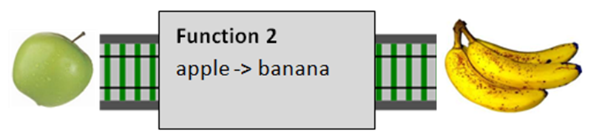
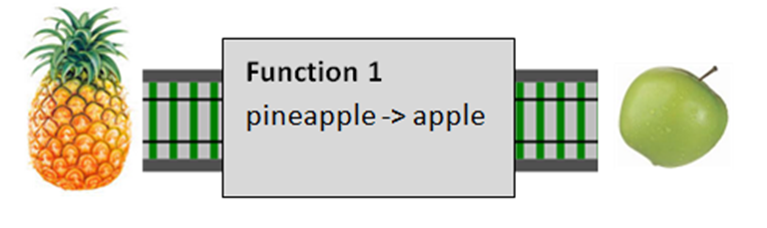
Composition is type checked!
X
>>
☹

Slide 17

An application is glued together from smaller functions

Slide 18
Low-level operation
string
ToUpper
string

Slide 19
Low-level operation
Low-level operation
Low-level operation
>>
>>
Composition
Service
Address
AddressValidator
Validation Result
Btw, a “Service” is just like a microservice but without the "micro" in front

Slide 20
Service
Service
Service
>>
>>
Composition
Use-case
ChangeProfile Request
UpdateProfileData
ChangeProfile Result

Slide 21
Use-case
Use-case
Use-case
>>
>>
Composition
Web application
Http Request
Http Response
“Composition is fractal”

Slide 22
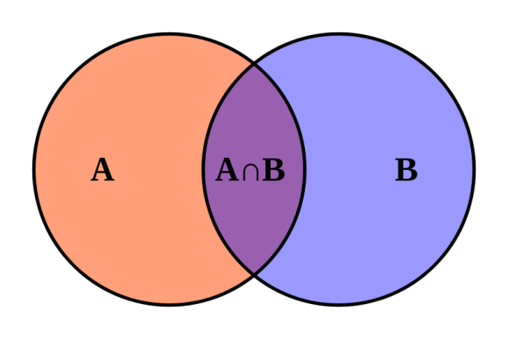
What are types?

Slide 23
What is a type?
Set of valid inputs
Set of valid outputs
Function
A type is a just a name for a set of things

Slide 24
1
2
3
4
5
6
Set of valid inputs
Set of valid outputs
Function
This is type "integer"
A type is a just a name for a set of things

Slide 25
Set of valid inputs
"abc"
"but"
"cobol"
"double"
"end"
"float"
Set of valid outputs
Function
This is type "string"
A type is a just a name for a set of things

Slide 26
Donna Roy
Javier Mendoza
Nathan Logan
Shawna Ingram
Abel Ortiz
Lena Robbins
Gordon Wood
Set of valid inputs
Set of valid outputs
Function
This is type "Person"
A type is a just a name for a set of things

Slide 27
Set of valid inputs
Set of valid outputs
Function
This is type "Fruit"
A type is a just a name for a set of things

Slide 28
Set of valid inputs
Set of valid outputs
Function
This is a type containing functions
A type is a just a name for a set of things

Slide 29
Types can be composed

Slide 30
composable means => like Lego

Slide 31
New types are built from smaller types in two ways

Slide 32
New types are built from smaller types in two ways
"AND"
type FruitSalad =
2 each of and and
Example: pairs, tuples, records

Slide 33
New types are built from smaller types in two ways
"OR"
type Snack = or or
Not available in C# or Java
Example coming up!

Slide 34
Real world example of type composition

Slide 35
type ChequeNumber = int
type CardNumber = string
Primitive types

Slide 36
type ChequeNumber = int
type CardNumber = string
type CardType = Visa | Mastercard
type CreditCardInfo = CardType * CardNumber
ORtype
AND type

Slide 37
type ChequeNumber = int
type CardNumber = string
type CardType = Visa | Mastercard
type CreditCardInfo = CardType * CardNumber
type PaymentMethod =
| Cash
| Cheque of ChequeNumber
| Card of CreditCardInfo
ORtype

Slide 38
type ChequeNumber = int
type CardNumber = string
type CardType = Visa | Mastercard
type CreditCardInfo = CardType * CardNumber
type PaymentMethod =
| Cash
| Cheque of ChequeNumber
| Card of CreditCardInfo
type PaymentAmount = decimal
type Currency = EUR | USD
Another primitive type
Another ORtype

Slide 39
type ChequeNumber = int
type CardNumber = string
type CardType = Visa | Mastercard
type CreditCardInfo = CardType * CardNumber
type PaymentMethod =
| Cash
| Cheque of ChequeNumber
| Card of CreditCardInfo
type PaymentAmount = decimal
type Currency = EUR | USD
type Payment = { Amount : PaymentAmount Currency: Currency Method: PaymentMethod }
AND type
Final type built from many smaller types

Slide 40
Functions
Function
Composition
Types
Congratulations! You now understand functional programming.

Slide 41
The End

Slide 42
Want more?

Slide 43

Forget everything you know about Object-Oriented programming
Before going further...

Slide 44
You must pass this test...
What is an object?
What is inheritance?
What is a subclass?
What is an exception?
What is casting?
What is overloading?
Correct answer: "I don't know!"

Slide 45
Four things that are very different
Function-oriented
Not object oriented
Expressions
rather than statements
Algebraic Types
for domain models
Pattern matching
for control flow

Slide 46
Functions and Mathematics
“Programming is one of the most difficult branches of applied mathematics” - E. W. Dijkstra

Slide 47
Domain (int)
Codomain (int)
…
-1
0
1
2
3
…
…
0
1
2
3
4
…
Function add1(x) input x maps to x+1

Slide 48
A function doesn’t “do” anything
Domain (int)
Codomain (int)
…
-1
0
1
2
3
…
int add1(int input)
{
switch (input)
{
case 0: return 1;
case 1: return 2;
case 2: return 3;
case 3: return 4;
etc ad infinitum
}
}
…
0
1
2
3
4
…
Function add1(x) input x maps to x+1
Input and output values already exist
A function is not a calculation, just a mapping
Input and output values are unchanged (immutable)

Slide 49
Domain (int)
Codomain (int)
…
-1
0
1
2
3
…
int add1(int input)
{
switch (input)
{
case 0: return 1;
case 1: return 2;
case 2: return 3;
case 3: return 4;
etc ad infinitum
}
}
…
0
1
2
3
4
…
Function add1(x) input x maps to x+1
A (mathematical) function always gives the same output value for a given input value
A (mathematical) function has no side effects

Slide 50
Anything can be mapped
Domain (days of week)
Codomain (hours)
…
Sun Mon Tue Wed …
int workingHours(Day input)
{
switch (input)
{ case Sun: return 0;
case Mon: return 8;
case Tue: return 8;
case Wed: return 8;
etc
}
}
…
0
8
8
8
…
Function WorkingHours(x) input Day maps to hours

Slide 51
Domain (customer)
Codomain (string)
…
Cust1 Cust2 Cust3 Cust3 …
string CustomerName(Customer input)
{
switch (input)
{ case Cust1: return “Alice”;
case Cust2: return “Bob”;
case Cust3: return “Sue”;
etc
}
}
…
Alice Bob
Sue John
…
Function CustomerName(x) input Customer maps to string

Slide 52
FP tries to emulate mathematics

Slide 53
Domain (int)
Mathematical function
Codomain (int)
…
-1
0
1
2
3
…
…
0
1
2
3
4
…
Function add1(x) input x maps to x+1

Slide 54
Domain (int)
Codomain (int)
…
-1
0
1
2
3
…
…
0
1
2
3
4
…
F# implementation
let add1 x = x + 1

Slide 55
Domain (int)
Codomain (int)
…
-1
0
1
2
3
…
…
0
1
2
3
4
…
let add1 x = x + 1
add1 : int -> int
Function signature

Slide 56
Domain (int)
Codomain (int)
…
-1
0
1
2
3
…
…
0
1
2
3
4
…
Input is immutable
let add1 x = x + 1

Slide 57
Domain (int)
Codomain (int)
…
-1
0
1
2
3
…
…
0
1
2
3
4
…
let add1 x = x + 1
Output is immutable

Slide 58
Data is immutable
x = 5
y = x+1
y is 6 what is x now?
If x changed we would be in big trouble!

Slide 59
Data is immutable
Take this principle and apply to all parts of the program
Different string! Input not changed
✓
string
ToUpper
string

Slide 60
Functions have no side effects
x = 5
y = x+1
y is 6 Did the missiles launch?
No. We know this for certain!

Slide 61
Functions have no side effects
Take this principle and apply to all parts of the program
No effect on other parts of the application
✓
string
ToUpper
string
We can reason about what this does safely

Slide 62
The power of pure* functions
Trivially parallelizable
Lazy - only evaluate it when I need the output
Cacheable – same answer every time
No dependencies – I can evaluate them in any order I like
* "pure" => has repeatable results and no side effects

Slide 63
"Unhelpful" properties of mathematical functions
The input and output values are immutable
A function always has exactly one input and one output
How in the world can you get anything done?
Actually, you can! Explanation coming soon!

Slide 64
"Values" not "variables"

Slide 65
thing1
thing2
thing3
thing4
Set of valid inputs
Set of valid outputs
Function
A value

Slide 66
Set of valid inputs
Set of valid outputs
Function
A value

Slide 67
Values (F#)
Simple Value let x = 1
Function Value let add1 x = x + 1
A value

Slide 68
Values (C#)
Simple Value int x = 1;
Function Value Func<int,int> add1 = x => x + 1;

Slide 69
Every value has a type (F#)
Simple values let x = 1
Simple types val x : int = 1 // val aName: type = constant
Function values let add1 x = x + 1
Function types val add1 : int -> int
// val functionName : inType -> outType

Slide 70
Every value has a type (C#)
Simple values var x = 1;
Simple types int x
Function values Func<int,int> add1 = x => x + 1;
Function types Func<int,int> add1

Slide 71
Values vs. Objects
A “value” is just a member of a type
Values have no behaviour
Values are immutable
Changes done by external functions
A “object” is an encapsulation of a data structure …
… with its associated behavior
Objects are expected to have state (that is, be mutable)
All operations that change the internal state must be provided by the object itself (via "dot" notation).

Slide 72
Function 1 apple -> banana
What is the type?
Example of a value?

Slide 73
Functions are “total”

Slide 74
Yes, it is a bit contrived!
int
int
…
3
2
1
0
…
int TwelveDividedBy(int input)
{
switch (input)
{
case 3: return 4;
case 2: return 6;
case 1: return 12;
case 0: return ??;
}
}
…
4
6
12
…
twelveDividedBy(x) input x maps to 12/x

Slide 75
int
int
…
3
2
1
0
…
int TwelveDividedBy(int input)
{
switch (input)
{
case 3: return 4;
case 2: return 6;
case 1: return 12;
case 0: return ??;
}
}
…
4
6
12
…
twelveDividedBy(x) input x maps to 12/x
What happens here?

Slide 76
int
int
…
3
2
1
0
…
int TwelveDividedBy(int input)
{
switch (input)
{
case 3: return 4;
case 2: return 6;
case 1: return 12;
case 0: throw InvalidArgException;
}
}
…
4
6
12
…
twelveDividedBy(x) input x maps to 12/x
You tell me you can handle 0, and then you complain about it?

Slide 77
int
int
…
3
2
1
0
…
int TwelveDividedBy(int input)
{
switch (input)
{
case 3: return 4;
case 2: return 6;
case 1: return 12;
case 0: throw InvalidArgException;
}
}
…
4
6
12
…
twelveDividedBy(x) input x maps to 12/x
int
Function int -> int
int
✗
This type signature is a lie!

Slide 78
How can we make the function handle all inputs?

Slide 79
One approach is to constrain the input
NonZeroInteger
int
…
3
2
1
-1
…
int TwelveDividedBy(int input)
{
switch (input)
{
case 3: return 4;
case 2: return 6;
case 1: return 12;
case -1: return -12;
}
}
…
4
6
12
…
twelveDividedBy(x) input x maps to 12/x
0 is missing from input
So 0 doesn’t have to be handled!

Slide 80
One approach is to constrain the input
NonZeroInteger
int
…
3
2
1
-1
…
int TwelveDividedBy(int input)
{
switch (input)
{
case 3: return 4;
case 2: return 6;
case 1: return 12;
case -1: return -12;
}
}
…
4
6
12
…
twelveDividedBy(x) input x maps to 12/x
NonZeroInteger
Function NonZeroInteger -> int
int
✓
Contract is explicit. (Types as documentation!)

Slide 81
Another approach is to extend the output
int
Option<Int>
…
3
2
1
0
-1
…
int TwelveDividedBy(int input)
{
switch (input)
{
case 3: return Some 4;
case 2: return Some 6;
case 1: return Some 12;
case 0: return None;
}
}
…
Some 4
Some 6
Some 12
None …
twelveDividedBy(x) input x maps to 12/x
0 is valid input
But "None" is returned in that case

Slide 82
Another approach is to extend the output
int
Option<Int>
…
3
2
1
0
-1
…
int TwelveDividedBy(int input)
{
switch (input)
{
case 3: return Some 4;
case 2: return Some 6;
case 1: return Some 12;
case 0: return None;
}
}
…
Some 4
Some 6
Some 12
None …
twelveDividedBy(x) input x maps to 12/x
int
Function int -> int option
int option
✓
Contract is explicit. (Types as documentation!)

Slide 83
Explicit contracts mean fewer bugs
Contract is implicit
int -> int
Contract is explicit
NonZeroInteger -> int
Contract is explicit
int -> int option

Slide 84
Explicit contracts mean fewer bugs
Could cause runtime error if misused.
int -> int
NonZeroInteger -> int
These can NEVER cause runtime errors.
int -> int option

Slide 85
Exercises!

Slide 86
Exercise:
Implement “TwelveDividedBy”
Once with constrained input.
Once with optional output.
Implement “StrToDayOfWeek”
With optional output.
Implement “ConvertStrToInt”
Once with constrained input.
Once with optional output.

Slide 87
Transformation oriented programming

Slide 88
"Unhelpful" properties of mathematical functions
The input and output values are immutable
A function always has exactly one input and one output

Slide 89
Immutable
Function 1 apple -> banana
Function 2 banana -> cherry
transformation
transformation

Slide 90
Piping (F#)

Slide 91
Standard way of nesting function calls – can lose focus on what is going on
add1 5 // = 6
double (add1 5) // = 12
square (double (add1 5)) // = 144
5
add1
6
double
12
square
144
This is easier to understand
pipe
5 |> add1 // = 6
5 |> add1 |> double // = 12
5 |> add1 |> double |> square // = 144
pipe

Slide 92
Standard way of nesting function calls – can lose focus on what is going on
add1 5 // = 6
double (add1 5) // = 12
square (double (add1 5)) // = 144
5
add1
6
double
12
square
144
5
|> add1
|> double
|> square // = 144
Splitting onto new lines is more readable for long chains

Slide 93
Piping (C#)

Slide 94
Func<int, int> add1 = x => x + 1;
Func<int, int> doubl = x => x + x;
Func<int, int> square = x => x * x;
5
add1
6
double
12
square
144
5.Pipe(Add1); // = 6
5.Pipe(Add1).Pipe(Double); // = 12
5.Pipe(Add1).Pipe(Double).Pipe(Square);
Helper function

Slide 95
Composition revisited
What’s the difference between piping and composition?

Slide 96
Function 1 apple -> banana
Function 2 banana -> cherry

Slide 97
Function 1 apple -> banana
Function 2 banana -> cherry
>>
Composition

Slide 98
New function
New Function apple -> cherry

Slide 99
Composition (F#)

Slide 100
let add1_double =
add1 >> double
let x = add1_double 5
5
add1
double
12
let add1_double_square =
add1 >> double >> square
let x = add1_double_square 5
5
add1
double
square
144

Slide 101
Composition (C#)

Slide 102
Func<int, int> add1 = x => x + 1;
Func<int, int> doubl = x => x + x;
Func<int, int> square = x => x * x;
var composed =
add1.Compose(doubl).Compose(square);
composed(5);
Helper function

Slide 103
Exercises!

Slide 104
Exercise: Think of a number
Think of a number.
Add one to it.
Square it.
Subtract one.
Divide by the number you first thought of.
Subtract the number you first thought of.
The answer is TWO!
Challenge, write this using a piping model.
Add1
SquareIt
SubtractOne

Slide 105
Exercise: FizzBuzz
Given a number
If it is divisible by 3, return "Fizz"
If it is divisible by 5, return "Buzz"
If it is divisible by 3 and 5, return "FizzBuzz"
Otherwise return the number as a string
Do NOT print anything
Challenge, write this using a piping model.
Test15
Test3
Test5

Slide 106
Exercise: Stack based calculator
1) Write functions for pushing 1,2,3 on the stack -- call them ONE, TWO, THREE
2) Write functions for adding and multiplying the top two items on the stack -- call them ADD, TIMES
ONE
TWO
THREE
ADD
TIMES

Slide 107
Exercise: Stack based calculator
3) Write functions for doubling and squaring the top item on the stack -- call them DOUBLE and SQUARE
Use composition to create them!
I should then be able to run this code:
EMPTY |> THREE |> TWO |> ONE
|> ADD |> PRINT
|> TIMES |> PRINT
|> DOUBLE |> PRINT
|> SQUARE |> PRINT
DOUBLE
SQUARE

Slide 108
Multiple arguments

Slide 109
"Unhelpful" properties of mathematical functions
The input and output values are immutable
A function always has exactly one input and one output
So how can you have multiple parameters?

Slide 110
(a) Pass two things as a single value
Pass two things as a single value: a tuple for example
let addTuple (x,y) = x + y
// val addTuple : (x:int * y:int) -> int
(int,int)
int

Slide 111
(b) Pass one thing and return a function
Pass one argument and then return a new function
let addReturningFunction x = fun y -> x + y
// val addReturningFunction : x:int -> y:int -> int
A function can be an output
int
int
int
let add1 = addReturningFunction 1 // returns new func
add1 3 // use it
Converting a tuple into a series of one argument functions is called "Currying"

Slide 112
(b) Pass one thing and return a function
Pass one argument and then return a new function
let addReturningFunction x = fun y -> x + y
// val addReturningFunction : x:int -> y:int -> int
int
int
int
Do as one line
let result = (addReturningFunction 1) 3
Converting a tuple into a series of one argument functions is called "Currying"

Slide 113
Currying (F#)
In F#, you get currying for free!
let add x y = x + y
// val add : x:int -> y:int -> int
exactly the same signature as addReturningFunction!
int
int
int
A function can be an output
// proof
let add1 = add 1 // returns a NEW function
add1 3 // which is used with one param
let result = (add 1) 3 // or, both on one line

Slide 114
Currying (C#)
In C# you need a helper function
Func<int, int, int> add = (x, y) => x + y;
var curriedAdd = add.Curry();
int
int
int
A function can be an output
// proof
var add1 = curriedAdd(1); // returns a NEW function
add1(3); // used with one param

Slide 115
Partial Application
Baking in one argument and leaving the rest free is "Partial Application"

Slide 116
Benefits of Partial Application (F#)
The benefit of partial application is that you can write a general function and bake in parameters as needed
let formatMessage message str =
printfn "%s: %s" message str
let hello = formatMessage "Hello"
Partial application
hello "Scott"
let goodbye = formatMessage "Goodbye"
goodbye "Scott"
A new function that we can pass around

Slide 117
Benefits of Partial Application (C#)
The benefit of partial application is that you can write a general function and bake in parameters as needed
Func<string, string, string> formatMessage =
(message, other) => String.Format("{0}: {1}", message, other);
var hello = formatMessage.Apply("Hello");
Partial application
hello("Scott");
var goodbye = formatMessage.Apply("Goodbye");
goodbye("Scott");
A new function that we can pass around

Slide 118
Partial Application with pipes (F#)
Rather than creating new functions, partial application is often used "inline"
let add x y = x + y
let multiply x y = x * y
5
|> add 2
|> multiply 2
"inline" partial application
Piping

Slide 119
Partial Application with pipes (C#)
Rather than creating new functions, partial application is often used "inline"
Func<int, int, int> add = (x, y) => x + y;
Func<int, int, int> multiply = (x, y) => x * y;
2
.Pipe(add.Apply(1))
.Pipe(multiply.Apply(2));
"inline" partial application
Piping

Slide 120
Higher Order Functions: "Parameterize all the things"

Slide 121
Parameterize all the things
let printList() =
for i in [1..10] do
printfn "the number is %i" i

Slide 122
Parameterize all the things
It's second nature to parameterize the data input:
let printList aList =
for i in aList do
printfn "the number is %i" i

Slide 123
Parameterize all the things
FPers would parameterize the action as well:
let printList anAction aList =
for i in aList do
anAction i
We've decoupled the behavior from the data
A good language makes this trivial to do!

Slide 124
Parameterize all the things
public static int Product(int n)
{
int product = 1;
for (int i = 1; i <= n; i++)
{
product *= i;
}
return product;
}
public static int Sum(int n)
{
int sum = 0;
for (int i = 1; i <= n; i++)
{
sum += i;
}
return sum;
}
Don't Repeat Yourself

Slide 125
Parameterize all the things
public static int Product(int n)
{
int product = 1;
for (int i = 1; i <= n; i++)
{
product *= i;
}
return product;
}
public static int Sum(int n)
{
int sum = 0;
for (int i = 1; i <= n; i++)
{
sum += i;
}
return sum;
}
Initial Value
Common Code
Action

Slide 126
Parameterize all the things
Initial Value
let product n =
let initialValue = 1
let action productSoFar x = productSoFar * x
[1..n] |> List.fold action initialValue
let sum n =
let initialValue = 0
let action sumSoFar x = sumSoFar+x
[1..n] |> List.fold action initialValue
Parameterized action
Common code extracted
Lots of collection functions like this: "fold", "map", "reduce", "collect", etc.

Slide 127
Function types are "interfaces"
Function types provide instant abstraction!

Slide 128
interface IBunchOfStuff
{
int DoSomething(int x);
string DoSomethingElse(int x);
void DoAThirdThing(string x);
}
Let's take the Single Responsibility Principle and the Interface Segregation Principle to the extreme...
Every interface should have only one method!

Slide 129
interface IBunchOfStuff
{
int DoSomething(int x);
}
An interface with one method is a just a function type
type IBunchOfStuff: int -> int
Any function with that type is compatible with it
let add2 x = x + 2 // int -> int
let times3 x = x * 3 // int -> int

Slide 130
Higher Order Functions: List transformations

Slide 131
It is obvious how transformation works for simple values such as ints and strings.
But say that we want to transform a more complex structure. Perhaps we want to transform a list into a different list? How does that work?
Function item-> item
Pass in a function that transforms individual items
Map list -> list
A list
A list
No loops allowed!
Transformations only!
If you are used to LINQ or SQL, then you are already familiar with the `map` concept, but under the name `Select`.

Slide 132
Map (F#)
Create a new function
let add1ToEveryElement = List.map add1
let doubleEveryElement = List.map double
let squareEveryElement = List.map square
Now use as list transformation
[1..10] |> add1ToEveryElement
[1..10]
|> add1ToEveryElement
|> doubleEveryElement
|> squareEveryElement

Slide 133
Map (C#)
Func<int, int> add1 = x => x + 1;
Func<int, int> doubl = x => x + x;
Func<int, int> square = x => x * x;
var add1ToEveryElement = Fun.Map(add1);
var doubleEveryElement = Fun.Map(doubl);
var squareEveryElement = Fun.Map(square);
Create a new function
var list = new List<int>() { 1, 2, 3 };
var result = add1ToEveryElement(list);
Now use as list transformation

Slide 134
"Inline" map (F#)
[1..10]
|> List.map add1
|> List.map double
|> List.map square
Don't both to create a new function -- use map "inline"
[1..10]
|> List.map (fun x -> x + 1)
|> List.map (fun x -> x * 2)
|> List.map (fun x -> x * x)
Or, even use lambdas

Slide 135
"Inline" map (C#)
var result = list
.Pipe(Fun.Map(add1))
.Pipe(Fun.Map(doubl))
.Pipe(Fun.Map(square));
Don't both to create a new function -- use map "inline"
var result = list
.Pipe(Fun.Map(x => x + 1))
.Pipe(Fun.Map(x => x + x))
.Pipe(Fun.Map(x => x * x));
Or, even use lambdas

Slide 136
Filter (F#)
let isEven x = (x%2 = 0)
let isPositive x = (x > 0)
let onlyEvenElements = List.filter isEven
let onlyPositiveElements = List.filter isPositive
[-5..5]
|> onlyEvenElements |> onlyPositiveElements // = [2; 4]
[-5..5]
|> List.filter isEven
|> List.filter isPositive // = [2; 4]
Or don't bother with intermediate function

Slide 137
Filter (C#)
Func<int, bool> isEven = x => (x % 2 == 0);
Func<int, bool> isPositive = x => (x > 0);
var onlyEvenElements = Fun.Filter(isEven);
var onlyPositiveElements = Fun.Filter(isPositive);
var list = new List<int>() { -1, 0, 1, 2, 3 };
var result = onlyEvenElements(list);
var result = list
.Pipe(Fun.Filter(isEven))
.Pipe(Fun.Filter(isPositive));
Or don't bother with intermediate function

Slide 138
Exercises!

Slide 139
Exercise: Make decorator pattern using function composition
We want to log the input and output. But how?
add1

Slide 140
Exercise: Make decorator pattern using function composition
Step 1: Create a log function
log
add1

Slide 141
Exercise: Make decorator pattern using function composition
Step 2: glue all the functions together using composition
log
add1
log

Slide 142
Exercise: Make decorator pattern using function composition
Step 2: glue all the functions together using composition
log
add1
log

Slide 143
Exercise: Make decorator pattern using function composition
Step 3: use the new function in place of old function
log
add1
log
There's no need for a "decorator pattern" in FP - it's just regular composition

Slide 144
Bad news: Composition patterns only work for functions that have one parameter! ☹

Slide 145
Good news! Every function is a one parameter function ☺
With currying, *every* function is a one parameter function!

Slide 146
Exercise: Strategy Pattern
Create a generic function “bestFood" that uses a strategy passed in to determine the best takeaway food from a list
Strategy ?? -> ??
BestFood
Available Food
Best Food

Slide 147
Exercise: Dependency Injection
Generic function to get a customer from a data store.
type GetCustomer = CustomerId -> Customer
Specific implementation is hidden
let getCustomerFromDatabase connection customerId = // from connection // select customer // where customerId = customerId
Make these look the same to the client and hide the implementation
let getCustomerFromMemory map customerId = map |> Map.find customerId

Slide 148
Four things that are very different
Function-oriented
Not object oriented
Expressions
rather than statements
Algebraic Types
for domain models
Pattern matching
for control flow

Slide 149
Everything is an expression

Slide 150
How many things could cause problems in this C# code?
public void IfThenElseStatement(bool aBool)
{
int result;
if (aBool)
{
result = 42;
}
Console.WriteLine("result={0}", result);
}
The result variable has to be set up before being used. What initial value should it be set to?
What if I forget to assign to the result variable in the if statement?
What is the value of the result variable in the "else" case?
The reliance on side-effects means that the statements are not easily extracted for refactoring

Slide 151
The same C# code written in an expression-oriented way doesn't have any of these issues
public void IfThenElseExpression(bool aBool)
{
int result = aBool ? 42 : 0;
Console.WriteLine("result={0}", result);
}
The result variable is assigned only when used. No need for an initial value.
Else case is required
I can't forget to assign to the result variable!
No side-effects means that the expression can be extracted for refactoring
public int StandaloneSubexpression(bool aBool)
{
return aBool ? 42 : 0;
}

Slide 152
FP languages take this expression-oriented approach to the logical conclusion. Everything is an expression!
let x1 = fun () -> 1
let x2 = match 1 with
| 1 -> "a"
| _ -> "b"
let x3 = if true then "a" else "b"
let x4 = for i in [1..10]
do printf "%i" i
let x5 = try
let result = 1 / 0
printfn "%i" result
with
| e ->
printfn "%s" e.Message

Slide 153
Final Exercise for Part 1

Slide 154
Roman Numeral Conversion
RomanNumber to int
String to RomanNumber
String to RomanNumber (with error handling)

Slide 155
Part 2 Algebraic Types

Slide 156
Record types
type Person = {First:string; Last:string}
let person1 = {First="John"; Last="Doe"}
Choice types
type Temp =
| DegreesC of float
| DegreesF of float
let tempF = DegreesF 98.6
let tempC = DegreesC 37.0
Much more to say about this!

Slide 157
Part 3 Data centric design in FP

Slide 158
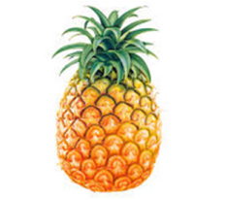
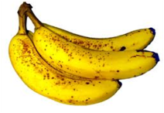
Function 1 pineapple -> apple
>>
Function 2 apple -> banana
Composition

Slide 159
New function
New Function 3 pineapple -> banana
Can't tell it was built from smaller functions!

Slide 160
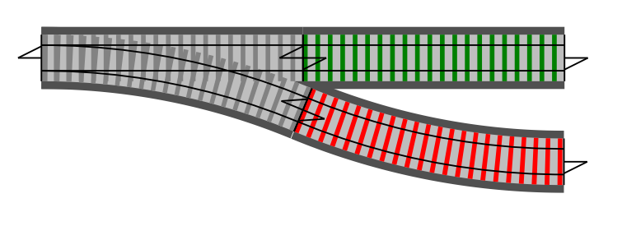
How can we design error handling?
Input ->
Success!
Failure

Slide 161
How can we build functionality from smaller pieces?
on success
Validate
UpdateDb
bypass

Slide 162
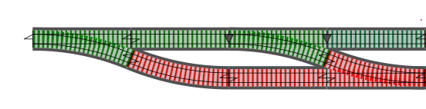
Validate
UpdateDb

Slide 163
New function
ValidateAndUpdate
Can't tell it was built from smaller functions!

