Slide 1

Capstone 2
Internet Speed Test in USA
Presented by: Iván J. Zapata-Rivera
Friday, May 7th, 2021

Slide 2
Introduction
InformatiTEK – Scope
Analysis of Internet accessibility in communities across the United States:
Affected by income inequality
Far away from large metropolitan areas
Datasets publicly available:
Ookla, leader in internet speed test analysis ¹
Economic Research Service, USDA ²
Census Bureau ³
Bureau of Economic Analysis ⁴

Slide 3
Introduction
InformatiTEK – Scope
Technology Advancement
Small communities may be falling between gaps of technology advancement
Interconnectivity is key for 21st century in all aspects of our daily lives
Economic Development
Many of these communities may fall behind in future economic opportunities
Internet accessibility is part of factors that may be center role for development
The more population that we have ready to participate in 21st century economics, the more beneficial it may be for our economic success

Slide 4
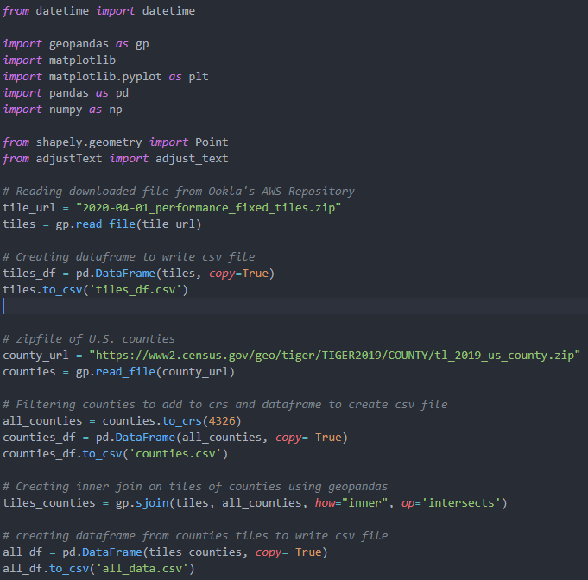
Data Preparation

Slide 5
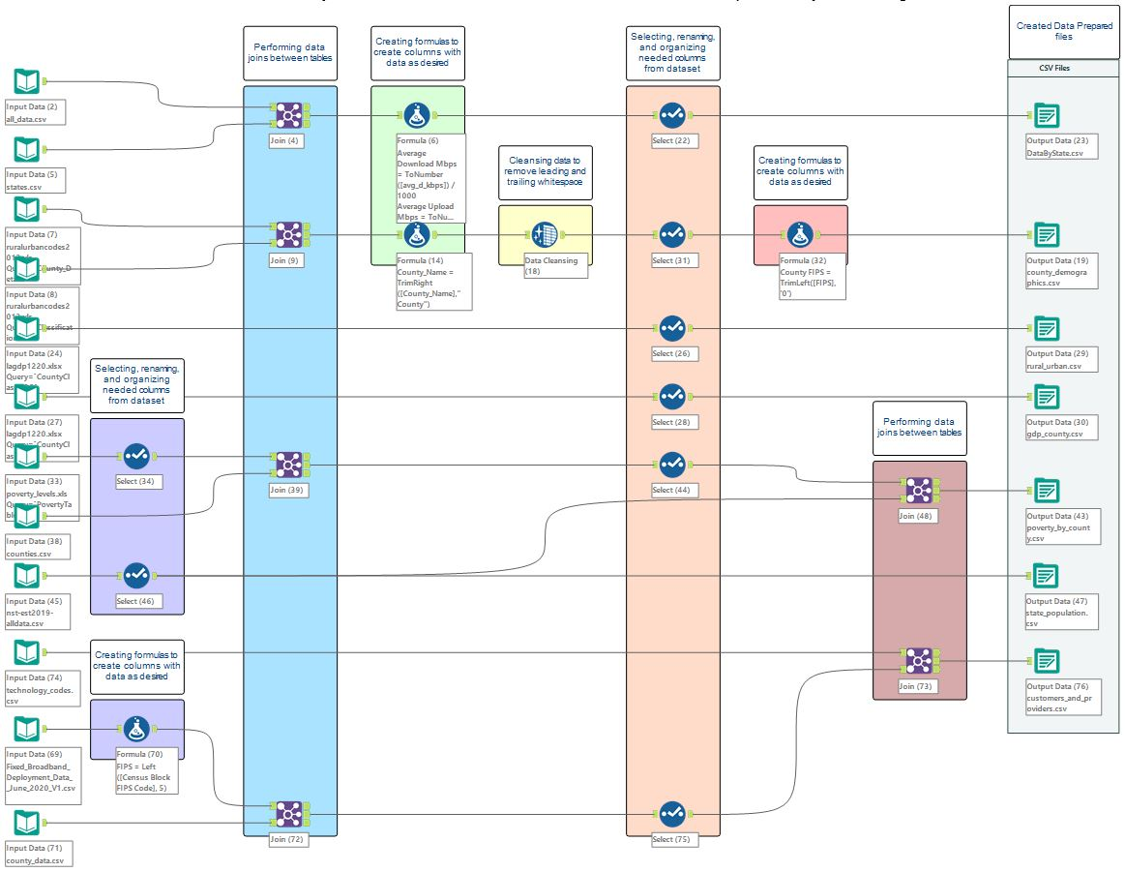

Slide 6
Demo – Data Analysis

Slide 7
Thank You

