Slide 1
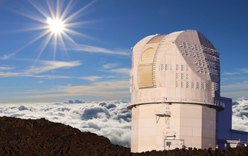
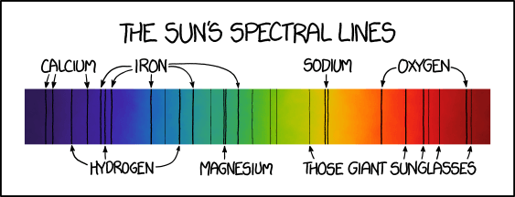
PHYS 7810: Solar Physics with DKIST
Lecture 12: Hands-on : Spectroscopy
Ivan Milic ivan.milic@colorado.edu

Slide 2
Previous classes
We started by studying instruments for gathering the light – telescopes
We moved to the instruments for analyzing the light – filtergraphs and spectrographs
Then to the instruments measuring polarization state – polarimeters
To understand polarimetric measurements we have to wait a bit (Zeeman effect, scattering polarization) – second part.
But we can already try to process some spectroscopic measurements and estimate study some physics from a datacube
That is the topic of todays hands-on

Slide 3
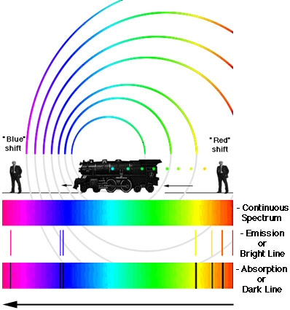

Doppler effect
So, if we are looking at one spectral line, what kind of spectral resolution do we need to measure velocity down to a 1 km/s precision?
Let’s discuss this for while, and we will demonstrate in the exercise.

Slide 4
Let’s look at the data and discuss
Where do the spectral lines come from?
Why is continuum not flat?
How to infer the wavelengths in this grid?
What can we learn simply from the intensity distribution of the wavelengths?
Let’s do it!

Slide 5
To – do:
Load and visualize the data
Calibrate the wavelengths using NIST database
https://physics.nist.gov/PhysRefData/ASD/lines_form.html
For each pixel, calculate the line centers of two referent lines
Use them to calculate velocity maps
Plot and discuss

Slide 6
Next step: downloading and prepping HINODE data:
Go to https://csac.hao.ucar.edu/sp_data.php
Pick a dataset (I usually choose my birthday ;))
Download the data
Assemble cubes out of individual spectra
Calibrate the wavelengths
Determine velocities!
Enjoy, and wait for the beautiful moment when we add magnetic field determination to this!

