Slide 1
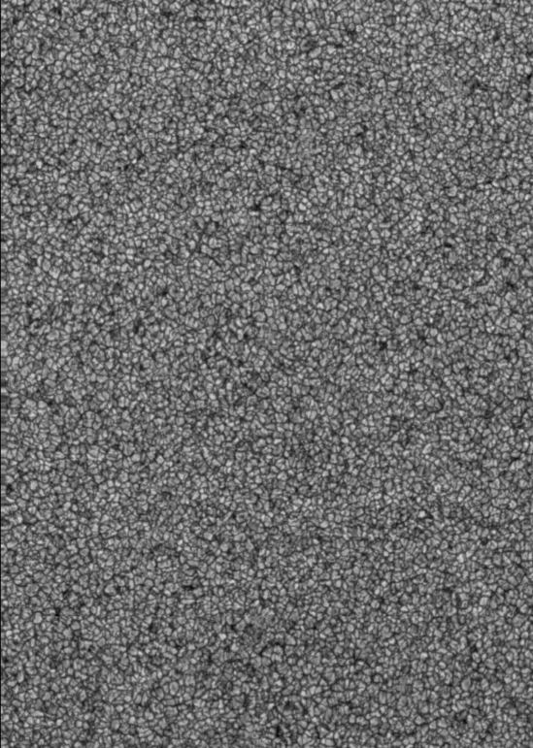



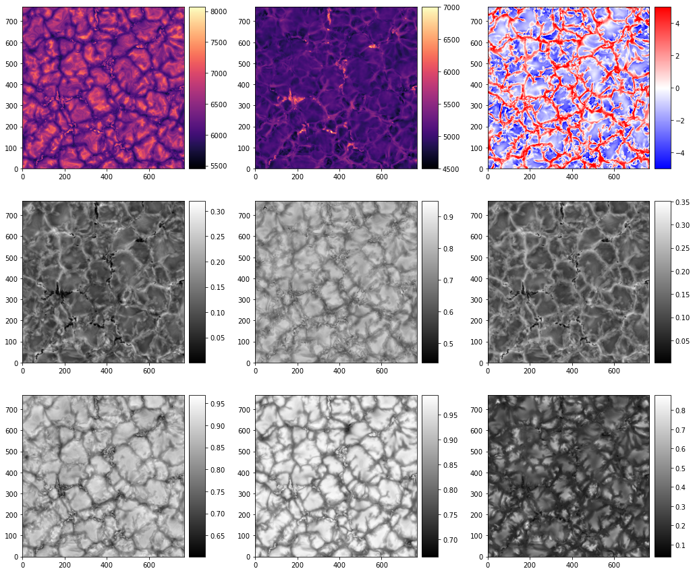
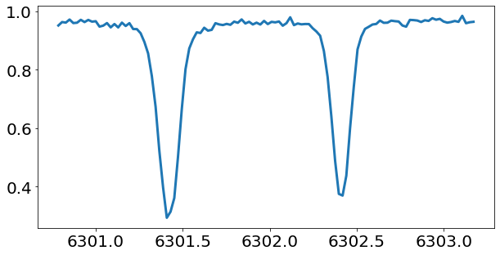
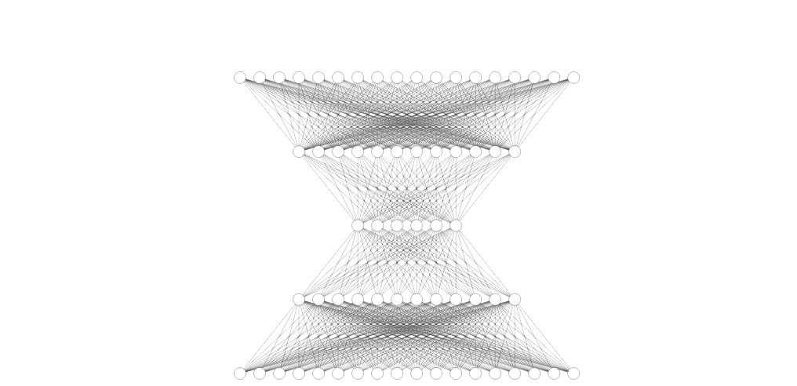
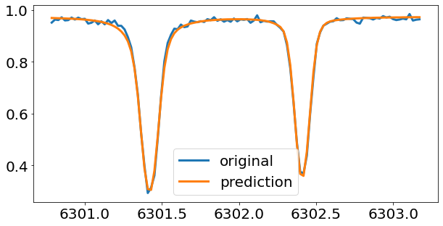
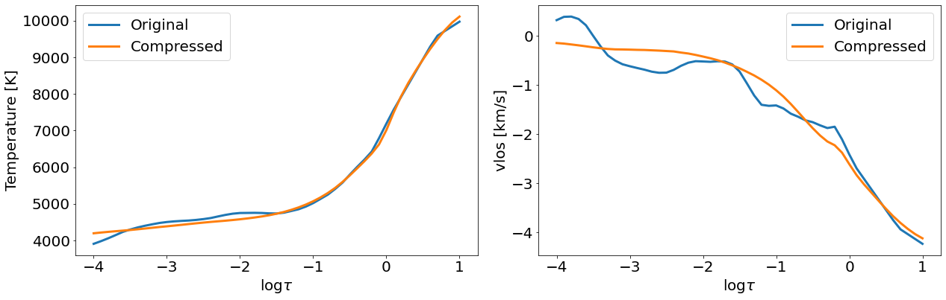
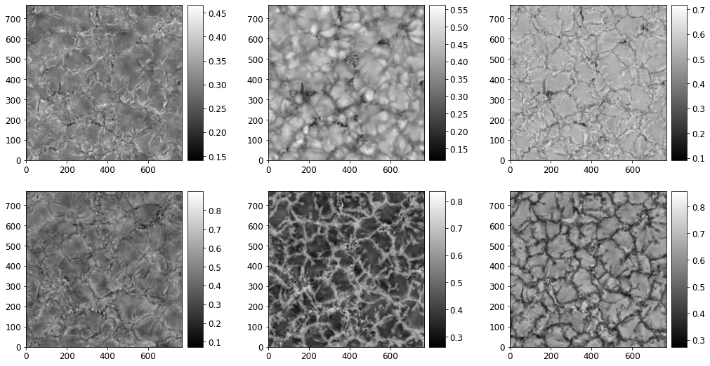
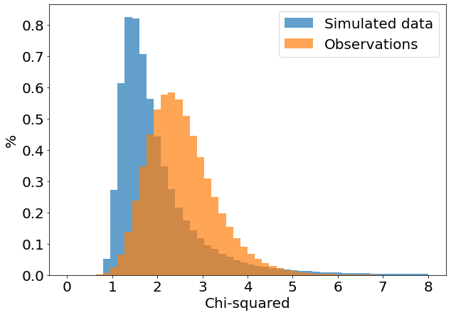
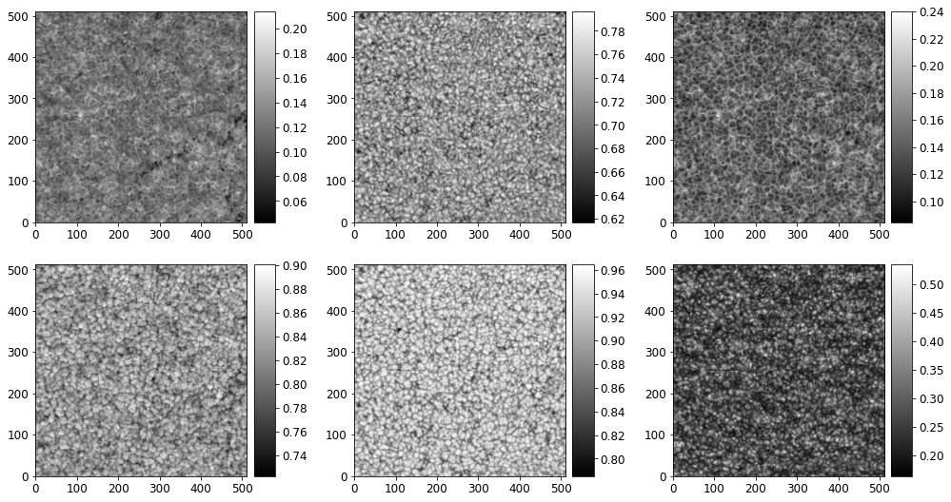

Sparse representation of HINODE
SOT/SP Spectra using Autoencoders
S. Flint^{1,2} ; I. Milić^{1,3}; B. Tremblay¹;
(1) Laboratory for Atmospheric and Space Physics (LASP), Boulder, Colorado; (2) University of Rochester, Rochester, NY; (3) Astronomical Observatory, Belgrade, Serbia;
Motivation
Spectropolarimetric inversions aim to infer depth-stratified atmospheres. Theoretically, these atmospheres have high depth resolution but our input does not carry sufficient information to reconstruct them. We parameterize them using nodes, but there is no robust methodology yet. Constraining the complexity of the output (atmospheres) to match the one of the input (spectra) might help design a more robust inversion.
Goals / questions
Compress the spectra to latent (sparse) space. (AE)
Do vectors in that space correspond to relevant physical parameters? (Yes, they seem to)
Does this help us make NN more interpretable? (Hopefully!)
Repeat for the atmospheres → Construct an inversion code (Soon!)
Autoencoder (AE)
A neural network (NN) that successively decreases the dimension of the input (encoder), followed by the series of layers that increase the dimension of the data (decoder). The aim is to reproduce the input
(output = input). The smallest dimension of the AE is called bottleneck and it is the sparse representation (compression) of our spectrum.
Structure of the latent space
We apply the AE to a set of synthetic observations (Fe I lines at 630 nm), to see if maps of compressed spectra have a meaningful structure.
‘
We use a simple, densely connected autoencoder to compress the data down to the given bottleneck. Optimal bottleneck is the one that reproduces the input data up to the assumed noise level. The network is trained on the data synthesized from a quiet Sun MuRAM simulation, spectrally degraded according to Hinode SOT/SP instrument specifications. For this set (Stokes I only), we found optimal bottleneck width to be 6. NN is verified on the unseen synthetic data synthesized and tested on another simulation (right) and the quiet Sun observations (below).
Fig. 2: Maps of temperature at log τ=0 (top left), log τ=-1( top mid), velocity at log τ=0 (top right), and the maps of compressed spectra (i.e. the six bottleneck values)
Fig. 1: Sketch of the autoencoder, with the example input spectrum and the output reconstruction. Note that layer dimensions are illustrative.
Compressing the atmospheres
Dimension estimated by the spectra compression implies the complexity of the atmospheres. We compress the simulated atmospheres using the same network architecture (but retrain the network). Compression is notably worse → This implies we simply can’t resolve all the details!
Compressing the observations
We used the quiet Sun Hinode scan from 10th of March 2007 to test our network (the NN is trained exclusively on the simulated data). We compare the compression between a validation (unseen, simulated dataset) and this test set.
Simulations capture the properties of the observed spectra very well!
Hopefully this means we can use the atmosphere compression to construct an inversion code that works in this compressed space.
Fig 5, Left: Example of the atmosphere compression for temperature and los velocity.
Fig 6, Bottom: maps of the compressed atmospheres (the bottleneck values)
Fig. 3, Left: Distributions of the chi-squared values between the input and the output spectra, for the validation (simulated) and the test (observations) dataset.
Fig. 4, Below: maps of the compressed spectra for a sub-set of the observed QS map. Note the structural similarities to the Fig. 2
Next steps
Map compressed intensities to compressed atmospheres via simple invertible relationship
Extend to full Stokes + Magnetic field
Get a robust inversion code!
All the codes, plots, and digital poster:
github.com/ivanzmilic/spectrum_ae
Reach out with questions and suggestions!

