Slide 1
Survivor AI:
Important decisions
Made by Iva Petrova

Slide 2

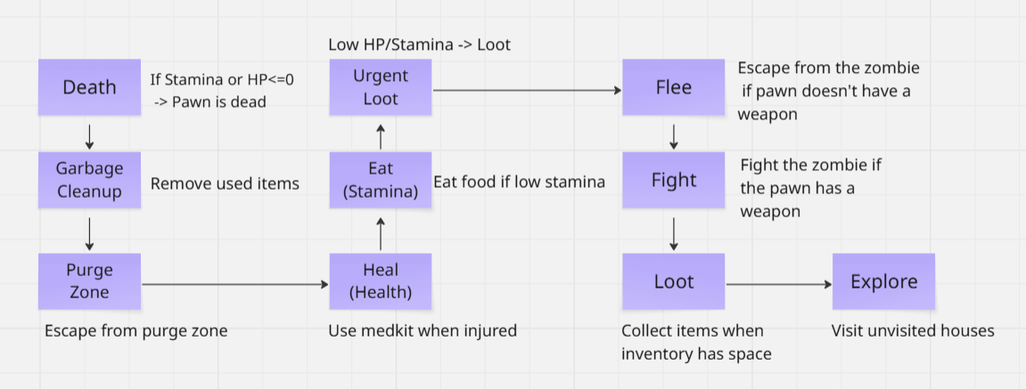
Decision Making

Slide 3
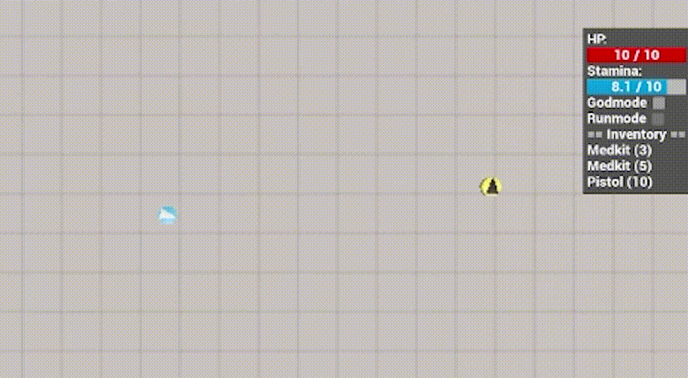
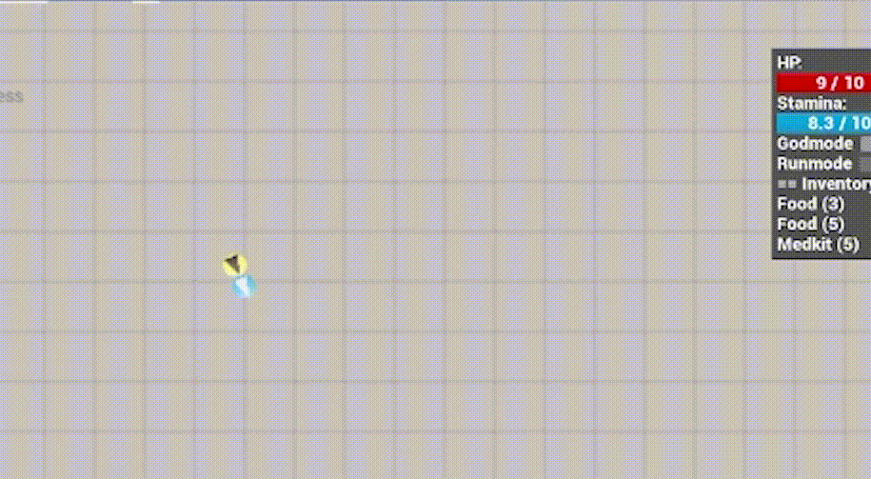
Enemy handling
Fight (when armed): Kites Heavy zombies (backs away while shooting), rushes all others via navmesh
Aiming: Face steering rotates the pawn toward the target each tick, then fires via line trace
Flee (when unarmed): Sprints using weighted escape vectors, predicts zombie movement, skips if inside a house

Slide 4
Inventory
Sensing: Items are detected via the AI perception system and cached in m_PerceivedItems; a cleanup timer removes stale entries every 0.5s.
Pickup: The items are scored by priority (Urgent to Skip) based on current health/stamina ratios. Unreachable items get blacklisted to prevent the agent getting stuck.
Usage: Medkits and food are only consumed when they won't overshoot max health/stamina. Depleted items are removed immediately after use.
Cleanup: A dedicated BT branch runs every tick to evict zero-value items, keeping slots free for new pickups.

Slide 5
Movement - Steering
Steering Behaviors:
Arrive- used in LootAction to smoothly decelerate toward an item
Flee- used in PurgeZoneAction (escape zone center) and FightAction (kite Heavy zombies)
Evade- used in FleeAction, predicting future zombie positions before fleeing
Face- used in FightAction to rotate the pawn toward a zombie before firing
Blended Steering?
Yes, but only in FleeAction- weighted blending is applied. Multiple zombies each contribute a flee vector, weighted by zombie tier and inverse distance. The resulting aggregate vector steers the agent away from all nearby zombies at once, with heavier/faster threats pushing harder.

Slide 6
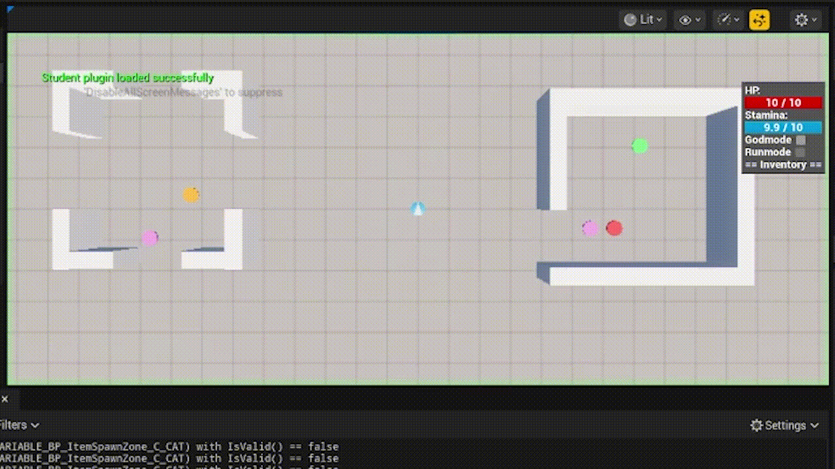
Movement - Exploration
Visits all unvisited houses in order of closest first
Remembers visited houses and never repeats them
If stuck on geometry, temporarily wanders in a random direction to break free before resuming navigation

Slide 7
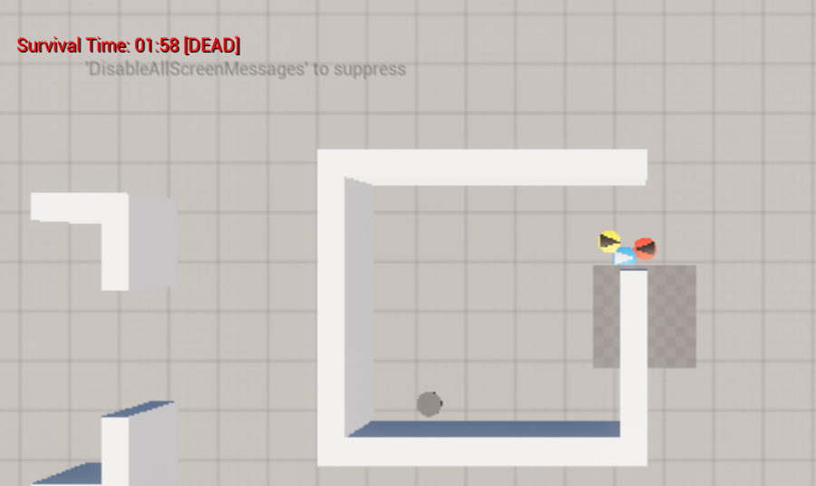
High Score
Top 5:

