Slide 1
Summary of Master Project
Ivar Svalheim Haugerud

Slide 2
Advection-Diffusion
Reciprocal relation
Diffusion with oscillating flow in a wavy channel
Diffusion in a square rough-walled channel

Slide 3
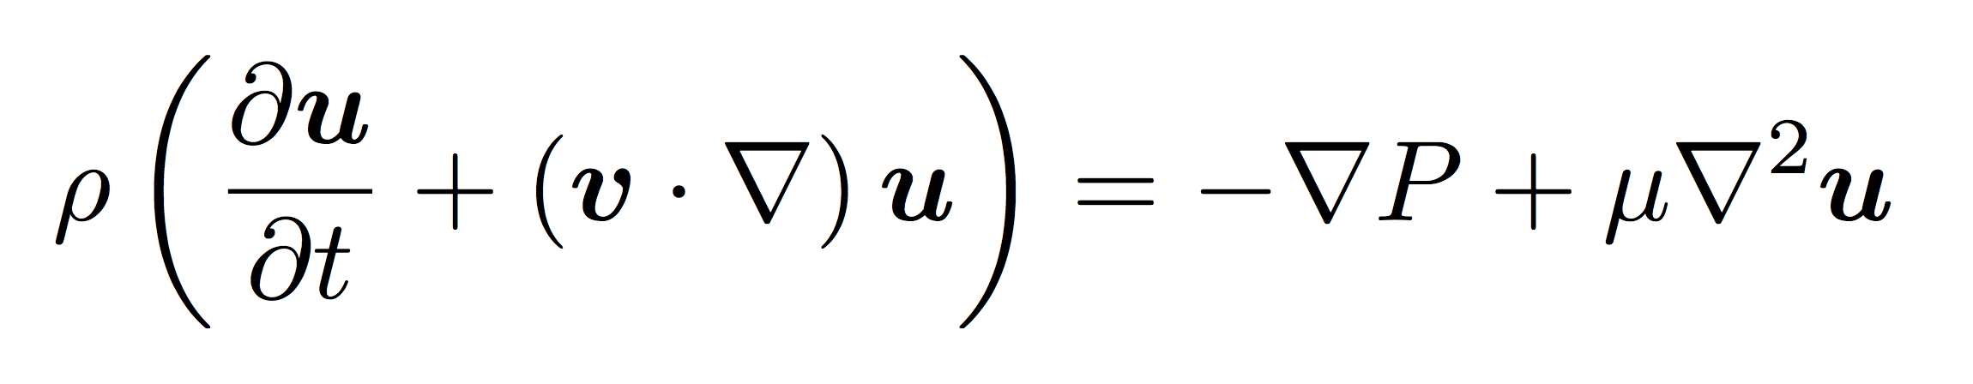
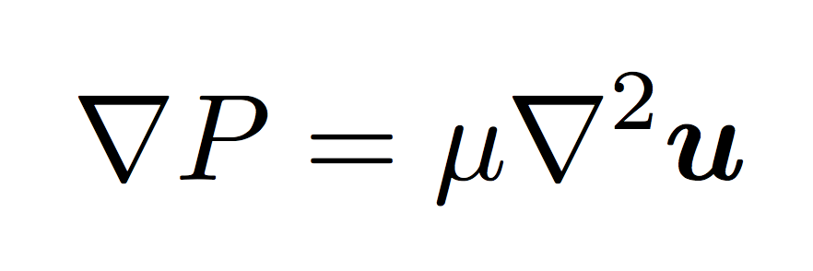
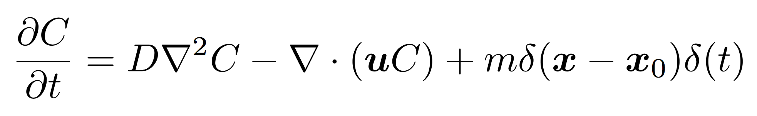
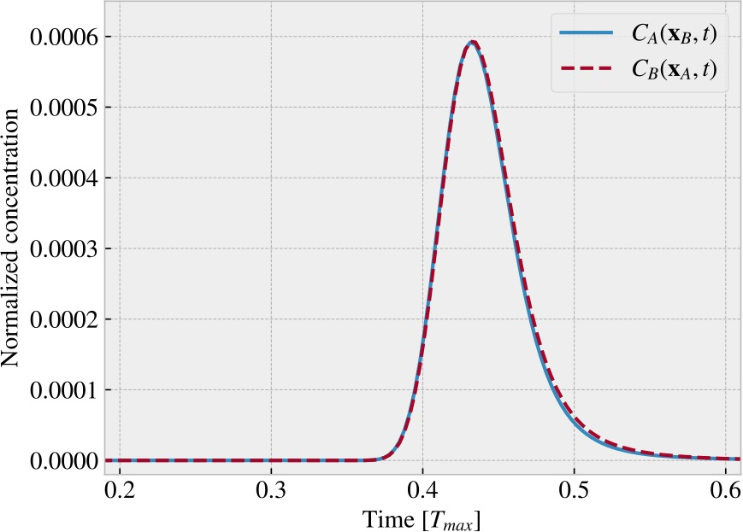
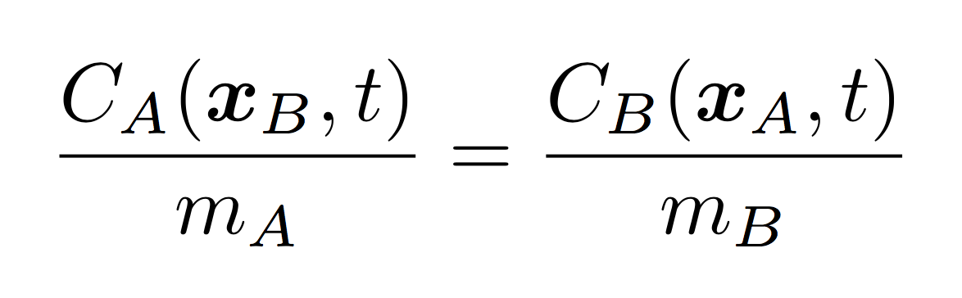
Reciprocal relation

Slide 4
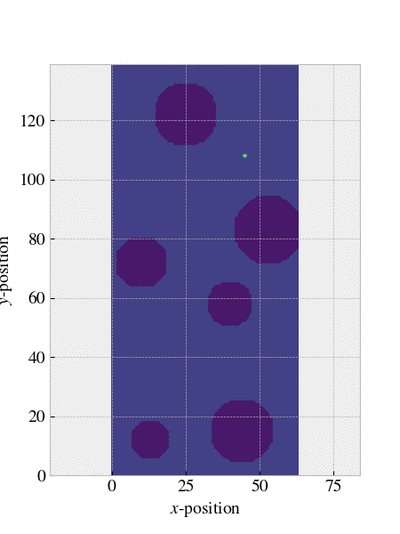


Slide 5
Reciprocal relation
Different injections
Heat and mass-diffusion
Time dependent flows
Behavior with different advective and diffusive transport rates

Slide 6
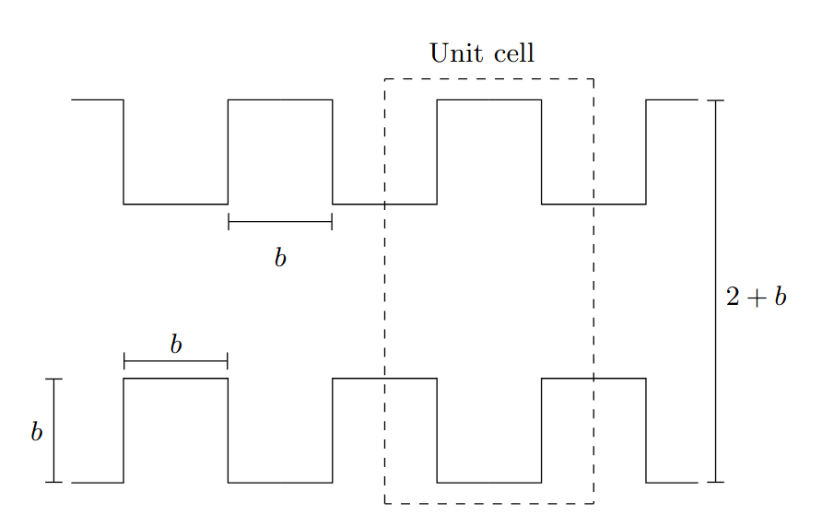


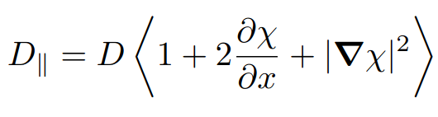
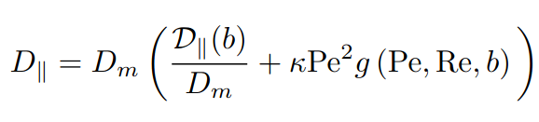
Diffusion in square channel

Slide 7
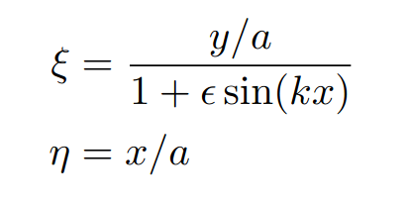
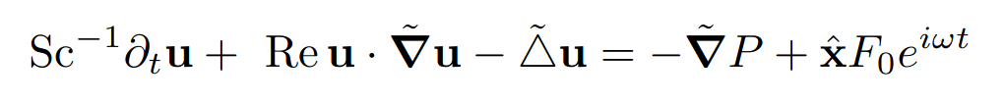
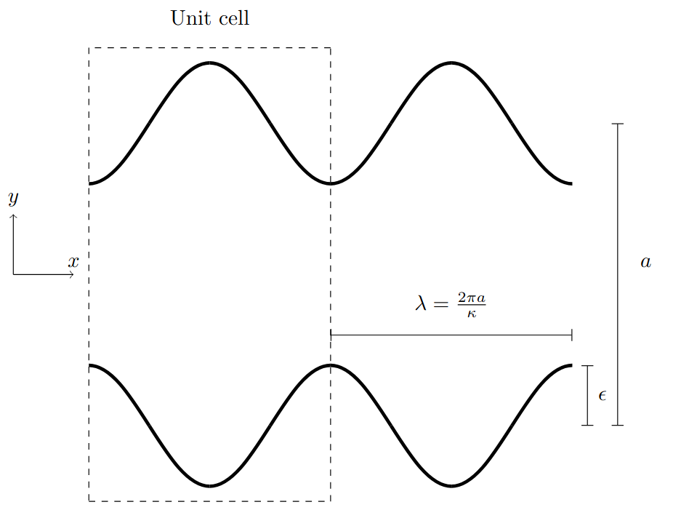
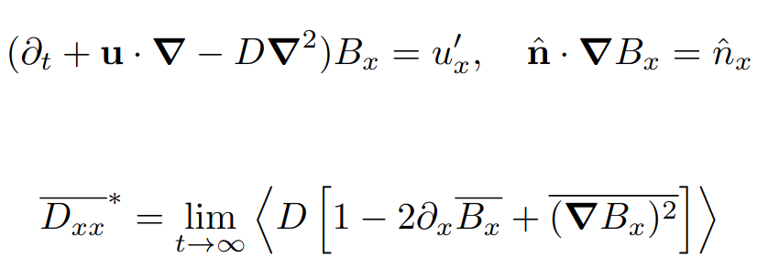
Oscillating flow in wavy channel

