Slide 1
Opening a Coffee place in Munich
Mauricio Montellano

Slide 2
Introduction
The goal is to open a coffee place, but the rent prices in Munich are extremely high. Therefore, a Borough which satisfies the limitations has to be identified:
• where a coffee would be a popular local,
• the rent prices are low,
• and the density of population is enough to sustain an additional coffee place.

Slide 3
Data
A table with data of the Boroughs in Munich https://de.wikipedia.org/wiki/Stadtbezirke_M%C3%BCnchens.
The data includes the name of each Borough (Stadtbezirk), surface area in km 2 (Fläche), inhabitants (Ein-wohner), density of population per km 2 (Dichte) and percentage of foreigners
(Ausländer).
The rent prices data for each Borough of Munich is obtained from a real state company at https://suedbayerische-immobilien.de/Mietpreise-Muenchen-Stadtteile.
The geographical location and extension of each borough of Munichis obtained from a GeoJ-SON file in https://stekhn.carto.com/tables/munich/public/map.

Slide 4
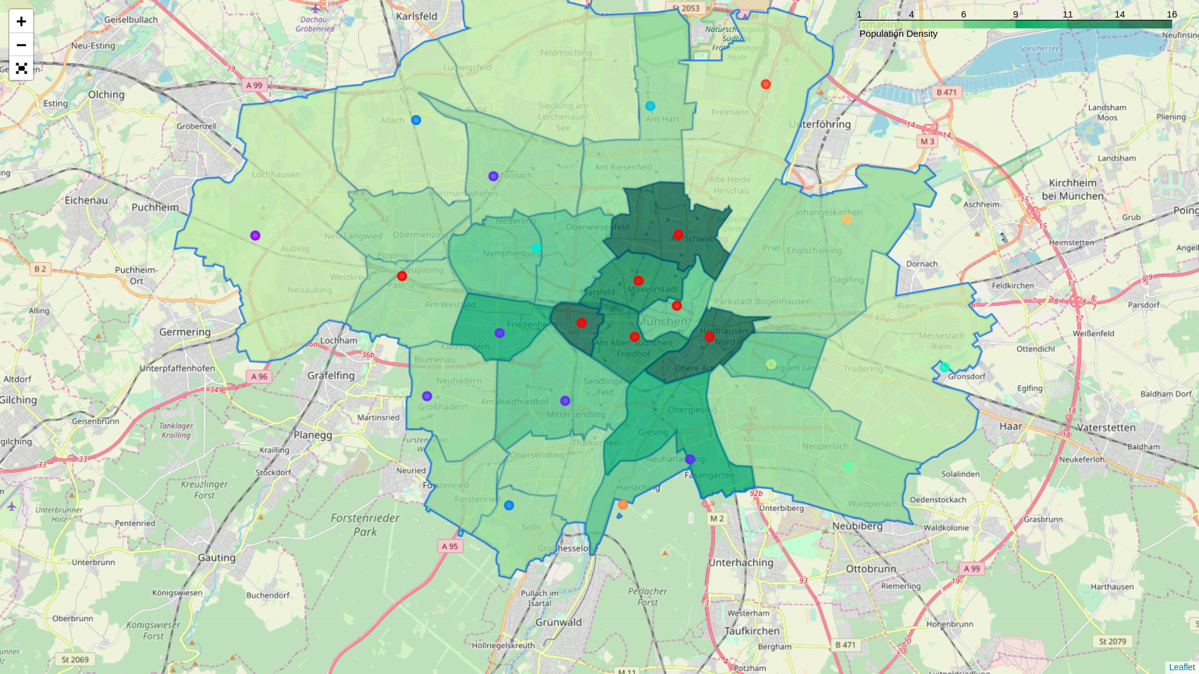
Map of Munich and clusters of venues

Slide 5
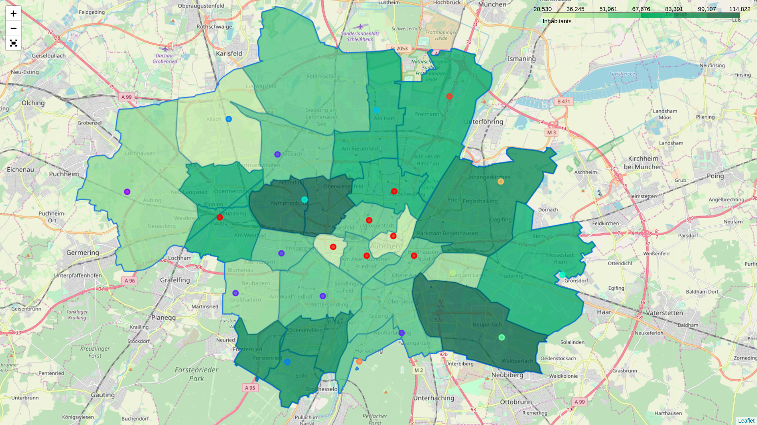
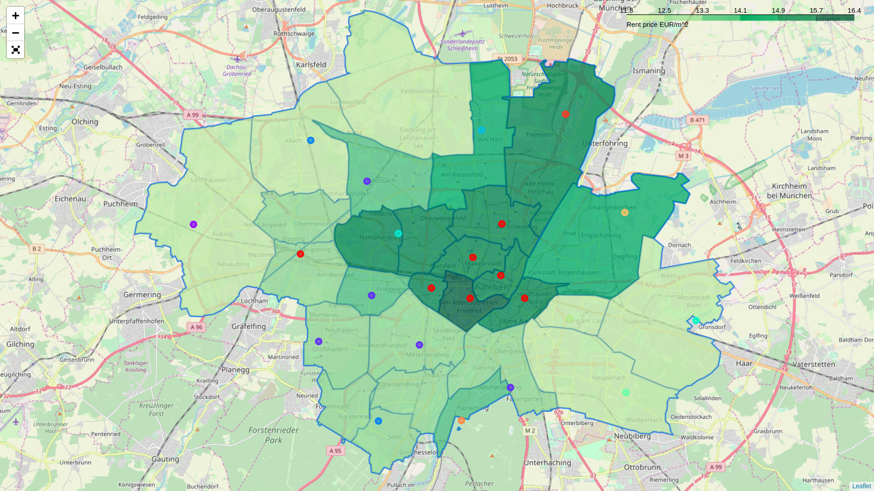
Rent and habitants
We want low rent and a lot of habitants
We want low rent and a lot of habitants
The red dots represent the places where caffees or restaurant are popular places

Slide 6
Final choice
From the analysis it is concluded that the Borough identifies as Pasing is the place where the new coffee place should be opened in order to minimize risks and reduce costs.

