Slide 1

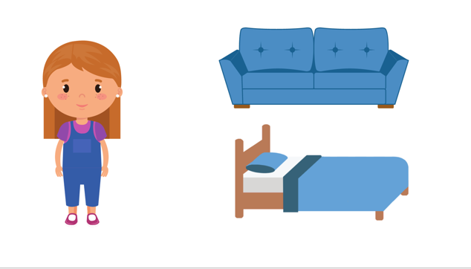
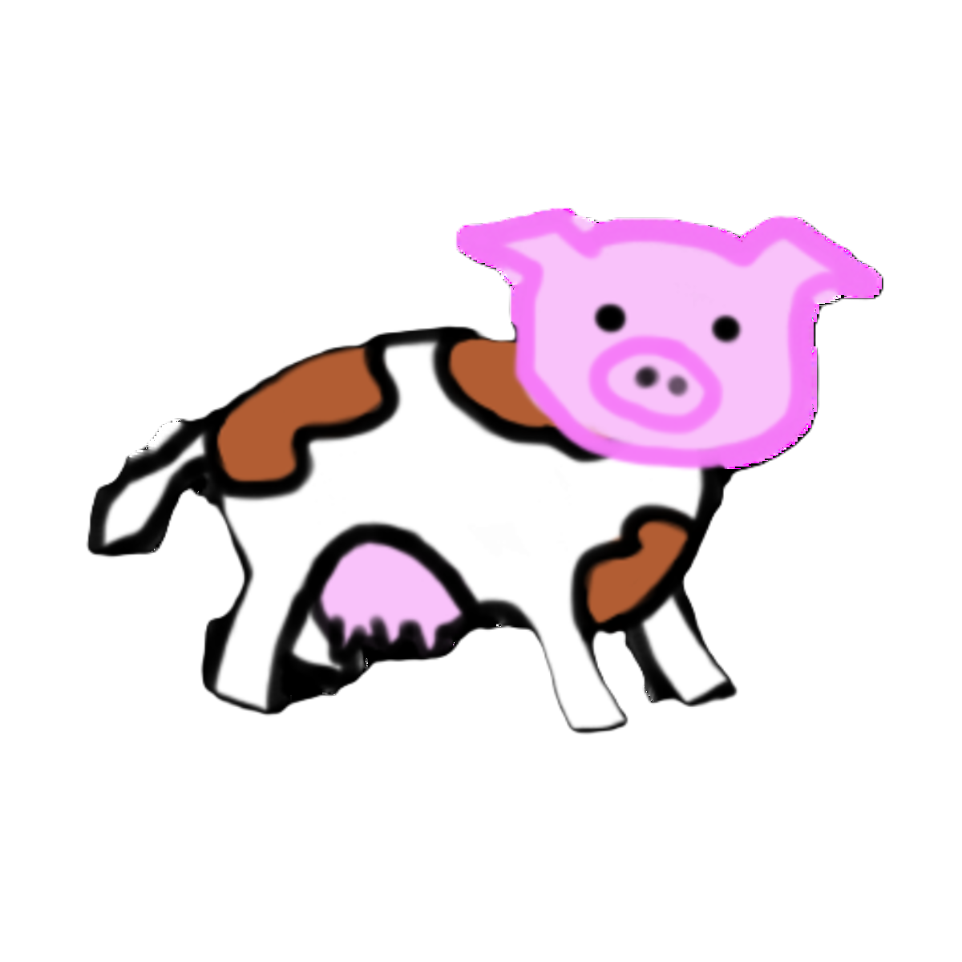

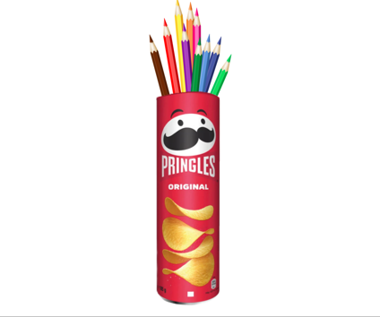
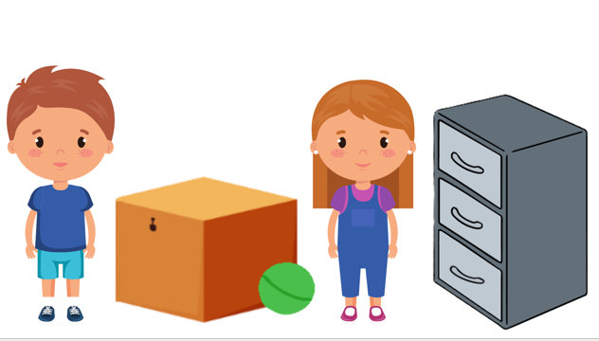

Animal Stroop Task
Theory of Mind (ToM) task
Response inhibition
What does Tommy want to eat?
pig
cow
What does Helen think is inside the can of potato chips?
Digit Span Task
Forward Digit Span | Backward Digit Span
Short-term memory | Working memory
3-9-6
5-2-7
Does Robin’s mother know that Robin has realized he will get a bicycle?
3-9-6
7-2-5

Slide 2
Animal Stroop Task
Theory of Mind (ToM) task
Response inhibition
What does Tommy want to eat?
pig
cow
What does Helen think is inside the can of potato chips?
Digit Span Task
Forward Digit Span | Backward Digit Span
Short-term memory | Working memory
3-9-6
5-2-7
Does Robin’s mother know that Robin has realized he will get a bicycle?
3-9-6
7-2-5

Slide 4



