Slide 1


Philosophical thought experiments and conflicting intuitions
Ivar Hannikainen & Joshua Knobe
6th European Experimental Philosophy Conference
University of Cagliari,
September 8–11, 2026

Slide 2
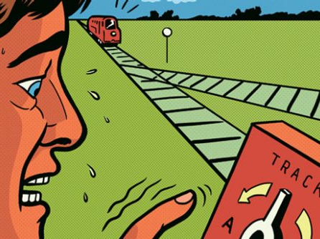

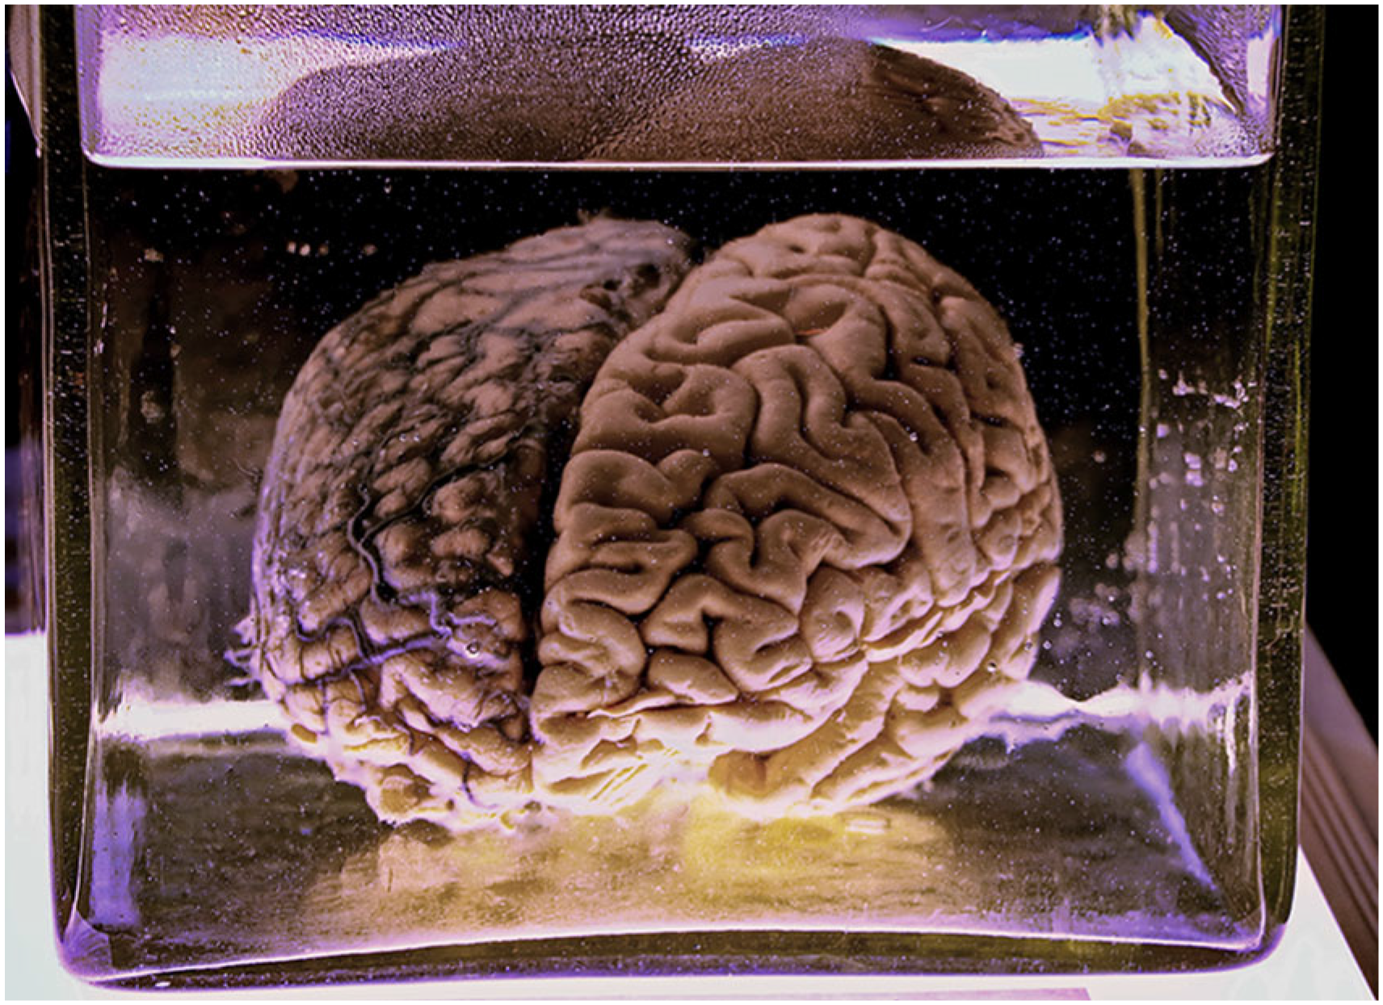


Slide 3

Nichols & Knobe, 2007
Imagine a universe in which everything that happens is completely brought about by whatever happened before it. […]For example, one day John decided to have vegetable soup at lunch. Like everything else, this decision was completely brought about by what happened before it. […] it had to happen that John would decide to have vegetable soup at lunch.

Slide 4
Nichols & Knobe, 2007
In this universe, a man named Bill has become attracted to his secretary, and he decides that the only way to be with her is to kill his wife and three children. Before he leaves on a business trip, he sets up a bomb that destroys his house and kills his family while he is away.

Slide 5
Nichols & Knobe, 2007
Did Bill act freely when he decided to kill his wife and children?
In this universe, a man named Bill has become attracted to his secretary, and he decides that the only way to be with her is to kill his wife and three children. Before he leaves on a business trip, he sets up a bomb that destroys his house and kills his family while he is away.

Slide 6


Split responses among philosophers

Slide 7
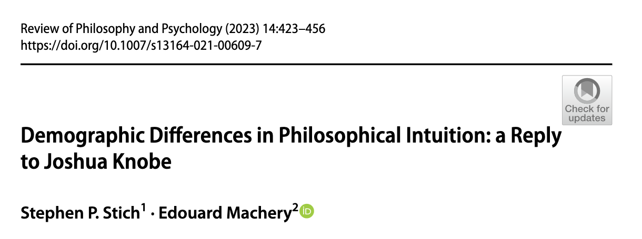
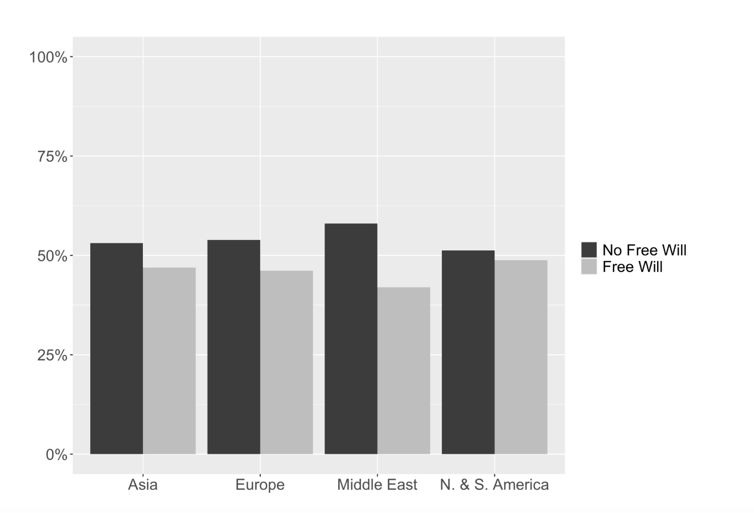


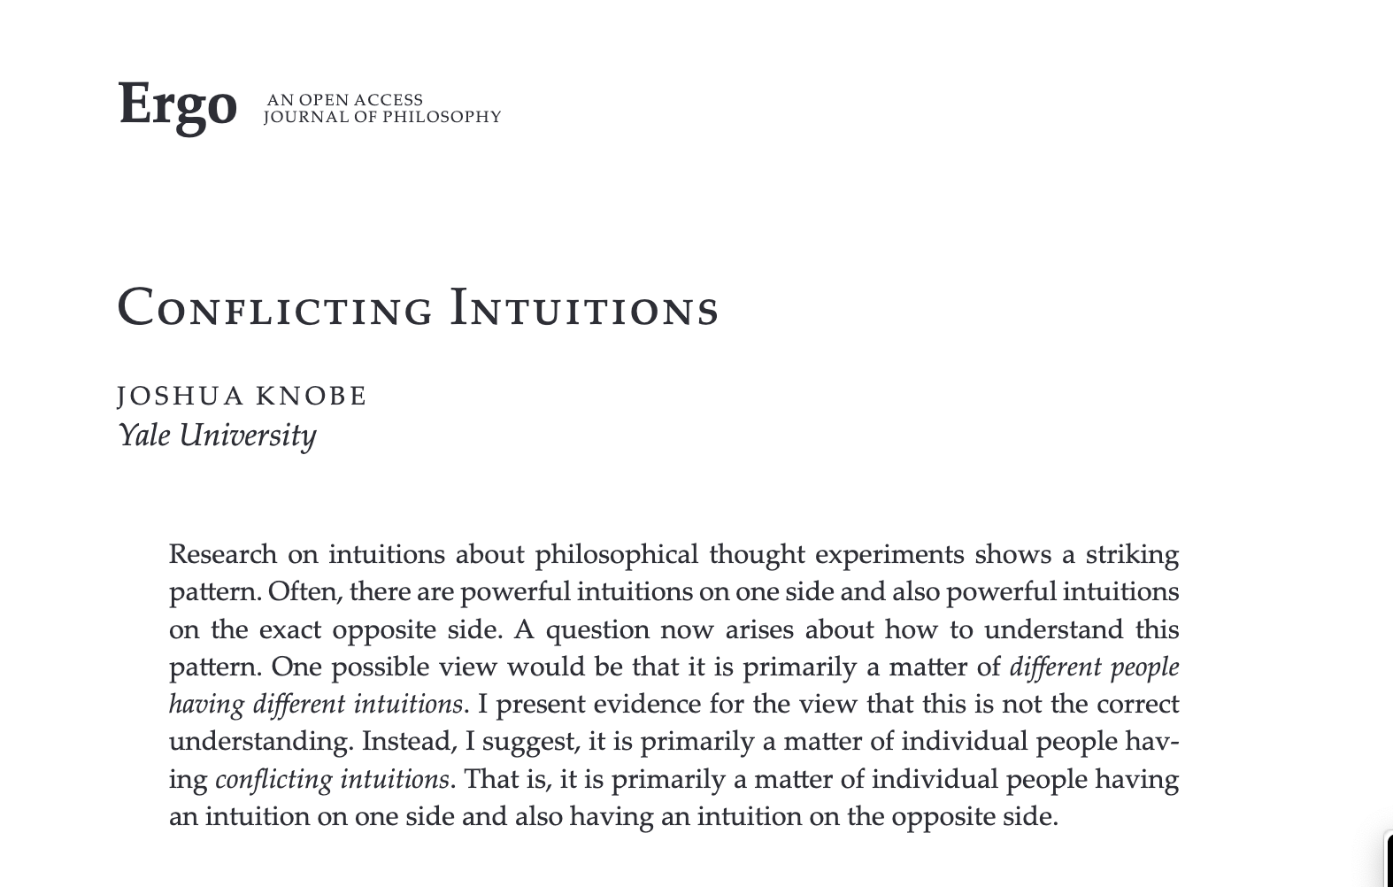
Split responses among non-philosophers
Yes
No

Slide 8
Fifteen philosophical thought experiments
Ship of Theseus, Truetemp, Individuation, Phineas Gage, Lying, Robot Consciousness, Happiness, Death, Twin Earth, Double Prevention, Knowledge without Belief.

Slide 9

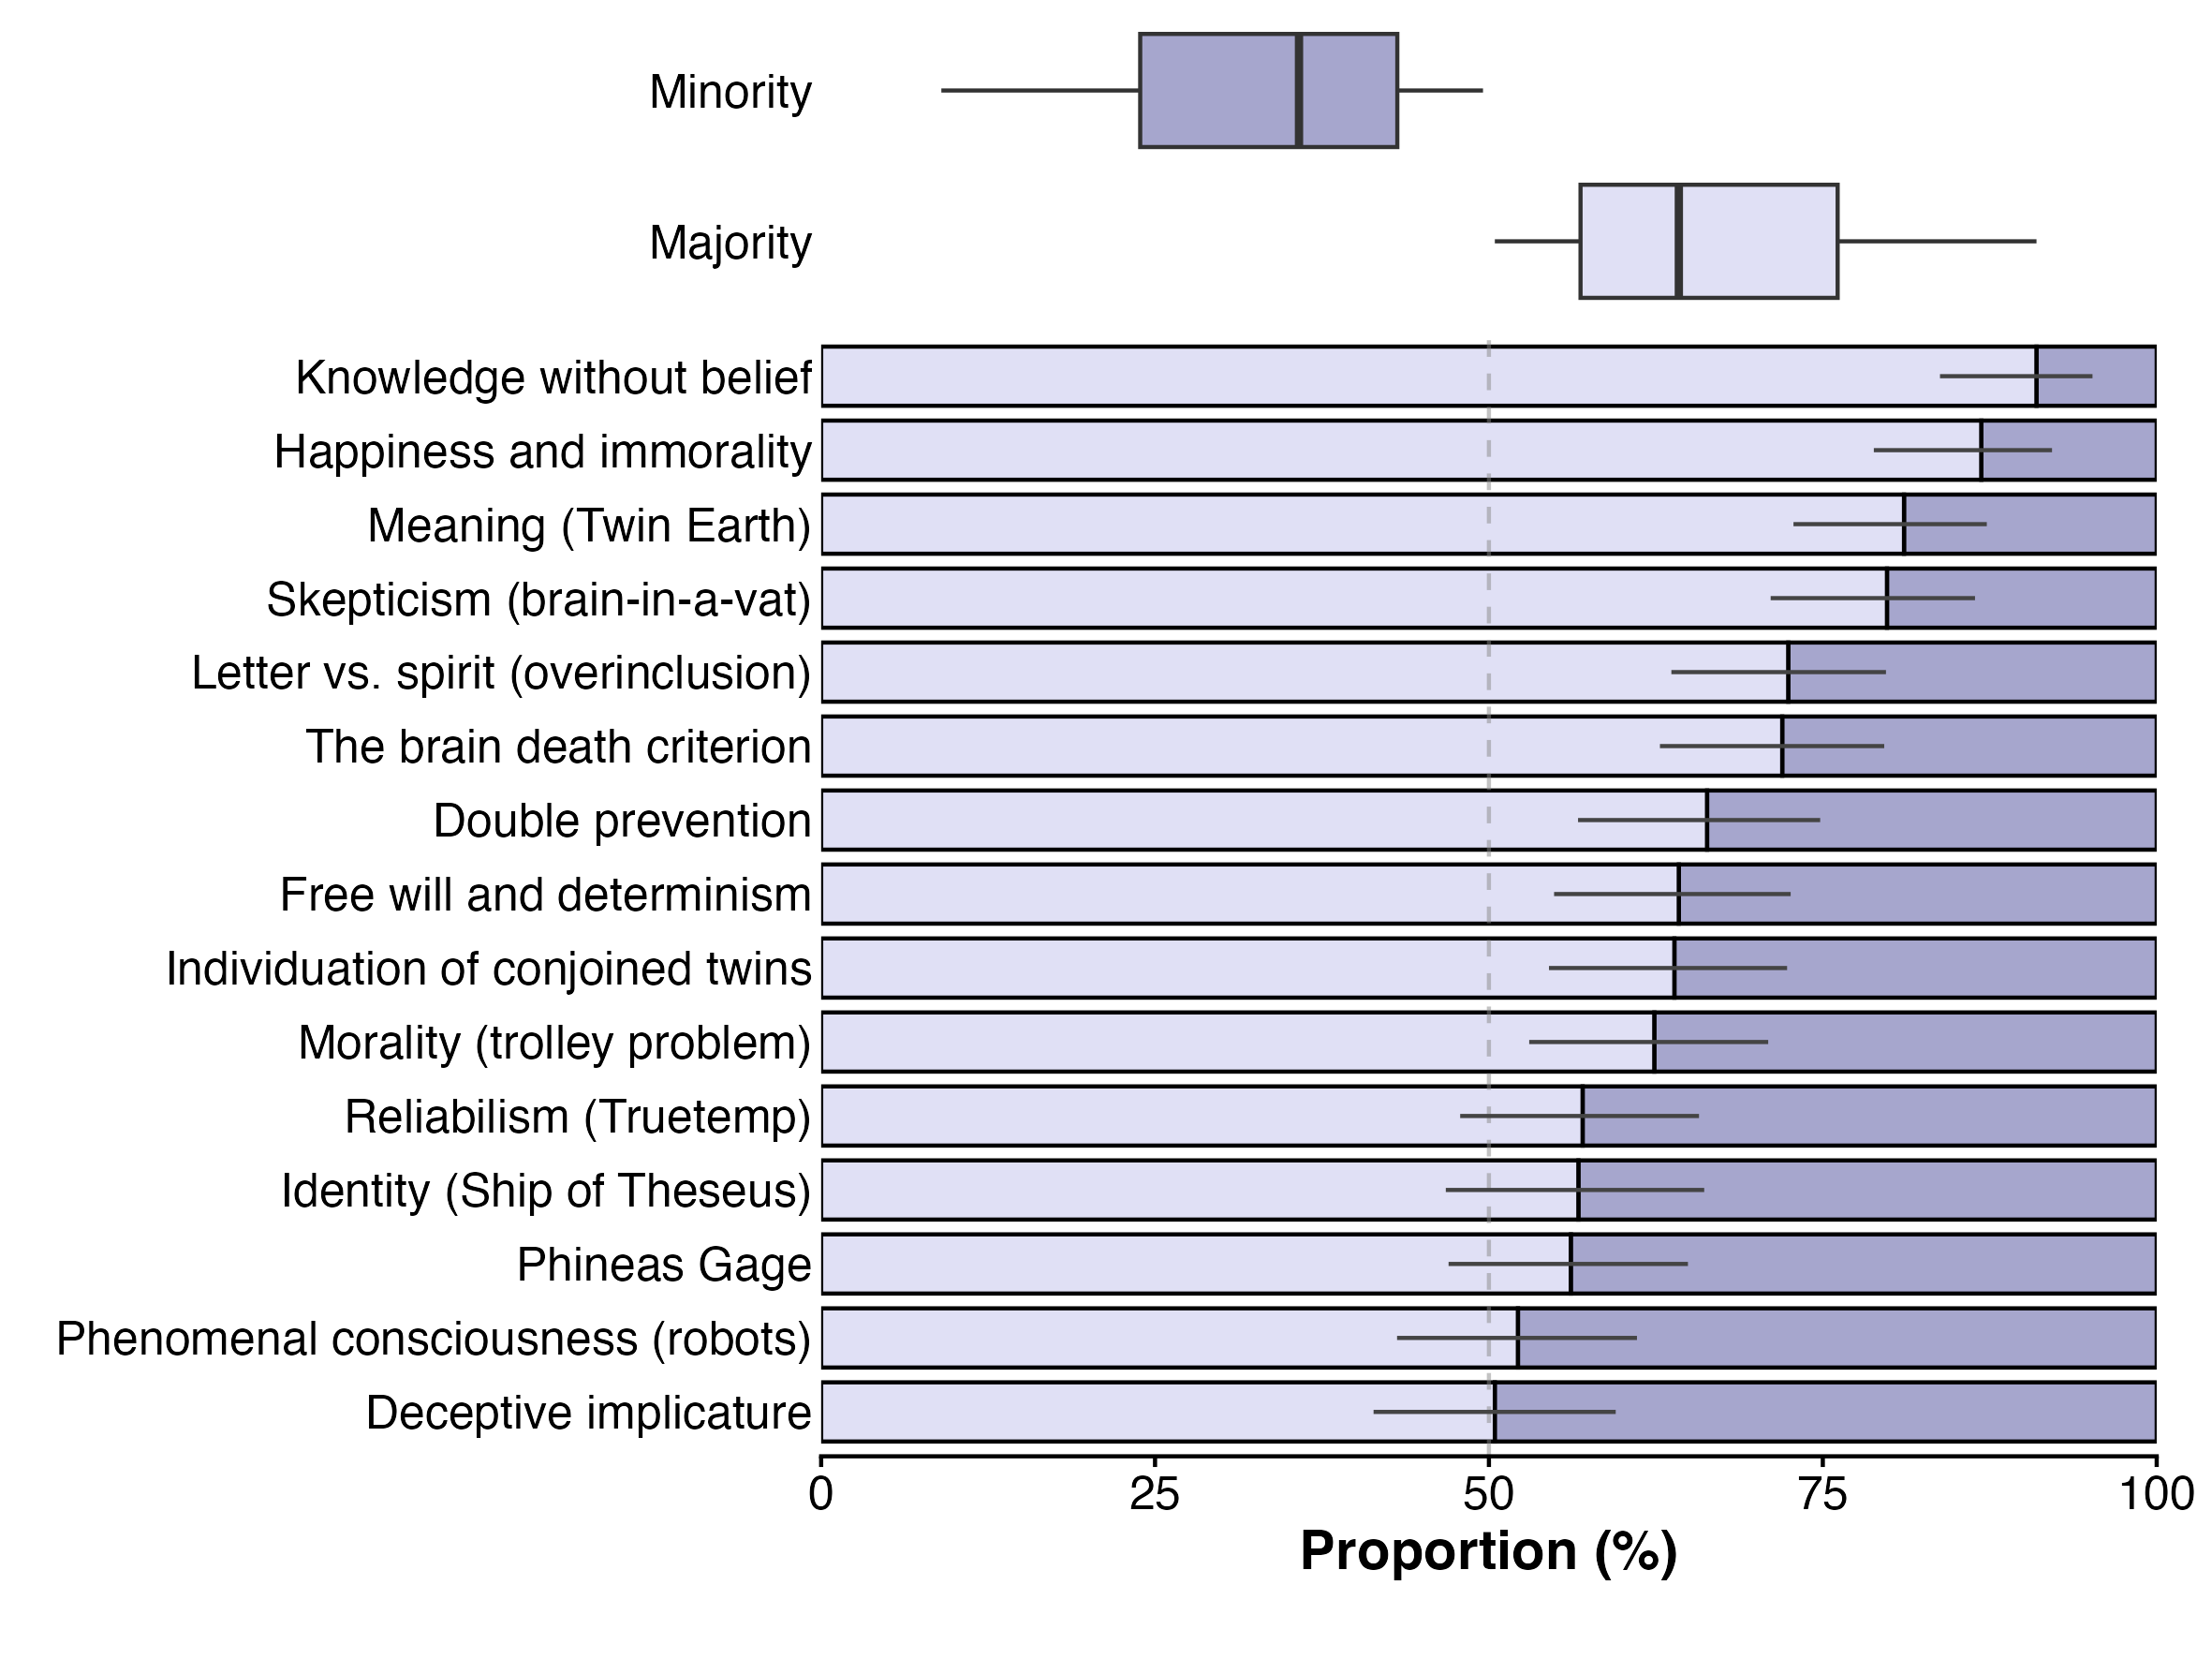
Split responses among non-philosophers
N = 1617

Slide 10
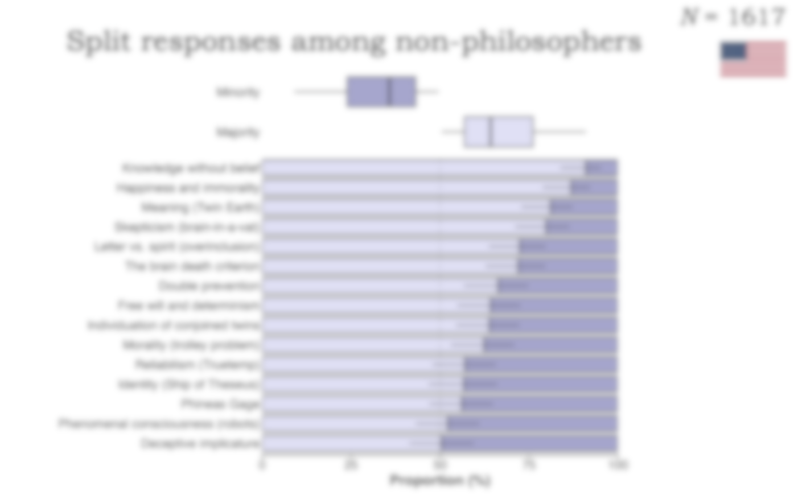
Why?

Slide 11
Why?
Yes
No
No
Yes
No
Yes
Different
intuitions
Conflicting
intuitions

Slide 12
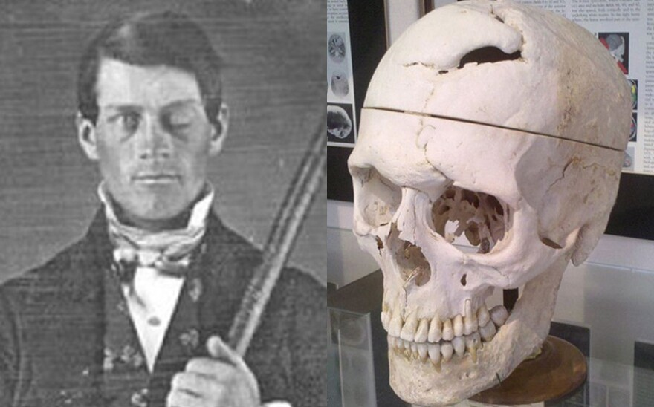
The ‘both’ question
On the previous page, you answered that the person after the accident is still Phineas. Even though you concluded in the end that this was the right answer, we want to know whether you initially felt pulled in both directions.

Slide 13
The ‘both’ question
When answering did you also have the feeling that the person after the accident is not Phineas anymore, or did you not have that feeling?
No, I did not.
Yes, I did.

Slide 14
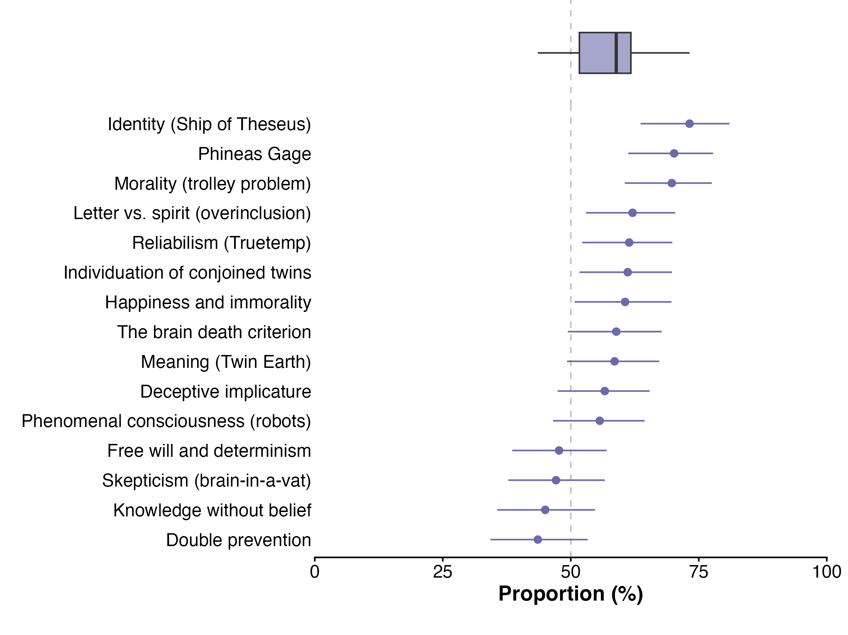
How prevalent are conflicting intuitions?
58%
95% CI [54%, 63%]

Slide 15
How prevalent are conflicting intuitions?
When do people have conflicting intuitions?
58%
95% CI [54%, 63%]

Slide 16
Per-issue analyses
Don’t push.
Push.

Slide 17

Per-issue analyses
Don’t push.
Push.
He’s free.
He’s not free.
You know.
You don’t know.
For 6 out of 7 issues in which p < .05, p(Both | Minority) > p(Both | Majority).

Slide 18
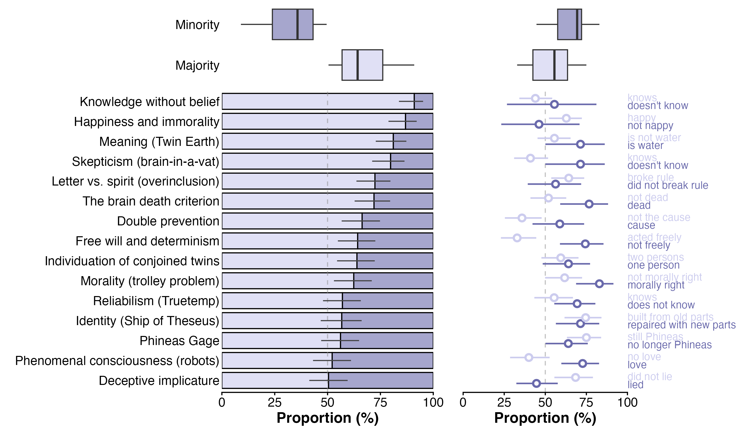
When do people have conflicting intuitions?

Slide 19
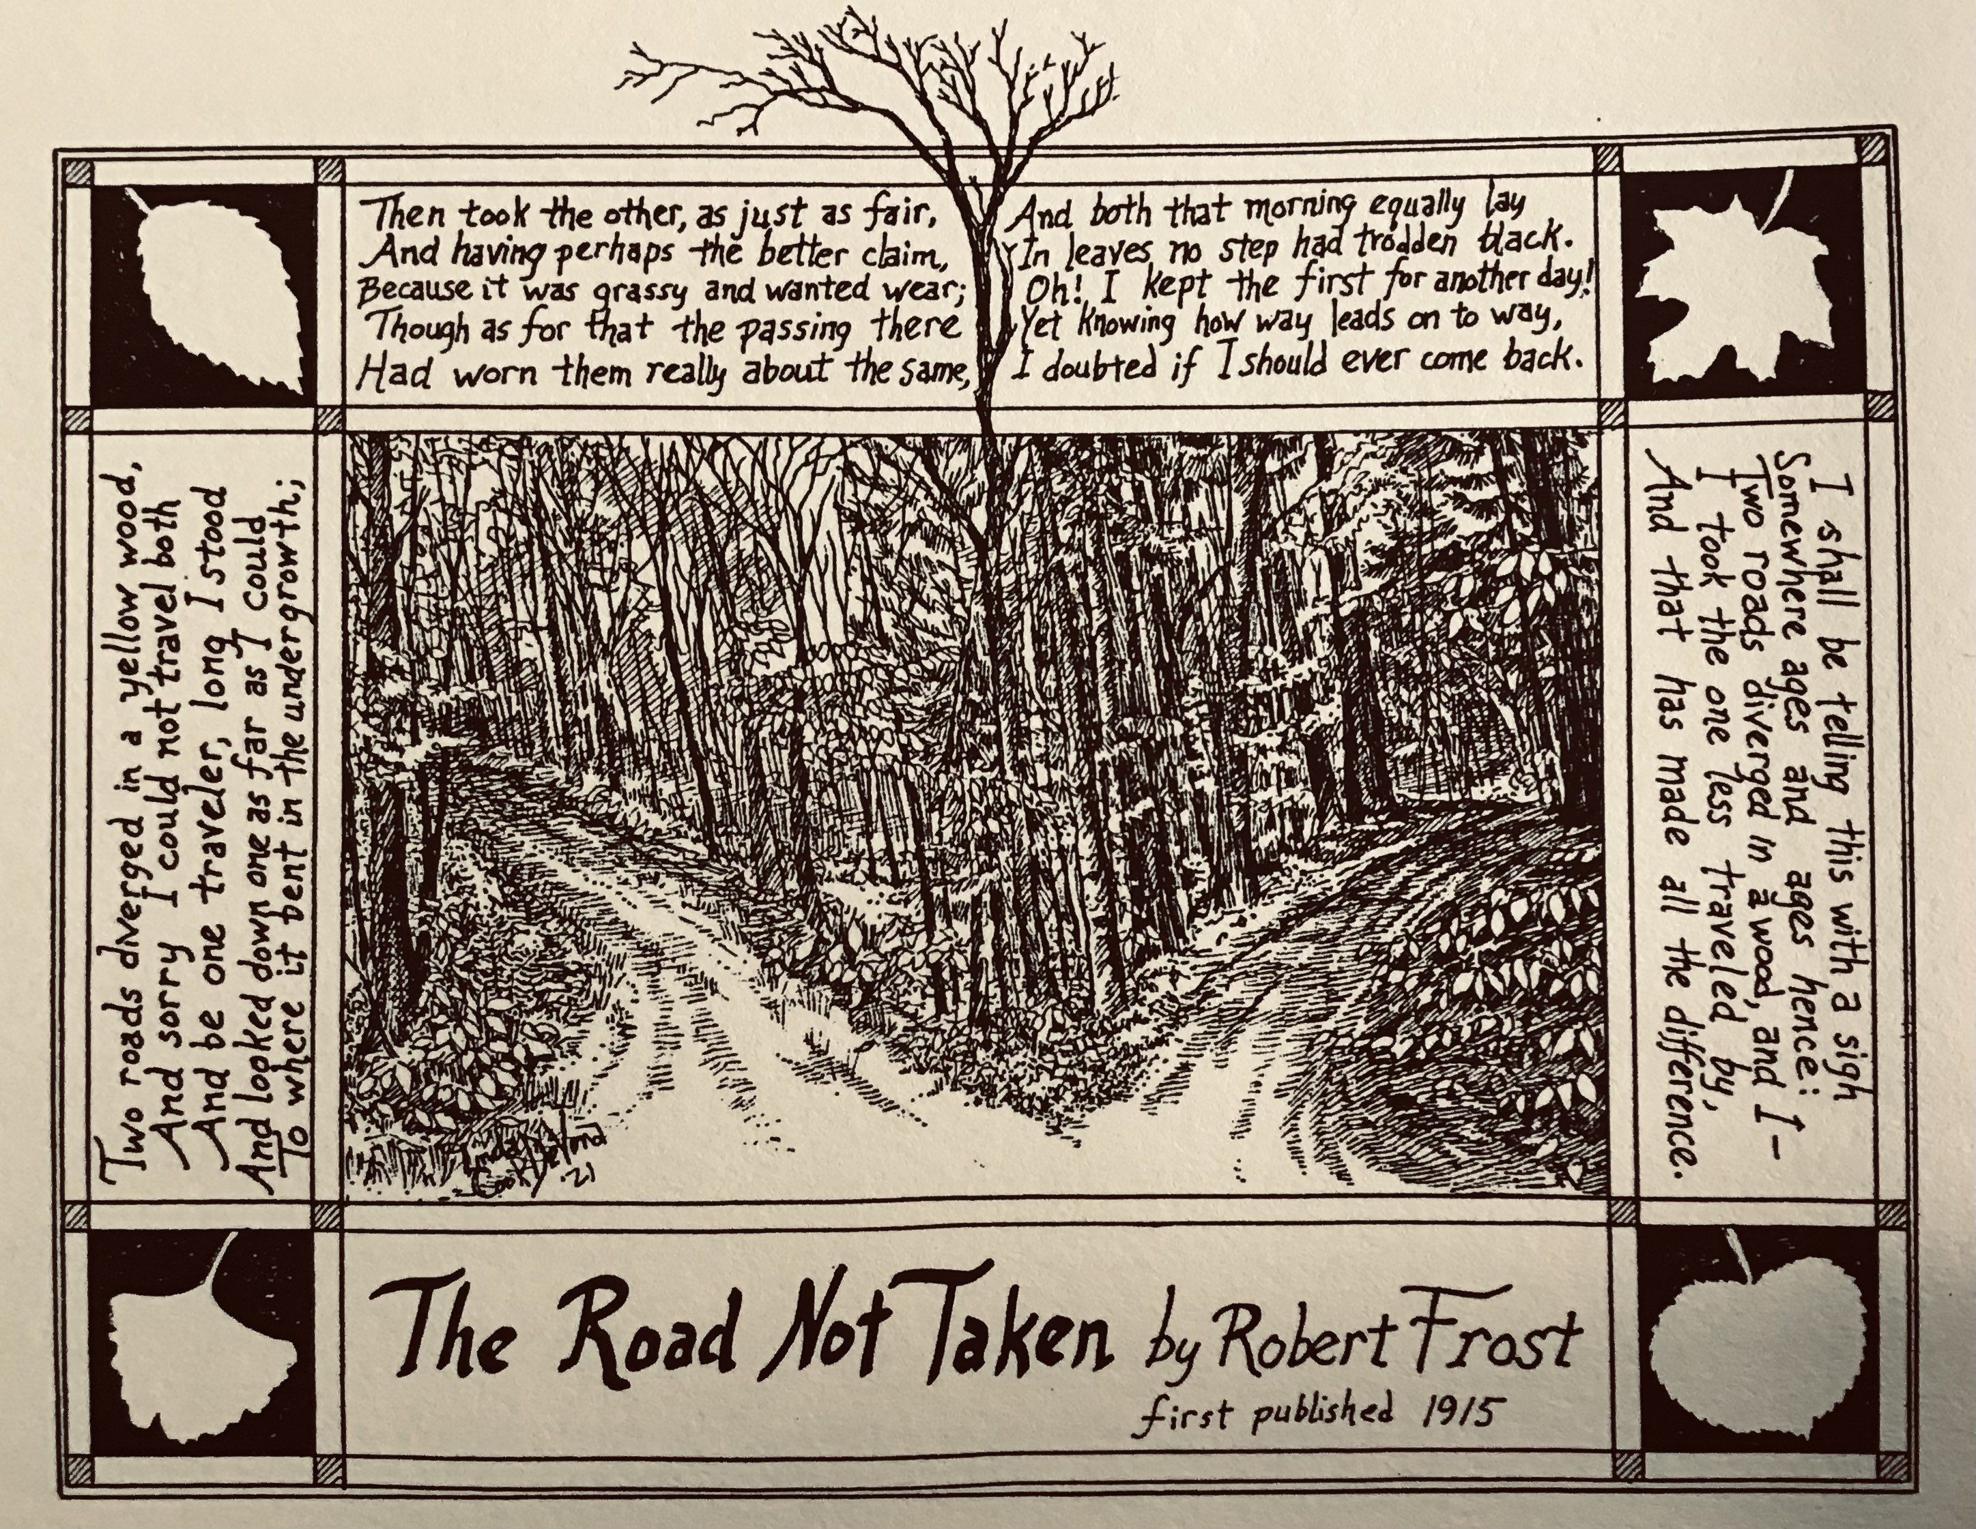
The popularity of the unchosen answer

Slide 20
The popularity of the unchosen answer

Slide 21
The popularity of the unchosen answer
OR = 3.80, 95% CI [2.03, 7.10], z = 4.19, p < .001

Slide 22
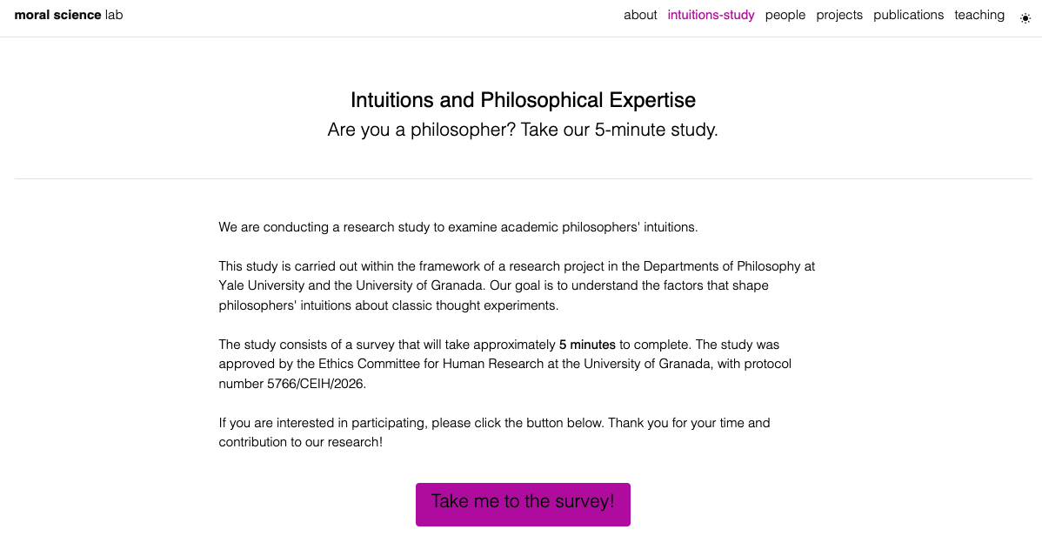

Slide 23

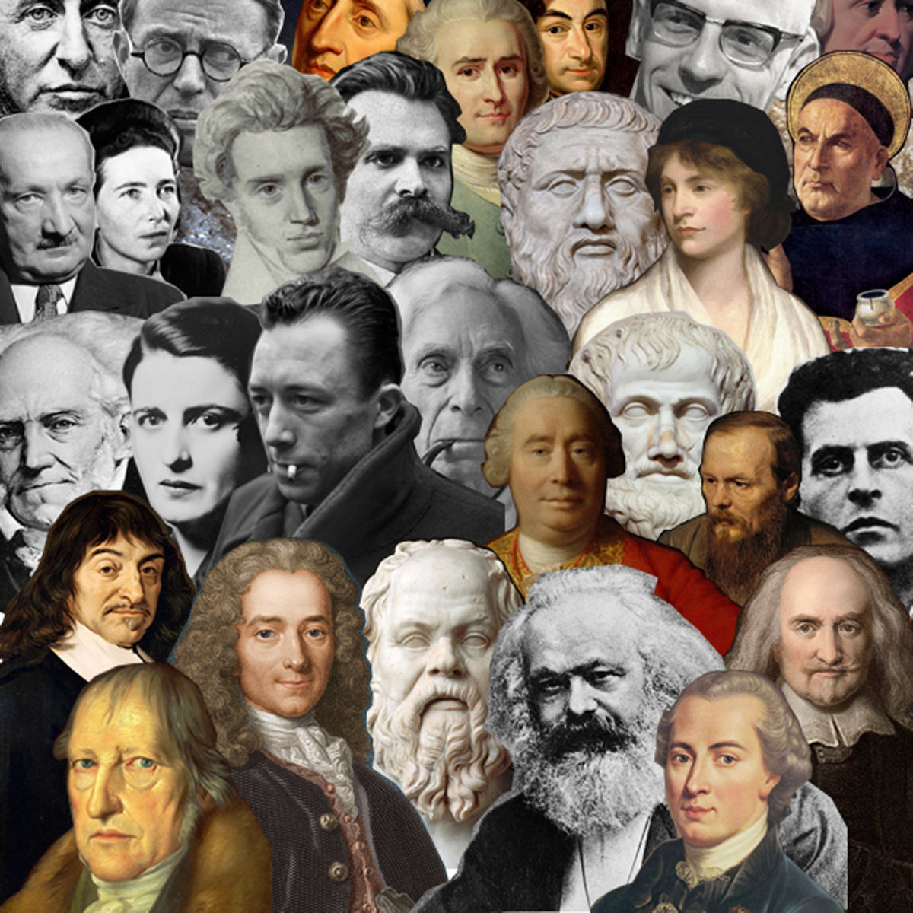
1249 laypeople
634 philosophers

Slide 24

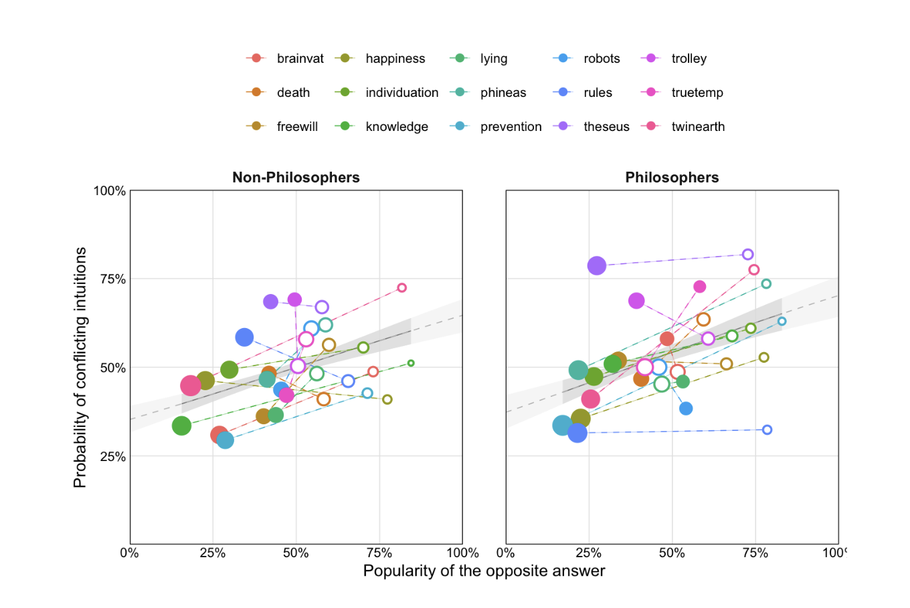
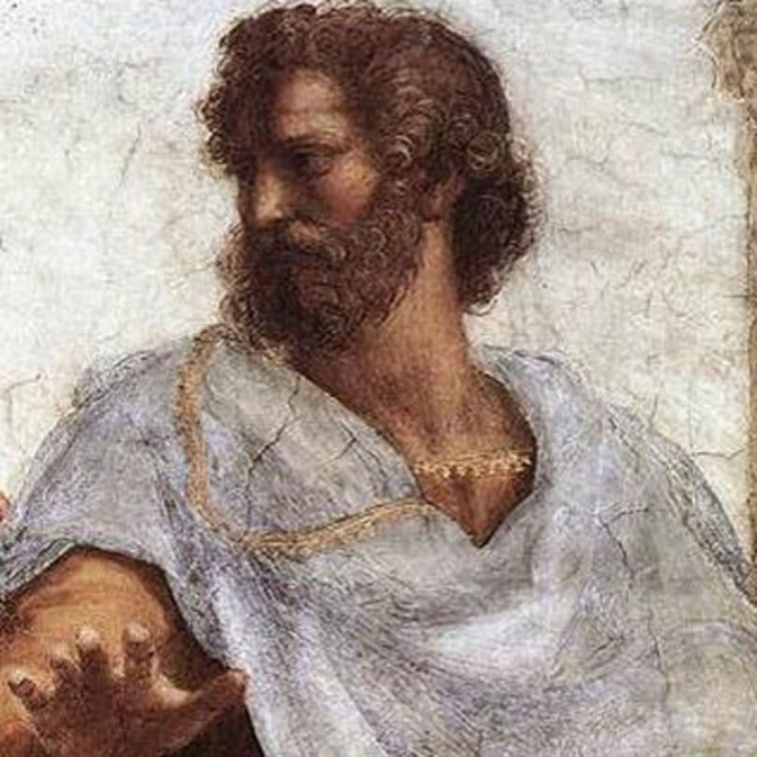
Intuitions of Philosophers
1249 Laypeople
634 Philosophers

Slide 25
Intuitions of Philosophers
1249 Laypeople
634 Philosophers

Slide 26
Intuitions of Philosophers
Philosophers also show the effect: The popularity of the opposite answer predicts the tendency toward conflicting intuitions, OR = 3.32, z = 4.38, p < .001.
1249 Laypeople
634 Philosophers

Slide 27
Why?

Slide 29


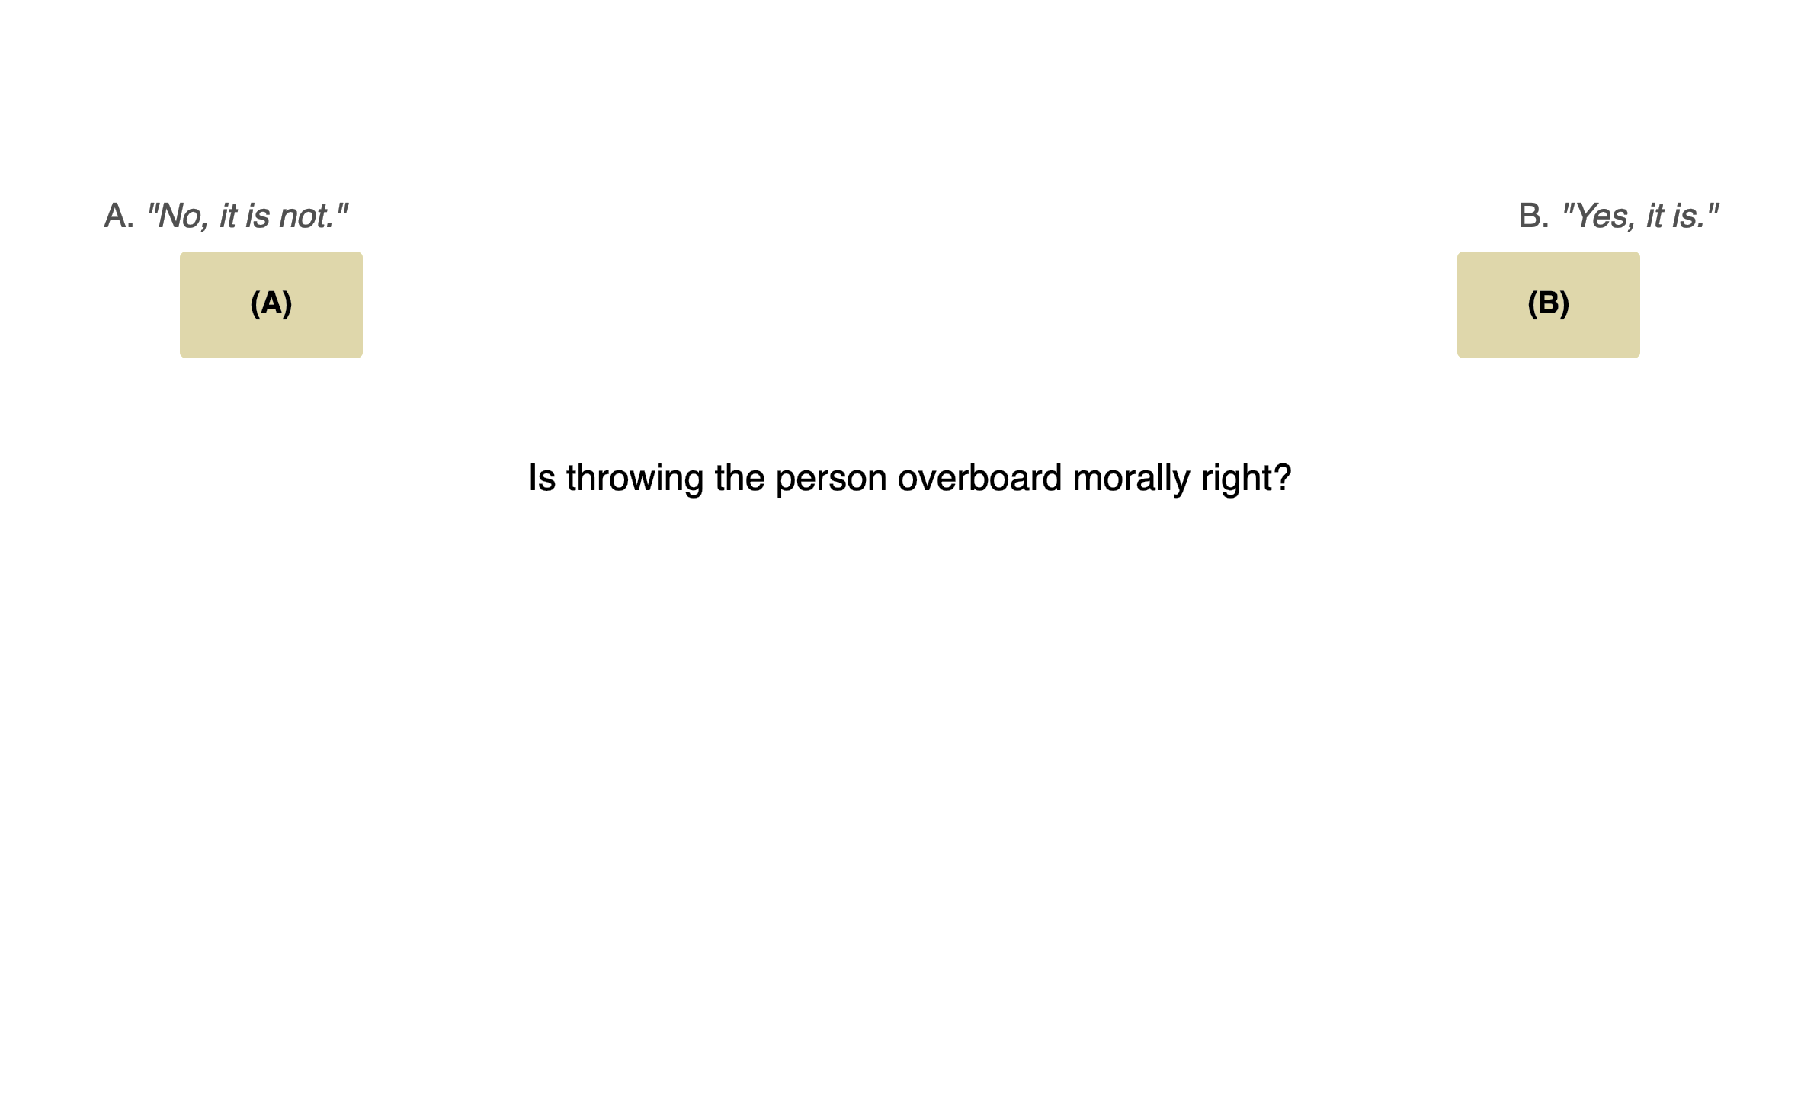

Beyond self-report

Slide 30
Curvature as conflict
(Nichols & Knobe, 2007)
Original
(Modified Nichols & Knobe, 2007)
Control
In an indeterministic universe…

Slide 31
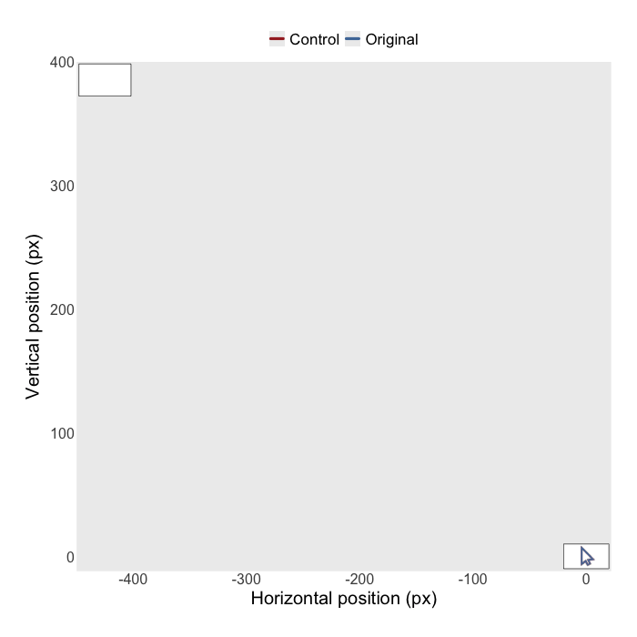
Curvature as conflict
In an indeterministic universe…

Slide 34
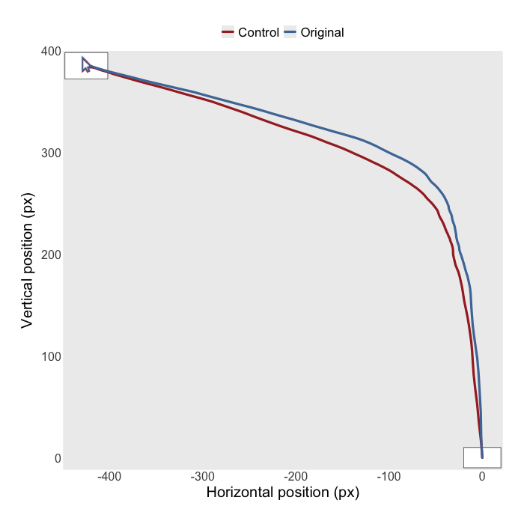
Time-resolved analyses
x
x
x
x
0
-32
-67
Time normalization (101 time steps)
Horizontal position as dependent variable

Slide 35
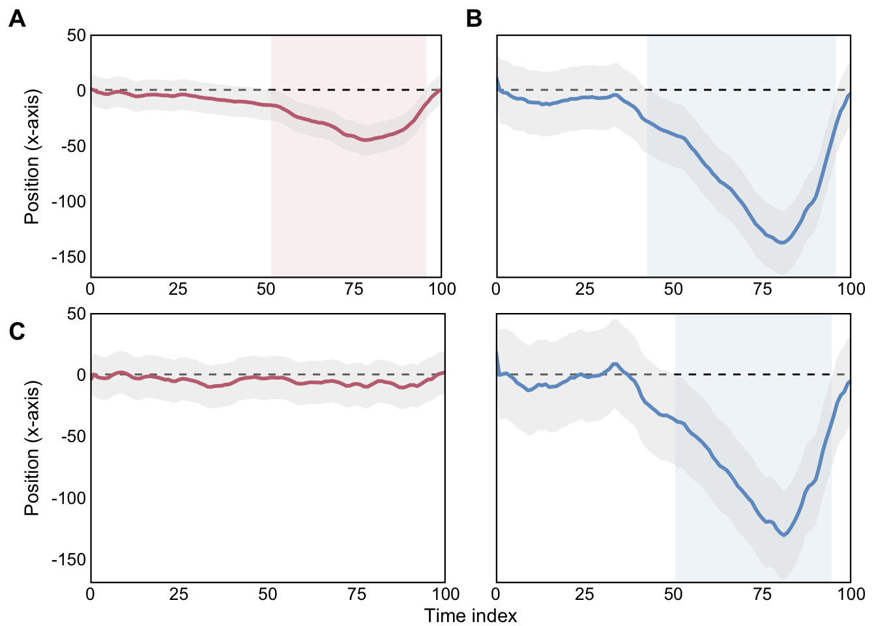
52nd – 95th
position = a * step + b * original + c * step * original

Slide 36
52nd – 95th
position = a * step + b * original + c * step * original
position = a * step + b * popularity-opposite + c * step * popularity-opposite

Slide 37
52nd – 95th
43rd – 95th
position = a * step + b * original + c * step * original
position = a * step + b * popularity-opposite + c * step * popularity-opposite

Slide 38
52nd – 95th
43rd – 95th
position = a * step + b * original + c * step * original

Slide 40
Core results
Substantial disagreement about which answer people think are correct.
These disagreements are not primarily a matter of people not having shared intuitions.
For each thought experiment, there is one intuition that is widely shared, even among those who believe it is incorrect.

Slide 41
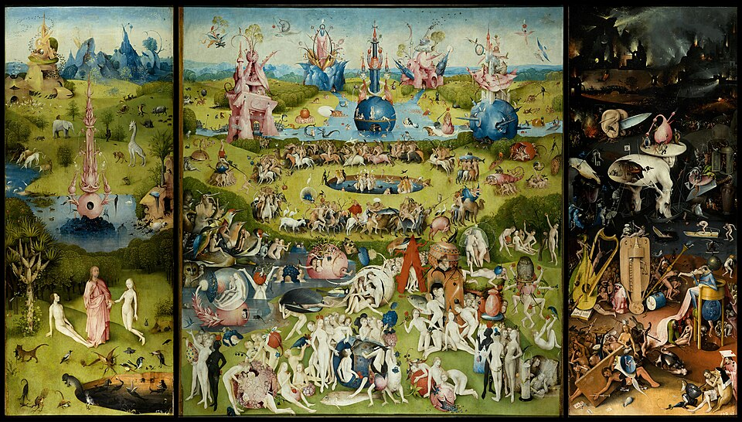
Extreme negative view
Reason for split responses is: Different people have different intuitions.
The intuitions you have are just idiosyncratic facts about you.
Thus, no philosophical pay-off in thinking deeply about those intuitions.

Slide 42
Extreme positive view
We have intuitions favoring both sides.
These intuitions are not just idiosyncratic; they are fundamental and widely shared.

Slide 43


Plausible positive view
We have intuitions favoring both sides.
These intuitions are not just idiosyncratic; they are fundamental and widely shared, even among people who believe those intuitions are not correct.

Slide 44
Future research
repeatedly sampling intuitions?

Slide 45
Future research
repeatedly sampling intuitions?
separate cognitive process?

Slide 46
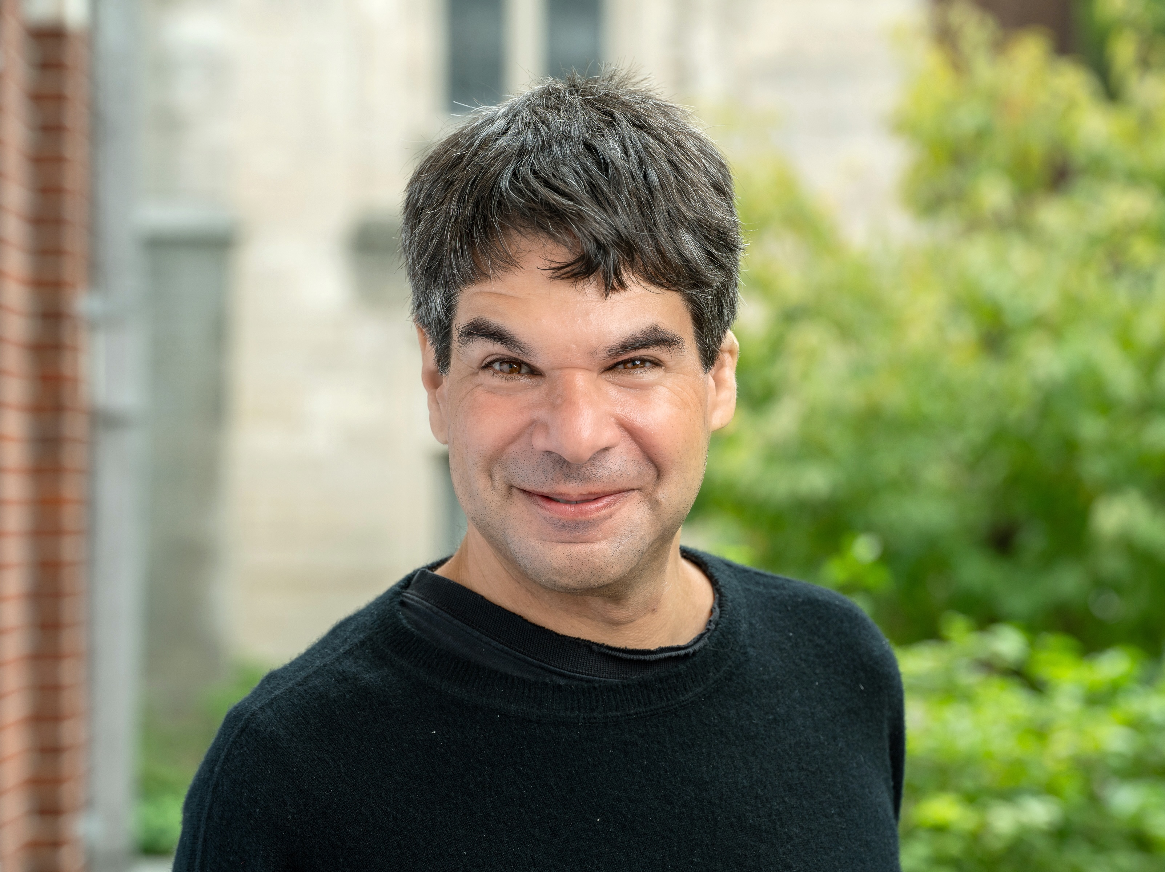
Thank you!
Joshua Knobe

Slide 47


Thank you!
6th European Experimental Philosophy Conference
University of Cagliari,
September 8–11, 2026

Slide 48
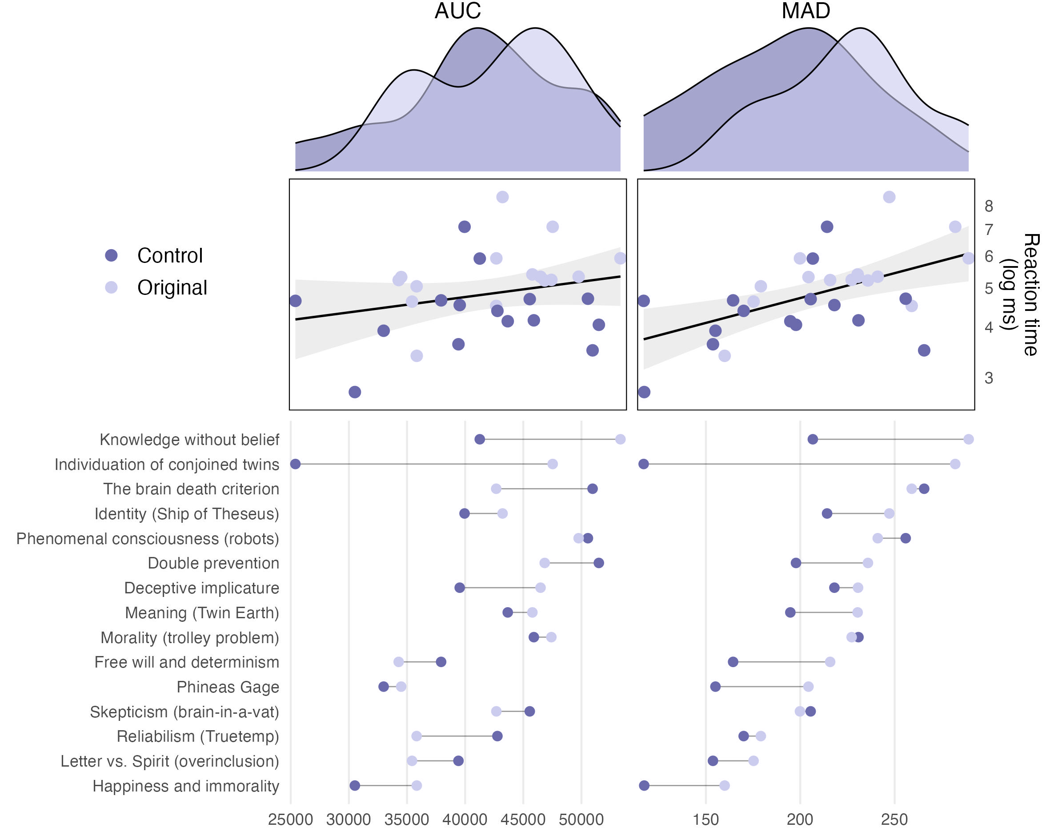

Slide 49
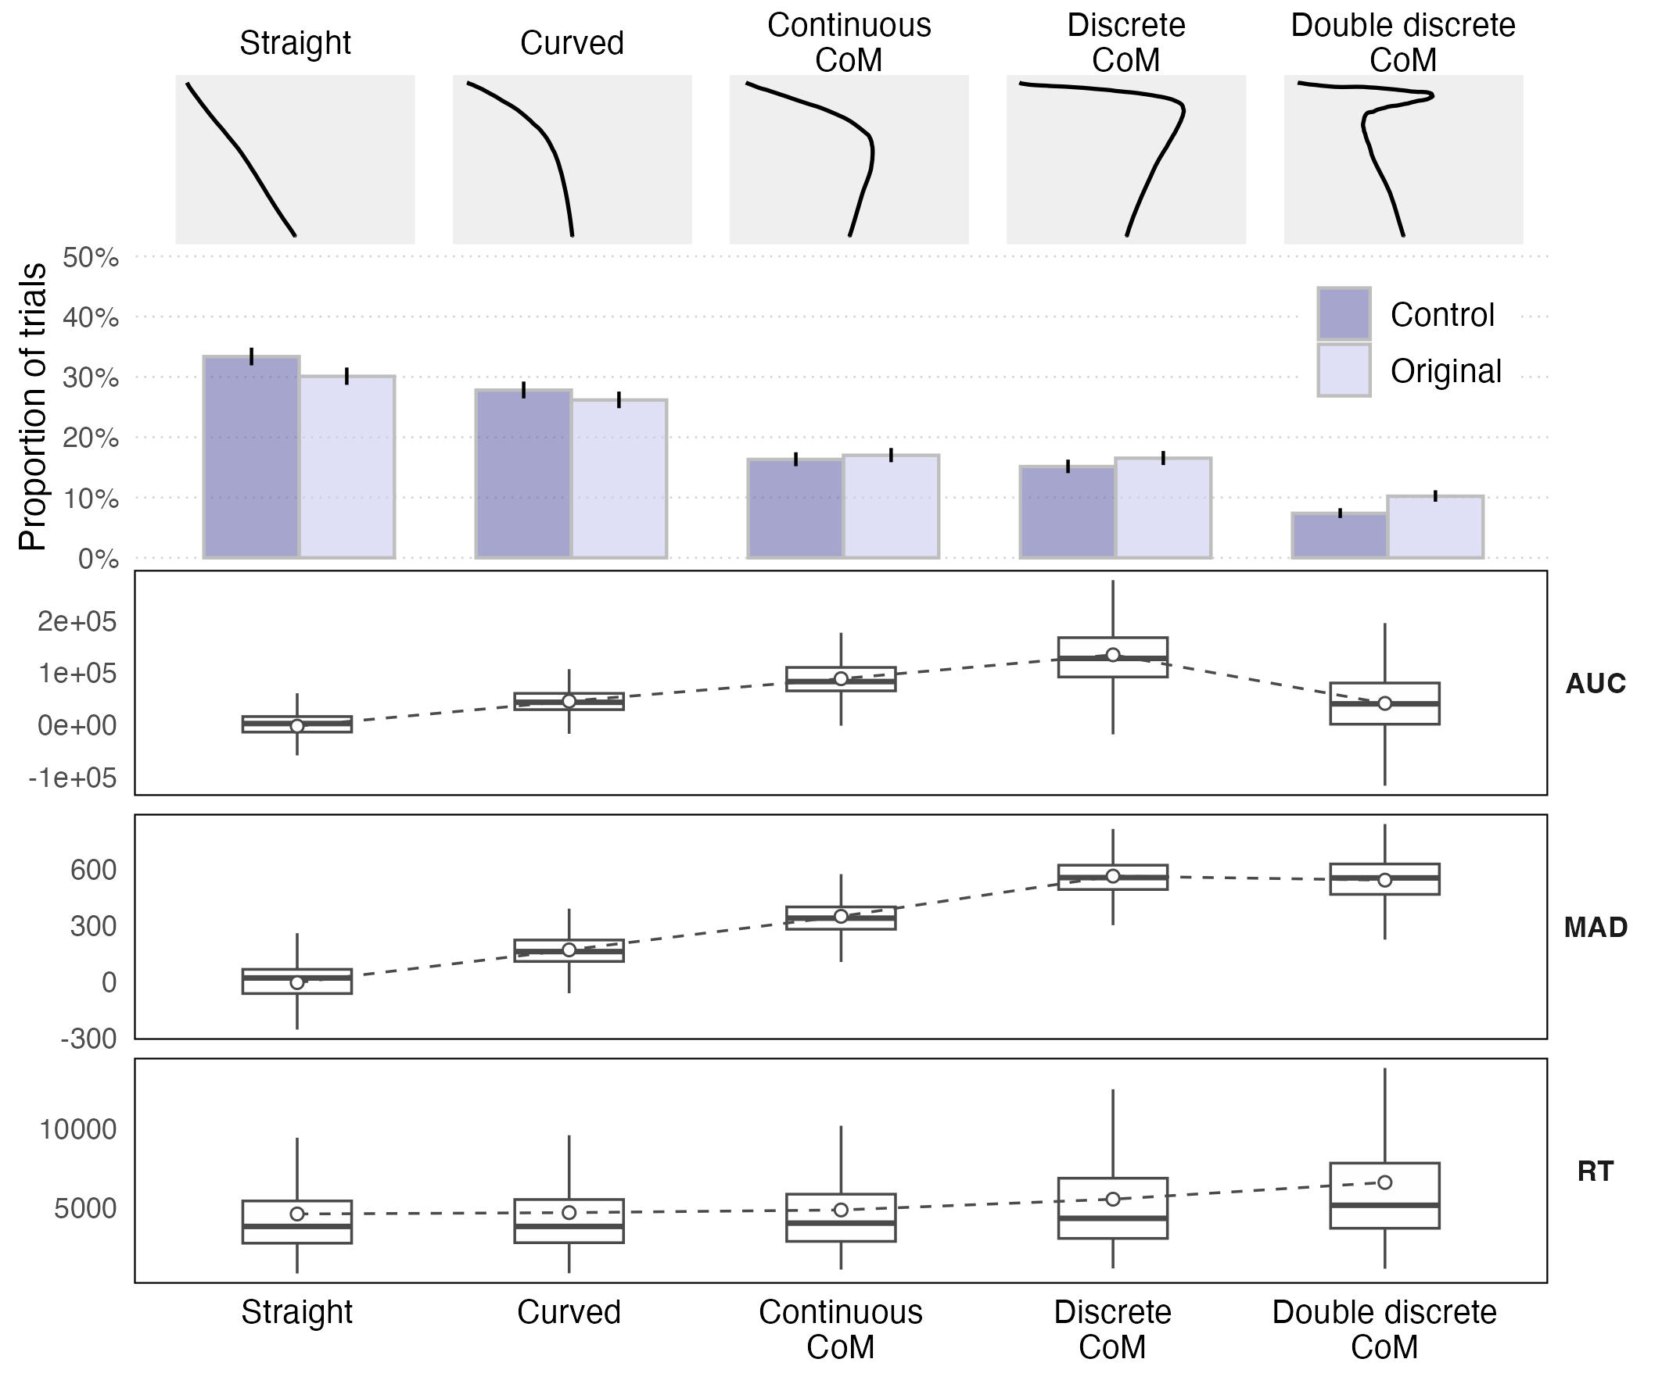

Slide 50
Trial-Level Analyses
Reaction time

Slide 51
Trial-Level Analyses
Reaction time
Maximum absolute deviation (MAD)

Slide 52
Trial-Level Analyses
Reaction time
Maximum absolute deviation (MAD)
Area under the curve (AUC)

