Slide 1

HR DASHBOARD Analysis
Presented By- Varun Malhotra

Slide 2

CONTENTS
Problem Statement
Objective
Benefits
Data Overview
Approach
Dashboard Components
Key Performance Indicator
Future Improvements
Conclusion

Slide 3
Problem Statement:
Green Destination is a well-known travel agency. The HR Director has recently noticed an increase in employees leaving(attrition). She would figure out any trends or patterns. She has surveyed the staff of Green Destinations and provided the data.
She would like to know the attrition rate (% of people who left the company).
She would also know if factors like age, years at the company and income play a part in determining if people will leave or not.

Slide 4
Objective:
Provide Insights to Hr. Director for employee attrition.
The staff of Green Destinations provided the data.
Create the KPI's accordingly.
Create a dashboard

Slide 5
Benefits:
Cost savings: Reduced revenue means lower recruitment and training costs.
Cultural improvements: A better understanding of the reasons for leaving will help foster a positive work culture.
Enhanced productivity: Lower turnover rates lead to a more stable and productive workforce.

Slide 6
Data Overview:
Age | Attrition | BusinessTravel | DailyRate
Department | DistanceFromHome | Education | EducationField
EmployeeCount | EmployeeNumber | Environment Satisfaction | Gender
HourlyRate | JobInvolvement | Job Level | JobRole
JobSatisfaction | MaritalStatus | MonthlyIncome | MonthlyRate
NumCompaniesWorked | Over18 | OverTime | PercentSalaryHike
PerformanceRating | RelationshipSatisfaction | StandardHours | StockOptionLevel
TotalWorkingYears | TrainingTimesLastYear | WorkLifeBalance | YearsAtCompany
YearsInCurrentRole | YearsSinceLastPromotion | YearsWithCurrManager

Slide 7
Approach:
Collect Raw Data- This step involves extracting the data from different sources relevant to the problem statement or obtaining data from the client.
Data Wrangling- Contains following steps gathering data, assessing data, handling missing data and adding columns.
Exploring Data- Once the data is loaded and pre-processed, we preform data analysis using python libraries and Business Intelligence tools like Tableau public and Power BI.
Deployment- The prepared visualizations are deployed on the public.tableau.com site. Where they will be available publicly.

Slide 8
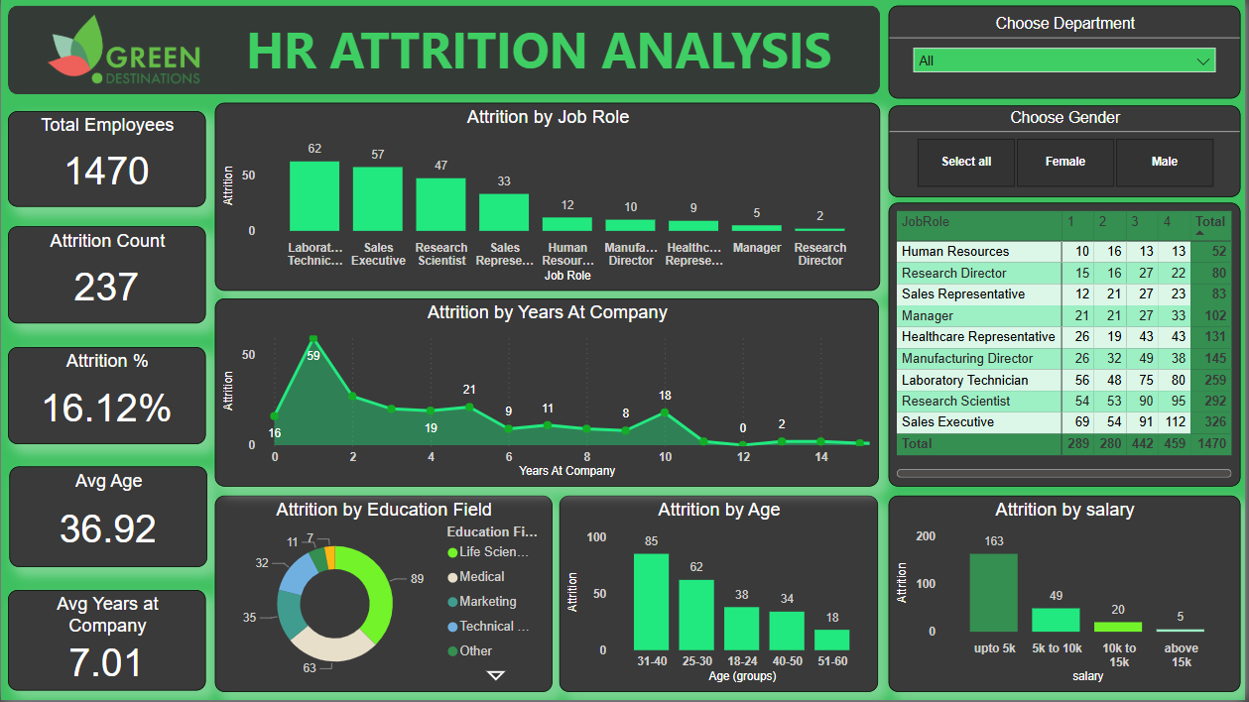
Dashboard Components:

Slide 9
Key Performance Indicators:
Total Employees- 1470
Attrition Count- 237
Attrition Rate %- 16.12%
Average Age- 36.92
Average Years at Company- 7.01

Slide 10
Future Improvements:
The dashboard provides helpful suggestions to reduce attrition, such as:
Employee engagement program: Implement programs to increase employee engagement and satisfaction.
Career development plans: Yield advancement opportunities and a clear career path.
Compensation and Benefits Evaluation: To remain competitive, compensation and benefits must be evaluated regularly.
Flexible working Arrangements: Offer flexible working arrangements to improve work-life balance

Slide 11
Conclusion:
The HR Attrition Analytics dashboard is a valuable resource for HR professionals and decision-makers seeking to better understand employee attrition. Companies may effectively reduce turnover and establish a stable, engaged, and productive workforce by studying demographic determinants, tracking KPIs, and applying improvement measures. more efficient.

Slide 12
THANK YOU

