Slide 1
SALARY ANALYSIS REPORTS
FOR SAN FRANCISCO EMPLOYEES
Prepared By: Varun Malhotra

Slide 2

CONTENTS
Objective
Data Overview
Tools and Technologies Used
Data Cleaning
Exploratory Data Analysis
Dashboard Components
Key Metrics Summary
Trend Analysis
Conclusion

Slide 3
Objective
The project aims to analyze employee compensation data, including Base Pay, Overtime Pay, Other Pay, Benefits, and their relation to Total Pay and Total Pay Benefits. This is achieved through Exploratory Data Analysis (EDA) and Visualization using Python in Jupyter Notebook and Microsoft Power BI Desktop.

Slide 4
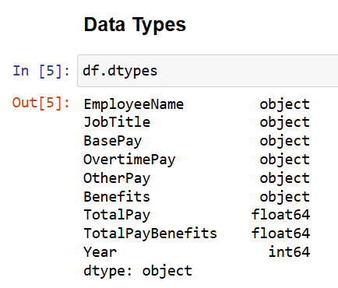
Data Overview
Columns in the dataset:
EmployeeName: Name of the employee.
JobTitle: Title of the job.
BasePay: Base salary pay.
OvertimePay: Pay for overtime work.
OtherPay: Any other types of compensation.
Benefits: Benefits provided to the employee.
TotalPay: The total pay without benefits.
TotalPayBenefits: Total pay with benefits included.
Year: The year of the payroll record.

Slide 5





Tools & Technologies Used

Slide 6
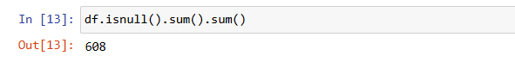
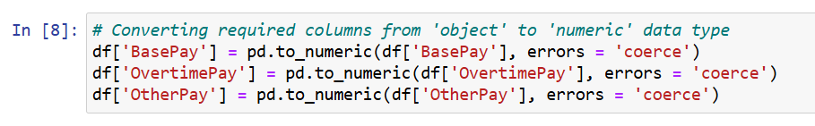
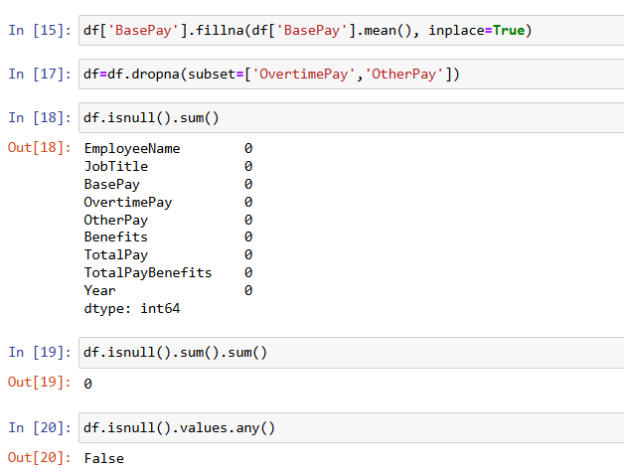
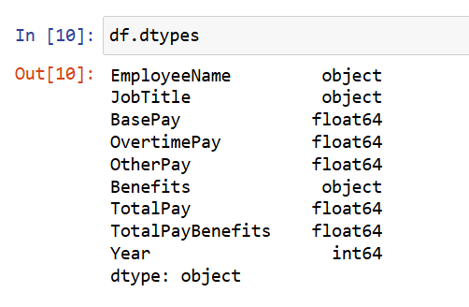
Data Cleaning
Handling Null Values
Typecasting

Slide 7
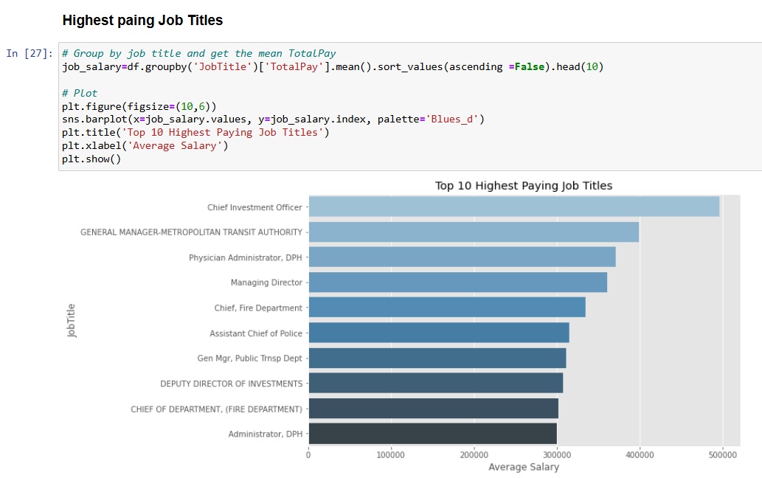
Exploratory Data Analysis

Slide 8
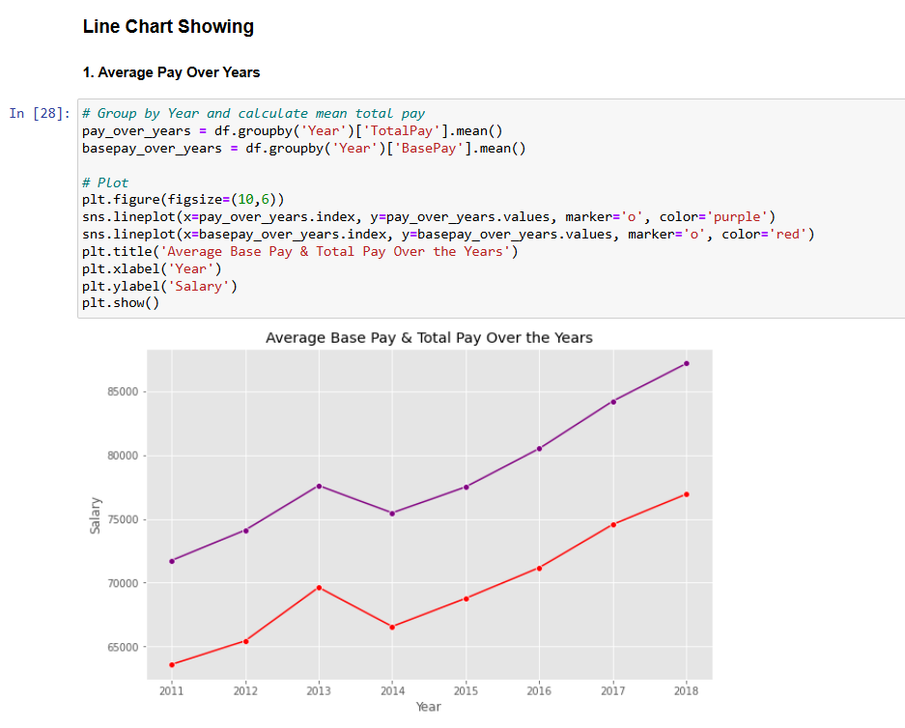
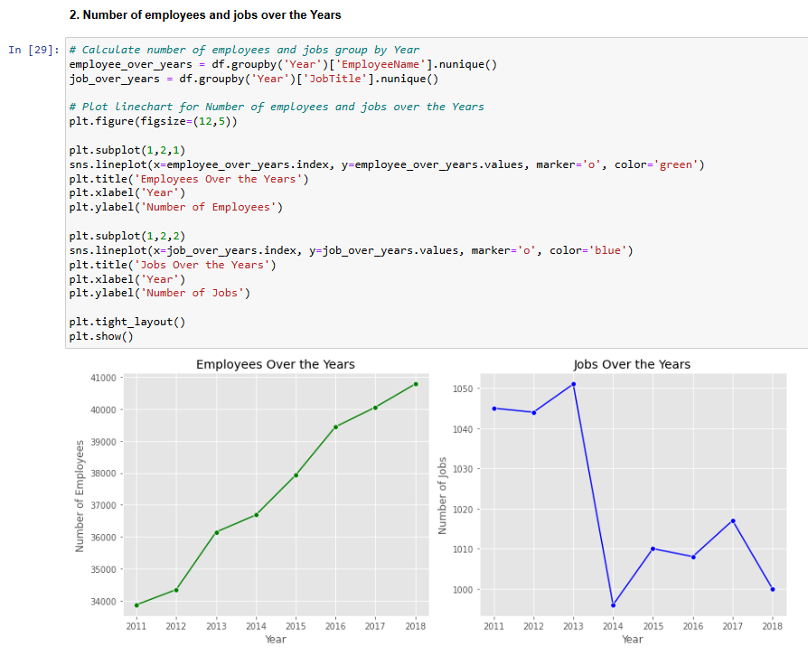
Line Charts

Slide 9
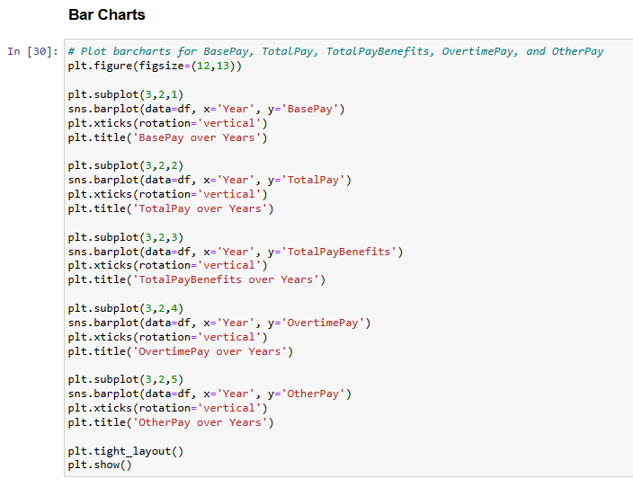
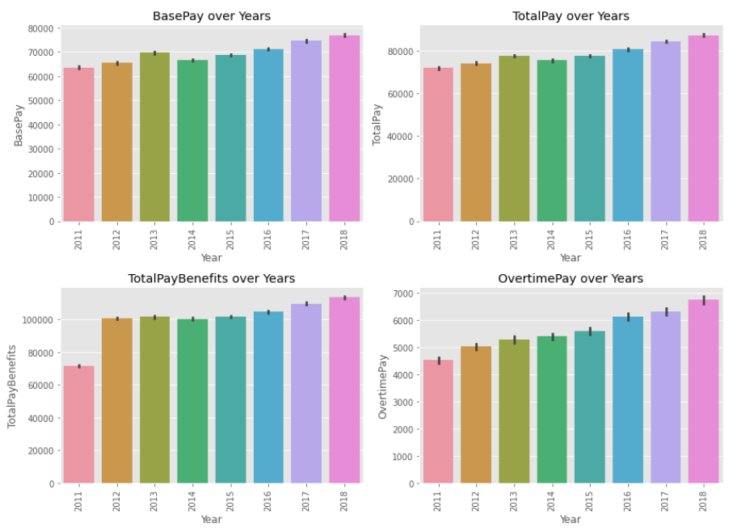
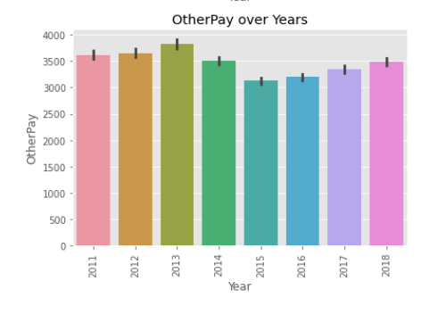
Bar Charts

Slide 10
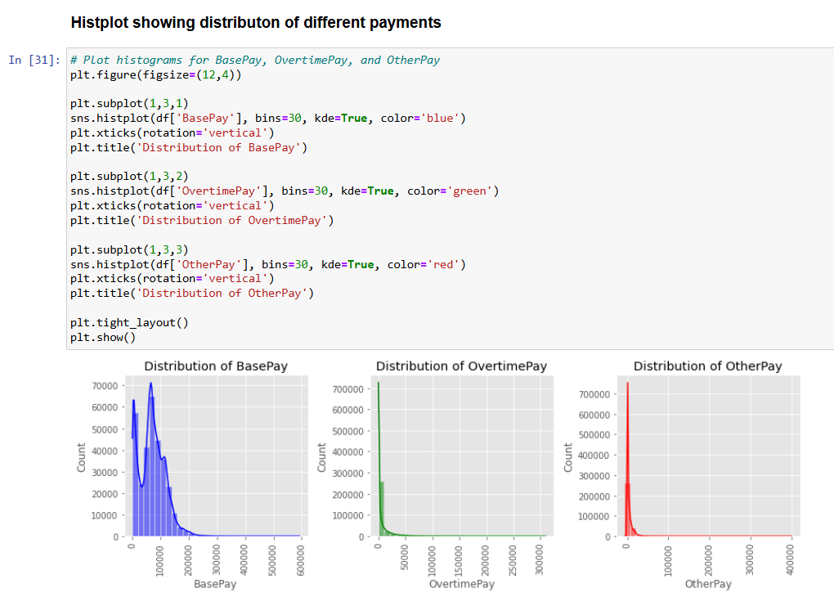
Graphs Showing distribution of payments

Slide 11
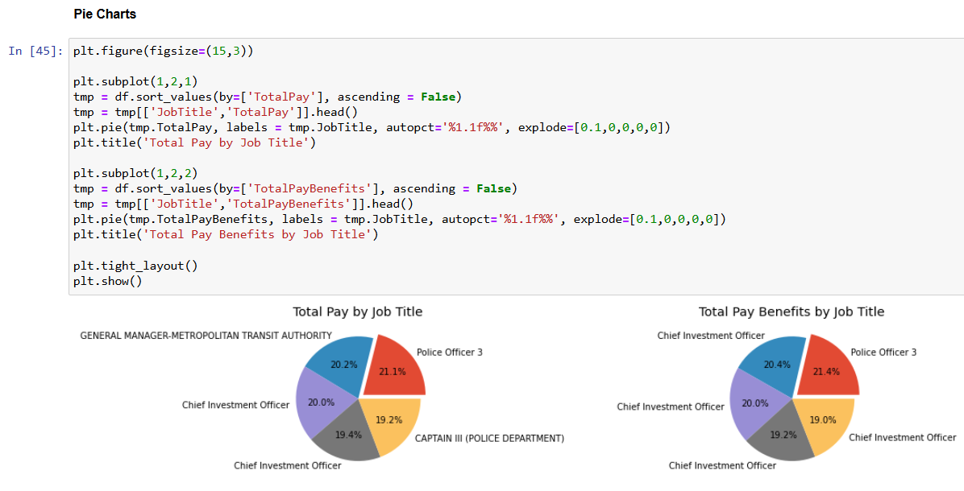
Pie Charts

Slide 12
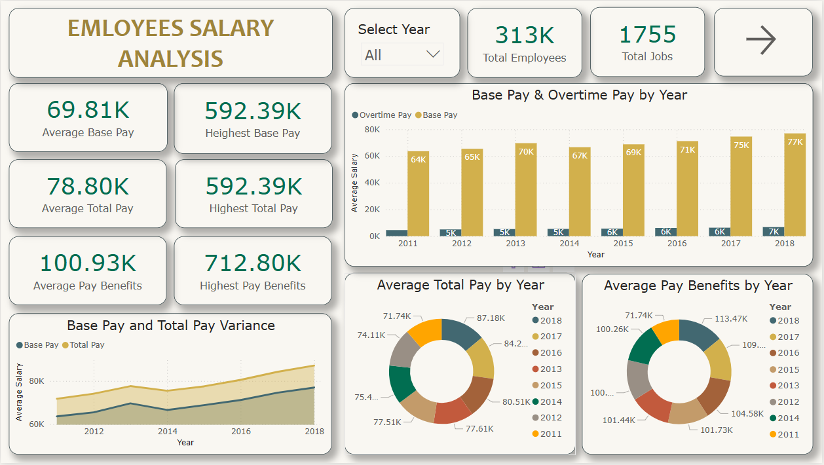
Dashboard Components

Slide 13
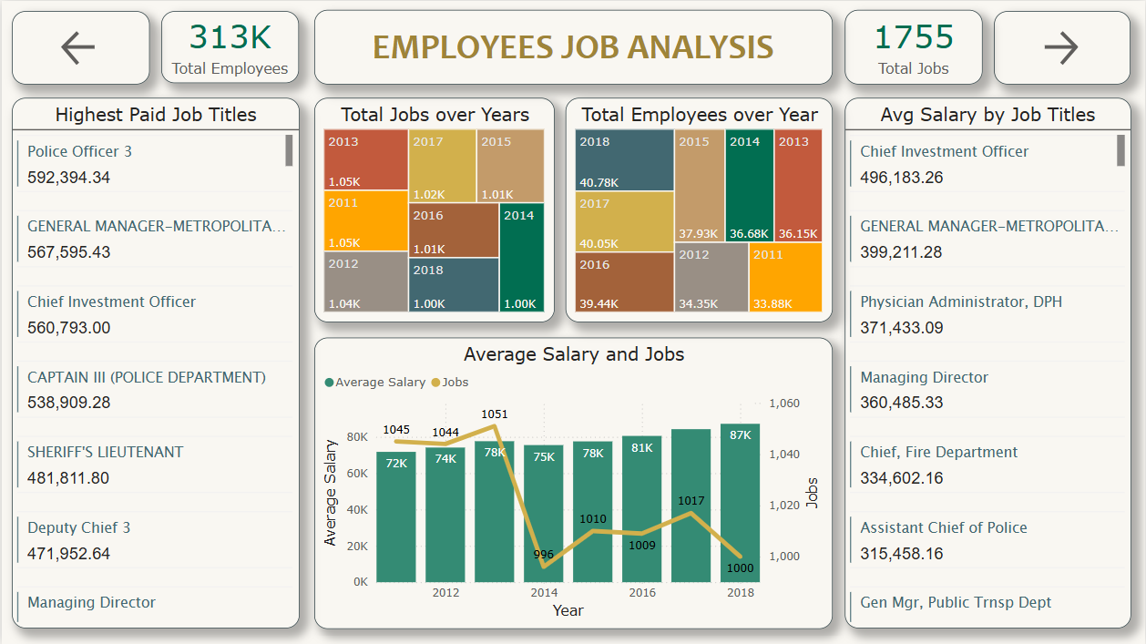
Dashboard Components

Slide 14
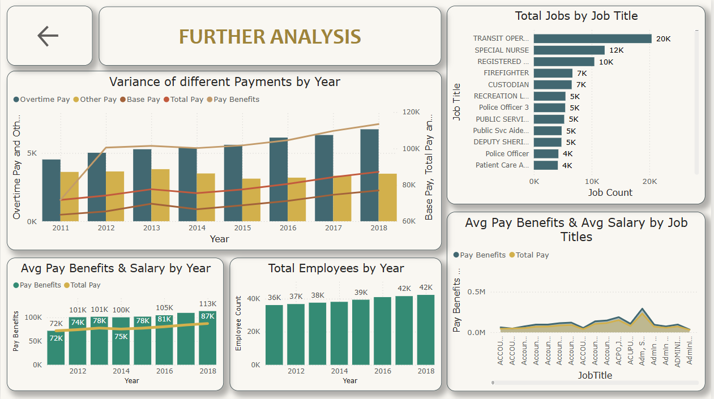
Dashboard Components

Slide 15
Key Metrics Summary
Salary Overview:
Average Base Pay: $69.81K
Highest Base Pay: $592.39K
Average Total Pay: $78.80K
Highest Total Pay: $592.39K
Average Pay Benefits: $100.93K
Highest Pay Benefits: $712.80K
Workforce Overview:
Total Employees: 313K
Total Job Titles: 1,755

Slide 16
Trend Analysis
Base Pay & Overtime Trends
From 2011 to 2018, Base Pay consistently increased from $64K to $77K.
Overtime Pay also showed a gradual increase, reflecting growing demand or workload.
Year-wise Variance
The line and bar charts show a steady upward trend in all salary components, especially after 2014.
Benefits and overtime form a growing share of total pay, suggesting either better benefit programs or greater reliance on overtime.
Total Pay & Pay Benefits
Total Pay rose from $72K (2011) to $87K (2018).
Pay Benefits climbed significantly from $72K to $113K, indicating a shift toward benefits-focused compensation.
Highest Paid Titles
Police Officer 3: $592,394
General Manager–Metropolitan: $567,595
Chief Investment Officer: $560,793
Captain III (Police Department): $538,909
High earners are predominantly from law enforcement and executive roles.

Slide 17
Trend Analysis
Average Salary by Title
Chief Investment Officer: $496,183 (highest average)
Assistant Chief of Police: $315,458
Reflects that administrative and public safety roles dominate top average salaries.
Total Jobs by Year
Job counts have remained relatively stable (~1,000 per year).
Minor fluctuations suggest consistent hiring practices or job reclassifications.
Employee Count Over Years
Number of employees increased from ~34K in 2011 to ~42K in 2018.
Growth implies workforce expansion or regular onboarding.
Jobs by Title
Transit Operator: 20K jobs
Special Nurse: 12K jobs
Registered Nurse: 10K jobs
Job volume indicates healthcare and transit are the most populous sectors.

Slide 18
Trend Analysis
Additional Insights:
Average Pay Benefits vs Avg Salary by Job
The chart shows job titles with disproportionately higher benefits compared to salary.
Indicates potential areas of cost optimization or restructuring.
Component Variance
From 2011 to 2018, overtime, pay benefits, and base pay showed consistent growth.
Increasing benefit load suggests a strategic shift or legal compliance changes.

Slide 19
Conclusion
This analysis provides a detailed view of the compensation landscape across years and job titles. With rising salaries, expanding benefits, and consistent job volumes, the data supports informed decision-making for HR planning, salary benchmarking, and organizational budgeting.

Slide 20

THANK YOU

