Slide 1


Top Instagram Influencers Analysis
Presented By- Varun Malhotra

Slide 2


CONTENTS
Objective
Data Overview
Data Cleaning
Data Preprocessing
Exploratory Data Analysis
Tools & Technologies Used
Summary

Slide 3
Objective
This project will analyze and predict insights on Instagram influencers using a dataset containing information on influencer ranking, engagement metrics, followers, likes, and more. This project targets a more advanced audience with 5 years of experience, so, it will involve detailed exploratory data analysis (EDA) and visualizations.

Slide 4
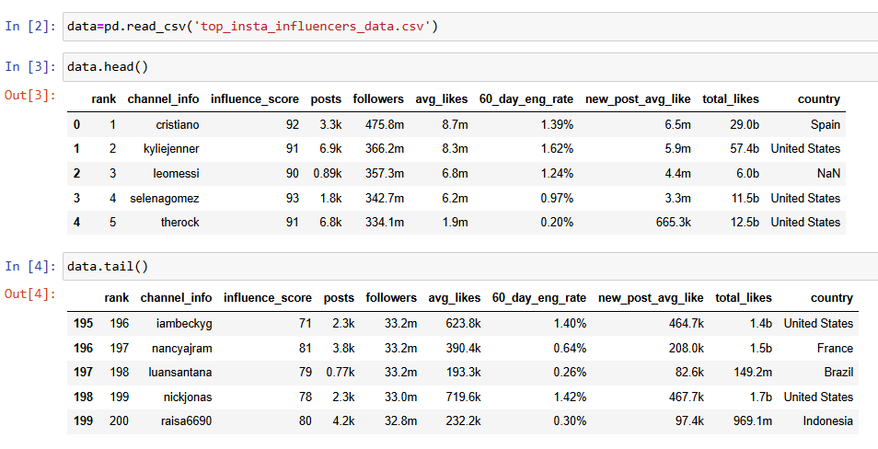
Data Overview

Slide 5
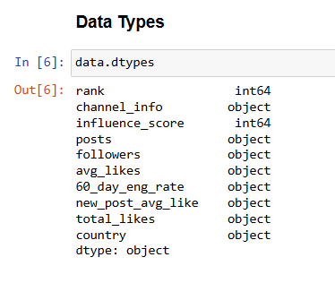
Columns Overview
rank: Influencer rank
channel_info: Instagram handle or channel information
influence_score: Calculated influence score based on engagement and followers
posts: Total number of posts made by the influencer
followers: Number of followers
avg_likes: Average likes per post
60_day_eng_rate: Engagement rate over the past 60 days
new_post_avg_like: Average likes on recent posts
total_likes: Cumulative likes on all posts
country: Influencer's country

Slide 6
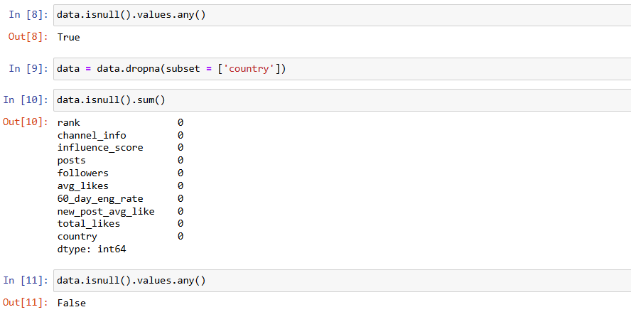
Data Cleaning

Slide 7
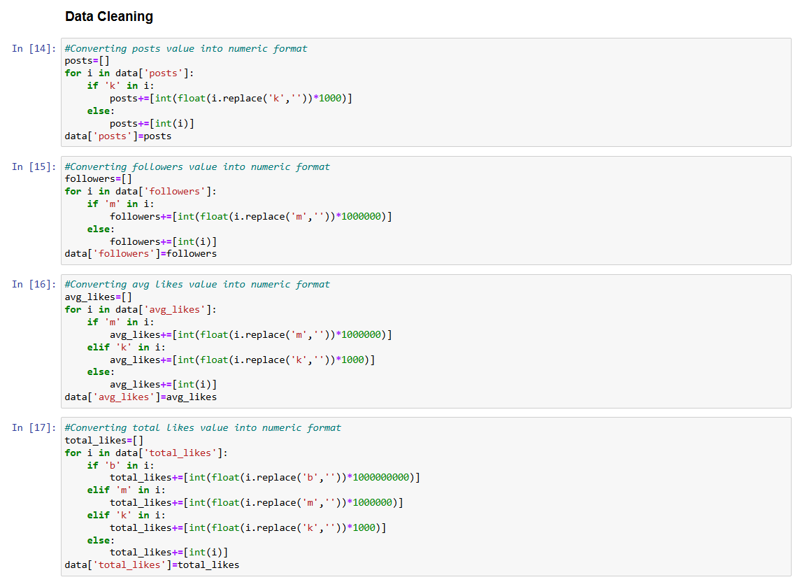
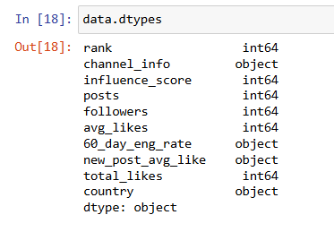
Data Preprocessing
Data Types After
typecasting

Slide 8
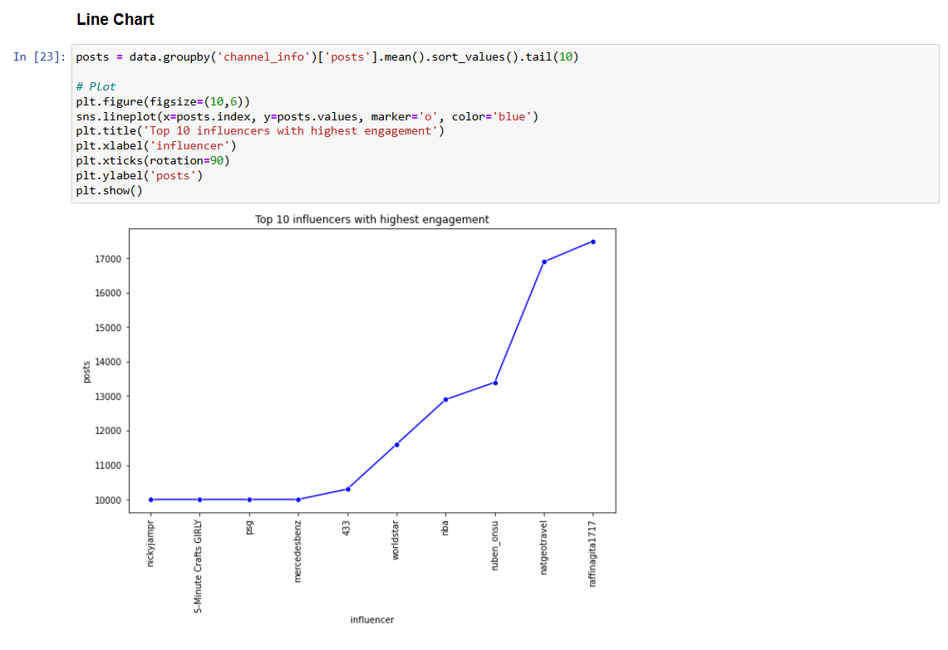
Exploratory Data Analysis

Slide 9
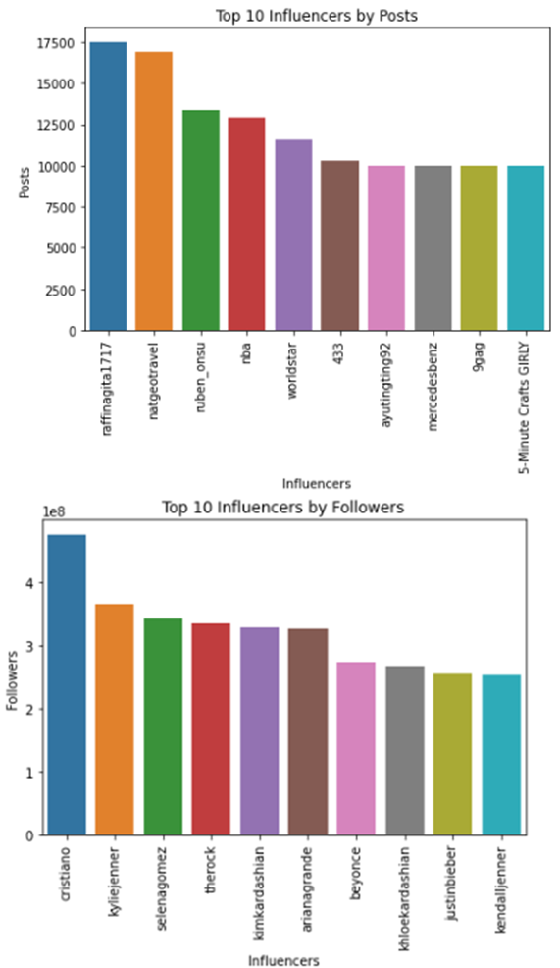
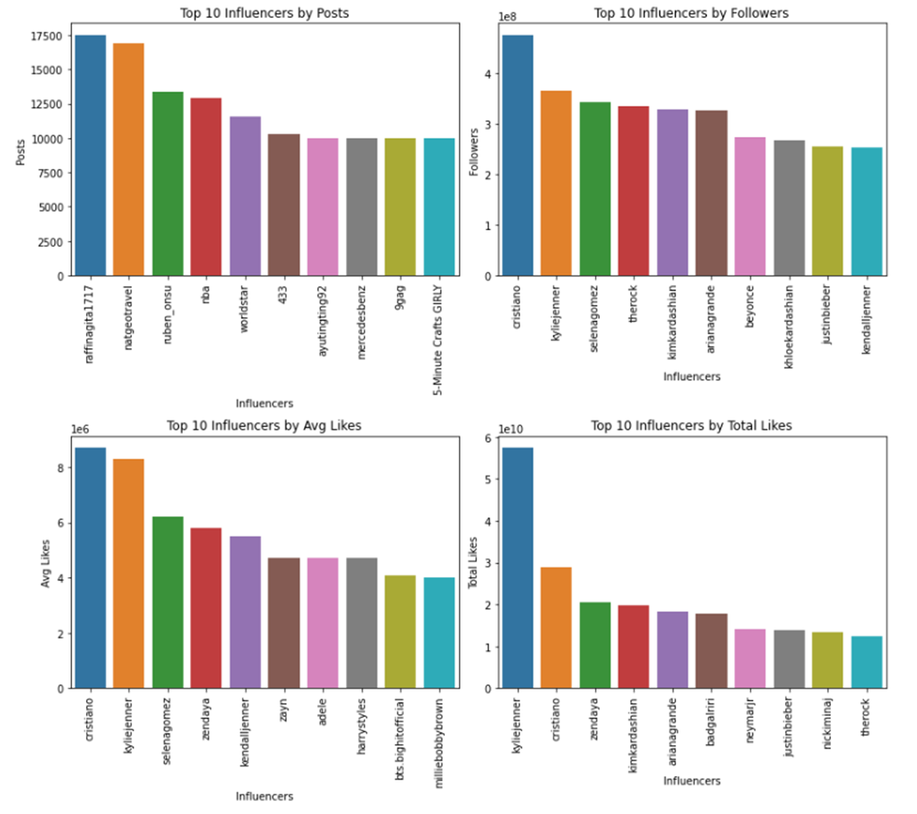
Bar Chart of Top 10 Influencers

Slide 10
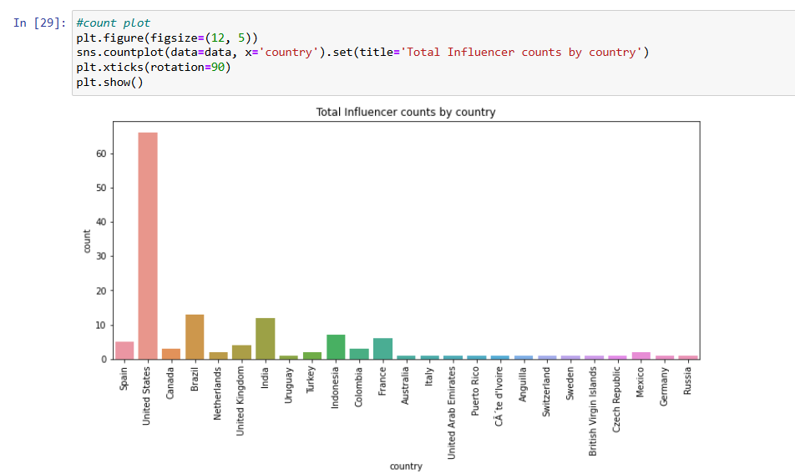
Influencers Count by Country

Slide 11
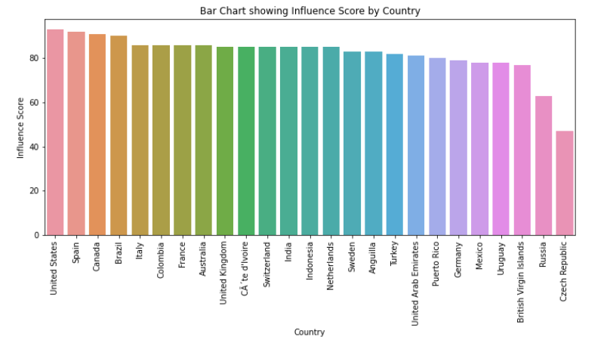
Influence Score by Country

Slide 12





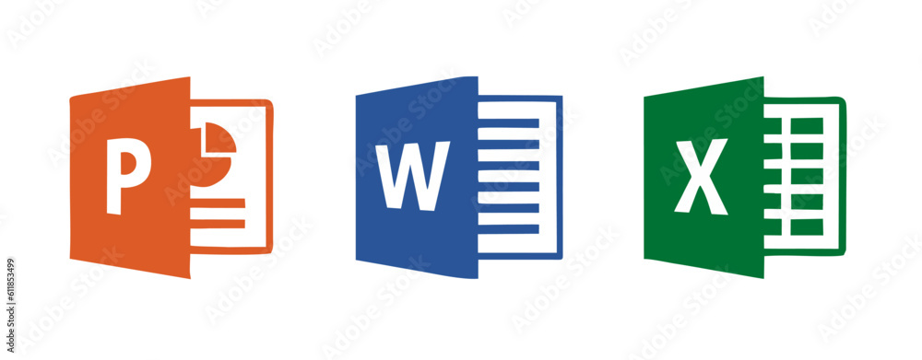
Tools & Technologies Used

Slide 13
Summary
Influencer Rankings and Distribution:
Analyzed top influencers, their reach, and engagement patterns.
Country-based Trends:
Identified which countries have the most active influencer bases and higher follower counts.
Micro-Influencers with High Engagement:
Discovered lower-followed influencers with significant engagement.
Growth Indicators:
Showcased influencers with rising engagement rates on recent posts.

Slide 14

THANK YOU
Varun Malhotra
varunvirenmalu@gmail.com
https://github.com/ivarunmalhotra
https://www.linkedin.com/in/i-varunmalhotra/

