Slide 1
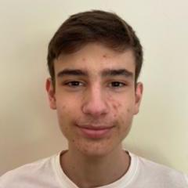
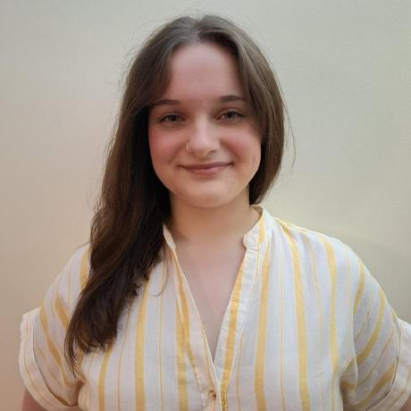


[Logistics On Rails] - SPRINT 1
G091
LAPR3 2025/2026
João Ferreira (1241166) | Iva Silva (1241176) | Diogo Silva (1241229) | Gonçalo Tavares (1241234)

Slide 2
Sprint planning – Sprint 1
Planned Start Date: 29/09/2025 Real Start Date: 30/09/2025
Planned End Date: 26/10/2025 Real End Date: 27/10/2025
SPRINT BACKLOG
Number of stories | 16
Number of bugs | 2
Number of tasks | 53
Number of Management Tasks (Scrum) | 4
Number of team members | Planned: 4 Actual: 6
Total planned estimation vs execution | Planned hours: (not mandatory) Executed hours: (not mandatory)

Slide 3
Sprint 1 planning
Assigned User Stories (as stated in the project assignment) | Commited? Yes / No (according to team planning) | Todo | Doing | Testing | Done | Blocked
USBD01 | Yes |  |  |  | X
USBD02 | Yes |  |  |  | X
USBD03 | Yes |  |  |  | X
USBD04 | Yes |  |  |  | X
USBD05 | Yes |  |  |  | X
USBD10 | Yes |  |  |  | X
USBD15 | Yes |  |  |  | X
USBD16 | Yes |  |  |  | X
USEI01 | Yes |  |  |  | X
USEI02 | Yes |  |  |  | X

Slide 4
Sprint 1 planning
Assigned User Stories (as stated in the project assignment) | Commited? Yes / No (according to team planning) | Todo | Doing | Testing | Done | Blocked
USEI03 | Yes |  |  |  | X
USEI04 | Yes |  |  |  | X
USEI05 | Yes |  |  |  | X
USLP01 | Yes |  |  |  | X
USLP02 | Yes |  |  |  | X
USLP03 | Yes |  |  |  | X
…
…
…
…

Slide 5
Work assigned by team member

Slide 6
Work assigned by type (componente)

Slide 7
Issues / Assumptions / unanswered questions
Description | Responsible | Date / sprint | Related issue / item in Git

Slide 8
Daily Meetings
Date (of the meeting) | Place / duration | João Ferreira | Iva Silva | Diogo Silva | Gonçalo Tavares
1/10/2025 | ISEP / 15 min | X | X | X | X
3/10/2025 | ISEP / 7 min | X | X | X | X
6/10/2025 | ISEP / 5 min | X | X | X | X
8/10/2025 | ISEP / 8 min | X | X | X | X
10/10/2025 | ISEP / 10 min | X | X | X | X
13/10/2025 | ISEP / 6 min | X | X | X | X
15/10/2025 | ISEP / 5 min | X | X | X | X
17/10/2025 | ISEP / 8 min | X | X | X | X
20/10/2025 | ISEP / 10 min | X | X | X | X
21/10/2025 | ISEP / 10 min | X | X | X | X
22/10/2025 | ISEP / 10 min | X | X | X | X
23/10/2025 | ISEP / 6 min | X | X | X | X
24/10/2025 | ISEP / 10 min | X | X | X | X

Slide 9

LLM performance assessment (use ChatGPT or Copilot)
Source file (attach the file you have used):
Input (write down the prompt you used to ask for the performance assessment):
We are a group of people working on a project for our university, named Integrative Project, using Scrum as a work methodology . We are now filling the sprint review, with one of the requirements being an LLM assessing our work from 0-5. I'll sent you a word file which contains data of all the daily meetings we had during the sprint, with information about what each member did, what are their thoughts on the team, and other important information. Also, we would like you to give us 1 or 2 short phrases for each member of the group, where you can say what we did right and in which areas we can improve. Keep the answer straight to the point.

Slide 10
LLM performance assessment - Output
Output file (attach the complete file extracted from the A.I. tool):
Output (write one line per team member):
João Ferreira: Strong leadership and organization throughout the sprint; could improve in anticipating and mitigating blockers earlier.
Diogo Silva: Reliable and collaborative contributor on database and testing tasks; could focus on earlier validation to minimize refinements.
Iva Silva: Consistent and effective in delivering assigned user stories; could take more initiative in suggesting process or design improvements.
Gonçalo Tavares: Supportive and technically solid teammate; could enhance task planning to better handle interdependencies.
Team Members’ Opinion about the A.I. output:

Slide 11
LLM performance assessment - Output
Team Members’ Opinion about the A.I. output:
We agree with the evaluation, since it reflects our strong teamwork, communication and consistency throughout the sprint. As the LLM said, we have room to improve in anticipating technical issues and optimizing task dependencies. Overall, we’re satisfied with our performance.

Slide 12
Sprint Retrospective Date: 26/10/2025
What went well?
The group chemistry allowed every member to be at its best, which made the project development easier for everyone.
Every team member was willing to help anyone at any point during the sprint, making so almost no impediments happened during this sprint.
What went wrong?
A misinterpretation of the assessment caused the team to have the necessity of remaking the entirety of the database.
Some software crashing issues caused some minor delay on the project development.
What we learned?
New ways to adapt at things that are out of our control, so we guarantee that everyone’s working.
We developed as a team, which makes so we go into Sprint 2 being more capable of adapting each of strengths and weaknesses of each team member, so we can get the best result possible.

Slide 13
Sprint Retrospective Date: 26/10/2025
Action items:

Slide 14

Overall Project performance:
Comments: None.
LLM evaluation: 4
How do you grade your performance (0-5): 5
How do you grade your results (0-5): 4

Slide 15


