Slide 1


Slide 2
Agenda
Problem Statement 03
Data Mining - 01 04
Data Mining - 02 05
Exploratory Data Analysis (EDA) 06
Data Visualization 07
Algorithms Used 08
Analysis of Results 09
Conclusion & Future Work 10

Slide 3
Problem Statement
The given dataset is the information about different people,their habits etc and predicting whether that person is liable to brain stroke.
A brain stroke is medical condition in which poor blood flow to the brain causes cell death.
‘stroke’ is the target variable , and stroke: 1 if the patient had a stroke or 0 if not.

Slide 4
Data Mining - 01
Firstly, after loading the dataset “full_data.csv”, find the null values. Here, there are no null values.
Then, check for duplicates. Here,there are no duplicates.
Then, find the number of unique values in each column.
Identify the target variable.
Running the info() command gives the information and datatypes of each variable. If there are any categorical values, use LabelEncoder to convert them into discrete values.
Check if there are any outliers in the variables influencing Target variable. If,there are any outliers in them, remove them and store it in a new dataset

Slide 5
Data Mining - 02
Check if the dataset is balanced/imbalanced. Here, the dataset is imbalanced. So, we have to balance it. This is done by Random OverSampling Technique.
Drop the variables which doesnot influence the target variable.
Seperate the Independent variables into one dataframe and the target variable into another.
Identify the columns that influence the target variable.
Split the data as train data and test data. Train data is used to train the model and test data is used to test the model.
Apply scaling techniques. Here, MinMaxScaler is used for scaling the columns/variables influencing the target variable.

Slide 6
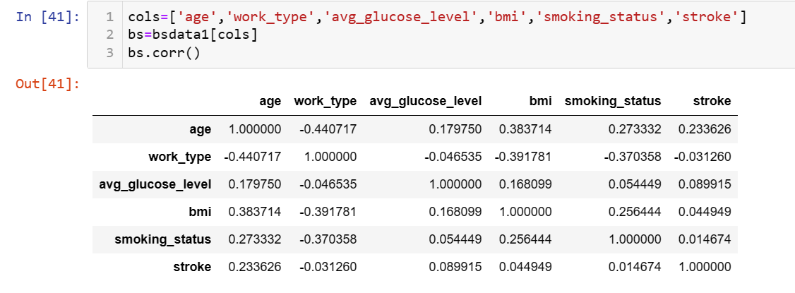
Exploratory Data Analysis (EDA)

Slide 7
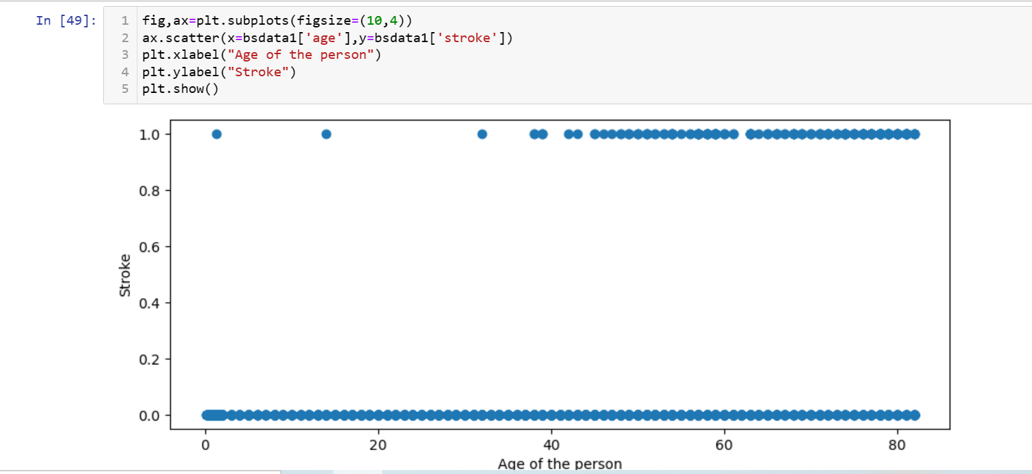
Data Visualization

Slide 8
Algorithms Used
For this dataset, following classification algorithms are used:
Logistic Regression
Decision Trees
RandomForest
ExtraTrees
KNeighbors(KNN)
GaussianNB
SVC(Gaussian)

Slide 9
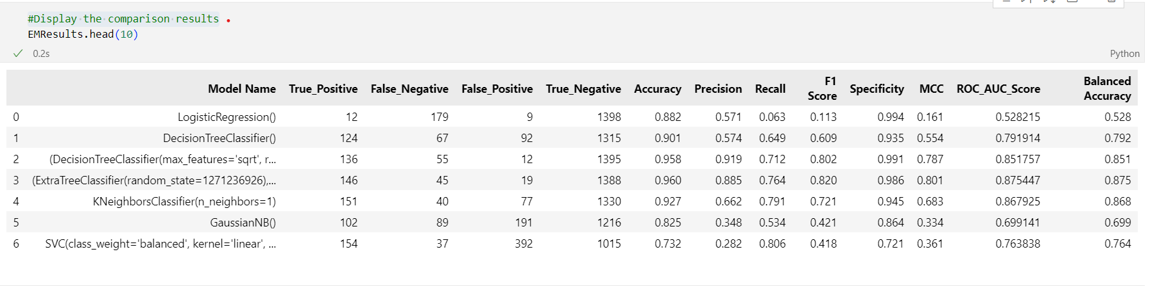
Analysis of Results

Slide 10
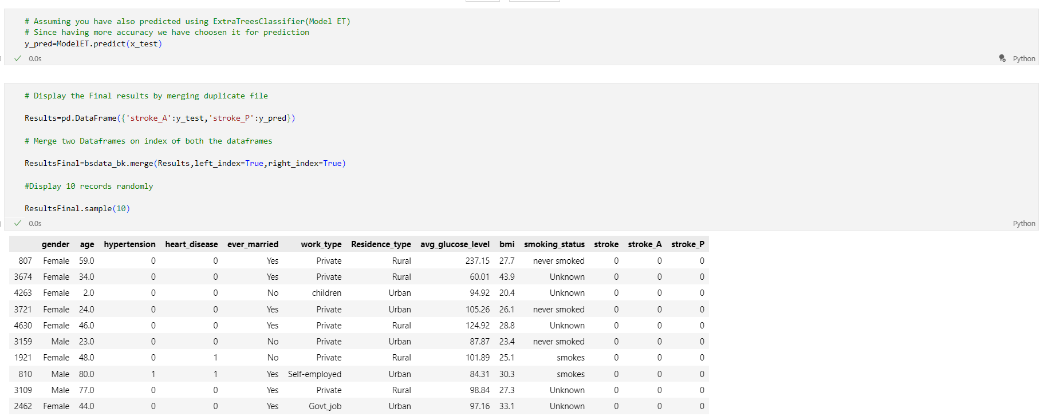
Conclusion and Future Work
Future Work:
Outliers can be identified to increase the efficiency.

Slide 11
Thank You
Q & A
Student Name: I P B Praveen
Roll Number: 21B91A05B5
SRKR Engineering College
Mobile: +91 9848639655
Email: 21b91a05b5@srkrec.ac.in
Bhimavaram - India

