Slide 1


C# API Scenarios
Code It Up Online Vol. 8

Slide 2
For questions
https://sli.do #api
The YouTube Live Chat Is Not Monitored
Presentation & Code https://github.com/ivaylokenov/C-Sharp-API-Scenarios-REST-GraphQL-gRPC

Slide 3
Live stream troubleshooting
Sometimes issues happen during a live stream…
And sometimes disasters happen, this is how memes are born…
If my Internet goes down and the stream stops:
Wait for 5 minutes, I have another one on a different network
If YouTube is showing “stream ended”:
I will post a new link in the comments section below this video
If something else happens unexpectedly:
Well, I will add a solution to this slide during my next event… ☹
If a major showstopper is happening – no electricity, for example
I will create a new event and we will schedule a new live stream…

Slide 4
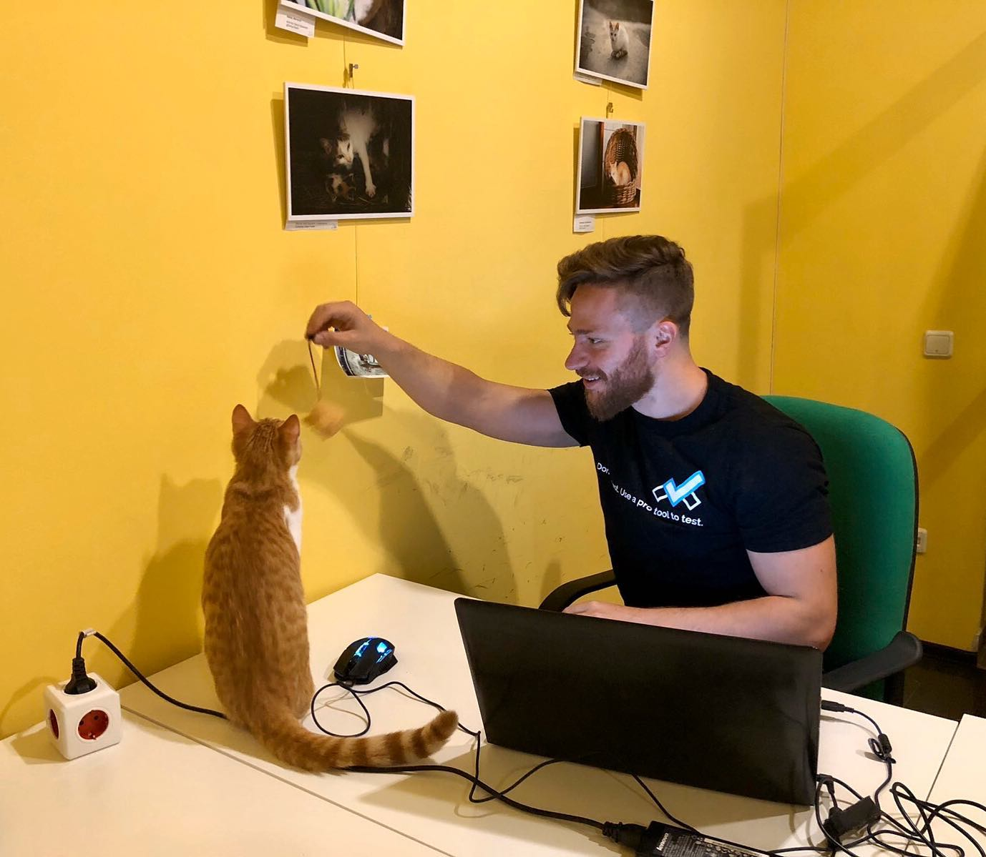
The Presenter
Ivaylo Kenov – Quality Code Advocate
Various job titles at the same time:
Organizer & Speaker @ Code It Up
CTO @ SoftUni
Full Stack Technical Trainer @ Everywhere
Code General @ https://MyTestedASP.NET
Meme Copy Machine @ Daily Programming Fun
{Insert Job Title Here}
Contacts
https://github.com/ivaylokenov
https://facebook.com/ivaylo.kenov
https://linkedin.com/in/kenov
https://www.instagram.com/ivaylokenov/
YouTube
https://www.youtube.com/c/CodeItUpWithIvo

Slide 5
Sponsors
This lecture is free thanks to our sponsors
Which will interrupt the lecture here and there
Because it takes quite a lot of personal time to prepare the materials
You will help the initiative a lot if you visit their web sites
And consider their propositions to you
I personally select various premium jobs to present them during the talk
These are the current ones:
INDEAVR - https://indeavr.com
SmartIT - https://smartit.bg
American Eagle - https://www.americaneagle.com

Slide 6
What Are We Going To COVER
About Code It Up
Why API Scenarios?
History Lesson
SOAP In a Nutshell
REST In a Nutshell
OData In a Nutshell
GraphQL In More Detail
gRPC in More Detail
API Types
General Advice for API Design
API Styles Comparison
Sample Scenarios

Slide 7
ABOUT CODE IT UP

Slide 8
Code it up
The Code It Up initiative:
Aims to provide detailed knowledge on advanced software development topics
Aimed at people with at least 1 year of C# experience
Purchased by SoftUni earlier this year
Code It Up Online
Free live-streamed online events
Led by me – mainly .NET, architecture, and infrastructure
We have 8 more lectures before the initiative ends
Code It Up Workshop
Paid events containing theory & practical exercises for the attendees
Future workshops may continue under the SoftUni brand

Slide 9
Thankful if you share a story
You can be extremely helpful to the initiative
Just share a story on Facebook or Instagram during the lecture
Make sure you tag me so that I can reshare your post - @ivaylokenov
Bonus – add the #codeitup hashtag
Thank you! You rock!

Slide 10
SOFTUNI ASP.NET MICROSERVICES COURSES
I currently teach a module with 3 courses for ASP.NET Microservices:
The Architecture of ASP.NET Core Microservices Applications
Architecture choices and microservices with ASP.NET Core
Best practices with ASP.NET Core microservices
Design and Processes in Microservice ASP.NET Core Applications
Design considerations when using microservices with ASP.NET Core
Containers, clusters, teamwork, deployment, configuration
Development of Microservice ASP.NET Core Applications
Domain-driven design with ASP.NET Core microservices
Clean and practical code for the microservice approach
Each Code It Up attendee receives a discount code!
CODEITUP10 – for a single course
CODEITUP10BUNDLE – for the whole module

Slide 11
Why API Scenarios?

Slide 12
Why api scenarios
In today's distributed applications you need lots of communication
There are various types of protocol you can use to send data
Developers should understand the pros and cons of each approach
There is no "one size fits all" solution
I made mistakes in the past so learn from me
Also, because GraphQL and gRPC are buzz words! ☺
Please understand this is not an advanced lecture!

Slide 13
History lesson

Slide 14
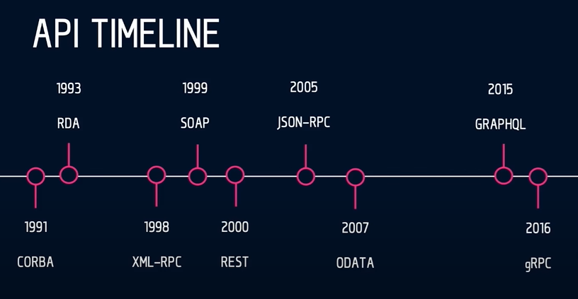
History Lesson

Slide 15
SOAP In a nutshell

Slide 16
Simple Object Access Protocol
Messaging protocol for exchanging structured information
Uses XML for communication
Uses various low-level protocols
It is platform and technology agnostic
Pretty much old school
I've seen it once and I have nightmares ever since ☹

Slide 17
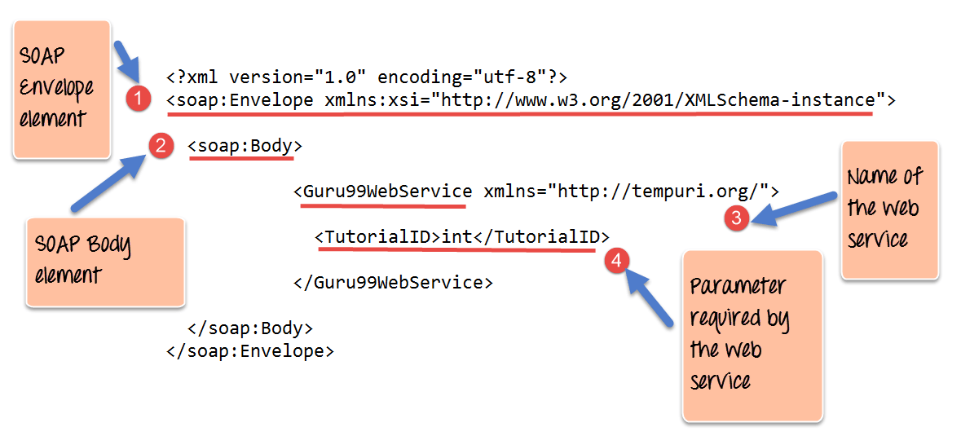
Simple Object Access Protocol

Slide 18
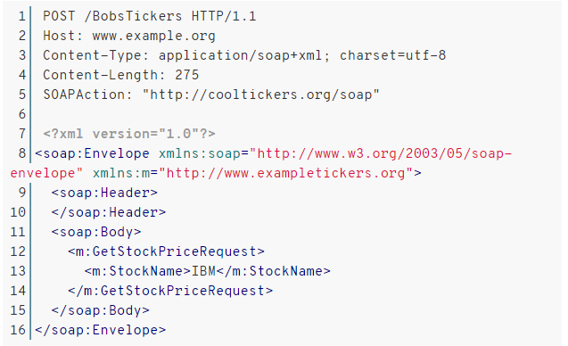
Simple Object Access Protocol

Slide 19
REST in a nutshell

Slide 20
REST
REST in peace, SOAP
After 2010
Representational State Transfer
The most used API nowadays
Developers use the HTTP verbs
GET, POST, PUT, DELETE
On the same URL
Stateless and self-describing

Slide 21
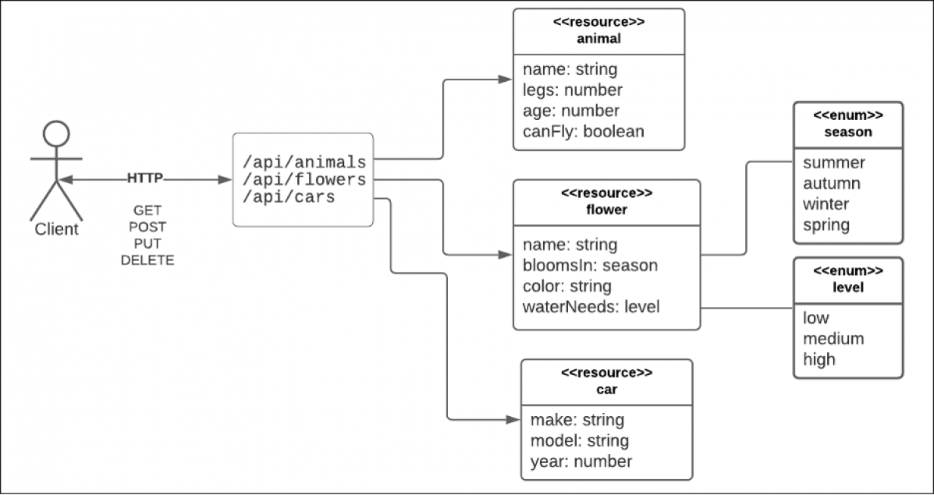
REST

Slide 22
REST Practical Use cases
Since REST is easy, we can pretty much add it everywhere
But is it OK?
Client to server communication is great for basic scenarios:
Browser to web-server
Mobile application to web-server
Desktop application to web-server
What about server to server?
Also a good option but consider the "rule of 1 hop"
It is better to use other approaches here when the communication is more complicated
For C# to C#, you can use Refit

Slide 23
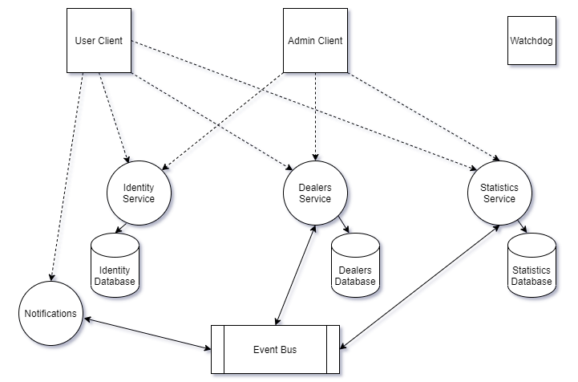
Sample Application

Slide 24
Running the demo Application
Start Docker Desktop and go to the application folder in your terminal
Build all images:
Run the application:
Clean up:
Make sure you use Docker Compose V1!
docker-compose build
docker-compose up -d
docker-compose down
docker volume prune

Slide 25
DEMO

Slide 26
BEFORE WE CONTINUE…

Slide 27
INDEAVR – The EVENT’s DIAMOND SPONSOR
They provide technology services focused on the Digital, Data, Cloud and Advanced Software Engineering expertise.
They are always in search for creative and passionate people with the combination of a sharp strategic mind, emotional maturity, entrepreneurial instincts, and the ability to deliver results.
https://www.indeavr.com/en/technology/application-services
https://www.indeavr.com/en/careers

Slide 28
ODATA In a nutshell

Slide 29
Odata
Defines a set of best practices for consuming REST APIs
OData is standardized
Gives you focus on the business logic
And not so much on the request-response shenanigans
OData is flexible and easy to consume
Gives you powerful querying mechanism
Enables powerful generic client proxies and tools

Slide 30
Odata
OData example request:
OData example C# client code:
GET https://services.odata.org/v4/TripPinServiceRW/People?$top=2 &amp; $select=FirstName, LastName &amp; $filter=Trips/any(d:d/Budget gt 3000)
var client = new ODataClient("https://services.odata.org/v4/TripPinServiceRW/");
var people = await client.For<People>()
.Filter(x => x.Trips.Any(y=> y.Budget > 3000))
.Top(2)
.Select(x => new {x.FirstName, x.LastName})
.FindEntriesAsync();

Slide 31
Sample Application

Slide 32
DEMO

Slide 33
GRAPHQL IN more DETAIL

Slide 34
GRAPHQL
GraphQL is the new REST?
The "next" big thing in client-to-server communication?
Client-driven
Adaptable
The client decides what data they want
Efficient
Delivers exactly what the client requests without over fetching
Flexible
GraphQl is cross-platform
Some say it is a fancy OData

Slide 35
GRAPHQL
GraphQL is query language and a server-side execution engine
It has a type system with validation, and it is not tied to any database or storage engine
On the front-end, you have content-negotiation with a single endpoint
The client can fine-tune a query to receive exactly what it wants
Without the deploying different server versions
On the back-end, you can grab data from different sources, and you have:
Schema definition – you can define what kind of resources you expose
Resolvers – functions that know what to do with queries
Optional visual environment – to execute queries
GraphQL has its own language to define schemas and queries

Slide 36
Difference from REST
REST compared to GraphQL:
Simple and easy to learn and use
Widely popular with huge community
Server-side limitation
The client may need to filter or aggregate the data
Multiple queries to fetch data – underfetching
Too much data without needing it – overfetching

Slide 37
GRAPHQL Core concepts
Schema:
Describes the API in full
Types:
Query, Mutation, Subscription, etc.
Resolvers:
Returns data for a given field
Data source:
Database, REST API, Microservice, etc.

Slide 38
GRAPHQL Types
Object types are the basic resource you can fetch from your service:
Explanations:
"Student" is a type with some fields
"name" and "enrolledIn" are the only fields in the "Student" type
"String" – a scalar type, there are also "Int", "Float", "Boolean", "ID"
"!" means "non-nullable" – always has a value
"enrolledIn" is an array of "Course" objects
type Student {
name: String!
enrolledIn: [Course!]!
}

Slide 39
GRAPHQL Types
Query types are the root object for a service:
Explanations:
You can query for students
You can query for a course by ID
There are other more advanced types as well
https://graphql.org/learn/schema/
type Query {
students: [Student]
course(id: ID!): Course
}

Slide 40
GRAPHQL Queries
Once you have the schema, you can write queries:
The result is always a JSON response
There are lots of advanced scenarios:
Fragments, arguments, variables, etc.
{
course(id: 1)
{
name
description
}
}

Slide 41
GRAPHQL
You can explore GraphQL with GitHub:
https://docs.github.com/en/graphql/overview/explorer
query {
viewer {
login
repository (name: "MyTested.AspNetCore.Mvc") {
description
labels(first: 20) {
nodes {
name
}
}
}
}
}

Slide 42
GRAPHQL With C#
Low level GraphQL for C#:
https://graphql.github.io/
var schema = Schema.For(@"
type Project {
name: String
}
");
var root = new { Name = "Code It Up" };
var json = await schema.ExecuteAsync(_ =>
{
_.Query = "{ name }";
_.Root = root;
});
Console.WriteLine(json);
{
"data": {
"name": "Code It Up"
}
}

Slide 43
GRAPHQL with C#
A better alternative is ChilliCream's Hot Chocolate
https://github.com/ChilliCream/hotchocolate
It gives you high-level abstraction for defining an API with GraphQL
There are other tools too:
Strawberry Shake – GraphQL client
Green Donut – data loader
Banana Cake Pop – IDE to analyze GraphQL
Marshmellow Pie – schema registry
ChilliCream have a great GraphQL workshop here:
https://github.com/ChilliCream/graphql-workshop/blob /master/docs/1-creating-a-graphql-server-project.md

Slide 44
GRAPHQL With C#
You need to install "HotChocolate.AspNetCore"
https://graphql.github.io/
Then create your root query and specify how to resolve it:
Then register it:
public class Query
{
public IQueryable<Cat> GetCats([Service] CatsDbContext context) => context.Cats;
}
services.AddGraphQLServer().AddQueryType<Query>();
endpoints.MapGraphQL();

Slide 45
GRAPHQL With C#
In a similar manner, we can add mutations to change our data:
public class Mutation
{
public async Task<AddCatPayload> AddCatAsync(
AddCatInput input,
[Service] CatsDbContext context)
{
var cat = new Cat
{
Name = input.Name,
Age = input.Age,
};
context.Cats.Add(cat);
await context.SaveChangesAsync();
return new AddCatPayload(cat);
}
}

Slide 46
GRAPHQL With C#
After registration, you can mutate data like so:
And then query it:
mutation AddCat {
addCat(input: {
name: "Sharo"
age: 6 }) {
cat {
id
}
}
}
query GetCatNames {
cats {
name
}
}

Slide 47
GRAPHQL With C#
Seems great, but there is a problem when running queries in parallel
GraphQL tries to optimize the query by fetching the fields in parallel
But the DbContext type is not thread-safe, so you should use pooling!
query GetCatNamesInParallel {
a: cats {
name
}
b: cats {
name
}
c: cats {
name
}
}

Slide 48
GRAPHQL With C#
Another problem is N+1 queries
In such cases, you need to create a data loader
And override the default fetching behavior
Fully-detailed C# tutorial here:
https://www.youtube.com/watch?v=HuN94qNwQmM
query GetSpecificCatById {
a: cat(id: 1) {
name
}
b: cat(id: 1) {
name
}
}

Slide 49
GRAPHQL is beyond CRUD
With GraphQL we need to think beyond just exposing the database
We need to think about human-readable API and the client's use-cases
It is a good idea to offer plural versions of the fields
And with GraphQL you do need to think about versioning
Typical APIs have limited control, so every change is breaking
With GraphQL clients request only what is explicitly requested
GraphQL needs careful designing (consider filtering and paging)
It is flexible enough so a naïve implementation may lead to a "chatty" service with too many database calls
Learn about Relay and how to incorporate it

Slide 50
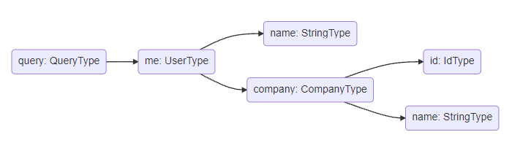
How Queries work
Queries have recursive resolvers:
And nested resolvers are atomic and executed in parallel
So, they should not have any side effects!
C# details can be found here on Hot Chocolate's documentation:
https://chillicream.com/docs/hotchocolate
query {
me {
name
company {
id
name
}
}
}

Slide 51
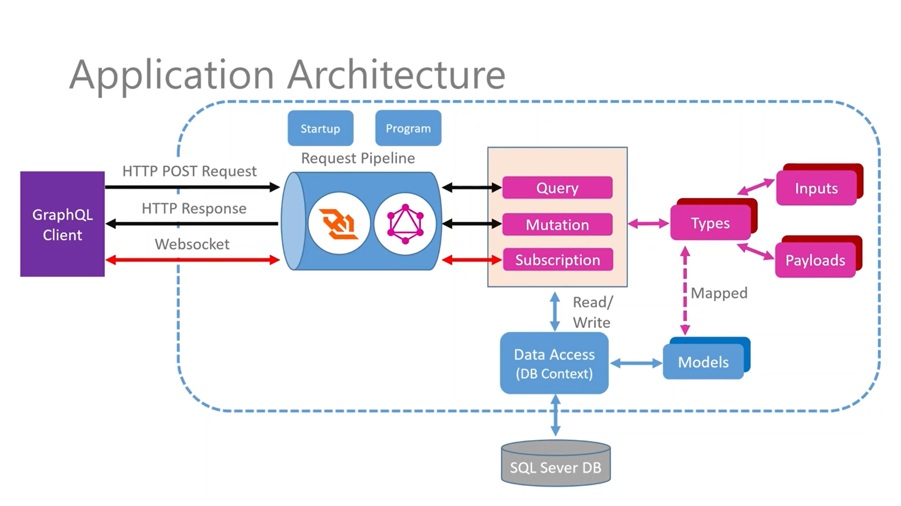
Graphql Architecture

Slide 52
Sample Application

Slide 53
demo

Slide 54
BEFORE WE CONTINUE…

Slide 55
Huge THANKS for your support & TRUST!
Everyone who got a paid ticket – 78 people in total! Thank you!
Top supporter – Borislava Parvanova – 50 BGN! Thank you, you rock! <3
Personal thanks to – Борислав, Valentin, Nikolay, Emiliyan, Plamen, Vladimir, Svetoslav
Thanks also to – Pavel, Dobromir, Ivo, Pavel, Mihail, Pavel, Pavel, mincho, Пламен, Genoveva, Ivan, Alexander, Martin, Dimitar, Dinyo, Aleksandar, Svetlozar, Hristo, Mariyan, Stanislav, Rosen, Nikolai, Дончо, Nikolay, Adrian, Dmitriy, David, viktor, ILIYA, Angel, Petar, Hristo, Miroslava, Blagovest, Daniel, Aleksandar, Ivaylo, Tsvetan, Krasimir, Mariyana, Hristo, Силвия, Deyan, Diana, Mira, Ivaylo, Yavor, Anna, Tsvetelin, Kristiyan, Todor, Vladimir, Nikolay, Andrey, Zlatko, Hristina , Veselin, Ivan, Явор, Pepi, Teodor, DIMITAR, Andreyan, Petar, Antoniya, Иван, Lyubomir, Ivo, Kristiyan, Dimitar,
And everyone who supported the initiative back in 2020!

Slide 56
These events are not Exactly free
I prefer to call them “Pay what you want”
Depending on how much you value the provided knowledge
It takes me a considerable amount of free time to prepare these lectures
And I want them to be perfect and complete!
I put my soul in them!
For this reason, I will be extremely thankful, if you decide to support me and my projects!
It is never expected, but always appreciated!
The easiest way is via
PayPal: http://paypal.me/ivaylokenov
Revolut: @ivaylokenov

Slide 57
GRPC in More DETAIL

Slide 58
GRPC
gRPC is the new message broker?
The "next" big thing in server-to-server communication?
Does not use text format but a binary one
A ".proto" is created for both servers
It is used as definition by which the data is encoded and decoded
Increases performance
Supports bidirectional and asynchronous messages
Based on the HTTP 2 protocol
Each separate element is "streamed" back to the caller
Multiple items are not aggregated into a single array

Slide 59
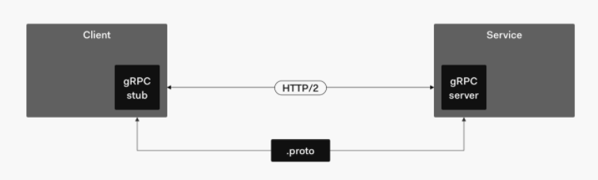
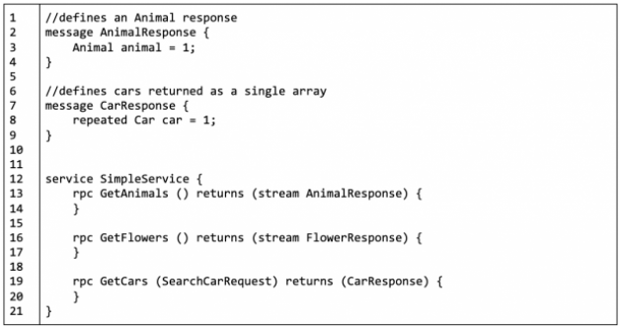
GRPC

Slide 60
Difference from normal API
REST compared to gRPC:
Browser support
Resource-oriented
Textual and human-readable
Client-server approach

Slide 61
GRPC Types
Unary RPC
The client sends a request message to the server and receives a response
Server streaming RPC
The client sends a request message to the server and receives a sequence of responses
Client streaming RPC
The client sends a sequence of messages and receives a single response from the server
Bidirectional streaming RPC
The client and the server exchange messages in both directions

Slide 62
Defining a contract
We need to define a contract in a ".proto" file:
syntax = "proto3"; // syntax version
option csharp_namespace = "CreditRatingService"; // C# namespace of the service
package CreditRating; // package identifier to prevent name clashes
service CreditRatingCheck {
rpc CheckCreditRequest (CreditRequest) returns (CreditReply); // exposed method
}
message CreditRequest { // Message format for the request
string customerId = 1; // These number are important for the binary serialization
int32 credit = 2;
}
message CreditReply { // Message format for the response
bool isAccepted = 1;
}

Slide 63
Importing a contract
Once we have a contract, we need to add it to our project:
<Project Sdk="Microsoft.NET.Sdk.Web">
<PropertyGroup>
<TargetFramework>netcoreapp3.1</TargetFramework>
</PropertyGroup>
<ItemGroup>
<Protobuf Include="Protos\credit-rating-service.proto" GrpcServices="Server" />
</ItemGroup>
<ItemGroup>
<PackageReference Include="Grpc.AspNetCore" Version="2.23.2" />
</ItemGroup>
</Project>

Slide 64
Implementing the service
Once we have a contract, we need to add it to our project:
namespace CreditRatingService
{
// Base class is generated at build time
public class CreditRatingCheckService: CreditRatingCheck.CreditRatingCheckBase
{
// Implementation of the "rpc" definition in the ".proto" file
public override Task<CreditReply> CheckCreditRequest(
CreditRequest request, ServerCallContext context)
{
return Task.FromResult(new CreditReply
{
IsAccepted = IsEligibleForCredit(request.CustomerId, request.Credit)
});
}
}
}

Slide 65
Adding gRPC
Register gRPC services:
Create a client application and import these packages:
Grpc.Net.Client
Google.Protobuf
Grpc.Tools
services.AddGrpc();
endpoints.MapGrpcService<CreditRatingCheckService>();
<ItemGroup>
<Protobuf Include="Protos\credit-rating-service.proto" GrpcServices="Client" />
</ItemGroup>

Slide 66
Using grpc client
Finally, use gRPC as a client:
You can use RequestStream and ResponseStream for multiple messages
And combine them with the new "await foreach"
https://www.stevejgordon.co.uk/server-streaming-with-grpc-in-asp-dotnet-core
var channel = GrpcChannel.ForAddress(serverAddress);
var client = new CreditRatingCheck.CreditRatingCheckClient(channel);
var creditRequest = new CreditRequest { CustomerId = "id0201", Credit = 7000};
var reply = await client.CheckCreditRequestAsync(creditRequest);

Slide 67
Sample Application

Slide 68
demo

Slide 69
API Types

Slide 70
API Types
Query APIs
Flexibility in mind – the client can query data however it wants
Streaming APIs
Real-time data is constantly streamed
RPC APIs
Remote procedural call – components calling each other through distributed networks
Web APIs
The usual HTTP API over the web

Slide 71
Which one of these is the best?
There is no universal best API style
But there is always a best style for YOUR problem
This is the key thing
We need to factor all constraints of the system
To make sure our choice is correct
All approaches have their pros and cons
So design wisely

Slide 72
General Advice for API Design

Slide 73
Business constraints
There are a lot of API decision constraints
Customer constraints
Business constraints
Product requirements
Performance or scalability constraints
If the customer expects REST, you will not be able to use RPC
These are all business constraints
What about the technology ones?

Slide 74
Technology constraints
The team's knowledge
Distributed systems and their fallacies:
The network is reliable
Latency is zero
Bandwidth is infinite
The network is secure
Topology doesn't change
There is one administrator
Transport cost is zero
The network is homogeneous
https://dzone.com/articles/understanding-the-8-fallacies-of-distributed-syste

Slide 75
General Advice
If an API is mostly CRUD and manipulation of related data
Use REST
Example URL: /purchases/2/items
If an API is mostly actions or between servers
Then choose RPC
Example URL: /purchases/increment
Do not build REST-ish APIs
If you cannot simply follow the REST pattern
Choose GraphQL

Slide 76
Various Issues to consider
SOAP is legacy
You should not consider it most of the time
Only when it is already implemented
REST may be slow
Over/under fetching with REST
N + 1 problem
GraphQL allows to fetch all data with one request
The slowest field is the performance indicator
In GraphQL you fetch data all at once
GraphQL is more flexible, if you do not know the client
But way more restrictive than REST

Slide 77
Versioning
GraphQL allows better versioning than REST
Allows "deprecations"
But where it is possible use graceful evolution
Graceful evolution:
Do not add required inputs
Do not remove outputs or make them optional
Do not change the type of a field

Slide 78
First create the contract
In GraphQL you have the schema
In gRPC you have the protocol buffer file
In REST you have Open API (Swagger)
Having a contract helps you mock the API during development
Integration is easier between the back-end and front-end

Slide 79
API Styles comparison

Slide 80
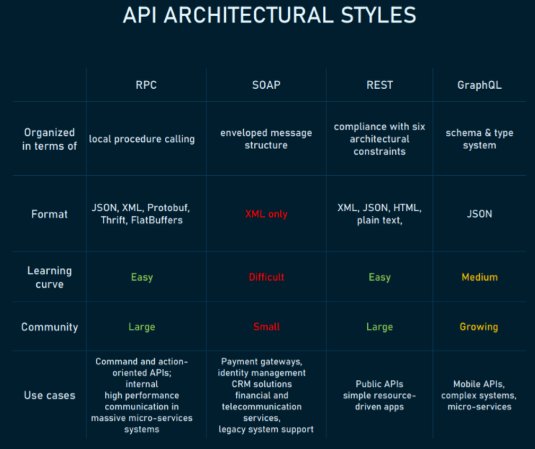
Styles Comparison

Slide 81
SOAP
Pros:
Language- and platform-agnostic
Bound to a variety of transport protocols
Built-in error handling
Several security extensions
Cons:
XML only
Heavyweight
Narrowly specialized knowledge
Tedious message updating
Use cases:
Highly secured data transmission

Slide 82
REST
Pros:
Decoupled client and server
Discoverability
Cache-friendly
Multiple formats support
Cons:
No single REST structure
Big payloads
Over-and under-fetching problems
Use cases:
Management APIs
Simple resource-driven apps

Slide 83
GraphQL
Pros:
Typed schema
Fits graph-like data very well
No versioning
Detailed error messages
Flexible permissions
Cons:
Performance issues
Caching complexity
A lot of pre-development education
Use cases:
Complex systems and microservices

Slide 84
RPC
Pros:
Straightforward and simple interaction
Easy-to-add functions
High performance
Cons:
Tight coupling to the underlying system
Low discoverability
Function explosion
Use cases:
Customer-specific APIs for internal microservices

Slide 85
Sample scenarios

Slide 86
Application web form
For example, buying an airplane ticket online
CRUD
Single client that uses all fields
This use case is well-suited for REST
Everything else is overcomplicated
Real-life example:
PayPal

Slide 87
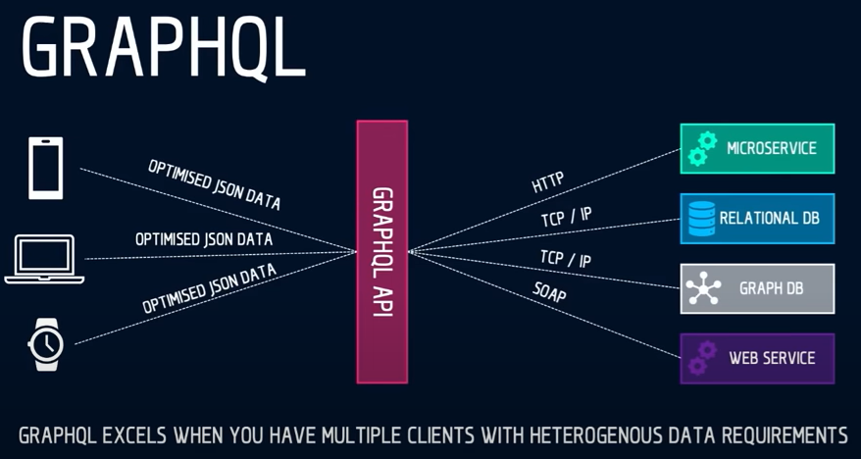
Composite API
For example, fetching prices from multiple stores
Aggregate data from various sources
Have one convenient API
Use GraphQL – it shines for these scenarios
Real-life example:
GitHub

Slide 88
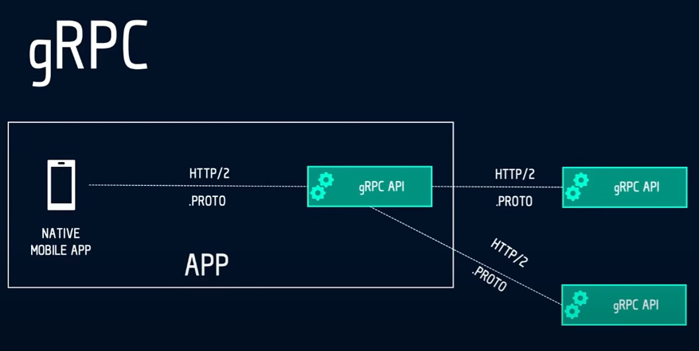
Native mobile
For example, stock market charts
We need a "back-end for front-end"
Single client
Static API
The use case is well suited for gRPC
Real-life example:
Foursquare

Slide 89
Polyglot microservices
For example, Amazon store front
Polyglot environment
Internal communication is required
Both asynchronous and with a response
gRPC is perfect for this scenario, if you want performance
Real-life example:
Google Cloud

Slide 90
FINAL WORDS

Slide 91
Summary
About Code It Up
Why API Scenarios?
History Lesson
SOAP In a Nutshell
REST In a Nutshell
OData In a Nutshell
GraphQL In More Detail
gRPC in More Detail
API Types
General Advice for API Design
API Styles Comparison
Sample Scenarios

Slide 92
SOFTUNI ASP.NET MICROSERVICES COURSES
I currently teach a module with 3 courses for ASP.NET Microservices:
The Architecture of ASP.NET Core Microservices Applications
Architecture choices and microservices with ASP.NET Core
Best practices with ASP.NET Core microservices
Design and Processes in Microservice ASP.NET Core Applications
Design considerations when using microservices with ASP.NET Core
Containers, clusters, teamwork, deployment, configuration
Development of Microservice ASP.NET Core Applications
Domain-driven design with ASP.NET Core microservices
Clean and practical code for the microservice approach
Each Code It Up attendee receives a discount code!
CODEITUP10 – for a single course
CODEITUP10BUNDLE – for the whole module

Slide 93
ANY QUESTIONS?
You can support me and my projects:
Via PayPal: http://paypal.me/ivaylokenov
Via Revolut: @ivaylokenov
On Patreon: https://www.patreon.com/ivaylokenov
On Open Collective: https://opencollective.com/mytestedaspnet
Via Buy Me A Coffee: http://buymeacoff.ee/ivaylokenov
Crypto: http://bit.ly/ik-sponsors
Never expected, always appreciated!
Make sure you check my sponsors!
INDEAVR - https://indeavr.com/
SmartIT - https://smartit.bg/

Slide 94
Thank You!
presentation And Code available here: https://github.com/ivaylokenov/C-Sharp-API-Scenarios-REST-GraphQL-gRPC

