Slide 1



Docker - From ABC To XYZ
Code It Up Online Vol. 4

Slide 2
For questions
https://sli.do #docker
The YouTube Live Chat Is Not Monitored
Presentation & Code https://github.com/ivaylokenov/Docker-From-ABC-To-XYZ

Slide 3
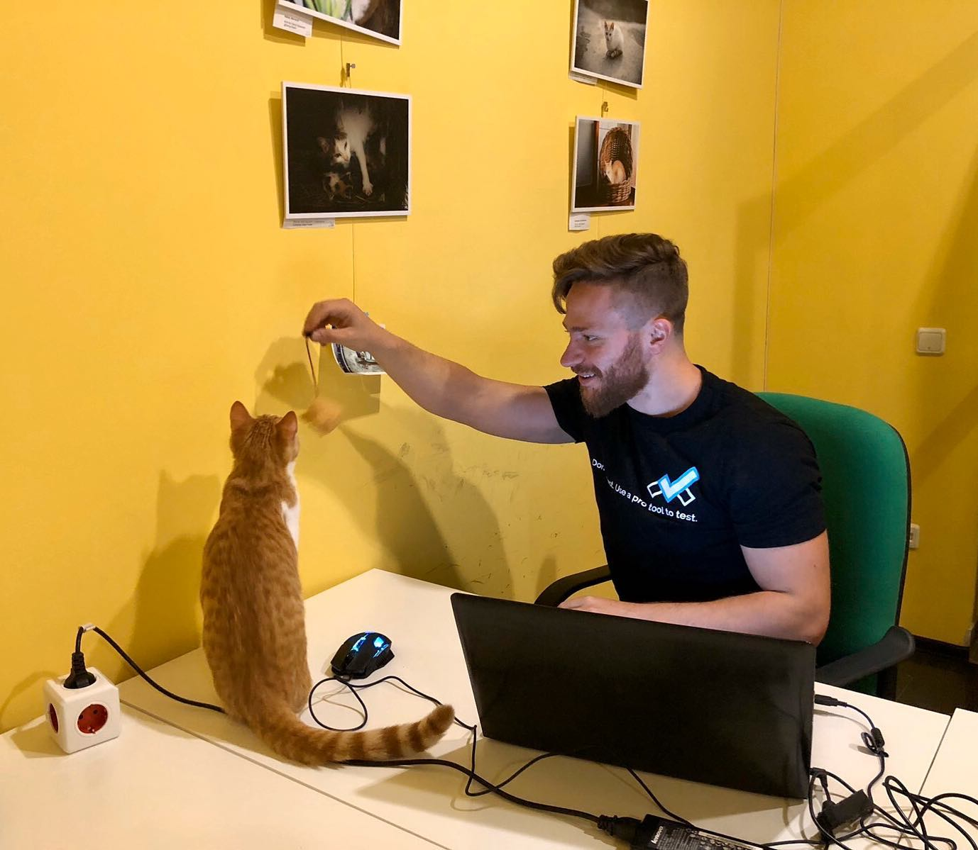
The Presenter
Ivaylo Kenov – Quality Code Advocate
Various job titles at the same time:
Organizer & Speaker @ Code It Up
CTO @ SoftUni
Full Stack Technical Trainer @ Everywhere
Code General @ https://MyTestedASP.NET
Meme Copy Machine @ Daily Programming Fun
{Insert Job Title Here}
Contacts
https://github.com/ivaylokenov
https://facebook.com/ivaylo.kenov
https://linkedin.com/in/kenov
https://www.instagram.com/ivaylokenov/
YouTube
https://youtube.com/MyTestedASPNETTV

Slide 4
What Are We Going To COVER
About Code It Up
Why Docker?
Docker Terminology
Docker CLI
Source Code in Containers
Building a Custom Image
Publishing to Docker hub
Linking Containers in Networks
Managing Containers with Compose
Moving to Kubernetes

Slide 5
ABOUT CODE IT UP

Slide 6
Code it up
The Code It Up initiative:
Aims to provide detailed knowledge on advanced .NET topics
Aimed at people with at least 1 year of C# experience
Code It Up Online
Free live-streamed online events
Code It Up Networking
Free on-sight events with live streaming
Guest speakers from the industry
Networking part (with pizza and beer)
Code It Up Workshop
Paid events containing practical exercises for the attendees

Slide 7
Upcoming Code it up Events
Events with set dates:
September 19 – Kubernetes for Web Developers
Events with no specific order or dates:
Automate Your Process with CI/CD
The Limits of the C# Runtime
API Scenarios - REST, GraphQL & gRPC
Serverless Real-Time C# Applications On AWS? Yes, It’s Possible & Easy!
C# On Rocket Fuel – Writing High Performance .NET
Software Engineering – Patterns & Anti-Patterns
Identity Server Done Right!
Plus many more! For example Microservices Details?
The SoftUni course for microservices is still available!

Slide 8
Thankful if you share a story
You can be extremely helpful to the initiative
Just share a story on Facebook or Instagram during the lecture
Make sure you tag me so that I can reshare your post - @ivaylokenov
Bonus – add the #codeitup hashtag
Thank you! You rock!

Slide 9
WHY docker?

Slide 10
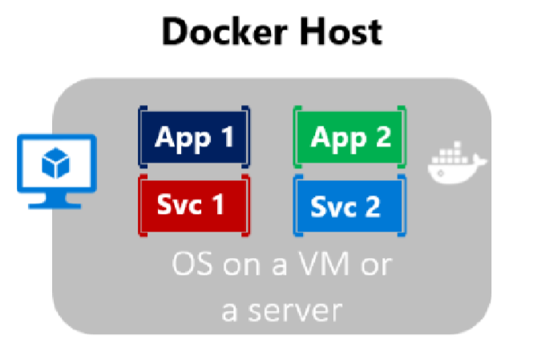
Containerization
Approach in which an application or service is packaged as an image
With its dependencies and configuration
The containerized application can be tested and deployed as a unit to the host OS
Allows deployments across environments with little or no modification
Containers also isolate applications from each other on a shared OS
The containers runs on a container host
The container host runs on an OS (Linux or Windows)
Thus having a smaller footprint than virtual machines

Slide 11
What is docker?
Docker is lightweight, open, secure
It simplifies building, shipping, and running applications
On different environments
Runs natively on Linux or Windows servers
Runs on Windows or Mac development machines
Relies on "images" and "containers"
The playground is a good starting point:
https://www.docker.com/play-with-docker

Slide 12
What is docker?
Image
An image is just like a blueprint
A read-only template
Contains the building blocks of an application
Framework, dependencies and code are "described" here
Container
Built from the image
It is the actual running environment for your application
Isolated and secured
It can be started, stopped, moved, and deleted
You create a container for your different application pieces
Database, Presentation, Caching, etc.

Slide 13
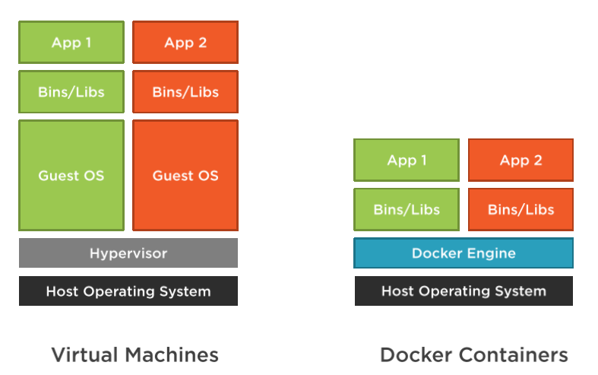
Docker VS Virtual Machines

Slide 14
Docker VS Virtual Machines
Virtual Machines
Have a guest OS, which is heavier
Images are bigger in terms of size
Slower startup time
Everything is a copy of the host OS
Docker
No guest OS, just a process
Images are small in terms of size
Fast startup time

Slide 15
Benefits for web developers
Accelerating developer onboarding
Eliminate application conflicts
Isolated containers
Environment consistency
If it runs on development environment, it should run on the staging/production
Ship software faster
Updating and migrating software is very easy

Slide 16
Docker Tools
Docker Desktop
Runs on Windows or Mac development machines
Includes Docker Engine, CLI and Kubernetes
Containerize and share any application
Complete Docker development environment
On Windows
Ability to switch between Linux and Windows Server environments
Supports Pro, Enterprise, and Education versions
For Home – you can only run Linux containers through WSL 2
There are third-party solutions for Linux – DockStation, CairoDock, and more…

Slide 17
Docker Tools
Docker Hub
Cloud-based application registry
Development team collaboration services
Supports public and private repositories
The world’s largest library of container images
Automated builds and webhooks
https://hub.docker.com/

Slide 18
Docker TERMINOLOGY

Slide 19
Docker Terminology
Container image
Package with all the dependencies and information needed to create a container
Includes all dependencies + deployment and execution configuration
Images are immutable once they are created
Dockerfile
A text file, which contains instructions for how to build an image
Build
An action of building an image based on the Dockerfile configuration
Use the docker build command

Slide 20
Docker Terminology
Container
An instance of the image
Represents the execution of a single application, process, or service
Volume
A writable file system, allowing containers to persist state
Repository
A collection of related Docker images
Registry
A service, which provides repositories
Default is Docker Hub

Slide 21
Docker Terminology
Compose
A tool for defining multi-container applications
Uses YAML
Cluster
A collection of Docker hosts
Exposed as single Docker host
Allows scalability
Orchestrator
A tool which simplifies management of clusters and Docker hosts
Responsible for running, distributing, and scaling workloads across nodes

Slide 22
Development process
Developers create an application
The application is packaged with its dependencies as an image
The image is instantiated to create a container
Containers are initially tested on the development machine’s Docker host
Developers store images in a registry
These images are used by the production orchestrators

Slide 23
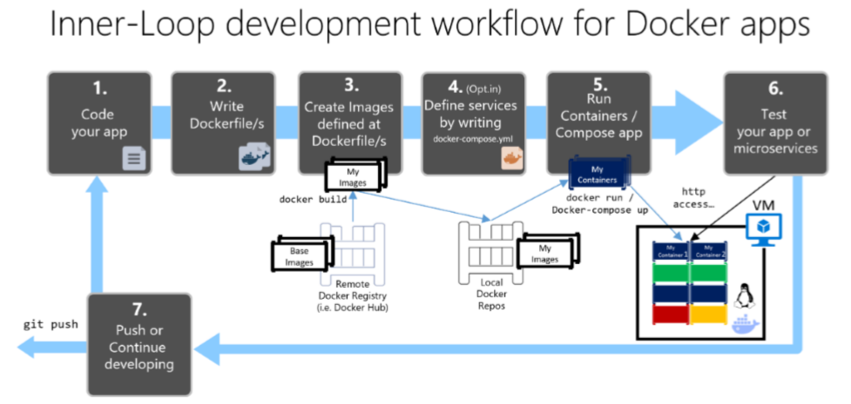
Development process

Slide 24
BEFORE WE CONTINUE…

Slide 25

INDEAVR – The EVENT’s DIAMOND SPONSOR
They provide technology services focused on the Digital, Data, Cloud and Advanced Software Engineering expertise.
They are always in search for creative and passionate people with the combination of a sharp strategic mind, emotional maturity, entrepreneurial instincts, and the ability to deliver results.
https://www.indeavr.com/en/technology/application-services
https://www.indeavr.com/en/careers

Slide 26
Docker CLI

Slide 27
Docker CLI
Docker CLI allow you to work with the Docker Engine
Build and manage images
Run and manage containers
Example commands:
docker pull [image]
docker run [image]
docker images
docker ps
docker logs [container]

Slide 28
Docker CLI
Let’s go to Docker Hub and find the hello-world image
Open a terminal and use the pull command:
You may check locally available images:
Run the image:
Then to stop a running image:
docker pull hello-world
docker images
docker run hello-world
docker stop hello-world

Slide 29
Docker CLI
To see all running containers you need the ps command:
To show all ran containers:
Remove the container, because it is not super impressive:
Remove the image too:
docker ps
docker ps -a
docker rm [container id]
# the id does not need to be full
docker rmi [image id]

Slide 30
Docker CLI
Let’s download a sample NGINX server
To run it, we need to expose ports from the container:
Go to localhost:5000 and see the server
You may run in detached mode with a name:
Or with clean-up after stopping
docker pull nginxdemos/hello
docker run -p 5000:80 nginxdemos/hello
docker run -p 5000:80 –d --name code_it_up nginxdemos/hello
docker run -p 5000:80 –d --rm nginxdemos/hello

Slide 31
Source code in containers

Slide 32
Hooking your Code into containers
To add your source code into a container there are two options
Using a container volume that points to the source code
Add your source code into a custom image
Building custom images is the preferred approach
But let’s start with the easier option

Slide 33
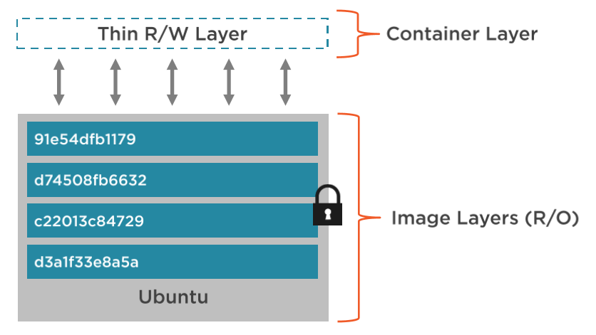
Layered file system
Each image has file system layers, which are read-only and isolated

Slide 34
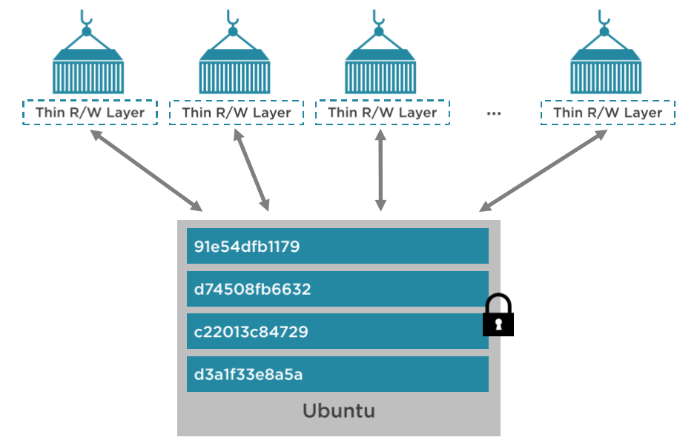
Layered file system
Containers share image layers
Therefore they load faster once you have them

Slide 35
Volumes
By default the writable file system of the container is deleted after you run the stop command
Which is not very suitable for persistence operations
Volumes to the rescue
Special type of directory in a container
Mapped to the real file system
Can be shared and reused among containers
Updates to the image won’t affect volumes
Persisted even after the container is deleted
You have full control over them

Slide 36
Let’s create a Node.js app
Install express and express-generator (you need Node.js):
Go to your working directory:
Create a sample web application:
Then run it and go to localhost:3000 to validate the application:
npm install express express-generator -g
cd C:\Data\Temp\Source
express node-website --hbs
cd node-website
npm install
npm start

Slide 37
Adding node.js source code to a volume
Pull the latest Node.js image
To run out source code we need the following:
Go to localhost:5000 to validate the application
docker pull node
docker run `
-d -p 5000:3000 `
-v ${PWD}:/www `
-w "/www" `
node npm start

Slide 38
Adding node.js source code to a volume
The previous command will add an anonymous volume to our app
You can see all available volumes with the volume command
You can delete a container with a volume like so:
To delete multiple objects, you can use the prune command:
docker volume ls # anonymous volumes need inspect [container]
docker rm –v [container id]
docker image prune –a # -f will delete without confirmation
docker container prune # deletes all stopped containers
docker volume prune # deletes all unused volumes

Slide 39
Let’s create an asp.net core application too
Create a new ASP.NET Core MVC application (you need .NET SDK):
Navigate to the application folder:
dotnet new mvc -n MyWebSite
cd MyWebSite

Slide 40
Let’s create an asp.net core application too
Pull the ASP.NET Core 3.1 image:
Set the application’s default port in launchSettings.json:
docker pull mcr.microsoft.com/dotnet/core/sdk:3.1
"MyWebSite": {
"commandName": "Project",
"environmentVariables": {
"ASPNETCORE_ENVIRONMENT": "Development",
"ASPNETCORE_URLS": "http://+:80"
}
}

Slide 41
Let’s create an asp.net core application too
Run the application locally first and go to https://localhost:80
We are going to use the container’s terminal this time:
Inside the inner terminal enter dotnet run (make sure the project targets 3.1)
Go to localhost:5000 to validate the application
dotnet run
docker run -it `
-p 5000:80 `
-v ${PWD}:/app `
-w /app `
mcr.microsoft.com/dotnet/core/sdk:3.1 /bin/bash

Slide 42
BEFORE WE CONTINUE…

Slide 43
Huge THANKS for your support & TRUST!
Everyone who got a paid ticket – 174 people in total! A new record!
Top supporter – Pavel Kolev - €25! Thank you, man! <3
Personal thanks to – Mihail, Dimo, Miroslava, Maria, Ivan, Vladimir, Stiliyan, Georgi, anelia, Petar, Tsonko, Svetoslav, Desislava, Stefan, Kristina, Anton, Miroslav, Zhelyazko, Diana, Georgi, Ivaylo, Pavel, Konstantin, Stefan
Thanks also to – Nelly, Petar, Bojidar, Pavel, Стоян, Kalin, Tihomir, Petar, Tsvetelin, Emilia, Desislav, Mario, Adrian, Nikola, Atanas, Ivaylo, Румен, Ivan, Ivan, Stoyan, Yohan, Ivo, Ivo, Marin, Alexander, Zdravko, Ivaylo, Nikolay, Dobromir, Kolyo, Dobrin, Dimitar, Boyan, Dimitar, Yavor, Lachezar, Georgi, Yavor, Georgi, Viktor, Борис, Yanko, Ioana, Atanas, Dobrinka, Борислав, Николай, Nikolai, Hristo, Dragomir, Petar, Hristo, Ivan, Zdravko, Dimitar, Dancho, Bozhidar, Kristiyan, Teodor, Georgi, Zdravko, Hristo, Ivo, Pavlin, Plamen, Bozhidar, Gencho, Dobromir, Iliya, Miroslav, Petko, Yanko, Stoil, Велислав, Димитър, Diana, Mira, Nikolay, Kristian, Denis, EMIL, Vasil, Rumen, Hristo, Hristo, Sinan, Krassimir, Velizar, Zhivko, Dimo, Borislav, Damyan, Hristina, Петър, Todor, Simona, Elena, Petar, Mihail, Dimitar, Julia, Emil, Asen, Zlatko, Aleksandar, Plamen, Ivaylo, Pavel, Daniel, Nikolay, Атанас, Iva, Stoyan, Цветан, Radoslav, Angel, Georgi, Pavel, Anna, Svetlin, Simeon, Ivan, Nikolay, Ivaylo, Petyo, Desimir, Grigoris, Petar, Emil, Mariyan, Darin, Radoslav, Petya, Ivanela, Yulian, Gergana, Панайот, Pavel, Mincho, Биляна, Martin, Mladen, Radoslav, Mariela, Todor, Stoyan, Aleksandar, Robert, Rosen, Vladislav, Dimitar, Ilina, Bozhidar, Plamen, Tsvetelina, Aleksandar

Slide 44
These events are not Exactly free
I prefer to call them “Pay what you want”
Depending on how much you value the provided knowledge
It takes me a considerable amount of free time to prepare these lectures
And I want them to be perfect and complete!
I put my soul in them!
For this reason I will be extremely thankful, if you decide to support me and my projects!
It is never expected, but always appreciated!
The easiest way is via
PayPal: http://paypal.me/ivaylokenov
Revolut: @ivaylowrlt

Slide 45
Mentorship program ON Patreon
These events are part of my mentoring program!
Target – junior to regular programmers with 0 to 2 years practical work
Help with:
Becoming better software developers
Code improvement in terms of quality and logic
Career choices and advancement
Interview preparation
And more
Approach – private groups, exclusive lessons, workshops, one-on-one meetings
More information on Patreon: https://www.patreon.com/ivaylokenov

Slide 46
Building a custom image

Slide 47
Dockerfile
Dockerfile is the way to create custom images
Contains build instructions
These instructions create an intermediate image that can be cached to increase future builds
Used with the docker build command
It is like compiling a source code

Slide 48
Dockerfile
Key instructions for getting started:
FROM – create an image from another image
LABEL – adds metadata in a key-value pair fashion
RUN – execute different command, like npm install, for example
COPY – copy different files in the image, like your source code
ENTRYPOINT – defining which command starts the container
WORKDIR – the working directory of the image, where are your files
EXPOSE – to expose a port externally
ENV – defining environment variables, like database connection strings
VOLUME – defining a volume for the container
CMD – execute a command-line operation

Slide 49
Dockerfile
FROM node
LABEL maintainer="Code It Up"
COPY . /app
WORKDIR /app
RUN npm install
EXPOSE 8080
ENTRYPOINT ["node", "server.js"]

Slide 50
Custom node.js dockerfile
Go to the Node.js source code folder and create a Dockerfile and .dockerignore file
FROM node:latest
LABEL maintainer="Code It Up"
ENV NODE_ENV=production
ENV PORT=3000
COPY . /app
WORKDIR /app
RUN npm install
EXPOSE $PORT
ENTRYPOINT [ "npm", "start" ]

Slide 51
Custom node.js dockerfile
Build the image now from the current directory
Check the new image
Run your image in a container
Go to localhost:3000 and validate the application
docker build . -t codeitup/node-app #-f for different dockerfile name
docker images
docker run -p 3000:3000 codeitup/node-app

Slide 52
Multi-stage Builds
Multi-stage builds have multiple FROM statements
Each step starts a clean image but has access to the previous one
# Copies in our code and runs npm install
FROM node:latest as builder
WORKDIR /usr/src/app
COPY package* ./
COPY src/ src/
RUN ["npm”, "install”]

Slide 53
Multi-stage Builds
# Runs Unit Tests
FROM node:latest as unit-tests
WORKDIR /usr/src/app
COPY --from=builder /usr/src/app/ .
RUN ["npm", "test"]
# Starts and Serves Web Page
FROM node:latest as serve
WORKDIR /usr/src/app
COPY --from=builder /usr/src/app/dest ./
COPY --from=builder /usr/src/app/package* ./
RUN ["npm", "start"]

Slide 54
Let’s add one to the ASP.NET Core Application
Install the C# extension for Visual Studio Code
Install the Docker extension for Visual Studio Code
Hit Ctrl+Shift+P (or Ctrl+Cmd+P)
Run the Docker: Add Docker Files to Workspace… command
Choose your options and run the container with:
Run the container with:
Go to localhost:5000
docker build . -t codeitup/asp-app
docker run -p 5000:80 codeitup/asp-app

Slide 55
Let’s add a development container
Add a new file named Dev.Dockerfile:
FROM mcr.microsoft.com/dotnet/core/sdk:3.1
WORKDIR /app
EXPOSE 80
CMD dotnet restore && dotnet watch run

Slide 56
Let’s add a development container
Build the image:
Then run it:
Go to localhost:5000 and validate your application
Change a file to see the watcher updating the content automatically
docker build -f Dev.Dockerfile -t codeitup/asp-app-dev .
docker run -p 5000:80 -v ${PWD}:/app codeitup/asp-app-dev

Slide 57
RUN VS CMD VS Entrypoint
RUN executes command in a new layer
Used for installing packages, for example
Multiple RUN commands are acceptable
CMD sets a default command to execute when the container runs
It can be overridden from the terminal
ENTRYPOINT configures a container that will run as an executable
It is not meant to be overridden from the terminal
More information is available here:
https://goinbigdata.com/docker-run-vs-cmd-vs-entrypoint/

Slide 58
Publishing to docker hub

Slide 59
Publishing to docker hub
First you need to login:
Then build the image with the correct namespace (your username):
Then push the image:
Once done, your team members can pull it:
docker login
docker build -f Dev.Dockerfile -t ivaylokenov/asp-app-dev .
docker push ivaylokenov/asp-app-dev
docker pull ivaylokenov/asp-app-dev

Slide 60
Linking containers in networks

Slide 61
Setup a database container
Pull a SQL Server 2019 image:
Run it with the following command:
You can connect to it through 127.0.0.1, 1433
Note: disable host’s SQL Server instances!
docker pull mcr.microsoft.com/mssql/server:2019-latest
docker run `
-e ACCEPT_EULA=Y `
-e SA_PASSWORD=yourStrongPassword12#$ `
-p 1433:1433 `
-d mcr.microsoft.com/mssql/server:2019-latest

Slide 62
Setup a database container
By default the data is not persisted after stopping the container:
We need to create a volume:
You can then easily backup/restore the data from the volume
docker run `
-e ACCEPT_EULA=Y `
-e SA_PASSWORD=yourStrongPassword12#$ `
-p 1433:1433 `
-v sqldata:/var/opt/mssql `
-d mcr.microsoft.com/mssql/server:2019-latest

Slide 63
Create a network
To link containers, we need to create a network first
Then in our run command we need to provide the network and a container name:
Then you can inspect your network:
docker network create my_network
docker run --network my_network --name mycontainer [container name]
docker network inspect my_network

Slide 64
Add SQL Server To our network
Let’s add the SQL Server container to our network:
Inspect the network:
docker run `
-e ACCEPT_EULA=Y `
-e SA_PASSWORD=yourStrongPassword12#$ `
-p 1433:1433 `
-v sqldata:/var/opt/mssql --rm --network my_network --name sqlserver `
-d mcr.microsoft.com/mssql/server:2019-latest
docker network inspect my_network

Slide 65
Add A Web Application To our network
Create a web application, which uses a database
For example, the Visual Studio ASP.NET Core MVC template with authentication
Make sure you use database migrations:
Update the application’s connection string:
using var scope = app.ApplicationServices.CreateScope();
scope.ServiceProvider.GetService<ApplicationDbContext>()
.Database.Migrate();
Server=sqlserver;Database=MyDatabase;User Id=sa; Password=yourStrongPassword12#$;MultipleActiveResultSets=true

Slide 66
Add A Web Application To our network
Add a Dockerfile and build the image:
Run the image in a container and attach it to our network:
Go to localhost:5000 to validate the application
docker build -f "./MyDataSite/Dockerfile" -t codeitup/asp-data-app .
docker run `
-p 5000:80 --rm `
--name web_app `
--network my_network `
codeitup/asp-data-app

Slide 67
BEFORE WE CONTINUE…

Slide 68
C# Multithreading Workshop
Held on May 2
Threads, Race Condition, Dead Lock, Thread Pool, Synchronisation and Optimization
Tasks include – Folder Synchronization, Parallel Sorting, Own Cache Implementation
3 hours lecture, 5 hours hands-on experience
Step-by-step guidebook about multithreading (20+ pages)
Lifetime support & Money-back guarantee
Recording – more than 5 hours + 20 pages guidebook + practical tasks
Just shoot me a message – wewritesoftware@gmail.com
And I will give you more details!

Slide 69
ASP.NET Clean Architecture Workshop
Held on May 30-31
Create a fully working ASP.NET Core application with DDD
4+ hours lecture, 12+ hours hands-on experience
Step-by-step guidebook about building “clean” apps (20+ pages)
Lifetime support & Money-back guarantee
Recording – more than 12 hours + 70 pages guidebook + fully working app
Just shoot me a message – wewritesoftware@gmail.com
And I will give you more details!

Slide 70
SOFTUNI ASP.NET MICROSERVICES COURSES
I will teach a module with 3 courses for ASP.NET Microservices:
The Architecture of ASP.NET Core Microservices Applications
Architecture choices and microservices with ASP.NET Core
Best practices with ASP.NET Core microservices
Design and Processes in Microservice ASP.NET Core Applications
Design considerations when using microservices with ASP.NET Core
Containers, clusters, teamwork, deployment, configuration
Development of Microservice ASP.NET Core Applications
Domain-driven design with ASP.NET Core microservices
Clean and practical code for the microservice approach
Each Code It Up attendee can use the following discount codes:
https://bit.ly/su-microservices
CODEITUP-onsite & CODEITUP-online

Slide 71
Managing containers with compose

Slide 72
Docker compose
Manages the whole application lifecycle
Consider a service to be a container you manage
Start, stop and rebuild services
View the status of running services
Stream the log output of running services
Run one command to run your application

Slide 73
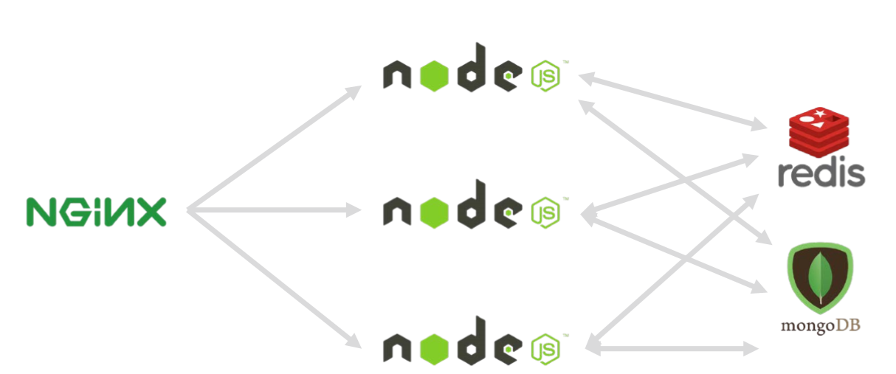
Docker compose example

Slide 74
Docker compose workflow
Define a docker-compose.yml file
Describe your services you are going to use
Define the networking rules
Build your services
Start up your services
Manage your services

Slide 75
Docker compose yaml file
Just add a docker-compose.yml file in your solution
The first line defines the version of the file:
Then normally you define services with various options:
build – allows you to build an image from a Dockerfile
environment – gives you the ability to set environment variables
image – set a ready to be used image
network – associate a service with a network
ports – options to expose ports
volumes – associate a volume with a service
version: "3.8"

Slide 76
Docker compose yaml file
version: "3.8"
services:
web:
build: .
ports:
- "3000:3000"
depends_on:
- postgres
postgres:
image: postgres:9.6.2-alpine
environment:
POSTGRES_USER: myuser
POSTGRES_DB: mydb

Slide 77
Docker compose commands
Commonly used commands:
docker-compose build – builds all images
docker-compose up – runs all services
docker-compose down – stops all services
docker-compose logs – show service logs
docker-compose stop – stop a service
docker-compose start – start a service
And more…

Slide 78
Configuring our ASP.NET Core application
Add a docker-compose.yml file in your solution:
Create a development.env file too:
Define the volumes and the network:
version: "3.8"
ACCEPT_EULA=Y
SA_PASSWORD=yourStrongPassword12#$
volumes:
sqldata:
networks:
my-network:

Slide 79
Configuring our ASP.NET Core application
Add the SQL Server container configuration in the services section:
sqlserver:
container_name: sqlserver
image: mcr.microsoft.com/mssql/server:2019-latest
ports:
- "1433:1433"
env_file: development.env
volumes:
- sqldata:/var/opt/mssql
networks:
- my-network

Slide 80
Configuring our ASP.NET Core application
Add the web application container configuration in the services section:
web_app:
container_name: web_app
build:
context: .
dockerfile: ./MyDataSite/Dockerfile
ports:
- "5000:80"
restart: on-failure
networks:
- my-network
depends_on:
- sqlserver

Slide 81
Configuring our ASP.NET Core application
Build the images:
Run the containers:
Or in “silent” mode:
Check whether the services are up and running:
docker-compose build
docker-compose up
docker-compose up -d
docker-compose ps

Slide 82
Other helpful commands
Remove everything:
Compose with multiple files:
Redeploy a single service:
docker-compose down –-rmi all --volumes
docker-compose -f docker-compose.yml -f production.yml up -d
docker-compose build web
docker-compose up --no-deps -d web

Slide 83
Moving to kubernetes

Slide 84
Moving beyond development
Docker Compose is great but it is more useful for development environments
We need a tool to helps us with:
Managing our application
Eliminating single points of failure
Self-healing containers
Scaling and load balancing
Updating containers without bringing down the application
Having a robust networking and persistent storage options
And it should be also supported by the major cloud systems

Slide 85
DEPLOYMENT
Each Docker container is a unit of deployment
A Docker host can handle multiple containers, but is not suitable for:
Load-balancing
Routing
Automatic Scaling
Automatic Startup and Shut-down
For large application with many microservices – we need clustering
And orchestration!
Usually available on public clouds
Kubernetes is an open-source product, solving the issue!

Slide 86
KUBERNETES
Contains a cluster of Docker hosts but exposes them as a single instance
You deploy everything at one place
The cluster handles:
Scalability
Health
And more!
The cluster has a master node to “orchestrate” operations
Multiple nodes, which allow containers to be deployed
Developers install a local cluster and deploy with a single command

Slide 87
KUBERNETES
Master
Basically the connection to all nodes
Ensures the requirements
Node
A computer running Kubelet
Runs pods
Pod
Runs 1 or more containers
Service
Handles requests
As a load balancer

Slide 88
Enabling KUBERNETES
We are going to cover Kubernetes “gently” since it is a huge system
Go to Docker Desktop
Click Settings
Then Kubernetes
Check Enable Kubernetes
Check Deploy Docker Stacks to Kubernetes by default

Slide 89
KUBERNETES key concepts
Deployment
Describe desired states in a YAML file
Can be used to replicate pods
Support rolling updates and rollbacks
Services
Pods live and die
Services abstract IP addresses
Load balancing between pods

Slide 90
Converting docker compose to k8s
Usually you will write your YAML files by hand, but this is a demo ☺
Install Kompose
https://github.com/kubernetes/kompose
On windows you need to download an CMD executable
And add it to the PATH environment variable
Change the version of our docker-compose.yml file to “3”
And validate it still works!
Go to the folder of your docker-compose.yml file and run:
Multiple YAML files should be generated
Move them to a .k8s folder
kompose convert

Slide 91
Fix our yaml files
Go to sqlserver-deployment.yaml and change the apiVersion:
Add a selector below spec:
Also the password for our SQL Server is wrong because why not ☹
In the sqlserver-development-env-configmap.yaml file
apiVersion: apps/v1
spec:
selector:
matchLabels:
io.kompose.service: sqlserver

Slide 92
Publish our containers
We need to publish our containers before deploying to Kubernetes:
Change the name of the image in the web-app-pod.yaml file:
docker image tag mydatasite_web_app codeitup/mydatasite_web_app
docker push codeitup/mydatasite_web_app
spec:
containers:
- image: ivaylokenov/mydatasite_web_app
name: web-app
ports:
- containerPort: 80

Slide 93
Commonly used commands
Get all deployments:
Get all pods:
Get all services:
Delete all services/deployments/pods:
kubectl get deployments
kubectl get pods
kubectl get services
kubectl delete deployments –all # or services instead of deployments

Slide 94
Commonly used commands
Deploy our application:
Inspect a pod:
To access your application you need to expose a port from the cluster:
Go to localhost:5000 to validate the application!
Reverse everything applied:
kubectl apply -f ./.k8s
kubectl logs -p [pod name]
kubectl port-forward web-app 5000:80
kubectl delete -f ./.k8s

Slide 95
BEFORE WE finish…

Slide 96
Kubernetes for web developers
Held on September 19
Everything you need to know about Kubernetes as a web developer
8 hours lecture, 8 hours hands-on experience
Step-by-step exercise book about Kubernetes (20+ pages)
Lifetime support & Money-back guarantee
2 types of attendance
Online
Recording
https://bit.ly/ciu-kub

Slide 97
SUPER EARLY BIRD DISCOUNT – KUB25
All current lecture attendees receive limited 25% discount
Use promo code KUB25 during checkout
The promo code is available until July 5 inclusive

Slide 98
FINAL WORDS

Slide 99
Summary
About Code It Up
Why Docker?
Docker Terminology
Docker CLI
Source Code in Containers
Building a Custom Image
Publishing to Docker hub
Linking Containers in Networks
Managing Containers with Compose
Moving to Kubernetes

Slide 100
Upcoming Code it up Events
Events with set dates:
September 19 – Kubernetes for Web Developers
Events with no specific order or dates:
Automate Your Process with CI/CD
The Limits of the C# Runtime
API Scenarios - REST, GraphQL & gRPC
Serverless Real-Time C# Applications On AWS? Yes, It’s Possible & Easy!
C# On Rocket Fuel – Writing High Performance .NET
Software Engineering – Patterns & Anti-Patterns
Plus many more!
A SoftUni course about microservices
https://bit.ly/su-microservices

Slide 101

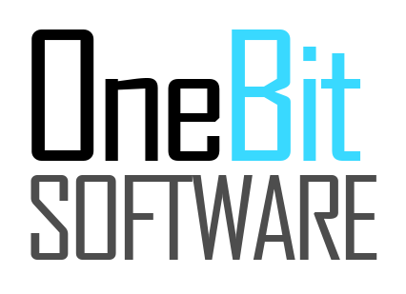
ANY QUESTIONS?
You can support me and my projects:
Via PayPal: http://paypal.me/ivaylokenov
Via Revolut: @ivaylowrlt
On Patreon: https://www.patreon.com/ivaylokenov
On Open Collective: https://opencollective.com/mytestedaspnet
Via Buy Me A Coffee: http://buymeacoff.ee/ivaylokenov
Crypto: http://bit.ly/ik-sponsors
Never expected, always appreciated!

Slide 102
Thank You!
presentation available here: https://github.com/ivaylokenov/Docker-From-ABC-To-XYZ

