Slide 1
The Most Affordable Destination for
Data Scientists
Xiao Huang
1/10/20

Slide 2








Tools

Slide 3

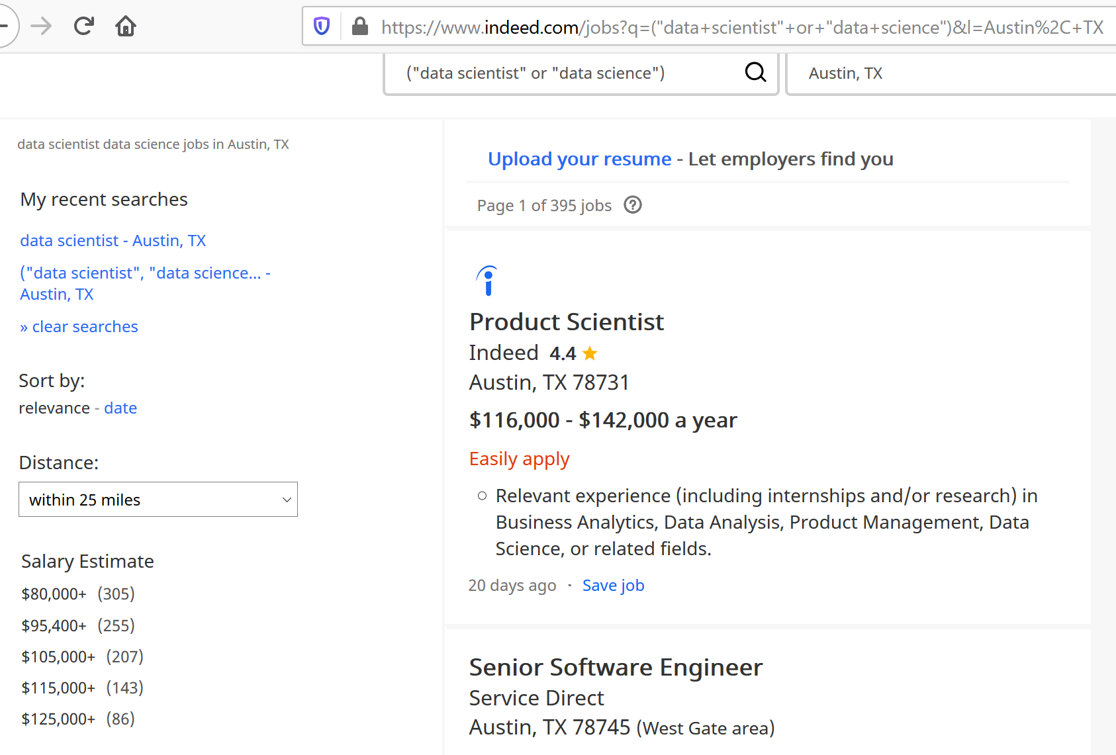
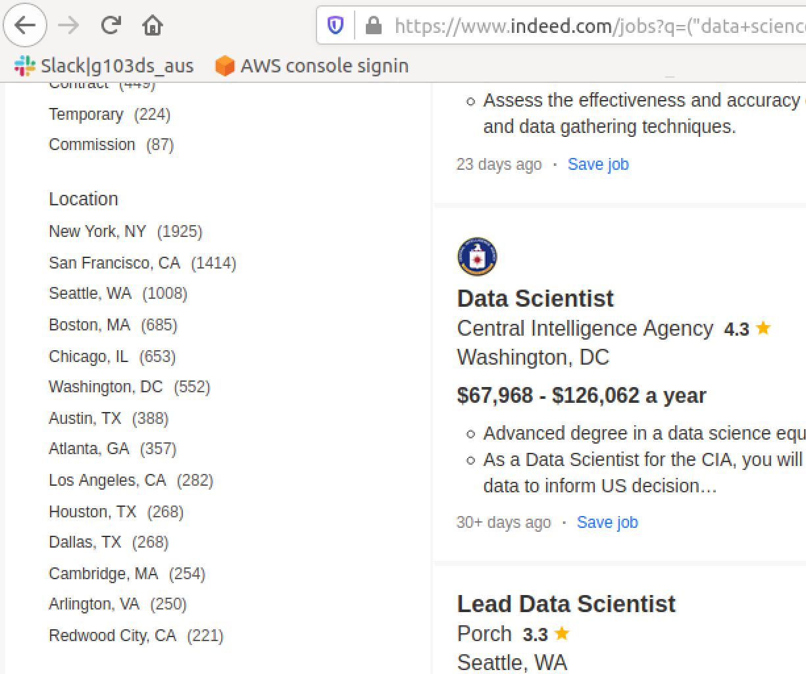
Data source: Web scraped on Indeed

Slide 4
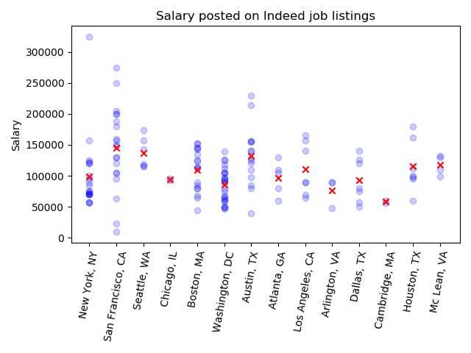
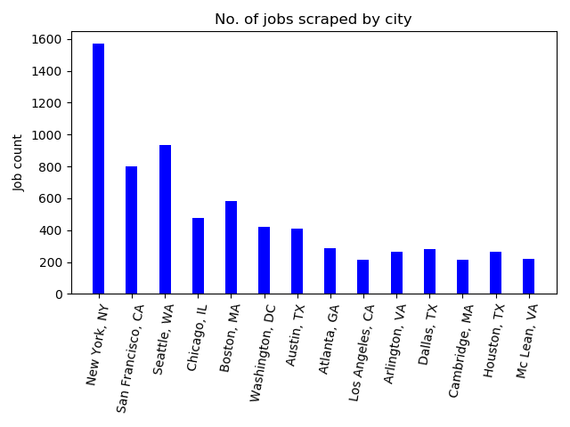
Challenge: Sparse Data
Total number of jobs scraped: 14000+
Total number of jobs have salary posted: ~300
9/14 major cities have less than 10 samples

Slide 5
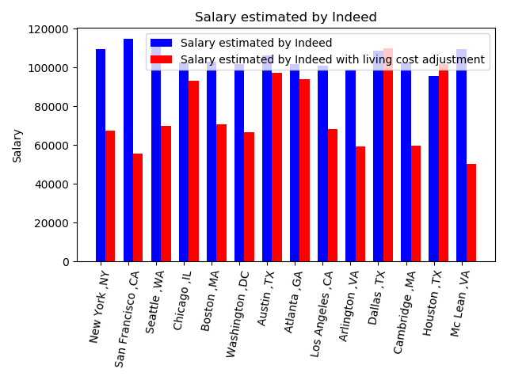
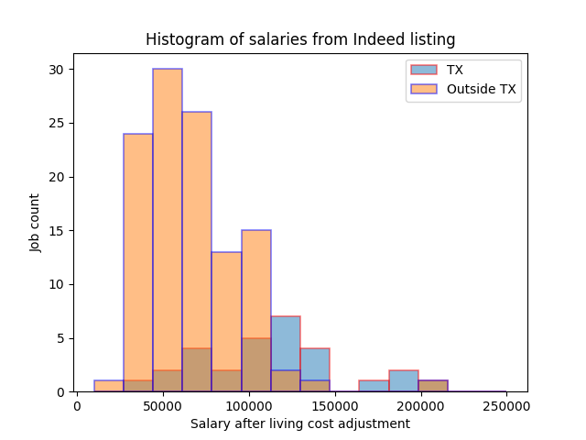
EDA and hypothesis testing
EDA: Cities in TEXAS similar salary and living cost
Data grouped as in TEXAS and in other states
A/B testing: salary after living cost adjustment in Texas is 34k higher than not in Texas with p value 0.04

Slide 6
Conclusion and future study
Salary adjusted by living cost in Texas are $34k higher than in other states
Future study:
Consider other factors like weather, crime, amenities etc.
Adjust weights of factors

Slide 7

Contact info
Linkedin: https://www.linkedin.com/in/xiao-huang-4a545b87
Github repo:https://github.com/ivboh/most_affordable_destinations_data_scientist
Ph.D. in Statistics, Washington University in St. Louis
B.S. in Statistics, University of Science and Technology of China

