Slide 1
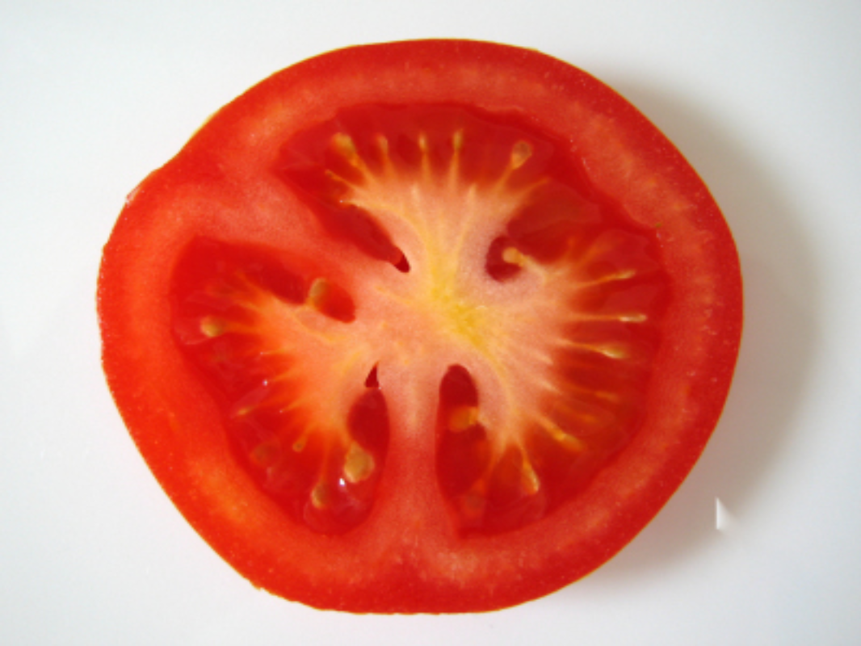
The
Pomodoro Technique
not in a fake Italian accent

Slide 2
Who am I?
  John Nolan
  Development Manager at Financial Services Company
  Msc Student at Manchester University in Advanced Computer Science
  Father
  and...

Slide 3

Procrastinator
Notes:
http://www.reputationdefenderblog.com/wp-content/uploads/2009/04/social-networking-sites.jpg

Slide 4
Anti-Pattern: Prioritisation
Doing a task but we have:
External interruptions:
  Phone calls (Support)
  Unsolicited visitors
  IM
  Twitter
Notes:
Like a magpie (or a gold fish)

Slide 5
Anti-Pattern : Magpie effect
Internal interruptions
  Trying to concentrate but flick on to email
  Hunger
  Bathroom
  Cuppa tea

Slide 6
What about us?
So you don't procrastinate but what if:
  You could be less anxious about deadlines
  Enhance focus and cut down on interruptions
  Increase awareness of your decisions
  Boost motivation and keep it constant
  Refine your estimation
  Strengthen your determination to keep on applying yourself in the face of complex
  situations

Slide 7
So ... the Pomodoro Technique
  Time Management technique
  Francesco Cirillo (Agile coach) in the 90s
Pomodoro Technique
  Simple
  lo-fi
All you need is :
  Pencil
  Timer
  To do list, Activity Inventory list, Records sheet.
Notes:
Pomodoro means tomato
concetrate for 10 mins at a time

Slide 8
How to do it
  Set your timer for 25 mins (this unit is called a pomodoro)
  do the first thing off that todo sheet
  concentrate on that for 25 mins.
  DO NOTHING ELSE - including answering phones, email, etc..
  if someone else interrupts DEFER them.
  if you cannot concentrate, its not a Pomodoro mark it as abandoned.
Notes:
inform negotiate defer

Slide 9
Did you make it?
  Mark an X against your task
  Take a break for 5 mins.
  Relax your brain.

Slide 10
Pomodoro rhythm
Never break a pomodoro.
Always take a SET break after 4 pomodori (20 mins)
If you task takes more than 7 its too big split it up.
If you finish mid pomodoro over-learn.
  Check your work?
  How can I improve this?
  Make notes

Slide 11
And that's it!
  We box off sections of time so that we focus 100% on a task
  By controlling interruptions our flow is not broken.
  Record what we have done within those time boxes allows us to measure true productivity.
  Because we break regularly we achieve a sustainable pace.
  With records we can now plan and estimate more effectively.

Slide 12
1st Pomodoro
  From yesterday’s to do list work out how many Pomodori you achieved.
  Transfer unfinished tasks back to Activity Inventory
  Pick tasks that you want to be done today.
  Try and achieve the amount you did yesterday.
  Estimate in pomodori

Slide 13
Last Pomodoro
  Were any tasks noticeably over/under estimate?
  What went good/bad?
  Am I respecting breaks?
  Can interruptions be avoided?
  Is rhythm established?

Slide 14
Changes to me
  Power to concentrate for a whole 25 minutes
  Focus on the mundane
  and the complex
  Guilt - free treats
  Emails dealt with in set breaks.

Slide 15
Any questions?
Links:
  Official site http://pomodorotechnique.com
  Staffan Nöteberg's 5 min blog post: http://bit.ly/FDnA
  My blog http://johnnosnose.blogspot.com/
  Twitter: @johnnonolan

