Slide 1
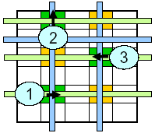
Droplet Manipulation in Cross-Referencing Digital Microfluidic Biochip
CSC5240 Project Report
XIAO Zigang, MPhil
CSE dept. , CUHK
zgxiao@cse.cuhk.edu.hk
December 12, 2008

Slide 2

Outline
Background
Problem Formulation
Modeling
Experimental Result
Conclusion & Future Work
Q & A

Slide 3
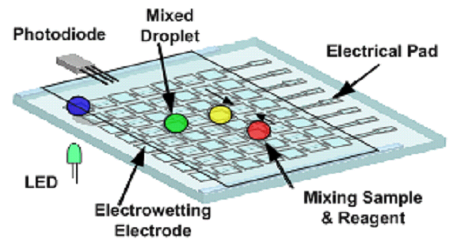
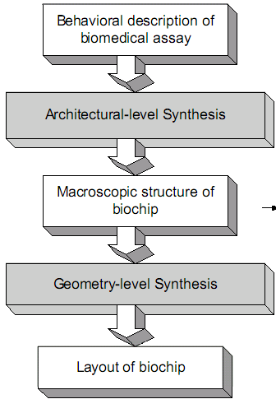
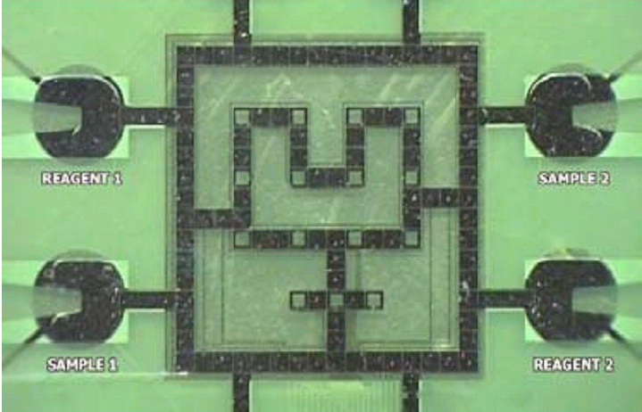
Background – DMFS, its Design
Digital Microfluidic Biochip (DMFS)
Top-down methodology

Slide 4
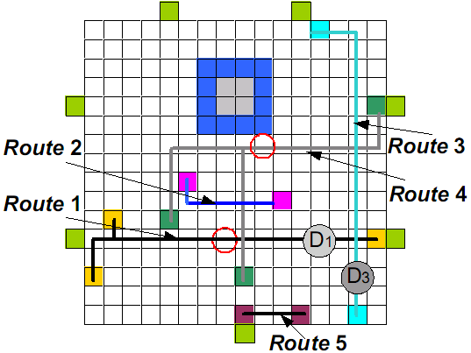
Background – Droplet Routing
Similar to Motion Planning in Robotics
  NP-hard even for only two robots!
Existing methods
  A* Search – Bohringer
  OSPF – Griffith
  Gen. & Mod. – Su
  Network-Flow – Yuh
  Bypassibility heuristic – Cho

Slide 5
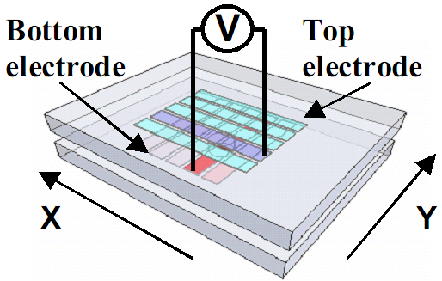
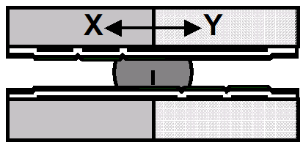
Background – Electrode Manipulation
Electrode Manipulation
  Direct-addressing : N*M pin
  Cross-referencing : N+M only!

Slide 6
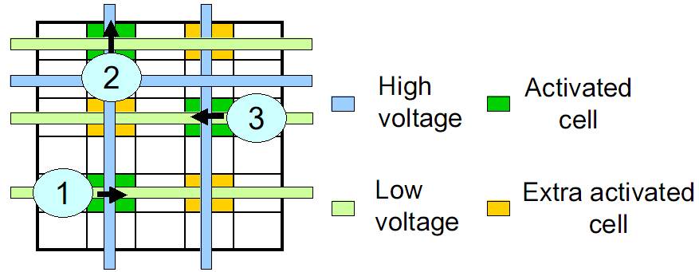
Cross-referencing: Pros and Cons
Simple, low cost
Large scale manufacture, but …
Impose severe constraints!!
  A correct schedule of voltage assignment
    Yet parallelism should be exploited
What if here is a droplet…?
Electrode Interference

Slide 7
Available Approach
View droplet routing and droplet manipulation as two sequential process. The former step’s output is the input for the latter step
Consider droplet routing while at the same time avoiding electrode interference, i.e. we treat droplet routing and droplet manipulation as a single process.

Slide 8

Contribution
Examine details
  Formulate problem
  Identify constraints
Try to model as a COP (Constraint Optimization Problem)
  No polynomial optimal algorithm in the literature
  Different models
  Use ILOG solver to solve
Perform experiments and benchmark
  Random and test cases from papers on this problem

Slide 9
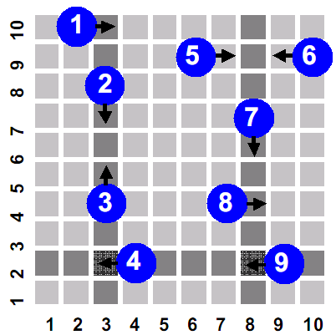
Problem Formulation
Given a snapshot during droplet routing, find a correct voltage assignment schedule, while minimizing the total time used
A series of snapshots could be obtained from direct-addressing result

Slide 10
Problem Formulation
A snapshot consists of:
  N rows and M columns
  n droplets denoted by adjacent start and end location
A voltage assignment schedule is:
  At time step t, the voltage on each row/column

Slide 11
Constraints
Fluidic Constraint
x | x | x | x
x | 1 | 2 | x
x | x | x | x
Timing Constraint
  All droplet be moved within time T.
    Upper bound by n (totally n droplets)
Electrode Constraint
  While activating some electrodes simultaneously, no interference is caused

Slide 12
First Trial: A Simple Model
Assumption:
Restrict row=H/F, col = L/F
Do not consider complicated scenario
Variables: d₁ … d_{n} , T
Domain: d_{i} ∈ [1..n], T ∈ [1..n]
Constraint:
  d_{i} <= T
  If d_{i} = d_{j} Then
    activate corresponding cells
Objective: minimize T

Slide 13
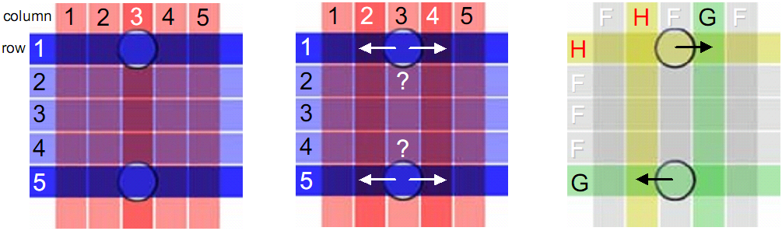
Modeling Consideration
With or without flexible voltage assignment
  With careful arrangement
  two droplets each time : a smaller upper bound
    e.g. 10 → 5, 9 → 4+1=5
    for n droplets : ceiling(n/2)+1

Slide 14
Modeling Consideration
Consider “critical area” or not
Before t
x | x | x | o
x | 1 | 2 | o
x | x | x | o
At t
x | x | x | o
x | 1 | 2 | o
x | x | x | o
After t
o | x | x | x
o | 1 | 2 | x
o | x | x | x
Consider merge(3-pin net) or not
x | x | x | x | x | x
x | 1 | 2 | 2 | 1 | x
x | x | x | x | x | x
x | x | x | x | x | x
x | 1 | 2 | 1 | x | x
x | x | x | x | x | x
Consider droplet move back or not
1
2

Slide 15
Modeling Consideration
But how to represent in constraint?
  Have to keep track of voltage assignment status at each time step
  Have to keep track of many ad-hoc information for adjacent cells
    NxMxT variables
  Search Space is HUGE

Slide 16
Allow Voltage Arrangement
Assumption:
  Voltage can be H/L/F for row and col
  Do not consider complicated scenario
(new) Variables:
  volRow_{1t},…, volRow_{Nt :} row i’s voltage at time t
  volCol_{1t},…, volCol_{Mt :} column j’s voltage at time t
Domain:
  {H,L,F}
Constraint:
  If no ‘2’ at a row/col, set to F
  If a ‘2’ at row=r,col=c, activated at time t, then
    volRow_{rt} == HIGH and volCol_{ct} == LOW or
    volRow_{rt} == LOW and volCol_{ct} == HIGH
  for row=r,col=c at time t, fluidic constraint not violated
    volRow_{rt} == HIGH and volCol_{ct} == LOW or
    volRow_{rt} == LOW and volCol_{ct} == HIGH

Slide 17
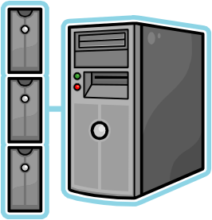
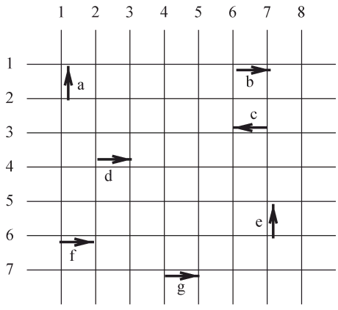
Experimental Setup
Environment:
  solar4@cse.cuhk.edu.hk
    SunOS
    ILOG solver 6.0
Test Case:
  Specific cases in papers
  Random test cases

Slide 18
Experimental Result – Case Study I
Model I
  T=2
  1:{1,2}
  2:{3}
Model II
  T=1
  1: 1 H L
  2: 1 H L
  3: 1 L H
Electrode Interference can be avoided through careful assignment

Slide 19
Experimental Result – Case Study II
Model I
  1:{1,2,3,4}
  2:{5,6}
  3:{7,8,9}
Both better than the greedy clique partitioning in [1]
Model II
  1: 1 H L
  2: 1 H L
  3: 1 H L
  4: 1 H L
  5: 1 L H
  6: 1 L H
  7: 2 L H
  8: 2 L H
  9: 2 L H
[1]Tao Xu et al., A cross-referencing-based droplet manipulation method for high-throughput and pin-constrained digital microfluidic arrays, DATE 2007:

Slide 20
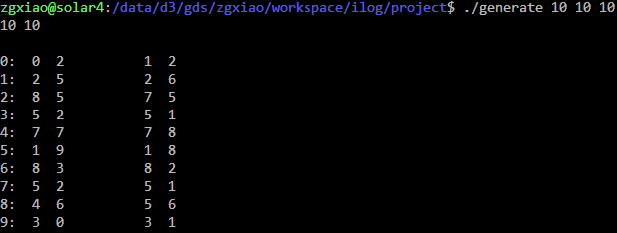
Experimental Result –
Random snapshot generator
A random snapshot generator
  Usage: generate N M D
  Generate D droplets in a NxM board satisfying fluidic constraint

Slide 21

Experimental Result – Comparison
 | 10 10 8 |  | 10 10 10 |  | 20 20 10 |  | 20 20 20
 | avg. opt. | avg. fail | avg. opt. | avg.fail | avg. opt. | avg.fail | avg. opt. | avg.fail
Model I | 4 | 1% | 6 | 2% | 6 | 2% | 8 | 5%
Model II | 2 | 10% | 3 | 50% | 3 | 50% | 7 | 70%
  Each class contains 100 test cases
  Avg. opt. = expected value of objective
  Avg. fail. = failed/total case( when runtime exceeds 1 mininue)
The simple model works very well
With flexible voltage assignment
  Better objective
  Much longer search time

Slide 22

Conclusion
With more flexible restriction, the problem becomes much harder
  What is the gross optimality we gained?
Not efficient enough for large case
  Better model required

Slide 23

Future Work
Extend the application
  incorporate into a router
  Use 2nd approach (routing+manipulation)
More real-world constraint needed
  Handle 3-pin net
User-defined constraint may be designed to perform constraint propagation
  Only modeling is studied here

Slide 24

Q & A
Thank You

