Slide 1
File Recovery in FAT32
CSC/CEG 3150 Tutorial 10
Cheong Chi Hong
November 13, 2007

Slide 2
File Size > One Cluster Size
Recall
  Cluster: store the file/directory content in data area
Sometimes the file/directory size is larger than the size of one cluster
Need more than one cluster to store a file/directory
Example
  1 cluster = 1 sector = 512 bytes
  The file size of test1.txt is 700 bytes
  We need 2 clusters to store test1.txt

Slide 3
File Size > One Cluster Size
Recall
  Directory entry: stores the file name, location of the first part of the file/directory … etc
From the directory entry, we only know the first cluster address
  The location where the first part of the file/directory can be found
Where can we find the remaining part of the file?
  Answer: File Allocation Table (FAT)

Slide 4
File Allocation Table (FAT)
FAT consists of equal-sized entries only, each of them corresponds to a cluster
The n-th entry in FAT corresponds to cluster n
  E.g. The 22nd entry in FAT corresponds to cluster 22
Therefore, FAT can be represented by an array, with a cluster address as its index
  Written as FAT[cluster address], E.g. FAT[22]
Recall
  The first cluster in data area is “cluster 2”, there is no “cluster 0” or “cluster 1”
The first two entries of FAT are useless in terms of file allocation
  FAT[0] stores a copy of the media type
  FAT[1] stores the dirty status of the file system

Slide 5
Usage of FAT
1. Indicate the location of the next part of the file/directory
  Point to the remaining cluster of the file/directory by the next cluster address
  E.g. If FAT[22] = 23, then the next cluster of cluster 22 is cluster 23
2. Indicate that there is no remaining part for the file/directory
  Indicate that the corresponding cluster is the last cluster of the file/directory by EOC (End of Clusterchain)
  Another name for EOC: EOF (End of File)
  E.g. If FAT[23] = EOC, then cluster 23 is the last cluster of that file/directory
3. Indicate an unused cluster by zero
4. Mark the bad cluster
5. Mark the reserved cluster

Slide 6
Cluster Chains
test1.txt
Cluster 22
V
Cluster 23
V
EOC

Slide 7
Size of a FAT entry
FAT32
  32-bit for each entry
    Each FAT = An array of 32 bits entries
  EOC = any value larger than or equal to 0x0fff fff8
  Maximum number of files = 268,435,437
FAT16
  16-bit for each entry
  EOC = any value larger than or equal to 0xfff8
  Maximum number of files = 65,517
FAT12
  12-bit for each entry
  EOC = any value larger than or equal to 0xff8
  Maximum number of files = 4,077

Slide 8
Notes to Assignment 3
Milestone 2 – List out all the files/directories in the root directory
  You cannot assume that one cluster is enough to contain the root directory
Recall
  There may be more than one FAT in FAT Area, they are mirrors of each other
If you have to update FAT, remember to update all FATs

Slide 9
How does FAT32 delete a file?
Suppose “rm –f /mnt/rd/dir1/test2.txt” is executed
  1. Locate the directory entry of dir1 in the root directory. Suppose dir1 is in cluster 30
  2. Go to cluster 30 that stores dir1
  3. Locate the directory entry of test2.txt in dir1. Change the first byte of the directory entry to 0xe5, i.e. “test2.txt → _est2.txt”. Suppose the first cluster address of test2.txt is 52
  4. Change all the values in the FAT entries that are related to test2.txt to zero.
  a. Read FAT[52] (E.g. FAT[52] = 54), then change its value to 0
  b. Read FAT[54] (E.g. FAT[54] = EOC), then change its value to 0
  c. Since FAT[54] = EOC, so no more change is needed

Slide 10
Before the rm command

Slide 11
After the rm command

Slide 12
After the rm command

Slide 13
Before and After
Changed
  The first character of the file name in the directory entry is changed to ‘_’ (0xe5)
  The related FAT entries are changed to zero
Unchanged
  All others
  For example
    The first cluster address
    File contents
    File size

Slide 14
File Recovery
Idea: restore the changes made by the deletion
1. The first character of the file name in the directory entry is changed to ‘_’ (0xe5)
  Restore ‘_’ back to the first character of the deleted file name
  How do we know the original file name?
    In Assg3, the file name is supplied by the user

Slide 15
File Recovery
2. The related FAT entries are changed to zero
  Restore the zero into EOC or the next cluster address
  How do we know which FAT entry should be restored?
    The first cluster address in the directory entry is unchanged
  How do we know the zero should be restored to EOC or a cluster address?
    In Assg3, the deleted file size is less than the size of a cluster
    So one cluster is enough to store the deleted file
    In practice, it is determined by the file size (it is unchanged in the directory entry) and the cluster size
    We can calculate the number of clusters needed to store the deleted file and deduce that originally it should be EOC or a cluster address
    What if it should be a cluster address?
      We will talk about it later

Slide 16
Other Things Related to Assg3
You may need to know them, but you don’t have to implement them
  File recovery for large files
  Long file name directory entries
  FAT32 FSINFO

Slide 17
File Recovery for Large Files
If the deleted file size is larger than one cluster size, then the FAT entry of the first cluster address should not be restored to EOC, but a cluster address instead
Algorithm 1
  The next cluster storing the deleted file is the next cluster
Algorithm 2
  The next cluster storing the deleted file is the next unallocated / unused cluster (marked with 0)
Both algorithms are not 100% successful

Slide 18
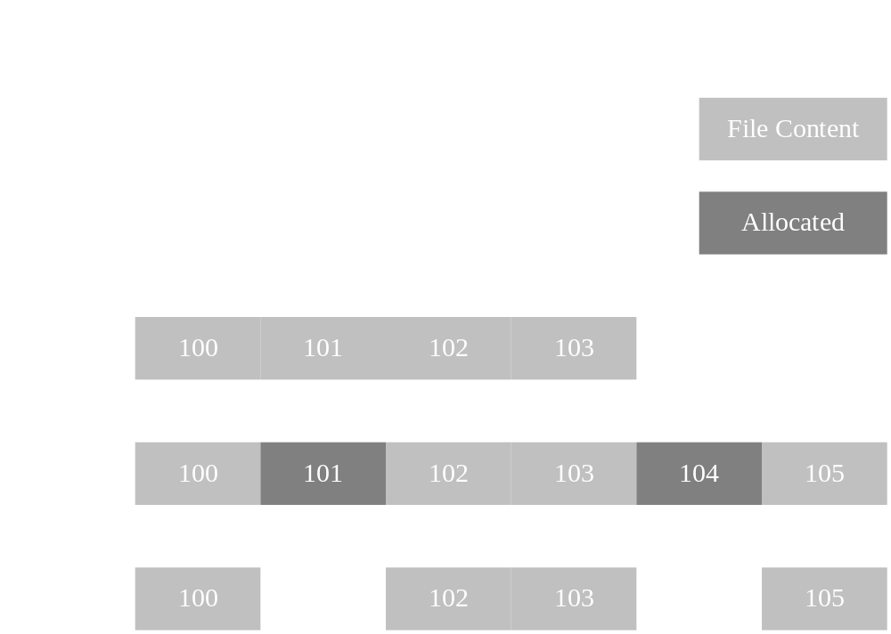
File Recovery for Large Files
Starting cluster: 100
File size: 3,535 bytes
Cluster size: 1,024 bytes
Algorithm 1 can only recover case A correctly
Algorithm 2 can only recover cases A and B correctly

Slide 19
Long File Name Directory Entries
The standard directory entry supports
  8 characters in the name
  3 characters in the extension
Long File Name (LFN) directory entry
  Longer name
  Name that use special characters
A file/directory has a normal entry in addition to any LFN entry
  The LFN entry precedes the normal entry
The file attributes of a LFN entry must be 0x0f

Slide 20
FAT32 FSINFO
Include hints about where to allocate new clusters
  Since it is very time consuming to search for a new cluster starting from “cluster 2”
Include the number of free clusters
However, it is still valid for them not to be updated

Slide 21
Data Structure of FSINFO
#pragma pack(push,1) // BYTE align in memory (no padding)
struct FSInfo
{
unsigned long FSI_LeadSig /* Signature (0x41615252) */
unsigned char FSI_Reserved1[480]; /* Not used */
unsigned long FSI_StrucSig; /* Signature (0x61417272) */
unsigned long FSI_Free_Count; /* Number of free clusters */
unsigned long FSI_Nxt_Free; /* Next free cluster (set to the last allocated cluster) */
unsigned char FSI_Reserved2[12]; /* Not used */
unsigned long FSI_TrailSig; /* Signature (0xAA550000) */
};
#pragma pack(pop) // BYTE align in memory (no padding)

Slide 22
dosfsck /dev/ram
After you have successfully recovered a file by your program, if you run “dosfsck /dev/ram”, you may encounter the following message
dosfsck 2.11, 12 Mar 2005, FAT32, LFN
Free cluster summary wrong (32231 vs. really 32230)
1) Correct
2) Don't correct
It is because the number of free clusters in FSINFO is not updated in the file recovery process
But you do not need to handle it in Assignment 3

Slide 23
End
You should be able to complete Milestone 2, 3, and 4, and also the bonus part after this tutorial

