Slide 1
Droplet-Routing-Aware Module Placement for Cross-Referencing Biochips
Zigang Xiao, Evangeline F. Y. Young
Department of Computer Science and Engineering
The Chinese University of Hong Kong
ISPD ’10, SFO, CA, USA
Mar. 17th, 2010

Slide 2
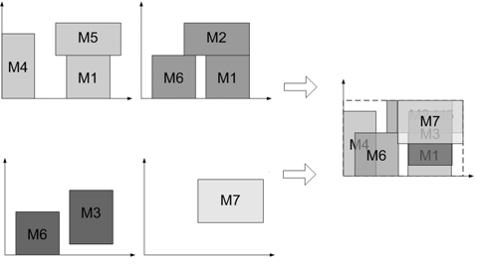
Outline
Background: Biochip & CAD
Problem Formulation & ILP Modeling
Experimental Result
Conclusion
Notes:
Change this Figure, draw by myself

Slide 3
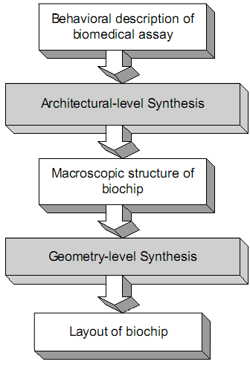
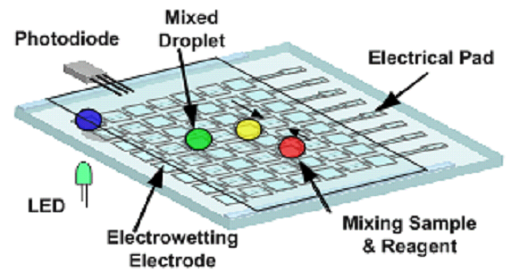
Background – DMFB
Digital Microfluidic Biochip (DMFB)
Droplet – Carrier of biochemical reaction material
Scheduling
Resource
Allocation
Placement
On-chip Resources:
Dispenser
Waster reservoir
Optical Detector
Routing
Top-down CAD design

Slide 4
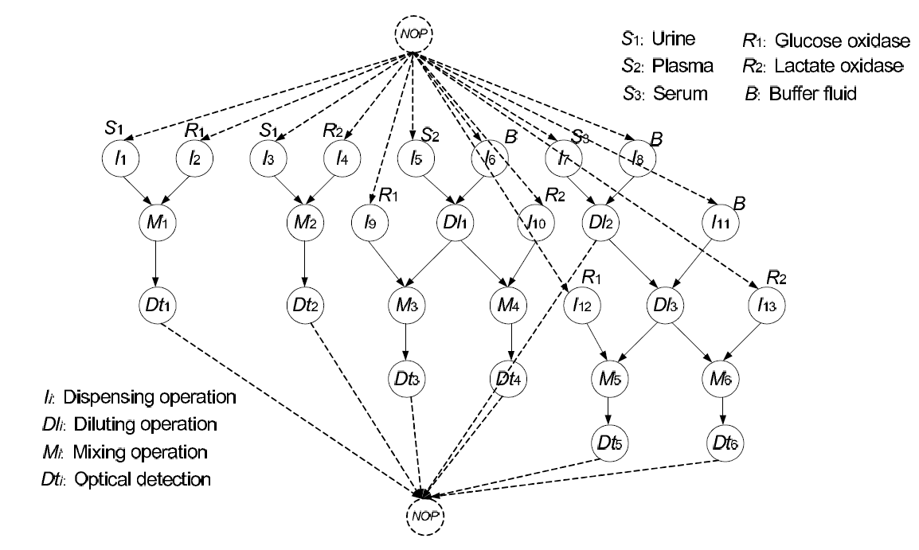
Sequence Graph
Sequence graph example

Slide 5
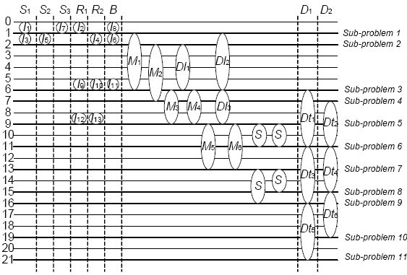
Scheduling/Resource Allocation of the Assay
result after schedule/resource binding

Slide 6
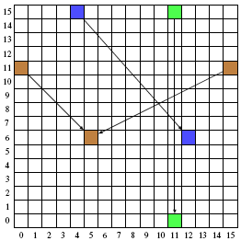
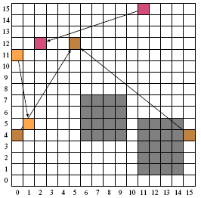
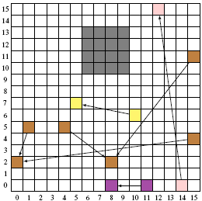
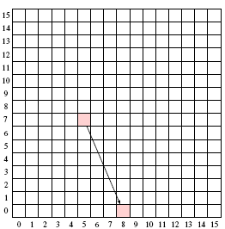
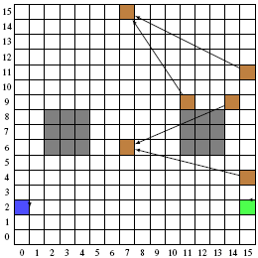
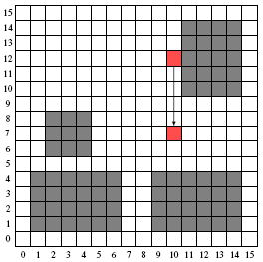
Placement Example
Subproblem 1
Subproblem 2
Subproblem 3
Subproblem 11
Subproblem 5
Subproblem 4

Slide 7
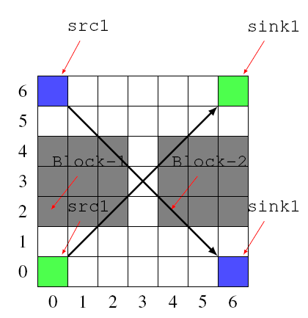
Placement for DMFB
Greatly affects the routing
DEADLOCK
Not a good placement result
Should coordinate during routing – downgrade to sequential

Slide 8
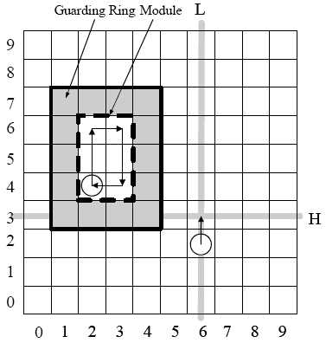
Background – Placement for DMFB
Different from traditional placement
  ‘Blocks’ issue
If applied…
We assume extra-activated cell inside is fine. Still Mixing inside
cannot apply L to column 1~4
L

Slide 9
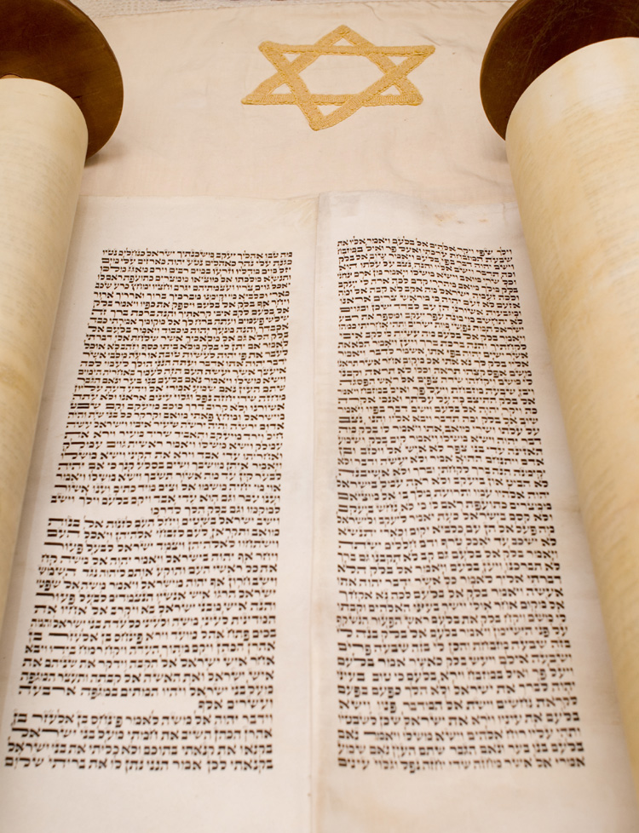
Background – Previous Work
Su et al. and Yuh et al. both proposed several methods based on Simulated Annealing (SA).
Su tried to solve the problem while considering fault-tolerance. Later he unified placement with other stages.
Yuh proposed different representations to be used in SA.
  T-tree
None of them aimed on designing for Cross-referencing DMFB.

Slide 10
Outline
Background: Biochip & CAD
Problem Formulation & ILP Modeling
Experimental Result
Conclusion

Slide 11
Problem Formulation
Input:
  Scheduling and resource binding result
  Chip specification, information about:
    Timing constraint
    Chip size
    Optical Detector
    Reservoir, dispenser
Output:
  Placement result, including:
    Location of modules, reservoir and dispenser
    Pin location of route
Objective:
  Minimize the sum of the extended covered area

Slide 12
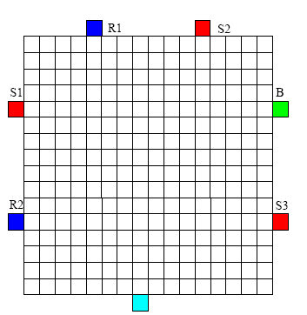
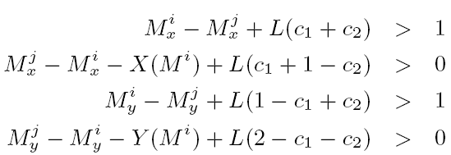
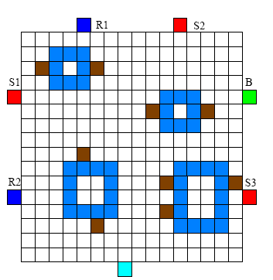
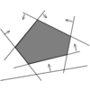
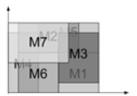
Our approach
Input
Dispenser and Reservoir Location Generation
ILP formulation
Pins
LP solver
Pins of a 3-pin net
Output
Pin Generation

Slide 13
ILP Formulation of Placement
Placement problem is NP-hard
Constrain the ILP size into reasonable size
Core idea: how to utilize the properties of Cross-Referencing DMFB?
Objective function:
  Sum of extended covered area

Slide 14
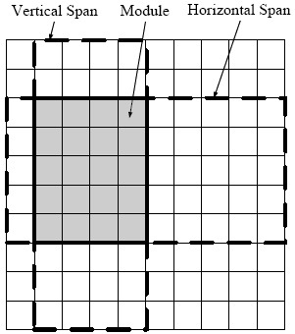
ILP - Extended Covered Area (ECA)
So many electrodes activated!
Rationale: minimizing the sum of ECAs
  For single droplet : shorter route
  For multiple droplets : reduce the possibilities of interference between routes

Slide 15
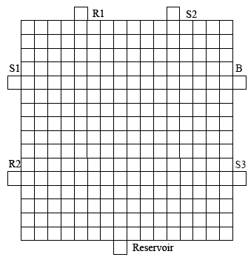
Constraints - 1
1.Validity of modules
Guarding Ring
Should be in side chip, one space away from boundary (otherwise block reservoir!)

Slide 16
Constraints - 2
2. Non-overlapping and separation
Guarding ring can be SHARED
Modules can not overlap if co-exist at some time

Slide 17
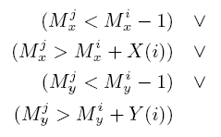
Transform to Linear
The previous constraint will be represented by several `or’ constraint, which cannot be handled in LP solvers.
Add two control variables
Original

Slide 18
Constraints - 3
3. Optical detector resource constraint
Module Dt1
Module Dt2
Dt1, Dt2 bound to the same optical detector, should be at the same place!
Time=3~6
Time=8~9

Slide 19
Constraints - 4
4. Bounding box of routes and objective
Objective = sum of all these areas
Subproblem i
Subproblem i+1

Slide 20
Outline
Background: Biochip & CAD
Problem Formulation & ILP Modeling
Experimental Result
Conclusion

Slide 21

Experiment Setup
Environment:
  lp_solve 5.5
  Intel Core II Duo 2.4GHz
  1.5G Ram
Two sets of real world benchmark
  in-vitro
  in-vitro2

Slide 22
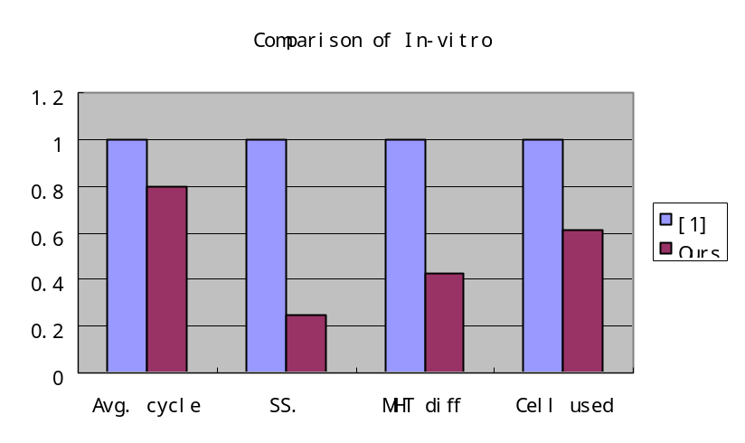
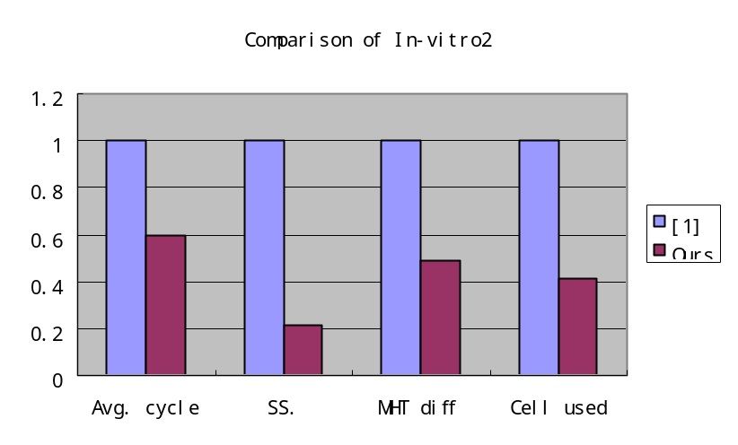

Experimental Result – Comparison
Name | # sub. | Routing result of [1] |  |  |  | Our placement method
 |  | Max/Avg. cycle | SS. | MHT diff | Cell used | Max/Avg. cycle | SS. | MHT diff | Cell used
In-vitro | 11 | 20/12.09 | 12 | 45 | 246 | 16/9.64 | 3 | 19 | 151
In-vitro_2 | 15 | 19/10.73 | 23 | 39 | 250 | 17/6.40 | 5 | 19 | 104
[1] P. Yuh, C. Yang, and Y. Chang, "Placement of defect-tolerant digital microfluidic biochips using the T-tree formulation", ACM Journal on Emerging Technologies in Computing Systems (JETC), vol. 3, no. 3, p. 13, 2007.

Slide 23

Conclusion
The properties of cross-referencing is beneficial to routing if considered. It should be explored and exploited MORE.
Future Improvement:
  Utilize more of cross-referencing (Effectiveness)
  More sophisticated modeling (Efficiency)
  Pin location (correctness)
  Integrate CrossRouter

Slide 24

Thank You

