Slide 1
CrossRouter: A Droplet Router for Cross-Referencing Digital Microfluidic Biochips
Zigang Xiao, Evangeline F. Y. Young
Department of Computer Science and Engineering
The Chinese University of Hong Kong
ASP-DAC ’10, Taipei, Taiwan
Jan. 20th, 2010

Slide 2
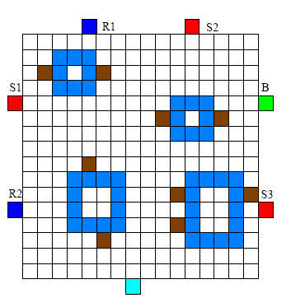
Outline
Droplet Routing in Cross-Referencing Biochip
Formulation of Droplet Routing
CrossRouter: Idea and Implementation
Effectiveness Demonstration of CrossRouter
Conclusion & Future Work

Slide 3
Droplet Routing Problem & Previous Works
Dispensers
Route 1
Route 3
Route 2
Module
Droplet
Waste Reservoir
Similar to Motion Planning in Robotics
  NP-hard even for only two robots!
Existing methods
  A* Search, [Bohringer TCAD’06]
  OSPF, [Griffith IJRR’05]
  Pattern Selection, [Su DATE’06]
  Network-Flow, [Yuh ICCAD’07]
  Bypassibility, [Cho ISPD’08]
  Graph-Coloring, [Griffith TCAD’06]
  Clique-Partitioning, [Xu DATE’07]
  Progressive ILP, [Yuh DAC’08]

Slide 4
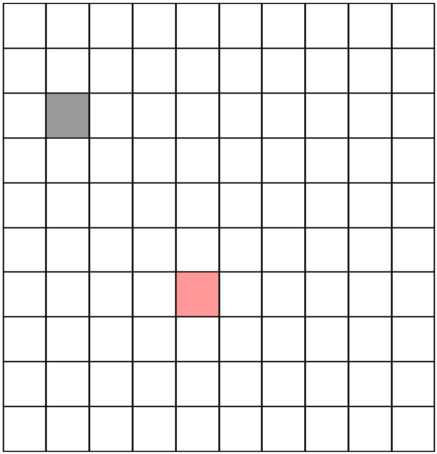
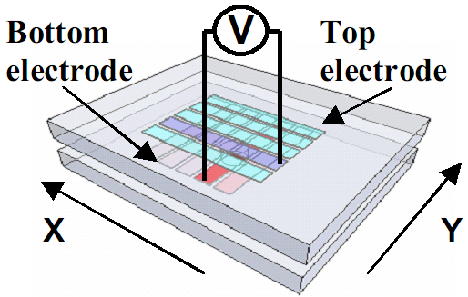


Electrode Manipulation in Cross-Referencing DMFB
N+M pins only
High voltage
source
(Cite from [1])
Low voltage
sink
droplet
cell
Impose severe constraints – Electrode Interference
[1] P. Yuh, S. Sapatnekar, C. Yang and Y. Chang, “A progressive-ILP based routing algorithm for cross-referencing biochips”, Design Automation Conference, pp.284-289, 2008.

Slide 5
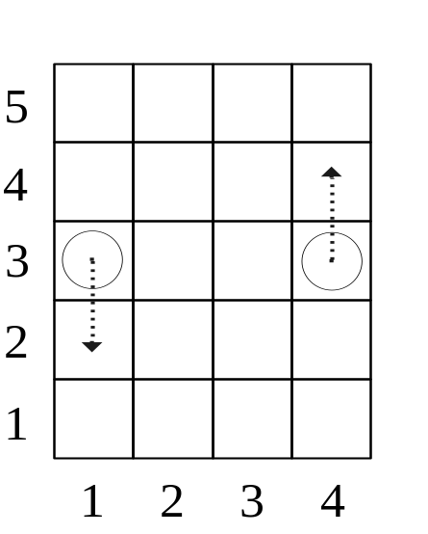
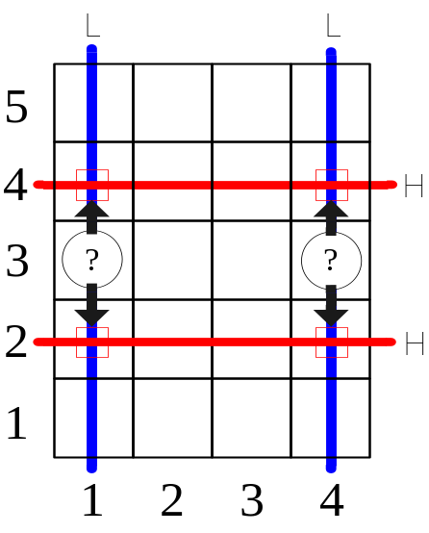
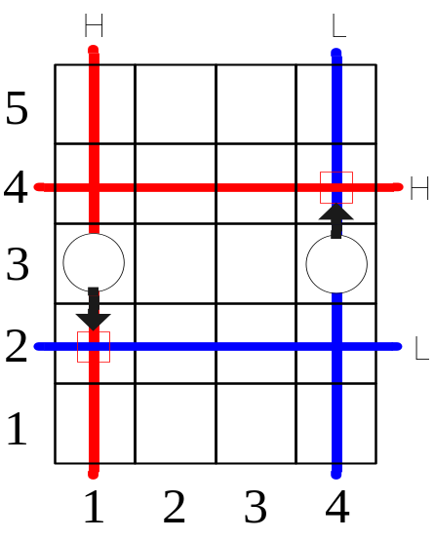
Handling Electrode Interference
Supposed movements
Electrode Interference
Solution
High voltage
droplet
Low voltage
cell

Slide 6
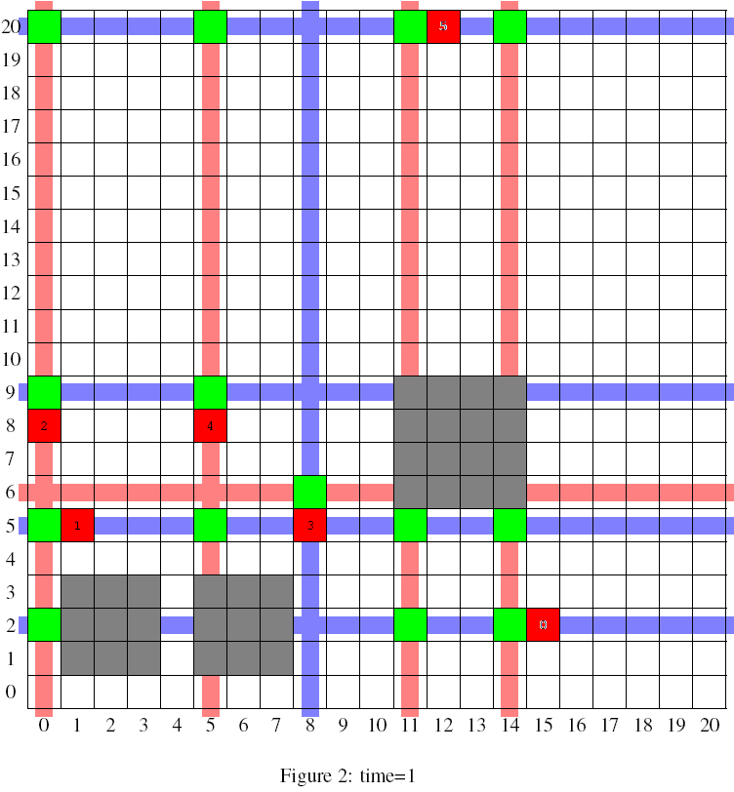
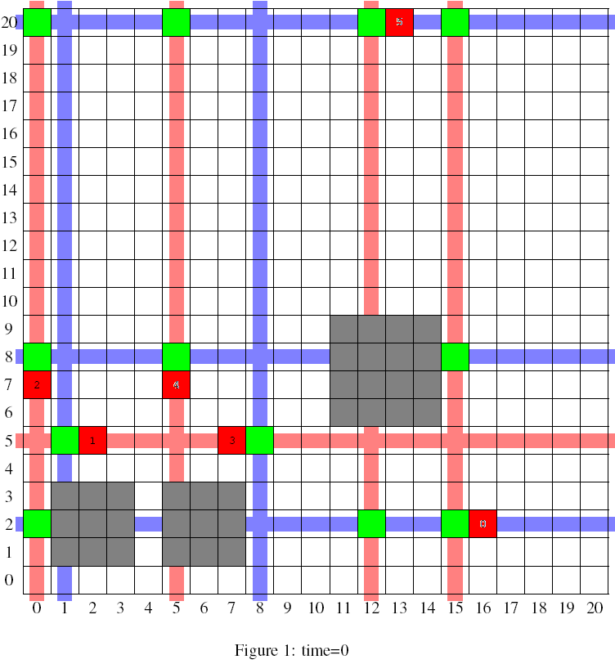
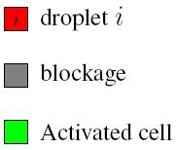

Example of Routing Result
Extra-activated cells without causing interference

Slide 7
Outline
Droplet Routing in Cross-Referencing Biochips
Formulation of Droplet Routing
CrossRouter: Idea and Implementation
Effectiveness Demonstration of CrossRouter
Conclusion & Future Work

Slide 8
Problem Formulation
Input:
  A WxH 2D array
  A netlist of N net, either 2-pin or 3-pin
  K blockages
  Waste disposal location WAT
  Time limit T
Output:
  A schedule of voltage assignment for each time step
  Fail if cannot finish routing before timing constraint
Objective:
  Route all droplets to their destinations
  Minimize time used
  (Minimize cell used)

Slide 9
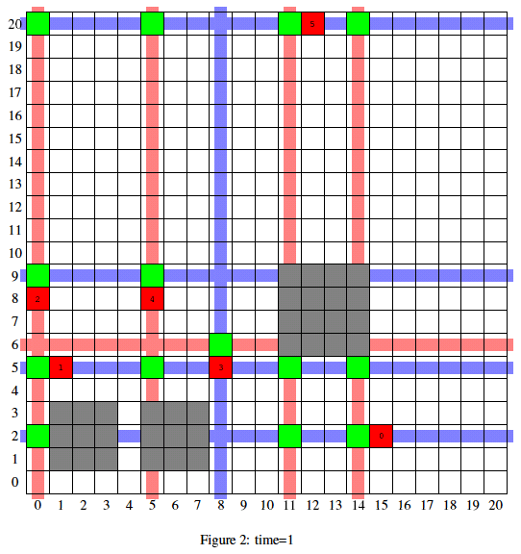
Voltage Assignment
L
Voltage assignment for this time step:
(Row)
H: 6
L: 2, 5, 9, 20
L
H
L
(Column)
H: 0, 5, 11, 14
L: 8
L

Slide 10
Constraints
Timing Constraint
  All droplet be moved within time T
Fluidic Constraint
  A minimum spacing of one cell should be kept
x | x | x | x
x | 1 | 2 | x
x | x | x | x
Electrode Constraint
  While activating some electrodes simultaneously, no interference is caused

Slide 11
Outline
Droplet Routing in Cross-Referencing Biochips
Formulation of Droplet Routing
CrossRouter: Idea and Implementation
Effectiveness Demonstration of CrossRouter
Conclusion & Future Work

Slide 12
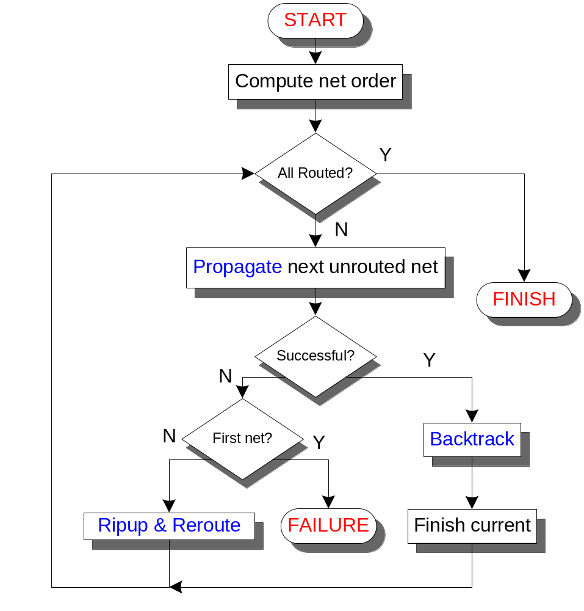
Overview of CrossRouter

Slide 13
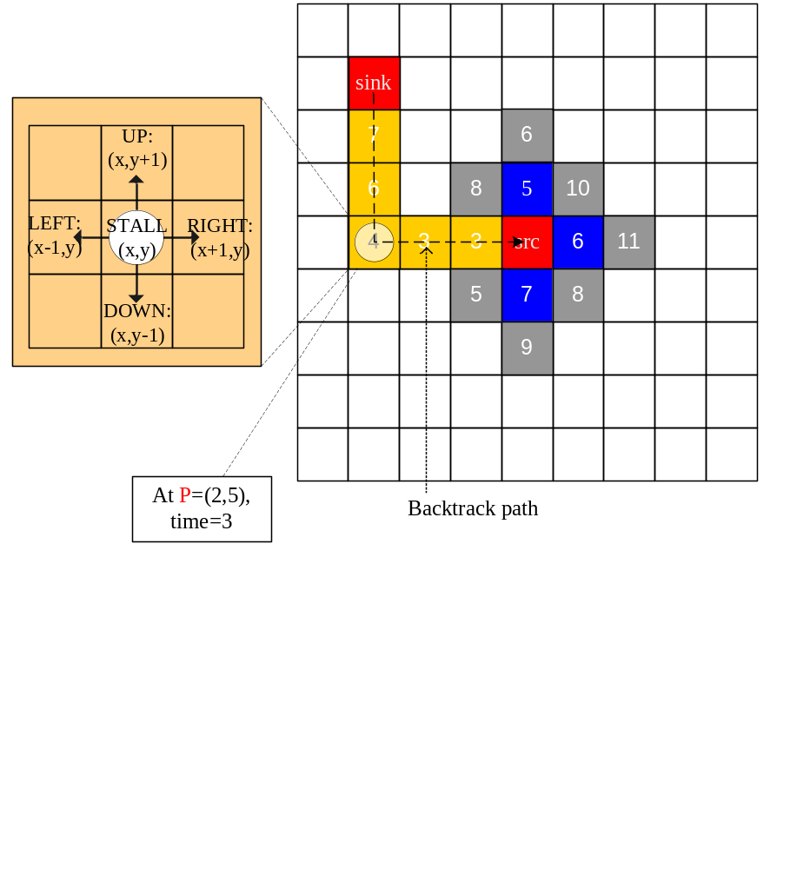
Propagation
Five possible movements
Need to perform
Fluidic/electrode check!
A ‘droplet
movement status’
Weight(P,t) = t + MD(P,src) + U(P) + Len(P,t)
N - #netuse
Current path length

Slide 14
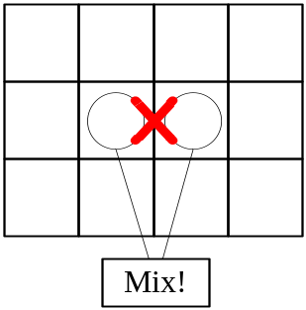
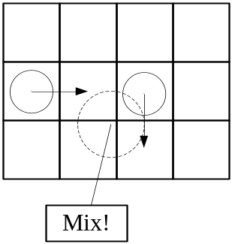
Fluidic Constraint
To avoid unexpected mixing
  Static fluidic constraint
    |x₁^{t}-x₂^{t}|>=2 or
    |y₁^{t}-y₂^{t}|>=2
  Dynamic fluidic constraint
    |x₁^{t+1}-x^{t}₂|>=2 or
    |x₁^{t}-x₂^{t+1}|>=2
    |y₁^{t+1}-y₂^{t}|>=2 or
    |y₁^{t}-y₂^{t+1}|>=2

Slide 15
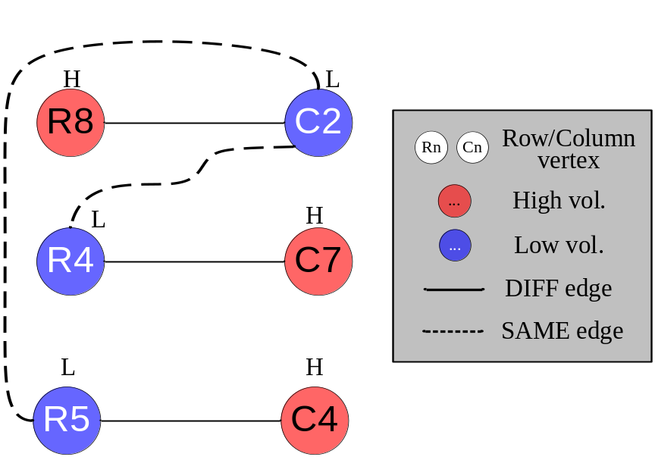
Electrode Constraint
A crucial part in CrossRouter
A constraint graph is used to determine if the simultaneous movements of a set of droplet is implementable
Constraint Graph G
  Vertices are electrodes that need to be assigned a H/L voltage
  Two types of edges:
    SAME and DIFF
2-colorability
  Each coloring corresponds to a voltage assignment
A Constraint Graph and a two-coloring

Slide 16
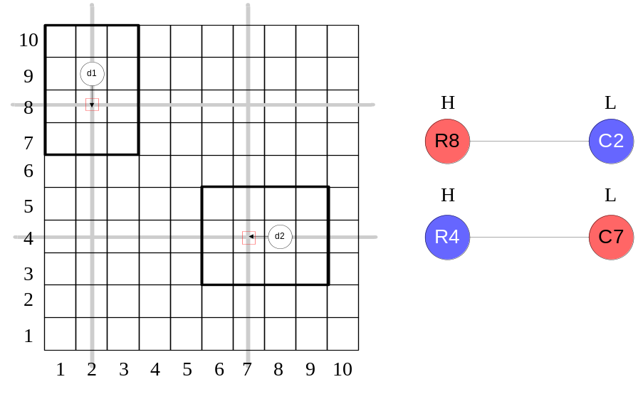
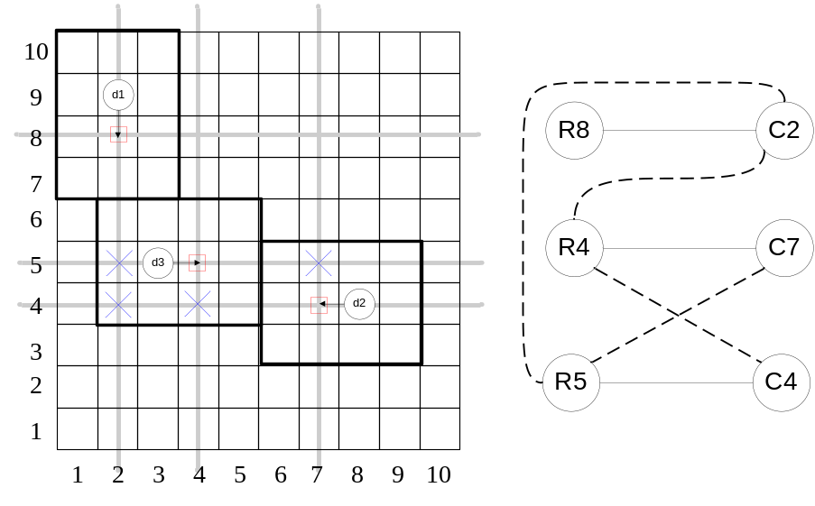
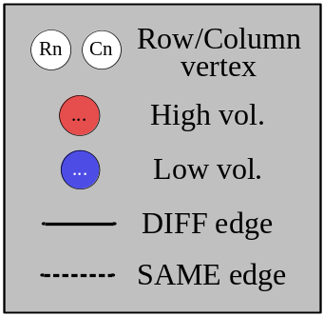
Constraint Graph by Example
Two colorable components
x
x
x
x
Forbidden cells
x
1
2
x
x
x
x
x
H
Scenario: d₃ is NOT present
H
H
L
SAME Edge!
NO valid assignment for the graph!
Scenario: d₃ is present

Slide 17
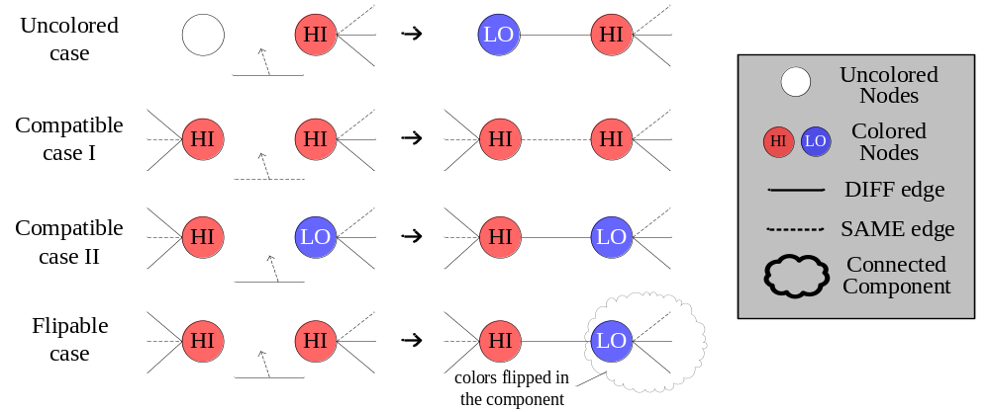
Speed Up Technique - Incremental Coloring
At every time step, a constraint graph is maintained.
  No need to construct graph from scratch
  Incrementally color the nodes
  Can perform electrode check very efficiently!

Slide 18
Outline
Droplet Routing in Cross-Referencing Biochips
Formulation of Droplet Routing
CrossRouter: Idea and Implementation
Effectiveness Demonstration of CrossRouter
Conclusion & Future Work

Slide 19
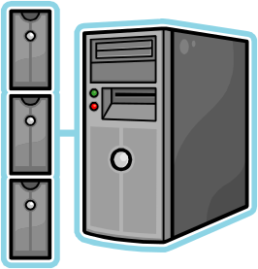
Experiment Setup
Environment:
  Implemented in C++ language
  Run on department’s Linux server
    Intel Pentium IV 3.20GHz
    2GB Ram
Benchmarks:
  Real world benchmark including:
    in-vitro, in-vitro2, protein, protein2
Compared with two previous works
  Yuh’s Progressive ILP
  Cho’s High Performance Droplet Router (in terms of cell used)

Slide 20

Experimental Result – Comparison I
Circuit | #sub. | Progressive ILP [1] |  | CrossRouter
 |  | Max/Average cycle | CPU time (sec.) | Max/Average cycle | CPU time (sec.)
In-vitro_1 | 11 | 24/13.09 | 2.55 | 20/12.09 | 0.92
In-vitro_2 | 15 | 22/11.00 | 2.53 | 19/10.73 | 1.21
Protein1 | 64 | 26/16.15 | 15.36 | 20/15.52 | 7.76
Protein2 | 78 | 26/10.23 | 6.70 | 20/9.86 | 2.22
Average |  | -/12.62 | - | -/12.05 | -
The timing constraint of these benchmarks are all 20 steps
In some subproblems, [1] exceeds the constraint, while CrossRouter completes all with smaller average cycle
[1] P. Yuh, S. Sapatnekar, C. Yang and Y. Chang, “A progressive-ILP based routing algorithm for cross-referencing biochips”, Design Automation Conference, pp.284-289, 2008.

Slide 21
Experimental Result – Comparison II
Circuit | # sub. | Size | # cell used
 |  |  | HPDRA [2] | CrossRouter
In-vitro_1 | 11 | 16x16 | 258 | 246
In-vitro_2 | 15 | 14x14 | 246 | 250
Protein1 | 64 | 21x21 | 1688 | 1664
Protein2 | 78 | 13x13 | 963 | 952
Average |  |  | 788.75 | 778
HPDRA is for direct-addressing DMFB, in which no electrode constraint and thus easier
We achieve a better cell used rate
  (For In-vitro_2, HPDRA found an earlier merging point for a 3-pin net and hence better)
[2] M. Cho and D. Pan, “A high-performance droplet router for digital microfluidic biochips”, Proceedings of the 2008 International Symposium on Physical Design, pp.200-206, 2008

Slide 22

Conclusion
The graph two-coloring based method is very succinct and powerful in handling the electrode constraint for droplet routing
CrossRouter is an efficient router for droplet routing problem on cross-referencing biochip
  Explores the degree of parallelism of moving droplets
    Comparing to the state-of-the-art Progressive ILP method, it can solve the problems within timing constraint and achieves shorter routing time
  Effectively minimizes the cell used during routing
    Comparing to HPDRA, better cell used rate acquired

Slide 23

Future Work
Incorporate into CAD tools for biochip
  Develop tools for CAD in biochip
    A placement method for cross-referencing DMFB has been developed (paper accepted in ISPD ’10)
Improve routability
  Cho’s Router has high routability, which is able to find route in many extremely difficult case
Explore more possibilities on 3-pin net
  Route toward together?
  Minimum Steiner Tree?

Slide 24

Thank You!

