Slide 1
Homework (jupyter notebook + IDV)
Ivenis Pita

Slide 2
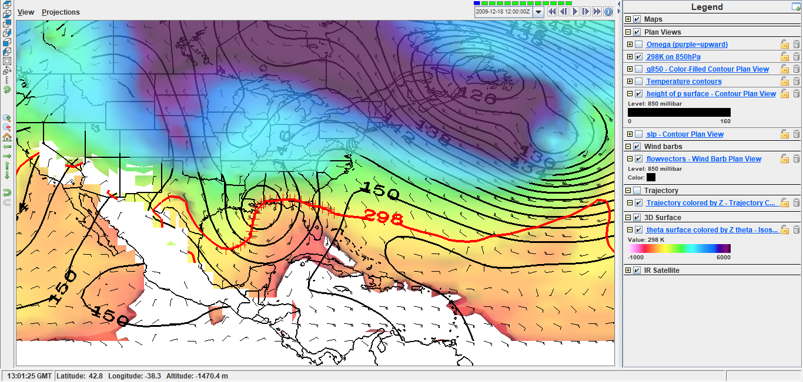
Exercise a) Do areas of ascent match expectations? Explain.
Greater gradient of ϴ surfaces.
Adiabatic motion is happening at the circled locations.

Slide 3
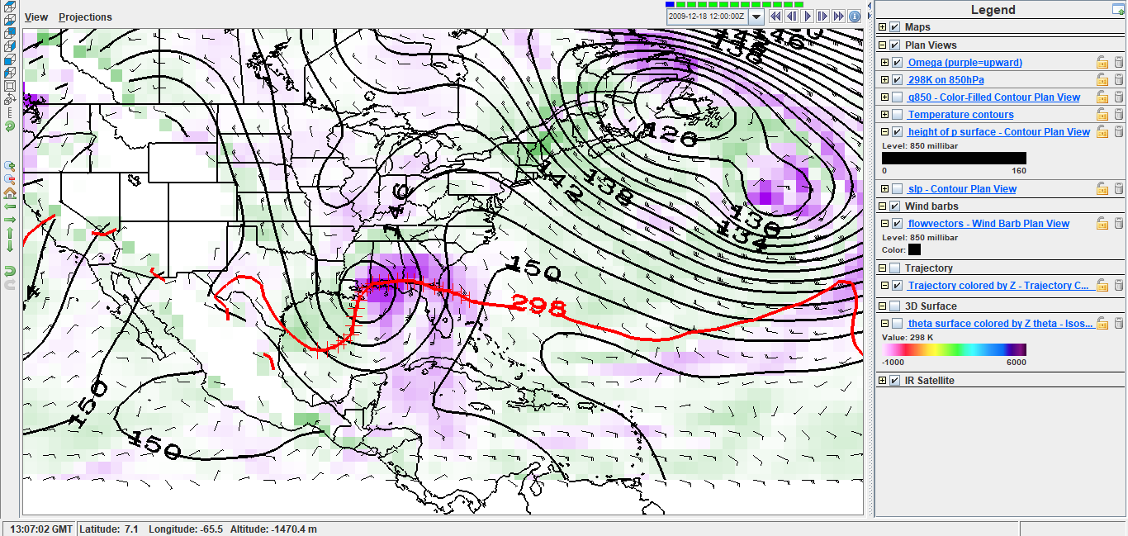
where do you expect upward motion, adiabatically?
Upward motion = circled locations.
Match on the left one.
Northern Florida has an upward motion as well.

Slide 4
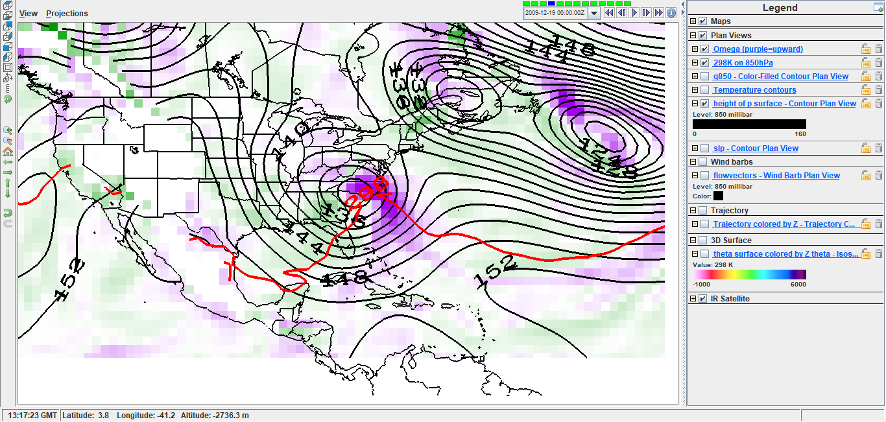
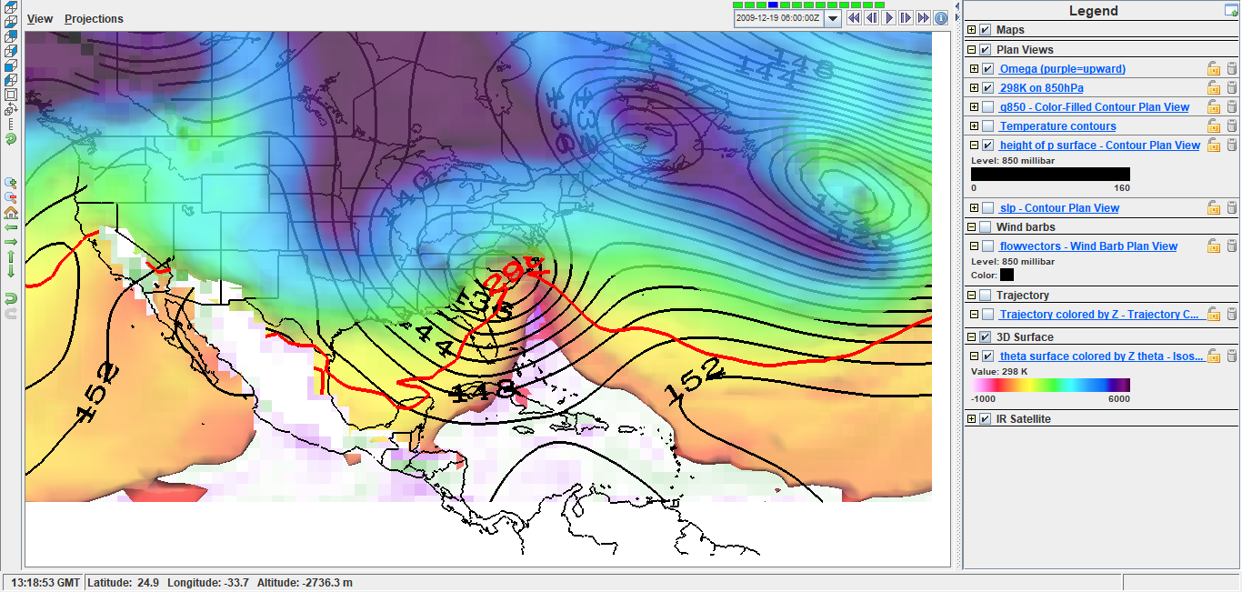
Exercise b) How well does 850-hPa omega along the thick red 850-hPa–298-K intersection line agree with the isentropic reasoning?
Part of the upward motion agrees with the 298 K isoline
The gradient of ϴ with height is more visible in the east of northern FL.
12/19/2019 0600

Slide 5
Are there places and times where the omega is opposite in sign to that from isentropic reasoning?
Yes, in the northern FL, right next to an Upward motion, there is a downward motion.
12/19/2019 0600

Slide 6
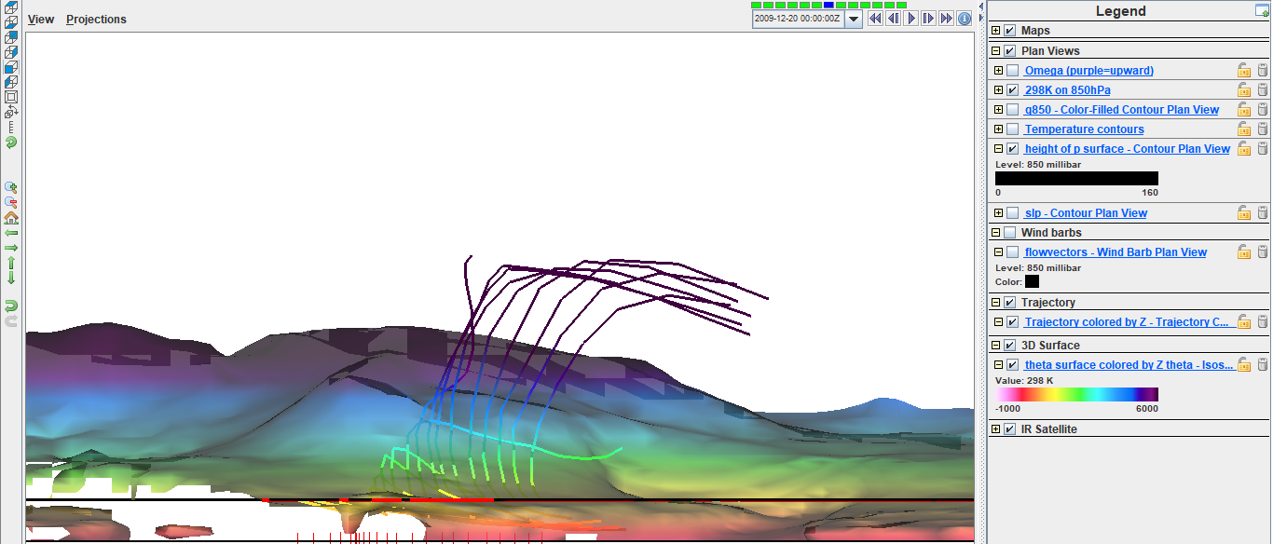
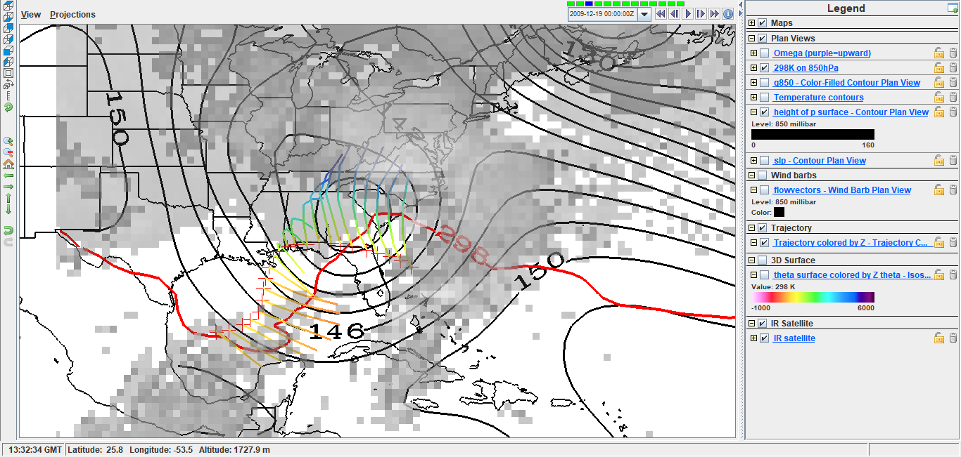
Exercise c)
The particle were probably advected by the wind resulted from the storm and went upward and eastward.
We can see the moment of the clouds going eastard.

Slide 7
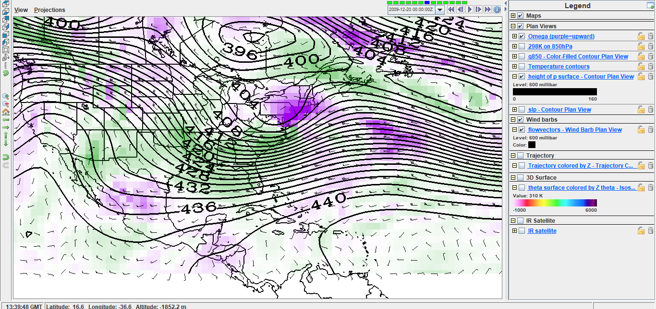
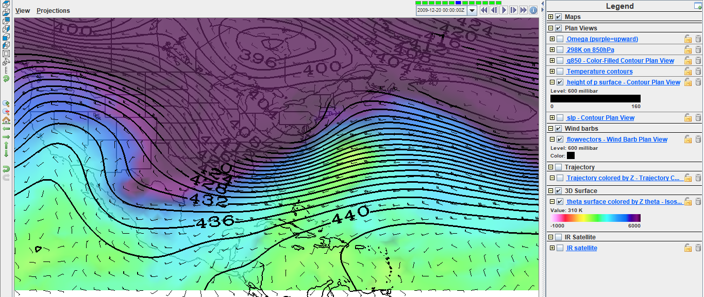
Changing altitude
Main upward movement regions are shown by red circles.
The isontropic surfaces still agrees in part with the areas of upward flow, however some other factor are influencing the vertical wind pattern. Shuch as advection . IR image shows intense clouds matching upward wind areas.

Slide 8
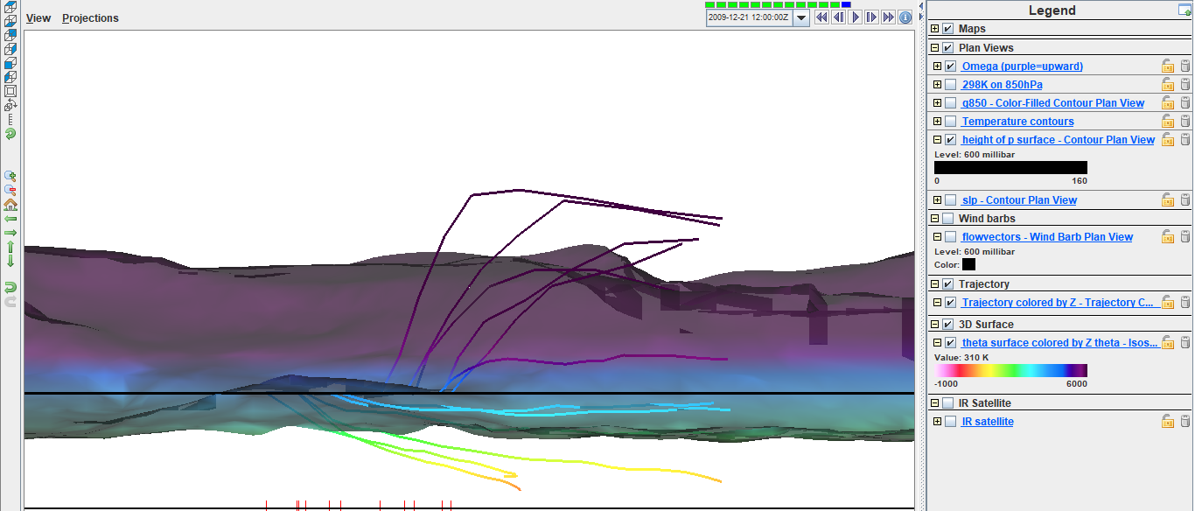
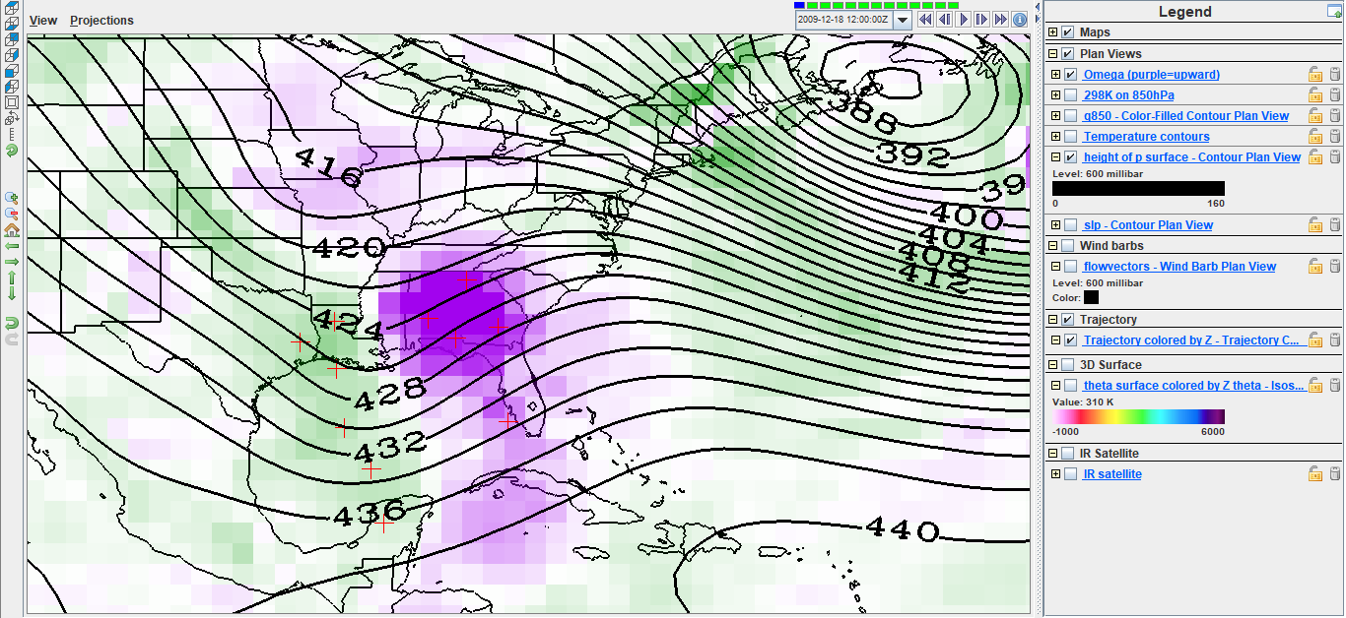
Creating trajectories
Some particle in

Slide 9
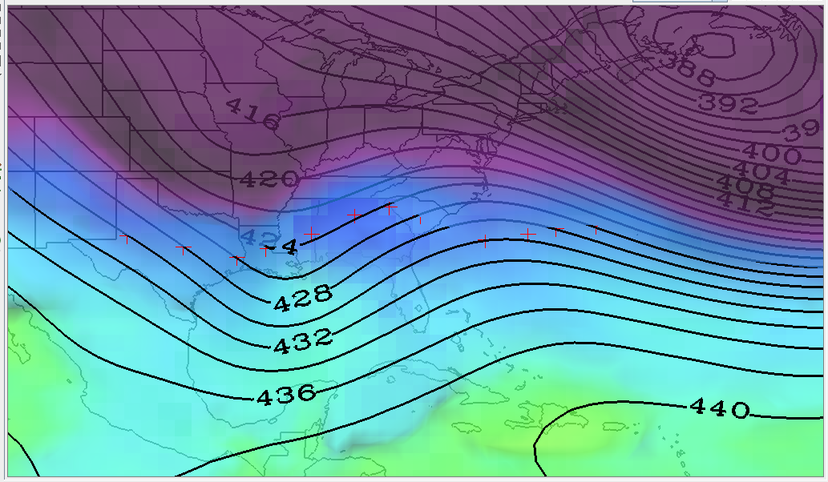
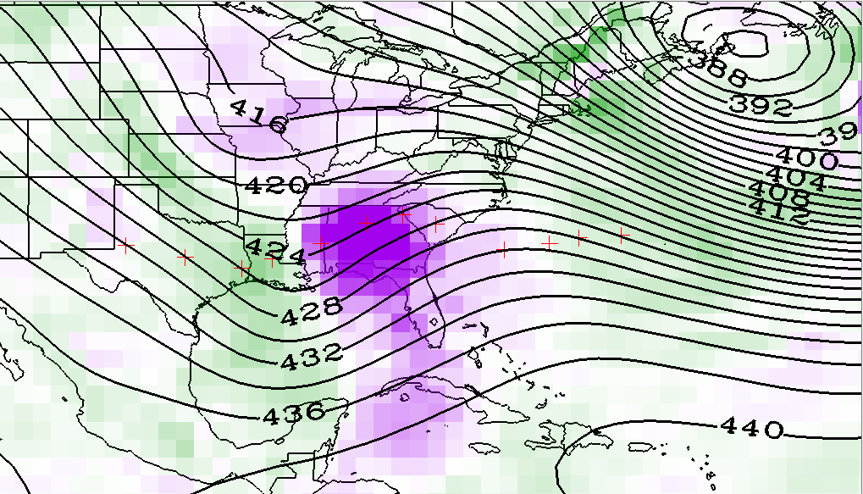
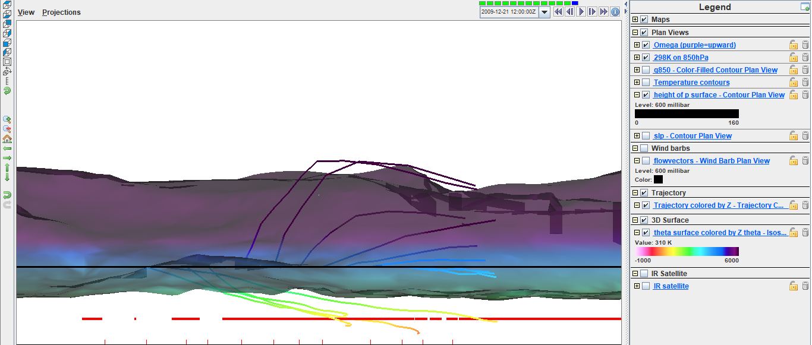
Creating trajectories
Particles followed the up/down wind pattern
Downward wind – particles went down
upward wind – particles went up
Weak vertical wind – particles didnt change height

