Slide 1





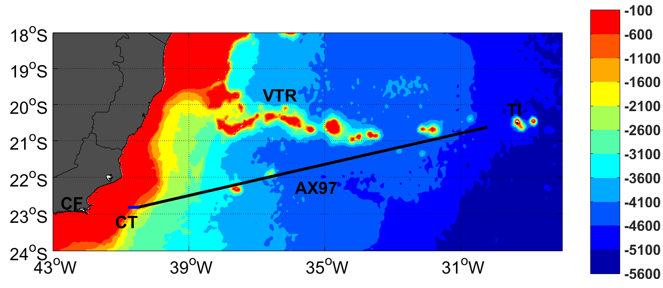
THE IMPORTANCE OF ALTIMETRY DATA ON DECIPHERING BRAZIL CURRENT CORE VELOCITIES AND CORRESPONDING VOLUME TRANSPORT
Pita, I.I.C.^{1,4} ; Cirano, M.¹ ; Mata, M. M.² ; Lima, M.³
¹Postgraduate Program in Meteorology, Federal University of Rio de Janeiro (UFRJ), Brazil; ² Postgraduate Program in Physical, Chemical and Geological Oceanography, Federal University of Rio Grande (FURG), Brazil; ³ I4sea, Brazil; ⁴ ivenis.pita@gmail.com
INTRODUCTION
RESULTS AND DISCUSSION
Brazil Current (BC) is the Western Boundary Current (WBC) linked to the circulation of the South Atlantic subtropical gyre. The BC is considered the main dynamic feature of the South Atlantic ocean. The analysis of WBC dynamics could be challenging for altimetry because the isobath-parallel main flow could deviate towards coastal, and shallower, areas. Coastal areas provide a great source of error for altimetry products. The proximity with land generates problems related with correction of tides, high-frequency atmospheric signal, and wet tropospheric components. Considering these aspects, the main objectives of this research were to compare: i) the surface velocity fields of BC from deeper areas up to the 200 m isobath, and ii) the BC volume transport along the NOAA high-density AX97 XBT transect between Cabo Frio - RJ (42º W, 23º S) and Trindade Island (30º W, 20º S), based on altimetry and temperature data.
Figure 2. Cross-component of the surface velocity for coastal and AX97 transects. a- and b- (c- and d-) are mean surface velocity and respectively variability for total period (cruise period). Solid (dashed) line represents AX97 (coastal transect). Negative values indicate southward flow.
The BC mean surface velocity is -0.18 ± 0.26, -0.21 ± 0.12 and -0.15 ± 0.17 m s⁻¹ for the MOVAR, ATOBA and AVISO data, respectively. In 51% of the 43 cruises, the BC surface core was observed at coastal areas (onshore of the AX97 domain) for at least one of altimetry products (Table 1). The analysis of the BC flow indicates that along the AX97 transect, the mean volume transport is -2.66 ± 3.52 Sv for the MOVAR data, -6.28 ± 9.54 Sv for the AVISO data, and -5.16 ± 7.64 Sv for the ATOBA data. The values obtained by coupling altimetry and MOVAR datasets are supported by a series of previous studies that estimated a mean transport between 2.3 and 5.5 Sv (Signorini, 1978; Lima et al., 1996; da Silveira et al, 2008; Mata et al, 2012; Pereira et al, 2014; Lima et al, 2016).
Figure 1. Study site. Colorbar represents local bathymetry in meters. Cabo Frio, Trindade Island and Vitória-Trindade Ridge are indicated by CB, TI and VTR, respectively. The black line represents AX97 reference transect and the blue line is the coastal transect (CT).
Table 1. The position of the BC core and its frequency of occurrence based on the cruise period analysis. Total period analysis is shown in parentheses. "AX97" column represents events where both altimetry data diagnosed the BC core along AX97 transect. "Coastal" column counts the cruises periods where BC's core was observed at the coastal transect by both altimetry data. The last column indicates the events where only one of the altimetry data captured the BC core along AX97 transect.
METHODOLOGY
 | AX97 | COASTAL | AX97/COASTAL
CRUISES (weeks) | 21 (314) | 11 (101) | 11 (106)
FREQUENCY (%) | 49 (60) | 25.5 (20) | 25.5 (20)
XBT temperature data were acquired by MOVAR (MOnitoring the upper ocean transport VARiability in the western South Atlantic) project during 43 oceanographic cruises between 2004 and 2013. XBT sampling was performed with a horizontal resolution of approximately 27 km, reduced to 18 km at both endings of the AX97 transect (Figure 1). A coastal transect was created between the 200 m isobath and the western limit of the AX97 transect.
Altimetry data consisted of two databases: Archiving, Validation, and Interpretation of Satellite Oceanographic (AVISO) provided by “Segment Sol multimissions d’ALTimétrie, d’Orbitographie et de localisation précise” / Developing Use of Altimetry for Climate Studies (SSALTO/DUACS); and Altimetry Tailored and Optimized for Brazilian Applications (ATOBA). The AVISO dataset used consists of daily outputs with a spatial resolution of 1/4º, while ATOBA data have a higher spatial resolution (1/12º) and weekly outputs. This study analyzed data from Jan/2004 to Dec/2013.
MOVAR geostrophic velocity values were calculated based on temperature data using the σ_{θ} = 26.8 kg/m³ as the isopycnal reference level. This isopycnal reference of σ_{θ} = 26.8 kg/m³ is commonly accepted as the transition level between the South Atlantic Central Water and the Antarctic Intermediate Water (Biló et al, 2014; Pereira et al., 2014). The altimetry surface geostrophic velocities were obtained based on maps of absolute dynamic topography. A coupling between altimetry and in situ data was carried out by using the surface geostrophic velocities provided by AVISO and ATOBA, and using the thermal wind equation to obtain the subsurface velocity fields. The volume transport was inferred by the vertical integration of the velocity fields, from the surface to the σ_{θ} = 26.8 km/m³ isopycnal depth, for the AX97 transect.
Figure 3. Cumulative graphic of integrated volume transport (from the surface up to isopycnal reference of ) of resultant volume (Sv) flowing across AX97 transect during Cruise Period. MOVAR, AVISO and ATOBA are represented (a-, b- and c-, respectively). Vertical lines represent the standard deviation for each point where the velocity was estimated. Negative values indicate a southward transport.
CONCLUSION
The use of altimetry data near the coast was crucial for a better understanding of the BC core horizontal variability, and the extension of AX97 transect is an aspect that must be considered in order to achieve a better in situ temperature sampling. Coupling between altimetry and MOVAR data obtained a positive outcome.
KEY REFERENCES
Lima, M.O., Cirano, M., Mata, M.M., Goes, M., Goni, G., Baringer, M., 2016. An assessment of the Brazil Current baroclinic structure and variability near 22° S in Distinct Ocean Forecasting and Analysis Systems. Ocean Dyn. 66, 893–916.
Mata, M.M., Cirano, M., van Caspel, M.R., Fonteles, C.S., Goñi, G., Beringer, M., 2012. Observations of the Brazil Current baroclinic transport near 22°S: variability from the AX97 XBT transect. Clivar Exch. 17, 5–10.
Pereira, J., Gabioux, M., Marta-almeida, M., Cirano, M., Paiva, A.M., Aguiar, A.L., 2014. The bifurcation of the Western Boundary Current System of the South Atrantic Ocean. Rev. Bras. Geofísica 32, 241–257.
Notes:
PRELIMINARY FEASIBILITY STUDY FOR THE IMPLEMENTATION OF AN ARTIFICIAL SURF REEF IN ALBANY, WESTERN AUSTRALIA

