Slide 1
THE IMPORTANCE OF ALTIMETRY DATA ON DECIPHERING BRAZIL CURRENT CORE VELOCITIES AND CORRESPONDING VOLUME TRANSPORT
Ivenis Pita¹ , Mauro Cirano¹ , Maurício Mata² and Mateus Lima³
¹⁻Postgraduate Program in Meteorology - UFRJ; ²⁻Postgraduate Program in Physical, Chemical and Geological Oceanography - FURG; ³⁻i4sea
Notes:
Hi, my name is Ivenis Pita and I am going to introduce my project related to the importance of altimetry data on Brazil Current dynamical analysis regarding core velocities and volume transport.

Slide 2






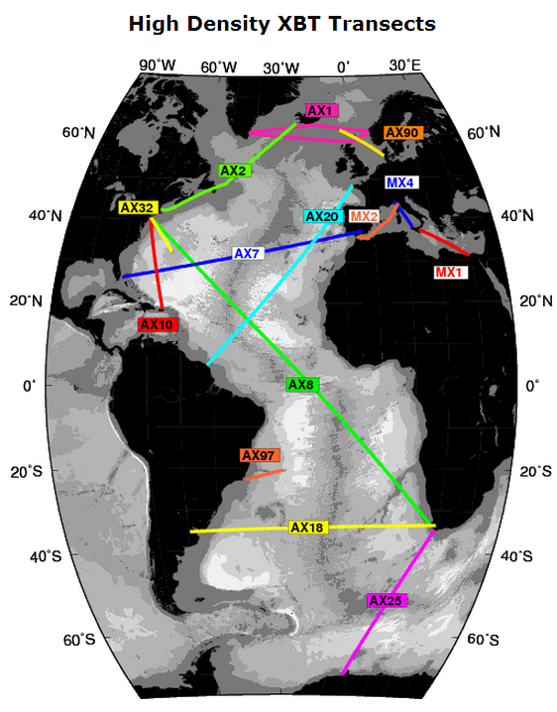
Key Points
MOVAR (AX97)
Brazil Current
↑ Variability
Altimetry datasets
AVISO
ATOBA
Source: NOAA/AOML
Notes:
The starting point of this work was based on MOVAR PROJECT, which is supported by NOAA XBT NETWORK.
MOVAR Project is responsible for the AX97 transect and measures the upper ocean temperature between Rio de Janeiro and Trindade Island since 2004 and is placed across the Brazil Current. Due to its elevated variability, sometimes the Brazil Current have not been fully captured by MOVAR Project.
Therefore, we opted to use two altimetry datasets in order to improve MOVAR analysis. Aviso, which is a well known altimetry dataset with 1/4th of horizontal resolution and daily outputs, and ATOBA, which was developed specially for the western portion of the South Atlantic Ocean and presents a horizontal resolution of 1/12th of degree and weekly outputs.

Slide 3
 | AX97 | COASTAL | AX97/COASTAL
CRUISES | 21 | 11 | 11
FREQUENCY (%) | 49 | 25.5 | 25.5
MOVAR AVISO ATOBA
-2.66 ± 3.52 Sv -6.26 ± 9.54 Sv -5.16 ± 7.64 Sv
Notes:
Based on that, here we have the mean surface velocity and standard deviation for the period between 2004 and 2013. And its important to mention the coastal transect (in a dashed line) created between 40 and 41 degrees west and the different patterns observed by altimetry data and MOVAR.
In addition, in 51% of the time, the core of Brazil Current was observed outside the MOVAR sampling area for at least one altimetry dataset.
Finally, the mean volume transport was calculated based on a coupling between the vertical structure observed by MOVAR and surface velocities from altimetry data. All values observed are according to previous studies.

Slide 4

THANKS!

