Slide 1
KM / BP Authority
Submission Tracker
Progress update — working prototype
One live record of every authority submission, from design approval to AP — replacing the per-project spreadsheet, the email thread and the manual status chase.
1
2
3
4
5
6
7
8
9
10
11
11 steps · 24 authorities · every business unit
Notes:
Progress update only — no decision needed today. The tracker is a working prototype covering the full KM/BP submission journey.

Slide 2
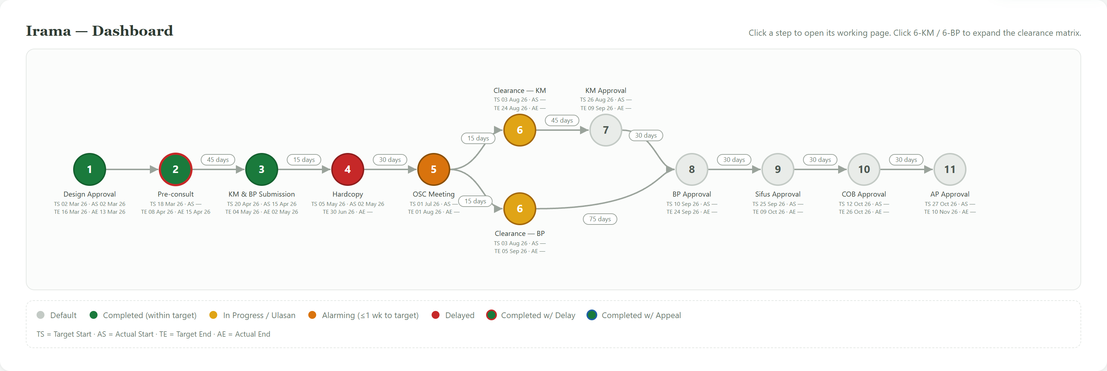
1
One live picture of every submission
Status is a by-product of doing the work — nobody maintains it
BEFORE
103
A colour-coded Excel per project, updated by hand. Delay surfaces when someone reads the sheet — or when the authority calls.
days to the project target date, counted down automatically
NOW
Every step colours itself from its own dates: on track, due within a week, overdue, completed late. KM and BP clearance run in parallel and both stay visible.
Notes:
Irama, mid-flight. Steps 1-3 closed, step 4 overdue in red, step 5 due within the week in orange, clearance running in yellow, later steps grey. Step 2 carries a red ring: completed, but after its target date.

Slide 3
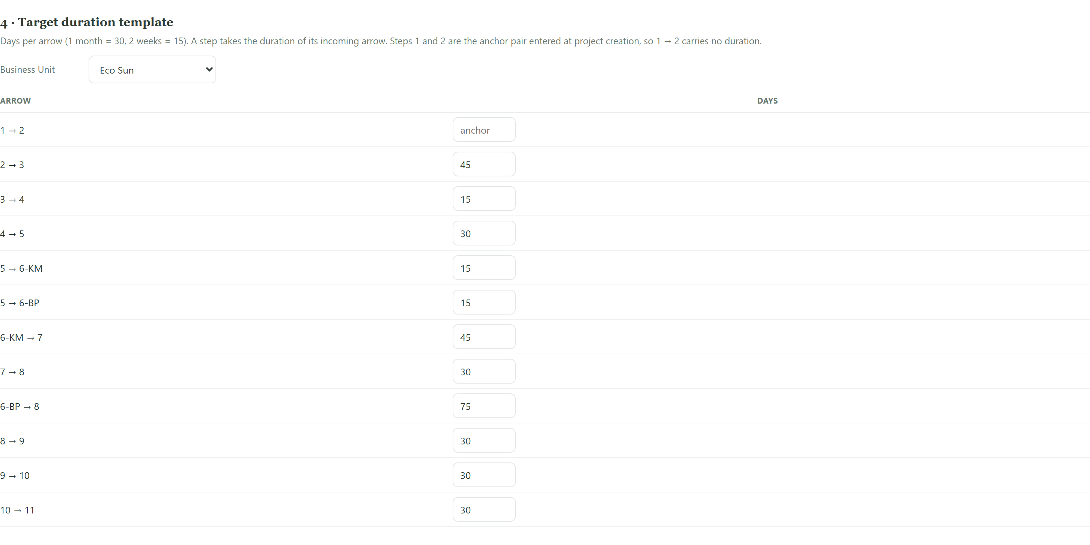
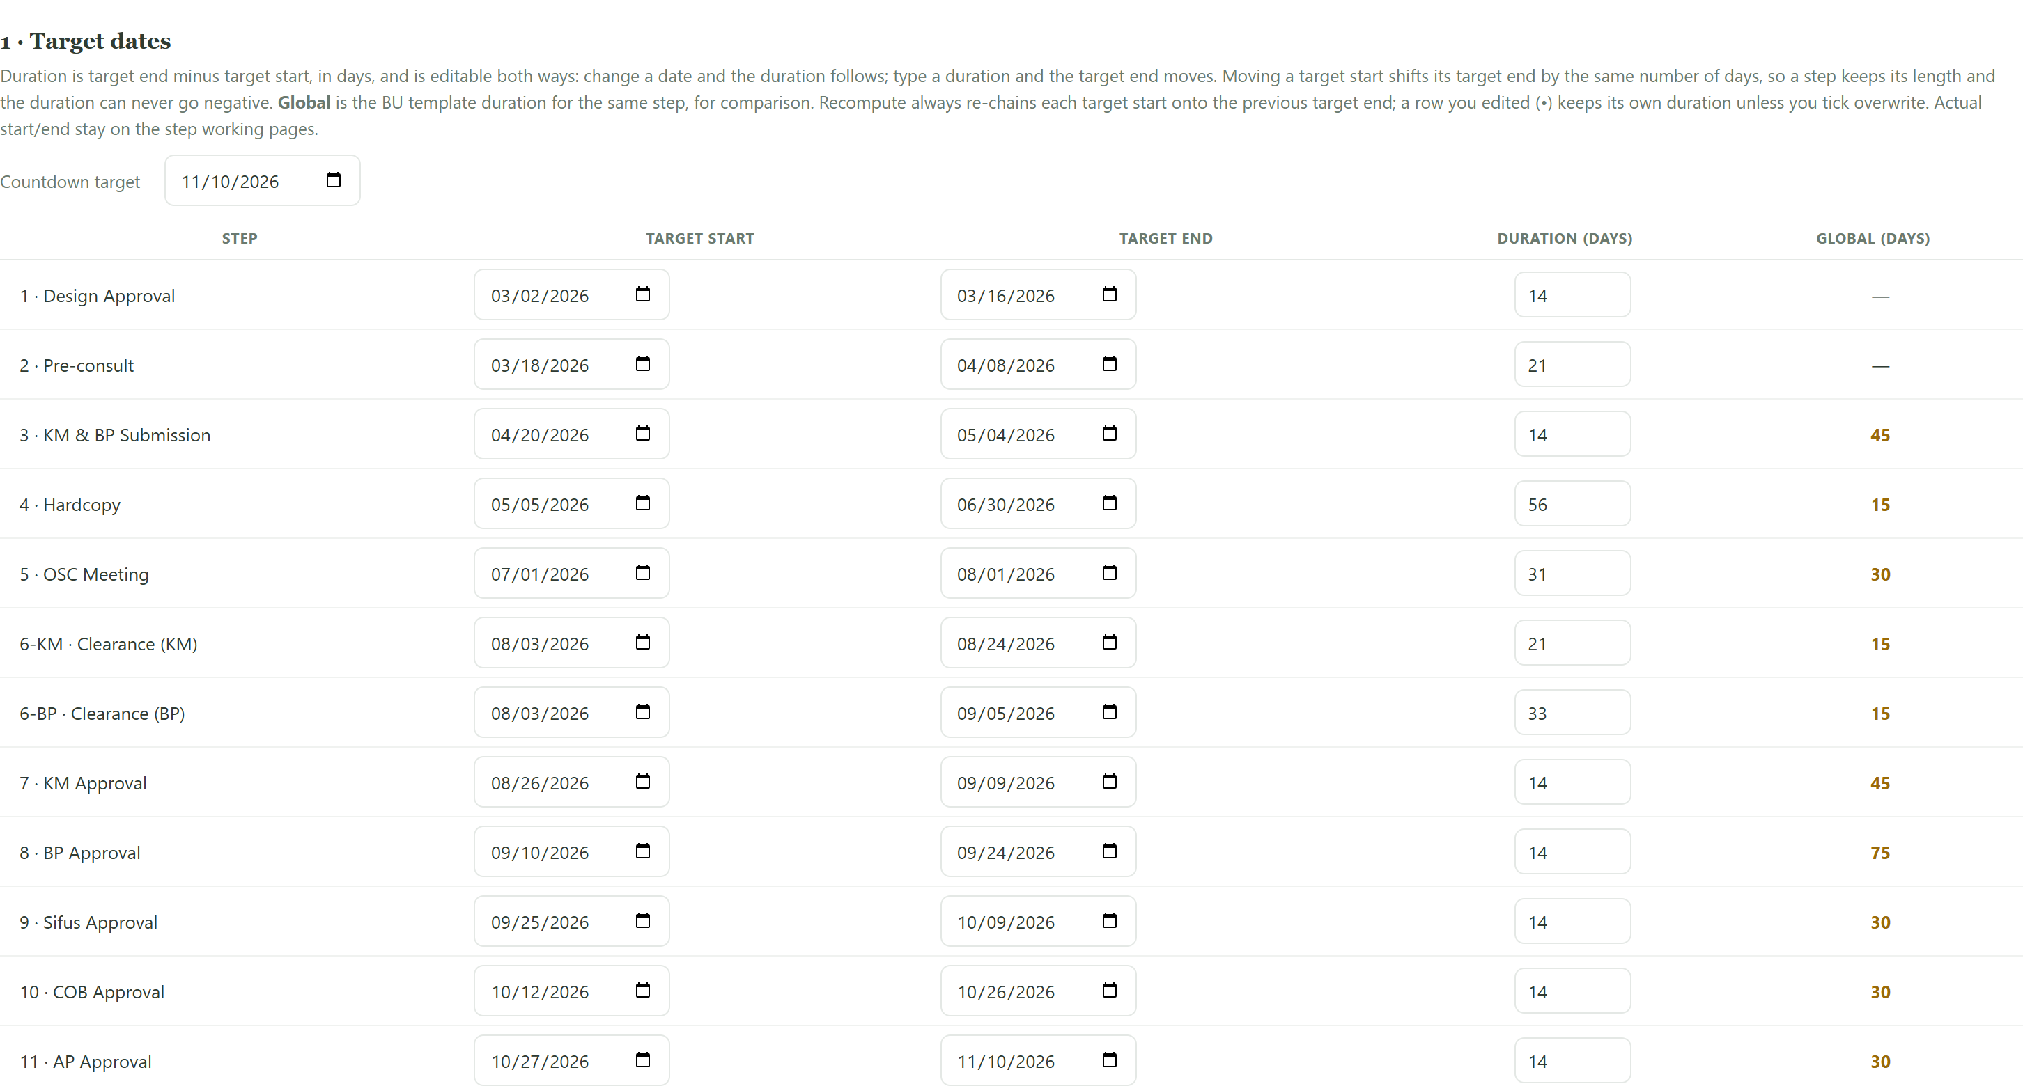
2
The programme builds itself — and re-plans when things slip
Standard durations per business unit, applied to every new project
Set the standard once…
…and every project inherits it, with variances flagged
BEFORE
BEFORE
Each PM works out 11 step dates by hand. Two PMs produce two different programmes, and a slip means re-typing every date downstream.
No way to see whether a project is planned to the agreed standard.
NOW
NOW
Each step shows its own duration beside the business-unit standard, and flags where the project differs.
Enter two start dates and steps 3-11 compute themselves. When a date moves, Recompute re-chains the rest and keeps the dates you set by hand.
Notes:
Durations are held per business unit in days. A new project needs only its first two target dates; the rest of the programme is computed.

Slide 4
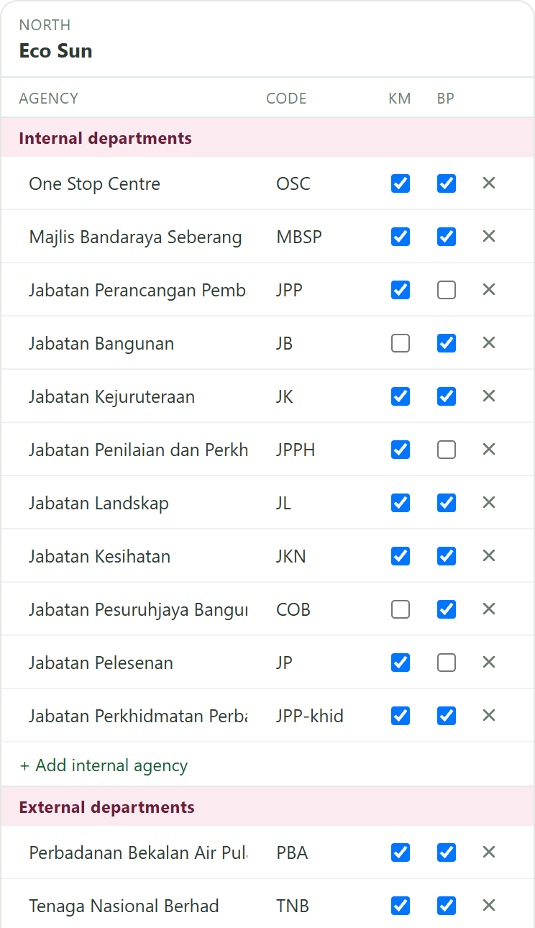
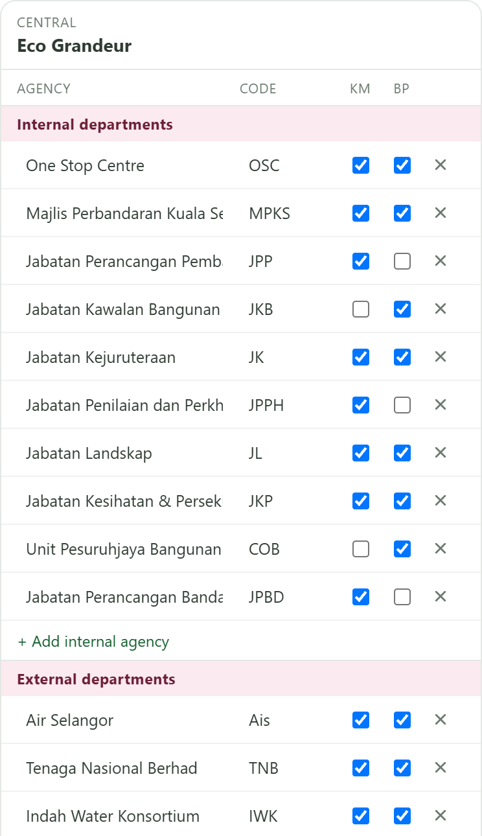
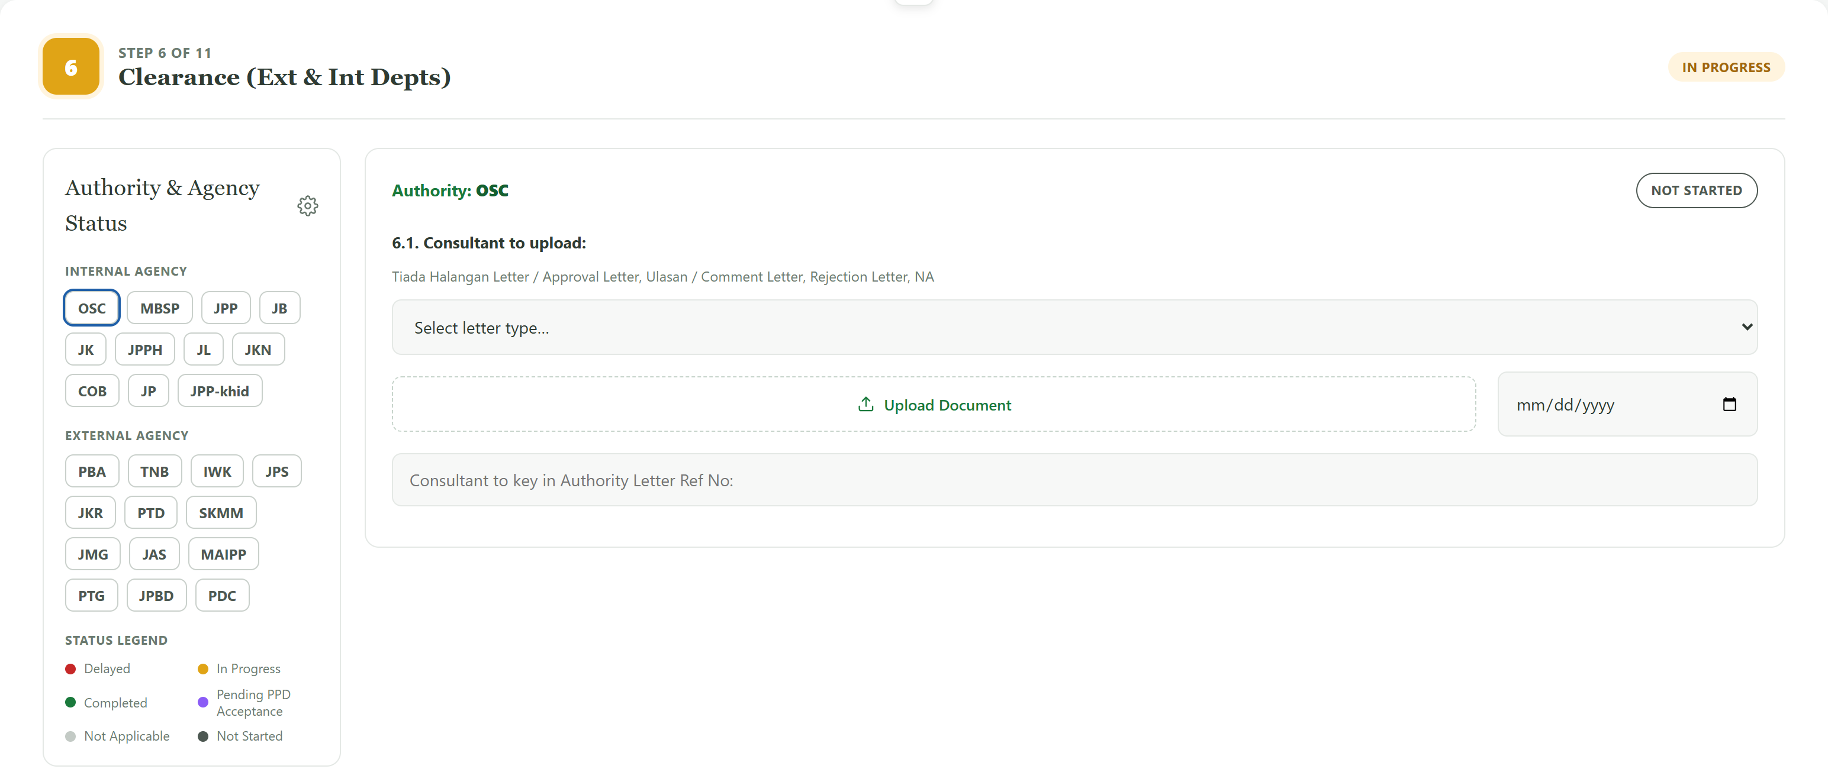
3
Every authority, every state — and the hardest step handled
Configured once per business unit, then inherited by its projects
BEFORE
Each business unit keeps its own agency list in its own format, and clearance runs in 24 separate email threads. Appeals, conditions and resubmission rounds live in a notebook.
NOW
The same role is a different authority in each state — MBSP in Penang, MPKS in Selangor — each marked as affecting KM, BP or both. Clearance tracks letters, appeals, CDO approval and every resubmission round, per agency.
Penang · Eco Sun
Selangor · Eco Grandeur
Notes:
Left: the agency list for two business units, showing the same roles mapping to different local authorities. Right: the step 6 clearance workroom, 24 agencies on one board.

Slide 5
What this changes
Same 11 steps, same rules, every project and every business unit
1
Status maintains itself
Colour comes from the dates and the work done, not from someone updating a sheet before a meeting.
2
Actual dates are captured once
The submission date entered on the working page is the actual date — no re-keying into a separate tracker.
3
Parallel KM and BP are modelled
Both clearance paths are tracked separately and must land before BP approval — a single Gantt row cannot show this.
4
Adding a project is a form
Two dates in, a full 11-step programme out, using that business unit's agreed durations and authority list.
Notes:
Close on the shift: the tracker turns status reporting from a separate chore into a by-product of the work itself.

