Slide 1

Defactify
SEMESTER 4
Ivet Kalcheva

Slide 2
TABLE OF CONTENTS
01
02
03
04
INTRODUCTION
TIMELINE
PRODUCT DEMO
QUESTIONS AND ANSWERS

Slide 3
INTRODUCTION
BREAKING NEWS
This project’s aim is to detect fake and real news by analyzing their textual features in news articles. The goal is to contribute to combating misinformation and to return the trust in journalism.

Slide 4
TIMELINE
Data Collection
Data Analysis
Model Training
Initially used an older dataset (couldn’t guarantee its authenticity);
Scraped recent news data independently (could ensure authenticity, a limited scope of resources).
Included features such as the journalist (when available) and category, which inadvertently introduced some bias;
Finally, focused primarily on the title and content of the news article for analysis.
Experimented with multiple models and evaluated their performance;
Achieved the best results using a Stacking Classifier with an SVM as the meta-model (94.15%).

Slide 5
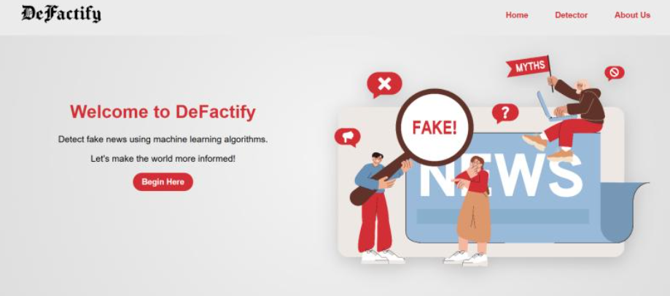
PRODUCT DEMO
BREAKING NEWS

Slide 6

QUESTIONS AND ANSWERS??
BREAKING NEWS
Time for the important part!!

Slide 7
THANK YOU FOR YOUR ATTENTION!
Please keep this slide for attribution

