Slide 1

BUILT YOUR OWN SHELL
By: Ivan Chamero de la Rosa

Slide 2
Introduction
This has been the first project that we do of the subject and also the first project that we have to do individually. The objective of the project is to make, using C code, a shell similar to the one we already have implemented in Ubuntu.

Slide 3
Analyzing the code: main function
The first thing I do is read the current directory using the getcw() function, in which I determine the char[] where it will be saved and the length of the char. After that, I simply printed the directory.
Next, I read the input from the shell with fgets(), I use this function and not another, because I can determine the maximum number of characters that can be read and that is determined by the statement. In this function I determine the char[] where I will save the input, the maximum input I can have and finally from where I read, in this case, from the stdin. The function returns the char*[] where it has saved the input as a target.
After reading, I separate the input by spaces (function separate()), and then I see if the function is builtin, in that case I call the function builtIn() or if it is not, then I call notBuiltIn().
Note that the first thing I do when I enter the loop is clean the structure in which I save the input, so that there are no previous inputs.
The variables addr, bc and should_run are global, this is because there are functions that modify them directly, and otherwise they could not or would have to pass them as parameters and then return them in the return.

Slide 4
Analyzing the code: separate function
In this function what I do is separate the input that I get through spaces, and save each element of the input separately in the inp_s structure.
In the function I create a two-dimensional matrix that is stored by columns each element of the input.
The structure has two parameters, one that keeps the number of inputs that enter me, and the second that is a char*[] that points to each of the elements separately. I have decided to make a global structure, because in this way I always have the input stored in a place that all functions can access without having to pass the structure as a parameter.
It is this same function where I see if the program has an "&", in this case, I set the global variable bc to 1, which will serve me further to do other things.

Slide 5
Analyzing the code: builtIn function
This is the function that the program accesses in case the input is a built-in function.
What I do in this function is, first of all I look at what command it is, for this I use strcmp(), as it is the best way to directly compare strings.
After verifying what command it is, I do what is necessary so that each function works as requested.

Slide 6
Analyzing the code: notBuiltIn function
I will access this function in case the command we enter is not recognized as a built-in command.
To do this function, I use the base that we have used so many times in theory classes to talk about the parent and child processes and that we have also used in some practice. But in this case, I use execvp() instead of execlp() to create the child process.
I have made this change because execvp() allows me to pass an array of char*[] and because it looks for the path of the command directly and makes things easier because of how I handle the inputs.
The last difference is when managing the parent process, here I use the global variable bc to know if I have the process in the background or not. If the process has to run in the background, I simply change the third parameter of the waitpid() to a WNOHANG and this way the process will run in the background and I can continue using the shell.

Slide 7
Analyzing the code: auxiliary functions
For shell programming, I make use of helper functions.
The first one in isBuiltIn(), in which I check if the command that they enter is in the built-in command list, in that case I return true or if it is not in the list, it returns false.
The second auxiliary function is to cleanStruct(), which is used to clean up the structure after each input so that nothing residual remains. In the function I simply set the num_args to 0 and loop through the *arg[] putting '\ 0' in each position.

Slide 8
Deploy the shell to a new user
The last thing we have to do is assign the new shell to the new user, which was already created in one of the labs.
To do this, the first thing we have to do is copy the executable of our shell in the / bin directory. When I already have it in the directory what I do is add the name of my shell as a viable shell in the /etc/shells, for this I do: command -v ish | sudo tee -a /etc/shells. To check that it is already added I do: cat /etc/shells and I see how now /bin/ish is inside the file.
Finally to assign it to the new user, what I do is: sudo chsh -s /bin/ish newuser.

Slide 9
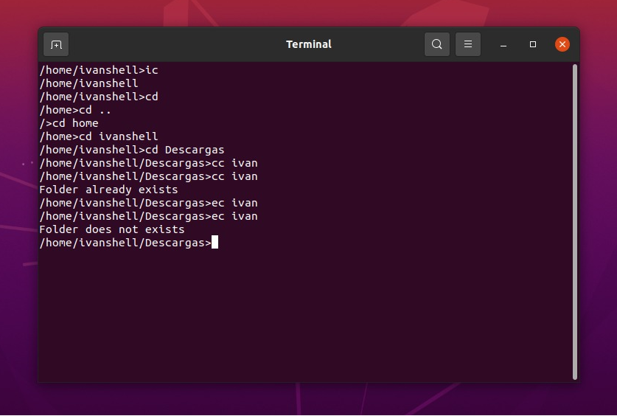
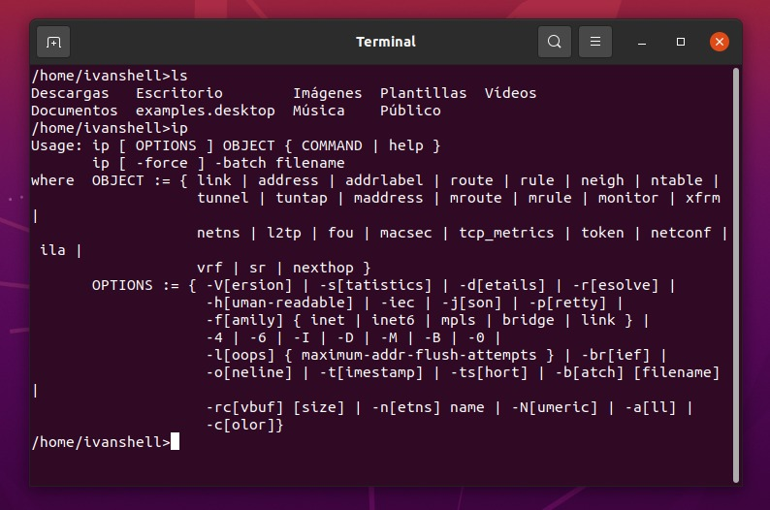
How the shell Works (1)

Slide 10
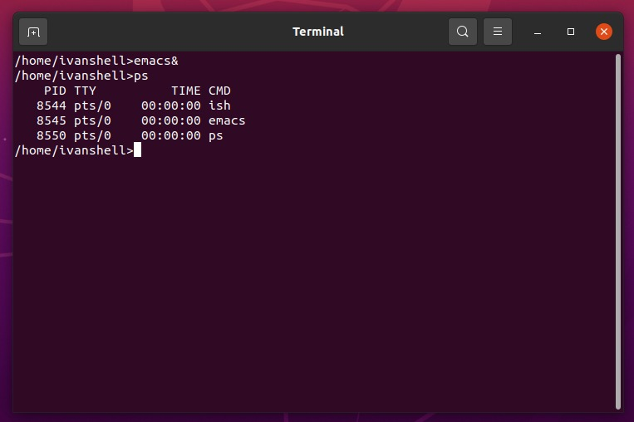
How the shell Works (2)
In these three images you can clearly see all the functions that I am being asked to implement.
In the first one you can see how the built-in commands work, in the second how the not built-in commands also work and finally in the last one you can see how emacs is executed in the background.

Slide 11
Conclusions
This has been my first solo project and the truth is that in general it has been a very good experience.
I have had a lot of problems especially when it comes to being able to read the input from the shell and when separating the input.
I have had to learn many things about the C language that I did not know, and I have also learned many new things about C that I did not know. I have had to ask in forums about certain things that I did not understand and I have even looked for shells made by other people to be able to guide me when considering how to program the shell. All this has made it possible for me to make a shell with the characteristics that were asked of me.
It has also come in handy to be able to review many of the concepts that we deal with in theory and in the laboratories but that we could not make real use of.
Truly, this has been a very good project to illustrate everything we do in the subject and that also collects things from other subjects such as having to program in C.

