Slide 1
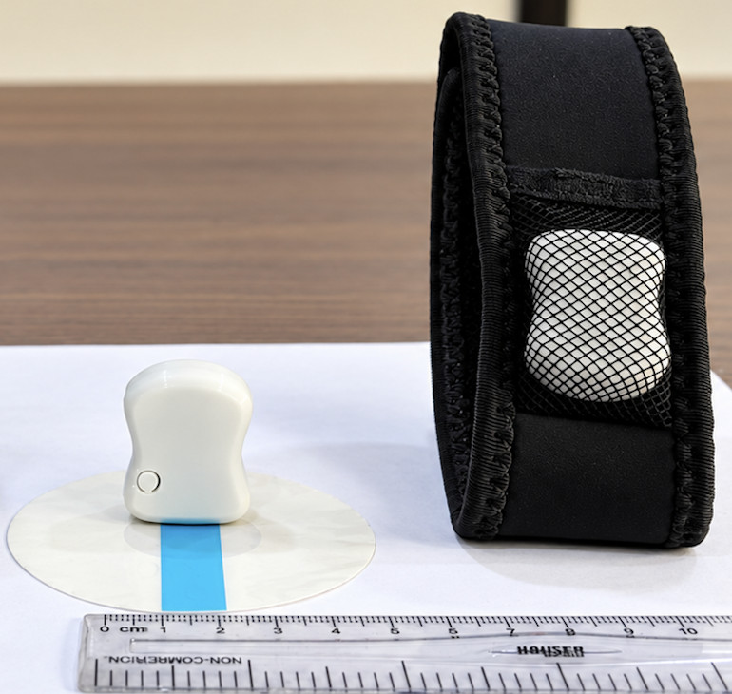
Medical Device Ethics Workshop
Bridging the Gap:
From Innovation
to Patients
Ethics, Evidence, Regulation and
Responsible Medical Device Translation
Dr Vikas Kumar Jha
KIIT University, Bhubaneswar
01
Notes:
SLIDE 1: Bridging the Gap: From Innovation to Patients
TIME: 1 minute
ACTIVITY: Opening and disclosure
Open with: "Imagine that the prototype on your desk is about to become a device in someone's home. What would you need to know before recommending it?"
Explain that this session uses FoGO and SwaKnee from our development work. I have professional interests in these examples, and I invite the audience to examine their evidence and limitations critically. Explain any relevant financial interests orally. Technical achievement is worth showing, while patient readiness remains a separate question.
The learning outcome is practical: participants should leave able to identify the intended use, judge what evidence supports a claim, recognise burdens and conflicts, and assign responsibility for unresolved risks.
The five-question framework is a workshop synthesis. It is not an official regulatory checklist or certification.
Transition: "Let's make a decision before we look at the details."
SOURCES
https://ethics.ncdirindia.org/asset/pdf/ICMR_National_Ethical_Guidelines.pdf
https://biodesignguide.stanford.edu/wp-content/uploads/2022/08/Principled-Decision-Making-v1.pdf
FoGO_BIRAC_BIG_Final_v2_with_script(1).pptx, supplied project material, retrieved 7 October 2026
Reference check: 7 October 2026.

Slide 2
Would you let a patient use it?
Working prototype.
Promising lab results.
Test licence.
1 Research study
2 Routine care
3 More information
What do you still need to know?
Hypothetical teaching case. Vote before discussing.
02
Notes:
SLIDE 2: Would you let a patient use it?
TIME: 2 minutes
ACTIVITY: Opening vote
This is a hypothetical teaching case, not a claim about the approval status or clinical performance of either project.
Read the three facts on screen. Ask for a show of hands: suitable for a research study, suitable for routine care, or more information needed? Do not supply an answer immediately. Ask one participant from each group what changed their decision.
Debrief: readiness depends on the proposed use. The information is insufficient even to authorise a patient study without knowing the protocol, risks, safeguards and required permissions. Routine care needs evidence and legal status appropriate to the intended use. A test licence alone does not settle either question.
Record two missing items verbally and promise to revisit the vote. Avoid suggesting that technical performance, a licence or a compelling demonstration is a complete patient-readiness assessment.
SOURCES
https://cdsco.gov.in/opencms/resources/UploadCDSCOWeb/2022/m_device/Medical%20Devices%20Rules%2C%202017.pdf
Reference check: 7 October 2026.

Slide 3
The patient’s five questions
01
Will it help me?
02
How could it harm me?
03
Can I freely choose?
04
Can I actually use it?
05
Who stays responsible?
A workshop framework, adapted from research-ethics principles.
03
Notes:
SLIDE 3: The patient’s five questions
TIME: 2 minutes
ACTIVITY: Patient perspective
Ask participants to view the development programme through the person who may use the device.
Will it help me? Define the unmet need and the benefit that matters to that patient. How could it harm me? Consider direct injury, misleading reassurance, missed care and burden. Can I freely choose? Explain uncertainty and alternatives in a form the person can understand. Can I actually use it? Consider fitting, cost, literacy, access, support and disability. Who stays responsible? Name the people and organisations that will respond to complaints, updates and harms.
These questions adapt research-ethics ideas for a development workshop. ICMR's principles govern research involving human participants. Applying them to broader design choices here is an educational interpretation, not a new regulatory requirement.
Return to these questions when reviewing both project cases. Ask which question the audience sees least often in device proposals.
SOURCES
https://ethics.ncdirindia.org/asset/pdf/ICMR_National_Ethical_Guidelines.pdf
https://biodesignguide.stanford.edu/wp-content/uploads/2022/08/Principled-Decision-Making-v1.pdf
Reference check: 7 October 2026.

Slide 4
The claim defines the promise
“Shows walking patterns”
“Detects freezing of gait
in Parkinson’s disease”
For whom?
Does what?
Where?
What action?
Hypothetical claims. Classification needs the full intended use and risks.
04
Notes:
SLIDE 4: The claim defines the promise
TIME: 3 minutes
ACTIVITY: Intended-use exercise
The two statements are deliberately incomplete hypothetical claims. Invite the room to identify the words that change the purpose: detecting a disease-associated event in a defined population carries a different promise from displaying activity patterns.
Ask four questions: for whom, what does the device do, in which setting, and what clinical decision or action follows? A credible intended-use statement needs these boundaries.
CDSCO's July 2026 software guidance emphasises intended medical purpose. General-wellness wording cannot be used to bypass obligations when the actual intended use is medical. Classification also depends on the complete function, claims and risks, not this sentence alone.
Transition to FoGO: "A sensing system has to show that it supports the exact use we promise."
SOURCES
https://cdsco.gov.in/opencms/export/sites/CDSCO_WEB/Pdf-documents/Guidance-document-on-Medical-Device-Software-under-MDR-2017.pdf
Reference check: 7 October 2026.

Slide 5
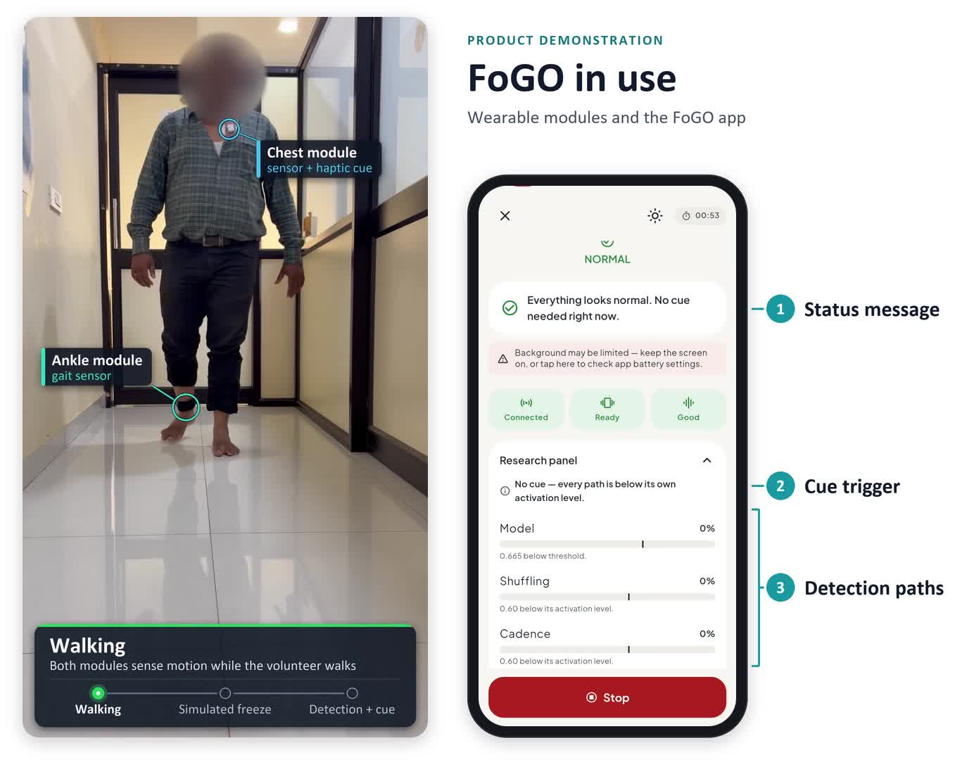
FoGO: what does the prototype show?
Sensing
Detection
Cueing
What did we
actually learn?
12 seconds
Staged demonstration.
Simulated freeze.
05
Notes:
SLIDE 5: FoGO: what does the prototype show?
TIME: 2 minutes
ACTIVITY: Embedded 12-second prototype clip
Introduce FoGO as a development project addressing detection of freezing of gait and responsive vibrotactile cueing in Parkinson's disease. The current project architecture describes ankle motion sensing, detection in the phone app and a chest cue module.
Play the 12.4-second clip from the supplied deck. The source identifies the person as a volunteer and the freeze as simulated. The face is obscured. This is a staged prototype demonstration, not footage proving treatment efficacy or reduced falls. Prototype iterations may have different sensor configurations.
Ask: "What did you see? What did you infer?" Separate visible system behaviour from unproven clinical benefit. A response to a simulated event does not establish detection reliability in people with Parkinson's or improvement in daily life.
Use the video to make the system understandable. Discuss efficacy only with appropriate study evidence.
SOURCES
FoGO_BIRAC_BIG_Final_v2_with_script(1).pptx, supplied project material, retrieved 7 October 2026
Reference check: 7 October 2026.

Slide 6
What have we shown? What remains?
1
Prototype demonstration
Reported technical work
Can the system respond?
2
Public-dataset testing
Reported preliminary work
How does detection perform?
3
Prospective patient evaluation
Planned in the project deck
Does it work for intended users?
4
Benefit in daily life
Requires appropriate evidence
Does it improve a meaningful outcome?
FoGO project-reported status. A planned outcome is not a result.
06
Notes:
SLIDE 6: What have we shown? What remains?
TIME: 2 minutes
ACTIVITY: Evidence progression
The supplied FoGO deck reports a working prototype and preliminary testing on public datasets, including subject-wise and cross-dataset evaluation. It describes prospective clinical proof of concept as future work. Do not describe the planned study or its success targets as completed results.
The diagram shows different questions, rather than a universal mandatory ladder. A prototype answers whether components can work together. Dataset testing assesses performance under specified evaluation conditions. Prospective patient evaluation asks whether the system works in the intended population and setting. Daily-life evaluation asks whether benefit and burden remain acceptable during real use.
Ask which gap would matter most before routine use. Discuss independent participant-level testing, event definitions, false alarms, detection delay, cue tolerability and meaningful outcomes. A favourable average score does not replace those assessments.
Transition: "The important result may be the failure the headline number hides."
SOURCES
FoGO_BIRAC_BIG_Final_v2_with_script(1).pptx, supplied project material, retrieved 7 October 2026
Reference check: 7 October 2026.

Slide 7
When FoGO gets it wrong
Failure | Possible consequence | Control to test
Missed freeze | No expected cue | Detection in relevant situations
False cue | Distraction or discomfort | Cue limits and usable stop control
Connection lost | False reassurance | Clear loss-of-monitoring state
Which would you prioritise, and why?
Proposed review examples. No FoGO failure rates or validated controls implied.
07
Notes:
SLIDE 7: When FoGO gets it wrong
TIME: 3 minutes
ACTIVITY: Failure-priority vote
All consequences and controls on this slide are proposed teaching examples. They are not measured FoGO adverse-event rates and do not imply that the listed controls have been validated in the final product.
Ask the room to prioritise missed freezes, false cues or loss of connection. Explain that priority needs both severity and probability. A missed event could leave the person without an expected cue. An unnecessary cue could distract or irritate. A lost connection could create false reassurance if monitoring failure is not apparent.
Ask what test would demonstrate that a control works. Include bench fault injection, performance during turning and with walking aids, participant feedback and clear loss-of-monitoring states. Consider cue limits and a usable stop control.
Keep the distinction between detection performance and fall prevention clear. Also ask how little personal data the system needs and who can access its event log.
SOURCES
FoGO_BIRAC_BIG_Final_v2_with_script(1).pptx, supplied project material, retrieved 7 October 2026
Reference check: 7 October 2026.

Slide 8
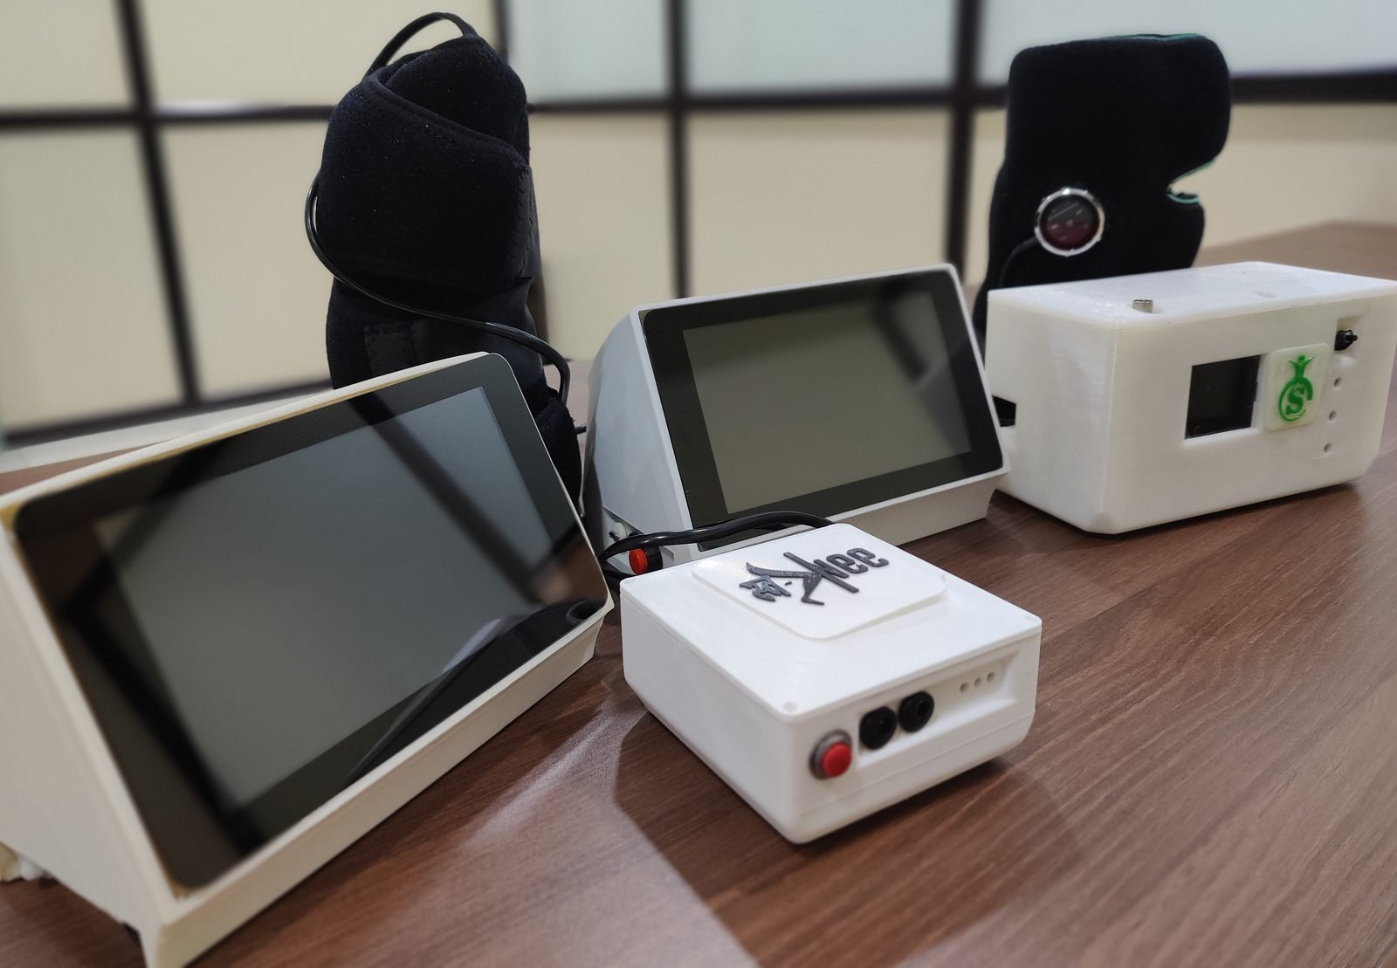
SwaKnee: a device, a routine, a burden
What must
the user
understand
and do?
20-second
product overview
Online explainer
Original product images. No clinical response shown.
08
Notes:
SLIDE 8: SwaKnee: a device, a routine, a burden
TIME: 2 minutes
ACTIVITY: Embedded 20-second product overview
Introduce SwaKnee as a knee applicator and controller applying pulsed electromagnetic fields, with an intended adjunctive role in knee osteoarthritis care.
The embedded clip is an authored overview using original product images. It shows hardware and prompts about use. It is not a recording of a clinical response. The company’s longer online explainer is linked on the slide and in the reference section as optional additional material.
Ask the audience to identify the steps a person must understand: fitting the applicator, connecting and operating the controller, following the appropriate instructions, recognising problems and accessing support. Discussion of fitting or duration here is not an instruction for an individual patient.
The supplied leaflet describes 45-minute daily sessions over 45 days. Use that as an illustration of time burden, not a current prescription or a guarantee of effect. Current instructions and clinician advice must define actual use.
SOURCES
https://www.swayogya.in/product.html
Swa knee_Leaflet.pdf, supplied project material, retrieved 7 October 2026
https://www.youtube.com/watch?v=IfQyVm8Kftc
Reference check: 7 October 2026.

Slide 9
Which claim can the evidence carry?
40 vs 42
participants
45 days
Pain improves.
Does cartilage
regrow?
Company-reported comparative study. Rounded relative changes from baseline.
These results do not establish cartilage regeneration.
09
Notes:
SLIDE 9: Which claim can the evidence carry?
TIME: 3 minutes
ACTIVITY: Claim challenge
The chart reproduces rounded public company-reported average pain changes from a comparative 45-day study: device group n=40, comparison group n=42, about 32% versus 14% reduction in VAS pain from baseline. These are relative average changes, not the percentage of participants who benefited. The slide is not an independently audited efficacy analysis.
The public evidence page does not provide enough information to establish randomisation, blinding, complete outcome handling or precision from this summary. It lists no independently published SwaKnee-specific paper. Ask for the protocol, absolute baseline and follow-up values, between-group estimates with uncertainty, attrition, co-interventions, adverse events and follow-up duration.
Invite a participant to defend a cautious symptom claim and another to challenge "regrows cartilage." Pain improvement cannot establish structural regeneration. A stronger claim needs evidence that directly measures that outcome.
This 82-participant public summary is not merged with other internal reports or studies. Avoid claims of universal relief, permanent benefit or avoided surgery.
SOURCES
https://www.swayogya.in/evidence.html
Reference check: 7 October 2026.

Slide 10
An average can hide a patient
92–96%
Pulse-oximeter
reading
Yet arterial
SaO₂ < 88%
Michigan cohort: 88/749 vs 99/2,778 qualifying paired measurements.
Recorded race. Observational study. Sjoding et al., NEJM 2020.
10
Notes:
SLIDE 10: An average can hide a patient
TIME: 3 minutes
ACTIVITY: Independent published case
Use the University of Michigan cohort in Sjoding and colleagues, NEJM 2020. In qualifying paired measurements with pulse-oximeter SpO2 of 92–96%, arterial SaO2 below 88% occurred in 88/749 measurements for Black patients (11.7%, 95% CI 8.5–16.0) and 99/2778 for White patients (3.6%, 95% CI 2.7–4.7).
The unit is paired measurements, not all patients. The study used recorded race, not direct skin-pigmentation measurement. It was observational and does not establish that every person or every oximeter has this error. It does not justify a simple race-based correction.
Ask: "Which users and conditions could our validation overlook?" For FoGO, consider walking aids, disease severity and real settings. For SwaKnee, consider fit, comorbidities, adherence and access. The lesson is to identify relevant variation and examine subgroup performance rather than rely on one overall number.
SOURCES
https://pmc.ncbi.nlm.nih.gov/articles/PMC7808260/
Reference check: 7 October 2026.

Slide 11
Can a patient comfortably say no?
“My treating doctor
is also the inventor.”
Can refusal change my care?
Care
Research
Filming
Hypothetical vignette. The choices need separate, understandable explanations.
11
Notes:
SLIDE 11: Can a patient comfortably say no?
TIME: 3 minutes
ACTIVITY: Brief role-play
The vignette is fictional and does not describe either project's actual consent procedures.
Ask one participant to be the patient and another the researcher. The treating clinician also has an inventor interest. The patient asks whether refusal will affect care and whether the clip will appear in a public talk. Invite a third participant to propose a safer consent process.
Helsinki 2024 calls for an appropriately qualified person independent of a dependent relationship to seek research consent in that situation. Explain the inventor interest, uncertain benefit, alternatives and withdrawal rights. Research participation must not become a condition of ordinary care.
Separate consent for research from permission to use identifiable images or video for teaching or publicity. A study-consent signature does not automatically authorise every future audience or reuse. Protect identity and limit collection, access and secondary use of data. Check understanding through a brief teach-back question.
SOURCES
https://www.wma.net/policies-post/wma-declaration-of-helsinki/
https://ethics.ncdirindia.org/asset/pdf/ICMR_National_Ethical_Guidelines.pdf
Reference check: 7 October 2026.

Slide 12
Different permissions answer different questions
Purpose | Question | Relevant route
Prototype evaluation | Can we make units for specified testing? | Test licence, as applicable
Human research | Can we expose participants? | Ethics and study permissions
Manufacture and market use | Can we supply for this intended use? | Applicable licensing and quality requirements
A test licence does not establish permission for routine care or sale.
MDR-2017. Device class, study purpose and specific exemptions determine the route.
12
Notes:
SLIDE 12: Different permissions answer different questions
TIME: 2 minutes
ACTIVITY: Indian pathway comparison
The table simplifies distinct decisions and is not an exhaustive pathway for every class of device.
MDR-2017 distinguishes test manufacture for specified evaluation purposes from clinical-investigation permission and manufacture or import for sale or distribution. MD-13 is a test licence, not proof of permission for routine use or sale.
For applicable investigational-device studies, consider Central Licensing Authority permission through the MD-22/MD-23 pathway, registered ethics-committee approval, prospective CTRI registration, safety reporting and arrangements for medical management and compensation. Rule 51(3) has a conditional exemption for qualifying academic studies on licensed devices with ethics approval and data not used for marketing submissions.
The applicable route depends on the device, its class, intended use and study. State or central responsibilities and specific exemptions must be checked. Keep forms in the notes so this remains a discussion about distinct questions and responsibilities, rather than a forms lecture.
SOURCES
https://cdsco.gov.in/opencms/resources/UploadCDSCOWeb/2022/m_device/Medical%20Devices%20Rules%2C%202017.pdf
https://cdsco.gov.in/opencms/export/sites/CDSCO_WEB/Pdf-documents/Guidance-document-on-Medical-Device-Software-under-MDR-2017.pdf
Reference check: 7 October 2026.

Slide 13
Can someone actually live with it?
Acquire
Set up
Use
Get help
Price
Accessories
Training
Language
Fit and time
Consumables
Repairs
Continuity
What changes when the person lives far from a clinic?
Review questions, not cost estimates for FoGO or SwaKnee.
13
Notes:
SLIDE 13: Can someone actually live with it?
TIME: 2 minutes
ACTIVITY: Burden-of-use discussion
Use the device journey to expand the discussion beyond purchase price. These are review questions, not cost estimates for either project.
At acquisition, ask who pays and whether the price excludes required accessories or service. At setup, ask who teaches the user and whether instructions work for that person's language, vision and literacy. During use, ask about fit, cleaning, charging, consumables, time and caregiver labour. When a problem occurs, ask where repairs happen, how long the person is without the device and how care continues.
Invite the room to imagine a person who lives far from a specialist service. What part of this pathway becomes the limiting burden? A rental or lower purchase price may help, but also needs a workable support arrangement.
Discuss reimbursement and sustainable service without turning this into a pricing pitch. A clinically valuable product needs a realistic plan for use in the intended setting.
SOURCES
https://ethics.ncdirindia.org/asset/pdf/ICMR_National_Ethical_Guidelines.pdf
Reference check: 7 October 2026.

Slide 14
The device changes. Does the evidence still apply?
Tested version
Proposed update
Existing evidence
Changed cue behaviour
Validate again
Review authorisation
Notify and record
Monitor and rollback
Hypothetical FoGO change. Review requirements depend on the change and intended use.
14
Notes:
SLIDE 14: The device changes. Does the evidence still apply?
TIME: 2 minutes
ACTIVITY: Hypothetical software-update decision
This is a hypothetical FoGO update, not a report of an actual release. Suppose a new detection threshold reduces nuisance cues but could miss more freezes. Ask whether the original evidence still covers this behaviour.
CDSCO's 2026 software guidance discusses lifecycle risk and documented change management, including version tracking, validation, communication and rollback planning. Guidance reflects current practice under MDR-2017 rather than creating a new legal control.
Review the revised benefit-risk balance before deployment, retain version-specific evidence and determine any applicable regulatory and ethics requirements. Communicate material changes to the right users and reviewers. Re-consent may be appropriate if a study change affects a participant's decision to continue.
Ask who can pause or reverse the release. An algorithm-change protocol, where relevant, is not a blanket exemption from applicable permission or review.
SOURCES
https://cdsco.gov.in/opencms/export/sites/CDSCO_WEB/Pdf-documents/Guidance-document-on-Medical-Device-Software-under-MDR-2017.pdf
Reference check: 7 October 2026.

Slide 15
Who responds when a device harms someone?
Care
Record
Report
Person’s immediate needs
Device, version and context
Applicable reporting channels
Follow up
Correct
Investigate
Person and ongoing safety
Action and its effectiveness
Cause and context
Who owns each action?
MvPI resources
15
Notes:
SLIDE 15: Who responds when a device harms someone?
TIME: 2 minutes
ACTIVITY: Responsibility assignment
Ask the audience to follow a reported problem through the loop. Who addresses the person's immediate clinical needs? Who records the device identity, version, context and event? Who reports through the applicable channels, investigates, implements a correction and follows up?
MvPI's current resource page includes hospital guidance and reporting resources. Use the link for the reporting pathway rather than treating a complaint register as the endpoint. Regulatory, sponsor and institutional reporting obligations may also apply and must be followed.
The proposed loop is a teaching workflow, not an official six-step MvPI algorithm. Manufacturer quality systems need to translate evidence into corrective action and monitor whether it works. Complaints about discomfort, loss of function or persistent false alerts can be informative even when no serious injury occurs.
Avoid a blanket instruction to stop a needed device. Safety decisions need appropriate clinical assessment and continuity of care. End with: "Who will still answer the phone after the sale?"
SOURCES
https://ipc.gov.in/mandates/materiovigilance-programme-of-india-mvpi/mvpi-resource-material.html
Reference check: 7 October 2026.

Slide 16
Would you let a patient use it now?
For which patient?
For which use?
With which evidence?
Under whose responsibility?
One missing item. Its owner. A condition for proceeding.
60 seconds in pairs. Then vote again.
16
Notes:
SLIDE 16: Would you let a patient use it now?
TIME: 3 minutes
ACTIVITY: Closing vote and pair exercise
Return to the same hypothetical prototype from slide 2. Ask the room to vote again. The objective is better reasons, not agreement with the speaker.
Give pairs 60 seconds. They must name one item they need before proceeding, who owns it and a condition under which use could be acceptable. Take two responses and ask whether each concerns a supervised study or routine clinical care.
Draw the distinction between delaying use to resolve important uncertainty and blocking potentially helpful research unnecessarily. The evidence and safeguards should be proportionate to the exact use and risk. Access and continuity remain part of the decision.
Close with: "A patient-ready decision names the patient, the purpose, the evidence, the limits and the person responsible. What would make you change your decision?"
Offer the review worksheet and reference slides for further discussion.
SOURCES
Reference check: 7 October 2026.

Slide 17
A patient-readiness review
Patient question | Evidence to review | Responsibility / condition
Will it help me? | Need, intended use and meaningful outcome | Clinical and study team
How could it harm me? | Risk controls and safety evidence | Engineering and safety leads
Can I freely choose? | Consent, alternatives and conflicts | Investigator and ethics review
Can I actually use it? | Usability, cost and support | Users, service and adoption team
Who stays responsible? | Reporting, changes and follow-up | Manufacturer and clinical team
For each unresolved item: name an owner and a condition for proceeding.
17
Notes:
SLIDE 17: A patient-readiness review
TIME: Reference slide
ACTIVITY: Reusable worksheet
Use this worksheet when reviewing a development programme, study or adoption proposal. The evidence column should link to actual documents. The responsibility column should identify a person or team and a condition for proceeding.
The five questions are a workshop synthesis and not a substitute for the applicable ethics, scientific, regulatory or quality review. The same device may meet the conditions for one narrowly defined use and remain unsuitable for another.
Participants can copy the table into their own review document. Ask them to mark unresolved items clearly rather than infer completion from a licence, patent, grant or institutional association.
SOURCES
https://ethics.ncdirindia.org/asset/pdf/ICMR_National_Ethical_Guidelines.pdf
Reference check: 7 October 2026.

Slide 18
What evidence would you ask for?
Question | FoGO | SwaKnee
Relevant outcome? | Detection and meaningful daily benefit | Meaningful pain and function changes
Valid comparison? | Reference events and appropriate cue comparison | Comparator, other care and uncertainty
Representative users? | Severity, walking aids and real settings | Fit, comorbidities and intended population
What burden or harm? | False cues, missed events and signal loss | Adverse events, adherence and support
A feasibility result and a confirmatory claim answer different questions.
18
Notes:
SLIDE 18: What evidence would you ask for?
TIME: Reference slide
ACTIVITY: Case review prompts
For FoGO, request a clear event definition and reference standard, participant-level evaluation, false-alarm burden and timing, loss-of-monitoring handling, cue tolerability and clinically meaningful outcomes in the intended setting. Detection performance alone cannot establish reduced falls.
For SwaKnee, request the full comparative-study design and absolute outcome values, effect estimates with uncertainty, attrition and co-interventions, safety accounting, adherence and longer follow-up. Symptom change alone cannot establish cartilage regeneration.
For either device, examine who was represented, how independence and conflicts were handled and which version was evaluated. A feasibility study may appropriately answer an early question if its design and participant exposure are proportionate. Confirmatory claims require evidence designed to support those claims.
SOURCES
FoGO_BIRAC_BIG_Final_v2_with_script(1).pptx, supplied project material, retrieved 7 October 2026
https://www.swayogya.in/evidence.html
Reference check: 7 October 2026.

Slide 19
Sources for practice in India
ICMR ethical guidelines
Consent, conflicts and research involving people
Medical Devices Rules, 2017
Test licensing, clinical investigation and market routes
CDSCO software guidance, July 2026
Intended use and lifecycle change management
MvPI reporting resources
Hospital safety monitoring and adverse-event reporting
Click a title to open the primary source. References checked 7 October 2026.
19
Notes:
SLIDE 19: Sources for practice in India
TIME: Reference slide
ACTIVITY: Clickable primary references
References checked 7 October 2026.
ICMR National Ethical Guidelines for Biomedical and Health Research Involving Human Participants, 2017, especially general principles, consent, conflicts and device trials.
Medical Devices Rules, 2017, including the applicable amendments and notifications, especially test licensing and clinical-investigation provisions.
CDSCO Guidance Document on Medical Device Software under MDR-2017, issued 21 July 2026, especially intended use and lifecycle risk/change management. This guidance does not replace the statutory rules.
Indian Pharmacopoeia Commission, MvPI resource material, including hospital safety-monitoring guidance and reporting resources. The page's update date is not evidence that every listed policy is new.
The visible titles are clickable.
SOURCES
https://ethics.ncdirindia.org/asset/pdf/ICMR_National_Ethical_Guidelines.pdf
https://cdsco.gov.in/opencms/resources/UploadCDSCOWeb/2022/m_device/Medical%20Devices%20Rules%2C%202017.pdf
https://cdsco.gov.in/opencms/export/sites/CDSCO_WEB/Pdf-documents/Guidance-document-on-Medical-Device-Software-under-MDR-2017.pdf
https://ipc.gov.in/mandates/materiovigilance-programme-of-india-mvpi/mvpi-resource-material.html
Reference check: 7 October 2026.

Slide 20
Cases, media and further reading
Pulse-oximetry study
Sjoding et al., NEJM 2020
Research consent
WMA Declaration of Helsinki, 2024
SwaKnee evidence and video
Company-reported study and optional online explainer
Principled Decision-Making
Stanford Biodesign, 2022
FoGO: supplied prototype clip, simulated freeze.
SwaKnee: product-image overview, no clinical response shown.
20
Notes:
SLIDE 20: Cases, media and further reading
TIME: Reference slide
ACTIVITY: Source and media credits
Sjoding MW, Dickson RP, Iwashyna TJ, Gay SE, Valley TS. Racial Bias in Pulse Oximetry Measurement. N Engl J Med. 2020;383:2477–2478. DOI: 10.1056/NEJMc2029240.
WMA Declaration of Helsinki, 2024 revision, for current research-consent principles.
Stanford Biodesign, Principled Decision-Making, 2022, as further reading on medical-technology decisions. No affiliation or endorsement is implied.
FoGO media and project status come from the supplied project deck. The embedded clip is a staged prototype demonstration with a simulated freeze, and the face is obscured. SwaKnee hardware images come from supplied product material and the company product site. The embedded SwaKnee sequence is a product-image overview, not a clinical-outcome video. Its original online explainer is an optional external link.
The SwaKnee result on slide 9 is attributed to the company's public evidence page and labelled company-reported throughout.
SOURCES
https://pmc.ncbi.nlm.nih.gov/articles/PMC7808260/
https://www.wma.net/policies-post/wma-declaration-of-helsinki/
https://biodesignguide.stanford.edu/wp-content/uploads/2022/08/Principled-Decision-Making-v1.pdf
FoGO_BIRAC_BIG_Final_v2_with_script(1).pptx, supplied project material, retrieved 7 October 2026
https://www.swayogya.in/evidence.html
https://www.youtube.com/watch?v=IfQyVm8Kftc
Reference check: 7 October 2026.

