Slide 1
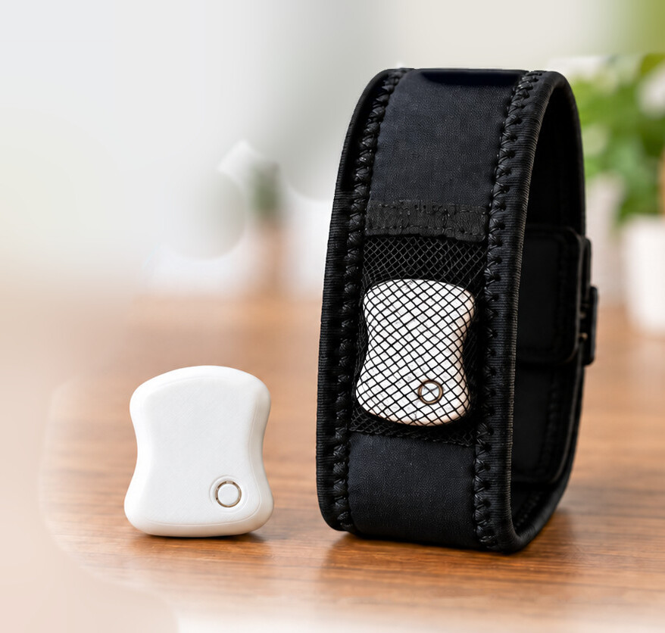
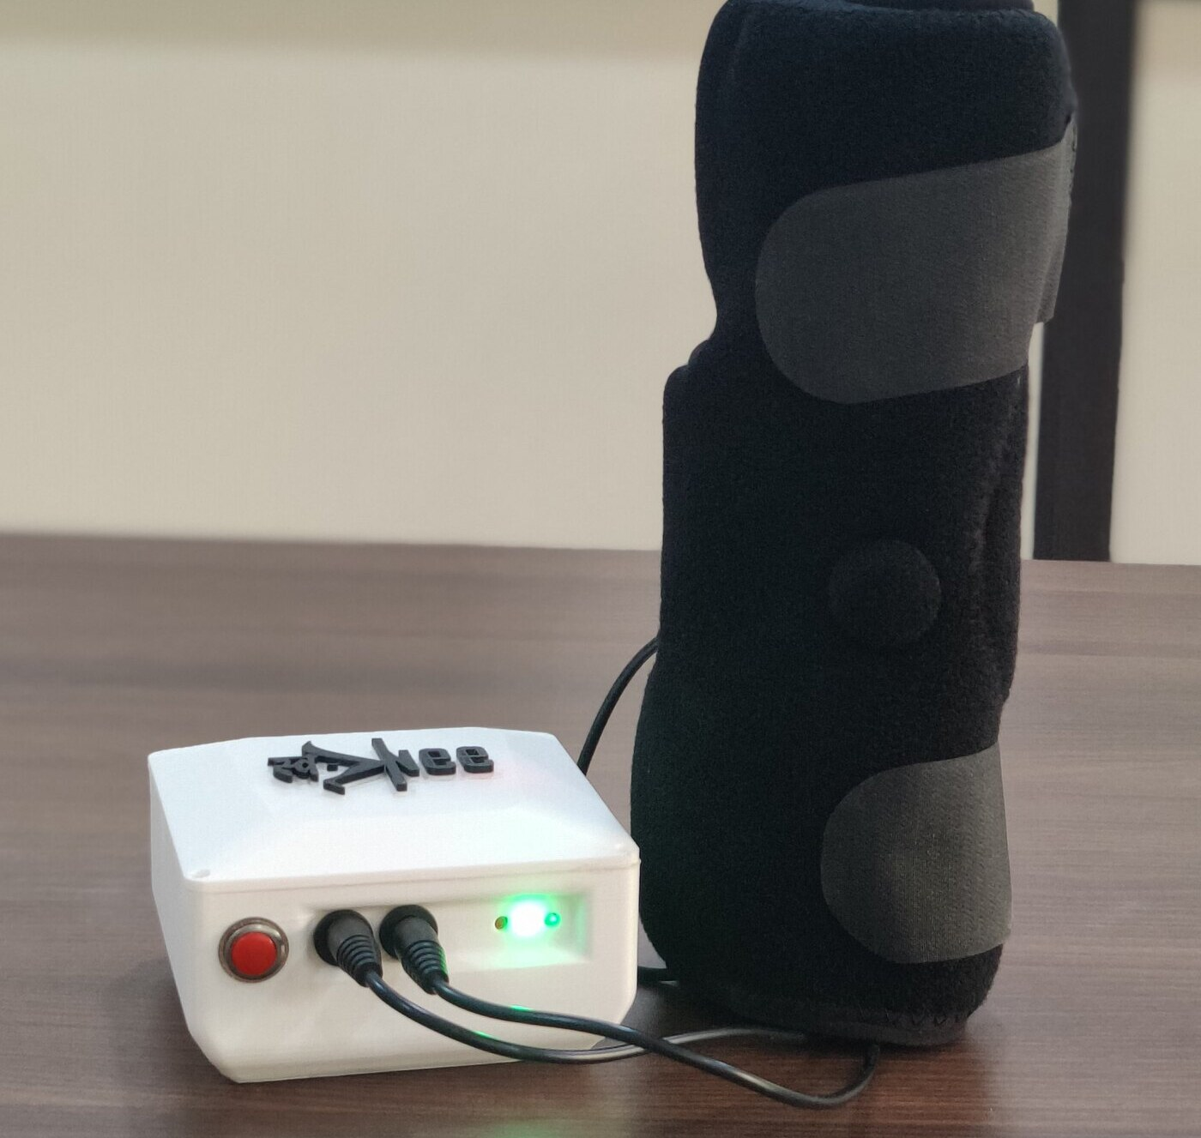
Bridging the Gap:
From Innovation to Patient Impact
MEDICAL DEVICE ETHICS WORKSHOP
Authentic device photographs
Ethics, Evidence, Regulation and Responsible Medical Device Translation
FoGO
Freezing-of-gait wearable
SwaKnee
PEMF knee system
Dr Vikas Kumar Jha
KIIT University, Bhubaneswar
Notes:
SLIDE 1 · Bridging the Gap: From Innovation to Patient Impact
TIME 0:45 min (clock 0:00–0:45)
ACTIVITY Opening question to the room
PRE-FLIGHT CHECKS (before the session)
1. Slide 2: replace “[state role]” with your SwaKnee (Swayogya Rehab Solutions) role and any equity, royalty or salary interest; add your FoGO equity position if you wish to state it.
2. Slide 13: re-check the SwaKnee figures (≈32% vs ≈14% average VAS reduction; n = 40 vs n = 42) against swayogya.in/evidence.html, and be ready to state SwaKnee’s CDSCO licence status and whether the study was registered on CTRI.
3. Align your own live web pages and leaflets with slide 13: the SwaKnee website source reviewed for this deck says “Clinically Proven”.
4. NPPA knee-implant cap: extended to 15 November 2026; check for any further extension (slide 19 notes).
5. Check the status of MDR-2017 amendments reported in August 2026, NMC conduct regulations, UCMPMD amendments and DPDP Rules phase dates (slides 16, 17, 20, 10).
6. Media: confirm written permission from the FoGO volunteer (face obscured) and the person in the SwaKnee step videos (no face shown) for public teaching.
7. Test both embedded videos on the venue computer; bring a flipchart, printed checklists, index cards and a timer.
CORE SCRIPT (say this; about 78 words)
Imagine this prototype is about to be used by someone at home: in Bhubaneswar, in Cuttack, or two hours from a neurologist. What would you need to know before recommending it? Today we practise that judgement on two devices I am involved with: FoGO, a wearable being developed to detect freezing of gait and cue walking, and SwaKnee, a pulsed electromagnetic knee system. By the end you will judge claims, evidence, consent, permission, cost and safety for yourselves.
DETAIL BELOW: use if time allows or if asked
PURPOSE
Start with the person who will use the device, not with the technology.
SAY
“Imagine the prototype on your desk is about to be used by someone at home — in Bhubaneswar, in Cuttack, or in a village two hours from a neurologist. What would you need to know before you recommended it?”
“Today we practise that judgement on two devices from my own development work: FoGO, a wearable being developed to detect freezing of gait in Parkinson’s disease and trigger a vibration cue (so far tested only on public datasets and in a staged demonstration), and SwaKnee, a pulsed electromagnetic field (PEMF) system for knee osteoarthritis. The photographs are authentic: the FoGO alpha prototype and the SwaKnee product.”
“By the end you should be able to: state an intended use and claim precisely; judge what evidence supports it; recognise consent, conflict-of-interest and affordability burdens; know which Indian permission answers which question; and assign responsibility for safety after launch.”
CAUTION
The decision checklist at the end is a workshop synthesis, not an official regulatory checklist or certification.
TRANSITION
“Before we start, you should know my interests.”
SOURCES
[1] Ahilaya Biomedicals Pvt Ltd. FoGO BIRAC BIG project presentation (supplied, 2026): alpha prototype (3 iterations, Jan 2024–Jun 2025); subject-wise F1 0.83–0.85 and cross-dataset F1 0.74–0.80 on Daphnet, CuPiD and Turning-in-place; 0.15–0.18 false alarms per minute; vibrotactile bench study; IEC 60601-1-2 EMC pre-compliance (Jul 2026); CDSCO test licence Form MD-13 for 25 units (10 Aug 2026); clinical proof-of-concept planned at AIIMS Bhubaneswar; 12 s demonstration clip (volunteer, simulated freeze, face obscured). Project-reported; not peer-reviewed.
[2] Swayogya website assets (ivikasjha/swayogya_website): product photographs and three 'How to use' step videos, edited into a 20 s silent clip with step captions; no faces shown. https://www.swayogya.in/product.html
Sources checked 7 October 2026.

Slide 2




My interests, stated first
DISCLOSURE
Vote before my view
I have professional interests in FoGO and SwaKnee.
Challenge every claim
FoGO founder, Ahilaya Biomedicals; patent filed
Protect identities
SwaKnee [state role]
Sources: University of Cambridge COI policy; Institute of Medicine (2009); Chao, Riskin & Krummel (2010); Stanford GSB case OIT105
Notes:
SLIDE 2 · My interests, stated first
TIME 1:00 min (clock 0:45–1:45)
ACTIVITY Disclosure and ground rules (1 minute)
CORE SCRIPT (say this; about 70 words)
Before you judge my evidence, you should know my interests. FoGO: I am founder and principal investigator of Ahilaya Biomedicals; a provisional patent and a design application are filed; we have received ₹25.5 lakh in grants, and a BIRAC BIG proposal is under review. SwaKnee: [state your role and any equity, royalty or salary interest]. So: vote before you hear my view, challenge every claim, mine included, and protect identities.
DETAIL BELOW: use if time allows or if asked
PURPOSE
Model good conflict-of-interest practice before asking the audience to judge evidence.
SAY
“I have professional interests in both case studies.” Say them specifically. FoGO: founder and principal investigator, Ahilaya Biomedicals Pvt Ltd (incubated at KIIT TBI); a provisional patent (202531119165) and a design application have been filed; ₹25.5 lakh in grants has been received from three programmes (Startup Odisha, DST NIDHI PRAYAS, Startup India Seed Fund); a BIRAC BIG proposal is under review. SwaKnee: state your role at Swayogya Rehab Solutions and any equity, royalty or salary interest (the slide shows “[state role]” until you edit it). Name any other financial interests.
“Apply a ‘reasonably perceived’ test to everything I say about these devices — the test used in the University of Cambridge conflict-of-interest policy. The Institute of Medicine defines a conflict of interest as circumstances that create a risk that judgement about a primary interest is unduly influenced by a secondary one — a risk, not an accusation.”
“Three ground rules: vote before you hear my view; challenge every claim, including mine; and protect identities — no names or photographs of patients from your own practice.”
DEBRIEF POINTS
Stanford sources flag physician-innovator roles as prone to conflicts of interest that should be managed without ending collaboration (Stanford GSB case OIT105), and question whether physician-innovators should evaluate their own devices (Chao, Riskin & Krummel 2010). Johnson and Rogers list conflicts of interest among four ethical challenges of surgical innovation; they apply to devices by analogy. We return to management on slide 16.
TRANSITION
“Let’s make a decision before we look at any details.”
SOURCES
[1] University of Cambridge. Conflict of Interest Policy. https://www.governanceandcompliance.admin.cam.ac.uk/files/conflict_of_interest_policy.pdf
[2] Institute of Medicine; Lo B, Field MJ, eds. Conflict of Interest in Medical Research, Education, and Practice. National Academies Press; 2009. https://www.nationalacademies.org/read/12598/chapter/11
[3] Chao KZ, Riskin DJ, Krummel TM. A patient-centered, ethical approach to medical device innovation. Virtual Mentor (now AMA J Ethics). 2010;12(2):91–95. https://journalofethics.ama-assn.org/article/patient-centered-ethical-approach-medical-device-innovation/2010-02
[4] Burns L, Denend L, Zenios S. The Role of Physicians in Device Innovation: Critical Success Factor or Conflict of Interest? Stanford GSB case OIT105; 2011. https://www.gsb.stanford.edu/faculty-research/case-studies/role-physicians-device-innovation-critical-success-factor-or-conflict
[5] Johnson J, Rogers W. Innovative surgery: the ethical challenges. J Med Ethics. 2012;38(1):9–12. https://jme.bmj.com/content/38/1/9
Sources checked 7 October 2026.

Slide 3



Would you let a patient use it?
OPENING VOTE
Routine care
Working prototype
1
Research study
Promising dataset results
2
Not yet
Test licence granted
3
Show 1, 2 or 3 fingers
Teaching case. Test licence: Form MD-13, Medical Devices Rules 2017
Notes:
SLIDE 3 · Would you let a patient use it? (opening vote)
TIME 2:00 min (clock 1:45–3:45)
ACTIVITY OPENING VOTE by show of fingers
CORE SCRIPT (say this; about 51 words)
Three facts: a working prototype, promising results on public datasets, a test licence granted. Hold up one finger for routine care, two for a research study, three for not yet. [Count and record the split.] Why did you choose that? I will not answer yet; we vote again at the end.
DETAIL BELOW: use if time allows or if asked
PURPOSE
Surface the room’s intuitions before any teaching, so we can see the shift at the end.
SAY
Read the three facts slowly: a working prototype, promising results on public datasets, a test licence granted.
“Hold up one, two or three fingers. One: suitable for routine care. Two: suitable for a research study. Three: not yet — I need more information.”
ASK / RUN
Count roughly and write the split on the flipchart (1 = __, 2 = __, 3 = __). Ask one person from each group: “What made you choose that?” Do not give the answer yet, and do not say which device this is.
DEBRIEF POINTS
Keep it brief; the full answer unfolds during the session.
• A test licence (Form MD-13 under the Medical Devices Rules, 2017) allows small quantities to be made for clinical investigation, test, evaluation, demonstration or training. Devices made under it cannot be sold. It is not permission to treat patients and not, by itself, permission to run a study.
• A study needs approval from an ethics committee registered with CDSCO and, for an investigational device, Central Licensing Authority permission (Form MD-22 → MD-23), prospective CTRI registration and arrangements for injury compensation.
• Routine care needs a licence for the intended use and evidence appropriate to the claim.
“We will vote again at the end with exactly the same options.”
CAUTION
These three facts match FoGO’s real status in August 2026 (alpha prototype, public-dataset results, MD-13 test licence for 25 units). Do not say so now. By slides 8–17 many people will have spotted it; at the closing vote (slide 23), confirm it.
TRANSITION
“To judge this well, we borrow three teaching traditions.”
SOURCES
[1] Ministry of Health and Family Welfare. Medical Devices Rules, 2017 (as amended), consolidated text, CDSCO. https://cdsco.gov.in/opencms/resources/UploadCDSCOWeb/2022/m_device/mdr,%202017%20(1).pdf
[2] CDSCO. Form MD-12: application for licence to manufacture medical devices for clinical investigation, test, evaluation, examination, demonstration or training (licence in Form MD-13). https://cdsco.gov.in/opencms/export/sites/CDSCO_WEB/Pdf-documents/medical-device/12MD.pdf
[3] CDSCO. Form MD-22: application for permission to conduct clinical investigation (permission in Form MD-23). https://cdsco.gov.in/opencms/export/sites/CDSCO_WEB/Pdf-documents/medical-device/22MD.pdf
[4] Ministry of Health and Family Welfare. New Drugs and Clinical Trials Rules, 2019 (ethics committee registration: Rules 7–8 with CDSCO; Rules 16–17 with DHR). https://cdsco.gov.in/opencms/resources/UploadCDSCOWeb/2022/new_DC_rules/NEW%20DRUGS%20ANDctrS%20RULE,%202019.pdf
Sources checked 7 October 2026.

Slide 4




Three traditions, one Indian patient
LENSES
Stanford Biodesign
Harvard bioethics
Cambridge design
Start from the need
Respect every person
Design for whole systems
India
CDSCO
ICMR
MvPI
NPPA
Sources: Stanford Biodesign; HMS Center for Bioethics, MRCT Center, Petrie-Flom; Cambridge EDC, Engineering Better Care, CCHLE
Notes:
SLIDE 4 · Three teaching traditions, one patient in India
TIME 0:30 min (clock 3:45–4:15)
CORE SCRIPT (say this; about 52 words)
We borrow from three traditions. Stanford Biodesign: start from a validated need. Harvard bioethics and the MRCT Center: respect and protect every participant. Cambridge’s design centres: design for the whole system and for the people it excludes. We apply all three to Indian rules and Indian patients: CDSCO, ICMR, MvPI and NPPA.
DETAIL BELOW: use if time allows or if asked
PURPOSE
Credit the frameworks we use and show how each is adapted to Indian practice.
SAY
Stanford Biodesign: innovation starts from a validated need, not a technology. Its Identify–Invent–Implement process asks teams to observe care, write solution-neutral need statements and screen needs before inventing. Its ‘Principled Decision-Making’ brief advises teams to write a team-culture document setting out their ethical principles early.
Harvard bioethics: the HMS Center for Bioethics teaches through cases; the MRCT Center of Brigham and Women’s Hospital and Harvard provides practical tools on diversity, accessibility, plain-language consent, return of results and post-trial access for devices; the Petrie-Flom Center studies device regulation, home digital health and AI.
Cambridge design and translation: the Engineering Design Centre’s Inclusive Design Toolkit asks who is excluded by a product’s demands; Engineering Better Care (2017; working group chaired by Cambridge’s Prof John Clarkson) adds people, systems, design and risk perspectives; Cambridge’s Institute for Biomedical Innovation (announced January 2026) addresses the gap between a lab prototype and trial-ready devices; Cambridge Judge Business School’s health centre focuses on making proven solutions affordable.
INDIA ADAPTATION
Stanford’s process was localised in India through Stanford-India Biodesign (from 2007–08), now the School of International Biodesign at AIIMS and IIT Delhi. Chaturvedi and colleagues (BMJ Innovations 2015) adapted it in an Indian emergency department: 100 needs, filtered to 10. Our regulatory and ethics anchors are CDSCO under MDR-2017, ICMR’s 2017 guidelines, MvPI, NPPA pricing, and the reality that families pay out of pocket for most outpatient devices.
CAUTION
None of these institutions has evaluated or endorsed FoGO or SwaKnee. The Biodesign textbook is Stanford content published by Cambridge University Press, so cite it as Stanford. IDEAL (slide 9) is Oxford-led, not Cambridge.
TRANSITION
“Now meet the two people we will keep in mind.”
SOURCES
[1] Stanford Mussallem Center for Biodesign. Our Process: Identify, Invent, Implement. https://biodesign.stanford.edu/about-us/process.html
[2] Stanford Biodesign. Principled Decision-Making. Student Guide to Biodesign; 2022. https://biodesignguide.stanford.edu/wp-content/uploads/2022/08/Principled-Decision-Making-v1.pdf
[3] Stanford Biodesign. Stanford Biodesign in India (Stanford-India Biodesign, 2007–2014; now School of International Biodesign, AIIMS and IIT Delhi). https://biodesign.stanford.edu/content/dam/sm/biodesign/documents/programs/global-initiatives/founders-forum/Stanford-Bioesign-in-India.pdf
[4] Chaturvedi J, Logan A, Narayan G, Kuttappa S. A structured process for unmet clinical need analysis for medical device innovation in India: early experiences. BMJ Innovations. 2015;1(3):81. https://innovations.bmj.com/content/1/3/81
[5] Harvard Medical School Center for Bioethics. Fellowship in Bioethics: curriculum. https://bioethics.hms.harvard.edu/education/fellowship-bioethics/curriculum
[6] MRCT Center of Brigham and Women's Hospital and Harvard. Achieving Diversity, Inclusion, and Equity in Clinical Research: Guidance Document and Toolkit; 2020. https://mrctcenter.org/diversity-in-clinical-research/
[7] Petrie-Flom Center, Harvard Law School. Diagnosing in the Home: the ethical, legal and regulatory challenges of digital home health (2021–2024). https://petrieflom.law.harvard.edu/diagnosing-in-the-home/
[8] University of Cambridge Engineering Design Centre. Inclusive Design Toolkit and Exclusion Calculator (Clarkson, Waller, Coleman). https://www-edc.eng.cam.ac.uk/research/inclusive-design
[9] Royal Academy of Engineering, Academy of Medical Sciences, Royal College of Physicians. Engineering Better Care: a systems approach to health and care design and continuous improvement; 2017 (working group chaired by Prof P. John Clarkson, University of Cambridge). https://raeng.org.uk/publications/reports/engineering-better-care
[10] University of Cambridge. New Cambridge institute will support high-value medical device translation; January 2026. https://www.cam.ac.uk/research/news/new-cambridge-institute-will-support-high-value-medical-device-translation
[11] Cambridge Judge Business School. Centre for Health Leadership and Enterprise. https://www.jbs.cam.ac.uk/centres/health/
Sources checked 7 October 2026.

Slide 5



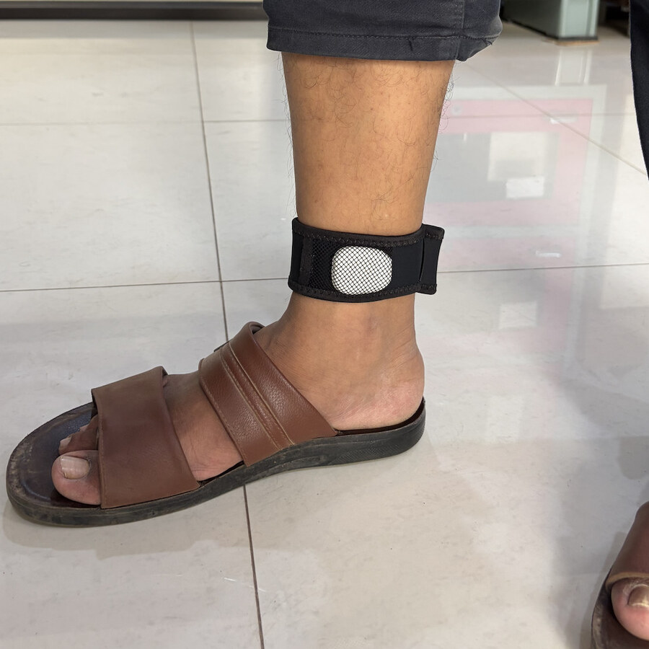

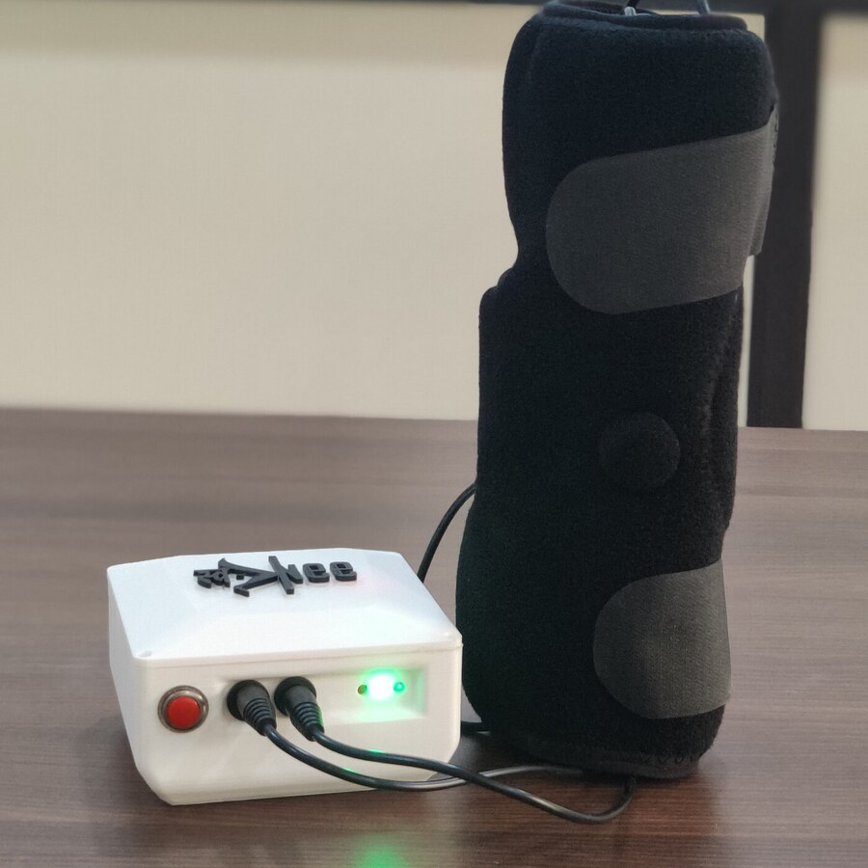




Two people we will follow
PATIENTS
Ramesh, 71
Kamala, 64
Parkinson’s disease
Knee osteoarthritis
Freezes in doorways
30 km from the clinic
Lives with his daughter
Pays out of pocket
FoGO
SwaKnee
Composite personas for teaching; not real patients. Photographs: FoGO alpha prototype; SwaKnee product (company photograph)
Notes:
SLIDE 5 · Two people we will follow
TIME 1:00 min (clock 4:15–5:15)
CORE SCRIPT (say this; about 52 words)
Meet Ramesh, 71, with Parkinson’s: he freezes in doorways, has fallen twice this year and borrows his daughter’s phone. And Kamala, 64, with knee osteoarthritis: she lives 30 km from the clinic and her family pays out of pocket. They are composites, not real patients. When you vote today, vote for them.
DETAIL BELOW: use if time allows or if asked
PURPOSE
Give every later decision a human face.
SAY
“Ramesh and Kamala are composites, not real patients, built from situations common in Odisha clinics.”
Ramesh, 71: Parkinson’s disease for eight years; freezes in doorways and when turning; has fallen twice this year; lives with his daughter, who works days and lends him her smartphone.
Kamala, 64: knee osteoarthritis in both knees; lives 30 km from the clinic at the district hospital; travels by shared auto; her household pays out of pocket and loses wages when someone accompanies her.
“Every decision today is made for one of them. When you vote, vote for them.”
INDIA ADAPTATION
Burden context: about 7.7 lakh people in India were living with Parkinson’s disease in 2019 (India State-Level Disease Burden Initiative, as cited in the FoGO project material). Knee osteoarthritis was found in 28.7% of 5,000 people in a five-site community survey (Pal et al. 2016) — one study, not a national estimate.
CAUTION
Do not attach these personas to the volunteer or demonstrator shown in the photographs or videos.
TRANSITION
“Their journey has six stages.”
SOURCES
[1] India State-Level Disease Burden Initiative Neurological Disorders Collaborators. The burden of neurological disorders across the states of India: GBD 1990–2019. Lancet Glob Health. 2021. https://www.ncbi.nlm.nih.gov/pmc/articles/PMC8295043/
[2] Pal CP, Singh P, Chaturvedi S, Pruthi KK, Vij A. Epidemiology of knee osteoarthritis in India and related factors. Indian J Orthop. 2016;50(5):518–522 (28.7% in a five-site community survey). https://pmc.ncbi.nlm.nih.gov/articles/PMC5017174
Sources checked 7 October 2026.

Slide 6






Every stage answers a patient question
THE JOURNEY
Need
Evidence
People
Permission
Access
Safety
“Will it help?”
“Is it proven?”
“Can I refuse?”
“Is it allowed?”
“Can I afford it?”
“Who answers?”
Workshop synthesis adapted from ICMR (2017) principles, the Stanford Biodesign process and Engineering Better Care
Notes:
SLIDE 6 · Each stage must answer a patient’s question
TIME 0:30 min (clock 5:15–5:45)
CORE SCRIPT (say this; about 44 words)
Every stage answers a question a patient would ask. Will it help? Is it proven? Can I refuse? Is it allowed? Can I afford it? Who answers if it fails? The dots at the top of later slides show which stage we are in.
DETAIL BELOW: use if time allows or if asked
PURPOSE
Introduce the six-stage spine of the session; the progress dots on later slides show where we are.
SAY
Need — Will it help me? Evidence — Is there proof, for people like me? People — Can I freely say no, and are the people asking me free of hidden interests? Permission — Is it allowed for this use? Access — Can I afford it, use it and keep using it? Safety — Who answers if it fails, after the sale?
“These questions adapt familiar research-ethics principles (benefit, risk minimisation, voluntary participation, accountability; compare the general principles in ICMR’s 2017 guidelines) to the device life cycle. The stages are not strictly sequential: Engineering Better Care’s ‘Sustain’ phase reminds us that access and safety must be designed from the start. We follow Ramesh and Kamala along this path.”
TRANSITION
“Stage one: what exactly are we promising?”
SOURCES
[1] Indian Council of Medical Research. National Ethical Guidelines for Biomedical and Health Research Involving Human Participants. New Delhi: ICMR; 2017 (Section 5 informed consent; Section 6 vulnerability; Section 7.7 device trials). https://ethics.ncdirindia.org/asset/pdf/ICMR_National_Ethical_Guidelines.pdf
[2] Stanford Mussallem Center for Biodesign. Our Process: Identify, Invent, Implement. https://biodesign.stanford.edu/about-us/process.html
[3] Royal Academy of Engineering, Academy of Medical Sciences, Royal College of Physicians. Engineering Better Care: a systems approach to health and care design and continuous improvement; 2017 (working group chaired by Prof P. John Clarkson, University of Cambridge). https://raeng.org.uk/publications/reports/engineering-better-care
Sources checked 7 October 2026.

Slide 7
Wording sets the evidence bar
NEED
“Shows walking patterns”
Low bar
STANFORD NEED STATEMENT
A way to [address problem] in [population] to [achieve outcome]
“Detects Parkinson’s freezing”
High bar: proof, licence
Sources: Stanford Biodesign, Need Statements (2022); MDR-2017; CDSCO Medical Device Software guidance (21 Jul 2026)
Notes:
SLIDE 7 · Claim wording sets the evidence bar
TIME 1:30 min (clock 5:45–7:15)
ACTIVITY Quick call-out: rewrite one need statement
CORE SCRIPT (say this; about 64 words)
Stanford’s need statement is solution-neutral: a way to address a problem, in a population, to achieve an outcome. No sensor, no app. Now the claims. ‘Shows walking patterns’ promises information. ‘Detects Parkinson’s freezing’ promises detection of a disease event: a medical claim, with a higher evidence bar and a licence. Your wording chooses your obligations. Quick task: rewrite Kamala’s need without naming any device.
DETAIL BELOW: use if time allows or if asked
PURPOSE
Show that the intended use and claim decide the regulatory route and the evidence needed.
SAY
Stanford’s need-statement format is: a way to [address the problem] in [a specific population] in order to [achieve a desired outcome]. It is deliberately solution-neutral. For Ramesh: “A way to reduce freezing-related immobility and falls in people with Parkinson’s disease living at home, in order to preserve safe, independent walking.” Notice: no sensor, no vibration, no app.
Now compare two claims. “Shows walking patterns” promises information. “Detects freezing of gait in Parkinson’s” promises detection of a disease-related event and, in FoGO, triggers an action (a cue). Under MDR-2017, intended use and claims determine whether a product is a medical device and its risk class (A–D). CDSCO’s Guidance on Medical Device Software (21 July 2026) covers software as a medical device, software in a device and IVD software, including AI and IoT, whenever the intended purpose is medical; risk depends on how far the output drives clinical decisions and how serious the condition is. Calling a product ‘wellness’ does not remove obligations when the real purpose is medical; Simon, Shachar and Cohen (JAMA 2022) describe the liability grey zone of ‘prediagnostic’ wearables.
ASK / RUN
“Rewrite Kamala’s need without naming any device.” Model answer: “A way to reduce pain and functional limitation in adults with knee osteoarthritis who cannot access or tolerate current options, in order to maintain daily function at an affordable cost.”
CAUTION
FoGO’s project material proposes Class B; that is the developer’s proposal, not a CDSCO classification. Do not state SwaKnee’s class as fact; confirm with CDSCO or a regulatory adviser.
TRANSITION
“Let’s look at what FoGO has actually shown.”
SOURCES
[1] Stanford Biodesign. Need Statements. Student Guide to Biodesign; 2022. https://biodesignguide.stanford.edu/wp-content/uploads/2022/07/Need-Statements-v2.pdf
[2] Ministry of Health and Family Welfare. Medical Devices Rules, 2017 (as amended), consolidated text, CDSCO. https://cdsco.gov.in/opencms/resources/UploadCDSCOWeb/2022/m_device/mdr,%202017%20(1).pdf
[3] CDSCO. Guidance Document on Medical Device Software under the Medical Devices Rules, 2017 (CDSCO/MD/GD/MDSW/01/2026); 21 July 2026. https://cdsco.gov.in/opencms/export/sites/CDSCO_WEB/Pdf-documents/Guidance-document-on-Medical-Device-Software-under-MDR-2017.pdf
[4] Simon DA, Shachar C, Cohen IG. Unsettled liability issues for 'prediagnostic' wearables and health-related products. JAMA. 2022;328:1391. https://hls.harvard.edu/bibliography/unsettled-liability-issues-for-prediagnostic-wearables-and-health-related-products
Sources checked 7 October 2026.

Slide 8
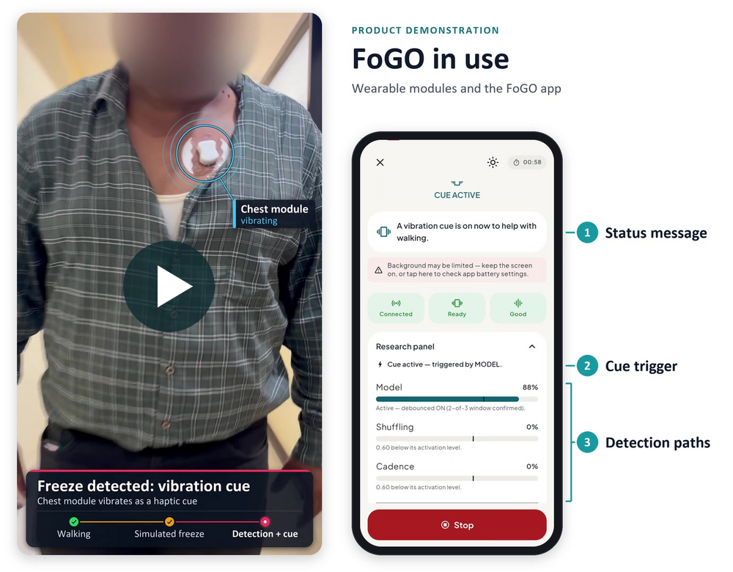
What did the prototype show?
EVIDENCE · FoGO
Seen
Not yet shown
Stop sensed
Real freezes
Stop flagged as freeze
Many users
Chest vibrates
Fewer falls
Staged demo · volunteer · simulated freeze
Source: FoGO project material (Ahilaya Biomedicals, BIRAC BIG), supplied. Staged demonstration; volunteer; simulated freeze
Notes:
SLIDE 8 · FoGO: what did the prototype actually show?
TIME 1:15 min (clock 7:15–8:30)
ACTIVITY Play the embedded 12-second clip, then ‘seen vs inferred’
CORE SCRIPT (say this; about 68 words)
Watch twelve seconds. [Play.] A volunteer stops on purpose to mimic a freeze; the ankle sensor registers the stop, the app flags it as a freeze, and the chest module vibrates. What did you see, and what did you infer? We saw the parts working together on a deliberate stop. We did not see real freezes, many users, a freeze told apart from a pause, or fewer falls.
DETAIL BELOW: use if time allows or if asked
PURPOSE
Separate what a demonstration shows from what it seems to promise.
SAY
Introduce FoGO: an ankle module with a six-axis motion sensor streaming at 100 Hz to a phone app, which runs the detection model and, when a freeze is confirmed, triggers a vibrotactile cue from a chest module worn on an adhesive patch.
Play the clip (click the video). It shows a volunteer, face obscured, stopping mid-walk on purpose to mimic a freeze. The ankle module registers the stop, the app’s detection paths cross their thresholds and flag it as a freeze, and the chest module vibrates.
Ask: “What did you see? What did you infer?” Write two columns on the flipchart.
DEBRIEF POINTS
Seen: the components work together in a staged demonstration, on a deliberate stop.
Not shown: detection of real freezes in people with Parkinson’s; whether it tells a real freeze from a voluntary stop or a pause at a doorway (at home, that would be a false cue); performance across many users, homes, turns, doorways and walking aids; tolerability of repeated cues; and any clinical benefit such as fewer falls or more walking.
A demonstration is valuable for understanding a system; it is not evidence of efficacy.
EVIDENCE STATUS
Demonstrated: staged prototype function (volunteer, simulated freeze). Not established: clinical detection performance and benefit.
CAUTION
The project has built three prototype iterations (January 2024 to June 2025); results apply to the version tested. Do not describe the clip as clinical footage.
TRANSITION
“So where does FoGO sit on the evidence ladder?”
SOURCES
[1] Ahilaya Biomedicals Pvt Ltd. FoGO BIRAC BIG project presentation (supplied, 2026): alpha prototype (3 iterations, Jan 2024–Jun 2025); subject-wise F1 0.83–0.85 and cross-dataset F1 0.74–0.80 on Daphnet, CuPiD and Turning-in-place; 0.15–0.18 false alarms per minute; vibrotactile bench study; IEC 60601-1-2 EMC pre-compliance (Jul 2026); CDSCO test licence Form MD-13 for 25 units (10 Aug 2026); clinical proof-of-concept planned at AIIMS Bhubaneswar; 12 s demonstration clip (volunteer, simulated freeze, face obscured). Project-reported; not peer-reviewed.
Sources checked 7 October 2026.

Slide 9
FoGO has climbed two rungs, not five
EVIDENCE · FoGO
Long-term safety and fairness
Benefit in daily life
Prospective patient study
Not established
Public datasets
F1 0.83–0.85
Not established
5
Staged demo, volunteer
Planned
4
Reported, preliminary
3
Demonstrated
2
1
Pre-IDEAL
Pre-IDEAL
IDEAL 1–2a
IDEAL 2b–3
IDEAL 4
Sources: FoGO project material (supplied; project-reported); IDEAL (Lancet 2009; 2019 update); IDEAL-D (BMJ 2016)
Notes:
SLIDE 9 · FoGO has climbed two rungs, not five
TIME 1:15 min (clock 8:30–9:45)
CORE SCRIPT (say this; about 61 words)
Five rungs. FoGO has a staged demonstration: demonstrated. It has project-reported F1 scores of 0.83 to 0.85 on public datasets: reported, preliminary. A prospective patient study is planned, not done. Benefit in daily life, and long-term, fair performance, are not established. The rungs are questions to answer, not a compulsory sequence. Which one matters most before Ramesh uses it at home?
DETAIL BELOW: use if time allows or if asked
PURPOSE
Make the difference between demonstrated, preliminary, planned and unestablished evidence visible.
SAY
Rung 1, Demonstrated: a staged demonstration on a volunteer (simulated freeze): sensing, flagging and the chest cue operate together.
Rung 2, Reported and preliminary: on three public datasets (Daphnet, CuPiD, Turning-in-place) the project reports subject-wise F1 scores of 0.83–0.85 (sensitivity 0.86–0.89, specificity 0.85–0.88), with 0.15–0.18 false alarms per minute in subject-wise tests, and F1 0.74–0.80 when tested on an unseen dataset (cross-dataset false-alarm rates appear higher, about 0.21–0.27 per minute on the project chart; confirm from the project analysis). A project bench study (sample not stated) found the chest had the lowest vibration-perception threshold (0.72) and the widest usable range (0.72–4.77, internal scale) of five body sites.
Both rungs are preclinical — ‘Pre-IDEAL’ in the 2019 update of the IDEAL framework.
Rung 3, Planned: a prospective clinical proof-of-concept with AIIMS Bhubaneswar neurology and rehabilitation advisers, proposed as an 18-month BIRAC BIG project (IDEAL stages 1–2a). The proposal is under review; the study is not yet funded, ethics-approved or permitted by CDSCO. A planned study and its targets are not results.
Rungs 4 and 5, Not established: benefit in daily life, and long-term safety and fair performance across groups.
ASK / RUN
“Which rung matters most before Ramesh uses it at home?”
DEBRIEF POINTS
Context: the best-known public benchmark, Daphnet, recorded 10 patients in a laboratory, of whom 8 froze (237 video-labelled events). One systematic review (Silva de Lima et al. 2017) reported sensitivity of 73–100% and specificity of 67–100%, mostly from laboratory studies; Pardoel et al. (2019) found that 68 of 74 studies addressed detection, and prediction is still early. So public-dataset F1 scores, however careful, cannot tell us how FoGO performs in Odisha homes.
IDEAL (McCulloch et al., Lancet 2009; Oxford-led) and IDEAL-D (Sedrakyan et al., BMJ 2016) ask for prospective design, registration and full reporting from the earliest human stages, and suggest that device approval can be staged and tied to registries. The rungs are questions, not a compulsory sequence.
For the next rung, ask for: video-annotated reference events; participant-level validation; false alarms per hour and detection latency in real use; and testing in homes, during turns and in doorways.
Cambridge’s Institute for Biomedical Innovation (announced January 2026) names the gap between ‘a clever prototype that works in a lab’ and devices suitable for clinical trials, and offers batch prototyping of tens to hundreds of devices in ISO-certified environments.
EVIDENCE STATUS
1 Demonstrated · 2 Reported, preliminary (project-reported, public datasets) · 3 Planned · 4–5 Not established.
TRANSITION
“Here is a realistic decision.”
SOURCES
[1] Ahilaya Biomedicals Pvt Ltd. FoGO BIRAC BIG project presentation (supplied, 2026): alpha prototype (3 iterations, Jan 2024–Jun 2025); subject-wise F1 0.83–0.85 and cross-dataset F1 0.74–0.80 on Daphnet, CuPiD and Turning-in-place; 0.15–0.18 false alarms per minute; vibrotactile bench study; IEC 60601-1-2 EMC pre-compliance (Jul 2026); CDSCO test licence Form MD-13 for 25 units (10 Aug 2026); clinical proof-of-concept planned at AIIMS Bhubaneswar; 12 s demonstration clip (volunteer, simulated freeze, face obscured). Project-reported; not peer-reviewed.
[2] Bächlin M, Plotnik M, Roggen D, et al. Wearable assistant for Parkinson's disease patients with the freezing of gait symptom. IEEE Trans Inf Technol Biomed. 2010 (10 patients in the laboratory; 8 froze; 237 video-labelled events). https://folia.unifr.ch/global/documents/222920
[3] Silva de Lima AL, Evers LJW, Hahn T, et al. Freezing of gait and fall detection in Parkinson's disease using wearable sensors: a systematic review. J Neurol. 2017 (sensitivity 73–100%, specificity 67–100%). https://www.ncbi.nlm.nih.gov/pmc/articles/PMC5533840/
[4] Pardoel S, Kofman J, Nantel J, Lemaire ED. Wearable-sensor-based detection and prediction of freezing of gait in Parkinson's disease: a review. Sensors. 2019;19(23):5141. https://www.ncbi.nlm.nih.gov/pmc/articles/PMC6928783/
[5] McCulloch P, Altman DG, Campbell WB, et al. No surgical innovation without evaluation: the IDEAL recommendations. Lancet. 2009;374:1105–1112 (IDEAL Collaboration; 2019 update adds Pre-IDEAL). https://www.ideal-collaboration.net/the-ideal-framework/
[6] Sedrakyan A, Campbell B, Merino JG, Kuntz R, Hirst A, McCulloch P. IDEAL-D: a rational framework for evaluating and regulating the use of medical devices. BMJ. 2016;353:i2372. https://pubmed.ncbi.nlm.nih.gov/27283585/
[7] University of Cambridge. New Cambridge institute will support high-value medical device translation; January 2026. https://www.cam.ac.uk/research/news/new-cambridge-institute-will-support-high-value-medical-device-translation
Sources checked 7 October 2026.

Slide 10


Home pilot for Ramesh next month?
WOULD YOU PROCEED? 1/4
Proceed
F1 0.83–0.85 on public data
A
Proceed with conditions
Ten users, alone at home
B
Not yet
Ramesh fell twice; asks to join
C
Hypothetical scenario. Sources: MDR-2017 (MD-13, MD-22/23); ICMR (2017); Declaration of Helsinki (2024) para 34
Notes:
SLIDE 10 · Would you proceed? A home pilot for Ramesh next month
TIME 3:00 min (clock 9:45–12:45)
ACTIVITY DECISION 1 of 4: vote A/B/C, then pairs name conditions
CORE SCRIPT (say this; about 65 words)
Facts: good scores on public data; ten users, alone at home; Ramesh has fallen twice and asks to join. A, proceed. B, proceed with conditions. C, not yet. Vote. Pairs: if B, name two conditions in 60 seconds. [Take three answers.] Did anyone ask whether ethics approval and CDSCO permission exist? They do not yet. Permissions come first, then a supervised study, then home use.
DETAIL BELOW: use if time allows or if asked
PURPOSE
Turn the evidence ladder into a concrete decision with conditions and owners.
SAY
Read the facts: F1 0.83–0.85 on public datasets; ten participants using the device alone at home; Ramesh has fallen twice this year and asks to join. Ethics approval and CDSCO permission are not yet in place: do not say so; see whether anyone asks.
“A: proceed. B: proceed only with conditions — name them. C: not yet.”
ASK / RUN
Vote. Give pairs 60 seconds: “If B, which two conditions?” Take three answers.
DEBRIEF POINTS
Conditions an ethics committee and regulator would expect:
1. Permissions first: approval from an ethics committee registered with CDSCO; for an unlicensed investigational device, CDSCO permission (MD-22 → MD-23) — the academic-study exemption covers only licensed devices; units built under the MD-13 test licence; prospective CTRI registration before the first participant; insurance and compensation arrangements.
2. Start supervised: in-clinic sessions with video-annotated freezes before any home use; then home use with a caregiver, stopping rules and a contact number.
3. Plan for failure: fall-risk assessment, cue limits, an easy off switch, a visible loss-of-monitoring alert.
4. Consent for fluctuating cognition: ICMR 2017 sections on consent and vulnerability; involve caregivers; plain language (MRCT Clinical Research Glossary).
5. Data: the app logs gait events; design notice, minimisation and retention now — under the DPDP Rules (notified 13 November 2025) the core obligations apply from about May 2027.
6. After the study: Declaration of Helsinki 2024 (para 34) requires post-trial provisions to be arranged in advance and disclosed in consent; the MRCT Center’s 2025 device framework shows how (apply by analogy).
“Not yet” is legitimate while permissions are pending, but it has a cost: Ramesh keeps falling meanwhile, so the answer is a fast, properly permitted and supervised study, not indefinite delay. Wexler and Largent (2023) note that even ‘harmless’ sensor tests on lab members merit independent oversight.
CAUTION
Hypothetical scenario built on real FoGO facts; it does not describe the planned FoGO proof-of-concept, which is proposed with AIIMS Bhubaneswar advisers; its protocol is not yet finalised or approved.
TRANSITION
“If we do proceed, which failures matter most?”
SOURCES
[1] CDSCO. Form MD-12: application for licence to manufacture medical devices for clinical investigation, test, evaluation, examination, demonstration or training (licence in Form MD-13). https://cdsco.gov.in/opencms/export/sites/CDSCO_WEB/Pdf-documents/medical-device/12MD.pdf
[2] CDSCO. Form MD-22: application for permission to conduct clinical investigation (permission in Form MD-23). https://cdsco.gov.in/opencms/export/sites/CDSCO_WEB/Pdf-documents/medical-device/22MD.pdf
[3] Ministry of Health and Family Welfare. Medical Devices Rules, 2017 (as amended), consolidated text, CDSCO. https://cdsco.gov.in/opencms/resources/UploadCDSCOWeb/2022/m_device/mdr,%202017%20(1).pdf
[4] Ministry of Health and Family Welfare. New Drugs and Clinical Trials Rules, 2019 (ethics committee registration: Rules 7–8 with CDSCO; Rules 16–17 with DHR). https://cdsco.gov.in/opencms/resources/UploadCDSCOWeb/2022/new_DC_rules/NEW%20DRUGS%20ANDctrS%20RULE,%202019.pdf
[5] Indian Council of Medical Research. National Ethical Guidelines for Biomedical and Health Research Involving Human Participants. New Delhi: ICMR; 2017 (Section 5 informed consent; Section 6 vulnerability; Section 7.7 device trials). https://ethics.ncdirindia.org/asset/pdf/ICMR_National_Ethical_Guidelines.pdf
[6] World Medical Association. Declaration of Helsinki: Ethical Principles for Medical Research Involving Human Participants. 75th General Assembly, Helsinki, October 2024 (para 27: dependent relationship; para 34: post-trial provisions). https://www.wma.net/policies-post/wma-declaration-of-helsinki/
[7] MRCT Center. Clinical Research Glossary (plain-language definitions; v3.0, 2025). https://mrctcenter.org/glossary/
[8] MRCT Center Post-trial Continued Access Task Force. Post-trial, Continued Access Responsibilities to Investigational Significant-Risk Devices: Framework; 2025. https://mrctcenter.org/wp-content/uploads/2025/04/2025-04-23c-Responsibilities-Framework_Devices.pdf
[9] Ministry of Electronics and Information Technology. Digital Personal Data Protection Rules, 2025 (notified November 2025; phased commencement). https://static.pib.gov.in/WriteReadData/specificdocs/documents/2025/nov/doc20251117695301.pdf
[10] Wexler A, Largent E. Ethical considerations for researchers developing and testing minimal-risk devices. Nat Commun. 2023;14. https://www.ncbi.nlm.nih.gov/pmc/articles/PMC10122640/
Sources checked 7 October 2026.

Slide 11






Rank failures by harm and likelihood
EVIDENCE · RISK
Severity
Critical
Missed freeze
9–16
Silent signal loss
false cues per walking hour, if dataset rates held
Serious
Data exposure
Flat battery mid-walk
Reported: 0.15–0.27/min
Minor
Which control first?
Skin irritation
False cue
Rare
Possible
Frequent
Likelihood
Illustrative ranking. False-alarm rate: FoGO project material (public datasets). Approach: ISO 14971:2019; Gerke et al. (2020)
Notes:
SLIDE 11 · Rank each failure by harm and likelihood
TIME 1:15 min (clock 12:45–14:00)
ACTIVITY Risk-map discussion
CORE SCRIPT (say this; about 62 words)
Risk is harm and likelihood together. A missed freeze or a silent signal loss could mean a fall; a false cue is minor but frequent. At the project’s reported dataset rates, Ramesh would feel about 9 to 16 unnecessary vibrations in every hour of walking, if those rates held at home. Would he keep wearing it? Which control would you test first?
DETAIL BELOW: use if time allows or if asked
PURPOSE
Practise risk prioritisation and connect it to testable controls.
SAY
“Risk combines severity and likelihood. The six failure modes are placed for discussion, not from measured data.”
Missed freeze: no cue when Ramesh needs one — serious, and possibly critical if he falls. Silent signal loss: the system stops monitoring without telling him — false reassurance. Flat battery mid-walk. False cue: frequent but usually minor. Skin irritation under the strap or patch. Data exposure from the app.
The right-hand panel translates reported numbers into lived experience: 0.15–0.18 false alarms per minute (subject-wise tests on public datasets) would mean about 9–11 unnecessary vibrations in every hour of walking, and the higher cross-dataset rates (about 0.21–0.27 per minute) about 13–16, if those rates held at home. Would Ramesh keep wearing it?
ASK / RUN
“Which control would you test first, and how would you show it works?”
DEBRIEF POINTS
ISO 14971:2019 approach: identify hazards; estimate and evaluate risk; control it; verify that controls work; and keep monitoring after release. Usability engineering (IEC 62366-1) tests whether real users can operate the controls.
The FoGO project material already names missed or false detections (2-of-3 debounce, patient-specific fine-tuning) and discomfort or habituation (cue intensity within the bench-tested range). Ask how each control will be shown to work.
Controls to test first: a visible and tactile loss-of-monitoring alert; cue-intensity limits and an easy stop; performance during turns, in doorways and with walking aids; low-battery warnings; encryption and short data retention.
Engineering Better Care’s risk perspective and Gerke and colleagues’ ‘system view’: evaluate the whole system — patient, caregiver, phone battery, network, physiotherapist follow-up — not only the algorithm. Kellmeyer and colleagues warn that closed-loop devices can blur accountability when automation fails.
CAUTION
Placement on the grid is illustrative. The 9–16 per hour range is an extrapolation from project-reported dataset rates, not a measured home rate.
TRANSITION
“Now to Kamala, and a different kind of burden.”
SOURCES
[1] Ahilaya Biomedicals Pvt Ltd. FoGO BIRAC BIG project presentation (supplied, 2026): alpha prototype (3 iterations, Jan 2024–Jun 2025); subject-wise F1 0.83–0.85 and cross-dataset F1 0.74–0.80 on Daphnet, CuPiD and Turning-in-place; 0.15–0.18 false alarms per minute; vibrotactile bench study; IEC 60601-1-2 EMC pre-compliance (Jul 2026); CDSCO test licence Form MD-13 for 25 units (10 Aug 2026); clinical proof-of-concept planned at AIIMS Bhubaneswar; 12 s demonstration clip (volunteer, simulated freeze, face obscured). Project-reported; not peer-reviewed.
[2] ISO 14971:2019. Medical devices — Application of risk management to medical devices. https://www.iso.org/standard/72704.html
[3] IEC 62366-1:2015+AMD1:2020. Medical devices — Part 1: Application of usability engineering to medical devices. https://webstore.iec.ch/en/publication/67220
[4] Royal Academy of Engineering, Academy of Medical Sciences, Royal College of Physicians. Engineering Better Care: a systems approach to health and care design and continuous improvement; 2017 (working group chaired by Prof P. John Clarkson, University of Cambridge). https://raeng.org.uk/publications/reports/engineering-better-care
[5] Gerke S, Babic B, Evgeniou T, Cohen IG. The need for a system view to regulate artificial intelligence/machine learning-based software as medical device. npj Digit Med. 2020. https://hls.harvard.edu/bibliography/the-need-for-a-system-view-to-regulate-artificial-intelligence-machine-learning-based-software-as-medical-device
[6] Kellmeyer P, Cochrane T, Müller O, et al. The effects of closed-loop medical devices on the autonomy and accountability of persons and systems. Camb Q Healthc Ethics. 2016;25(4):623–633. https://www.research-collection.ethz.ch/handle/20.500.11850/126117
Sources checked 7 October 2026.

Slide 12
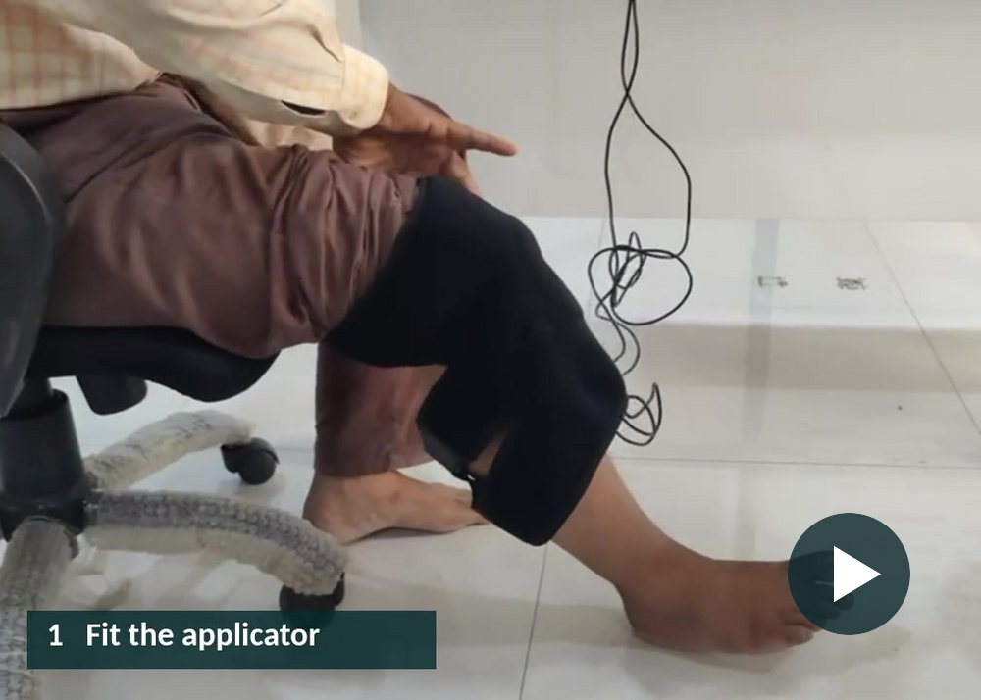

A device is also a daily routine
EVIDENCE · SWAKNEE
≈34 hours
45 minutes a day for 45 days
Who helps Kamala when something goes wrong?
Company demonstration of use · not outcome footage
Sources: SwaKnee leaflet (supplied): 45 min daily for 45 days; company ‘how to use’ footage
Notes:
SLIDE 12 · A device is also a daily routine
TIME 1:15 min (clock 14:00–15:15)
ACTIVITY Play the embedded 20-second clip
CORE SCRIPT (say this; about 48 words)
SwaKnee delivers pulsed electromagnetic fields to the knee. [Play the 20-second clip.] The leaflet describes 45 minutes a day for 45 days: about 34 hours of Kamala’s time, before travel, charging and help from family. Who helps her when the cuff slips or the controller shows an error?
DETAIL BELOW: use if time allows or if asked
PURPOSE
Show that use burden is part of benefit–risk.
SAY
Introduce SwaKnee: a knee applicator and controller that deliver pulsed electromagnetic fields, described in the supplied original deck as having an intended adjunctive role in knee osteoarthritis care. State its current labelled intended use and CDSCO licence status yourself; this deck does not assert either.
Play the clip: fit the applicator, switch on the controller, rest for the session. It is a company demonstration of use; it shows no clinical response.
“The supplied leaflet describes 45-minute sessions daily for 45 days. That is 2,025 minutes — about 34 hours of Kamala’s time — before travel, fitting, charging and help from family.”
ASK / RUN
“Who helps Kamala when the cuff slips, the controller shows an error, or her knee feels warm?”
DEBRIEF POINTS
Use burden affects adherence, which affects real-world benefit. Each task also makes demands on vision, dexterity, reach and memory — we audit these on slide 18.
Optional: the company’s longer online explainer video (YouTube link in Sources) can be shared after the session.
CAUTION
The 45 × 45 schedule illustrates time burden. It is not a prescription; current instructions and clinician advice define actual use.
TRANSITION
“What can the SwaKnee evidence support?”
SOURCES
[1] Swa knee_Leaflet.pdf. Supplied product material: 45-minute daily sessions over 45 days (illustration of time burden, not a prescription).
[2] Swayogya website assets (ivikasjha/swayogya_website): product photographs and three 'How to use' step videos, edited into a 20 s silent clip with step captions; no faces shown. https://www.swayogya.in/product.html
[3] Swayogya Rehab Solutions. SwaKnee explainer video on YouTube (company material; optional, longer than the embedded clip). https://www.youtube.com/watch?v=IfQyVm8Kftc
Sources checked 7 October 2026.

Slide 13
Which claim can this evidence carry?
EVIDENCE · SWAKNEE
“Less pain on average, one company study”
Reported
“Clinically proven”
Not established
“Regrows cartilage”
Important change per patient ≈ 41% (Tubach 2005)
Not measured
Source: Swayogya evidence page, figures as given in the supplied deck (company-reported; not peer-reviewed). Threshold: Tubach et al., Ann Rheum Dis 2005
Notes:
SLIDE 13 · Which claim can this evidence carry?
TIME 2:30 min (clock 15:15–17:45)
ACTIVITY Claim challenge: one participant defends, one challenges
CORE SCRIPT (say this; about 77 words)
The company reports that average pain fell about 32% with SwaKnee and 14% with comparison care, in one 45-day study of 82 people. That is an average. A change patients notice as important is about 41% for each person, so how many reached it? Which claim can this carry? ‘Less pain on average in one company study’: yes, if labelled. ‘Clinically proven’: not established. ‘Regrows cartilage’: never measured. One volunteer defends claim 1; another challenges claim 3.
DETAIL BELOW: use if time allows or if asked
PURPOSE
Match the strength of a claim to the strength of the evidence.
SAY
The chart reproduces the company-reported 45-day comparative study: device group n = 40, comparison group n = 42; average VAS pain fell by about 32% versus 14% from baseline. These are average relative changes, not the proportion of people who improved.
The callout adds a patient’s yardstick: in knee osteoarthritis, the minimal clinically important improvement in pain is about −19.9 mm, or −40.8%, on a 100 mm scale (Tubach et al. 2005). An average fall of 32% does not tell us how many people reached a change they would notice as important.
The public summary does not report: how groups were allocated; blinding or a sham control; prospective CTRI registration; how missing data were handled; the between-group difference with its confidence interval; adverse events; or durability beyond 45 days. [Presenter: state what the full study report shows, or that it is not public.]
SwaKnee today: CDSCO licence status [state, with document]; CTRI registration [number, or not registered]; planned independent trial [describe, or none disclosed].
ASK / RUN
Invite one person to defend claim 1 and another to challenge claim 3.
DEBRIEF POINTS
Claim 1, “less pain on average in one 45-day company study”, is acceptable if clearly labelled as company-reported.
Claim 2, “clinically proven”, needs independent, prospectively registered, sham-controlled trials and consistent results. Independent evidence on PEMF is mixed: a Cochrane review (2013; 9 trials, all osteoarthritis sites and electromagnetic field types) found pain probably improves by about 15 points out of 100 more than sham, with function uncertain; meta-analyses disagree (Chen 2019, knee OA, 8 RCTs: no pain advantage over placebo; Yang 2020, all OA sites, 16 RCTs: an advantage); OARSI’s 2019 guideline strongly recommends against electromagnetic therapy.
Claim 3, “regrows cartilage”, was not measured. No human evidence of cartilage regeneration was found; a pain change cannot establish structural change.
Industry sponsorship matters: a Cochrane methodology review found manufacturer-sponsored drug and device studies reach favourable conclusions more often (RR 1.34). The same standard applies to every leaflet and web page, including those of any company the presenter is linked to (see slide 2).
EVIDENCE STATUS
Reported (company study; not peer-reviewed or independently verified). ‘Clinically proven’: not established. Cartilage regrowth: not measured.
CAUTION
The MCII is a within-patient threshold from a four-week cohort, not a between-group minimal important difference; use it to ask whether individuals improved meaningfully, not as a pass/fail test.
TRANSITION
“Even a good average can mislead.”
SOURCES
[1] Swayogya Rehab Solutions. SwaKnee evidence page: company-reported comparative 45-day study, device n=40 vs comparison n=42, ≈32% vs ≈14% average VAS pain reduction from baseline. Rounded figures as transcribed in the supplied original deck; re-check the live page before presenting. https://www.swayogya.in/evidence.html
[2] Tubach F, Ravaud P, Baron G, et al. Evaluation of clinically relevant changes in patient reported outcomes in knee and hip osteoarthritis: the minimal clinically important improvement. Ann Rheum Dis. 2005;64(1):29–33 (knee OA pain MCII −19.9 mm, −40.8%). https://ard.bmj.com/content/64/1/29.full.pdf
[3] Li S, Yu B, Zhou D, et al. Electromagnetic fields for treating osteoarthritis. Cochrane Database Syst Rev. 2013;(12):CD003523 (9 trials, 636 adults: pain probably improves about 15/100 more than sham; function uncertain). https://www.cochrane.org/evidence/CD003523_electromagnetic-fields-treatment-osteoarthritis
[4] Chen L, Duan X, Xing F, et al. Effects of pulsed electromagnetic field therapy on pain, stiffness and physical function in patients with knee osteoarthritis: a systematic review and meta-analysis. J Rehabil Med. 2019;51(11):821–827 (no pain advantage; function improved). https://medicaljournals.se/jrm/content/abstract/10.2340/16501977-2613
[5] Yang X, He H, Ye W, Perry TA, He C. Effects of pulsed electromagnetic field therapy on pain, stiffness, physical function, and quality of life in patients with osteoarthritis: a systematic review and meta-analysis. Phys Ther. 2020;100(7):1118–1131. https://pubmed.ncbi.nlm.nih.gov/32251502/
[6] Bannuru RR, Osani MC, Vaysbrot EE, et al. OARSI guidelines for the non-surgical management of knee, hip, and polyarticular osteoarthritis. Osteoarthritis Cartilage. 2019 (electromagnetic therapy strongly recommended against). https://www.esceo.org/sites/esceo/files/pdf/Bannuru_O%26C_OARSIguidelines_2019.pdf
[7] Lundh A, Lexchin J, Mintzes B, Schroll JB, Bero L. Industry sponsorship and research outcome. Cochrane Database Syst Rev. 2017;(2):MR000033 (drug and device studies: favourable conclusions RR 1.34, 95% CI 1.19–1.51). https://pubmed.ncbi.nlm.nih.gov/28207928/
Sources checked 7 October 2026.

Slide 14



An average can hide a patient
EVIDENCE · EQUITY
Who is missing from our data?
Ramesh: walking aids, crowded homes
Kamala: obesity, other illnesses, rural care
Report results by subgroup
Source: Sjoding et al., NEJM 2020, University of Michigan cohort (paired measurements, SpO₂ 92–96%; observational; recorded race)
Notes:
SLIDE 14 · An average can hide a patient
TIME 0:45 min (clock 17:45–18:30)
OPTIONAL: skip if running behind (keep all votes and decisions)
CORE SCRIPT (say this; about 55 words)
An average can hide a patient. In one US hospital cohort, oximeters reading 92 to 96% missed dangerously low oxygen in 11.7% of paired readings for Black patients, against 3.6% for White patients. Who is missing from our data? For Ramesh: walking aids, saris, crowded homes. For Kamala: women, rural users, people with other illnesses.
DETAIL BELOW: use if time allows or if asked
PURPOSE
Show, with an independent published case, why subgroup performance matters.
SAY
Sjoding and colleagues (NEJM 2020), University of Michigan cohort: when the pulse oximeter read 92–96%, arterial oxygen saturation was below 88% in 11.7% of paired measurements for Black patients versus 3.6% for White patients (88 of 749 vs 99 of 2,778; 95% CI 8.5–16.0 vs 2.7–4.7), more than three times as often. The unit is paired measurements; race was recorded, not skin pigmentation measured; it was observational. It does not justify a race-based correction — it shows that a device that looked accurate on average missed dangerous low oxygen more often in one group.
Regulators responded: the US FDA’s January 2025 draft guidance asks for clinical testing across a diverse range of skin tones, assessed on the Monk Skin Tone scale.
ASK / RUN
“Who is missing from our data?” Take two answers for each case.
DEBRIEF POINTS
Ramesh: people using walking aids; cognitive fluctuation; crowded homes and floor-level living; clothing such as saris or dhotis over the sensor; public datasets with few or no Indian participants.
Kamala: women, people with obesity, manual and agricultural workers, people with other illnesses, rural users.
The MRCT Center’s diversity guidance defines diversity broadly — including comorbidities, concurrent medicines and environment — and asks for subgroup reporting. Stanford Biodesign’s health-equity programme trains innovators to see how decisions at the identify, invent and implement stages affect equity.
TRANSITION
“Now the people: consent and conflicts.”
SOURCES
[1] Sjoding MW, Dickson RP, Iwashyna TJ, Gay SE, Valley TS. Racial bias in pulse oximetry measurement. N Engl J Med. 2020;383(25):2477–2478. doi:10.1056/NEJMc2029240. https://www.nejm.org/doi/full/10.1056/NEJMc2029240
[2] US FDA. Pulse Oximeters for Medical Purposes: Non-Clinical and Clinical Performance Testing, Labeling, and Premarket Submission Recommendations. Draft guidance, 7 January 2025 (diverse skin-tone testing, Monk Skin Tone scale). https://www.fda.gov/regulatory-information/search-fda-guidance-documents/pulse-oximeters-medical-purposes-non-clinical-and-clinical-performance-testing-labeling-and
[3] MRCT Center of Brigham and Women's Hospital and Harvard. Achieving Diversity, Inclusion, and Equity in Clinical Research: Guidance Document and Toolkit; 2020. https://mrctcenter.org/diversity-in-clinical-research/
[4] Stanford Biodesign. Health Equity programme and resources. https://biodesign.stanford.edu/programs/health-equity.html
Sources checked 7 October 2026.

Slide 15


His neurologist is the inventor
WOULD YOU PROCEED? 2/4
Recruit now
“Will saying no change my care?”
A
Proceed with safeguards
Consent form: English only
B
Not yet
Only neurologist within 100 km
C
Hypothetical vignette. Sources: Declaration of Helsinki (2024) para 27; ICMR National Ethical Guidelines (2017); MRCT Center (Harvard) Clinical Research Glossary
Notes:
SLIDE 15 · Would you proceed? Ramesh’s neurologist is also the inventor
TIME 3:00 min (clock 18:30–21:30)
ACTIVITY DECISION 2 of 4: vote, then 60-second role-play (patient, recruiter, observer)
CORE SCRIPT (say this; about 77 words)
Ramesh’s neurologist is FoGO’s inventor and wants to recruit him. Ramesh asks, ‘Will saying no change my care?’ The consent form is in English only, and this is the only neurologist within 100 km. A, recruit now. B, proceed with safeguards. C, not yet. Vote. Then 60 seconds of role-play: patient, recruiter, observer. Observer: what would make refusal easier? Key safeguards: an independent person takes consent, in Ramesh’s language, with teach-back, and the inventor’s interest is disclosed.
DETAIL BELOW: use if time allows or if asked
PURPOSE
Practise consent when there is a dependent relationship, a language barrier and a request to film.
SAY
Read the facts: Ramesh asks, “Will saying no change my care?”; the consent form is in English only; this neurologist is the only one within 100 km, and the study needs participants by March.
Twist if time allows: the clinic also wants to film him for a talk.
“A: recruit as planned. B: proceed with safeguards — which ones? C: not yet.”
ASK / RUN
Vote. Then one participant plays Ramesh, one the recruiting neurologist, and one observes for 60 seconds. The observer reports one thing that would make refusal easier.
DEBRIEF POINTS
• Dependent relationship: the Declaration of Helsinki (2024, para 27) says that when a potential participant is in a dependent relationship with the physician, consent must be sought by an appropriately qualified individual independent of that relationship. State plainly that refusal will not change care.
• Disclose the inventor’s interest to the ethics committee and in the consent conversation (ICMR 2017; CIOMS Guideline 25); use an independent outcome assessor.
• Language and understanding: ICMR 2017 requires consent in a language the participant understands, with an impartial witness if the participant cannot read. Put key information first (the US Common Rule’s ‘key information’ requirement is a useful model) and use teach-back; the MRCT Clinical Research Glossary helps explain ‘investigational’ and ‘sham’.
• Therapeutic misconception (Appelbaum): participants may assume research procedures are care chosen for them; say clearly what is uncertain.
• Filming: separate, specific and revocable consent for recordings used in teaching or publicity, in writing for public media (the UK GMC’s guidance is a good comparator); gait videos usually identify people, so anonymisation rarely suffices; never make filming a condition of care or of study entry.
Good answers: B with these safeguards, or C until the consent process is fixed. “Not yet” has a cost here too: excluding Ramesh because the only neurologist is conflicted denies him access; the fix is an independent consenter and assessor, not exclusion.
CAUTION
Fictional vignette; it does not describe either project’s actual consent procedure.
TRANSITION
“Disclosure is only the start.”
SOURCES
[1] World Medical Association. Declaration of Helsinki: Ethical Principles for Medical Research Involving Human Participants. 75th General Assembly, Helsinki, October 2024 (para 27: dependent relationship; para 34: post-trial provisions). https://www.wma.net/policies-post/wma-declaration-of-helsinki/
[2] Indian Council of Medical Research. National Ethical Guidelines for Biomedical and Health Research Involving Human Participants. New Delhi: ICMR; 2017 (Section 5 informed consent; Section 6 vulnerability; Section 7.7 device trials). https://ethics.ncdirindia.org/asset/pdf/ICMR_National_Ethical_Guidelines.pdf
[3] CIOMS with WHO. International Ethical Guidelines for Health-related Research Involving Humans. 4th ed. Geneva; 2016 (Guideline 9 consent; Guideline 25 conflicts of interest). https://cioms.ch/wp-content/uploads/2017/01/WEB-CIOMS-EthicalGuidelines.pdf
[4] US HHS. Protection of Human Subjects, 45 CFR 46.116(a)(5)(i): consent must begin with a concise presentation of key information. International comparator. https://www.ecfr.gov/current/title-45/subtitle-A/subchapter-A/part-46/subpart-A/section-46.116
[5] MRCT Center. Clinical Research Glossary (plain-language definitions; v3.0, 2025). https://mrctcenter.org/glossary/
[6] Appelbaum PS, Roth LH, Lidz C. The therapeutic misconception: informed consent in psychiatric research. Int J Law Psychiatry. 1982;5(3–4):319–329. https://psychnews.psychiatryonline.org/doi/10.1176/appi.pn.2021.7.30
[7] Appelbaum PS, Roth LH, Lidz CW, Benson P, Winslade W. False hopes and best data: consent to research and the therapeutic misconception. Hastings Cent Rep. 1987;17(2):20–24. https://philpapers.org/rec/APPFHA
[8] General Medical Council (UK). Making and using visual and audio recordings of patients (effective 2011; updated December 2024). International comparator. https://www.gmc-uk.org/professional-standards/the-professional-standards/making-and-using-visual-and-audio-recordings-of-patients
Sources checked 7 October 2026.

Slide 16









Disclose, then manage
CONFLICTS OF INTEREST
Interests
Risks
Safeguards
Equity or royalties
Pressure to enrol
Independent assessor
Grants, institution
Optimistic reading
CTRI registration
Reputation
Selective reporting
Publish all results
Sources: Lundh et al., Cochrane 2017; HMS COI policy (2010); Stanford GSB case OIT105; Cambridge spinout guidance (2024); UCMPMD 2024; IMC 2002 cl. 6.8
Notes:
SLIDE 16 · Disclosure starts the work; management finishes it
TIME 0:30 min (clock 21:30–22:00)
CORE SCRIPT (say this; about 42 words)
Disclosure starts the work; management finishes it. Interests create risks: pressure to enrol, optimistic reading, selective reporting. Manage them with independent consent and assessment, CTRI registration before the first participant, and publication of every result. Which safeguard is cheapest to add today?
DETAIL BELOW: use if time allows or if asked
PURPOSE
Move from declaring conflicts to managing them.
SAY
Interests: equity or royalties; grants and institutional reputation; personal reputation.
Risks: pressure to enrol dependent patients; optimistic reading of outcomes; selective reporting of positive results. A Cochrane methodology review found that manufacturer-sponsored drug and device studies report favourable conclusions more often than other studies (RR 1.34).
Safeguards: independent consent and outcome assessment; prospective CTRI registration with pre-specified outcomes; publication of all results, including null and negative ones, with a plain-language summary to participants.
ASK / RUN
“Which safeguard is cheapest to add today?” (Usually CTRI registration and naming an independent assessor.)
DEBRIEF POINTS
Cambridge’s spinout guidance advises founders to be clear about when they are working for the company and when for research. Harvard Medical School’s 2010 policy moved from disclosure to limits (for example, no industry speakers’ bureaus). The US publishes industry payments to physicians (Open Payments); the UK Cumberlege Review recommended a register of doctors’ financial interests.
In India the rules are split: the Uniform Code for Marketing Practices in Medical Devices (2024, amended 2026) is a voluntary code for companies; for doctors, the NMC’s 2023 regulations were held in abeyance on 23 August 2023 (no replacement was found in October 2026 searches; check nmc.org.in), so the IMC 2002 regulations apply; clause 6.8 covers the ‘pharmaceutical and allied health sector industry’, commonly read to include device companies; ICMR 2017 requires COI disclosure to ethics committees. None removes the need for project-level management.
TRANSITION
“Next: which Indian permission answers which question?”
SOURCES
[1] Lundh A, Lexchin J, Mintzes B, Schroll JB, Bero L. Industry sponsorship and research outcome. Cochrane Database Syst Rev. 2017;(2):MR000033 (drug and device studies: favourable conclusions RR 1.34, 95% CI 1.19–1.51). https://pubmed.ncbi.nlm.nih.gov/28207928/
[2] Chao KZ, Riskin DJ, Krummel TM. A patient-centered, ethical approach to medical device innovation. Virtual Mentor (now AMA J Ethics). 2010;12(2):91–95. https://journalofethics.ama-assn.org/article/patient-centered-ethical-approach-medical-device-innovation/2010-02
[3] Burns L, Denend L, Zenios S. The Role of Physicians in Device Innovation: Critical Success Factor or Conflict of Interest? Stanford GSB case OIT105; 2011. https://www.gsb.stanford.edu/faculty-research/case-studies/role-physicians-device-innovation-critical-success-factor-or-conflict
[4] University of Cambridge Innovation and Entrepreneurship. How to Guide 3: Spinouts; 2024. https://ie.cam.ac.uk/wp-content/uploads/2024/04/H2G-3-Spinouts_V2_ISSUU.pdf
[5] Harvard Medical School. Policy on Conflicts of Interest and Commitment (2010 revision). https://hms.harvard.edu/news/changes-conflicts-policy-heighten-transparency
[6] Centers for Medicare & Medicaid Services. Open Payments: public reporting of industry payments to physicians and teaching hospitals. https://www.cms.gov/files/document/physician-fact-sheetpdf
[7] Independent Medicines and Medical Devices Safety Review (chair Baroness Cumberlege). First Do No Harm; 8 July 2020. https://www.immdsreview.org.uk/downloads/IMMDSReview_Web.pdf
[8] Department of Pharmaceuticals. Uniform Code for Marketing Practices in Medical Devices, 2024 (circular of 6 September 2024; as amended on 30 April 2026). Voluntary code administered through industry associations. https://pharma-dept.gov.in/sites/default/files/UCMDMD%20circular%201-2026+UCMDMP%20code%20as%20amended%20on%2030.4.2026%20(1).pdf
[9] Medical Council of India. Indian Medical Council (Professional Conduct, Etiquette and Ethics) Regulations, 2002, clause 6.8 (inserted 2009); operative after the NMC 2023 regulations were held in abeyance on 23 August 2023. https://www.delhimedicalcouncil.org/pdf/EthicsRegulations-2002.pdf
[10] The Wire. NMC puts new guidelines on doctors’ ethics in abeyance; August 2023. https://thewire.in/health/nmc-puts-new-guidelines-on-doctors-ethics-in-abeyance-after-imas-meeting-with-health-minister
[11] Indian Council of Medical Research. National Ethical Guidelines for Biomedical and Health Research Involving Human Participants. New Delhi: ICMR; 2017 (Section 5 informed consent; Section 6 vulnerability; Section 7.7 device trials). https://ethics.ncdirindia.org/asset/pdf/ICMR_National_Ethical_Guidelines.pdf
[12] MRCT Center. Return of Aggregate Results to Participants: Guidance Document and Toolkit, v3.1; 2017. https://mrctcenter.org/wp-content/uploads/2023/03/2017-12-07-MRCT-Return-of-Aggregate-Results-Toolkit-3.1.pdf
Sources checked 7 October 2026.

Slide 17



Each permission answers a different question
PERMISSION · INDIA
Test
licence
Clinical
investigation
Manufacturing
licence
Post-market
duties
Make units for testing?
Test in people?
Sell for this use?
Still safe?
MD-12 → MD-13
MD-22 → MD-23 · ethics · CTRI
Class A/B: State · C/D: Central
PSUR · MvPI · recall
FoGO TODAY ✓ MD-13 test licence, 25 units (Aug 2026) → Next: MD-22, ethics, CTRI
Sources: Medical Devices Rules 2017; CDSCO Forms MD-12, MD-22; CDSCO software guidance (2026); FoGO project material (supplied)
Notes:
SLIDE 17 · Each permission answers a different question
TIME 1:30 min (clock 22:00–23:30)
ACTIVITY “Where is Ramesh’s device on this path today?”
CORE SCRIPT (say this; about 79 words)
Each Indian permission answers a different question. A test licence lets you make units for testing. Clinical-investigation permission, with ethics approval and CTRI registration, lets you test in people. A manufacturing licence lets you sell for the intended use: State for Class A and B, Central for C and D. Post-market duties keep it safe. FoGO today has an MD-13 test licence for 25 units; next come MD-22, ethics approval and CTRI. Where is your project on this path?
DETAIL BELOW: use if time allows or if asked
PURPOSE
Give a practical map of the Indian route, anchored in a real project.
SAY
Test licence: application in Form MD-12, licence in MD-13 (Central Licensing Authority) — make small quantities for test, evaluation, clinical investigation, demonstration or training; not for sale.
Clinical investigation of an investigational device: application in Form MD-22 (Rule 51) with Seventh Schedule documents (clinical investigation plan, investigator’s brochure, risk management, verification and validation, informed consent form, insurance); permission in MD-23 (Rule 52); an ethics committee registered with CDSCO; CTRI registration before the first participant.
Manufacturing licence for sale: Class A/B from the State Licensing Authority (MD-3 → MD-5); Class C/D from the Central Licensing Authority (MD-7 → MD-9); quality management system under the Fifth Schedule (aligned with ISO 13485).
Post-market: complaint handling, periodic safety update reports (reported as six-monthly for two years, then annually for two), adverse-event and recall duties, and reporting to MvPI. Software follows CDSCO’s Medical Device Software guidance (21 July 2026).
FoGO today: MD-13 test licence for 25 units (10 August 2026, for evaluation with AIIMS Bhubaneswar and AMTZ), after IEC 60601-1-2 EMC pre-compliance testing (July 2026). Next: an MD-22 application, ethics approval and CTRI registration.
DEBRIEF POINTS
International comparison: in the US the sponsor proposes, and the IRB decides, whether a device study is significant or non-significant risk (FDA is the final arbiter); significant-risk studies need an investigational device exemption (21 CFR 812), followed by 510(k), De Novo or PMA. In the EU, notified-body CE marking is followed by post-market clinical follow-up under MDR 2017/745; transition deadlines run to 2027–2028 and a targeted revision proposed in December 2025 is under negotiation. Clinical investigations worldwide follow ISO 14155, now in its 2026 edition. Rules differ; the ethical duties do not.
A licence is not proof of benefit: among 157 US cardiovascular devices with Class I recalls (2013–2022), only 19.1% had any premarket clinical testing (Kadakia et al. 2024).
Rule 51(2) waives the clinical-investigation fee for government-run or government-funded institutions. Current-affairs digests reported in late August 2026 that MoHFW had proposed MDR-2017 amendments to simplify compliance; content and status are unconfirmed, so check before the talk.
Risk class (shown in the third card): Class A and B manufacturing licences come from the State Licensing Authority, C and D from the Central Licensing Authority; higher classes need more evidence and central review.
CAUTION
Simplified overview; device class, study purpose and specific exemptions determine the route. The academic clinical-study exemption applies only to licensed devices with ethics approval and data not used for marketing submissions. FoGO’s ‘Class B (proposed)’ is the developer’s proposal.
TRANSITION
“Permission does not mean people can use it.”
SOURCES
[1] Ministry of Health and Family Welfare. Medical Devices Rules, 2017 (as amended), consolidated text, CDSCO. https://cdsco.gov.in/opencms/resources/UploadCDSCOWeb/2022/m_device/mdr,%202017%20(1).pdf
[2] CDSCO. Form MD-12: application for licence to manufacture medical devices for clinical investigation, test, evaluation, examination, demonstration or training (licence in Form MD-13). https://cdsco.gov.in/opencms/export/sites/CDSCO_WEB/Pdf-documents/medical-device/12MD.pdf
[3] CDSCO. Form MD-22: application for permission to conduct clinical investigation (permission in Form MD-23). https://cdsco.gov.in/opencms/export/sites/CDSCO_WEB/Pdf-documents/medical-device/22MD.pdf
[4] CDSCO. Regulatory pathway under the Medical Devices Rules, 2017 (overview). https://cdsco.gov.in/opencms/export/sites/CDSCO_WEB/Pdf-documents/medical-device/RegulatoryMDR-2017.pdf
[5] Ministry of Health and Family Welfare. New Drugs and Clinical Trials Rules, 2019 (ethics committee registration: Rules 7–8 with CDSCO; Rules 16–17 with DHR). https://cdsco.gov.in/opencms/resources/UploadCDSCOWeb/2022/new_DC_rules/NEW%20DRUGS%20ANDctrS%20RULE,%202019.pdf
[6] CDSCO. Guidance Document on Medical Device Software under the Medical Devices Rules, 2017 (CDSCO/MD/GD/MDSW/01/2026); 21 July 2026. https://cdsco.gov.in/opencms/export/sites/CDSCO_WEB/Pdf-documents/Guidance-document-on-Medical-Device-Software-under-MDR-2017.pdf
[7] CDSCO. Draft Guidance on Post Market Surveillance of Medical Devices; 2018. https://cdsco.gov.in/opencms/resources/UploadCDSCOWeb/2018/UploadPublic_NoticesFiles/2Draft%20Guidance%20on%20PMS.pdf
[8] Ahilaya Biomedicals Pvt Ltd. FoGO BIRAC BIG project presentation (supplied, 2026): alpha prototype (3 iterations, Jan 2024–Jun 2025); subject-wise F1 0.83–0.85 and cross-dataset F1 0.74–0.80 on Daphnet, CuPiD and Turning-in-place; 0.15–0.18 false alarms per minute; vibrotactile bench study; IEC 60601-1-2 EMC pre-compliance (Jul 2026); CDSCO test licence Form MD-13 for 25 units (10 Aug 2026); clinical proof-of-concept planned at AIIMS Bhubaneswar; 12 s demonstration clip (volunteer, simulated freeze, face obscured). Project-reported; not peer-reviewed.
[9] US FDA. Information Sheet: Significant Risk and Nonsignificant Risk Medical Device Studies (21 CFR 812). https://www.fda.gov/files/about%20fda/published/Significant-Risk-and-Nonsignificant-Risk-Medical-Device-Studies---Information-Sheet.pdf
[10] Regulation (EU) 2017/745 on medical devices, Art. 61 and Annex XIV Part B (post-market clinical follow-up); transition extended to 2027/2028 by Regulation (EU) 2023/607. https://eur-lex.europa.eu/eli/reg/2017/745/2023-03-20
[11] European Commission. Proposal for a targeted revision of the medical device regulations, COM(2025) 1023 final, 16 December 2025 (under negotiation). https://eur-lex.europa.eu/legal-content/EN/TXT/HTML/?uri=CELEX:52025PC1023
[12] ISO 14155:2026. Clinical investigation of medical devices for human subjects — Good clinical practice (supersedes ISO 14155:2020). https://www.iso.org/standard/83968.html
[13] Kadakia KT, et al. Class I recalls of cardiovascular devices between 2013 and 2022: a cross-sectional analysis. Ann Intern Med. 2024;177(11) (19.1% had premarket clinical testing). https://www.acpjournals.org/doi/10.7326/ANNALS-24-00724
Sources checked 7 October 2026.

Slide 18









Who can’t use it?
INCLUSIVE DESIGN
FoGO
SwaKnee
Vision
INDIA ADDS
Language
Hearing
Thinking
Literacy
Communication
Power cuts
Locomotion
No smartphone
Reach and stretch
Dexterity
Caregiver needed
Low
Medium
High
Method: Cambridge Engineering Design Centre, Inclusive Design Toolkit. Ratings illustrative. India additions: workshop adaptation
Notes:
SLIDE 18 · Who can’t use it? Audit the demands
TIME 0:45 min (clock 23:30–24:15)
OPTIONAL: skip if running behind (keep all votes and decisions)
ACTIVITY Inclusive-design audit: pick one demand to redesign
CORE SCRIPT (say this; about 56 words)
Cambridge’s Inclusive Design Toolkit asks what a product demands of seven capabilities. FoGO asks someone with Parkinson’s to bend, strap and pair a phone; SwaKnee asks an older person to position an applicator and time a session. India adds language, literacy, power cuts, no smartphone and dependence on a caregiver. Which demand would you redesign first?
DETAIL BELOW: use if time allows or if asked
PURPOSE
Make usability and exclusion an ethical question, not only a design question.
SAY
The Cambridge Engineering Design Centre’s Inclusive Design Toolkit rates the demands a product makes on seven capabilities: vision, hearing, thinking, communication, locomotion, reach and stretch, and dexterity. Its Exclusion Calculator estimates how many people cannot complete the tasks.
On the slide the ratings are illustrative. FoGO asks a person with Parkinson’s to bend and strap an ankle module, stick on a chest patch and pair a phone — high demands on reach, dexterity and thinking. SwaKnee asks an older person with knee osteoarthritis to position an applicator, connect a controller and time a 45-minute session.
The FoGO team reports consulting 30+ potential users (project-reported); a common request was more comfort and easier use.
ASK / RUN
“Which one demand would you redesign first?” A quick classroom version of the Cambridge simulation tools: try fastening a strap wearing thick gloves.
INDIA ADAPTATION
Add Indian demands the toolkit does not list: language (Odia, Hindi, English), literacy, unreliable power, shared or no smartphone, and dependence on a caregiver. The Exclusion Calculator uses UK population data from 1996–97, so its percentages must not be presented as Indian figures. The MRCT Center’s Accessibility by Design toolkit (2023) supports including people with disabilities in research; adaptations such as home visits, travel support and accessible consent formats follow from it (workshop suggestions). Usability engineering under IEC 62366-1 turns these into testable requirements.
TRANSITION
“And then there is cost.”
SOURCES
[1] University of Cambridge Engineering Design Centre. Inclusive Design Toolkit and Exclusion Calculator (Clarkson, Waller, Coleman). https://www-edc.eng.cam.ac.uk/research/inclusive-design
[2] MRCT Center. Accessibility by Design in Clinical Research Toolkit; 2023. https://mrctcenter.org/resource/accessibility-by-design-abd-toolkit-release/
[3] IEC 62366-1:2015+AMD1:2020. Medical devices — Part 1: Application of usability engineering to medical devices. https://webstore.iec.ch/en/publication/67220
[4] University of Cambridge Department of Engineering. Part IIB module 4G9: Biomedical Engineering / Biomedical Innovation (syllabus). https://teaching.eng.cam.ac.uk/content/engineering-tripos-part-iib-4g9-biomedical-engineering-2024-25
[5] Ahilaya Biomedicals Pvt Ltd. FoGO BIRAC BIG project presentation (supplied, 2026): alpha prototype (3 iterations, Jan 2024–Jun 2025); subject-wise F1 0.83–0.85 and cross-dataset F1 0.74–0.80 on Daphnet, CuPiD and Turning-in-place; 0.15–0.18 false alarms per minute; vibrotactile bench study; IEC 60601-1-2 EMC pre-compliance (Jul 2026); CDSCO test licence Form MD-13 for 25 units (10 Aug 2026); clinical proof-of-concept planned at AIIMS Bhubaneswar; 12 s demonstration clip (volunteer, simulated freeze, face obscured). Project-reported; not peer-reviewed.
Sources checked 7 October 2026.

Slide 19



Price is only part of the cost
ACCESS
NPPA PRECEDENT
91%
Buy or rent
Travel
34 hours
Family time
Repairs
?
?
?
?
?
of home-device brands cut prices
Who pays each step?
Trade-margin cap, July 2021
Sources: PIB/NPPA trade-margin cap on five home-use devices (13 Jul 2021); Cambridge Judge CCHLE. Journey steps illustrative
Notes:
SLIDE 19 · The price tag is only part of the cost
TIME 1:30 min (clock 24:15–25:45)
CORE SCRIPT (say this; about 67 words)
Walk Kamala’s 45 days: buy or rent, travel, about 34 hours of sessions, family time, repairs. Who pays each step? Call out an answer for each box. Usually it is the household, out of pocket. Price policy can reach home devices: after NPPA capped trade margins in July 2021, 91% of brands of five home devices cut their prices. Affordability is a design input, not an afterthought.
DETAIL BELOW: use if time allows or if asked
PURPOSE
Widen affordability from purchase price to the total cost of use.
SAY
Walk Kamala’s 45 days: buy or rent the device; travel 30 km to the clinic for fitting and training; about 34 hours of sessions; a family member’s time and lost wages; repairs and support. “Who pays for each step?” Ask the room to fill each dashed box. For home-use devices this is usually the household, out of pocket.
The panel: in July 2021 NPPA capped trade margins on five home-use devices (pulse oximeters, BP monitors, nebulisers, digital thermometers, glucometers); 91% of 684 brands cut their MRP, by up to 88%. Home devices are within the reach of price policy.
An implant precedent: on 16 August 2017 the National Pharmaceutical Pricing Authority capped knee-implant prices; the average price of the widely used cobalt-chromium primary knee fell from ₹1,58,324 to ₹54,720 (65%). The cap has been extended repeatedly, most recently to 15 November 2026. Coronary stents were capped on 13 February 2017 (₹7,260 bare-metal, ₹29,600 drug-eluting). Close with: “Affordability is an ethical design input, not an afterthought.”
DEBRIEF POINTS
Cambridge Judge Business School’s Centre for Health Leadership and Enterprise describes progress in three phases: develop technologies, integrate them into care at scale, and make proven solutions affordable and widely available. The Harvard Business School Aravind case shows affordability built in through local manufacture (Aurolab lenses) with quality systems. FoGO’s plan targets ₹27,000 plus a ₹3–4,000 annual service plan — a planned price, not a market result.
Responsible options for an adjunct with modest evidence: rental rather than purchase; clinic-shared devices; a trial period with refund if not tolerated; a transparent statement of the total cost of a course.
CAUTION
Price caps are a trade-off: manufacturers sought to withdraw some premium stents (refused), and observers feared hospitals would shift costs to other charges — a reported concern, not a measured effect. SwaKnee is not an implant and is not covered by the knee-implant cap. Check NPPA for any extension after 15 November 2026.
TRANSITION
“Now a commercial decision.”
SOURCES
[1] Press Information Bureau. Government caps trade margin up to 70% on price-to-distributor for pulse oximeters, BP monitors, nebulisers, digital thermometers and glucometers; 13 July 2021 (91% of 684 brands cut MRP, by up to 88%). https://www.pib.gov.in/PressReleasePage.aspx?PRID=1735430
[2] Press Information Bureau. Government fixes ceiling prices of knee implants (cobalt-chromium primary knee: average MRP Rs 1,58,324 to Rs 54,720, 65%; special metals 69%); 16 August 2017. https://www.pib.gov.in/newsite/PrintRelease.aspx?relid=170040
[3] Medical Dialogues. NPPA continues price cap on orthopaedic knee replacement implants for another year, till 15 November 2026. https://medicaldialogues.in/news/industry/medical-devices/nppa-continues-price-cap-on-orthopedic-knee-replacement-implants-for-another-year-till-november-15-2026-158881
[4] Press Information Bureau. NPPA ceiling prices for coronary stents: Rs 7,260 (bare-metal) and Rs 29,600 (drug-eluting); 13 February 2017. https://www.pib.gov.in/newsite/PrintRelease.aspx?relid=158452
[5] TCTMD. Stents as essential medicine: India’s cap on stent prices could have ripples around the globe; 2017 (withdrawal applications refused). https://www.tctmd.com/news/stents-essential-medicine-indias-cap-stent-prices-could-have-ripples-around-globe
[6] Cambridge Judge Business School. Centre for Health Leadership and Enterprise. https://www.jbs.cam.ac.uk/centres/health/
[7] Rangan VK. The Aravind Eye Hospital, Madurai, India: In Service for Sight. Harvard Business School case 593-098; 1993.
[8] Ahilaya Biomedicals Pvt Ltd. FoGO BIRAC BIG project presentation (supplied, 2026): alpha prototype (3 iterations, Jan 2024–Jun 2025); subject-wise F1 0.83–0.85 and cross-dataset F1 0.74–0.80 on Daphnet, CuPiD and Turning-in-place; 0.15–0.18 false alarms per minute; vibrotactile bench study; IEC 60601-1-2 EMC pre-compliance (Jul 2026); CDSCO test licence Form MD-13 for 25 units (10 Aug 2026); clinical proof-of-concept planned at AIIMS Bhubaneswar; 12 s demonstration clip (volunteer, simulated freeze, face obscured). Project-reported; not peer-reviewed.
Sources checked 7 October 2026.

Slide 20


Launch with this brochure?
WOULD YOU PROCEED? 3/4
Launch as written
Clinically proven!
Distributor insists
A
Regrows cartilage
Doctor recommended
Fix claims first
Cash lasts 3 months
B
Avoid surgery forever
Not yet
HYPOTHETICAL
C
Hypothetical brochure. Sources: Uniform Code for Marketing Practices in Medical Devices (2024, amended 2026); Drugs and Magic Remedies Act 1954
Notes:
SLIDE 20 · Would you proceed? Launch with this brochure
TIME 2:00 min (clock 25:45–27:45)
ACTIVITY DECISION 3 of 4: vote, then rewrite one claim
CORE SCRIPT (say this; about 74 words)
Kamala’s son finds this brochure: ‘Clinically proven! Regrows cartilage. Doctor recommended. Avoid surgery forever.’ The distributor insists, and the company has three months of cash. A, launch as written. B, fix the claims first. C, not yet. Vote, then each table rewrites one claim in 30 seconds. A better line: ‘In one company study of 82 adults over 45 days, average pain fell more with SwaKnee than with comparison care; independent trials are needed.’
DETAIL BELOW: use if time allows or if asked
PURPOSE
Practise responsible commercialisation under real pressure.
SAY
Kamala’s son finds this hypothetical brochure online: “Clinically proven! Regrows cartilage. Doctor recommended. Avoid surgery forever.” The distributor insists on these claims, and the company has cash for three months.
“A: launch as written. B: fix the claims first, then launch. C: not yet.”
ASK / RUN
Vote. Then ask each table to rewrite one claim in 30 seconds.
DEBRIEF POINTS
• “Clinically proven” needs independent, controlled replication; one company study is not enough, and guideline bodies are sceptical of PEMF (OARSI 2019).
• “Regrows cartilage” was not measured, and no human evidence of regeneration was found.
• “Doctor recommended” implies an endorsement and raises conflict-of-interest questions for the company (marketing code) and the doctor (professional conduct rules).
• “Avoid surgery forever” is an absolute promise no evidence supports.
The Uniform Code for Marketing Practices in Medical Devices (2024, as amended 30 April 2026) requires product information to be accurate, balanced, not misleading and capable of substantiation, and bars gifts and hospitality to healthcare professionals; it is a voluntary code run through industry associations. The Drugs and Magic Remedies (Objectionable Advertisements) Act, 1954 lists ‘rheumatism’ among conditions for which cure claims may not be advertised — take legal advice on how it applies to device claims. The ASCI Code (Chapter I.1) requires truthful and substantiated claims.
A better line: “In a company study of 82 adults over 45 days, average pain fell more with SwaKnee than with comparison care. Independent trials are needed to confirm this.”
Stanford’s Principled Decision-Making brief advises teams to write a team-culture document setting out their ethical principles early, before moments like this.
“Not yet” also has a cost: if the company folds, current users lose support and service. That is why B, honest claims and a launch, is usually the responsible answer.
CAUTION
The brochure is hypothetical and does not reproduce any actual SwaKnee material. Check any of your own live web or print claims against this standard before the talk.
TRANSITION
“The last decision comes after launch.”
SOURCES
[1] Department of Pharmaceuticals. Uniform Code for Marketing Practices in Medical Devices, 2024 (circular of 6 September 2024; as amended on 30 April 2026). Voluntary code administered through industry associations. https://pharma-dept.gov.in/sites/default/files/UCMDMD%20circular%201-2026+UCMDMP%20code%20as%20amended%20on%2030.4.2026%20(1).pdf
[2] Drugs and Magic Remedies (Objectionable Advertisements) Act, 1954 (Schedule includes ‘rheumatism’). https://www.indiacode.nic.in/indiacode/bitstream/123456789/1412/1/A1954-21.pdf
[3] Advertising Standards Council of India. Consumer Complaints Council recommendations press release (June 2022): health advertisements assessed under ASCI Code Chapter I.1 (truthful, substantiated claims) and III.4. https://www.ascionline.in/wp-content/uploads/2022/09/asci_june-17_ccc_recomm_press_release.pdf
[4] Bannuru RR, Osani MC, Vaysbrot EE, et al. OARSI guidelines for the non-surgical management of knee, hip, and polyarticular osteoarthritis. Osteoarthritis Cartilage. 2019 (electromagnetic therapy strongly recommended against). https://www.esceo.org/sites/esceo/files/pdf/Bannuru_O%26C_OARSIguidelines_2019.pdf
[5] Stanford Biodesign. Principled Decision-Making. Student Guide to Biodesign; 2022. https://biodesignguide.stanford.edu/wp-content/uploads/2022/08/Principled-Decision-Making-v1.pdf
[6] Swayogya Rehab Solutions. SwaKnee evidence page: company-reported comparative 45-day study, device n=40 vs comparison n=42, ≈32% vs ≈14% average VAS pain reduction from baseline. Rounded figures as transcribed in the supplied original deck; re-check the live page before presenting. https://www.swayogya.in/evidence.html
Sources checked 7 October 2026.

Slide 21
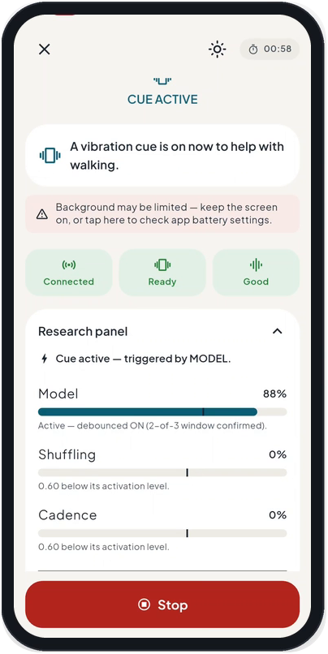
Push tonight’s FoGO update?
WOULD YOU PROCEED? 4/4
Push to everyone
Fewer false cues
A
Staged release with rollback
May miss more freezes
B
Not yet
Tested on stored data
C
Hypothetical update. Sources: CDSCO Medical Device Software guidance (2026); US FDA PCCP guidance (Dec 2024)
Notes:
SLIDE 21 · Would you proceed? Push tonight’s FoGO update
TIME 1:30 min (clock 27:45–29:15)
ACTIVITY DECISION 4 of 4
CORE SCRIPT (say this; about 60 words)
Tonight’s update gives fewer false cues, but it may miss more freezes, and it has been tested only on stored data. A, push to everyone. B, staged release with monitoring and rollback. C, not yet. Vote. Evidence belongs to a version: results for version 1 may not cover version 2. Who in your team can pause or reverse a release?
DETAIL BELOW: use if time allows or if asked
PURPOSE
Show that evidence belongs to a version, and changes need governance.
SAY
Read the facts: the new detection threshold gives fewer false cues, may miss more freezes, and has been tested on stored data only.
“A: push to all users tonight. B: staged release after review, with monitoring and rollback. C: not yet.”
The screenshot is the real prototype app: the cue was ‘debounced’ — confirmed in two of three windows — before it fired. Changing that rule changes the device’s behaviour.
DEBRIEF POINTS
A threshold trades sensitivity against specificity: fewer nuisance cues can mean more missed freezes. Evidence for version 1 may not cover version 2.
CDSCO’s Medical Device Software guidance (21 July 2026) expects lifecycle documentation, version control, validation and documented change management, and says an Algorithm Change Protocol may be devised where applicable — the guidance describes itself as interpreting the Rules, not adding a new control. The US FDA’s predetermined change control plan (PCCP) guidance for AI-enabled device software (December 2024) lets manufacturers pre-specify modifications with a validation protocol and impact assessment — it is not a blank cheque.
If the device is in a study: notify the ethics committee, seek an amendment, and re-consent if the change could affect a participant’s decision.
A good release: shadow mode first; a small staged group; pre-set monitoring metrics and a rollback trigger; tell users and clinicians what changed. Who can pause or reverse the release? Name them.
CAUTION
Hypothetical update; not a report of an actual FoGO release.
TRANSITION
“And if, despite all this, someone is harmed?”
SOURCES
[1] CDSCO. Guidance Document on Medical Device Software under the Medical Devices Rules, 2017 (CDSCO/MD/GD/MDSW/01/2026); 21 July 2026. https://cdsco.gov.in/opencms/export/sites/CDSCO_WEB/Pdf-documents/Guidance-document-on-Medical-Device-Software-under-MDR-2017.pdf
[2] CDSCO. Draft Guidance Document on Medical Device Software; 21 October 2025. https://cdsco.gov.in/opencms/resources/UploadCDSCOWeb/2018/UploadPublic_NoticesFiles/Draft%20guidance%20document%20on%20Medical%20Device%20Software%2021%2010%202025.pdf
[3] US FDA. Marketing Submission Recommendations for a Predetermined Change Control Plan for Artificial Intelligence-Enabled Device Software Functions. Final guidance, December 2024 (revised version reported August 2025). https://www.fda.gov/regulatory-information/search-fda-guidance-documents/marketing-submission-recommendations-predetermined-change-control-plan-artificial-intelligence
[4] Gerke S, Babic B, Evgeniou T, Cohen IG. The need for a system view to regulate artificial intelligence/machine learning-based software as medical device. npj Digit Med. 2020. https://hls.harvard.edu/bibliography/the-need-for-a-system-view-to-regulate-artificial-intelligence-machine-learning-based-software-as-medical-device
[5] Kellmeyer P, Cochrane T, Müller O, et al. The effects of closed-loop medical devices on the autonomy and accountability of persons and systems. Camb Q Healthc Ethics. 2016;25(4):623–633. https://www.research-collection.ethz.ch/handle/20.500.11850/126117
[6] Ahilaya Biomedicals Pvt Ltd. FoGO BIRAC BIG project presentation (supplied, 2026): alpha prototype (3 iterations, Jan 2024–Jun 2025); subject-wise F1 0.83–0.85 and cross-dataset F1 0.74–0.80 on Daphnet, CuPiD and Turning-in-place; 0.15–0.18 false alarms per minute; vibrotactile bench study; IEC 60601-1-2 EMC pre-compliance (Jul 2026); CDSCO test licence Form MD-13 for 25 units (10 Aug 2026); clinical proof-of-concept planned at AIIMS Bhubaneswar; 12 s demonstration clip (volunteer, simulated freeze, face obscured). Project-reported; not peer-reviewed.
Sources checked 7 October 2026.

Slide 22




When harm happens, who answers?
SAFETY
Care
INDIA
ASR metal-on-metal hips
Follow up
Record
≈4,700 implanted in India; recalled 2010
Patient
1,080 traced by 2018
Correct
Report
Report harm: MvPI 1800-180-3024
Investigate
Sources: MvPI (IPC); ASR: MoHFW expert committee report as reported (2018), PIB compensation formula (29 Nov 2018); Kramer et al. 2013
Notes:
SLIDE 22 · When harm happens, someone must answer
TIME 1:15 min (clock 29:15–30:30)
ACTIVITY Assign an owner to each step of the loop
CORE SCRIPT (say this; about 61 words)
Suppose Ramesh falls after a missed cue. Who answers? Follow the loop: care for him; record the device and software version; report to MvPI on 1800-180-3024; investigate; correct; follow up. In India’s ASR hip recall, about 4,700 people had the implant, but only 1,080 had been traced by 2018. Traceability starts on day one. Who owns each step in your team?
DETAIL BELOW: use if time allows or if asked
PURPOSE
Make post-market responsibility concrete.
SAY
“Suppose Ramesh falls after a missed cue.” Follow a report around the loop. Care: meet the person’s immediate needs. Record: device identity, serial number, software version, context. Report: to the Materiovigilance Programme of India using the Medical Device Adverse Event Reporting Form (helpline 1800-180-3024; mvpi-ipc@gov.in) and through the manufacturer’s statutory channels; in a study, to the sponsor and ethics committee. Investigate: root cause and context. Correct: corrective and preventive action, labelling, software fix or recall. Follow up: the person, and whether the correction worked.
Indian case: DePuy recalled its ASR metal-on-metal hip systems worldwide in August 2010. About 4,700 ASR surgeries had been done in India (2004–2010). A Health Ministry expert committee chaired by Dr Arun K Agarwal reported on 19 February 2018; by August 2018 only 1,080 patients had been traced. The compensation formula — a ₹20 lakh base adjusted for disability and age — was approved only on 29 November 2018. Traceability and registries matter from day one.
ASK / RUN
“Who in your team owns each of the six steps?”
DEBRIEF POINTS
MvPI was launched on 6 July 2015 at the Indian Pharmacopoeia Commission, Ghaziabad; manufacturers, importers, distributors, healthcare professionals and patients can report. Kramer and colleagues (PLoS Medicine 2013) found that post-market systems in the US, EU, Japan and China rely mainly on passive reporting. Passive systems are prone to under-reporting (our inference), so build reporting into the product (serial numbers, an in-app ‘report a problem’ button, a phone line). The UK Cumberlege Review (2020) recommended a Patient Safety Commissioner, redress and device registries.
Avoid a blanket instruction to stop a needed device; safety decisions need clinical assessment and continuity of care.
TRANSITION
End with: “Who will still answer the phone after the sale?”
SOURCES
[1] Indian Pharmacopoeia Commission. Materiovigilance Programme of India (MvPI): About us. Launched 6 July 2015; helpline 1800-180-3024; mvpi-ipc@gov.in. https://ipc.gov.in/mandates/materiovigilance-programme-of-india-mvpi/about-us.html
[2] Indian Pharmacopoeia Commission. Medical Device Adverse Event Reporting Form, version 1.2 (open to manufacturers, importers, distributors, healthcare professionals and patients). https://nhsrcindia.org/sites/default/files/Medical-Devices-Adverse-Event-Reporting-Form-(Version-1.2).pdf
[3] Business Today. Govt to ask Johnson & Johnson to compensate for faulty hip implants (Agarwal committee report, 19 Feb 2018: about 4,700 ASR surgeries in India 2004–2010; 1,080 patients traced); 25 August 2018. https://www.businesstoday.in/amp/latest/economy-politics/story/johnson-johnson-faulty-hip-implants-surgeries-compensation-109085-2018-08-25
[4] Press Information Bureau. Health Ministry approves compensation formula for hip implant cases (Central Expert Committee; base amount Rs 20 lakh adjusted for disability and age); 29 November 2018. https://www.pib.gov.in/Pressreleaseshare.aspx?PRID=1554266
[5] Kramer DB, Tan YT, Sato C, Kesselheim AS. Postmarket surveillance of medical devices: a comparison of strategies in the US, EU, Japan, and China. PLoS Med. 2013. https://pmc.ncbi.nlm.nih.gov/articles/PMC3815401/
[6] Independent Medicines and Medical Devices Safety Review (chair Baroness Cumberlege). First Do No Harm; 8 July 2020. https://www.immdsreview.org.uk/downloads/IMMDSReview_Web.pdf
[7] Ministry of Health and Family Welfare. Medical Devices Rules, 2017 (as amended), consolidated text, CDSCO. https://cdsco.gov.in/opencms/resources/UploadCDSCOWeb/2022/m_device/mdr,%202017%20(1).pdf
Sources checked 7 October 2026.

Slide 23
Would you let a patient use it now?
CLOSING VOTE
Which patient?
Routine care
1
Which use?
Research study
2
Which evidence?
Who is responsible?
Not yet
3
Did your vote change? Why?
Compare with the opening vote
Notes:
SLIDE 23 · Would you let a patient use it now? (closing vote)
TIME 1:30 min (clock 30:30–32:00)
ACTIVITY CLOSING VOTE with the same options as slide 3
CORE SCRIPT (say this; about 66 words)
Same three facts: a working prototype, promising dataset results, a test licence. Same options. First answer silently: which patient, which use, which evidence, who is responsible? Vote. [Compare with the opening split.] What changed your mind? As many of you spotted, this is FoGO today. My own answer as its inventor: option 2, a supervised study, and only after ethics approval, MD-23 permission and CTRI registration.
DETAIL BELOW: use if time allows or if asked
PURPOSE
Let the room see its own change in reasoning.
SAY
Read the three facts again: a working prototype, promising results on public datasets, a test licence granted. “Same three facts, same three options. Before you vote, answer four questions silently: which patient, which use, which evidence, and who is responsible?”
ASK / RUN
Vote and compare with the opening split on the flipchart. Ask two people whose vote changed: “What changed your mind?”
DEBRIEF POINTS
Confirm what many will have spotted: “The three facts on slide 3 describe FoGO in August 2026 — an alpha prototype, public-dataset results and an MD-13 test licence for 25 units. My own answer, as the inventor, is option 2 only after ethics approval, MD-23 permission and CTRI registration: a supervised research study, not routine care.” Disclosing this models the behaviour we asked for on slide 2.
The goal is better reasons, not agreement with the speaker. Delaying use to resolve important uncertainty is different from blocking useful research: safeguards should be proportionate to the exact use and risk. Access and continuity remain part of the decision.
“A patient-ready decision names the patient, the purpose, the evidence, the limits and the person responsible.”
TRANSITION
“Now make it personal.”
SOURCES
[1] Ahilaya Biomedicals Pvt Ltd. FoGO BIRAC BIG project presentation (supplied, 2026): alpha prototype (3 iterations, Jan 2024–Jun 2025); subject-wise F1 0.83–0.85 and cross-dataset F1 0.74–0.80 on Daphnet, CuPiD and Turning-in-place; 0.15–0.18 false alarms per minute; vibrotactile bench study; IEC 60601-1-2 EMC pre-compliance (Jul 2026); CDSCO test licence Form MD-13 for 25 units (10 Aug 2026); clinical proof-of-concept planned at AIIMS Bhubaneswar; 12 s demonstration clip (volunteer, simulated freeze, face obscured). Project-reported; not peer-reviewed.
[2] CDSCO. Form MD-12: application for licence to manufacture medical devices for clinical investigation, test, evaluation, examination, demonstration or training (licence in Form MD-13). https://cdsco.gov.in/opencms/export/sites/CDSCO_WEB/Pdf-documents/medical-device/12MD.pdf
[3] CDSCO. Form MD-22: application for permission to conduct clinical investigation (permission in Form MD-23). https://cdsco.gov.in/opencms/export/sites/CDSCO_WEB/Pdf-documents/medical-device/22MD.pdf
Sources checked 7 October 2026.

Slide 24
Commit to one change
TAKEAWAY · 90 SECONDS
Before [next step], I will [action].
Owner: [name]
Write it.
Share it.
Keep it.
I proceed only if [condition].
Adapted from Stanford Biodesign, Principled Decision-Making (2022)
Notes:
SLIDE 24 · Commit to one change in your own project
TIME 2:30 min (clock 32:00–34:30)
ACTIVITY TAKEAWAY EXERCISE: 90 seconds writing, 60 seconds sharing
CORE SCRIPT (say this; about 37 words)
Think of your own device, study or project. Complete the card: Before [next step], I will [action]. Owner: [name]. I proceed only if [condition]. You have ninety seconds. Then read it to a neighbour. [Take two examples.]
DETAIL BELOW: use if time allows or if asked
PURPOSE
Convert discussion into one specific, owned action.
SAY
“Think of a device, study or project you are working on. Complete the card: Before [next step], I will [action]. Owner: [name]. I proceed only if [condition].”
Example: “Before our first home test, I will register the study on CTRI. Owner: me. I proceed only if the ethics committee approves and an independent outcome assessor is named.”
ASK / RUN
Read it to a neighbour. Take two examples from the room.
DEBRIEF POINTS
Stanford’s Principled Decision-Making brief advises teams to write down their ethical principles early; this exercise adapts that advice into a personal commitment. Encourage participants to photograph or keep their card; the printable checklist handout has space for it.
TRANSITION
“Here is a checklist to keep using.”
SOURCES
[1] Stanford Biodesign. Principled Decision-Making. Student Guide to Biodesign; 2022. https://biodesignguide.stanford.edu/wp-content/uploads/2022/08/Principled-Decision-Making-v1.pdf
Sources checked 7 October 2026.

Slide 25
Patient-impact decision checklist
REUSABLE TOOL
Stage | Ask before proceeding | Evidence to see | Owner | Go?
Need | Is the need validated with patients and clinicians? | Need statement, observation notes | Clinical lead | ☐ Yes ☐ Not yet
Evidence | Does evidence match the claim, users and version? Are failures controlled? | Protocol, subgroups, risk file, version log | Study lead | ☐ Yes ☐ Not yet
People | Can people refuse freely? Are conflicts managed? | Consent in local language, COI plan | Investigator, ethics committee | ☐ Yes ☐ Not yet
Permission | Which CDSCO permission covers this use? | Class, licence or permission, CTRI | Regulatory lead | ☐ Yes ☐ Not yet
Access | Can users afford, use and maintain it? Do claims match evidence? | Total cost, service plan, claims review | Product and service | ☐ Yes ☐ Not yet
Safety | Who records, reports and acts on harm? | Complaint log, MvPI route, update plan | Manufacturer, clinic | ☐ Yes ☐ Not yet
For every “Not yet”: name the owner and the condition for proceeding.
Workshop synthesis — not a regulatory checklist. Copy, adapt and reuse
Notes:
SLIDE 25 · Patient-impact decision checklist
TIME 0:30 min (clock 34:30–35:00)
ACTIVITY Reusable tool and printed handout
CORE SCRIPT (say this; about 48 words)
Here is a checklist to keep: one row per stage, with the evidence to see, an owner and a go or not-yet column. Every ‘not yet’ needs an owner and a condition for proceeding. A licence, patent, grant or famous partner is not evidence of readiness. Thank you.
DETAIL BELOW: use if time allows or if asked
PURPOSE
Leave participants with a tool they can apply to any device decision.
SAY
Use one row per stage. The evidence column should link to real documents; the owner column names a person or team; every ‘Not yet’ needs an owner and a condition for proceeding.
Row sources: Need — Stanford need statements. Evidence — IDEAL-D, subgroup reporting (MRCT), ISO 14971 risk file and a version log. People — Declaration of Helsinki 2024, ICMR 2017, conflict-of-interest management. Permission — MDR-2017 and CDSCO’s 2026 software guidance. Access — Cambridge inclusive design, total cost of use, NPPA context. Safety — MvPI reporting, ISO 14971 risk management, change control.
CAUTION
A workshop synthesis, not a substitute for ethics, scientific, regulatory or quality review. One device can meet the conditions for a narrowly defined use and remain unsuitable for another. Do not infer completion from a licence, patent, grant or institutional association.
TRANSITION
Close: thank the audience; point to the appendix and the handout.
SOURCES
[1] Stanford Biodesign. Need Statements. Student Guide to Biodesign; 2022. https://biodesignguide.stanford.edu/wp-content/uploads/2022/07/Need-Statements-v2.pdf
[2] Sedrakyan A, Campbell B, Merino JG, Kuntz R, Hirst A, McCulloch P. IDEAL-D: a rational framework for evaluating and regulating the use of medical devices. BMJ. 2016;353:i2372. https://pubmed.ncbi.nlm.nih.gov/27283585/
[3] MRCT Center of Brigham and Women's Hospital and Harvard. Achieving Diversity, Inclusion, and Equity in Clinical Research: Guidance Document and Toolkit; 2020. https://mrctcenter.org/diversity-in-clinical-research/
[4] World Medical Association. Declaration of Helsinki: Ethical Principles for Medical Research Involving Human Participants. 75th General Assembly, Helsinki, October 2024 (para 27: dependent relationship; para 34: post-trial provisions). https://www.wma.net/policies-post/wma-declaration-of-helsinki/
[5] Indian Council of Medical Research. National Ethical Guidelines for Biomedical and Health Research Involving Human Participants. New Delhi: ICMR; 2017 (Section 5 informed consent; Section 6 vulnerability; Section 7.7 device trials). https://ethics.ncdirindia.org/asset/pdf/ICMR_National_Ethical_Guidelines.pdf
[6] Ministry of Health and Family Welfare. Medical Devices Rules, 2017 (as amended), consolidated text, CDSCO. https://cdsco.gov.in/opencms/resources/UploadCDSCOWeb/2022/m_device/mdr,%202017%20(1).pdf
[7] CDSCO. Guidance Document on Medical Device Software under the Medical Devices Rules, 2017 (CDSCO/MD/GD/MDSW/01/2026); 21 July 2026. https://cdsco.gov.in/opencms/export/sites/CDSCO_WEB/Pdf-documents/Guidance-document-on-Medical-Device-Software-under-MDR-2017.pdf
[8] University of Cambridge Engineering Design Centre. Inclusive Design Toolkit and Exclusion Calculator (Clarkson, Waller, Coleman). https://www-edc.eng.cam.ac.uk/research/inclusive-design
[9] Indian Pharmacopoeia Commission. Materiovigilance Programme of India (MvPI): About us. Launched 6 July 2015; helpline 1800-180-3024; mvpi-ipc@gov.in. https://ipc.gov.in/mandates/materiovigilance-programme-of-india-mvpi/about-us.html
[10] ISO 14971:2019. Medical devices — Application of risk management to medical devices. https://www.iso.org/standard/72704.html
Sources checked 7 October 2026.

Slide 26
Evidence to request before stronger claims
APPENDIX · CASE REVIEW
Question | FoGO | SwaKnee
Outcome | Freeze detection against video-annotated events; falls, confidence, walking | Pain and function with minimal important difference; structural outcomes only if claimed
Comparison | Participant-level validation; cue vs no-cue or sham cue | Randomised, blinded sham comparison; co-interventions recorded
Who | Disease stage, walking aids, homes, turning and doorways | Age, BMI, severity, comorbidities, rural access
Burden and harm | False cues, missed events, signal loss, skin, data | Adverse events, adherence to 45-minute sessions, support needs
Version | Firmware and model version for every result | Controller and applicator version for every result
Prompts for evidence review; not a description of completed work
Notes:
SLIDE 26 · Evidence to request before stronger claims
TIME Reference slide (use during Q&A or as a handout)
PURPOSE
Back-pocket slide for Q&A on what each project should show next.
SAY
FoGO: freeze detection against video-annotated events; participant-level validation; false alarms per hour and latency in real use; cue versus no-cue (or sham) comparison; falls, confidence and walking outcomes; testing in homes, turns and doorways; firmware and model version for every result.
SwaKnee: a randomised, blinded, sham-controlled design with prospective registration; pain and function compared with patient-important thresholds; adverse events; adherence to 45-minute sessions; durability; structural outcomes only if structural claims are made; the controller and applicator version for every result.
SOURCES
[1] Ahilaya Biomedicals Pvt Ltd. FoGO BIRAC BIG project presentation (supplied, 2026): alpha prototype (3 iterations, Jan 2024–Jun 2025); subject-wise F1 0.83–0.85 and cross-dataset F1 0.74–0.80 on Daphnet, CuPiD and Turning-in-place; 0.15–0.18 false alarms per minute; vibrotactile bench study; IEC 60601-1-2 EMC pre-compliance (Jul 2026); CDSCO test licence Form MD-13 for 25 units (10 Aug 2026); clinical proof-of-concept planned at AIIMS Bhubaneswar; 12 s demonstration clip (volunteer, simulated freeze, face obscured). Project-reported; not peer-reviewed.
[2] Swayogya Rehab Solutions. SwaKnee evidence page: company-reported comparative 45-day study, device n=40 vs comparison n=42, ≈32% vs ≈14% average VAS pain reduction from baseline. Rounded figures as transcribed in the supplied original deck; re-check the live page before presenting. https://www.swayogya.in/evidence.html
[3] Sedrakyan A, Campbell B, Merino JG, Kuntz R, Hirst A, McCulloch P. IDEAL-D: a rational framework for evaluating and regulating the use of medical devices. BMJ. 2016;353:i2372. https://pubmed.ncbi.nlm.nih.gov/27283585/
[4] Tubach F, Ravaud P, Baron G, et al. Evaluation of clinically relevant changes in patient reported outcomes in knee and hip osteoarthritis: the minimal clinically important improvement. Ann Rheum Dis. 2005;64(1):29–33 (knee OA pain MCII −19.9 mm, −40.8%). https://ard.bmj.com/content/64/1/29.full.pdf
Sources checked 7 October 2026.

Slide 27





What independent evidence says
APPENDIX · EVIDENCE CONTEXT
Freezing-of-gait detection and cueing (FoGO)
PEMF for knee osteoarthritis (SwaKnee)
Best-known benchmark: 10 patients, laboratory only (Daphnet, 2010)
Cochrane 2013 (all OA sites): pain probably eases ≈15/100 more than sham
One review: sensitivity 73–100%, specificity 67–100%, mostly in laboratories
Meta-analyses disagree on pain (Chen 2019, knee; Yang 2020, all OA sites)
Cueing: modest gait gains (RESCUE trial); no trial found showing fewer falls
OARSI 2019: electromagnetic therapy strongly recommended against
FoGO: F1 0.83–0.85 on public data; prospective study planned (project-reported)
No human evidence found of cartilage regrowth
Sources: Daphnet (2010); Silva de Lima (2017); Nieuwboer (RESCUE, 2007); Cochrane (2013); Chen (2019); Yang (2020); OARSI (2019)
Notes:
SLIDE 27 · What independent evidence says
TIME Reference slide (use during Q&A or as a handout)
PURPOSE
Back-pocket slide: the independent literature around each case, for Q&A.
SAY
FoGO domain: the Daphnet benchmark has 10 laboratory patients (8 froze); one systematic review (Silva de Lima 2017) reported sensitivity of 73–100% and specificity of 67–100%, mostly in laboratories; the RESCUE home-cueing trial (n = 153) found small gait gains and lower freezing severity in freezers, but fall counts were not measured, and no trial found here showed fewer falls (narrative review: Ginis 2018); FoGO’s own results are project-reported on public datasets, with a prospective study planned.
SwaKnee domain: the Cochrane review (2013; 9 trials, 636 adults, all osteoarthritis sites and electromagnetic field types) found pain probably improves by about 15/100 more than sham, with function uncertain; meta-analyses disagree (Chen 2019, knee OA, 8 RCTs: no pain advantage; Yang 2020, all OA sites, 16 RCTs: an advantage); OARSI 2019 strongly recommends against electromagnetic therapy; NICE NG226 (2022) advises against several electrotherapies for insufficient evidence; no human evidence of cartilage regeneration was found.
CAUTION
‘Not found’ in our searches is not proof of absence. NICE NG226’s list does not name PEMF explicitly.
SOURCES
[1] Bächlin M, Plotnik M, Roggen D, et al. Wearable assistant for Parkinson's disease patients with the freezing of gait symptom. IEEE Trans Inf Technol Biomed. 2010 (10 patients in the laboratory; 8 froze; 237 video-labelled events). https://folia.unifr.ch/global/documents/222920
[2] Silva de Lima AL, Evers LJW, Hahn T, et al. Freezing of gait and fall detection in Parkinson's disease using wearable sensors: a systematic review. J Neurol. 2017 (sensitivity 73–100%, specificity 67–100%). https://www.ncbi.nlm.nih.gov/pmc/articles/PMC5533840/
[3] Pardoel S, Kofman J, Nantel J, Lemaire ED. Wearable-sensor-based detection and prediction of freezing of gait in Parkinson's disease: a review. Sensors. 2019;19(23):5141. https://www.ncbi.nlm.nih.gov/pmc/articles/PMC6928783/
[4] Ginis P, Nackaerts E, Nieuwboer A, Heremans E. Cueing for people with Parkinson's disease with freezing of gait: a narrative review. Ann Phys Rehabil Med. 2018;61(6):407–413. https://pubmed.ncbi.nlm.nih.gov/28890341/
[5] Nieuwboer A, et al. Cueing training in the home improves gait-related mobility in Parkinson's disease: the RESCUE trial. J Neurol Neurosurg Psychiatry. 2007;78(2):134 (n=153; small gait gains and lower freezing severity in freezers; fall counts not measured). https://jnnp.bmj.com/content/78/2/134
[6] Ahilaya Biomedicals Pvt Ltd. FoGO BIRAC BIG project presentation (supplied, 2026): alpha prototype (3 iterations, Jan 2024–Jun 2025); subject-wise F1 0.83–0.85 and cross-dataset F1 0.74–0.80 on Daphnet, CuPiD and Turning-in-place; 0.15–0.18 false alarms per minute; vibrotactile bench study; IEC 60601-1-2 EMC pre-compliance (Jul 2026); CDSCO test licence Form MD-13 for 25 units (10 Aug 2026); clinical proof-of-concept planned at AIIMS Bhubaneswar; 12 s demonstration clip (volunteer, simulated freeze, face obscured). Project-reported; not peer-reviewed.
[7] Li S, Yu B, Zhou D, et al. Electromagnetic fields for treating osteoarthritis. Cochrane Database Syst Rev. 2013;(12):CD003523 (9 trials, 636 adults: pain probably improves about 15/100 more than sham; function uncertain). https://www.cochrane.org/evidence/CD003523_electromagnetic-fields-treatment-osteoarthritis
[8] Chen L, Duan X, Xing F, et al. Effects of pulsed electromagnetic field therapy on pain, stiffness and physical function in patients with knee osteoarthritis: a systematic review and meta-analysis. J Rehabil Med. 2019;51(11):821–827 (no pain advantage; function improved). https://medicaljournals.se/jrm/content/abstract/10.2340/16501977-2613
[9] Yang X, He H, Ye W, Perry TA, He C. Effects of pulsed electromagnetic field therapy on pain, stiffness, physical function, and quality of life in patients with osteoarthritis: a systematic review and meta-analysis. Phys Ther. 2020;100(7):1118–1131. https://pubmed.ncbi.nlm.nih.gov/32251502/
[10] Markovic L, Wagner B, Crevenna R. Effects of pulsed electromagnetic field therapy on outcomes associated with osteoarthritis: a systematic review of systematic reviews. Wien Klin Wochenschr. 2022 (heterogeneous schemes; no sufficient proof of efficacy). https://www.ncbi.nlm.nih.gov/pmc/articles/PMC9213303/
[11] Bannuru RR, Osani MC, Vaysbrot EE, et al. OARSI guidelines for the non-surgical management of knee, hip, and polyarticular osteoarthritis. Osteoarthritis Cartilage. 2019 (electromagnetic therapy strongly recommended against). https://www.esceo.org/sites/esceo/files/pdf/Bannuru_O%26C_OARSIguidelines_2019.pdf
[12] NICE. Osteoarthritis in over 16s: diagnosis and management (NG226); October 2022 (do not offer listed electrotherapies: insufficient evidence of benefit). https://www.nice.org.uk/guidance/ng226/chapter/Recommendations
[13] Tubach F, Ravaud P, Baron G, et al. Evaluation of clinically relevant changes in patient reported outcomes in knee and hip osteoarthritis: the minimal clinically important improvement. Ann Rheum Dis. 2005;64(1):29–33 (knee OA pain MCII −19.9 mm, −40.8%). https://ard.bmj.com/content/64/1/29.full.pdf
Sources checked 7 October 2026.

Slide 28
Teaching materials: Stanford Biodesign and Harvard (1/2)
APPENDIX · SOURCES
Stanford Biodesign, Our Process
Stanford Mussallem Center for Biodesign. Our Process: Identify, Invent, Implement.
Stanford Biodesign in India
Stanford Biodesign. Stanford Biodesign in India (Stanford-India Biodesign, 2007–2014; now School of International Biodesign, AIIMS and IIT Delhi).
Stanford Biodesign, Need Statements (2022)
Stanford Biodesign. Need Statements. Student Guide to Biodesign; 2022.
Chaturvedi et al., BMJ Innovations (2015)
Chaturvedi J, Logan A, Narayan G, Kuttappa S. A structured process for unmet clinical need analysis for medical device innovation in India: early experiences. BMJ Innovations. 2015;1(3):81.
Stanford Biodesign, Principled Decision-Making (2022)
Stanford Biodesign. Principled Decision-Making. Student Guide to Biodesign; 2022.
Yock, Zenios et al., Biodesign, 2nd ed. (2015)
Yock PG, Zenios S, Makower J, Brinton TJ, Kumar UN, Watkins FTJ, et al. Biodesign: The Process of Innovating Medical Technologies. 2nd ed. Cambridge University Press; 2015 (Stanford Biodesign content).
Stanford Biodesign, JEDI brief (2022)
Stanford Biodesign. Justice, Equity, Diversity and Inclusion (JEDI). Student Guide to Biodesign; 2022.
Chao, Riskin & Krummel (2010)
Chao KZ, Riskin DJ, Krummel TM. A patient-centered, ethical approach to medical device innovation. Virtual Mentor (now AMA J Ethics). 2010;12(2):91–95.
Stanford Biodesign, Health Equity
Stanford Biodesign. Health Equity programme and resources.
HMS Center for Bioethics
Harvard Medical School Center for Bioethics. Fellowship in Bioethics: curriculum.
Stanford GSB case OIT105 (2011)
Burns L, Denend L, Zenios S. The Role of Physicians in Device Innovation: Critical Success Factor or Conflict of Interest? Stanford GSB case OIT105; 2011.
MRCT Center, Diversity guidance (2020)
MRCT Center of Brigham and Women's Hospital and Harvard. Achieving Diversity, Inclusion, and Equity in Clinical Research: Guidance Document and Toolkit; 2020.
Click a title to open the source. No institution listed has evaluated or endorsed FoGO or SwaKnee.
Notes:
REFERENCE SLIDE · Teaching materials: Stanford Biodesign and Harvard (1/2)
Clickable source list for participants and for Q&A. Each linked title opens the source; the line below gives the full citation. Sources checked 7 October 2026.

Slide 29
Teaching materials: Stanford Biodesign and Harvard (2/2)
APPENDIX · SOURCES
MRCT Center, Accessibility by Design (2023)
MRCT Center. Accessibility by Design in Clinical Research Toolkit; 2023.
Simon, Shachar & Cohen, JAMA (2022)
Simon DA, Shachar C, Cohen IG. Unsettled liability issues for 'prediagnostic' wearables and health-related products. JAMA. 2022;328:1391.
MRCT Center, Clinical Research Glossary
MRCT Center. Clinical Research Glossary (plain-language definitions; v3.0, 2025).
Cohen, Gerke & Kramer, Milbank Q (2020)
Cohen IG, Gerke S, Kramer DB. Ethical and legal implications of remote monitoring of medical devices. Milbank Q. 2020;98(4):1257–1289.
MRCT Center, post-trial access for devices (2025)
MRCT Center Post-trial Continued Access Task Force. Post-trial, Continued Access Responsibilities to Investigational Significant-Risk Devices: Framework; 2025.
HMS conflict-of-interest policy (2010)
Harvard Medical School. Policy on Conflicts of Interest and Commitment (2010 revision).
MRCT Center, Return of Aggregate Results (2017)
MRCT Center. Return of Aggregate Results to Participants: Guidance Document and Toolkit, v3.1; 2017.
Harvard Catalyst Regulatory Foundations
Harvard Catalyst. Regulatory Foundations, Ethics, and Law Program.
Petrie-Flom, Diagnosing in the Home
Petrie-Flom Center, Harvard Law School. Diagnosing in the Home: the ethical, legal and regulatory challenges of digital home health (2021–2024).
HBS case, Aravind Eye Hospital (1993) · no public link
Rangan VK. The Aravind Eye Hospital, Madurai, India: In Service for Sight. Harvard Business School case 593-098; 1993.
Gerke, Babic, Evgeniou & Cohen (2020)
Gerke S, Babic B, Evgeniou T, Cohen IG. The need for a system view to regulate artificial intelligence/machine learning-based software as medical device. npj Digit Med. 2020.
Kramer et al., PLoS Med (2013)
Kramer DB, Tan YT, Sato C, Kesselheim AS. Postmarket surveillance of medical devices: a comparison of strategies in the US, EU, Japan, and China. PLoS Med. 2013.
Click a title to open the source. No institution listed has evaluated or endorsed FoGO or SwaKnee.
Notes:
REFERENCE SLIDE · Teaching materials: Stanford Biodesign and Harvard (2/2)
Clickable source list for participants and for Q&A. Each linked title opens the source; the line below gives the full citation. Sources checked 7 October 2026.

Slide 30
Teaching materials: Cambridge, and evaluation frameworks
APPENDIX · SOURCES
Cambridge EDC, Inclusive Design Toolkit
University of Cambridge Engineering Design Centre. Inclusive Design Toolkit and Exclusion Calculator (Clarkson, Waller, Coleman).
University of Cambridge COI policy
University of Cambridge. Conflict of Interest Policy.
IE Cambridge, How to Guide: Spinouts (2024)
University of Cambridge Innovation and Entrepreneurship. How to Guide 3: Spinouts; 2024.
Engineering Better Care (2017)
Royal Academy of Engineering, Academy of Medical Sciences, Royal College of Physicians. Engineering Better Care: a systems approach to health and care design and continuous improvement; 2017 (working group chaired by Prof P. John Clarkson, University of Cambridge).
Clarkson, Design Science (2018)
Clarkson PJ. What has engineering design to say about healthcare improvement? Design Science. 2018;4:e17.
Cambridge CEBC, Improving Improvement toolkit
University of Cambridge Centre for Engineering Better Care. Improving Improvement: a toolkit for Engineering Better Care.
McCulloch et al., Lancet (2009), IDEAL
McCulloch P, Altman DG, Campbell WB, et al. No surgical innovation without evaluation: the IDEAL recommendations. Lancet. 2009;374:1105–1112 (IDEAL Collaboration; 2019 update adds Pre-IDEAL).
Cambridge Engineering module 4G9
University of Cambridge Department of Engineering. Part IIB module 4G9: Biomedical Engineering / Biomedical Innovation (syllabus).
Sedrakyan et al., BMJ (2016), IDEAL-D
Sedrakyan A, Campbell B, Merino JG, Kuntz R, Hirst A, McCulloch P. IDEAL-D: a rational framework for evaluating and regulating the use of medical devices. BMJ. 2016;353:i2372.
Cambridge Institute for Biomedical Innovation (2026)
University of Cambridge. New Cambridge institute will support high-value medical device translation; January 2026.
Kellmeyer et al., Camb Q Healthc Ethics (2016)
Kellmeyer P, Cochrane T, Müller O, et al. The effects of closed-loop medical devices on the autonomy and accountability of persons and systems. Camb Q Healthc Ethics. 2016;25(4):623–633.
Cambridge Judge, CCHLE
Cambridge Judge Business School. Centre for Health Leadership and Enterprise.
Engineering Better Care: RAEng, AMS and RCP (Cambridge-chaired). IDEAL is Oxford-led. Kellmeyer et al. is a Cambridge University Press journal paper, not University of Cambridge material.
Notes:
REFERENCE SLIDE · Teaching materials: Cambridge, and evaluation frameworks
Clickable source list for participants and for Q&A. Each linked title opens the source; the line below gives the full citation. Sources checked 7 October 2026.

Slide 31
India: regulation, ethics, pricing and safety (1/2)
APPENDIX · SOURCES
Medical Devices Rules, 2017
Ministry of Health and Family Welfare. Medical Devices Rules, 2017 (as amended), consolidated text, CDSCO.
ICMR National Ethical Guidelines (2017)
Indian Council of Medical Research. National Ethical Guidelines for Biomedical and Health Research Involving Human Participants. New Delhi: ICMR; 2017 (Section 5 informed consent; Section 6 vulnerability; Section 7.7 device trials).
CDSCO Form MD-12 (test licence application)
CDSCO. Form MD-12: application for licence to manufacture medical devices for clinical investigation, test, evaluation, examination, demonstration or training (licence in Form MD-13).
CDSCO draft guidance on post-market surveillance (2018)
CDSCO. Draft Guidance on Post Market Surveillance of Medical Devices; 2018.
CDSCO Form MD-22 (clinical investigation)
CDSCO. Form MD-22: application for permission to conduct clinical investigation (permission in Form MD-23).
IPC, Materiovigilance Programme of India
Indian Pharmacopoeia Commission. Materiovigilance Programme of India (MvPI): About us. Launched 6 July 2015; helpline 1800-180-3024; mvpi-ipc@gov.in.
CDSCO, Regulatory pathway under MDR-2017
CDSCO. Regulatory pathway under the Medical Devices Rules, 2017 (overview).
MvPI Medical Device Adverse Event Reporting Form
Indian Pharmacopoeia Commission. Medical Device Adverse Event Reporting Form, version 1.2 (open to manufacturers, importers, distributors, healthcare professionals and patients).
CDSCO, Medical Device Software guidance (21 Jul 2026)
CDSCO. Guidance Document on Medical Device Software under the Medical Devices Rules, 2017 (CDSCO/MD/GD/MDSW/01/2026); 21 July 2026.
DPDP Rules, 2025
Ministry of Electronics and Information Technology. Digital Personal Data Protection Rules, 2025 (notified November 2025; phased commencement).
CDSCO draft software guidance (21 Oct 2025)
CDSCO. Draft Guidance Document on Medical Device Software; 21 October 2025.
Uniform Code for Marketing Practices in Medical Devices (2024, amended 2026)
Department of Pharmaceuticals. Uniform Code for Marketing Practices in Medical Devices, 2024 (circular of 6 September 2024; as amended on 30 April 2026). Voluntary code administered through industry associations.
New Drugs and Clinical Trials Rules, 2019
Ministry of Health and Family Welfare. New Drugs and Clinical Trials Rules, 2019 (ethics committee registration: Rules 7–8 with CDSCO; Rules 16–17 with DHR).
Checked October 2026. Verify current amendments and extensions before use.
Notes:
REFERENCE SLIDE · India: regulation, ethics, pricing and safety (1/2)
Clickable source list for participants and for Q&A. Each linked title opens the source; the line below gives the full citation. Sources checked 7 October 2026.

Slide 32
India: regulation, ethics, pricing and safety (2/2)
APPENDIX · SOURCES
IMC Professional Conduct Regulations 2002, clause 6.8
Medical Council of India. Indian Medical Council (Professional Conduct, Etiquette and Ethics) Regulations, 2002, clause 6.8 (inserted 2009); operative after the NMC 2023 regulations were held in abeyance on 23 August 2023.
PIB/NPPA: trade-margin cap on five home-use devices (13 Jul 2021)
Press Information Bureau. Government caps trade margin up to 70% on price-to-distributor for pulse oximeters, BP monitors, nebulisers, digital thermometers and glucometers; 13 July 2021 (91% of 684 brands cut MRP, by up to 88%).
NMC 2023 conduct regulations in abeyance
The Wire. NMC puts new guidelines on doctors’ ethics in abeyance; August 2023.
TCTMD: manufacturers’ responses to India’s stent cap
TCTMD. Stents as essential medicine: India’s cap on stent prices could have ripples around the globe; 2017 (withdrawal applications refused).
Drugs and Magic Remedies (Objectionable Advertisements) Act, 1954
Drugs and Magic Remedies (Objectionable Advertisements) Act, 1954 (Schedule includes ‘rheumatism’).
ASR hip implants: MoHFW expert committee (2018)
Business Today. Govt to ask Johnson & Johnson to compensate for faulty hip implants (Agarwal committee report, 19 Feb 2018: about 4,700 ASR surgeries in India 2004–2010; 1,080 patients traced); 25 August 2018.
ASCI Code, Chapter I.1 (CCC press release)
Advertising Standards Council of India. Consumer Complaints Council recommendations press release (June 2022): health advertisements assessed under ASCI Code Chapter I.1 (truthful, substantiated claims) and III.4.
PIB: compensation formula for ASR hip implant cases (29 Nov 2018)
Press Information Bureau. Health Ministry approves compensation formula for hip implant cases (Central Expert Committee; base amount Rs 20 lakh adjusted for disability and age); 29 November 2018.
PIB/NPPA: coronary stent ceiling prices (13 Feb 2017)
Press Information Bureau. NPPA ceiling prices for coronary stents: Rs 7,260 (bare-metal) and Rs 29,600 (drug-eluting); 13 February 2017.
Pal et al., Indian J Orthop (2016)
Pal CP, Singh P, Chaturvedi S, Pruthi KK, Vij A. Epidemiology of knee osteoarthritis in India and related factors. Indian J Orthop. 2016;50(5):518–522 (28.7% in a five-site community survey).
PIB/NPPA: knee implant ceiling prices (16 Aug 2017)
Press Information Bureau. Government fixes ceiling prices of knee implants (cobalt-chromium primary knee: average MRP Rs 1,58,324 to Rs 54,720, 65%; special metals 69%); 16 August 2017.
India State-Level Disease Burden Initiative, Lancet Glob Health (2021)
India State-Level Disease Burden Initiative Neurological Disorders Collaborators. The burden of neurological disorders across the states of India: GBD 1990–2019. Lancet Glob Health. 2021.
Knee implant cap extended to 15 Nov 2026
Medical Dialogues. NPPA continues price cap on orthopaedic knee replacement implants for another year, till 15 November 2026.
Checked October 2026. Verify current amendments and extensions before use.
Notes:
REFERENCE SLIDE · India: regulation, ethics, pricing and safety (2/2)
Clickable source list for participants and for Q&A. Each linked title opens the source; the line below gives the full citation. Sources checked 7 October 2026.

Slide 33
Ethics and international comparison (1/2)
APPENDIX · SOURCES
WMA Declaration of Helsinki (2024)
World Medical Association. Declaration of Helsinki: Ethical Principles for Medical Research Involving Human Participants. 75th General Assembly, Helsinki, October 2024 (para 27: dependent relationship; para 34: post-trial provisions).
Appelbaum et al., Hastings Cent Rep (1987)
Appelbaum PS, Roth LH, Lidz CW, Benson P, Winslade W. False hopes and best data: consent to research and the therapeutic misconception. Hastings Cent Rep. 1987;17(2):20–24.
Johnson & Rogers, J Med Ethics (2012)
Johnson J, Rogers W. Innovative surgery: the ethical challenges. J Med Ethics. 2012;38(1):9–12.
CIOMS International Ethical Guidelines (2016)
CIOMS with WHO. International Ethical Guidelines for Health-related Research Involving Humans. 4th ed. Geneva; 2016 (Guideline 9 consent; Guideline 25 conflicts of interest).
Wexler & Largent, Nat Commun (2023)
Wexler A, Largent E. Ethical considerations for researchers developing and testing minimal-risk devices. Nat Commun. 2023;14.
Institute of Medicine (2009), Conflict of Interest
Institute of Medicine; Lo B, Field MJ, eds. Conflict of Interest in Medical Research, Education, and Practice. National Academies Press; 2009.
GMC, recordings of patients (2011, updated 2024)
General Medical Council (UK). Making and using visual and audio recordings of patients (effective 2011; updated December 2024). International comparator.
Lundh et al., Cochrane (2017)
Lundh A, Lexchin J, Mintzes B, Schroll JB, Bero L. Industry sponsorship and research outcome. Cochrane Database Syst Rev. 2017;(2):MR000033 (drug and device studies: favourable conclusions RR 1.34, 95% CI 1.19–1.51).
US Common Rule, key information first (45 CFR 46.116)
US HHS. Protection of Human Subjects, 45 CFR 46.116(a)(5)(i): consent must begin with a concise presentation of key information. International comparator.
Appelbaum et al., Int J Law Psychiatry (1982)
Appelbaum PS, Roth LH, Lidz C. The therapeutic misconception: informed consent in psychiatric research. Int J Law Psychiatry. 1982;5(3–4):319–329.
US FDA, significant vs non-significant risk device studies
US FDA. Information Sheet: Significant Risk and Nonsignificant Risk Medical Device Studies (21 CFR 812).
International sources are comparators; Indian law and guidance govern practice in India.
Notes:
REFERENCE SLIDE · Ethics and international comparison (1/2)
Clickable source list for participants and for Q&A. Each linked title opens the source; the line below gives the full citation. Sources checked 7 October 2026.

Slide 34
Ethics and international comparison (2/2)
APPENDIX · SOURCES
US FDA, PCCP guidance for AI-enabled device software (Dec 2024)
US FDA. Marketing Submission Recommendations for a Predetermined Change Control Plan for Artificial Intelligence-Enabled Device Software Functions. Final guidance, December 2024 (revised version reported August 2025).
CMS Open Payments (US Sunshine Act)
Centers for Medicare & Medicaid Services. Open Payments: public reporting of industry payments to physicians and teaching hospitals.
ISO 14971:2019, risk management
ISO 14971:2019. Medical devices — Application of risk management to medical devices.
US FDA, pulse oximeter draft guidance (Jan 2025)
US FDA. Pulse Oximeters for Medical Purposes: Non-Clinical and Clinical Performance Testing, Labeling, and Premarket Submission Recommendations. Draft guidance, 7 January 2025 (diverse skin-tone testing, Monk Skin Tone scale).
ISO 14155:2026, device clinical investigation GCP
ISO 14155:2026. Clinical investigation of medical devices for human subjects — Good clinical practice (supersedes ISO 14155:2020).
EU MDR 2017/745 (as amended by 2023/607)
Regulation (EU) 2017/745 on medical devices, Art. 61 and Annex XIV Part B (post-market clinical follow-up); transition extended to 2027/2028 by Regulation (EU) 2023/607.
IEC 62366-1:2015+A1:2020, usability engineering
IEC 62366-1:2015+AMD1:2020. Medical devices — Part 1: Application of usability engineering to medical devices.
European Commission targeted MDR/IVDR revision proposal (Dec 2025)
European Commission. Proposal for a targeted revision of the medical device regulations, COM(2025) 1023 final, 16 December 2025 (under negotiation).
Kadakia et al., Ann Intern Med (2024)
Kadakia KT, et al. Class I recalls of cardiovascular devices between 2013 and 2022: a cross-sectional analysis. Ann Intern Med. 2024;177(11) (19.1% had premarket clinical testing).
Cumberlege Review, First Do No Harm (2020)
Independent Medicines and Medical Devices Safety Review (chair Baroness Cumberlege). First Do No Harm; 8 July 2020.
International sources are comparators; Indian law and guidance govern practice in India.
Notes:
REFERENCE SLIDE · Ethics and international comparison (2/2)
Clickable source list for participants and for Q&A. Each linked title opens the source; the line below gives the full citation. Sources checked 7 October 2026.

Slide 35
Case evidence, media and status labels (1/2)
APPENDIX · SOURCES
Sjoding et al., NEJM (2020)
Sjoding MW, Dickson RP, Iwashyna TJ, Gay SE, Valley TS. Racial bias in pulse oximetry measurement. N Engl J Med. 2020;383(25):2477–2478. doi:10.1056/NEJMc2029240.
Nieuwboer et al., RESCUE trial (2007)
Nieuwboer A, et al. Cueing training in the home improves gait-related mobility in Parkinson's disease: the RESCUE trial. J Neurol Neurosurg Psychiatry. 2007;78(2):134 (n=153; small gait gains and lower freezing severity in freezers; fall counts not measured).
Bächlin et al. (2010), Daphnet dataset
Bächlin M, Plotnik M, Roggen D, et al. Wearable assistant for Parkinson's disease patients with the freezing of gait symptom. IEEE Trans Inf Technol Biomed. 2010 (10 patients in the laboratory; 8 froze; 237 video-labelled events).
Li et al., Cochrane (2013), electromagnetic fields for OA
Li S, Yu B, Zhou D, et al. Electromagnetic fields for treating osteoarthritis. Cochrane Database Syst Rev. 2013;(12):CD003523 (9 trials, 636 adults: pain probably improves about 15/100 more than sham; function uncertain).
Pardoel et al., Sensors (2019)
Pardoel S, Kofman J, Nantel J, Lemaire ED. Wearable-sensor-based detection and prediction of freezing of gait in Parkinson's disease: a review. Sensors. 2019;19(23):5141.
Chen et al., J Rehabil Med (2019)
Chen L, Duan X, Xing F, et al. Effects of pulsed electromagnetic field therapy on pain, stiffness and physical function in patients with knee osteoarthritis: a systematic review and meta-analysis. J Rehabil Med. 2019;51(11):821–827 (no pain advantage; function improved).
Silva de Lima et al., J Neurol (2017)
Silva de Lima AL, Evers LJW, Hahn T, et al. Freezing of gait and fall detection in Parkinson's disease using wearable sensors: a systematic review. J Neurol. 2017 (sensitivity 73–100%, specificity 67–100%).
Yang et al., Phys Ther (2020)
Yang X, He H, Ye W, Perry TA, He C. Effects of pulsed electromagnetic field therapy on pain, stiffness, physical function, and quality of life in patients with osteoarthritis: a systematic review and meta-analysis. Phys Ther. 2020;100(7):1118–1131.
Ginis et al., Ann Phys Rehabil Med (2018)
Ginis P, Nackaerts E, Nieuwboer A, Heremans E. Cueing for people with Parkinson's disease with freezing of gait: a narrative review. Ann Phys Rehabil Med. 2018;61(6):407–413.
Status labels: Demonstrated · Reported, preliminary · Planned · Not established.
Notes:
REFERENCE SLIDE · Case evidence, media and status labels (1/2)
Clickable source list for participants and for Q&A. Each linked title opens the source; the line below gives the full citation. Sources checked 7 October 2026.

Slide 36
Case evidence, media and status labels (2/2)
APPENDIX · SOURCES
Markovic et al., Wien Klin Wochenschr (2022)
Markovic L, Wagner B, Crevenna R. Effects of pulsed electromagnetic field therapy on outcomes associated with osteoarthritis: a systematic review of systematic reviews. Wien Klin Wochenschr. 2022 (heterogeneous schemes; no sufficient proof of efficacy).
FoGO BIRAC BIG project presentation, supplied
Ahilaya Biomedicals. FoGO BIRAC BIG presentation (supplied, 2026): alpha prototype; public-dataset F1 0.83–0.85; MD-13 test licence (25 units, Aug 2026); AIIMS Bhubaneswar proof-of-concept planned. Project-reported.
OARSI guideline (2019)
Bannuru RR, Osani MC, Vaysbrot EE, et al. OARSI guidelines for the non-surgical management of knee, hip, and polyarticular osteoarthritis. Osteoarthritis Cartilage. 2019 (electromagnetic therapy strongly recommended against).
SwaKnee leaflet, supplied
Swa knee_Leaflet.pdf. Supplied product material: 45-minute daily sessions over 45 days (illustration of time burden, not a prescription).
Swayogya evidence page (company-reported)
Swayogya Rehab Solutions. SwaKnee evidence page: company-reported comparative 45-day study, device n=40 vs comparison n=42, ≈32% vs ≈14% average VAS pain reduction from baseline. Rounded figures as transcribed in the supplied original deck; re-check the live page before presenting.
NICE NG226 (2022)
NICE. Osteoarthritis in over 16s: diagnosis and management (NG226); October 2022 (do not offer listed electrotherapies: insufficient evidence of benefit).
Tubach et al., Ann Rheum Dis (2005)
Tubach F, Ravaud P, Baron G, et al. Evaluation of clinically relevant changes in patient reported outcomes in knee and hip osteoarthritis: the minimal clinically important improvement. Ann Rheum Dis. 2005;64(1):29–33 (knee OA pain MCII −19.9 mm, −40.8%).
SwaKnee photographs and step videos
Swayogya website assets (ivikasjha/swayogya_website): product photographs and three 'How to use' step videos, edited into a 20 s silent clip with step captions; no faces shown.
SwaKnee explainer video (company, optional)
Swayogya Rehab Solutions. SwaKnee explainer video on YouTube (company material; optional, longer than the embedded clip).
Status labels: Demonstrated · Reported, preliminary · Planned · Not established.
Notes:
REFERENCE SLIDE · Case evidence, media and status labels (2/2)
Clickable source list for participants and for Q&A. Each linked title opens the source; the line below gives the full citation. Sources checked 7 October 2026.

